Slide 1
REVIEW WORKSHOP
Attracting & Retaining Youth
in Agriculture
16th June 2020
Dr Upasana Singh
Senior Scientist & Head
Krishi Vigyan Kendra, Ambala (Haryana)

Slide 2
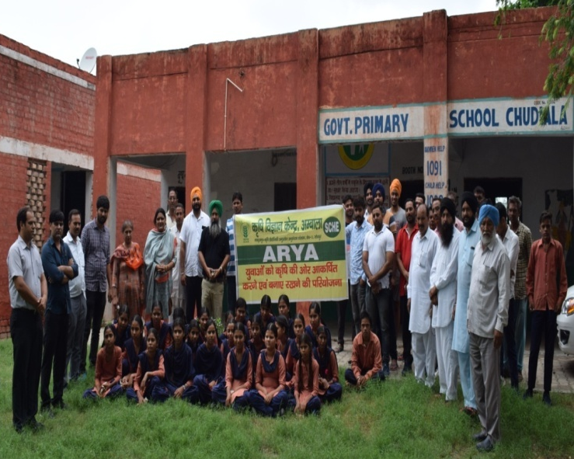
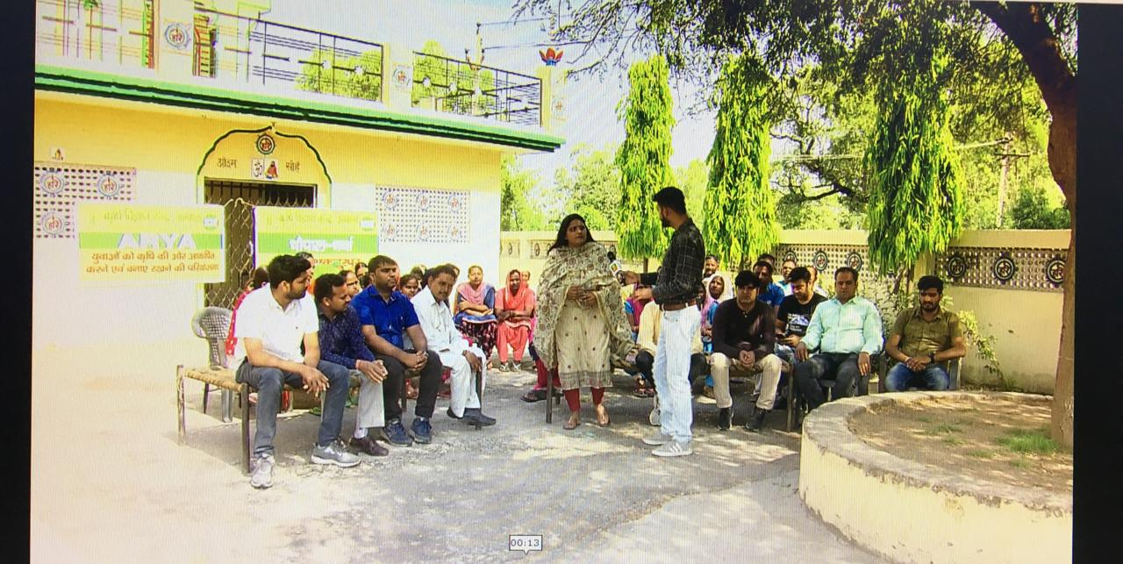
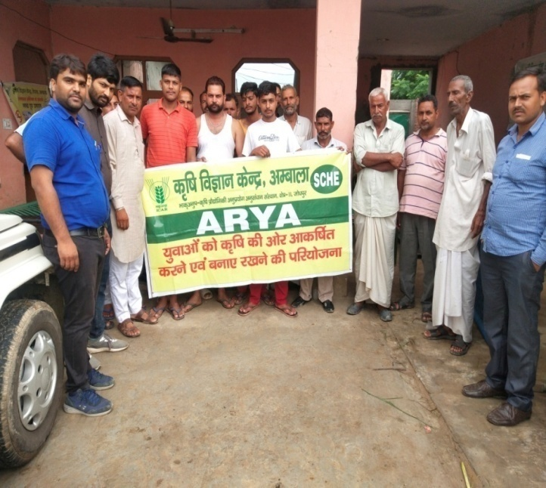
Bench Mark
Bench Mark Survey: PRA of village; group meetings, ex-trainees meet, interactions, discussions with sarpanches, etc.
Awareness : Chopal Charcha programme on DD Kisan
Selection of Suitable Enterprise: Need & interest of identified youth; available resources and existing market feasibility
Potential Rural Youth: Age group of 18-35 years from different blocks of the Ambala district

Slide 3
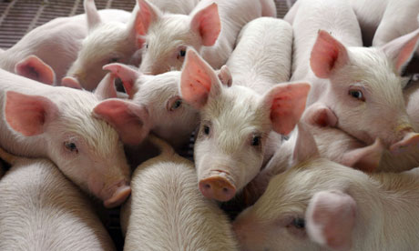
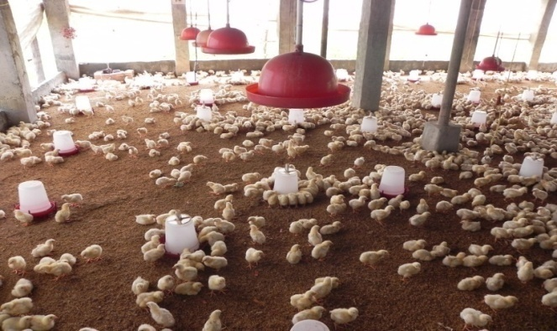
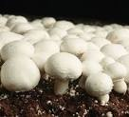
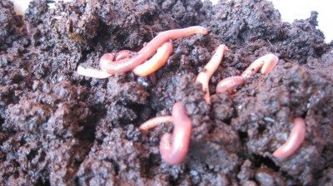
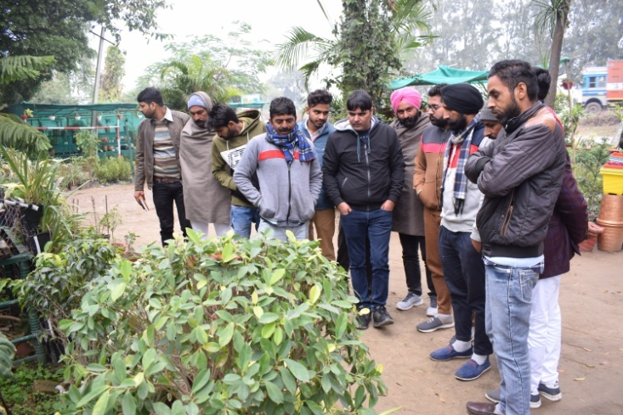
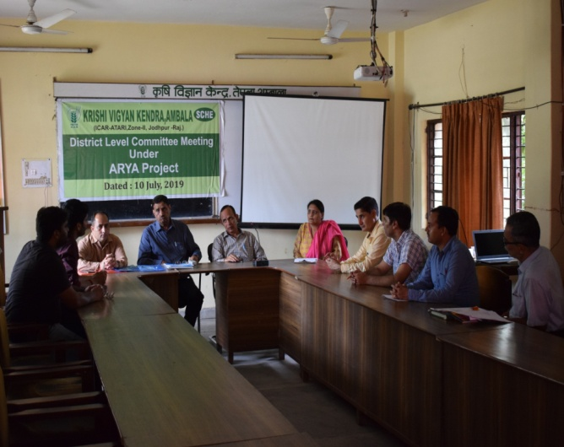
Enterprises under ARYA Project
Piggery, Poultry, Mushroom Cultivation, Nursery Management
District level ARYA Committee Meeting

Slide 4
Clients Description
Total 162 youth were trained under identified four enterprises
Three fourth of youth are educated up to matric level
Majority of selected youth belongs to SC/OBC category
Majority of youth were unemployed or working on daily wages
Three fourth of youth were having no scientific knowledge in any enterprises

Slide 5
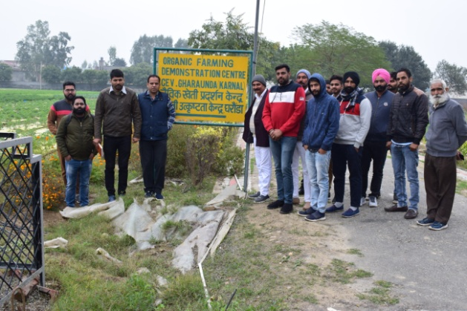
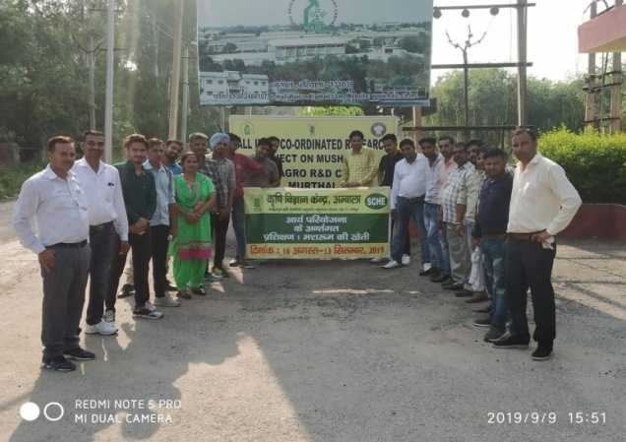
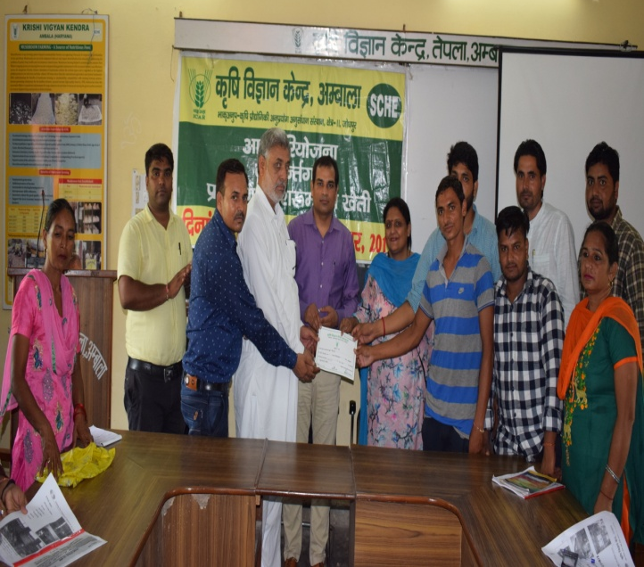
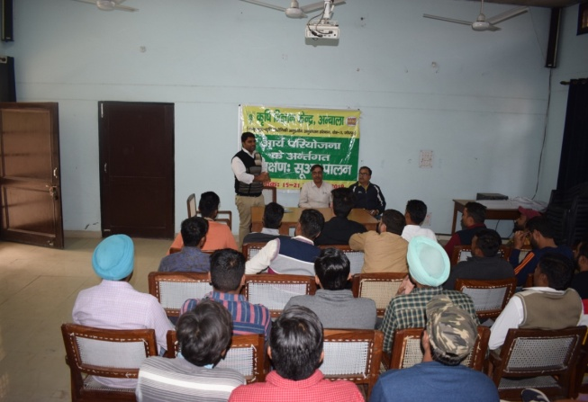
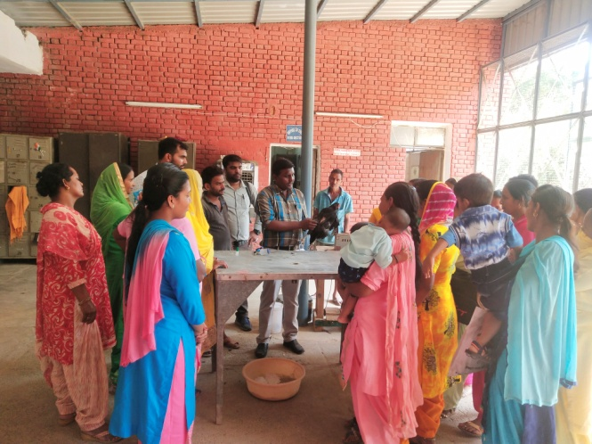
Linkages
Lala Lajpat University of Veterinary & Animal Sciences,Hisar
Disease Investigation Lab/ Pashu Vigyan Kendra, Ambala City
National Dairy Research Institute, Karnal
National Bureau of Ani. Genetic Resources,Karnal
Haryana Veterinary Training Institute, Uchani
Department of Horticulture Department, Ambala
NHB, Chandigarh & MIDH, Panchkula
Horticulture Training Institute,Uchani,Karnal
National Horticultural Res.& Dev.Foundation,Salaru, Karnal
Directorate of Mushroom Research, Solan
Private Nurseries /Master Trainer/Progressive Farmers
Centre of Excellence for Vegetables
HAIC Agro R & D Centre,Murthal
NABARD,Ambala
Animal Husbandry Deptt
CPDO (NR) Chandigarh

Slide 6
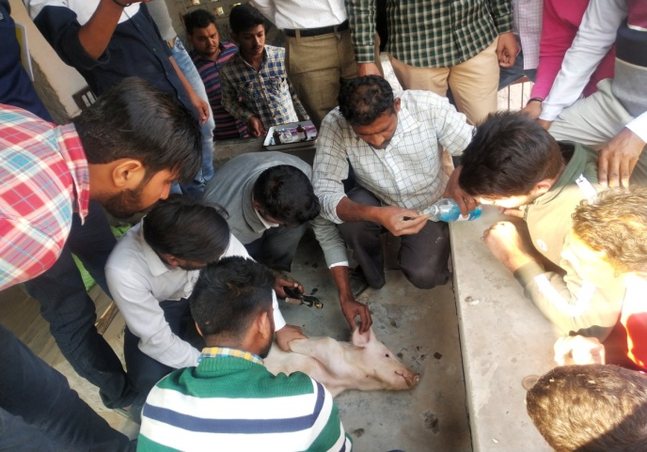
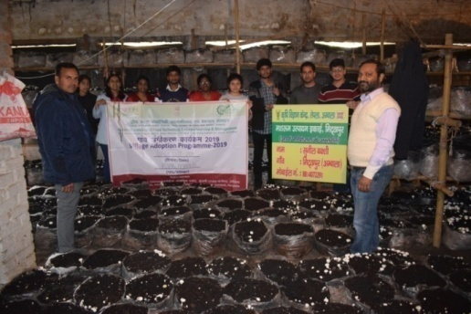
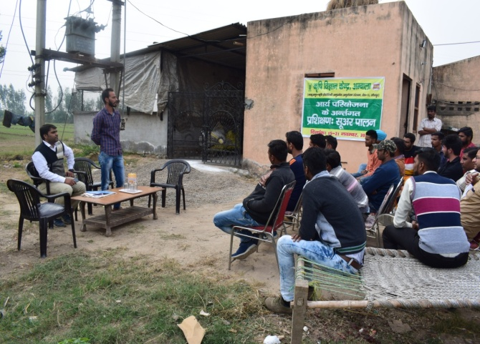
Achievements
Sl. No. | Enterprises | Youth trained (No.) | Unit established (No.) | Youth visited at units (No.) | Awareness (No.) | WhatsApp group (No.)
1 | Piggery | 50 | 15 | 120 | Exposure visit -4 Meeting-1 Media-4 | 1 Member:42
2 | Poultry | 50 | 32 | 160 | Exposure visit -2 Media-3 | 1 Member:28
3 | Mushroom Cultivation | 30 | 18 | 156 | Exposure visit -4 | 1 Member:25
4 | Nursery Management | 32 | 10 | 45 | Exposure visit-3 Media-2 | 1 Member:15
 | Total | 162 | 75 | 481 | 47 | 4 (110)

Slide 7
IMPACT
Sl. No. | Enterprises | Size of unit (No.) | Production Cost (Rs./yr./unit) | Gross return (Rs./yr./unit) | Net Return (Rs./yr./unit)
1 | Piggery | 10+1 | 1,35,000 | 2,80,000 | 1,45,000
2 | Poultry
 | i. Poultry (Small scale) | 15-20 birds | 8,500 | 22,000 | 13,500
 | ii. Commercial | 1000-1500 birds | 2,60,000 | 4,80,000 | 2,20,000
3 | Mushroom Cultivation | 300 compost bags | 31,218 (season) | 67,500 (season) | 36,282 (season)
4 | Nursery Management | 1000 M² | 2,15,000 (season) | 4,62,500 (season) | 2,47,500 (season)

Slide 8
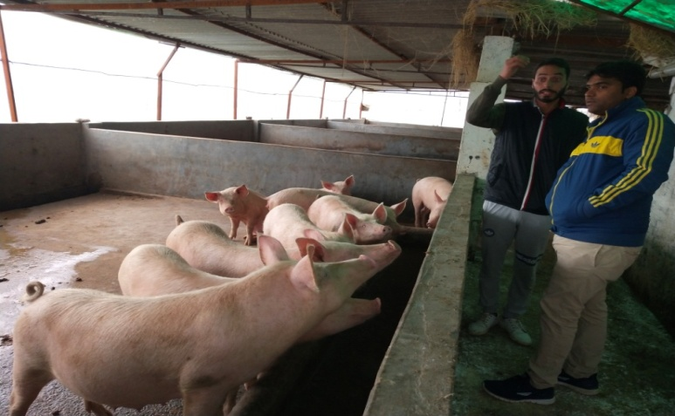
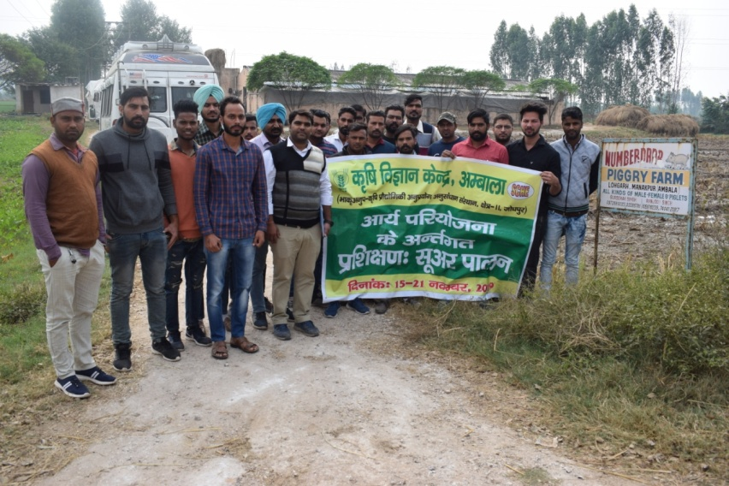
I. Enterprise : Piggery
Numberdar Piggery Farm,Lohgarh
Name | Ranjod Singh
Village | Lohgarh (Ambala)
Age | 28 yrs.
Education | Graduate
Mob.No. | 7988003657
KVK Intervention : Training , Piglets (Large White York Shire) & FAS/ Technology/ Disease Management, Linkages with PDO
Economics of Unit (50+5)
Expenditure (Rs./Year)
Feed,vaccine, medicine etc. | 2,92,000
Income (Rs./Year)
Sale of piglets (323) @ Rs 2500 | 8,07,500
Additional Income (Manure & fish) | 50,000
Gross income | 8,57,500
Net Income | 5,65,500
Master Trainer
WhatsApp group
Recognition
You tube (https://youtu.be/aFJEhZ6Eqhs)
Horizontal spread : 5 units
Unit established : 15 (Income upto 6 lakhs/year)

Slide 9
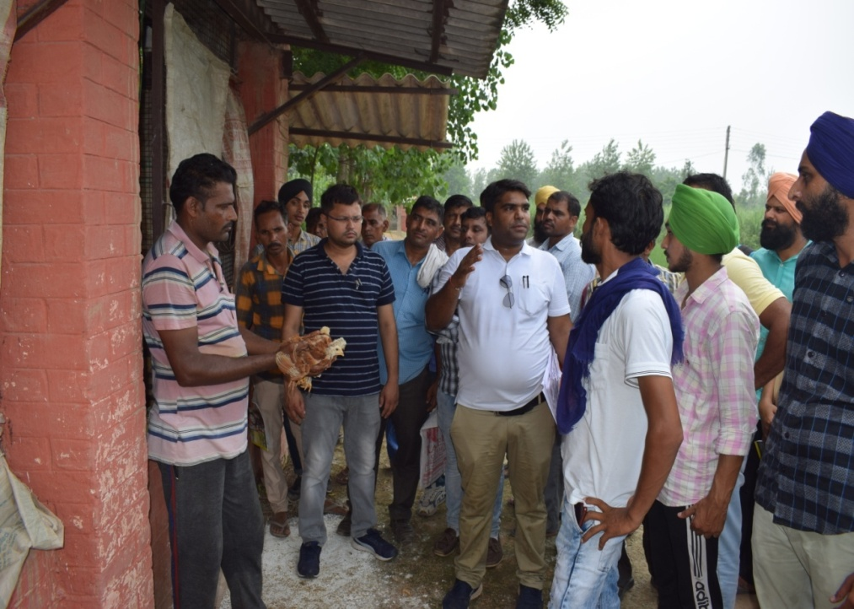
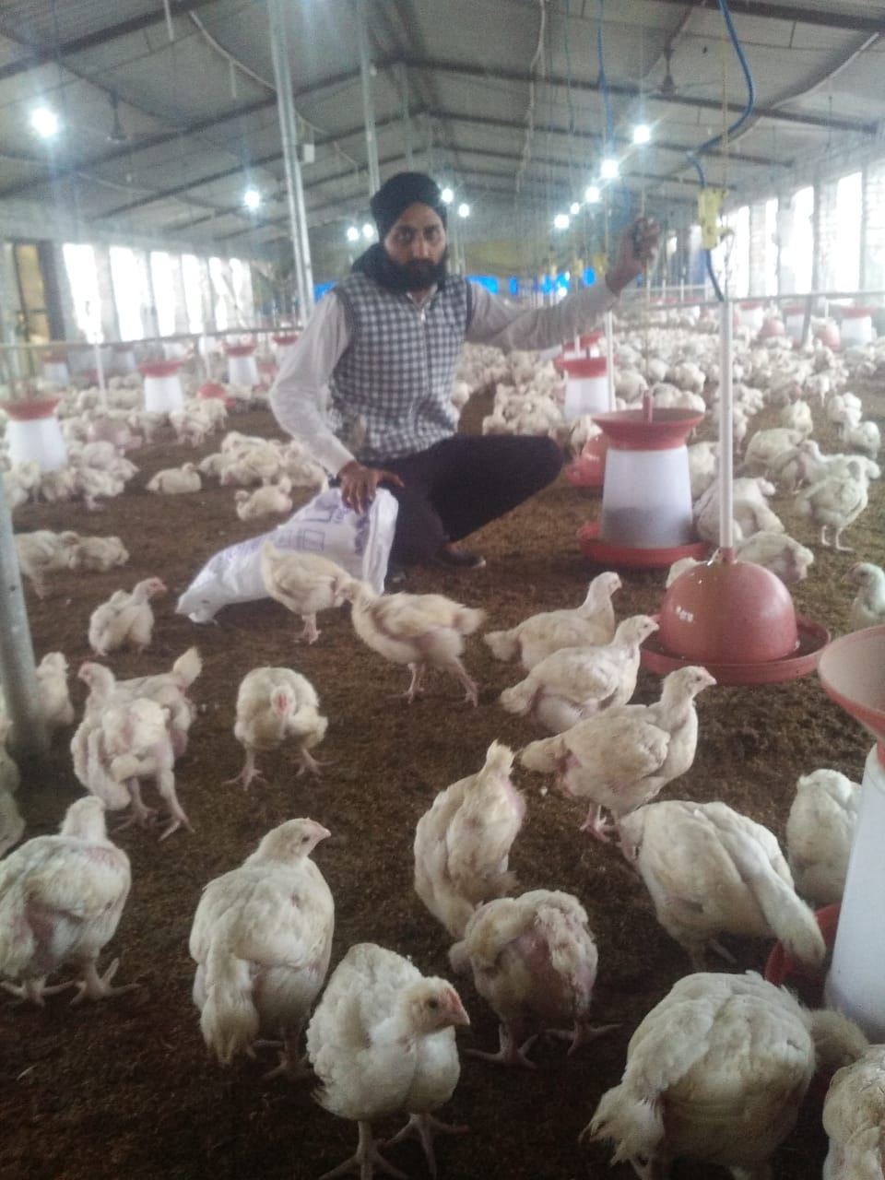
II. Enterprise : Poultry
Gurnam Poultry Farm, Sherpur
Name | Malkit Singh
Village | Sherpur Salkhani (Ambala)
Age | 28 years
Education | 10+2
Mob.No. | 9896371520
KVK Intervention : Training (Year 2019), Poultry Birds (Chabron),FAS/ Technology/Disease Management
Economics of Contract farming (2500 birds) (6 months) (Rs.)
I. Expenditure (6 months) | Amount
a) Water, Electricity etc. b) Depreciation (10% ) of capital | 32,500 50,000
Total Expenditure | 82,500
II. Income
Contract farming (Avg.40,000/month) | 2,40,000
Net Profit = 1,57,500/
Contract Farming with Sugna Pvt.Ltd.Hyderabad
Unit established : 32 No.

Slide 10
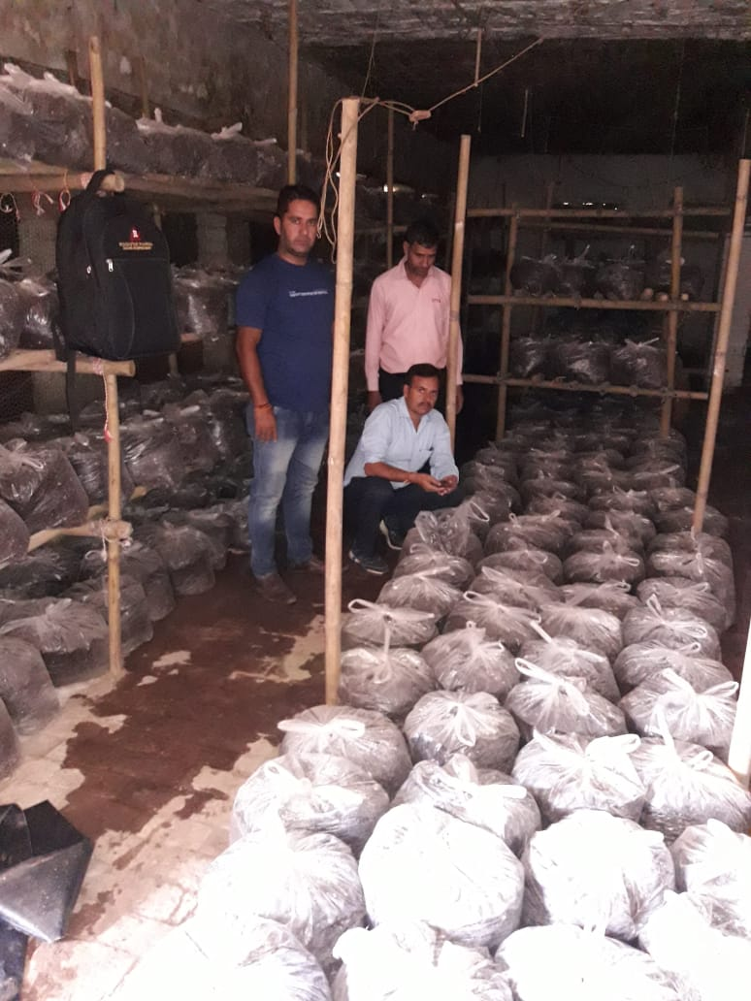
III. Enterprise : Mushroom cultivation
Mushroom Farm,Mithapur
Name | Rajni
Village | Tangail
Age | 32 yrs
Education | 10+2
Mob.No | 8059911813
Unit size | 1500 bags
KVK Intervention :Training (2019), Compost bags, Farm advisory Services
Economics :
Input (Ist Season) Rs.
I. Start up Cost | Amount
a)Infrastructure & Equipments | 60,000
b) Recurring (FYM,Spawn and casing, Chemical etc.) c) Depreciation 10% & interest 15% on Fixed Capital (4-6 months) | 97,500 7,500
Total Recurring | 1,05,000
II. Production & Income (1500 bag) 1.5 kg./bag/season (1500 bagsX1.5 kg.)=2250 kg. @ Rs.75/kg | 1,68,750
Net Profit (Rs.1,68,750-1,05,500) = 63,250/-
Unit established : 18 No.

Slide 11
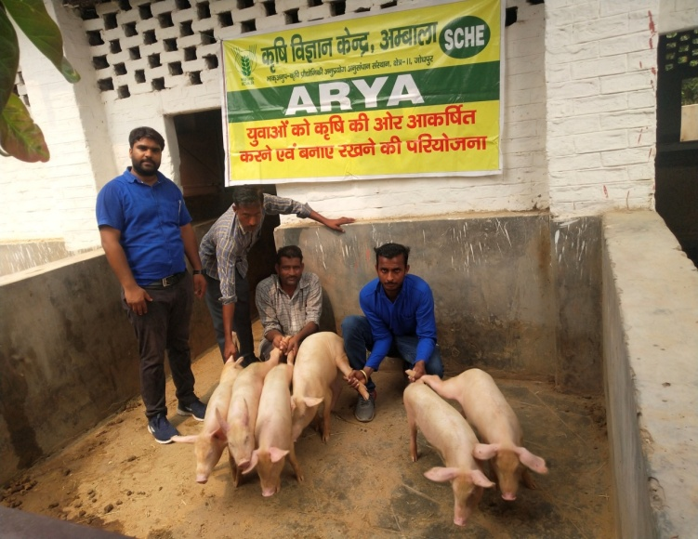
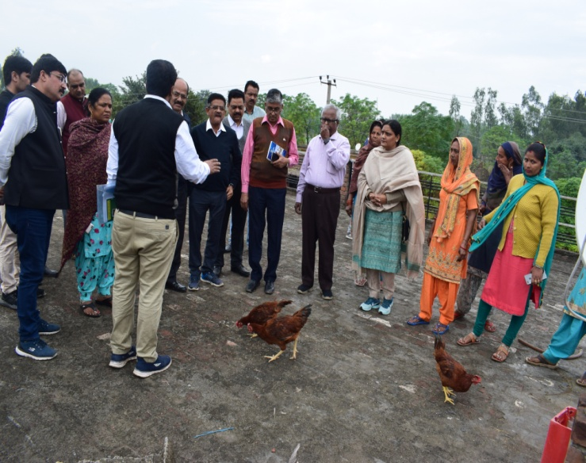
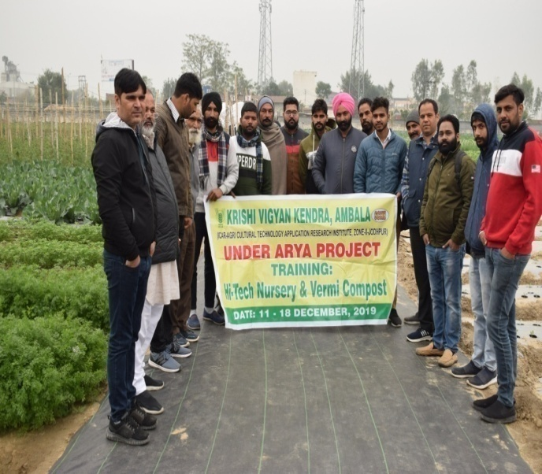
Budget Utilization (2019-20)
Head | Amount released during 2019-20 | Expenditure incurred during 2019-20 | Unspent balance as on 31-03-2020
Capital | 8,32,000.00 | 5,36,892.00 | 2,95,108.00
General | 9,07,000.00 | 3,02,109.00 | 6,04,891.00
Total | 17,39,000.00 | 8,39,001.00 | 8,99,999.00

Slide 12
Action Plan (2020-21)
1. Training Programme
Sl. No. | Enterprises | Training Programme (Number) | Youth to be involved (Number)
1 | Piggery | Target completed (2019-20) | Already trained (50)
2 | Poultry | Target completed (2019-20) | Already trained (50)
3 | Mushroom cultivation | 1 | 20
4 | Nursery Management | 1 | 18
2. Promotion, popularization, multiplication of all Enterprises
3. Small units will be strengthen for commercial
4. Role Models will be identified for Horizontal spread of technology
among youth in nearby villages
5. Linkages & documentation of Successful Cases

Slide 13
Chopal Charcha (DD Kisan)
ARYA (Poultry, Piggery, Poultry, Nursery Management )
Thanks

