Slide 1



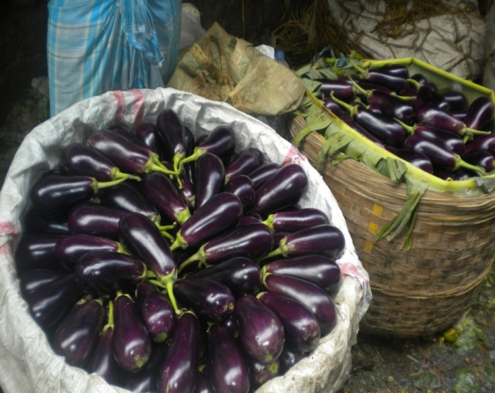
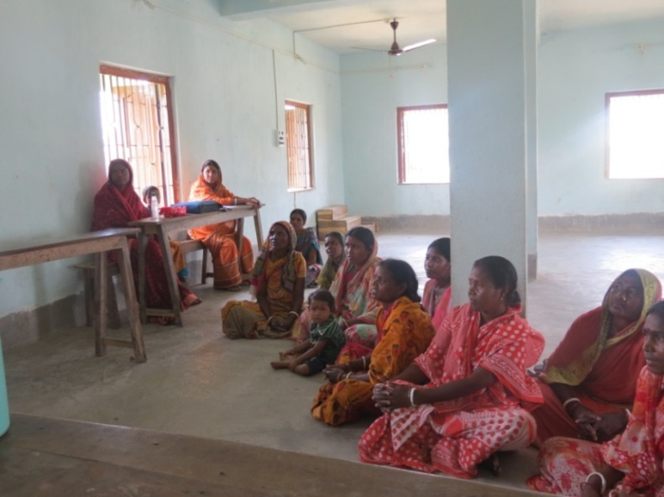
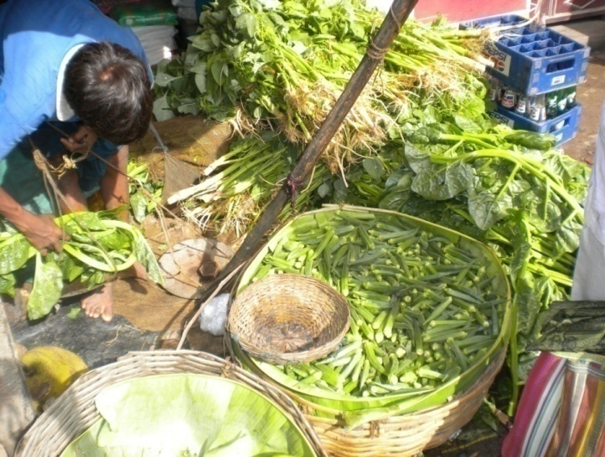

Agricultural Marketing in West Bengal - Agriculture to Agribusiness
Dr. Subhasis Mandal, Pr. Scientist
ICAR-Central Soil Salinity Research Institute,
RRS Canning Town
subhasis2006@gmail.com

Slide 2
Content….
Agriculture challenges
Agri marketing
  constraints, status, challenges
Farmers distress
  case of potato cultivation
Corporate entry into agri-retailing
  implications, Way forward
Transform agriculture to agribusiness
  Sustainable Food Value Chain
  e-National Agriculture Market
  FPO

Slide 3
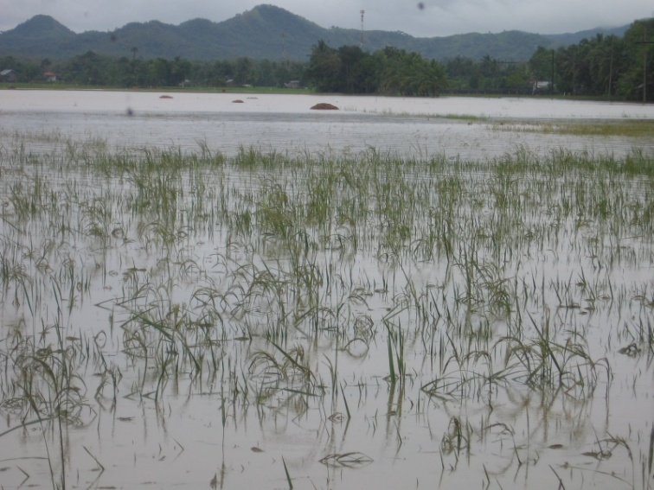
Challenges
Agriculture sector gets an unprecedented 84 % hike in budget allocation (47,912 crores) during FY 2016-17 as compared to previous year.
The goal is to look beyond food security - doubling farmer’s income by 2022.
First time 'Krishi Kalyan Cess' has been proposed in the budget.
Real concern is how best such allocation can be utilised towards 'income security' of the small-holder farmers ?
Farmers are constrained with problems
  tiny land holdings (mostly less than half a hectare),
  salinity, lack of good irrigation water,
  waterlogged, poor road connectivity & infrastructure,
  unpredictable market prices,
  inadequate market linkages and o
  climate vulnerability
  Extent and magnitude of existing risk in farming, farm-level coping strategies and response of farmers towards different government sponsored risk management strategies needs to be understood.

Slide 4
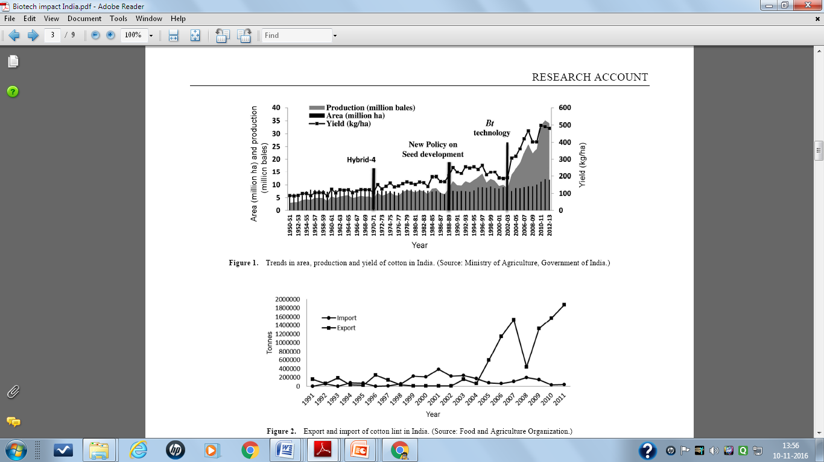
Bt Cotton…fastest adopted technology in India (Srivastava and Kolady 2016)

Slide 5
Background
Indian farming is run by 138 million operational holdings, farming on 160 million ha of area with an average holding size of 1.15 ha
Eastern Region of India, with its diverse natural resources has been under special focus by Planning Commission for ushering second green revolution of country.
West Bengal, one of the eastern states of India has plenty of natural resources as well as diverse agro-eco-regions for increasing food production of the country. Besides, producing food grains, the region has great potential to produce several high value commodities for augmenting farm income.
Horticulture, livestock and fisheries sectors have all potential to pull the growth of agriculture sector of this region.
Market prices are the key drivers to change the farm economy but we all are aware of the high price volatility in agri-marketing sector that adversely affect the up-scaling of these agro-technologies.

Slide 6
Contribution of WB in producing selected important crops
(2013-14)
Crops | Production |  | % Share of WB to India | All India Rank (prodn) | Value of output (Rs crores) | Value in % share to total
 | WB | India
Rice (m t) | 15.37 (2.79) | 106.65 (2.42) | 14.41 | 1st | 22926 | 13.32
Jute & Mesta (m t) | 8.88 (2.78) | 11.69 (2.51) | 75.96 | 1st | 3678 | 81.20
Potato (000 t) | 90.30 (21.90) | 41555 (21.06) | 21.73 | 2nd | 4993 | 23.33
Fruits & Vegetables (000 t) | 26678 (16.70) | 277352 (17.30) | 9.62 (14.15)* | 1st | 38720 | 13.30
Fish (000 t) | 1580.65 | 9576.61 | 16.50 | 2nd | 21003 | 23.28
Agricultural Statistics at a Glance 2015; Jute production in million bales; Figures in parentheses is yield in tonnes/ha; National Accounts Statistics, CSSO; * Figures in parenthesis indicates sshare of vegetables production;

Slide 7
Agricultural Marketing – Constraints
Predominantly marginal or small farmers – Hence small marketable surpluses & limited bargaining power
Poor availability of markets & monopolistic tendencies of APMCs
Inadequate infrastructure in wholesale markets/ rural primary markets
Lack of fair price discovery mechanism
Multiple and exploitative intermediaries – low returns
Fragmented supply chain, poor cold chain & high post-harvest losses
Lack of cleaning, grading, packaging & quality certification facilities
Limited access to market information and marketing opportunities available
UKS CHAUHAN

Slide 8
Current status of agri-marketing
The small scale of production unit produces these high value commodities with high production efficiency but severely constraints with poor marketing efficiency.
The system is operating under a vicious cycle like – large no of small producer - producing low marketable surplus – resulting low bargaining power and – low profit. Then these commodities passes to large no of small traders who are handling these produce in a small scale subjected to high degree of post harvest losses – ultimately resulting the whole marketing system a non-commercial venture.
Besides this traditional agri-marketing system, the agricultural marketing environment throughout the country including this region is also undergoing the process of rapid transformation due to large-scale corporate entry into this marketing system. However, so far the share in total volume of retail through such marketing is very less.

Slide 9
Price spread (vegetables marketing )
Producers’ share in consumer rupee (vegetables marketing )
What causes distress in Potato cultivation in West Bengal ???

Slide 10
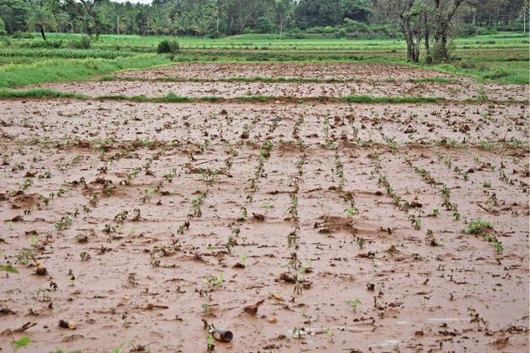
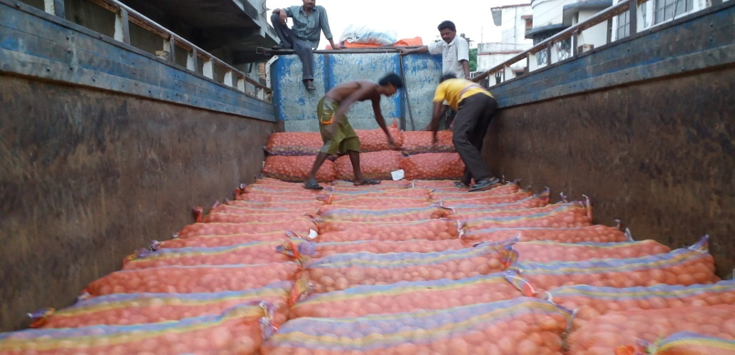
Are Potato Farmers under Distress?
Beginning of the year 2015, there was a series of shocking media reports on ‘unnatural’ death of farmers in Bengal. Most of these incidents were assumed to be linked with falling potato price due to excess production and thereby distress selling of potato or no takers immediately after harvest.

Slide 11
Are Potato Farmers under Distress? insights from Hooghly District of West Bengal
(1) was the non-repayment of the credit is the major reason for this distress? How far the Kisan Credit Card (KCC) can be problem solving in this regard?
(2) Are farmers’ expectations were too high? Are they thinking the cultivation of potato is like doubling your money in just three months?
(3) Was it the excess production that caused the falling price of potato during harvest?
(4) Was there any prohibition to the traders to buy potato freely? Any trade barrier forces?
(5) Why the problem persists only for a short period of time? How other farmers cope up the distress situation?
(6) Is the cold storage capacity of the state adequate?
(7) How the market for potato can be expanded to other states or country?
(8) What kind of contingency plan can be useful to reduce the distress?

Slide 12
Causes of distress…
Existing marketing options have limited alternatives, manipulation by middlemen and lack strategies for wider market expansion, particularly during surplus production, made the potato cultivation in the state risky.
Uncertainty in price, was it less production due to pest & diseases attack or over production due to favourable weather condition.
Escalating input prices coupled with high degree of instability of market prices; farmers failed to recover the cost of cultivation
Contract farming though offered assured price but was not a complete alternative to mitigate the distress situation.
Contracting organisations procured potato of specific qualities (size and shape) after suitable sorting and grading but farmers produced the same in varying quality

Slide 13
Causes of distress…
Falling price of potato affected their livelihoods drastically and they were forced to avail loan from local moneylender in exchange their valuables or land mortgage.
There was lack of market integration and imperfect market situation across different markets.
Once potato stored in the cold storages, the stock was under the absolute control of cold-storage owner.

Slide 14
Interventions suggested
first, need fair competition from market to market with well integration. Information on quantity available should be available to all traders and online system might be a good option for trading;
second, farmers needed to be educated to grow different varieties of potato as demands were varying by consumers when used table or processing purpose;
third, proper market supervision was required to check malpractices by the large traders because once the potato was in cold storage, the market was controlled by the storage owners;
fourth, farmers needed to encourage to avail the benefits of crop insurance schemes available;
fifth, contract farming although provided assured price but was not full-proof measure/alternative to manage the distress. There should be written or formal agreement for contract to make the system more transparent and fair; and
finally; transparency of potato price determination centralised information about market arrival was essential and promotion of e-auction would be more efficient way for price discovery.
Can corporate retailing be a solution ????

Slide 15
Corporate entry into agricultural marketing – what does it imply?
Direct purchase from farmers
  Unless the retailer marketers will be allowed to purchase directly form the farmers (presently not happening due to various interference) the producers price on consumer rupee would not be improved significantly.
Market consolidation vs land fragmentation
  retail markets are becoming consolidated and the producers are becoming further fragmented
Elimination of middlemen but how benefit sharing?
Inclusion of marginal farmers
Predatory pricing
Quality differentiations

Slide 16
Way forward - Strategies
Corporate entry be allowed
  Perfect competition and better price discovery
Ideal marketing model
  Technology, remunerative price and insurance
Promoting production in clusters
  Higher marketable surplus and better resource use efficiencies
Consolidation of farmers
  Promotes efficient marketing and business
Agri-marketing be allowed to handle by professionals
  Marketing innovations, sustainable value chain, better supply management

Slide 17
How to transform the smallholder farming operation to self-reliant framing business ?

Slide 18

Sustainable Food Value Chain
Food value chains (FVCs) increasingly globalized
FVC has become main paradigm in development thinking & practice and new modus operandi in international agricultural R4D
  + sustainability = SFVC
  + R4D = R4SFVCD

Slide 19
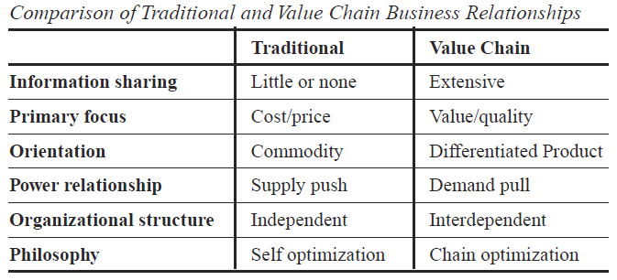
Definition

Slide 20

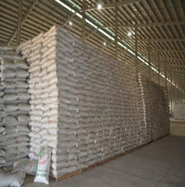
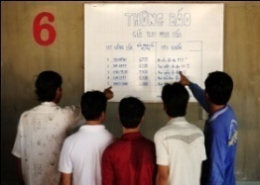
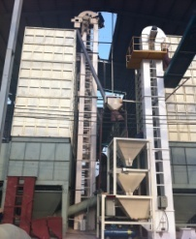
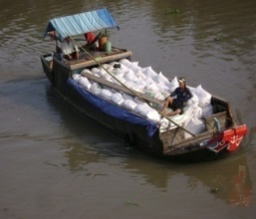
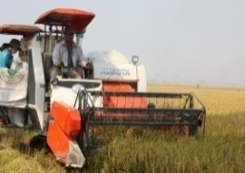
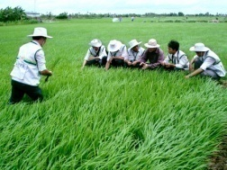
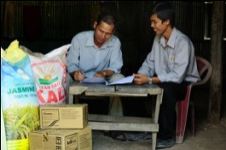
AGPPS’ business model (Vietnam)
(An Giang Plant Protection Joint Stock Company)
Farmers sell rice
Proactive:
- Sell price
- Time for selling
Free 30-day storage
Free drying service
Support transportation to factory
Harvest help and support
Available stock for trading, defining cost price
Transfer process & monitor cultivation process
Sign contracts to supply seed, fertilizer & plant protection chemicals – 120-days credit without interest
Export
(branded rice)
Domestic trading (branded rice)

Slide 21
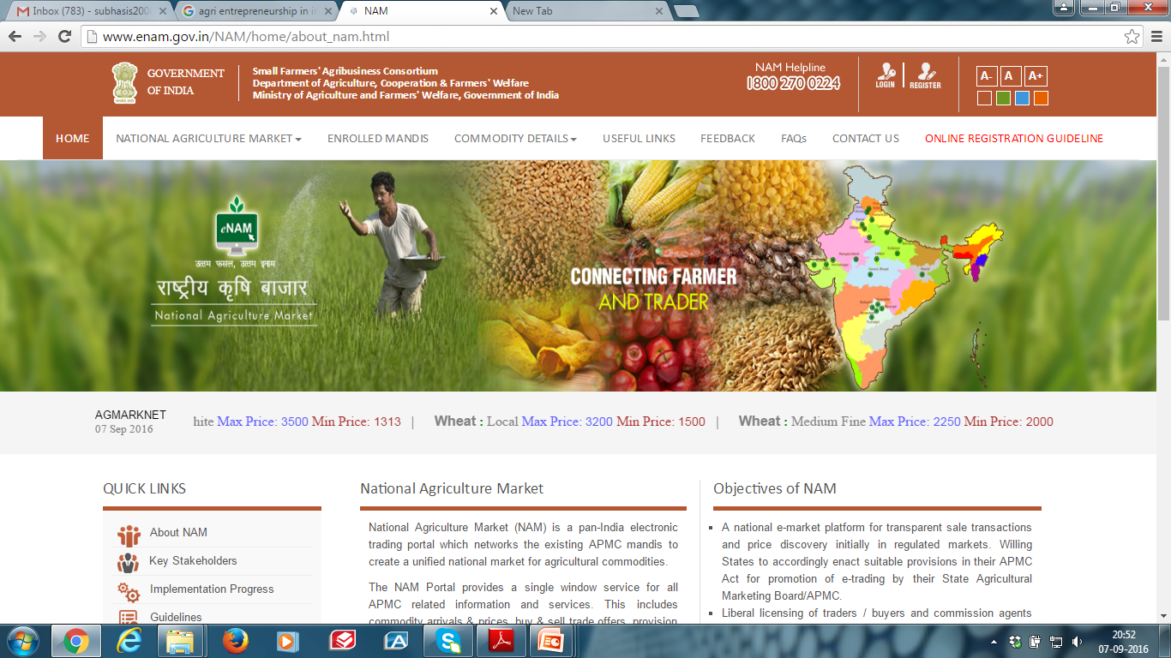
National Agriculture Market
(www.enam.gov.in)

Slide 22
Stakeholders
Mandis
  Reduction in book keeping and reporting system
  Better monitoring of commission agent
  Complete transparency
  Transparent market fee collection & accounting
  Analysis and forecasting
Farmers
  More options & competitive returns
Traders
  Access to large national market for secondary market
Buyers, Processers & Exporters
  Allows direct participation in local mandi trade and reduce intermediation cost

Slide 23
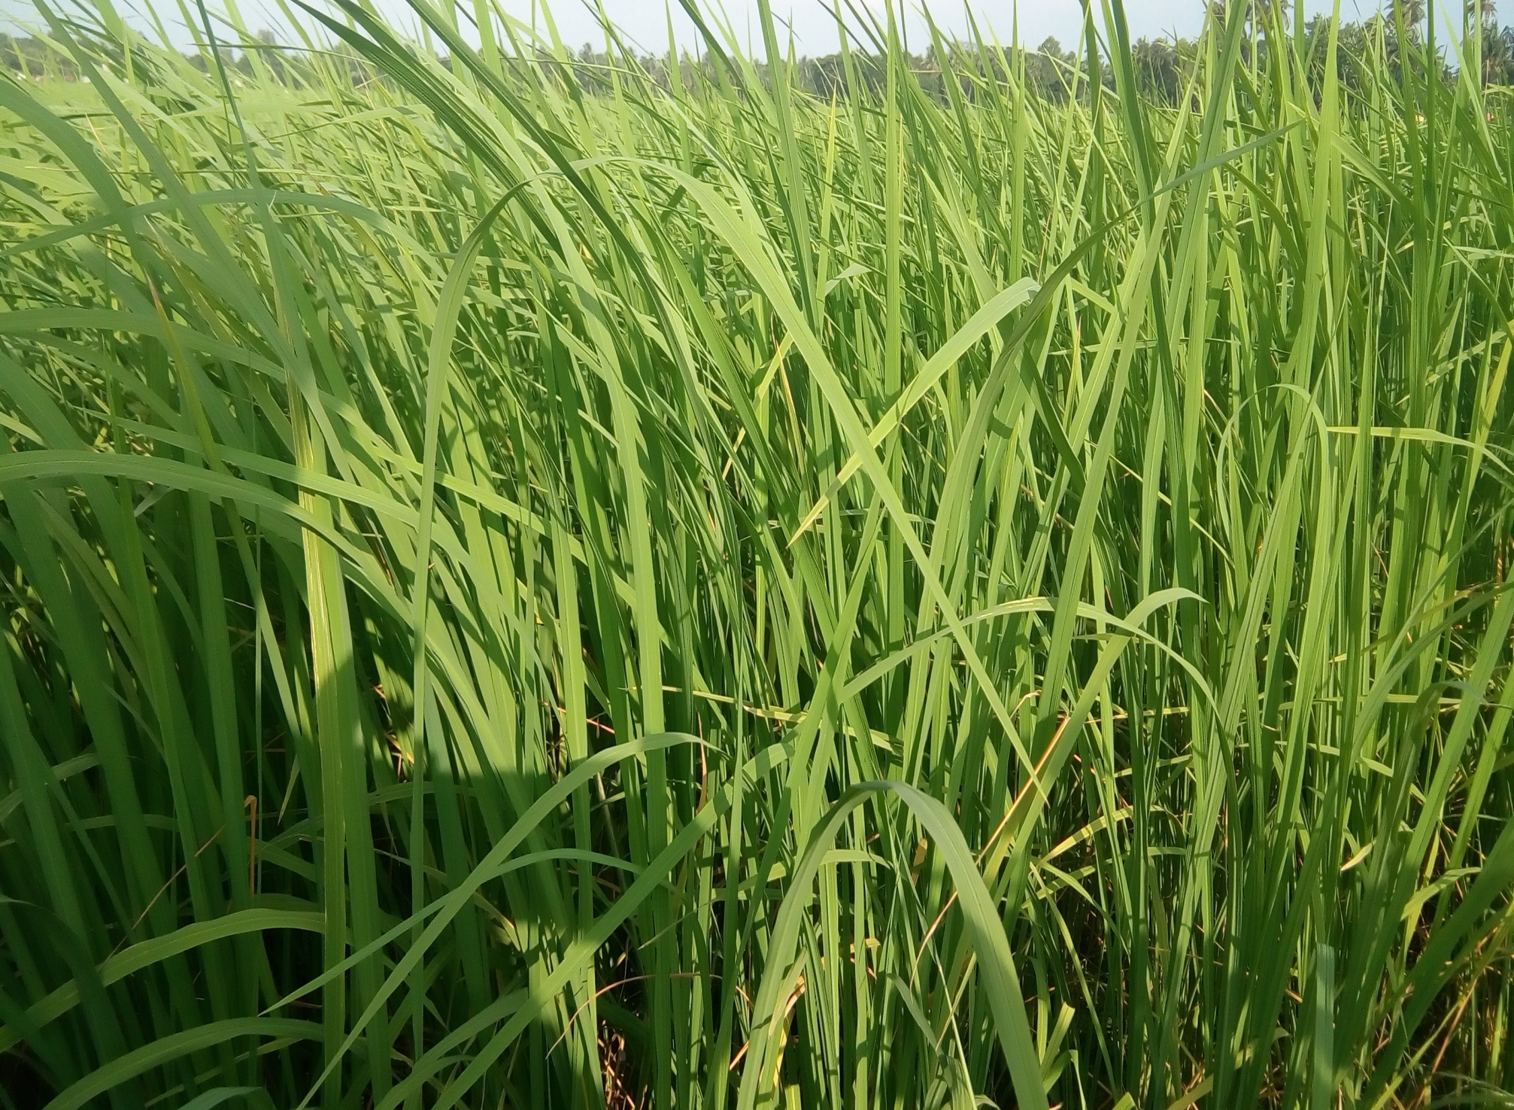
THANK YOU

