Slide 1
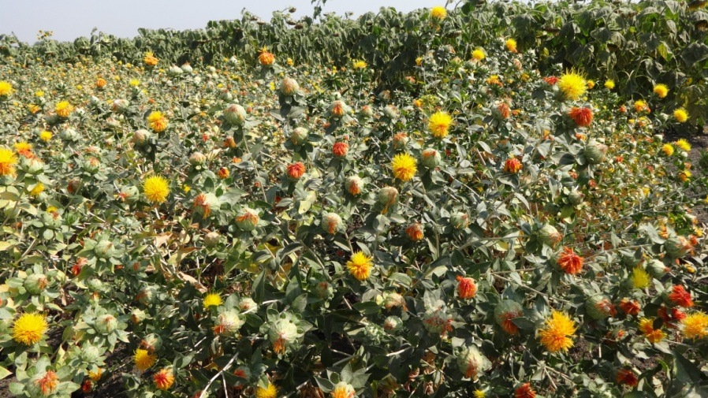
Objective 1: Productivity potential of non-spiny cultivars of safflower
under rainfed and irrigated conditions
Soil moisture | Variety/Hybrid | SY* | PY*
Irrigated | NARI-NH-1/NARI-6/ PBNS-40 | 2000 | 100
Sufficient availability (350 mm) | NARI-6/NARI-NH-1 | 1750 | 80
Medium Availability (280 mm) | NARI-6 | 900 | 35
*(kg/ha)

Slide 2
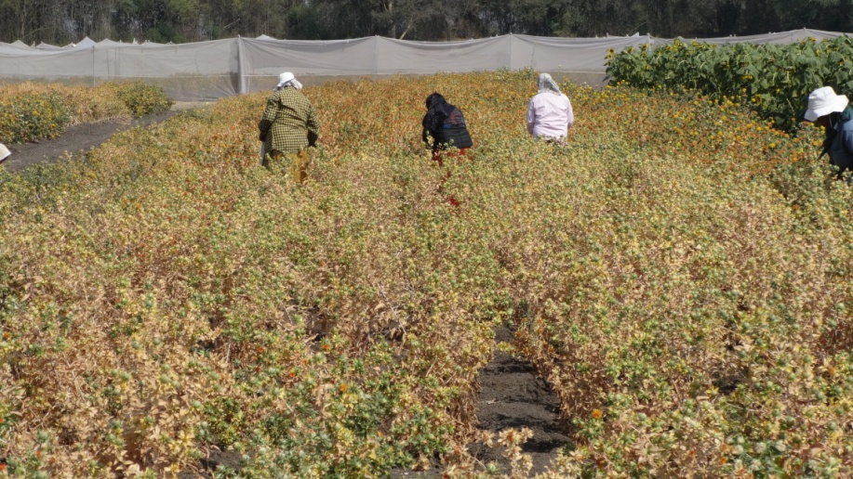
Objective 2: Productivity response of non-spiny safflower to low, medium
and high input environments
Soil moisture | Variety/ Hybrid | Spacing (cm) | Fertilizer | SY* | PY*
Irrigated | NARI-NH-1/ NARI-6 | 60 x 20 | 150% NPK | 2000 | 100
Sufficient availability (350 mm) | NARI-NH-1 /NARI-6 | 60 x 20 | 100% NPK | 1700 | 70
Medium Availability (280 mm) | NARI-6 | 45 x 20 | 100% NPK | 950 | 30
*(kg/ha)

Slide 3
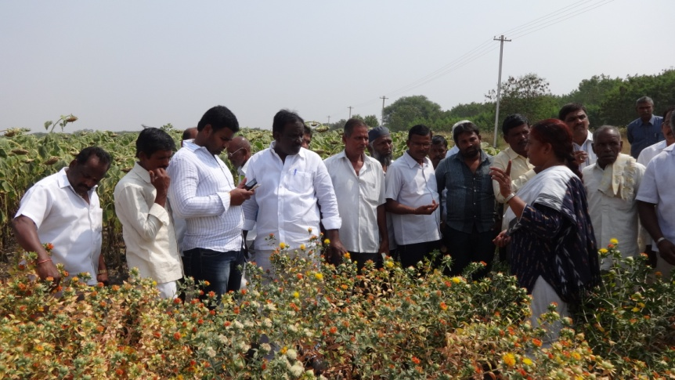
On-farm trials at Parbhani and Tandur (20015-16)
Location |  | Package demonstrated | Seed yield * | Petal yield *
Parbhani (two) | Irrigated | Variety: PBNS-40, Plant spacing: 60 x 20 cm Fertilizer: 150% NPK | 1950 | 75
Tandur (two) | Rainfed | Variety: NARI-6 Plant spacing: 45 x 20 cm Fertilizer: 100% NPK | 850 | 25
*(kg/ha)
Field day at ICRISAT farm 9 Feb. 2016
Thank you..

