Slide 1
Media Coverage

Slide 2
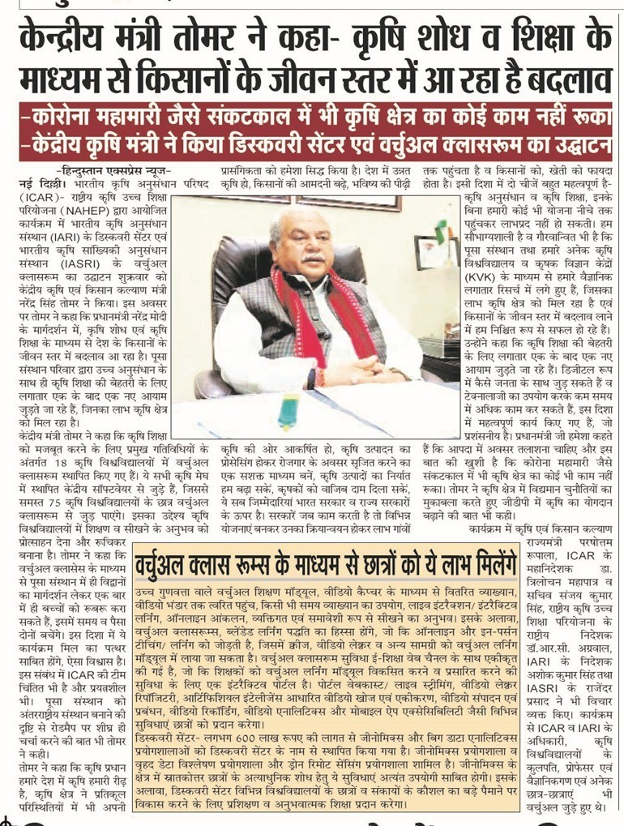
Central

Slide 3
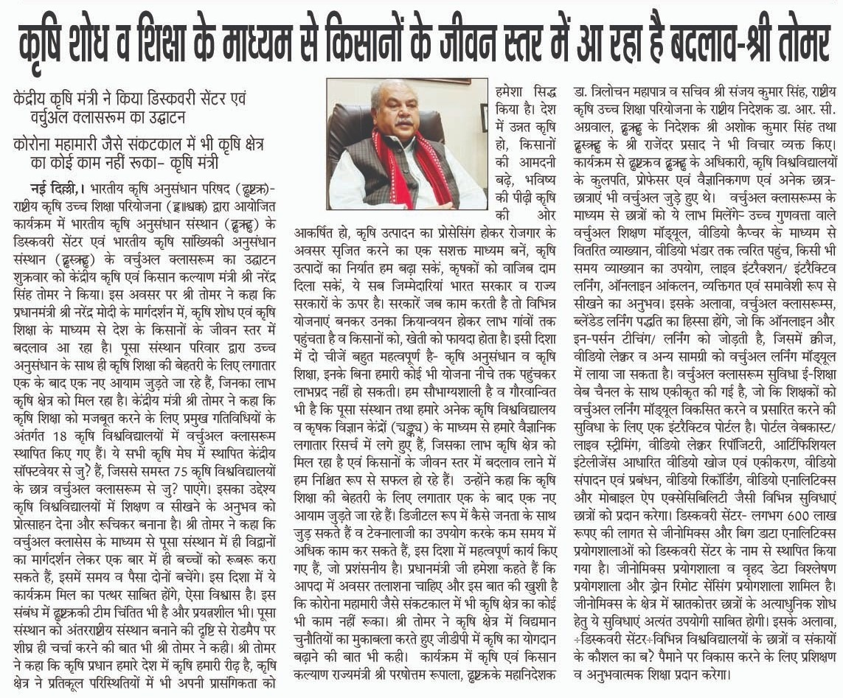
Central
https://deshpran.com/changes-in-the-standard-of-living-of-farmers-through-agricultural-research-and-education-agriculture-minister/

Slide 4
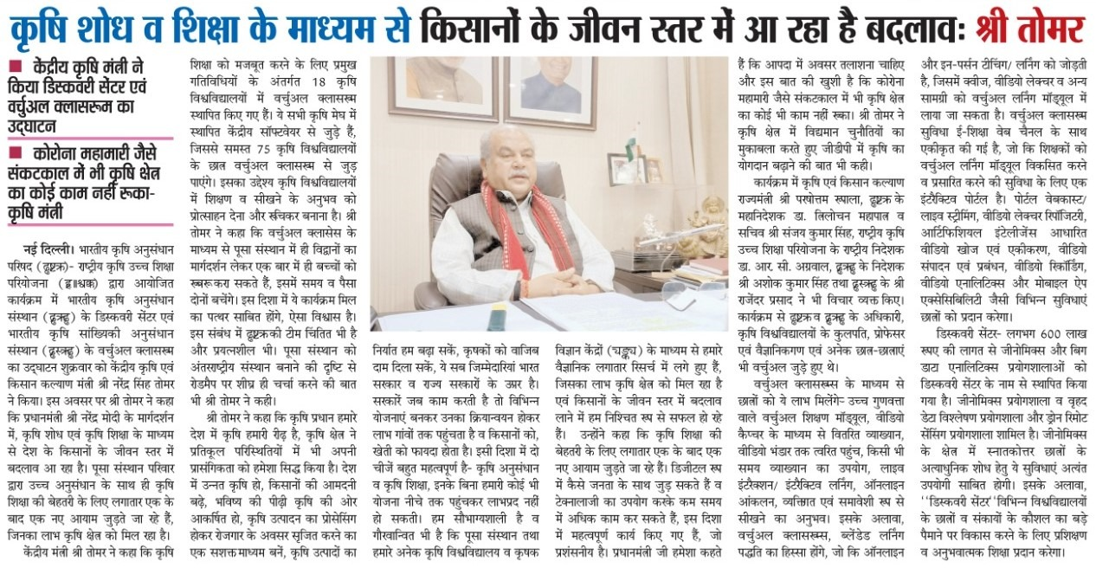
Central
https://www.jagran.com/uttarakhand/udhamsingh-nagar-union-agriculture-minister-inaugurates-virtual-lab-in-pant-university-21565631.html

Slide 5
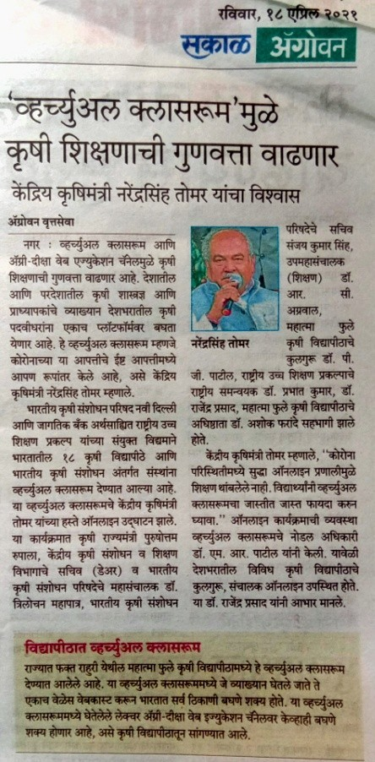
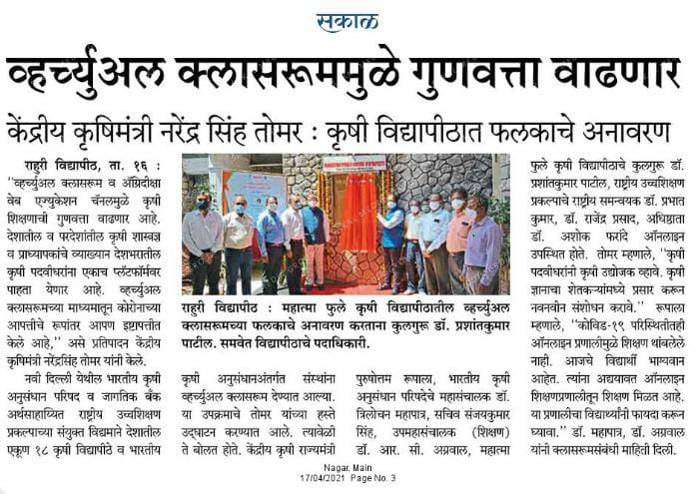
MPKV, Rahuri

Slide 6
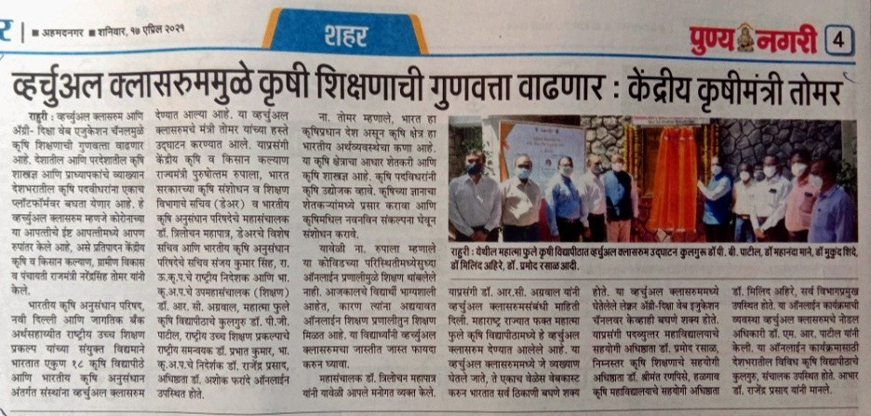
MPKV, Rahuri

Slide 7
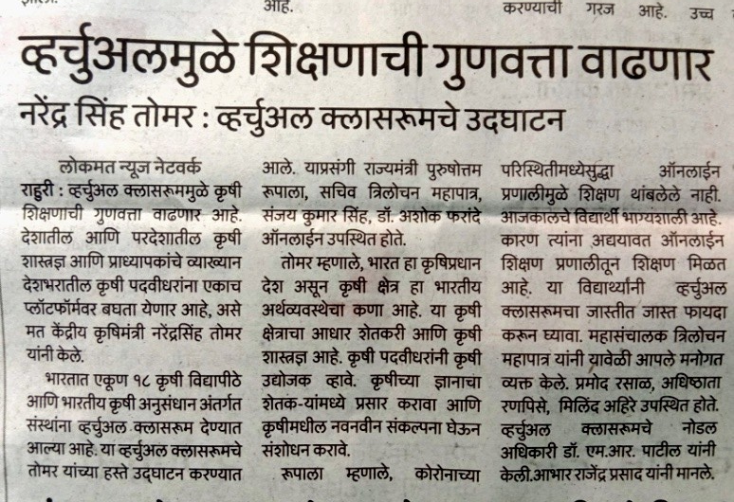
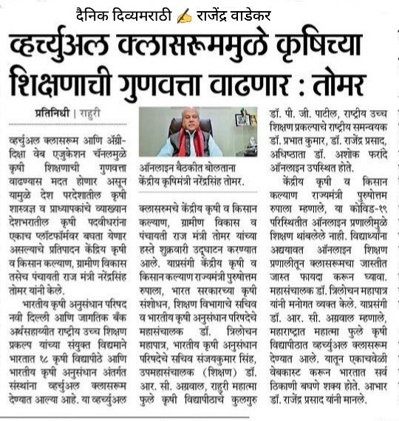
MPKV, Rahuri

Slide 8
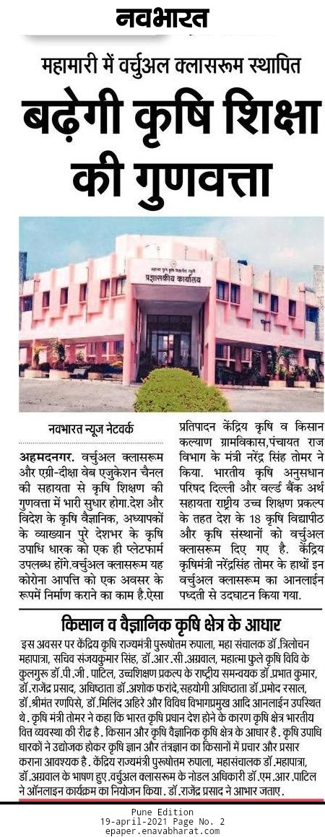
MPKV, Rahuri

Slide 9
CIFE, Mumbai

Slide 10
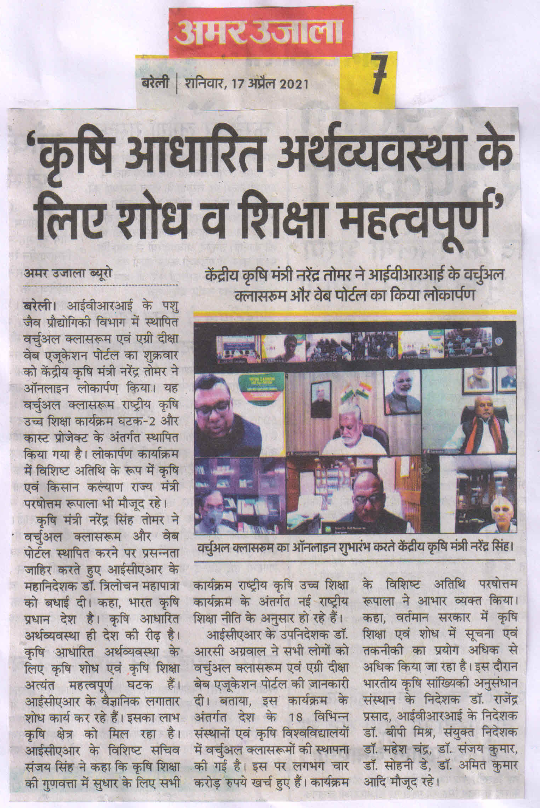
IVRI, Izatnagar

Slide 11
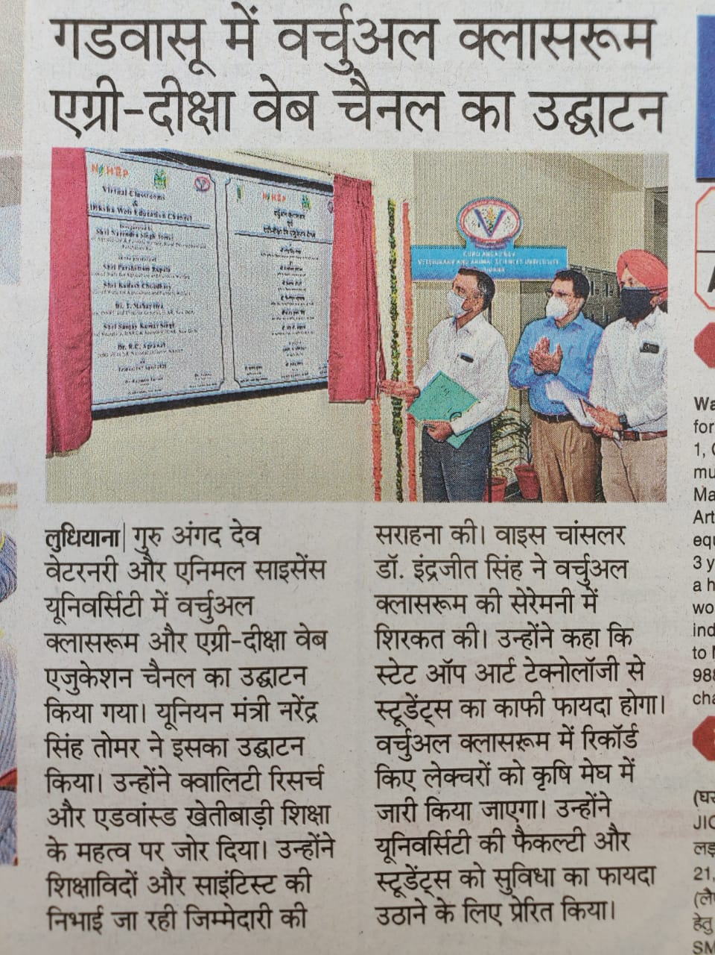
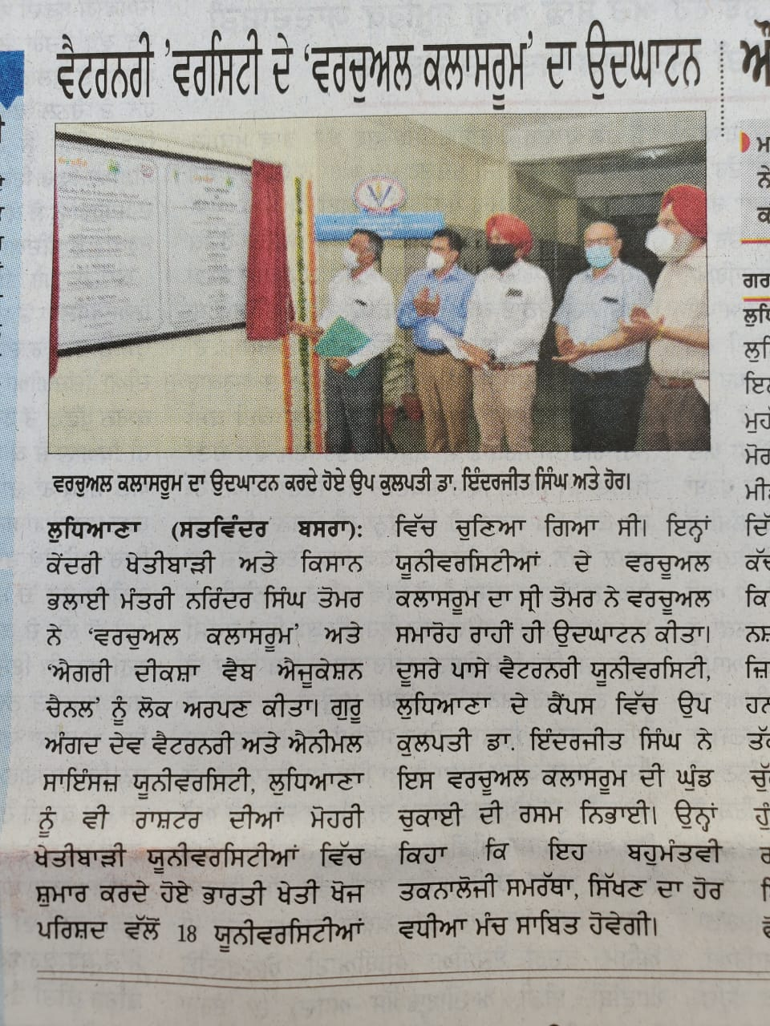
GADVASU, Ludhiana
https://www.babushahi.com/view-news.php?id=119802

Slide 12
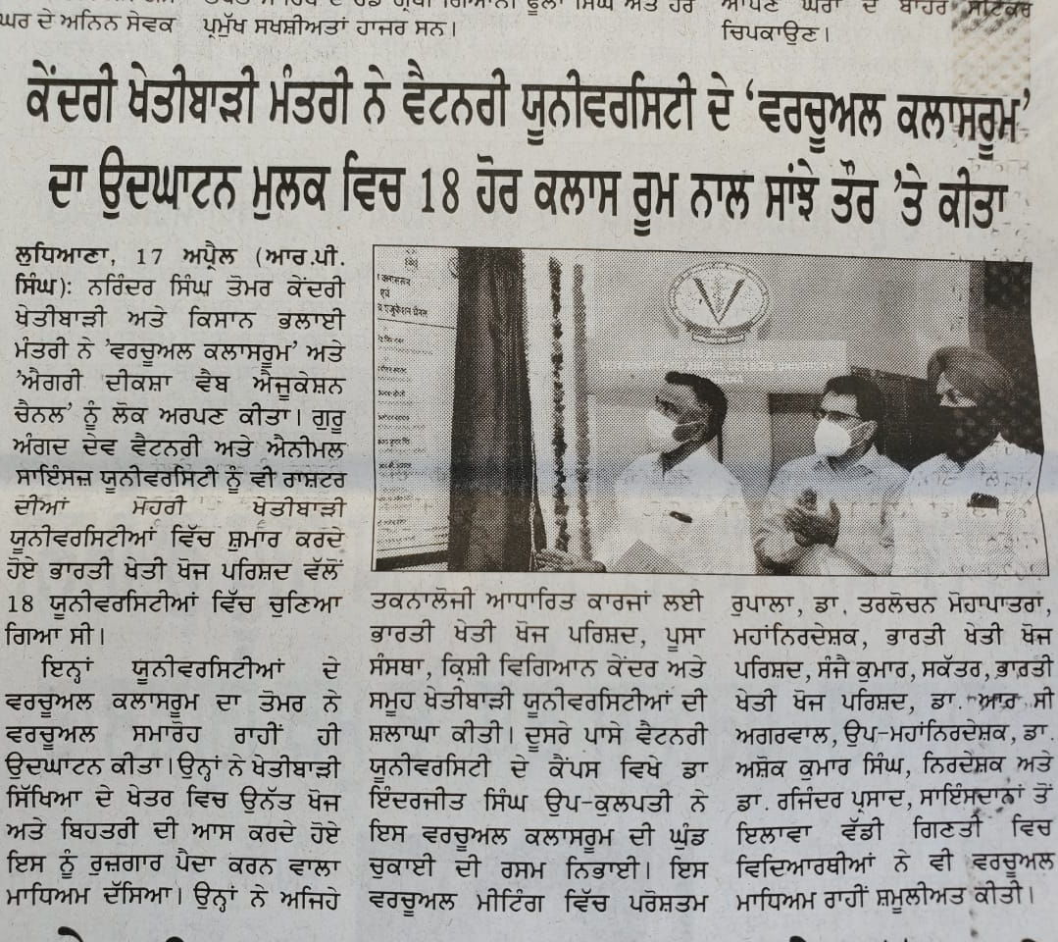
GADVASU, Ludhiana

Slide 13
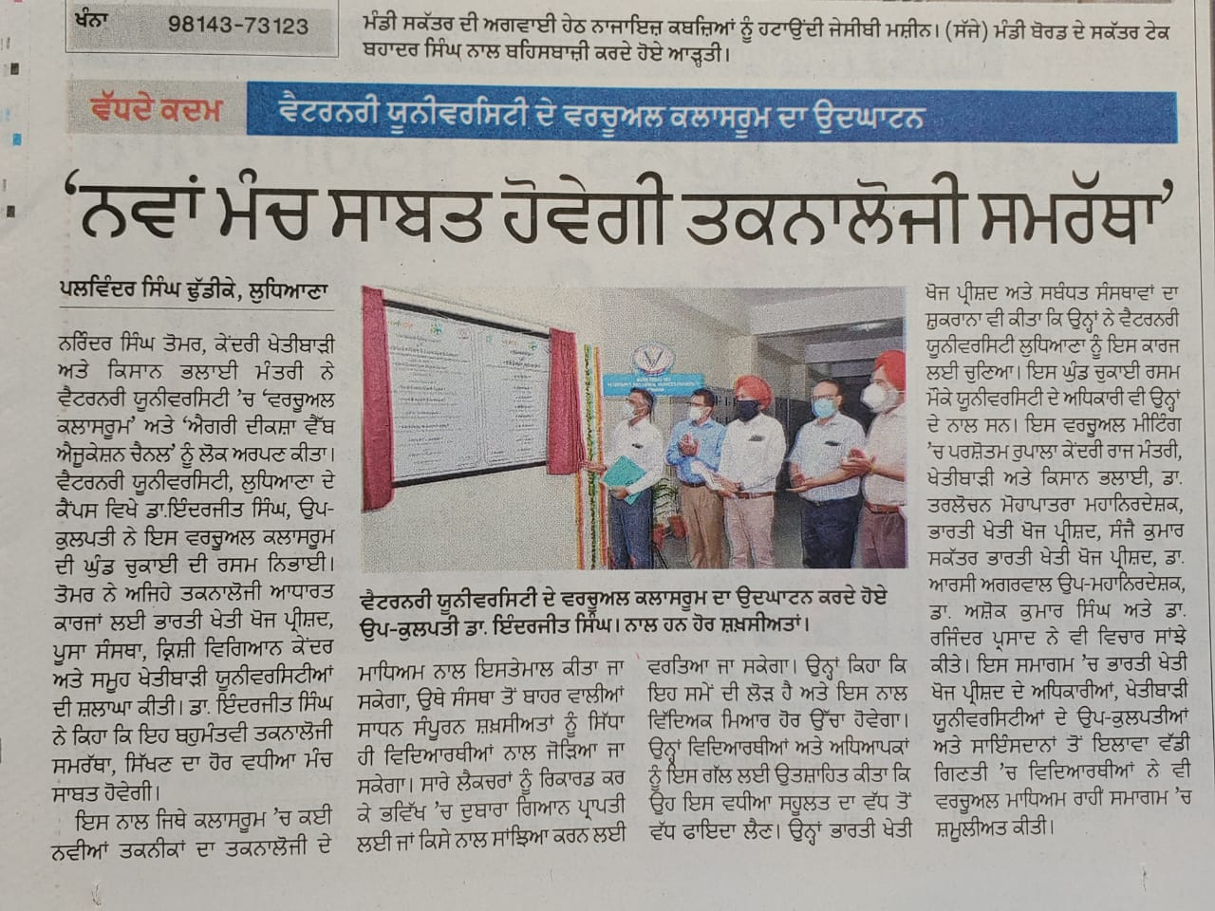
GADVASU, Ludhiana

Slide 14
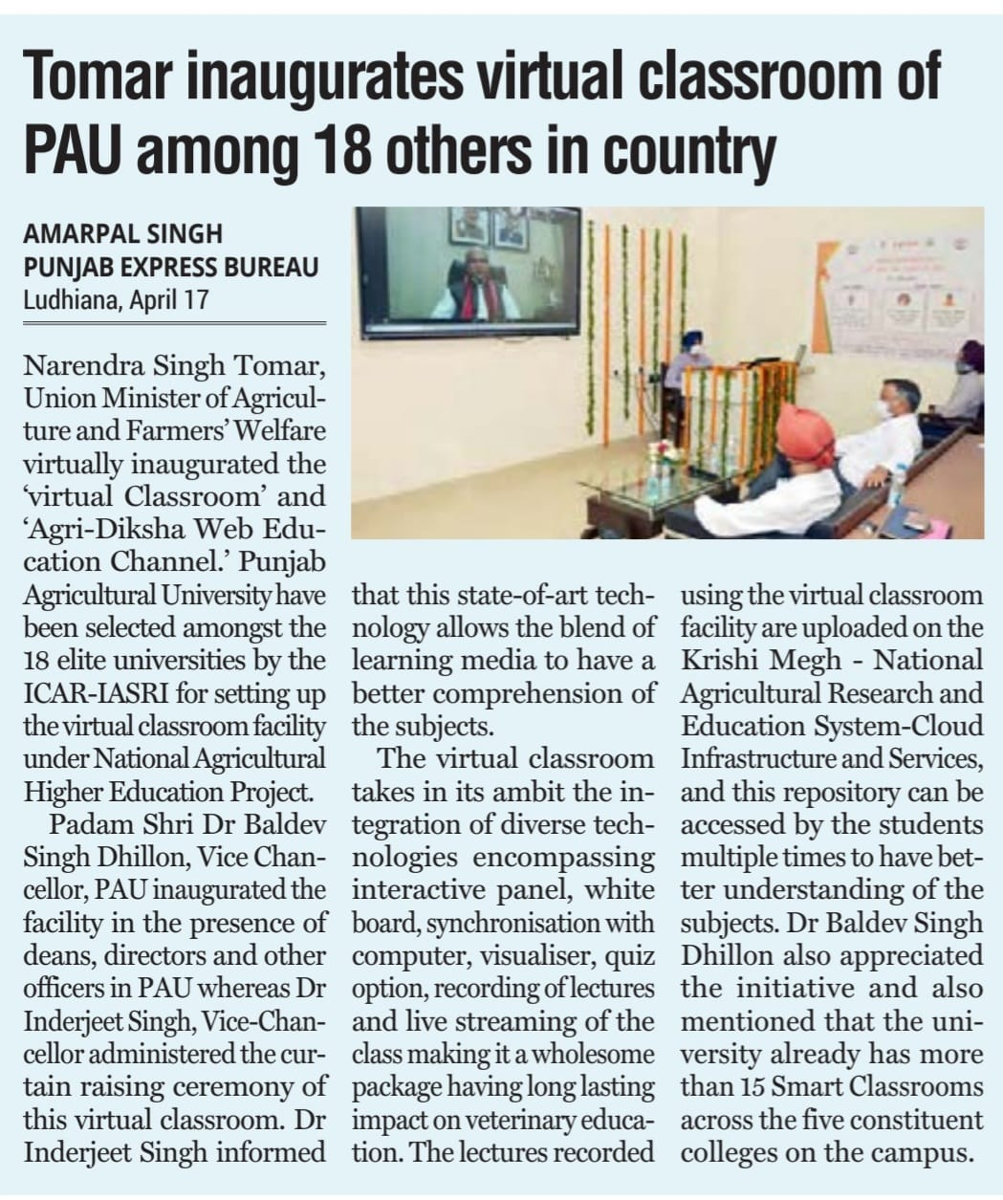
GADVASU, Ludhiana
https://krishijagran.com/agriculture-world/tomar-inaugurates-virtual-classroom-of-gadvasu/

Slide 15
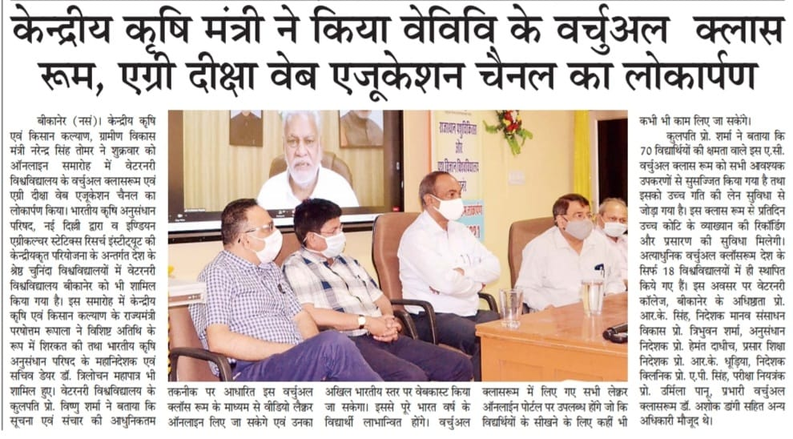
RAJUVAS, Bikaner

Slide 16
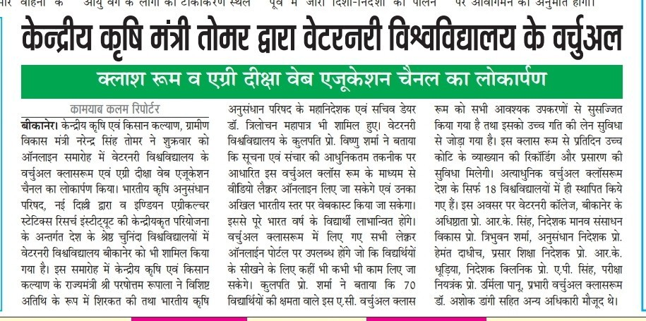
RAJUVAS, Bikaner

Slide 17
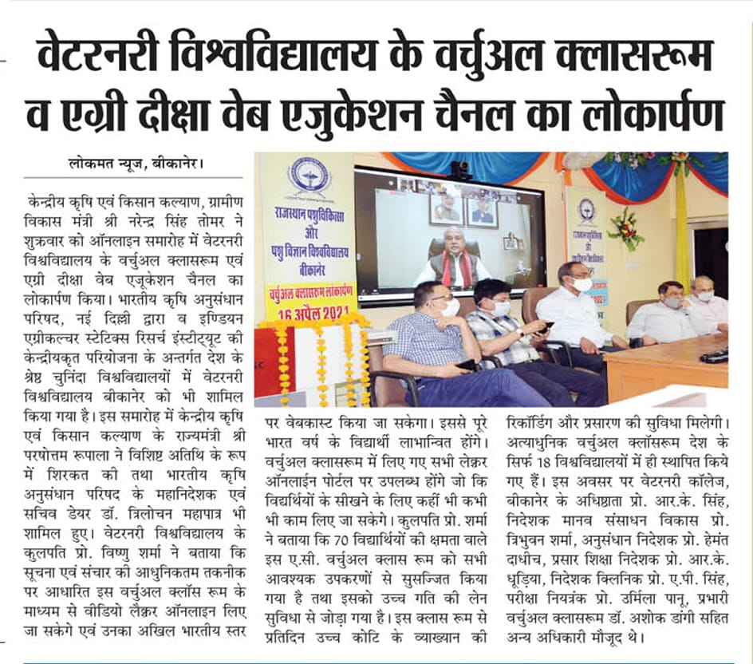
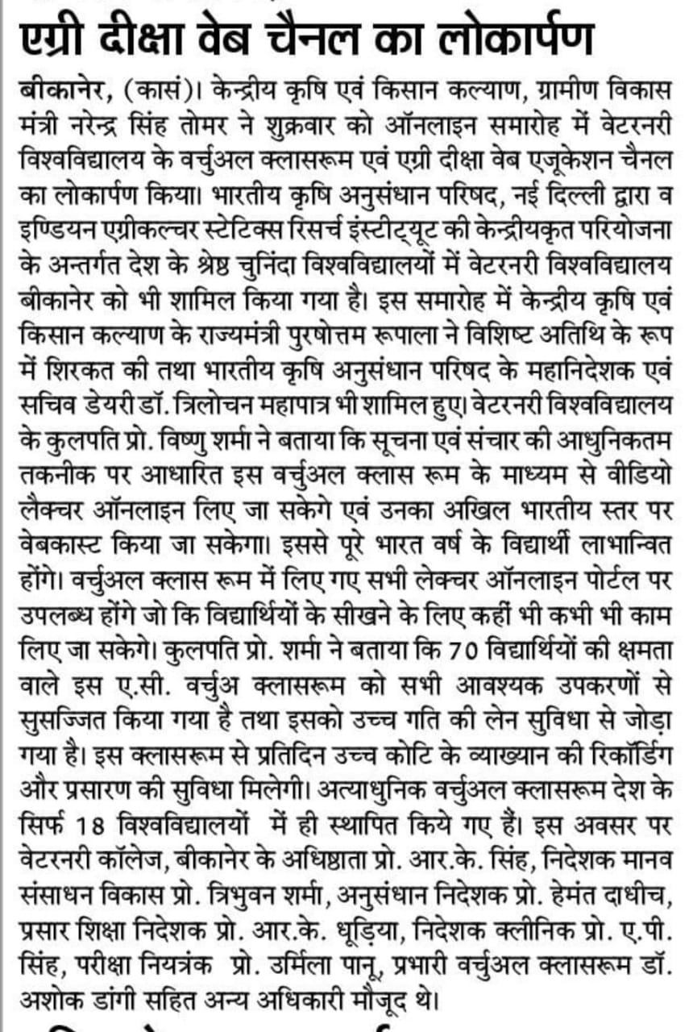
RAJUVAS, Bikaner

Slide 18
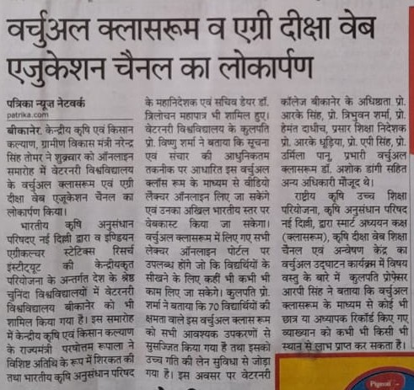
RAJUVAS, Bikaner

Slide 19
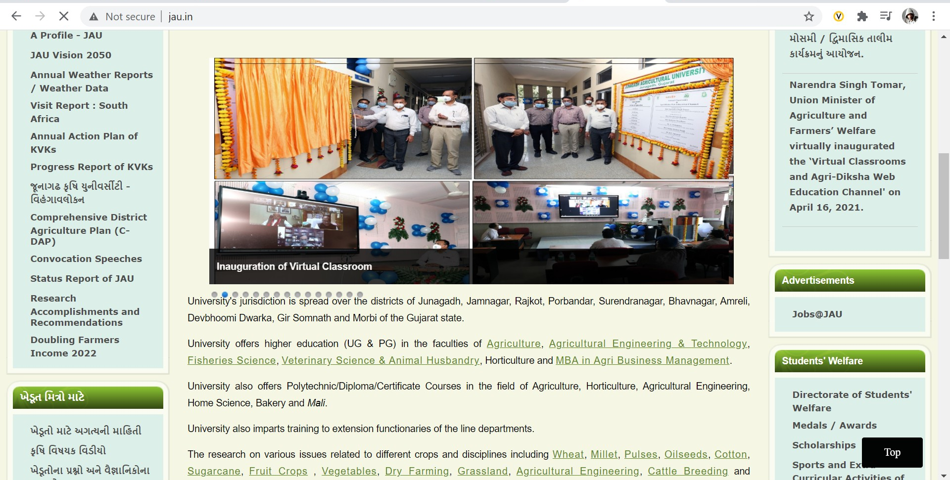
JAU, Junagarh
http://www.jau.in/

Slide 20
RLBCAU, Jhansi

Slide 21
RLBCAU, Jhansi

Slide 22
SKUAST, Kashmir
https://cdn.skuastkashmir.ac.in/NewsDoc/637542125900201249revised_Press%20Note.pdf

Slide 23
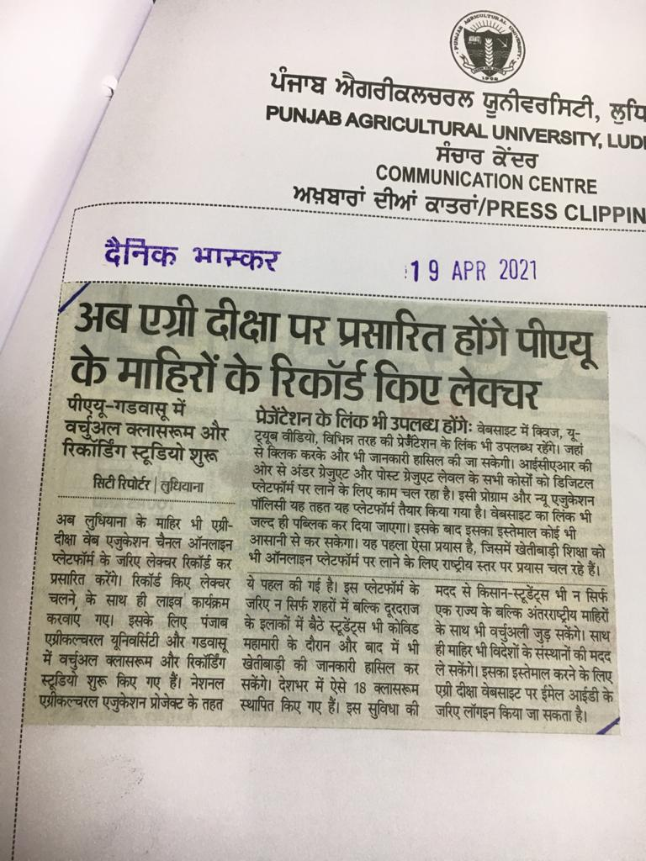
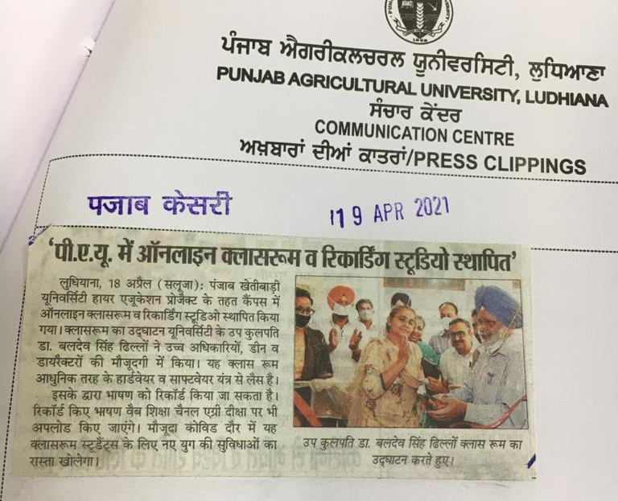
PAU, Ludhiana

Slide 24
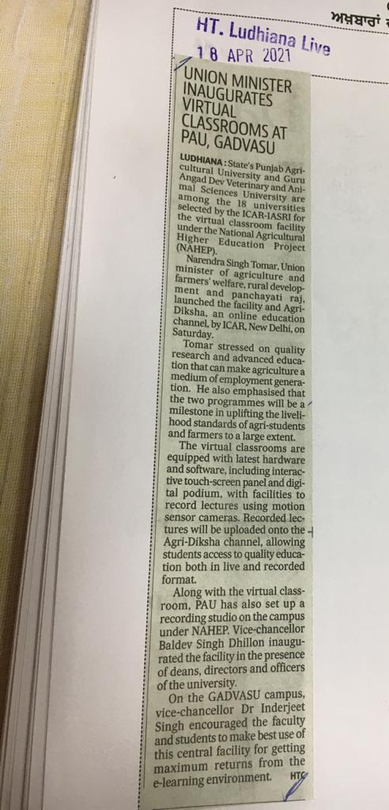
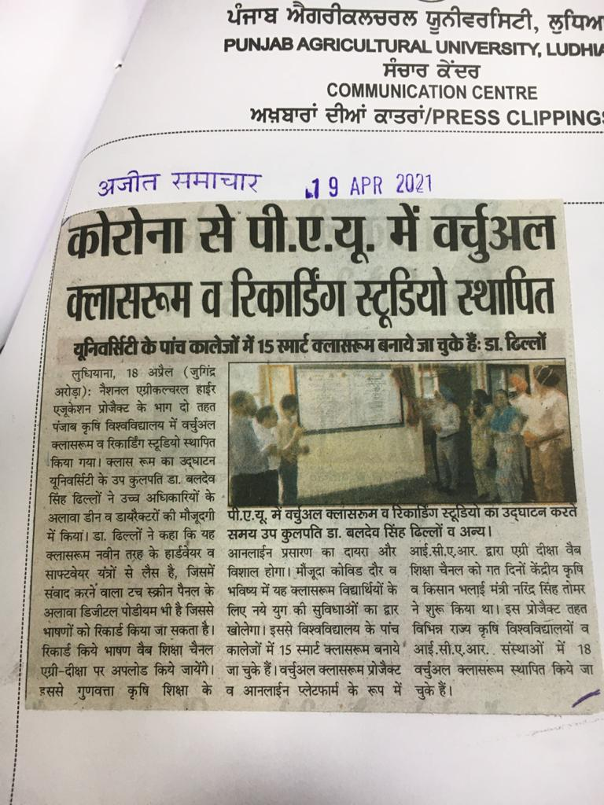
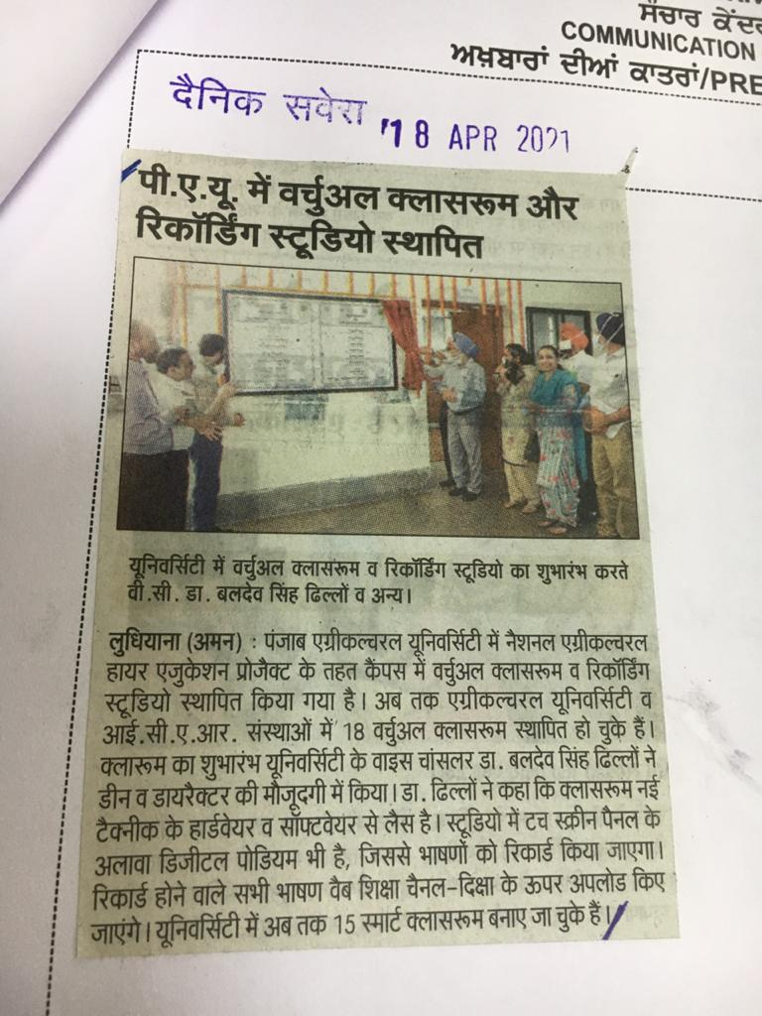
PAU, Ludhiana

Slide 25
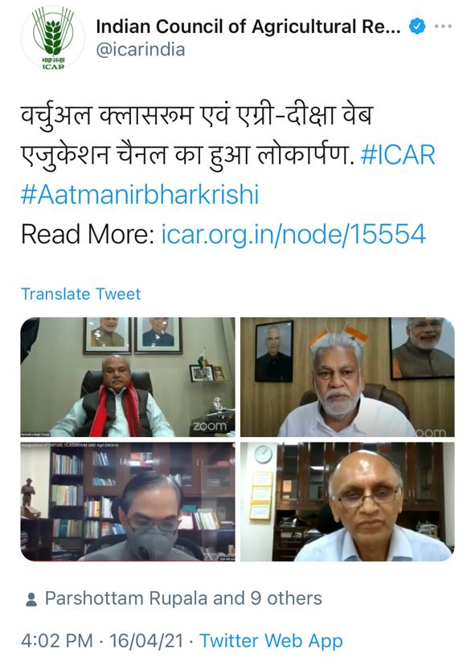
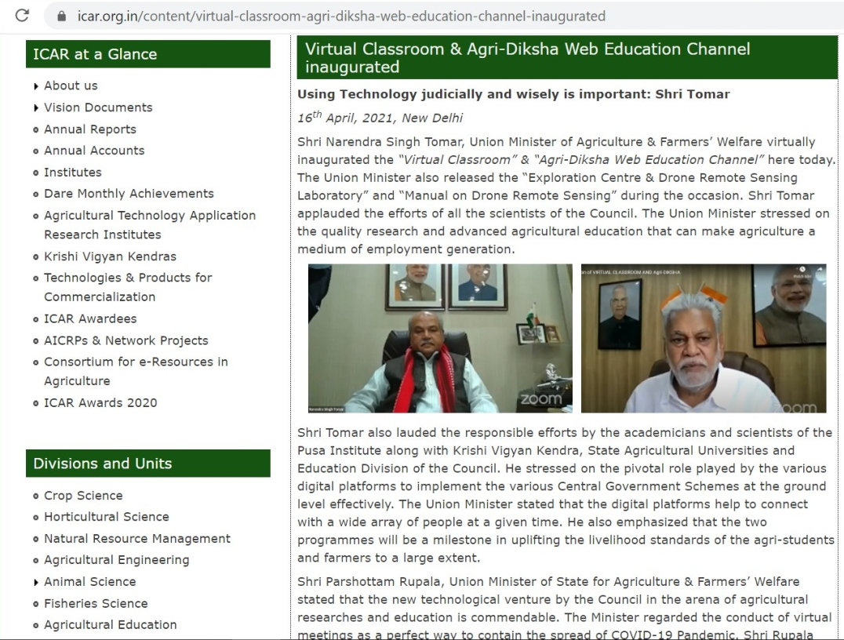
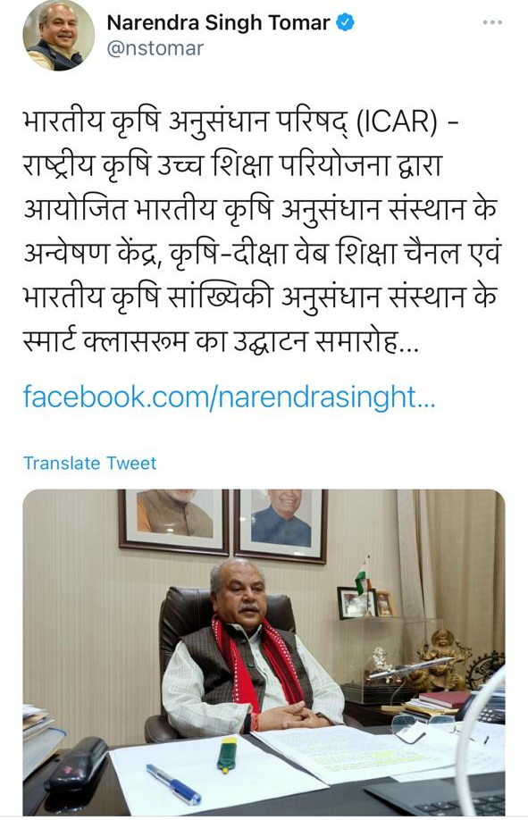
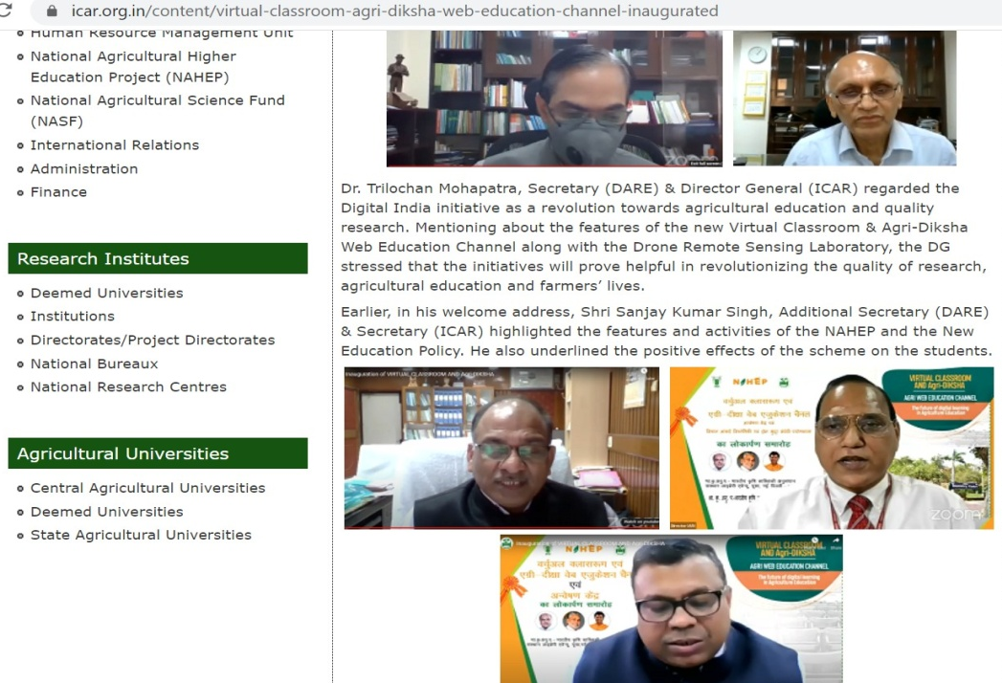
Social Media
https://icar.org.in/content/virtual-classroom-agri-diksha-web-education-channel-inaugurated

Slide 26
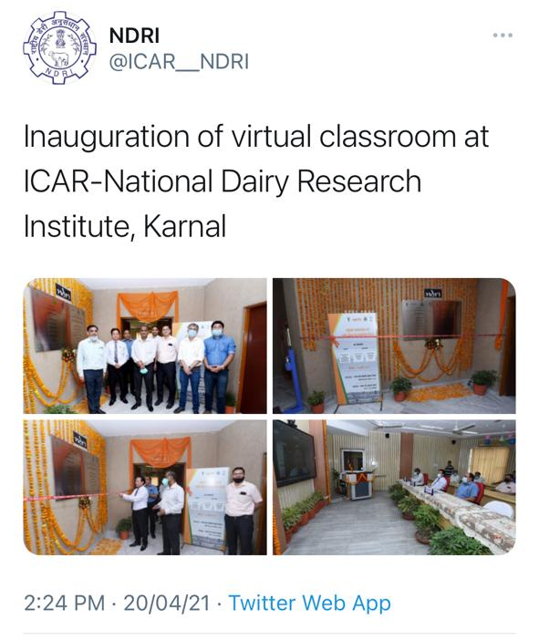
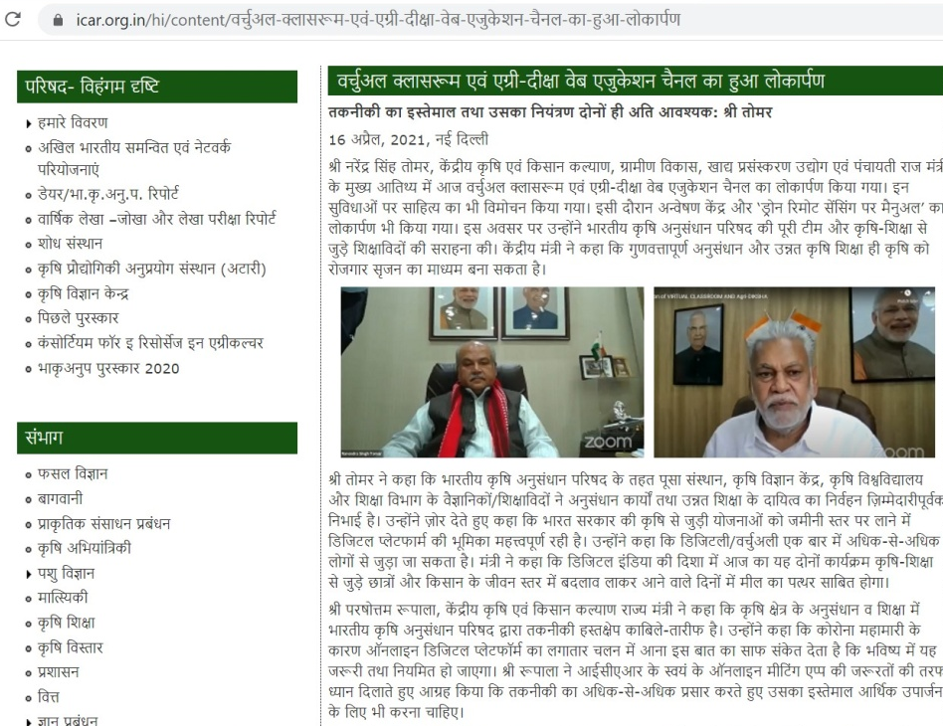
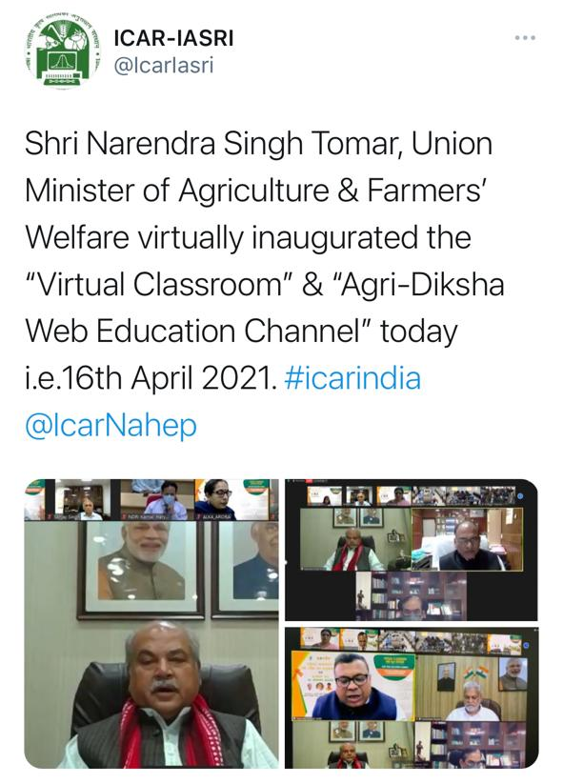
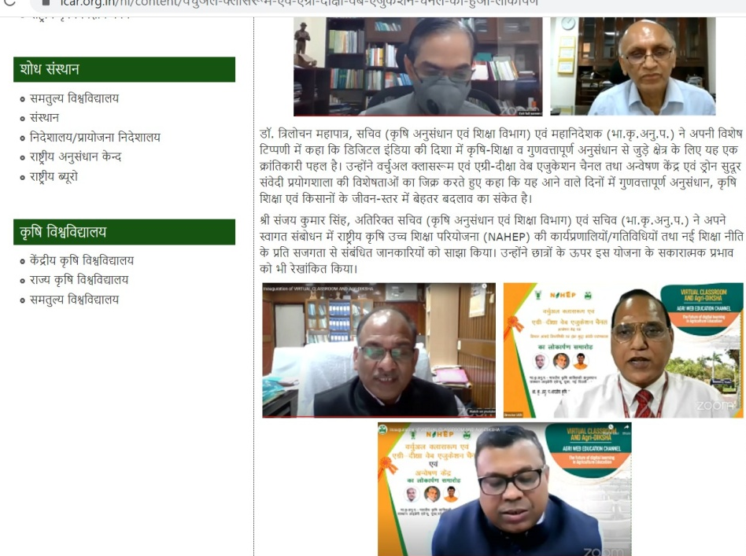
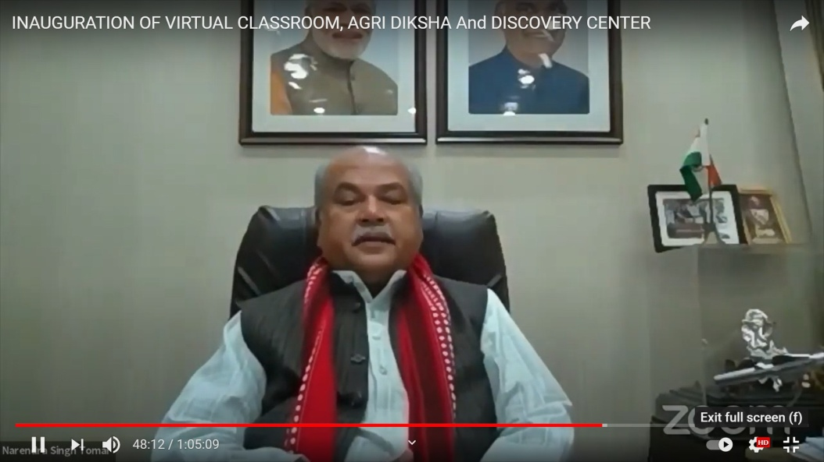
Social Media
https://www.youtube.com/watch?v=-J9QLcz2p1g
https://icar.org.in/content/virtual-classroom-agri-diksha-web-education-channel-inaugurated

