Slide 1
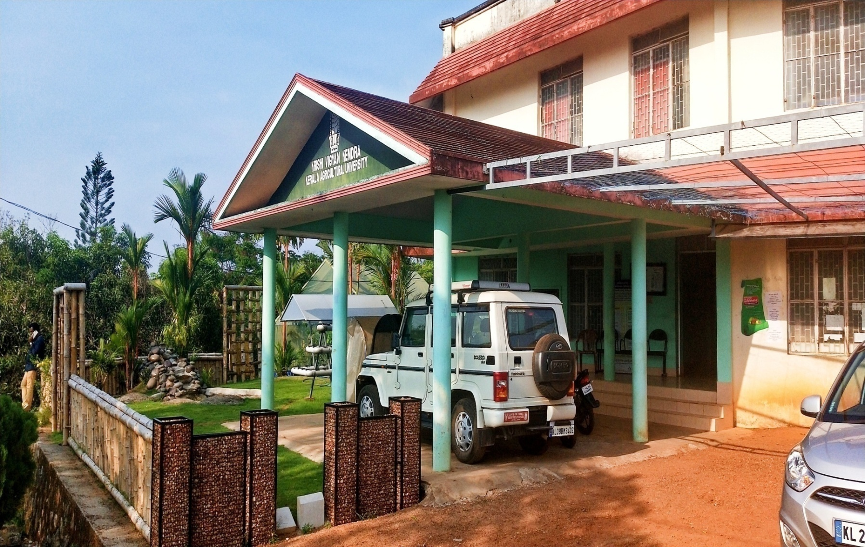


ICAR Krishi Vigyan Kendra Kollam
ACTION PLAN 2022-23

Slide 2
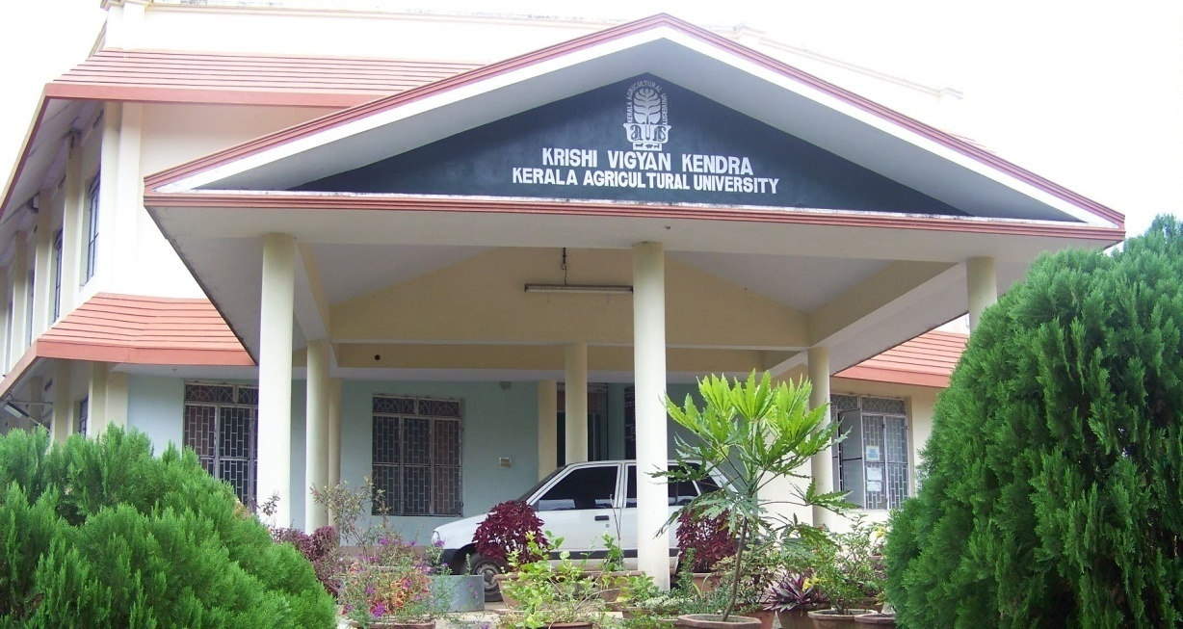

KRISHI VIGYAN KENDRA, KOLLAM
STAFF POSITION
CATEGORY OF POSTS | SANCTIONED | FILLED
Programme Coordinator | 1 | 1
Subject Matter Specialist | 6 | 6
Programme Assistant | 3 | 2
Administrative staff | 2 | 2
Auxiliary staff | 2 | 1
Supporting staff | 2 | 2
Total | 16 | 14

Slide 3


Operational Area
Krishi Vigyan Kendra, Kollam

Slide 4
Cluster Villages Identified for Interventions
AGRO ECOLOGICAL UNITS | CLUSTER VILLAGES
AEU 1: Southern Coastal Plain | Kundara, Kollam, Chathannur, Chirakkara, Perinad, Panayam, Poothakkulam, Elamballoor, Eravipuram
AEU 3: Onattukara Sandy Plain | North Sooranad, Ochira, Chavara, Clappana, Thazhava, Karunagappally
AEU 9: South Central Laterites | Kunnathoor, Sasthamkotta, Kottarakkara, Mylom, Ezhukone, Poyappally, Ummannoor, Kunnikkode
AEU 12: Southern Foot Hills | Vettikavala, Thalavoor, Anchal, Punalur
AEU 14: Southern high hills | Aryankavu
Krishi Vigyan Kendra, Kollam

Slide 5
Major Problems
Low yield due to imbalanced nutrient application
Yield reduction in paddy due to heavy incidence of weeds
Non availability of high yielding varieties of high value crops in Kollam District
Crop loss due to Cassava root rot in tapioca
Heavy application of chemical pesticides
IPDM in coconut
Slow growth rate of existing variety in fishery sector
KVK Kollam

Slide 6
Major Problems
High perishability and improper post harvest management
Under utilization of medicinal plants
Shortage of broiler duck meat in festival season
Shortage of green fodder in summer season
High cost of duck feed
Lack of egg production in Kollam district
KVK Kollam

Slide 7
Thrust Areas Identified
Varietal evaluation and crop diversification
INM and soil test based nutrient management
Enhancing crop productivity and profitability through appropriate technologies
Promotion of organic methods of cultivation
Sustainable production and profit maximisation
Income generating enterprises for self employment
Nutritional security
Enhancing production and productivity of livestock , poultry and fisheries
Value addition and post harvest management
Farm mechanisation
Doubling farmers income
KVK Kollam

Slide 8
Target Interventions
Intervention | Target number/ Quantity
On Farm Trial | 5 (29)
Front Line Demonstration | 14(80)
EDP 2
Special Programme 1
Capacity development | 152(2330)
Extension Activities | 1450(9800)
Krishi Vigyan Kendra, Kollam

Slide 9
ON FARM TRIALS 2022-2023
Krishi Vigyan Kendra, Kollam

Slide 10
ON FARM TRIALS 2022-2023
S.No | Particulars | No. of trials | Cost (Rs)
1. | Assessment of foliar application of N fertilizers in sesame in Kollam district | 7 | 5110
2. | Assessment of hybrid ornamental banana in Kollam district | 10 | 21000
3. | Assessment of water melon varieties in Kollam district | 5 | 10250
4 | Assessment of ICAR CIFA improved Catla for freshwater farming in Kollam district | 3 | 10,000
5. | Assessment of egg production during summer season in different poultry layer varieties | 4 | 9000
 | Total | 29 | 55360
KVK Kollam

Slide 11
FRONTLINE DEMONSTRATIONS 2022-2023
Krishi Vigyan Kendra, Kollam

Slide 12
FRONTLINE DEMONSTRATIONS 2022-2023
S.No | Particulars | No. of demo | Cost (Rs)
1. | Management of Limnocharis flava– A major weed in the rice growing tracts of Kollam district | 15 | 30750
2. | Demonstration of Nutrient Sticks in Vegetables (Tomoto and Chilli) in terrace gardens of Kollam district | 15 | 29100
3 | Demonstration of Andrographis variety Vallabh Kalmegh-01 | 6 | 3900
4. | Demonstration of Marigold variety Pusa Bahar | 6 | 25800
5. | Demonstration on integrated management of Cassava root rot in Kollam district | 7 | 5250
Krishi Vigyan Kendra, Kollam

Slide 13
FRONTLINE DEMONSTRATIONS 2022-2023
S.No | Particulars | No. of demo | Cost (Rs)
6. | Demonstration of Cashew Nut Shell Liquid based botanical pesticide for pest management in cowpea | 7 | 9275
7. | Compact area group approach for the management of coconut beetle, Oryctes rhinoceros L. in Kollam district | 2 | 17000
8. | Demonstration on formulated feed for Channa striata (Varaal) | 3 | 39000
9. | Demonstration of syrup and RTS using Medicinal plants-Brahmi-(Bacopa monnieri) and Muthill (Centella asiatica) | 3 | 24000
10. | Demonstration of Mushroom based high value product-Mushroom soup powder | 2 | 19000
Krishi Vigyan Kendra, Kollam

Slide 14
FRONTLINE DEMONSTRATIONS 2022-2023
S.No | Particulars | No. of demo | Cost (Rs)
11 | Modified drying technology for shelf life enhancement of prawns | 2 | 17000
12 | Demonstration of Vigova Broiler duck variety for meat production in coastal areas of Kollam district | 4 | 10000
13 | Demonstration of Super Napier fodder variety in Dairy cattle for improved milk production | 5 | 2000
14 | Demonstration of Azolla as an economic feed supplement in Ducks for increasing egg production | 4 | 6500
 | Total | 81 | 2,38,575/-
Krishi Vigyan Kendra, Kollam

Slide 15
Capacity development
Farmers and farm women | 48(940)
Extension personnel | 13(210)
Rural youth | 52(520)
Vocational Trainings | 18 (220)
Sponsored Trainings | 21 (440)
TOTAL | 152(2330)

Slide 16
Extension Programmes
No | Extension programme | No. of programmes or activities
1. | Diagnostic visits | 85
2. | Field Day | 15
3. | Self -help groups meetings | 5
4. | Exhibition | 5
5. | Scientists' visit to farmers field | 250
6. | Plant/Soil health/Animal health camps | 5
7. | Ex-trainees meetings | 3
8. | Farmers' seminar/workshop | 12
9. | Technology week | 1
Krishi Vigyan Kendra, Kollam

Slide 17
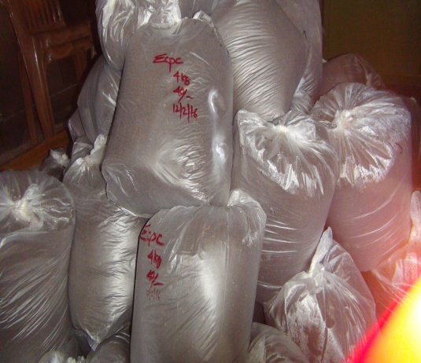
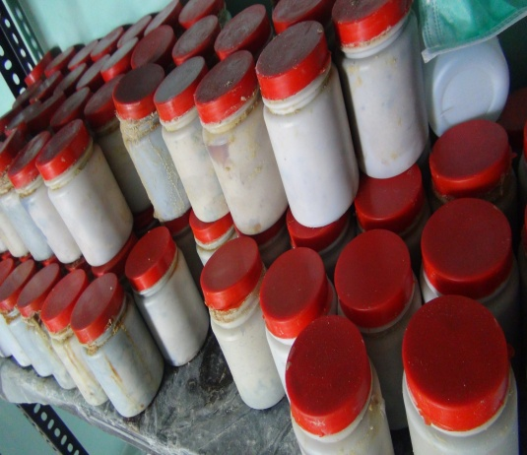
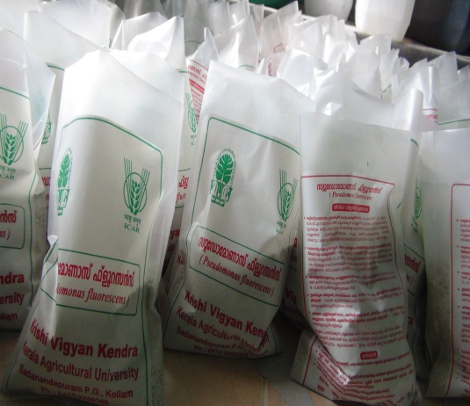
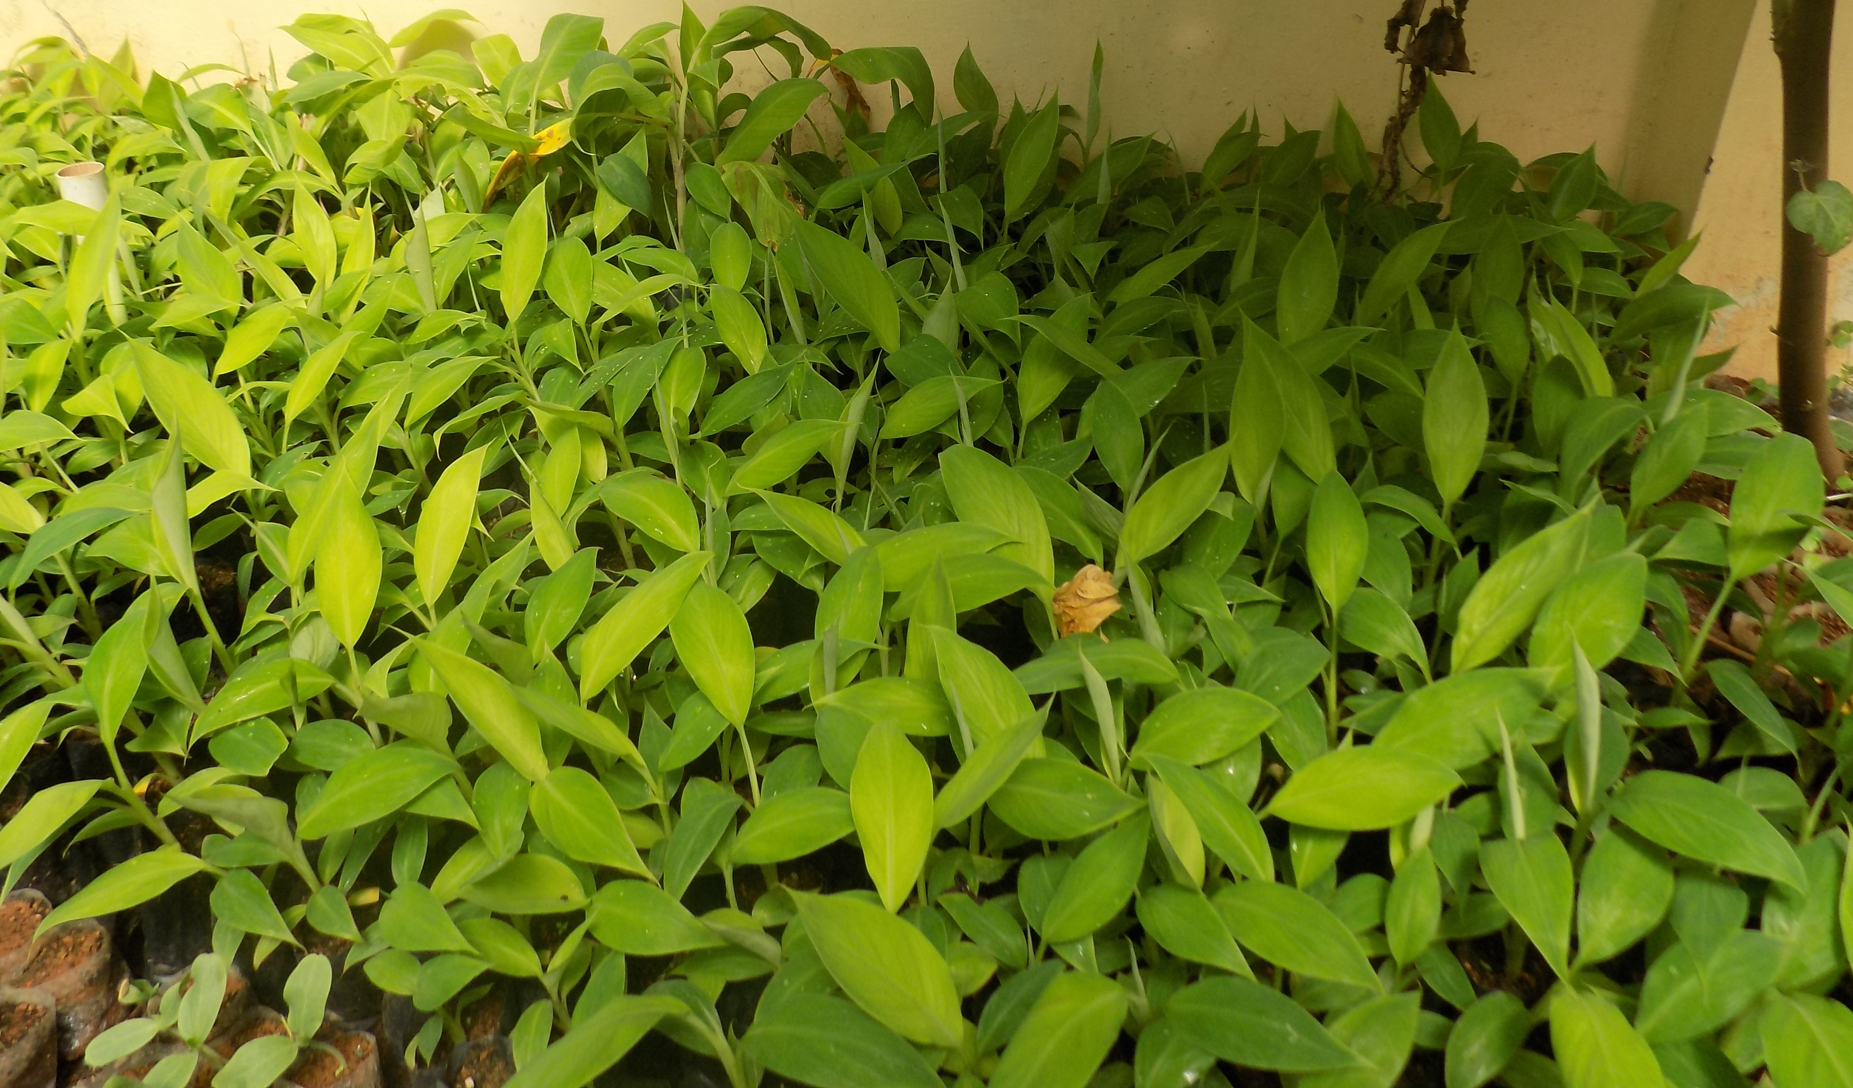
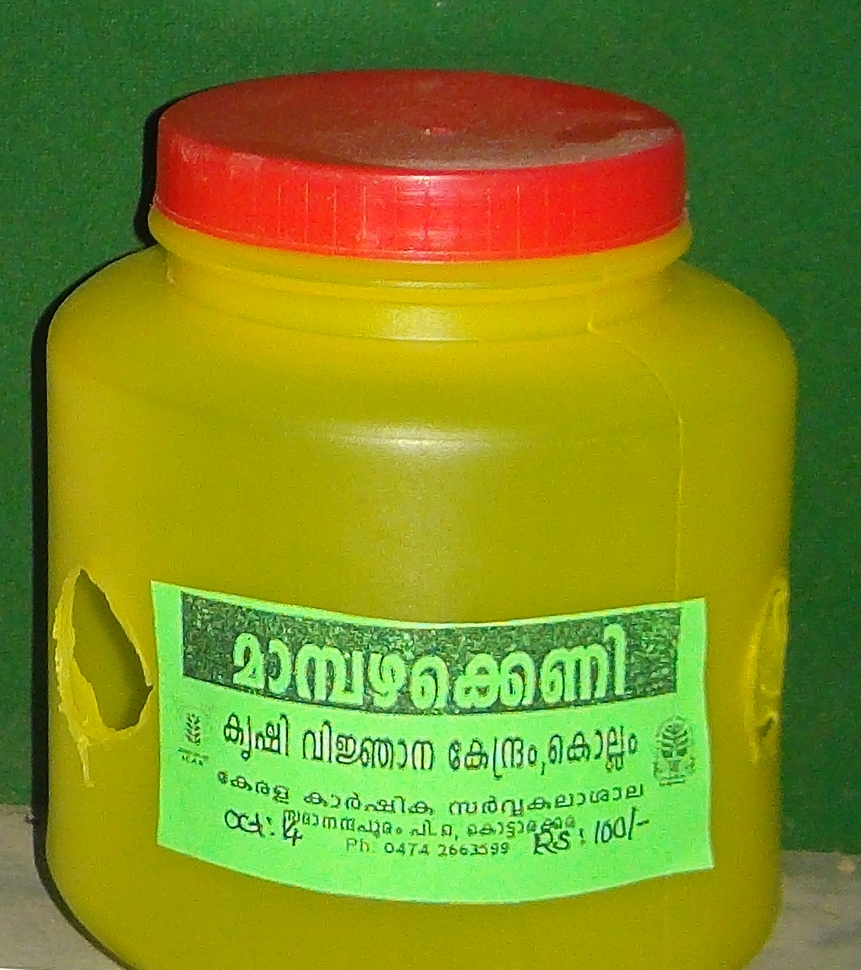
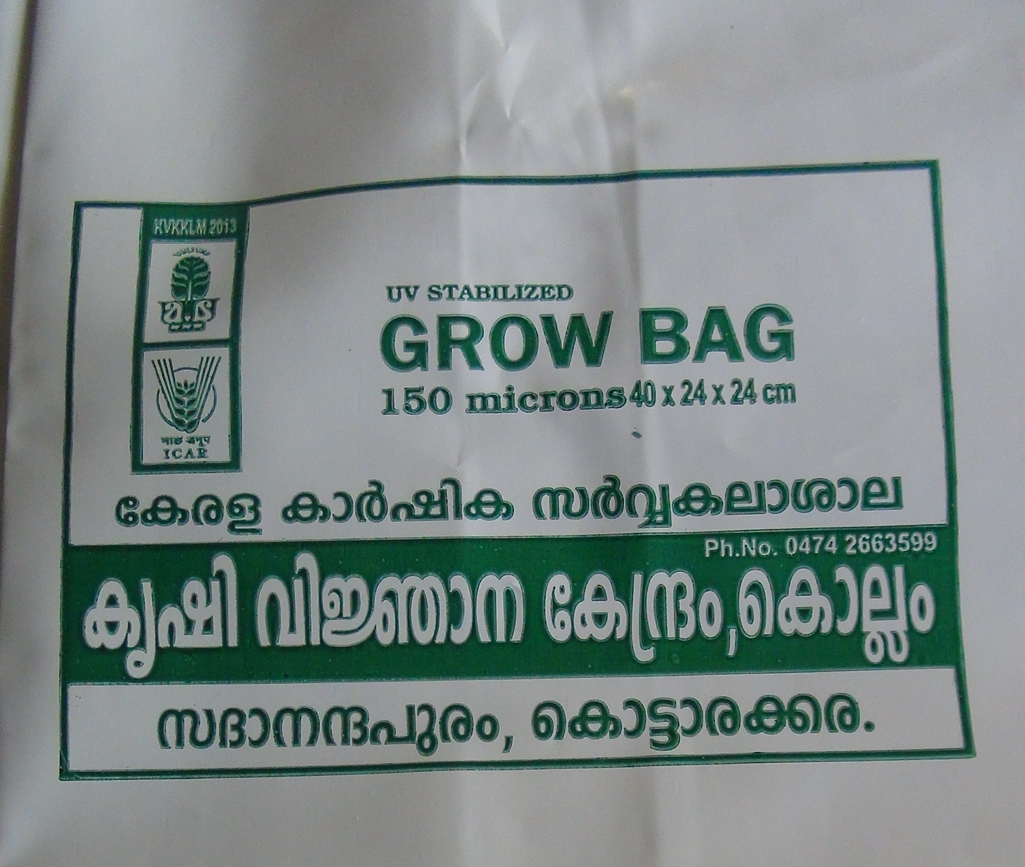
ACTIVITIES UNDER REVOLVING FUND
Seedlings & Planting Materials
3000 kg
Enriched coir pith compost
85000 Nos.
Pheromone Traps
750 Nos.
300 Kg
KVK Raksha
Pseudomonas
2500 Kg
30000 Nos
Grow Bag
Krishi Vigyan Kendra, Kollam

Slide 18
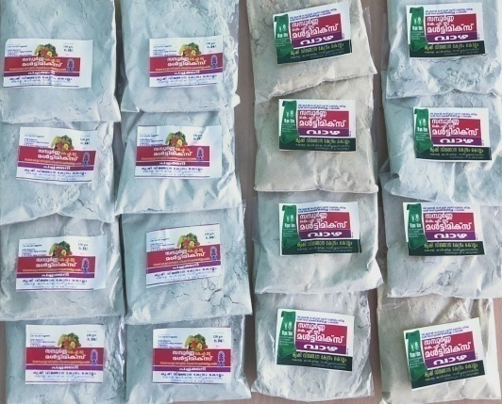
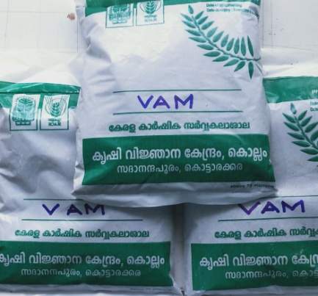
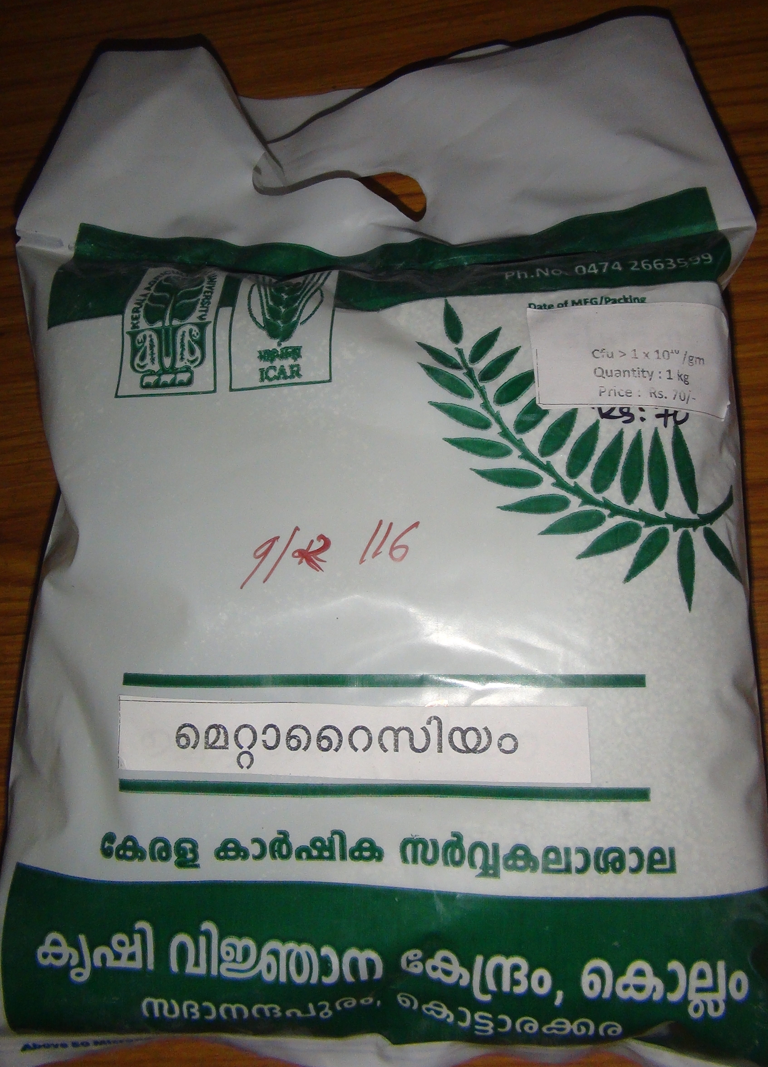
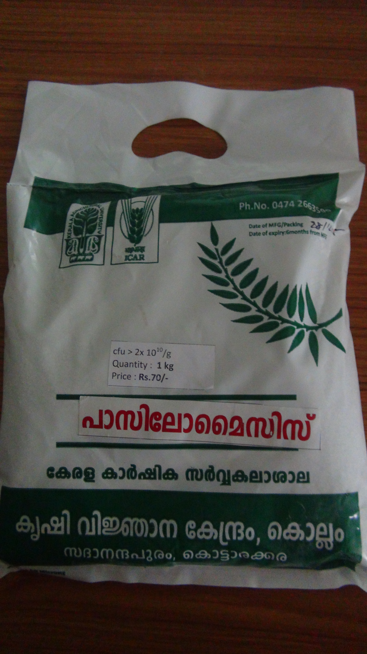
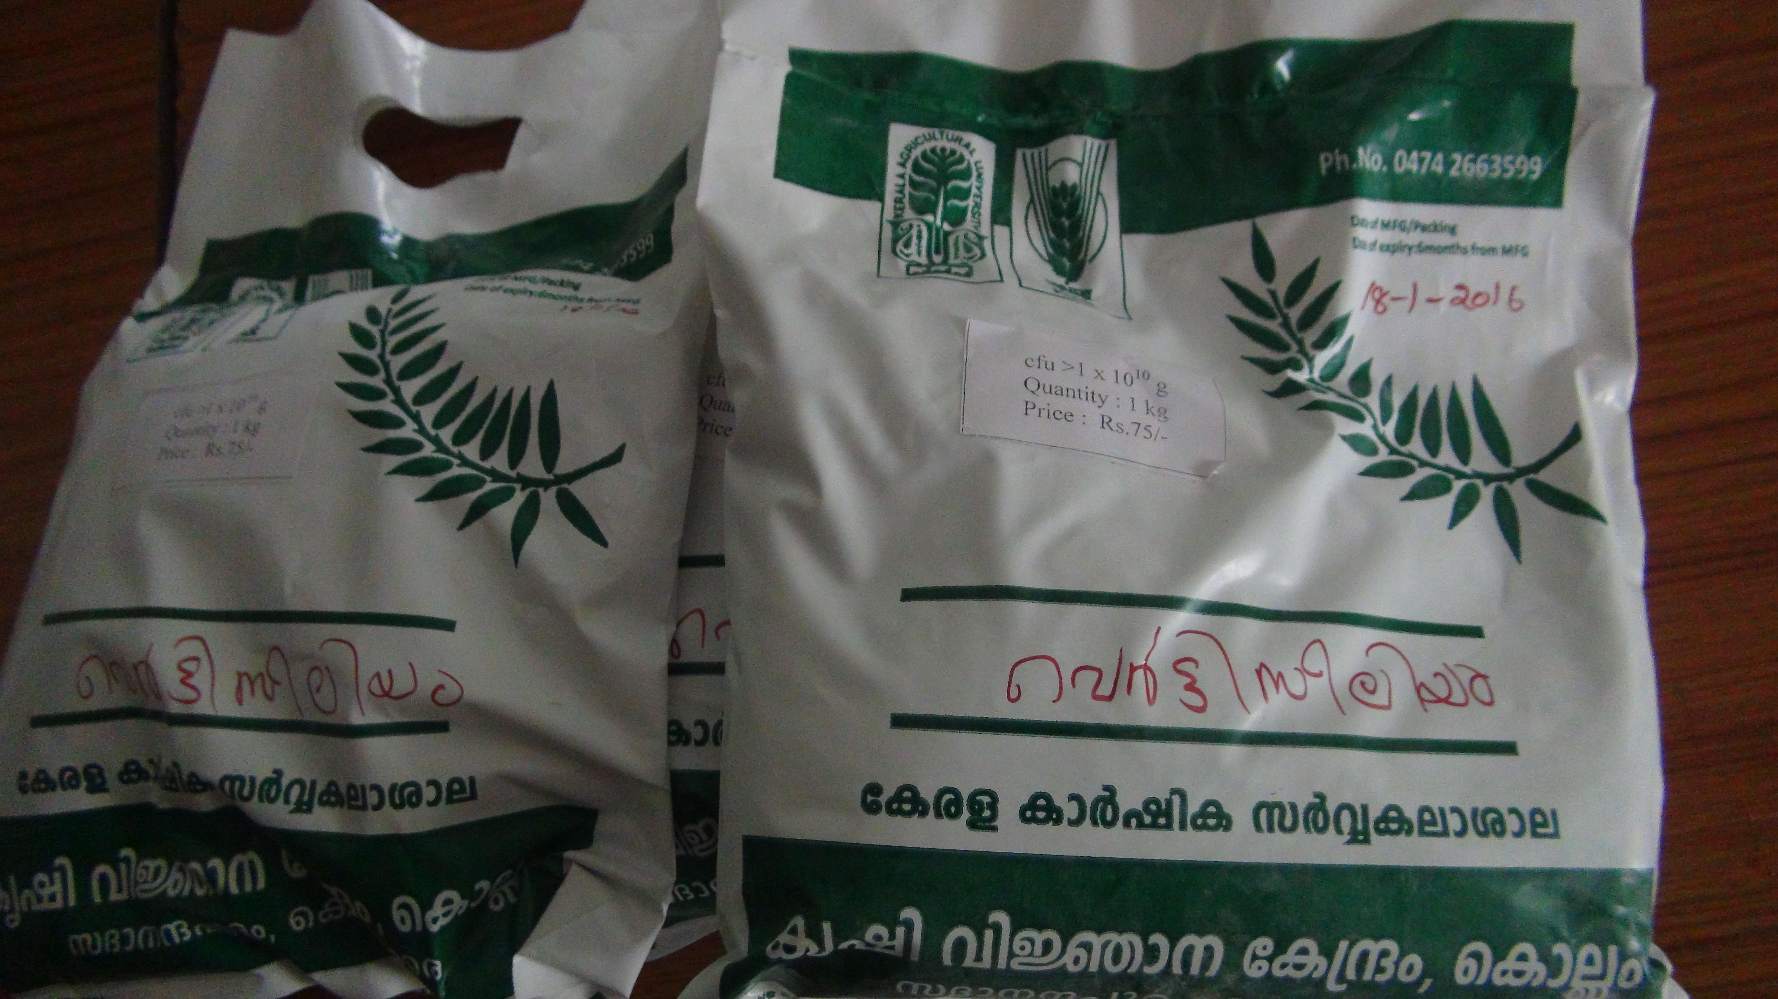
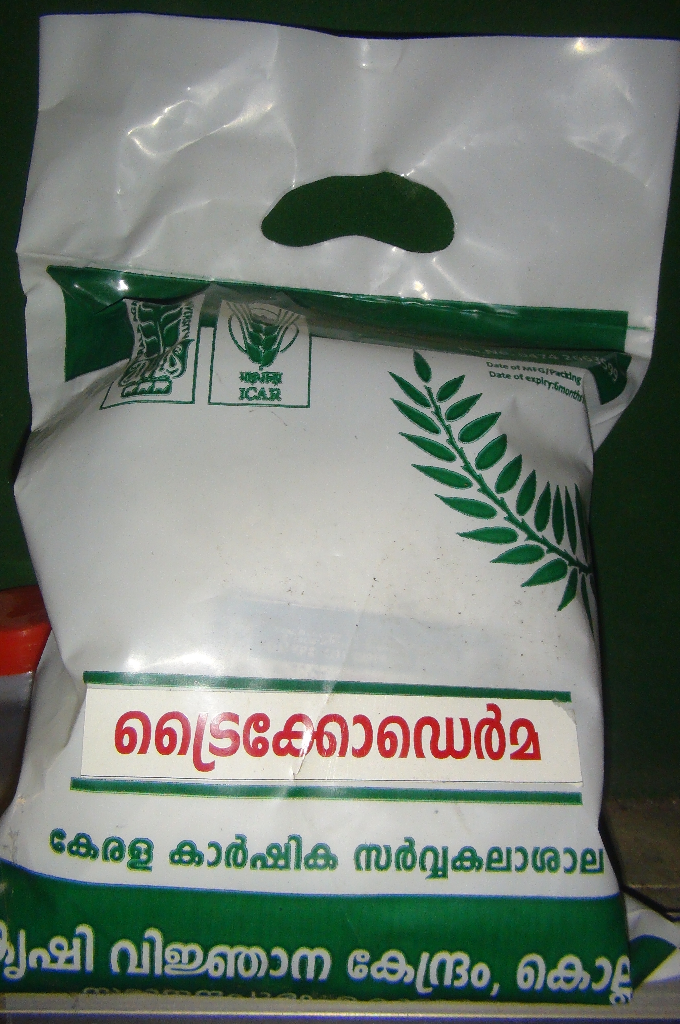
ACTIVITIES UNDER REVOLVING FUND
Verticilium
500 Kg
600 Kg
Beauvaria
Metarhizium
100 Kg
2000 Kg
Trichoderma
4250 kg
1500 kg
Micro nutrients
Vam
Krishi Vigyan Kendra, Kollam

Slide 19
ICAR-Krishi Vigyan Kendra, Kollam
ACTION PLAN 2022-2023 (Agronomy)

Slide 20
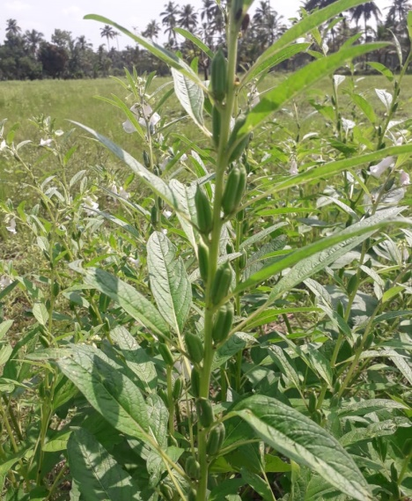
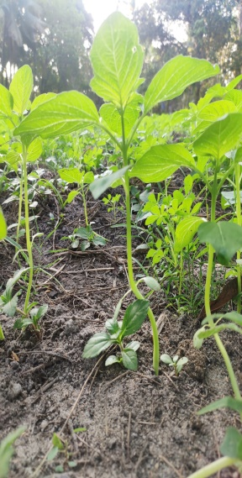
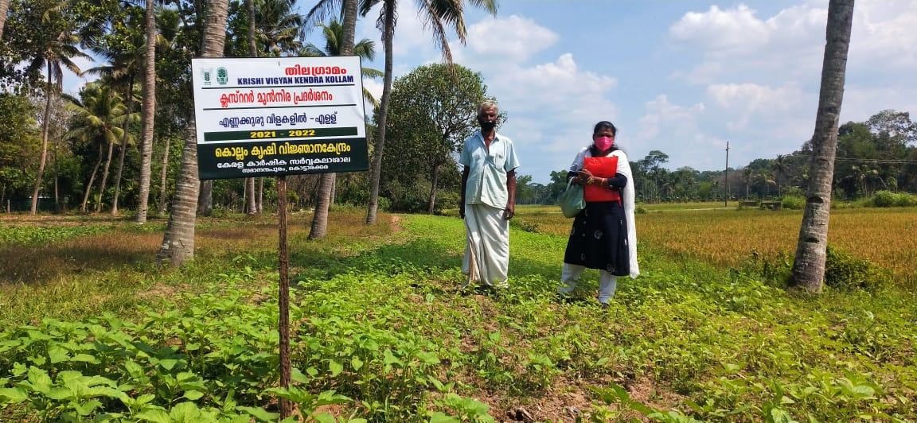
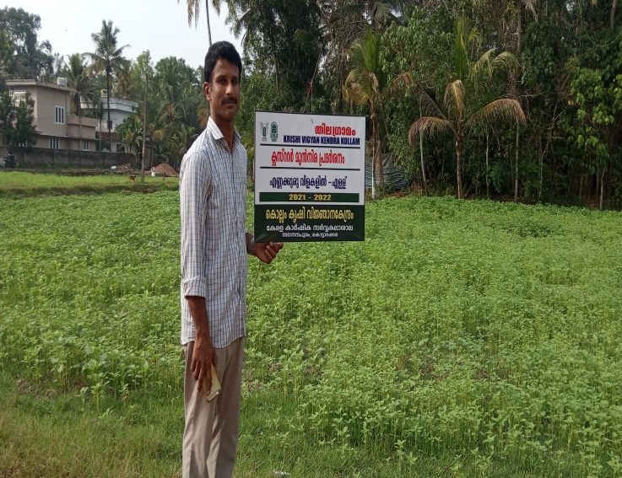
OFT | Assessment of foliar application of N fertilizers in sesame in Kollam district
1
Thrust area | Integrated Nutrient Management
Problem prioritized | Low yield due to skipping of urea top dressing
Number of trials | 7
Area | 0.84 ha
Operational Area: Sooranadu North , Ochira , Clappana, Thazhava(AEU 3)
Krishi Vigyan Kendra, Kollam

Slide 21


OFT | Assessment of foliar application of N fertilizers in sesame in Kollam district
1
 | Technology to be assessed | Source of technology | Parameters of assessment
TO 1 | Farmers practice |  | Yield, BCR Pest and disease incidence
TO 2 | Foliar application of conventional urea 3% | KAU,2016
TO 3 | Foliar application of nano urea @0.4% | IFFCO,NBRC Gujarat
Details of Technology
KVK Kollam
Krishi Vigyan Kendra, Kollam

Slide 22
OFT | Assessment of foliar application of N fertilizers in sesame in Kollam district
1
Budget details
SlNo. | Critical input | Quantity/trial | Cost/trial (Rs)
1 | Nano Urea | 500 ml | 240
2 | Seeds | 0.5 kg | 100
3 | Bio fertilizer and bioagents | 2 kg | 160
4 | Botanicals | 200 gm | 120
5 | Soil testing | 1 | 110
Cost per trial : Rs. 730/-
Cost for assessment : Rs. 5110/-
Krishi Vigyan Kendra, Kollam

Slide 23
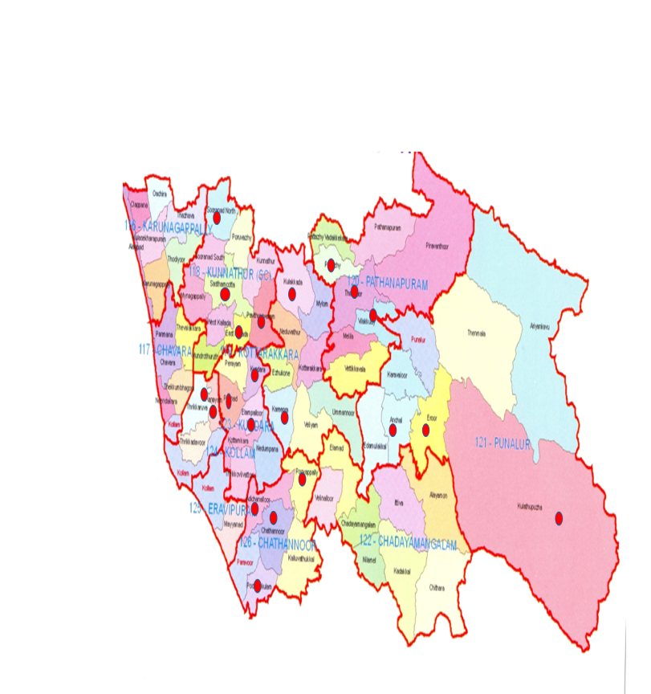
FLD | Management of Limnocharis flava– A major weed in the rice growing tracts of Kollam district
1
Problem prioritized | Yield reduction due to heavy incidence of broad leaved weed Limnocharis flava
Source of Technology | KAU,2017
Technology Demonstrated | Stale seed bed and application of Metsulfuron ethyl 10%+Chlorimuron ethyl 10% @6gm ai /ha
Operational Area: | Panayam and Perinad (AEU 1)
Number of demonstration | 15
Area | 3ha
Parameters | Weed Count , Yield, BC Ratio
63 padasekharam surveyed
30 -heavy incidence
21 Panchayaths out of 69
Krishi Vigyan Kendra, Kollam

Slide 24
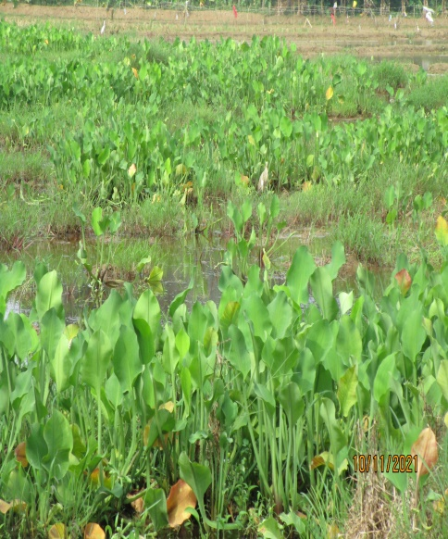
FLD | Management of Limnocharis flava– A major weed in the rice growing tracts of Kollam district
1
Budget Details
Sl.No | Critical input | Quantity | Cost /demo(Rs)
1 | Glufosinate | 0.48 l | 750
2 | Metsulfuron ethyl 10%+Chlorimuron ethyl 10% | 6 g | 300
3 | Skilled demonstrator | 1 no | 1000
Cost per demonstration | Rs.2050/-
Cost for demonstration | Rs. 30750/-
KVK Kollam
Krishi Vigyan Kendra, Kollam

Slide 25
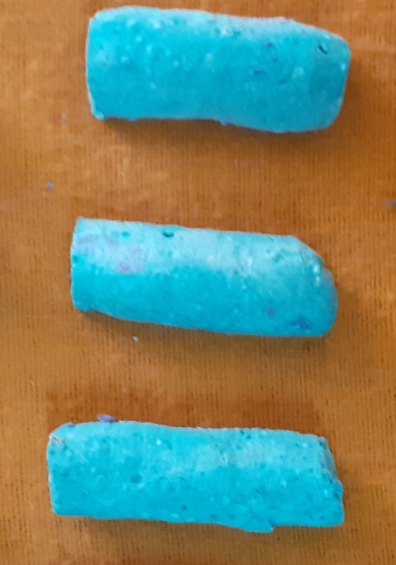
FLD | Demonstration of Nutrient Sticks in Vegetables (Tomoto and Chilli) in terrace gardens of Kollam district
2
Problem prioritized | Low yield due to imbalanced use of fertilizer application
Source of Technology | KAU,2021
Technology Demonstrated | Use of nutrient stick a slow releasing fertilizer form in terrace vegetable @ of 2 sticks/pot ( at planting and 30 days after planting)
Operational Area: | Kollam Corporation(AEU 1), Kottarakkara Muncipality(AEU 9)
Number of demonstration | 15
Area/ grow bags | 450 nos
Parameters of assessment | Yield, BCR, Pest and disease incidence
Krishi Vigyan Kendra, Kollam

Slide 26
FLD | Demonstration of Nutrient Sticks in Vegetables (Tomoto and Chilli) in terrace gardens of Kollam district
2
Budget Details
Sl.No | Critical input | Quantity | Cost /demo(Rs)
1 | Nutrient Stick | 60 | 200
2 | Bio fertilizer | 3 kg | 240
3 | Botanicals | 200gm | 120
4 | Soil testing(potting mixture)pre and post Demo and check | 3 | 1380
Cost per demonstration | Rs.1940/-
Cost for demonstration | Rs. 29100/-
KVK Kollam
Krishi Vigyan Kendra, Kollam

Slide 27
ICAR-Krishi Vigyan Kendra, Kollam
ACTION PLAN 2022-2023(Horticulture)

Slide 28
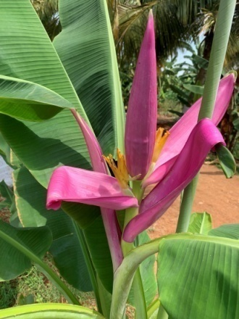
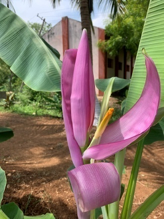
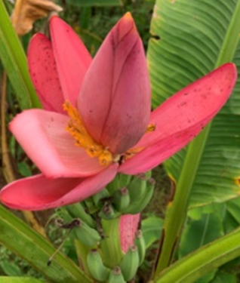
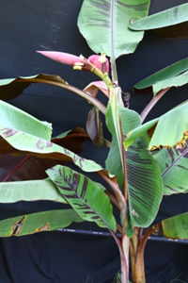
OFT | Assessment of hybrid ornamental banana in Kollam district
2
Thrust area | Varietal evaluation
Problem prioritized | Non availability of hybrid ornamental banana in Kollam district.
Technology assessed | Source of Technology
TO 1- Nil
TO2 - O x Z (M. ornata x M.acuminata subsp. zebrina) | NRC for Banana, 2021
TO 3 - R x Z (M. rubra x M.acuminata subsp. zebrina)
TO4 - O x R (M. ornata x M. rubra )
Operational area:
Elamballoor, Kundara, Chathanoor, Kollam (AEU 1) Chavara and Karunagapally (AEU 3).
Krishi Vigyan Kendra, Kollam

Slide 29
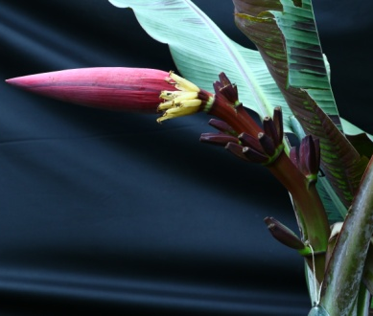
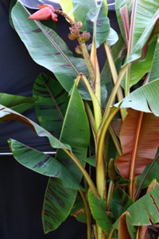

OFT | Assessment of hybrid ornamental banana in Kollam district
2
Fig.1. O x Z
Fig.1: M. Ornata ×
M. acuminata subsp. zebrina
Fig.2. R x Z
Fig.3. O x R
Fig.2 : M. rubra ×
M. acuminata subsp. zebrina
Fig.3:
M. ornata× M. rubra
Number of trials | 10 | Parameters: BCR, Pest and disease incidence.
Area/trial Total Area | 0.048 ha (12 cent) 0.48 ha
Krishi Vigyan Kendra, Kollam

Slide 30


OFT | Assessment of hybrid ornamental banana in Kollam district
2
Budget details
Sl.No. | Critical input | Quantity/trial | Cost/ trial (Rs.) | Total Cost (Rs)
1 | Suckers | 750 | Assured by NRCB on free of cost. | 11500.00 Courier charges :Rs 115/Kg
2 | Bio control agents & Botanicals | 9 kg | 950.00 | 9500.00
Total |  |  |  | 21000.00
Cost per trial : Rs. 2100/-
Total cost : Rs. 21000/-

Slide 31
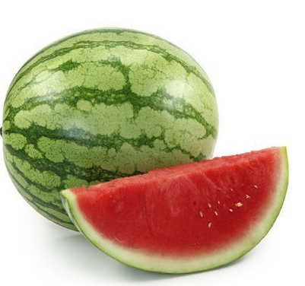
OFT | Assessment of water melon varieties in Kollam district
3
Thrust area | Varietal evaluation
Problem prioritized | Non availability of high yielding varieties in Kollam District
Technology assessed | Source of Technology
TO 1- Nil
TO2 - Swarna | KAU, 2015
TO 3 - Shonima | KAU, 2015
TO4 - Arka Shyama | IIHR, 2019
Number of trials | 5
Area/ trial Total Area | 0.040 ha (10 cent) 0.20 ha
Operational area: Sooranadu North , Karunagapally, Ochira(AEU 3),Kundara(AEU 1), Anchal Parameters:BCR, Pest and disease incidence.

Slide 32
OFT | Assessment of water melon varieties in Kollam district
3
Budget details
Sl.No. | Critical input | Quantity/trial | Cost/ trial (Rs.) | Total Cost (Rs)
1 | Seeds | Seeds - 45 g | 1500.00 | 7500.00
2 | Bio control agents & Botanicals | 5 kg | 550.00 | 2750.00
Total |  |  |  | 10,250.00
Cost per trial : Rs. 2050/-
Total cost : Rs. 10250/-
Krishi Vigyan Kendra, Kollam

Slide 33
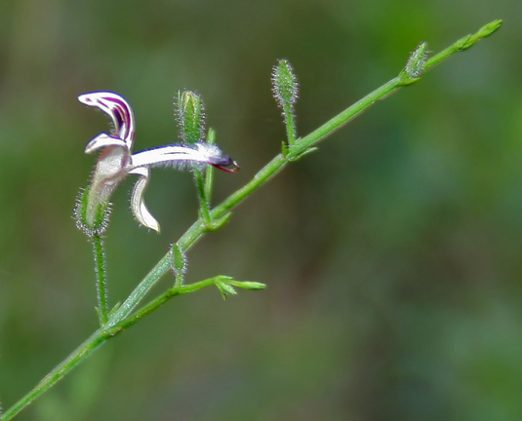
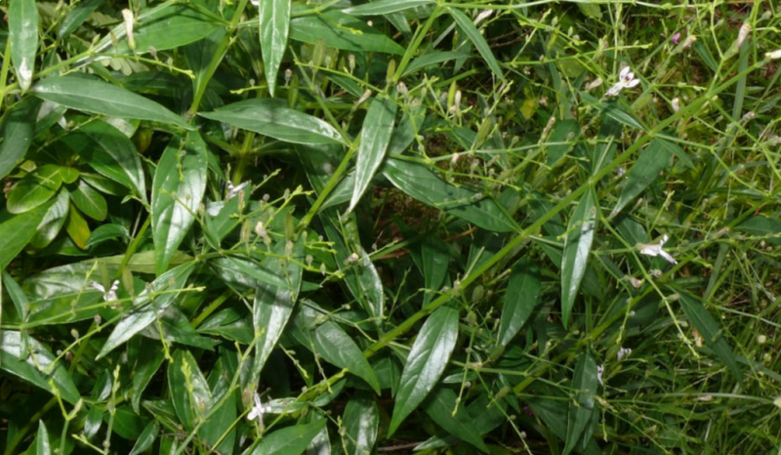
FLD | Demonstration of Andrographis variety Vallabh Kalmegh-01
3
Problem prioritized | Lack of knowledge on suitable high yielding Kalmegh variety
Source of Technology | DMAPR -ICAR, 2019
Technology demonstrated | Demonstration of Andrographis variety Vallabh Kalmegh-01
Operational area: Poothakulam, Chathanoor, Chirakkara (AEU 1) Sooranad (AEU 3), Punalur, Anchal (AEU 12)
Parameters: BCR, Pest and disease incidence.
Number of demo | 6
Area /demo | 0.024 ha (6 cent)
Total area | 0.144 ha
Krishi Vigyan Kendra, Kollam

Slide 34
FLD | Demonstration of Andrographis variety Vallabh Kalmegh-01
3
Budget Details
Sl.No | Critical input | Quantity/demo | Cost /demo(Rs)
1 | Seeds | Seeds- 50 g | 200 Assured by DMAPR, Anand on free of cost
2 | Bio control agents & Botanicals | 6 kg | 650
Cost per demonstration | Rs.650/-
Cost for demonstration | Rs. 3900/-
KVK Kollam
Krishi Vigyan Kendra, Kollam

Slide 35
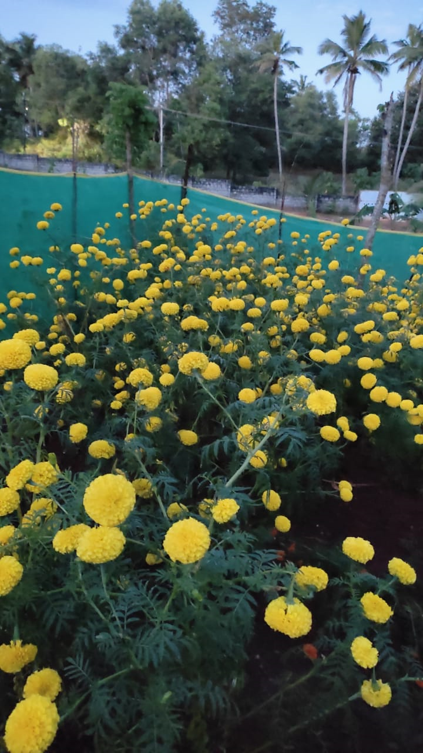
FLD | Demonstration of Marigold variety Pusa Bahar
4
Problem prioritized | Lack of knowledge on suitable marigold variety
Source of Technology | IARI, 2017
Technology demonstrated | Demonstration of Marigold variety Pusa Bahar
Operational area: Vettikavala, Anchal (AEU 12) Ezhukone , Pooyapally (AEU 9), Elampallor, chirakkara (AEU 1)
Number of demo | 6
Area /demo | 0.024 ha (6 cent)
Total area | 0.144 ha
Parameters: BCR, Pest and disease incidence.
Krishi Vigyan Kendra, Kollam

Slide 36



FLD | Demonstration of Marigold variety Pusa Bahar
4
Budget Details
Sl.No | Critical input | Quantity/demo | Cost/demo Rs. | Total Cost (Rs)
1 | Seedlings | 1500 Rs. 2.5 per seedling | 3750.00 | 22,500.00
2 | Bio control agents & Botanicals | 5 kg | 550.00 | 3300.00
 | Total |  |  | 25800.00
Cost per demonstration | Rs.4300/-
Cost for demonstration | Rs. 25800/-
KVK Kollam

Slide 37
ICAR-Krishi Vigyan Kendra, Kollam
ACTION PLAN 2022-2023 (Plant Protection)

Slide 38
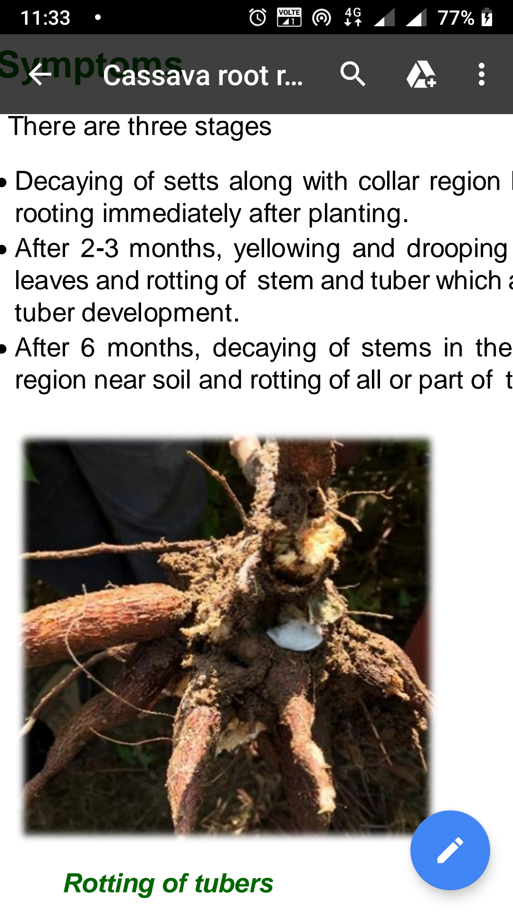
FLD | Demonstration on integrated management of Cassava root rot in Kollam district
5
Thrust area | Integrated Disease Management
Problem prioritized | Crop loss due to Cassava root rot in tapioca
Source of technology | CTCRI Adhoc recommendation 2021
Technology demonstrated | Lime @150g/plant, Neem cake 20g, trichoderma enriched manure 50g/plant, sett treatment with carbendazim 0.1 % for 10 minutes, drenching carbendazim 0.1% 3 times starting from planting at 15 days interval (15-30-45 DAP).
Number of demo | 7
Area | 0.028 ha
Operational area: Mylom (AEU 9), Thalavoor, Vettikkavala, Ummannoor (AEU 12)
Krishi Vigyan Kendra, Kollam

Slide 39
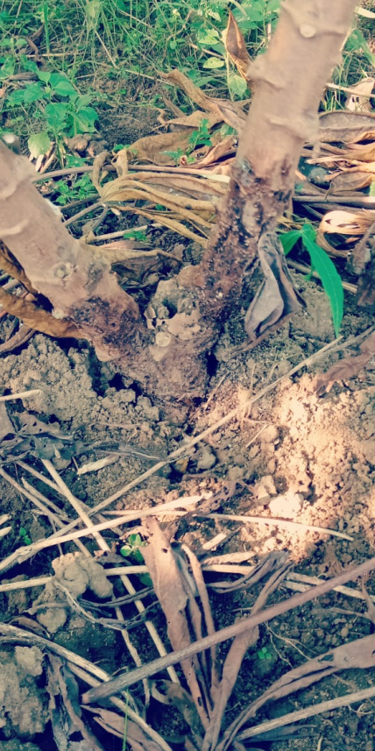
FLD | Demonstration on integrated management of Cassava root rot in Kollam district
5
Budget details
Sl.No. | Critical input | Quantity/demo | Cost/demo
1. | Lime | 7.5 kg | 150
2. | Neem cake | 1.5 kg | 60
3 | Trichoderma enriched manure | 5 kg | 175
4 | Carbendazim | 100g | 100
5 | Biocontrol agents | 2 Kg | 265
Cost per demo : 750/-
Cost for demonstration : 5250/-
Krishi Vigyan Kendra, Kollam

Slide 40
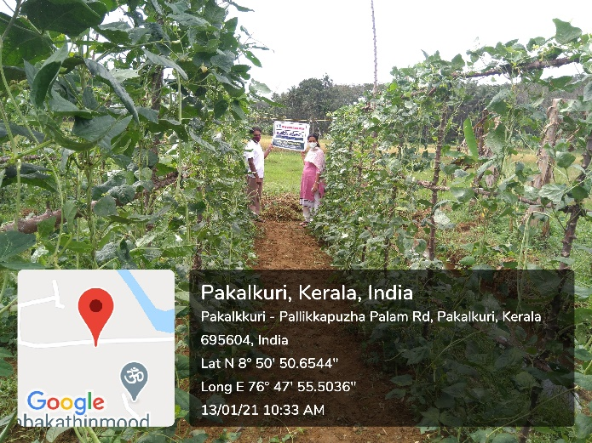
FLD | Demonstration of Cashew Nut Shell Liquid based botanical pesticide for pest management in cowpea
6
Thrust area | Organic pest management
Problem prioritized | Heavy application of chemical pesticides especially due to severe incidence of sucking pests.
Source of technology | KAU, 2020, KVK OFT 2020-21
Technology demonstrated | Cashew nut shell liquid based botanical formulation 20 % EC @ 0.3%
Number of demo | 7
Area | 0.14 ha
Operational area: Chirakkara, Kundara (AEU 1). Vettikkavala, and Ummannoor (AEU 12), Chavara (AEU 3)
Krishi Vigyan Kendra, Kollam

Slide 41
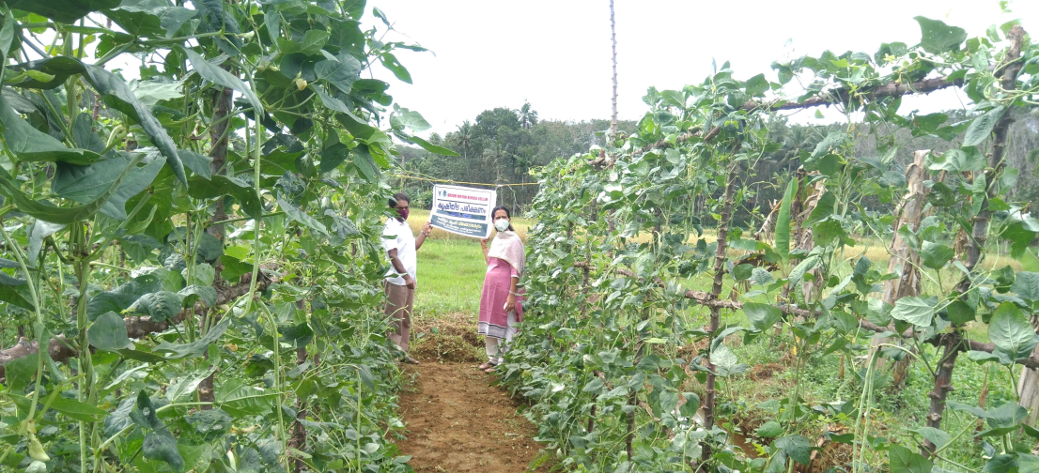
FLD | Demonstration of Cashew Nut Shell Liquid based botanical pesticide for pest management in cowpea
6
No. | Critical input | Quantity/demo | Cost/demo (Rs)
1. | CNSL EC formulation | 1 lit | 800
2 | KAU Raksha | 400 g | 240
3 | Biocontrol agents | 3 Kg | 285
 | Total |  | 1325
Cost per demo : Rs. 1325/-
Cost for demonstration : Rs. 9275/-
Krishi Vigyan Kendra, Kollam

Slide 42
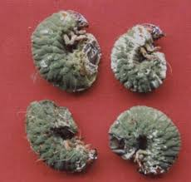

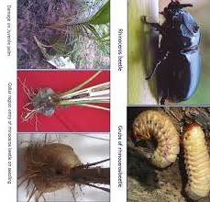
FLD | Compact area group approach for the management of coconut beetle, Oryctes rhinoceros L. in Kollam district
7
Thrust area | Biological pest management
Problem prioritized | Severe infestation of coconut beetle, Oryctes rhinoceros L. in coconut
Source of Technology | CPCRI, 2014
Technology Demonstrated | Entomopathogenic fungus, Metarhizium application in cowdung pits (5X10¹¹ spores/m³)
Number of demo | 2 (50 farmers each)
Area | 6 ha
Operational Area | Chavara (AEU 3), Vettikkavala (AEU 12)
Parameters: Pest incidence, yield, BC ratio
Krishi Vigyan Kendra, Kollam

Slide 43
FLD | Compact area group approach for the management of coconut beetle, Oryctes rhinoceros L. in Kollam district
7
Sl.No. | Critical input | Quantity/demo | Cost/demo (Rs.)
1. | Green muscardine fungus, Metarhizium anisopliae | 100 kg | 8500
Cost per demo : 8500/-
Cost for demonstration: 17000/-
KVK Kollam

Slide 44


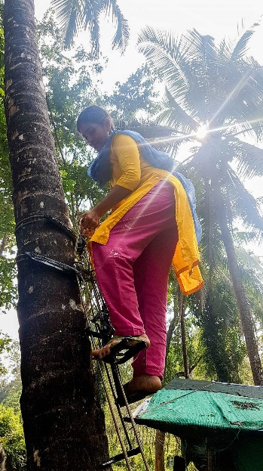
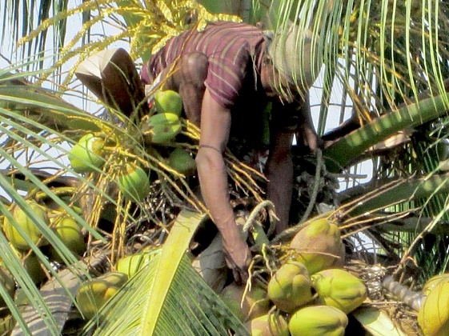
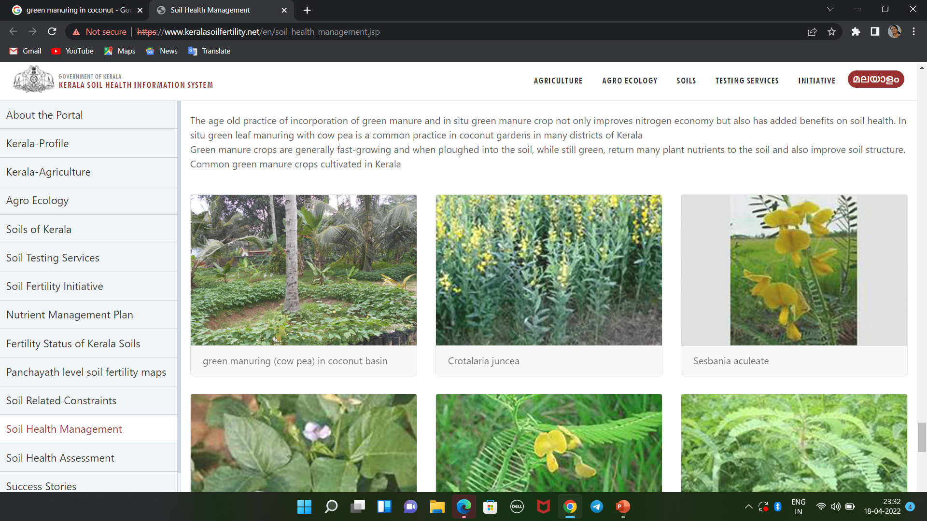
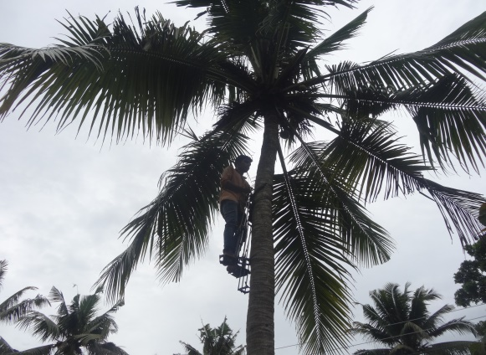
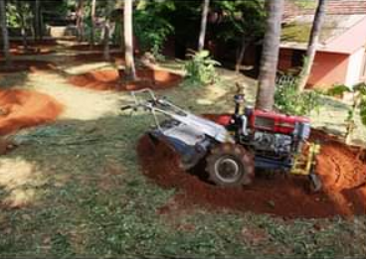
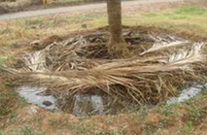
Special Programme- KalpaMithra
Grooming KeraMithra in KVK, Kollam for reviving Coconut palms in Kollam district -As per SAC recommendations on 26 Feb 2022
Budget: Rs. 1.5 lakhs
Bhoothakkulam (AEU 1), Chavara (AEU 3), Vettikavala, Mylom, Kottarakkara , Ezhukone (AEU 9), Anchal (AEU 12)
KVK’s Skilled army for saving coconut farmers of Kollam
Krishi Vigyan Kendra, Kollam

Slide 45
Innovative Programme – KalpaMithra
Objectives
Grooming technically trained rural professional team for reviving the health and yield of coconut palms in Kollam district.
Capacity building programme on coconut production and protection technologies.
Drudgery reduction by equipping the team with implements and machineries.
Ensuring the service of KVK groomed KalpaMithra rural youth at the doorsteps of coconut growers in Kollam district

Slide 46
ICAR-Krishi Vigyan Kendra, Kollam
ACTION PLAN 2022-2023 (Agrl Extension)

Slide 47
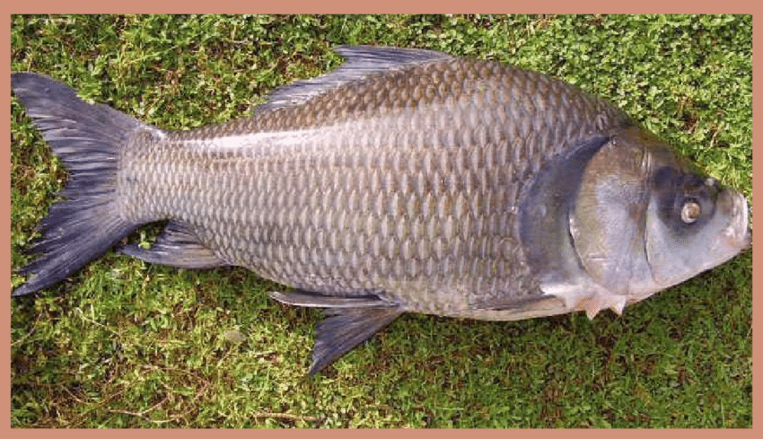
OFT | Assessment of ICAR CIFA improved Catla for freshwater farming in Kollam district
4
Thrust area | Varietal evaluation
Problem prioritised | Slow growth rate
Number of trials | 3
Operational area | Anchal, Vettikkavala (AEU 12), Soornad (AEU 3)
Krishi Vigyan Kendra, Kollam

Slide 48
OFT | Assessment of ICAR CIFA improved Catla for freshwater farming in Kollam district
4
Details of Technology
TO | Technology to be assessed | Source of technology | Parameters of assessment
TO 1 | Farmers practice- normal Catla (Catla catla) |  | Survival %, Growth rate- Avg. Weight, Avg. Length, Feed conversion ratio, Cost benefit ratio
TO 2 | ICAR CIFA Improved Catla (Catla catla) | ICAR-CIFA, Odisha
Budget details
Input | Budget
Fish seed 1000 numbers @ Rs.10/- per seed for one unit ( 25 cent/unit) | 10,000/-
TOTAL ( 3 units) | 30,000/-
KVK Kollam
Krishi Vigyan Kendra, Kollam

Slide 49
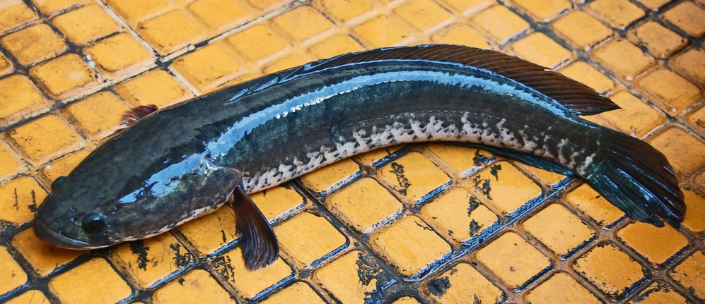
FLD | Demonstration on formulated feed for Channa striata (Varaal)
8
Problem prioritized | Slow growth Cannibalism Low nutrient content in farm made feeds
Source of Technology | ICAR-CIFA, Odisha
Technology Demonstrated | Formulated feed for Channa striata (Varaal) (40 % protein and 12 % fat)
No. of demonstrations | 3
Operational Area: Sasthamcotta (AEU 3), Anchal (AEU 12)
Krishi Vigyan Kendra, Kollam

Slide 50
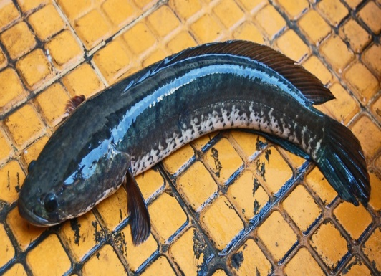

FLD | Demonstration on formulated feed for Channa striata (Varaal)
8
Budget details
Critical input | Quantity/ Demo (Nos) | Cost/ demo(Rs) | Cost for demonstration
Formulated feed | 100 Kg @ Rs.130/- per Kg for one unit | 13000.00 | 39000.00
Parameters | Survival %, Growth rate- Avg. Weight, Avg. Length, Feed conversion ratio, Cost benefit ratio
Krishi Vigyan Kendra, Kollam

Slide 51
ICAR-Krishi Vigyan Kendra, Kollam
ACTION PLAN 2022-2023 (Home Science)

Slide 52
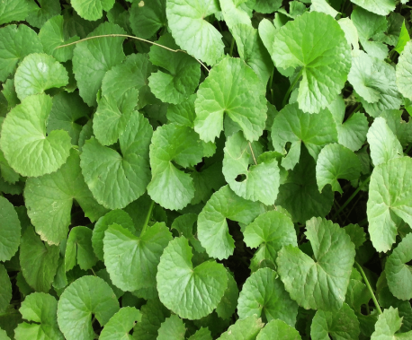

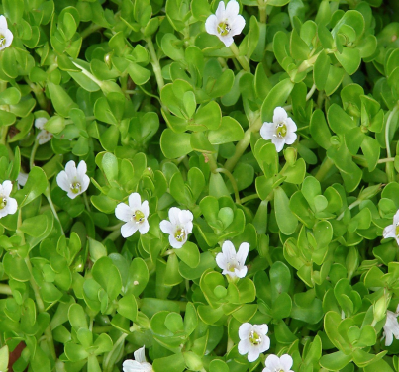
FL D | Demonstration of syrup and RTS using Medicinal plants-Brahmi-(Bacopa monnieri) and Muthill (Centella asiatica)
9
Problem prioritized | Under Utilization of Brahmi and Muttill as acceptable products
Trust area | Value Addition and high value functional product from medicinal plant
Technology (ITK, KAU) | Brahmi and Muttil based RTS and Syrup using Honey and rock candy
No. Demo: 3
Operational Area: Thazhava (AEU 3) Aaryankavu (AEU 14) Eravipuram (AEU 1)
Krishi Vigyan Kendra, Kollam

Slide 53
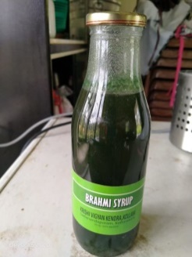
FL D | Demonstration of syrup and RTS using Medicinal plants-Brahmi-(Bacopa monnieri) and Muthill (Centella asiatica)
9
Budget details
No. | Critical input | Cost/demo (Rs)
1 | Raw materials | 2500
2 | Packaging materials | 1500
3 | Labeling materials | 1000
4 | Microbial studies | 3000(common)
5 | Nutrient analysis | 6000(common)
Parameters
Shelf life Organoleptic evaluation Microbial studies Nutrient analysis BCR
Cost per Demo : Rs.5000/-
Total: Rs.15000/-
Total (including microbial and nutrient analysis) Rs.24000/-
Krishi Vigyan Kendra, Kollam

Slide 54
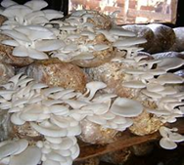



FL D | Demonstration of Mushroom based high value product-Mushroom soup powder
10
Problem prioritized | High perishability
Trust area | Value Addition and high value functional product from mushroom
Technology | Long term product-Soup powder (DMR-SOLAN)
No. Demo: 2
Operational Area: Mylom (AEU 9) Kunnicode (AEU 12)
Krishi Vigyan Kendra, Kollam

Slide 55

FLD | Demonstration of Mushroom based Functional and high value products
10
Budget details
Parameters
Shelf life Organoleptic evaluation Microbial studies Nutrient analysis BCR
No. | Critical input | Cost/demo(Rs)
1 | Raw materials | 2000
2 | Packaging materials | 2000
3 | Labeling materials | 1000
4 | Microbial studies | 3000(common)
5 | Nutrient analysis | 6000
Cost per Demo : Rs.5000/-
Total: Rs.10000/-
Total (including microbial and nutrient analysis) Rs.19000/-
Krishi Vigyan Kendra, Kollam

Slide 56



FL D | Modified drying technology for shelf life enhancement of prawns
11
Problem prioritized | High perishability and colour retention
Trust area | Value Addition and scientific drying methods for fish.
Technology demonstrated ICAR-CIFT | Sodium Chloride-3%+ Citric acid-1% (modified treatment) blanching + drying
No. Demo: 2
Operational Area: Shastamkotta (AEU 9) Thazhava (AEU 3)
Krishi Vigyan Kendra, Kollam

Slide 57

FL D | Modified drying technology for shelf life enhancement of prawns
11
Budget details
Parameters
Shelf life Organoleptic evaluation Microbial studies Nutrient analysis BCR
No. | Critical input | Cost/demo (Rs)
1 | Raw materials | 2000
2 | Packaging materials | 1000
3 | Labeling materials | 1000
4 | Microbial studies | 3000
5 | Nutrient analysis | 6000
Cost per Demo : Rs.4000/-
Total: Rs.8000/-
Total (including microbial and nutrient analysis) Rs.17000/-
Krishi Vigyan Kendra, Kollam

Slide 58





EDP | Entrepreneurship Development including Branding and Labeling of Tapioca based products-ODOP
1
Problem prioritized | Low market price and poor shelf life and Loss due to improper post harvest management
Trust area | Value addition of agrl. produces
Technology (ICAR-CTCRI) | Flavoured fried Tapioca chips, Pasta
Budget | 50000/-
No.demo:4 | Operational Area: Vettikavala, Anchal (AEU 12), Eravipuram(AEU 12), Chavara(AEU 3)
Krishi Vigyan Kendra, Kollam

Slide 59
ICAR-Krishi Vigyan Kendra, Kollam
ACTION PLAN 2022-23 (Animal Husbandry)

Slide 60





OFT | Assessment of egg production during summer season in different poultry layer varieties
5
Problem Prioritized | Shortage of egg production during summer season
Thrust Area | Varietal Evaluation
No of demo | 4 ( 25 birds/demo)
Operational area: | Chathannur (AEU 1), Sooranadu (AEU 3), Mylom(AEU 9)
Krishi Vigyan Kendra, Kollam

Slide 61



OFT | Assessment of egg production during summer season in different poultry layer varieties
5
Sl. No | Technology to be assessed | Source of technology | Parameter of assessment
TO1 | Gramapriya | ICAR (Hyderabad) | Average egg production Feed efficiency BC ratio
TO2 TO3 | Athulya (ILM-90) BV380 | AICRP , KAU 1990 Venkateshwara research and breeding farm
Krishi Vigyan Kendra, Kollam

Slide 62



OFT | Assessment of egg production during summer season in different poultry layer varieties
5
 | Critical Input | Quantity/ trial | Cost/trial(Rs)
TO1 | Gramapriya | 25
TO2 T03 | Athulya BV380 | 25 25 | 1000 1250
Cost per trial | Rs. 2,250/-
Cost for assessment | Rs. 9000/-
Krishi Vigyan Kendra, Kollam

Slide 63



FLD | Demonstration of Vigova Broiler duck variety for meat production in coastal areas of Kollam district
12
Problem Prioritized | Shortage of broiler duck meat in festival season
Thrust Area | Varietal Evaluation
No of demo | 4 ( 50 birds/demo)
Source of technology | CDBF, Banglore
Operational area: | Chathannur (AEU 1) , Sooranadu (AEU 3), Mylom (AEU 9)
Krishi Vigyan Kendra, Kollam

Slide 64


FLD | Demonstration of Vigova Broiler duck variety for meat production in coastal areas of Kollam district
12
Budget Details
Sl. No | Critical Input | Quantity/demo | Cost/demo (Rs)
1. | Vigova super –M ducklings | 50 | 2000
2. | Feed | 10kg | 500
Cost per demo |  | Rs . 2500/-
Cost for demonstration |  | Rs. 10000/-
Parameters assessed | Body weight , Feed conversion ratio, BC ratio
Krishi Vigyan Kendra, Kollam

Slide 65


FLD | Demonstration of Super Napier fodder variety in Dairy cattle for improved milk production
13
Problem Prioritized | Shortage of green fodder in summer season
Thrust Area | Dairy fodder Management
Technology demonstrated | Fodder production for dairy cattle
Source of technology | TANUVAS
No of demo | 5
Operational area: | Sooranadu (AEU 3), Mylom, Kottarakkara (AEU 9)
Krishi Vigyan Kendra, Kollam

Slide 66

FLD | Demonstration of Super Napier fodder variety in Dairy cattle for improved milk production
13
Budget Details
Sl. No | Critical Input | Quantity/demo | Cost/demo (Rs)
1. | Super Napier stem slits | 200 | 400
Cost per demo |  | Rs . 400/-
Cost for demonstration |  | Rs. 2,000/-
Parameters | Average milk yield, BC ratio
Krishi Vigyan Kendra, Kollam

Slide 67



FLD | Demonstration of Azolla as an economic feed supplement in Ducks for increasing egg production
14
Problem Prioritized | High cost of duck feed
Thrust Area | Reduction of Poultry concentrate feed
Technology demonstrated | Azolla @25% in daily standard duck Layer feed
Source of technology | TANUVAS
No of demo | 4
Operational area: | Chathannor (AEU 1), Mylom, Kottarakkara(AEU 9)
Krishi Vigyan Kendra, Kollam

Slide 68
FLD | Demonstration of Azolla as an economic feed supplement in Ducks for increasing egg production
14
Budget Details
Sl. No | Critical Input | Quantity/demo | Cost / demo(Rs)
1. | Silpaulin Azolla tank | 1 | 1250
2. | Azolla seeds | 1kg | 50
Cost per demo |  | Rs 1300/-
Cost for demonstration |  | Rs. 6500/-
Parameters | Feed efficiency, egg production, BC ratio
Krishi Vigyan Kendra, Kollam

Slide 69


EDP | Promotion of earn while you learn programme for School students by egger nursery unit management
2
Problem Prioritized | Lack of sustainability of egg production in Kollam district
Thrust Area | Poultry Development
Technology demonstrated | Scientific management of egg laying poultry
Source of technology | KVASU
No of demo | 1
Operational area: | Chathannur (AEU 1), Mylom, Kottarakara (AEU 9)
Krishi Vigyan Kendra, Kollam

Slide 70


EDP | Promotion of earn while you learn programme for School students by egger nursery unit management
2
Budget Details
Sl. No | Critical Input | Quantity | Cost( Rs)
1. | Day old Gramapriya chicks | 500 chicks | 25,000
Parameters assessed | Body weight, Mortality, BC ratio
Krishi Vigyan Kendra, Kollam

Slide 71
THANK YOU
Krishi Vigyan Kendra, Kollam

