Slide 1
Development of Geospatial Database for KRISHI Portal
1st Nodal Officers Workshop
4th-5th August, 2015
New Delhi

Slide 2
Database Grid
Decision
Support
Value
Knowledge
Volume
Information
Data

Slide 3
CORE OBJECTIVE OF KRISHI PORTAL
Is to provide the location specific agri-based services, service of geographic data along with the metadata in a compatible format of international standards through a common infrastructure.

Slide 4
What is simple GeoPortal architecture?
Users
❖
⬥
Search Catalog and Find
Connect and Use
Download and use
Data providers control access to their data
GIS Web Services Portals
Publish GIS data and services
Data Servers
GeoPortal
FTP
◆
GIS Data
GIS
Data
The GeoPortal does not store the data
GIS
Data
Notes:
Users do not have to know where services are located.
Everyone can ‘participate’ both as users and as service providers.
Enable, not enforce.
The portal opens resources to larger numbers of users.
The portal is not one big geodatabase.
Concept of portal : like eBay. On one side, a group of providers. (I’m providing something – a book, a bike). But for consumer to buy, want to know description (age, colour, etc.). This description is metadata. The portal is the “eBay”.
Same is GIS. On one side, have services, data, etc/.
Portal is location where providers can publish and users can search catalog to find what they are needing. Data itself is NOT in the portal. Once find “Data” in portal, must contact original source to actually obtain it. Doesn’t matter where actual data resides.

Slide 5
What are the main services of GeoPortal
Discovery service = CSW (Catalogue Service Web)
Viewing service = WMS, WCS (Web Map Service, Web Coverage Service)
Download service = WFS (Web Feature Service)

Slide 6
Spatial data
Any data which are directly or indirectly referenced to a location on the surface of the earth are spatial data.
Non-Spatial data
When a dataset cannot usefully be related to a location on the surface of the earth are non-spatial data.

Slide 7
Why we need Geospatial data for KRISHI
To explore both geographical and thematic components of data in a holistic way
To address geographical aspects of a agricultural research issues
To allow handling and exploration of large volumes of spatial datasets
To allow integration of data from widely disparate sources
To allow a wide variety of forms of visualisation

Slide 8
Data in GIS
Spatial and attribute
Geo-referencing data
Raster and vector
Layers of data
Querying a GIS database
Integrating data with GIS

Slide 9
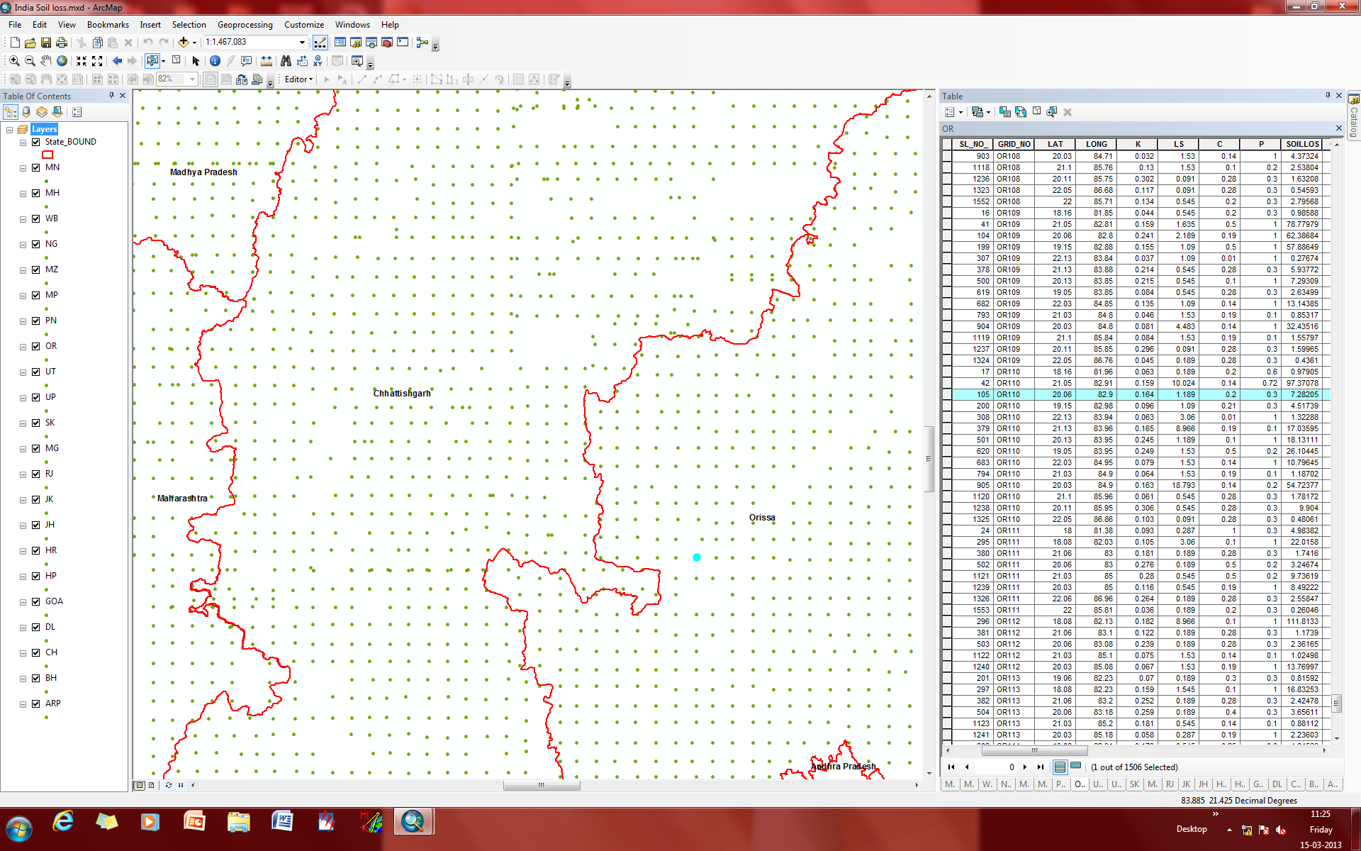
Spatial and attribute

Slide 10
Coordoning System
Coordinate units – at DDMMSS (degree, minutes, seconds)
Projection System: UTM projection
World Geodetic System 1984 (WGS 84)

Slide 11
Layers
Data on different themes are stored in separate “layers”
As each layer is geo-referenced layers from different sources can easily be integrated using location
This can be used to build up complex models of the real world from widely disparate sources

Slide 12
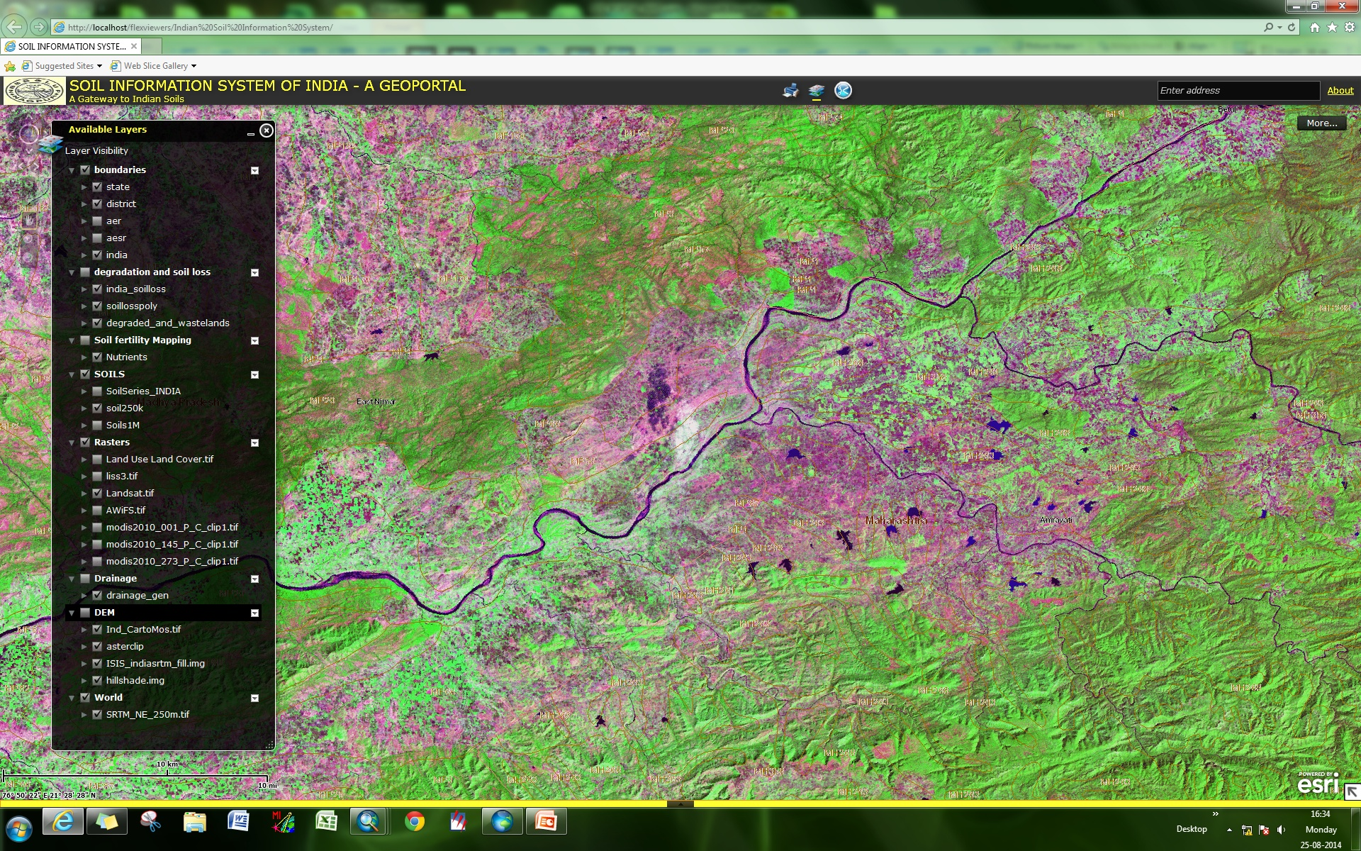
Raster data
Satellite Sensor: Landsat ETM+
Spatial resolution: 30 m.

Slide 13
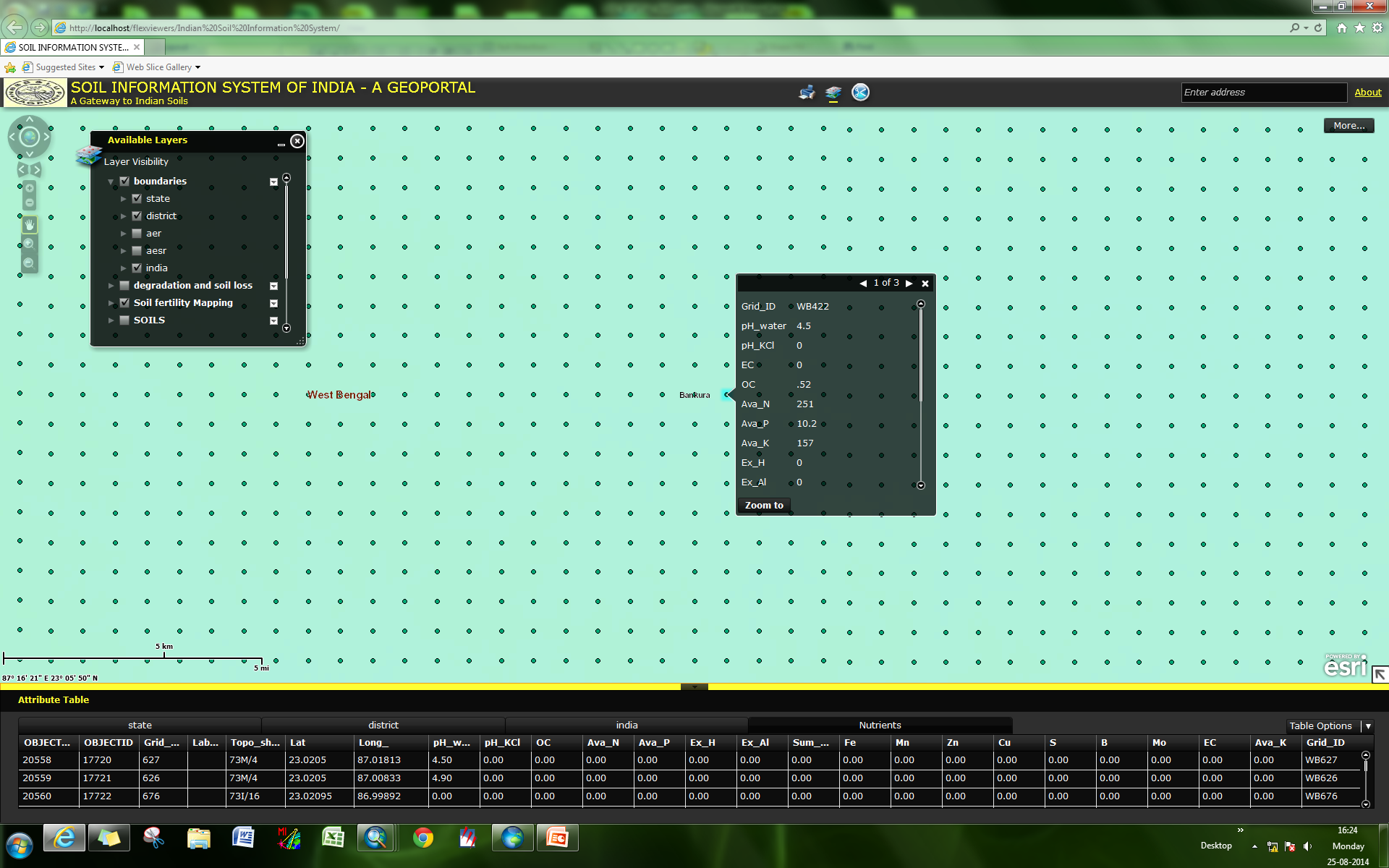
Vector data

Slide 14
Querying GIS data
Attribute query
Select features using attribute data (using SQL)
Results can be mapped or presented in conventional database form
Can be used to produce maps of subsets of the data or choropleth maps
Spatial query
Clicking on features on the map to find out their attribute values
Used in combination these are a powerful way of exploring spatial patterns in database

Slide 15
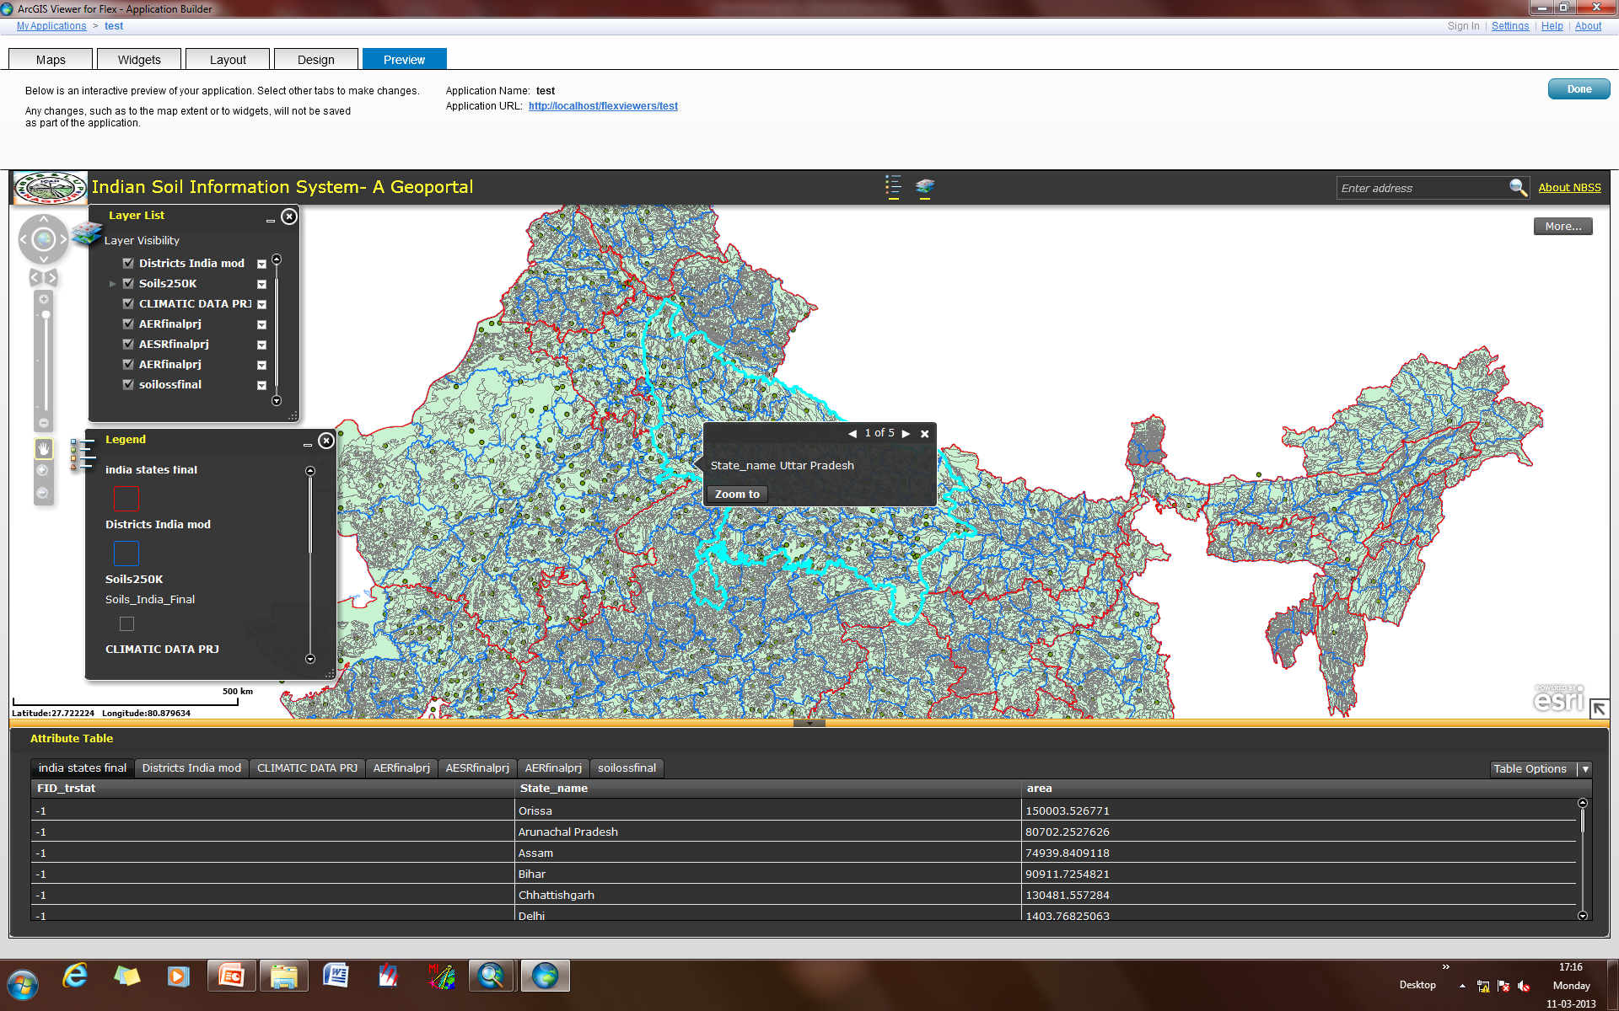
Data query based on administrative units- State

Slide 16
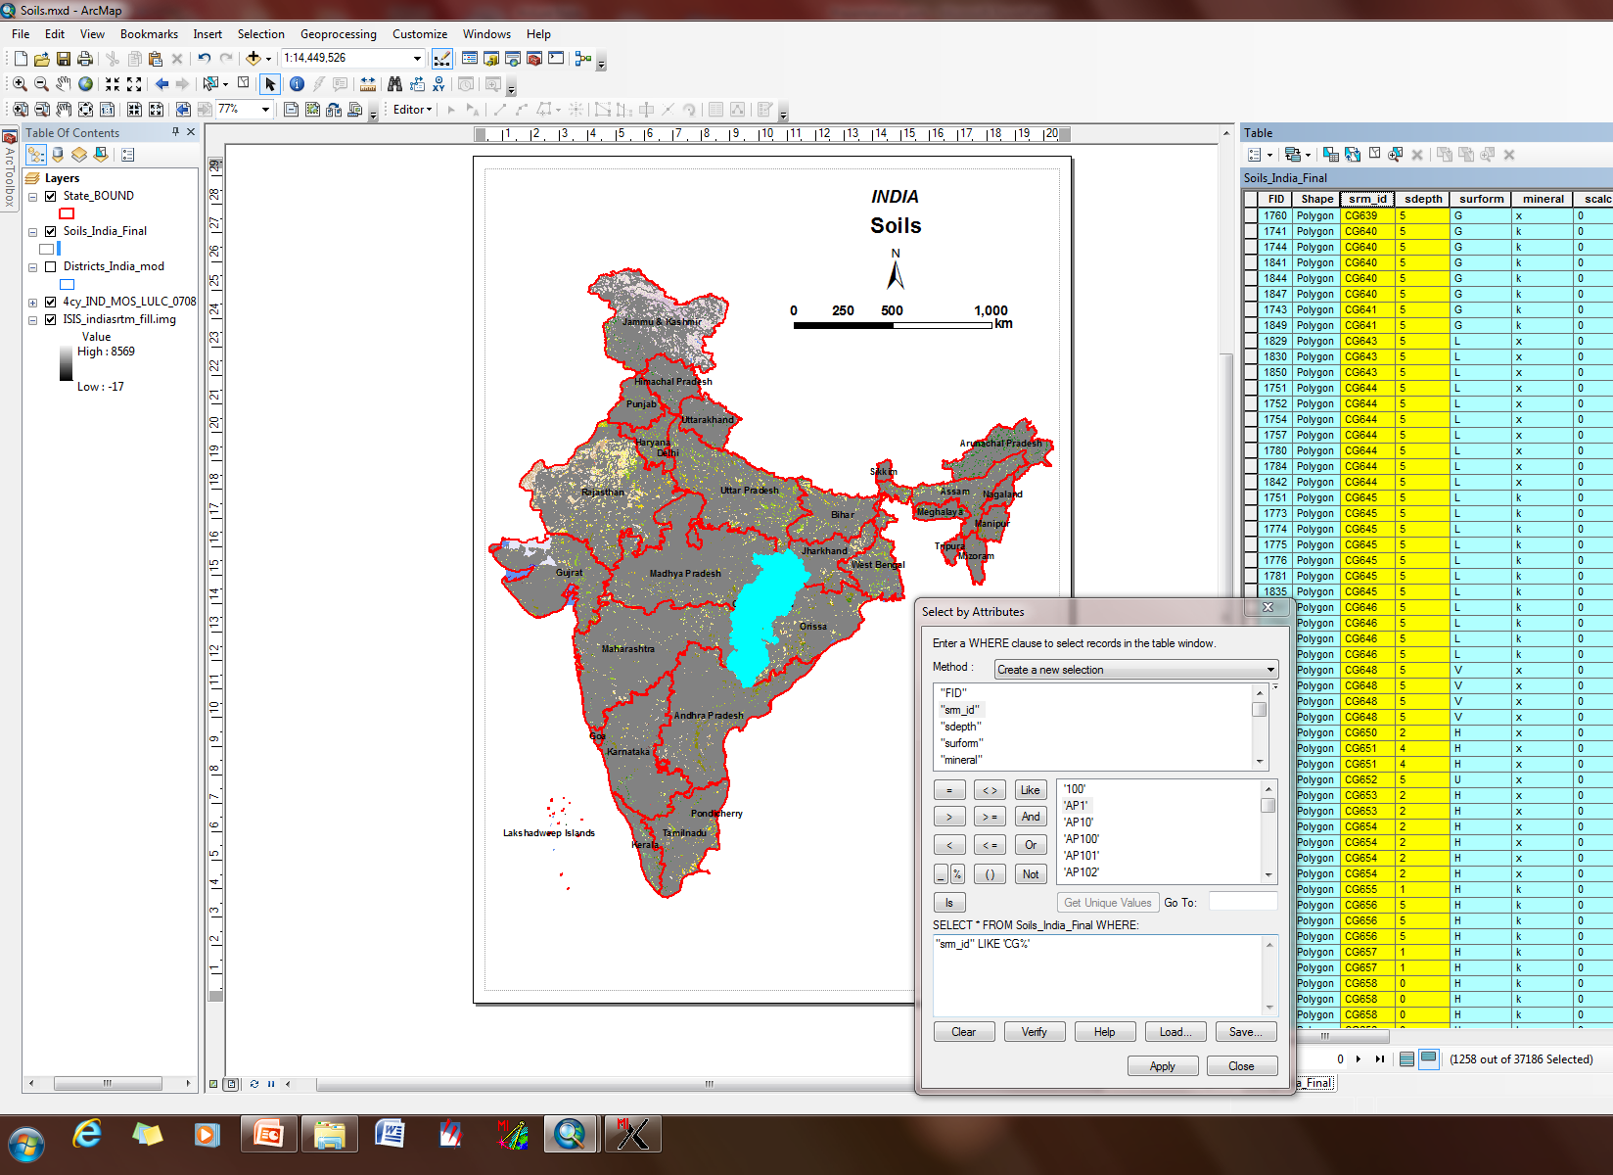
Data query - Selection of soils of particular state

Slide 17
Geo-Spatial Data on Soils
Soil Resource Database
1:1M
Site Characteristics
Soil Morphological Characteristics
Physical Characteristics
Chemical Characteristics

Slide 18
Soil Site Characteristics

Slide 19
Soil Site Characteristics
A
Observation No
Arial Photo Interpretation
Photo No
Elevation Above MSL
Topography And Landform type
Soil_Mapping_legend
Toposheet No
Geology
Series and/or Local Name
Physiographic Unit
Location
Latitude And Longitude
Village
Tehsil
District
State
Parent Material
Alluvium
Colluvium
Aeolian
Granite
Gneiss
Schist
Sandstone
Basalt
Limestone
Glacial
Marine Sediments
Undifferentiated
Weathered Basalt
Granite Gneiss
Climate
Humid
Sub-Humid(Moist)
Sub-Humid(Dry)
Per humid
Semi-Arid(Moist)
Semi-Arid(dry)
Typic-Arid
Hyper-Arid
Slope Gradient(%)
Level to nearly level
Very gently sloping
Gently sloping
Moderately sloping
Moderately steep
Steeply sloping
Very steeply sloping
Slope Gradient(m)
Rainfall
Very-low
Low
Moderately-low
Moderate
Moderately-High
High
Very-high
Excessive
Author and date of examination
Erosion
None to very slight
Slight
Moderate
Severe
Very Severe
Suitability Class
Suitable
Moderately Suitable
Marginally Suitable
Actually unsuitable but potentially suitable
Actually & potentially unsuitable
Important Crops
Cereals
Oilseeds
Cash Crops
Management Practices
Low
Medium
High

Slide 20
Soil Site Characteristics
Observation No, Toposheet No, Photo No, Author and Date of Examination
S.No | Data Element Name | Short Name | Data Type | Unit Of Measure | Mini-mum value | Maxi-mum Value | Description
1 | Observation_No |  | Chara-cter |  |  |  | Follow codification as indicated below (district symbol followed by block, village and profile number).
2 | Toposheet_No |  | Chara-cter |  |  |  | A toposheet is a shortened name for topographic sheet. They are essentially contain information about an area like roads, railways, settlements, canals, rivers, electric poles, post offices etc.
3 | Photo_No |  | Chara-cter |  |  |  | The number assigned to the photo, where the photo was captured at the profile site.
4 | Author_And_Date_Of_Examination |  | Character |  |  |  | Give the name of the Officer in-charge of the field party and date of observation.
5 | Location details |  | Chara-cter |  |  |  | Indicate the exact location of the profile on the cadastral map within the survey number and describe the location of the profile with reference to some nearby fixed features.

Slide 21
Drainage
21 | Drainage | d | Character | Unit Of Measure | Mini-mum value | Maxi-mum Value | Natural drainage class refers to the frequency and duration of wet periods under conditions similar to those under which the soil developed. Alteration of the water regime, either through drainage or irrigation, is not a consideration unless the alterations have significantly changed the morphology of the soil.
 | Very poor |  | Character |  |  |  | Similar to poorly drained soils except that the soils occur on level or depressed areas and are frequently ponded. Thick organic (0) horizons are common
 | poor |  | Character |  |  |  | Water is removed so slowly that the soil is wet at shallow depths , sometimes for long periods . Water table is persistently shallow, such that most crops cannot be grown unless the soil is artificially drained .
 | Imperfectly drained |  | Character |  |  |  | The soil is wet at a shallow depth for significant periods during the growing season. Wetness restricts the growth of crops unless artificial drainage is provided. The soils commonly have a pervious layer, a high water table , additional water from seepage and/or nearly continuous rainfall.
 | Moderately well |  | Character |  |  |  | Water is removed from the soil somewhat slowly. Soil is wet for only a short time within the rooting zone during the growing season , but long enough that most mesophytic crops are affected . These soils commonly have a slowly pervious layer within the upper one metre, periodically receive high rainfall, or both
 | Well |  | Character |  |  |  | Water is removed from the soil readily but not rapidly . Water is available to plants throughout most of the growing season. Wetness does not inhibit growth of roots for most or all of the growing season.
 | Somewhat Excessive |  | Character |  |  |  | Similar to excessively drained soils, but the water table may not be as deep and the soil may be slightly fine textured
 | Excessive |  | Character |  |  |  | Water is removed from the soil very rapidly . Soil is commonly very coarse textured or rocky

Slide 22
Soil Morphological Characteristics

Slide 23
SOIL MORPHOLOGICAL CHARACTERISTICS
A
Horizon
Organic Material
Mineral Horizon
Mineral Horizon
Mineral Horizon
Mineral Horizon
Bed Rock
Depth
Very Deep
Very Shallow
Shallow
Moderately Shallow
Moderately deep
Deep
Extremely Shallow
Boundary
Distinctness
abrupt
clear
gradual
diffuse
T-Topography
smooth
wavy
irregular
Broken
Mottle Color (Munsell)
A-Abundance
few
common
many
S-Size
fine
medium
coarse
C-Contrast
faint
distinct
prominant
Consistence
D-Dry
loose
soft
slightly hard
hard
very hard
extremely hard
M-Moist
loose
very friable
friable
firm
-very firm
extremely firm
W-Wet
non sticky
slightly sticky
sticky
very sticky
non plastic
slightly plastic
plastic
very plastic
Structure
S-Size
very fine
fine
medium
-coarse
very coarse
G-Grade
Structure less
weak
moderate
strong
Type
granular
crumb
columnar
prismatic
platy
angular blocky
sub angular block
single grain
massive
Texture( USDA)
sand
loamy fine sand
loamy sand
sandy loam
loam
silty loam
silt
sandy clay loam
clay loam
silty clay loam
sandy clay
silty clay
clay
Cutans
Ty-Type
Argiilan
farran
Mangan
Organ
Th-Thickness
thin
moderately thick
thick
Q-Quantity
patchy
broken
continuous

Slide 24
Coarse fragments
8 | Coarse_ fragments |  | Chara-cter | Percent |  |  | This refers to the presence of coarse fragments (>2 mm in size) on or near the soil surface. The classes used are pebbles, cobbles, stones and boulders. Gravel is a collection of pebbles that have diameters ranging from 2 to 75 mm. The size of the cobbles range from 23 75 to 250 mm (3 to 10 inches), stones from 250 to 600 mm (10 to 24 inches) and boulders above 600 mm (>24 inches). Assessment for the surface fragments is done separately for the gravel and for stones and boulders. Indicate the size of the fragments observed in the field.
 | fine gravel | fg | Character |  |  | <2.5 | The coarse fragments that have diameters less than 2.5 cm
 | coarse gravel | cg | Character |  | 2.5 | 7.5 | The coarse fragments that have diameters ranging from 2.5 to 7.5 cm.
 | stone | st | Character |  | 7.5 | 25 | The coarse fragments that have diameters ranging from 7.5 to 25 cm.

Slide 25
Soil Physical Characteristics

Slide 26
SOIL PHYSICAL CHARACTERISTICS
Bulk Density
Saturated Hydraulic Conductivity
Horizon
Organic Material
Mineral Horizon
Mineral Horizon
Mineral Horizon
Mineral Horizon
Bed Rock
Depth
Very Deep
Very Shallow
Shallow
Moderately Shallow
Moderately deep
Deep
Extremely Shallow
Particle size Class
Fragmental
Sandy skeletal
Loamy skeletal
Clayey Skeletal
Sandy
Very Fine
Coarse loamy
Fine Loamy
Coarse silty
Silty
Clayey
Fine
Loamy
Moisture Retention
Texture(USDA)
Sand
loamy fine sand
loamy sand
sandy loam
loam
silty loam
silt
sandy clay loam
clay loam
silty clay loam
sandy clay
silty clay
clay
Available Water Capacity
Water Holding Capacity

Slide 27
Soil Depth
2 | Depth | D | Integer | cm |  |  | Soil depth indicates the depth of the solum, which includes A and B horizons, occurring above the parent material or hard rock. Depth is measured from the soil surface.
 | Extremely Shallow |  | Integer | cm | 0 | 10 | Soil depth ranging from 0 to 10 cm
 | Very Shallow |  | Integer | cm | 10 | 25 | Soil depth ranging from 10 to 25 cm
 | Shallow |  | Integer | cm | 25 | 50 | Soil depth ranging from 25 to 50 cm
 | Moderately Shallow |  | Integer | cm | 50 | 75 | Soil depth ranging from 50 to 75 cm
 | Moderately deep |  | Integer | cm | 75 | 100 | Soil depth ranging from 75to 100 cm
 | Deep |  | Integer | cm | 100 | 150 | Soil depth ranging from 100 to 150 cm
 | Very Deep |  | Integer | cm |  | >150 | Soil depth > 150 cm

Slide 28
Soil Chemical Characteristics

Slide 29
SOIL CHEMICAL CHARACTERISTICS
Soil reaction (pH)
Strongly acidic
Moderately acidic
Slightly acidic
Neutral
Slightly alkaline Moderately alkaline
Strongly alkaline
Salinity
Negligible
Slight
Moderate
Moderately Strong
Strong
Severe
Very Severe
Sodicity
Negligible
Slight
Strong
Severe
Depth
Very Deep
Very Shallow
Shallow
Moderately Shallow
Moderately deep
Deep
Extremely Shallow
Horizon
Organic Material
Mineral Horizon
Mineral Horizon
Mineral Horizon
Mineral Horizon
Bed Rock
Calcium Carbonate
Electrical_Conductivity
Extractable_Nutrients
Nitrogen
Phosporous
Potassium
Sulphur
Calcium
Magnesium
Boron
Manganese
Zinc
Iron
Copper
Cation Exchange Capacity
Calcium
Magnisium
Sodium
Potassium
Aluminium
Hydrogen
Extractable Cations
Calcium
Magnisium
Sodium
Potassium
Base saturation Percent
Exchangeable Sodium Percentage
Sum Of Cations
Organic Carbon

Slide 30
Soil Reaction(pH)
3 | Soil reaction (pH) | pH | Float | ----- | 0 | 14 | Both colorimetric and electrometric methods are used for measuring pH. It is the negative logarithm of hydrogen iron concentration.
 | Strongly acidic |  | Float |  | 4 | 4.5 | pH ranges from 4 to 4.5
 | Moderately acidic |  | Float |  | 4.5 | 5.5 | pH ranges from 4.5 to 5.5
 | Slightly acidic |  | Float |  | 5.5 | 6.5 | pH ranges from 5.5 to 6.5
 | Neutral |  | Float |  | 6.5 | 7.5 | pH ranges from 6.5 to 7.5
 | Slightly alkaline |  | Float |  | 7.5 | 8.5 | pH ranges from 7.5 to 8.5
 | Moderately alkaline |  | Float |  | 8.5 | 9.5 | pH ranges from 8.5 to 9.5
 | Strongly alkaline |  | Float |  |  | >9.5 | pH is greater than 9.5

Slide 32
Metadata Development

Slide 33
Metadata
Metadata is usually described as data about the data. It is the information you need to document your dataset sufficiently so that an outsider can understand all the key issues involved in the construction of the dataset.

Slide 34
Roles/purposes of Metadata
Information retrieval, cataloguing, querying and searching for data electronically.
Describing fitness for use (applicability) and documenting the usability and quality of data.
Describing how to transfer, access or process data
Documenting all relevant characteristics of data needed to use it
Data permanence; creates institutional memory;

Slide 35
Why use and create metadata
To organize and maintain spatial data
Metadata can catalogue the changes and updates made to each spatial dataset
To provide information to the users
It makes sense to share existing data sets rather than producing new ones if they are already available
To document the history of a spatial data set
Metadata documents what changes have been made to each dataset, such as changes in geographic projection, adding or deleting attributes, editing line intersections, or changing file formats.

Slide 36
Metadata Should Include
Date of data collected
Date of coverage generated
Bounding coordinates
From where original data came
Who did processing
Projection
coordinate System
Datum
Units
Spatial scale
Attribute definitions
Who to contact for more information
Notes:
Example of non-standard metadata: (source: http://ag.arizona.edu/SRER/index.html)
THIS COVERAGE HAS BEEN PROJECTED TO THE FOLLOWING PARAMETERS - September 2000:
Projection: UTM Zone: 12
Units: meters
Datum: NAD83 (previously NAD27)
Spheroid: GRS80 (previously Clarke 1866)
THIS DOCUMENT WAS CREATED AT ART, UNIVERSITY OF ARIZONA, September 14, 2001
NAME OF DATASET: QUADS DATA
TYPE: Vector-polygon
DESCRIPTION OF CONTENT: These are the boundary polygons of the four quadrangles for the Santa Rita Experimental Range in southeast Arizona.
FORMAT: Arc/Info
DATA SIZE: Approximate Megabytes: .017
HISTORY: This coverage was originally reselected out of the ART Arizona General Reference Library which contains data originally from ALRIS.
MAINTENANCE: NONE
COLUMN ITEM NAME WIDTH OUTPUT TYPE N.DEC
AREA 4 12 F 3
PERIMETER 4 12 F 3
QUADS# 4 5 B -
QUADS-ID 4 5 B -
QUAD 4 4 I -
21 NAME 25 25 C –
USER ATTRIBUTES
QUAD -- the ALRIS 4 digit quad codes
NAME -- USGS quad sheet name

Slide 37
Documentation and Metadata
Critical components usually break down into:
Dataset identification, overview
Data quality
Spatial reference information
Data definition
Administrative information (distribution)

Slide 38
Documentation and Metadata
1. Data identification
General info: name and brief ID of dataset and owner organization, geographic domain, general description/ summary of content, data model used to represent spatial features, intent of production, language used constraints on access and use

Slide 39
2. Data quality should address:
Positional accuracy
Attribute accuracy
Logical consistency
Completeness
Lineage
Processing steps

Slide 40
3. Spatial reference should include:
Coordinate system (e.g. UTM projection)
Includes projection details like, latitudes and longitude extends, projection origin, projection zone etc,.
Geodetic model (WGS 84)

Slide 41
4. Data definition, also known as “Entity and Attribute Information,” should include:
Entity types (e.g. point, polygon, raster)
Information about each attribute, including label, definition, domain of values
Sometimes will include a data dictionary, or description of attribute codes, while sometimes it will reference a document with those codes if they are too long and complex

Slide 42
5. Data distribution info usually includes:
Name, address, phone, email of contact person and organization
Liability information
Ordering information, including online and ordering by other media; usually includes fees

Slide 43
Metadata Format

Slide 44
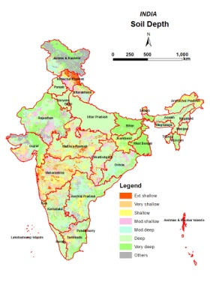
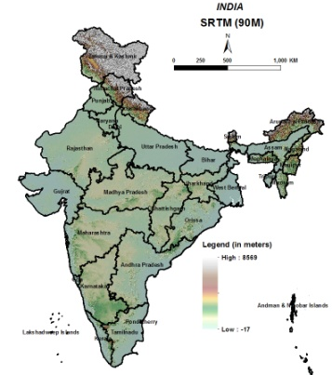
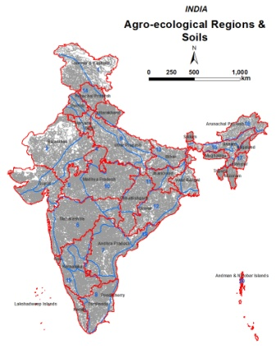
KRISHI GeoPortal Architecture
Spatial database
Outputs
User Interface
Attribute
database
Shell and GUI
KRISHI Geoportal
Attribute database
Meta database
Geometrical database
Raster database

Slide 45
Thank you

