Slide 1
KRISHI: Knowledge based Resources Information Systems Hub for Innovations in Agriculture
ICAR Research Data Repository for Knowledge Management
http://krishi.icar.gov.in

Slide 2
Guiding Principles for Research Data Management in Indian Council of Agricultural Research
Dr. AK Singh, DDG(NRM) Chairman
Dr. H.S. Gupta, Director, IARI Member
Dr. SK Datta, DDG(CS) Member
Dr. (Mrs.) B. Meena Kumari, DDG(Fisheries) Member
Dr. NK Krishna Kumar, DDG(Horticulture) Member
Dr. NK Singh, National Professor Member
Dr. BS Prakash, ADG (AN&P) Member
Dr. MM Roy, Director, CAZRI Member
Dr. S. Mauria, ADG(IP&TM) Member Secretary
28 August 2012

Slide 3
Terms of Reference and Process
TOR: To formulate guidelines for data management at the ICAR institutes
Process:
Deliberated based on the current practices, information received from Directors/Scientists of IASRI, New Delhi; Directorate of Sorghum Research, Hyderabad; NAARM, Hyderabad and Indian Institute of Spices Research, Calicut and practices of data management followed in various International organisations
Circulated Draft report to all Institutes for comments/suggestions.
Submitted Revised report after incorporating the suggestions.
Circulated revised report.
Guideline for ICAR Research Data Management Policy: approved by the Governing Body on March 12, 2014.
Published and circulated in October 2014.

Slide 4
Guidelines for Research Data Management in ICAR
Guidelines are under the following headings:
- Definition of Data - Data Ownership
- Data Collection and Recording
- Data Storage and Security
- Data Access and Sharing
- Data Retention
- General Recommendations
Guidelines are a comprehensive set of standards for effective management of data in the Institutes and are intended to increase awareness of maintaining data integrity; and outline ICAR’s expectations for maintaining prescribed standards of work performance and ethical conduct expected of all persons engaged in research in ICAR Institutes.

Slide 5
2. Definition of data
2.1 Data would include factual information (as measurements or statistics) used as a basis for recording, characterisation, reasoning, discussion or calculation.
Data would include all those research products necessary to validate the integrity of published or reported work.
Would consist of much more than just information and observations written in a lab notebook as part of scientific inquiry but also the materials, the means and the products of that inquiry (such as variety, technology, equipment developed, software, information system, etc.).

Slide 6
2. Definition of data
Some Indicative examples of types of Data in ICAR Institutes are
Laboratory/field measurements and observations;
Germplasm related information;
Information on products such as vaccines, bio-pesticides, equipments, software, source code for softwares/information systems, both data as well as material;
Novel microbes or virus isolates of scientific/commercial importance;
Technologies, processes, methodologies;
Information related to surveys, sample survey data, bio-prospecting, know-how etc. ;
Publications, photographs, audio-visual materials, databases, drawings, etc.;
Information related to IPR applications, technology commercialisation etc.;
Information of services functions (e.g. training, consultancy, contract research, contract service, infrastructure facilities, liaison, other facilitation/ partnerships);
Information/data on the compliance of guidelines and special regulations that apply to the project's implementation such as those involving exchange of genetic material, biosafety, handling of hazardous materials etc.

Slide 7
3. Data Ownership
3.1 All data collected/generated from research, educational or allied activities conducted at the Institute and using ICAR resources shall belong to ICAR, including data generated by consultants hired by Institute/ICAR.
imply retaining the data after the project is completed and
right to transfer data to third parties.
PME Cell of the Institute shall be the nodal unit in the Institute to manage data from research activities under various projects.
Director of the Institute shall be the Competent Authority to implement it as per the guiding principles.

Slide 8
4. Data Collection and Recording
4.1 PME Cell shall oversee that the data is collected in a consistent, systematic manner ensuring its reliability.
4.2 A nodal person, depending upon the activity, should be given primary responsibility for data collection, proper attribution, recording, storage, retention, and disposal or transfer to the archives.
4.3 Data records should be maintained in a durable and accessible medium/manner.
Depending upon the activity/ project, best suitable model for data collection and record keeping shall have to be worked out on a case-to-case basis.
4.4 Wherever feasible, record data in suitable electronic forms. All the data files should be so named that it clearly identifies the project, data collected etc.

Slide 9
4. Data Collection and Recording
4.5 Notebooks/registers, a convenient way for data recording and tracking daily progress, may be supplemented as needed by specialized methods of record keeping.
Notebooks/registers, accessioned by PME Cell, page numbered and issued separate notebooks/registers for each project by name.
Entries dated, legible, clear, made in ink, and in a chronological and consistent manner;
Avoid Leaving blank lines between entries;
Errors and deletions should be lined/marked, dated and initialled (and never erased out);
Properly catalogue supporting materials or records and include the reference to location(s) in the notebook.

Slide 10
4. Data Collection and Recording
4.6 Transferring of records from written to electronic format ~ using double entry system or double checked manually to avoid any incorrect data entry.
For the situations, where it may be difficult to migrate notebook data records to electronic files, follow a combination of written and electronic record keeping.
Accord priority to development of mechanisms of online data management system (at Institute Level and/or at Central level) with the provision of value addition.
4.7 Upon completion of the project, maintain all original laboratory and field notebooks with PME Cell and a copy with the concerned section or laboratory.
4.8 Complete switchover to electronic data recording by all the Institutes by a stipulated date.

Slide 11
5. Data Storage and Security
5.1 Data storage for making it accessible in future to researchers and to establish precedence.
5.2 Make adequate data security provisions to protect data against physical damage, unauthorized use of the database or its application, unauthorized/accidental deletions; modification; disclosure, loss, theft, confidentiality and integrity breaches for data in data transport; and physical storage and disasters.
Keep notebooks or data in other physical forms in a safe and secure location.
Use coded identifiers in place of names and other information to ensure privacy and anonymity; the encoding key may be kept in a different secure location.

Slide 12
5. Data Storage and Security
5.3 Protecting the electronic data could include:
Protecting unauthorised access to data;
Protecting the system by maintaining up-to-date versions of all software, anti-virus/firewall protection and media storage devices, etc.
Protecting data integrity using encryption/electronic signatures to track authorship and changes made to data files,
Back-up and archive electronic data periodically and store backed-up files in PME Cell and/or Institute library.
5.4 Each data set should be properly documented:
Precise content of documentation will vary depending upon the scientific area, study design, the type of data collected, and characteristics of the dataset to be decided on case-to-case basis.
Undertake a larger exercise to develop standards across disciplines.

Slide 13
5. Data Storage and Security
Broadly classify information in following four Groups:
Group 1: Common for all data: Primarily identify type of information, Project title in which data generated, author(s) {PI, Co-PIs etc.} responsible for generating, Institute Name (s), Contact details along with affiliations, date generated, source of funding, etc.
Group 2: Subject Level details: Depending on the subject(s), the standards should be developed. For example, if the data is from an experiment pertaining to Soil-Science, the standards may be soil type, previous crop grown, sowing date, irrigation schedules followed, field locations (preferably geo-referenced), etc. For general data, this level should be able to capture general information, such as broad area (related to Finance/Administration circulars); and cross-references to earlier data.

Slide 14
5. Data Storage and Security
Group 3: Experimental/survey data: Project level details, name of the project, project code, objectives, experiment/survey details, hypothesis under investigation, statistical design/survey design applied, previous experiment/benchmark survey reference, Dates, Actual data, Unit, treatment unit details, details on codes if data is coded, type of transformation(s) used, if any on the variables, data is processed or raw, statistical techniques used for analysis performed, etc.
Group 4: Data not covered in any of the above three levels.
Need to finalize attributes/units etc. to be recorded

Slide 15
5. Data Storage and Security
5.5: Creation of data repositories in two different formats:
generate metadata (data about the type of data available, location of data availability and identification of the source) to enable data discovery and its exploration for the research and developmental activities at PME cell (Action: All Institutes)
the centralized online research data repository along with standardization of analysis and reports to be taken up in a phased manner.
Historical data:
Efforts would also be made to enter the past data (with complete or partial information), wherever feasible.

Slide 16
6. Data Access and Sharing
6.1 Maintain privacy of data as per confidentiality agreements and regulations while making it easily accessible to scientific supervisors and collaborators,
Authorize PIs/Co-PI or nodal person to permit access to the data to eligible persons for legitimate institute purposes.
Authorization to access institutional data may vary according to sensitivity of data.
Institutes may classify data based on their sensitivity and value as
open access, registered access and restricted access,
sharing within ICAR, with other Government agencies, paid access, etc.
high value and low value categories.
Identify some data sets for sharing on National Data Sharing and Accessibility Policy.

Slide 17
6. Data Access and Sharing
6.2 Access to and use of research data ~ limited by restrictions for:
national security: data pertaining to intelligence or political decision making;
data pertaining to protection of germplasm resources, biological resources, protection of rare, threatened or endangered species;
trade secrets and IPRs, data on or from business or other parties that contain confidential information;
personal data subject to restricted access under laws of India and policies to protect confidentially and privacy;
data under consideration in legal actions (sub-judice); and
participant confidentiality concerns, third-party licensing or use agreements; etc.

Slide 18
6. Data Access and Sharing
6.3 Encourage Data sharing through publication of results in a scientific journal or establishing IPR on a scientific product or process.
No obligation to share any preliminary data before publication or obtaining IPR.
After research data have been published/IP protected the information related to the project ~ consider open data and share with other researchers as per restrictions.
5.4 Identify different cooling periods for different data sets. For example, the data of agro-meteorology, productivity, area under different crops, land usage patterns, etc. may not have any cooling period.
Cooling period of 3-4 years for raw experimental data and one year for mean data/ analysed results.
Share data/results required for obtaining IPRs after decision on the IPR application.
5.5 Sign data sharing agreements while sharing data across organizations to impose restrictions on the usage.

Slide 19
6. Data Access and Sharing
6.4 Identify different cooling periods for different data sets.
Proposed cooling period for sharing of different types of data:
Meteorological data, productivity, area under different crops, land-use pattern etc. ~ real time/immediate;
Raw experimental data: 3-4 years;
Means/analyzed results: one year;
Share data/results required for obtaining IPRs after decision on the IPR application.
Anyone who uses the data must acknowledge original source of data;
6.5 Sign data sharing agreements while sharing data across organizations to impose restrictions on the usage.

Slide 20
7. Data Retention
7.1 Data retention can be for much more period in case of experiments which could have long term implications such as climate change, nutrient mapping, etc.
Minimum storage period ~ decided by PME Cell in consultation with PI/nodal person.
Store primary data in the Unit/Centre/Station and not necessarily submitted to PME Cell. PME Cell should retain enough data necessary to reconstruct/evaluate the findings of a project with ease;
In case research involves supporting materials, such as the use of biological specimens, care should be taken to retain their quality during the storage period.
7.2 Give due credit to the earlier institutes/researchers who have contributed in the long-term research when publications are being made using the archived data.

Slide 21
7. Data Retention
7.3 Individuals involved in research projects, may be permitted to take copies of research data for projects on which they have worked and which is essentially required for research publication on transfer or leaving the Institutes due to resignation/superannuation.
Grant permission subject to a written assurance that guarantees:
acceptance of custodial responsibilities for the data, and
access to the data for Institute/ICAR. Retaining original data at the Institute by the next PI taking over charge for the project or the PME Cell.

Slide 22
Implementation
ICAR Research Data Repository for knowledge Management
Data Management Policy in ICAR Institutes ~ the emphasis was on Creation of Research Data Repositories of Actual Trial/experimental/Survey level data and Standardization of Analysis.
Action Points for DARE/ICAR from Cabinet Secretariat, Point No. 5(v): All Agricultural Research carried out across the country should be consolidated and digitised at one place and made available to farmers,
Repositories Added: Technology Database; Geo-Portal; Publication Repository; Observational Data Repository; etc.
Concept Note submitted to the Council on July 02, 2014

Slide 23
Why to Share Data?
They are bloodline of research and IPRs;
To fulfill funding agencies requirements; Increased expectations to share the data from publicly funded research;
Some journals and societies require data archiving, i.e., Nature, and the Dryad partner journals have a Joint Data Archiving Policy (JDAP);
To raise interest in your research;
Sharing detailed research data is associated with increased citation rate. (PLoS ONE);
To speed research, particularly in complex research fields;
To establish priority and a public record;

Slide 24
Some Uses of shared data
It is not always necessary that data mining by the team managing the data would only bring utility to data. Research data repositories are also important as:
Once the data is available and shared, the experts from similar domain, particularly in complex research fields can make use of data generated by others and made available in research data repositories.
It helps in establishing the priority to the team which generated the data
We may think of assigning a Unique identifier to each experiment/data for further citations

Slide 25
Implementation
Objectives
To develop knowledge repositories related to proven technologies, and publications created by ICAR institutes
To develop research data repositories and standardization of analysis of unit level experimental/survey data including observational data
To create Agricultural Geo-portal for strengthening, visualization and analysis of spatial data
To develop Agricultural Knowledge Portal to provide access and manage knowledge repositories and create tools for efficient data management and statistical data analysis

Slide 26
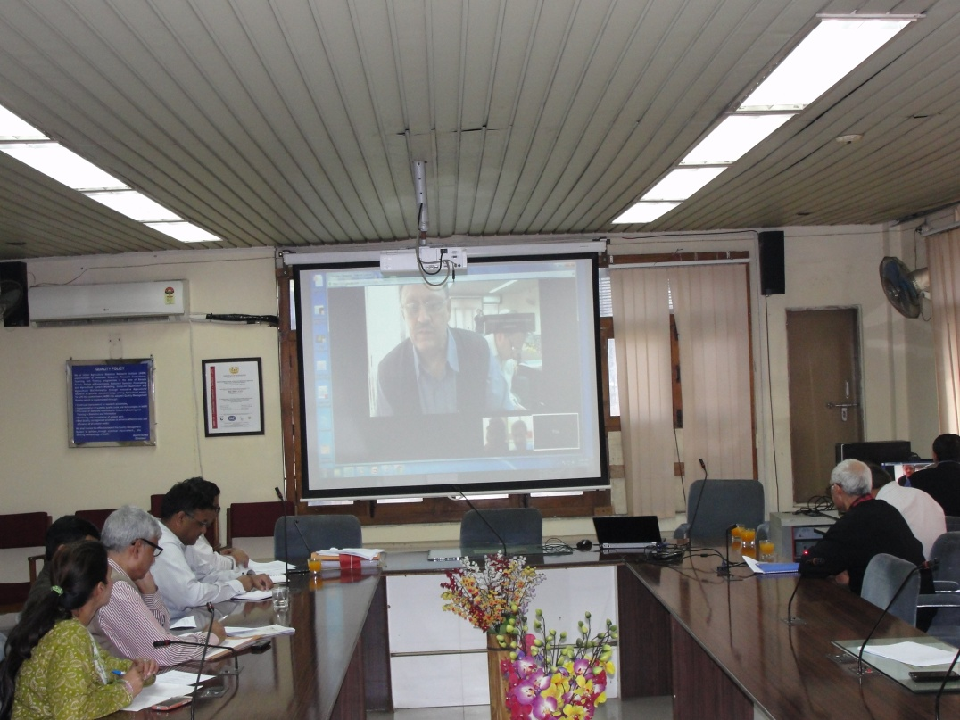
Implementation
Several meetings for implementation of Data management Policy were held (including Virtual Meetings through Google Hangouts)
Prepared Draft Formats for Technology database in consultation with SMDs and Meta data for Geo-portal.
Made a presentation in SOC Meeting on February 27, 2015; Director’s Conference on may 15, 2015

Slide 27
Implementation
Steering Committee/Task Force:
DDG(NRM), Chairman; DDG(Engineering), Co-Chairman
Nominated Nodal Officers from SMDs as Members
Dr. SK Chaudhuri, ADG (SW&M)
Dr. Shiva Dhar Singh, ADG (Inland Fisheries)
Dr. BS Prakash, ADG (ANP)
Dr. Kanchan K Singh, ADG (Farm Engineering)
Dr. G. Venkateshwarlu, ADG (EQA&R)
Dr. T. Janakiram, ADG (HS-I)
ADG (CC)
ADG (Agricultural Extension)
Director, NAARM, IARI, IASRI, NBSS&LUP as Members
PI/Coordinator of Project as Member Secretary

Slide 28
Implementation: Two Tiers
First Tier: Core Institutes:
ICAR-IASRI, New Delhi;
ICAR-NAARM, Hyderabad;
ICAR-NBSS&LUP, Nagpur;
ICAR-IARI, New Delhi;
ICAR-DKMA, New Delhi
Based on need and requirements some more ICAR Institutes may also be asked to help in creation of various data repositories
Second Tier: Institute where it will be implemented and Nodal Officers would be nominated and would be responsible for quality and timeliness updating of data.

Slide 29
Implementation: Two Tiers
Core Institutes:
Technology data base for digitization and dissemination: NAARM, IASRI, DKMA
Unit level experimental/survey data for research data repository, Standardization of analysis, Uniform reporting process: IASRI, NAARM (CRIDA for observational data, as per need)
ICAR Geo-portal: NBSSLUP, IARI, NAARM, IASRI
For Publication Repository: IASRI, NAARM (CMFRI)
To provide single window access/integration of all repositories/applications: IASRI
Uploading, updating and maintaining services at Data Centre: IASRI

Slide 30
Implementation
Domain Name Approved
krishi.icar.gov.in (Knowledge based Resource Information Systems Hub for Innovations in Agriculture)
Six Sub-Repositories
Technology Repository
ICAR Geo-Portal
Experimental Data Repository
Survey Data Repository
Observational Studies Data Repository
Publication Repository
Other data repositories that may be included in this portal are Learning Resources Repository, Historical Repository, etc.

Slide 31
Phase Wise Implementation
Phase I: Institute Level
Heads of Division or Project Coordinator, depending upon the activity may be nominated as nodal officers for primary responsibility of data collation, proper attribution, recording, storage, retention, and disposal or transfer to the archives.
Designate PME Cell Incharge along with AKMU Incharge as officer Incharge for Data and also proper indexing of data about location and extent of availability.
In “No Dues Proforma” on superannuation or transfer, keep a provision to ensure that data is submitted in the Institute to the next PI, Nodal Person and PME Cell.
Nominated Nodal Officer from the Institute would be responsible for coordinating with the project team and implement the data management policies at the Institute level.

Slide 32
Implementation
2.5.5: Creation of data repositories in two different formats:
generate metadata (data about the type of data available, location of data availability and identification of the source) to enable data discovery and its exploration for the research and developmental activities at PME cell (Action: All Institutes)
the centralized online research data repository along with standardization of analysis and reports to be taken up in a phased manner.
Historical data:
Efforts would also be made to enter the past data (with complete or partial information), wherever feasible.

Slide 33
Phase Wise Implementation
Phase II: Creation of Data Standards and Formats, Requirement Analysis Document both for Software and Hardware
Precise content of documentation will vary depending upon the scientific area, study design, the type of data collected, and characteristics of the dataset to be decided on case-to-case basis.
Different sets of standards may be evolved.
Undertake a comprehensive exercise to develop these standards across disciplines, under the guidance of a steering committee/task force for different SMDs.
The requirements of hardware and software would be assessed and the steps would be taken up to procure/develop them.

Slide 34
Phase Wise Implementation
Phase III: Software Development, Implementation in Central Data Repositories
Creation of Central Data Repositories .
Unit level data repositories by taking one or two model Institutes/AICRPs from each SMD in XII Plan and upscale it for all AICRPs later.

Slide 35
Implementation
Agricultural Engineering:
AICRP on Farm Implements and Machinery
AICRP on Post Harvest Technology
Animal Science:
AICRP on Poultry
AICRP on FMD
Natural Resources Management:
AICRP on Long Term Fertilizer Experiments
AICRP on Water Management
Horticultural Science:
AICRP on Vegetable Crops
AICRP on Fruits
Fisheries Science: Central Institute of Fisheries Technology, Cochin
Crop Science: All India Coordinated Sorghum Improvement Project
Sent letter for unit level data information to selected 10 AICRPs/Institutes

Slide 36
Implementation
Sensitization of Researchers: In the first two years, all efforts would be made to sensitize the researchers about the importance of digitization of research data.
Main emphasis on preparing Meta data, bringing data in Institutional Repositories, etc.
Creating Central data repositories, with different authentication levels. The reporting/analysis etc. may be taken up in next phases.

Slide 37
Work flow for Data Approval for Central Repository
Scientist: Enters the unit level data (main source of information);
Head of Division: Approve and Forward to Nodal Officer;
Nodal Officer: Edit/Verify the Information and Forward to I/c PME Cell (If Nodal Officer himself not the PME Cell I/c);
PME-Cell I/C: Verifies the information, if correct forwards to Director for approval and if incorrect, sends back to the scientist;
Director: Approving authority (if approved, the information goes to KRISHI Portal with a notification to SMD Nodal Officer, otherwise goes back to the concerned scientist);
Data in Technology Repository may be entered at Nodal Officer/PME Cell

Slide 38
Scientists - Main Source of Information
Enter the Data
Work flow mechanism for Data/Information Approval
Head – Approve/ Forwarded to Nodal Officer
No
Nodal Officer of the Institute – Upload /Edit/check the information
Is Data/
Information
Correct?
PME Cell I/C – Check and Verify
Forwarded to Director for Approval
Yes
Is Approved by Director?
No
Yes
Notification to
SMD Nodal Officers
KRISHI PORTAL

Slide 39
Implementation
First Step:
To initiate Web Portal KRISHI with Six Repositories
To provide links of all digitized databases /knowledge repositories available on ICAR Institute website or other Government Agencies on KRISHI Portal so as to facilitate single window access to all knowledge repositories available within ICAR.
Provided links of 130 online resources within ICAR under (i) Technologies and Knowledge Resources; (ii) Crop Specific Knowledge Resources; (iii) Genetic Resources Portals; (iv) Databases; (v) Experimental Data Resources; (vi) Survey Data Repository; (vii) Geo-Portal; (viii) Publication Repositories; (ix) Statistical Learning and Computing Resources; (x) Bio-informatics Resources and (xi) Management Information Systems.
Useful links from other Government Departments are also included.

Slide 40
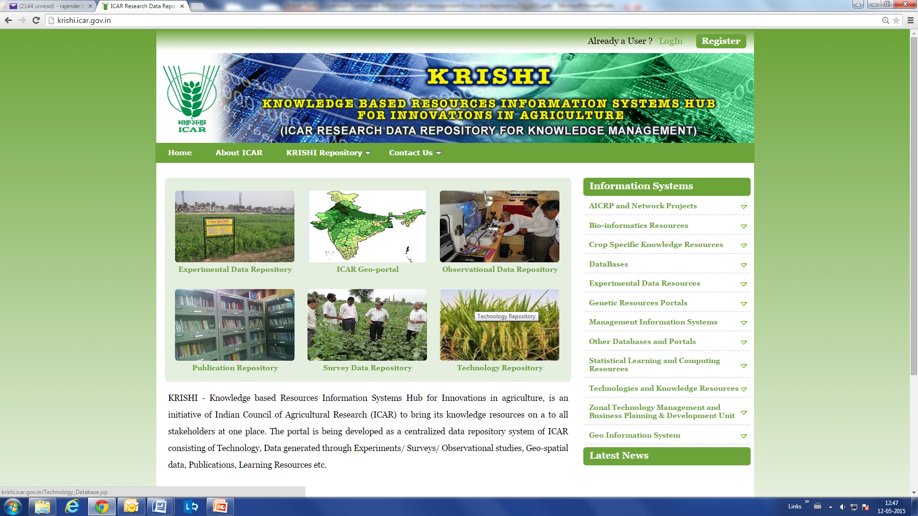
First Screen of KRISHI

Slide 41
Progress Made
Technology Repository (http://krishi.icar.gov.in/Technology_Database.jsp)
Information on Crop Varieties: ICAR Institutes
Partial information from the priced publications on Agricultural Technologies published by ICAR in January 2014
Selected Agricultural Technologies: A Compendia

Slide 42
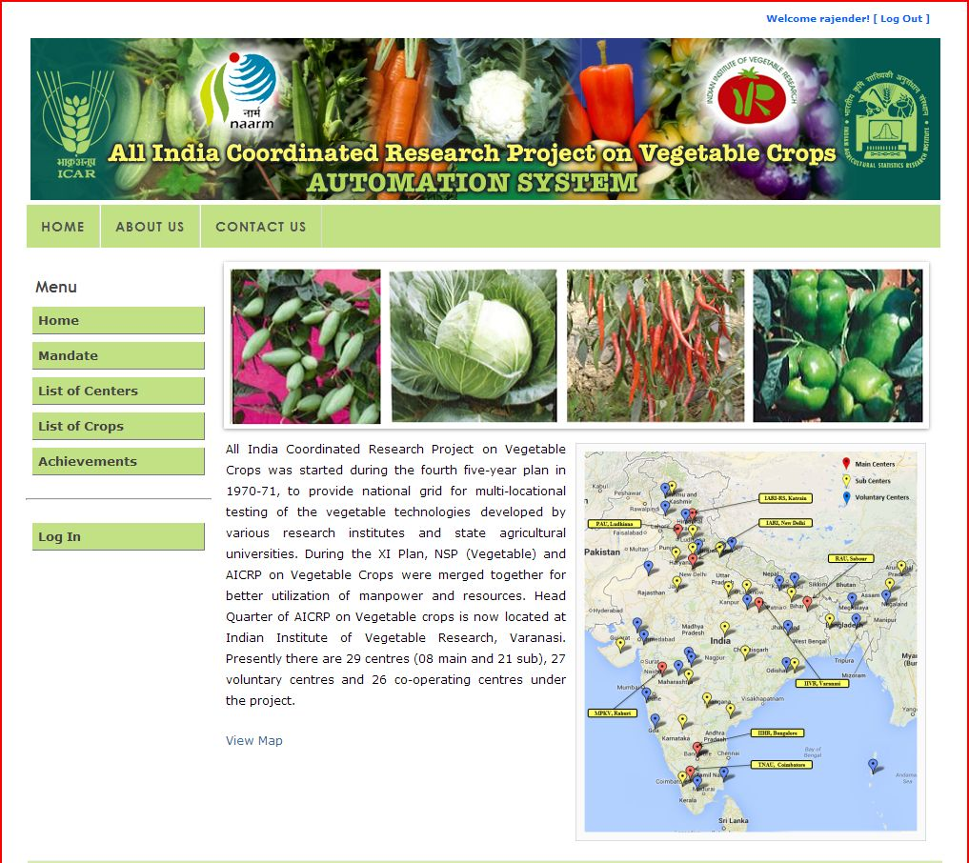
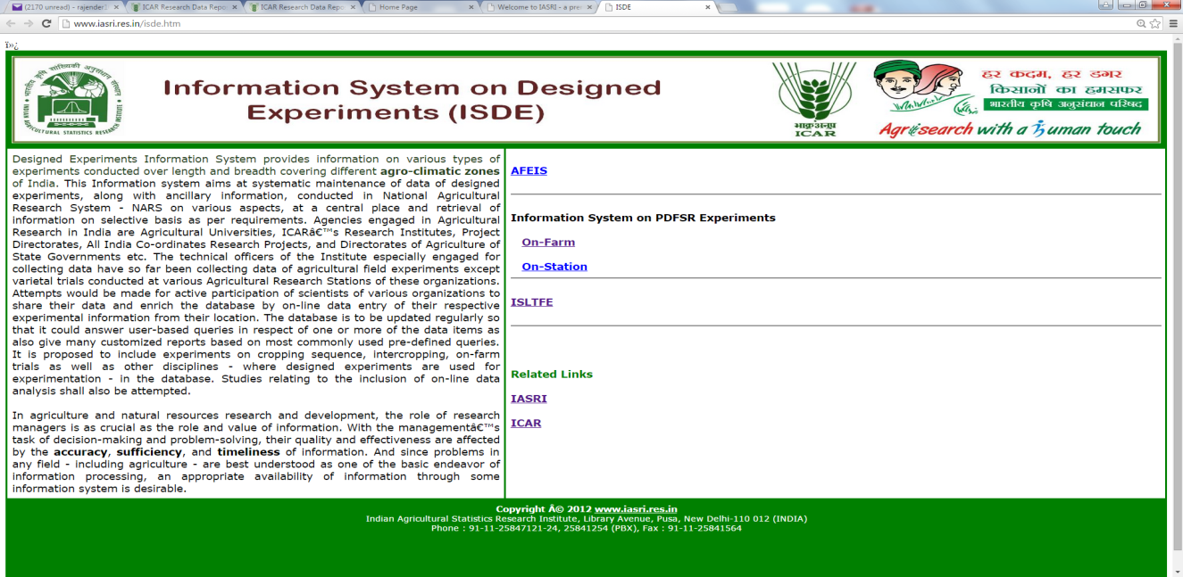
Unit Level Research Data Repositories

Slide 43
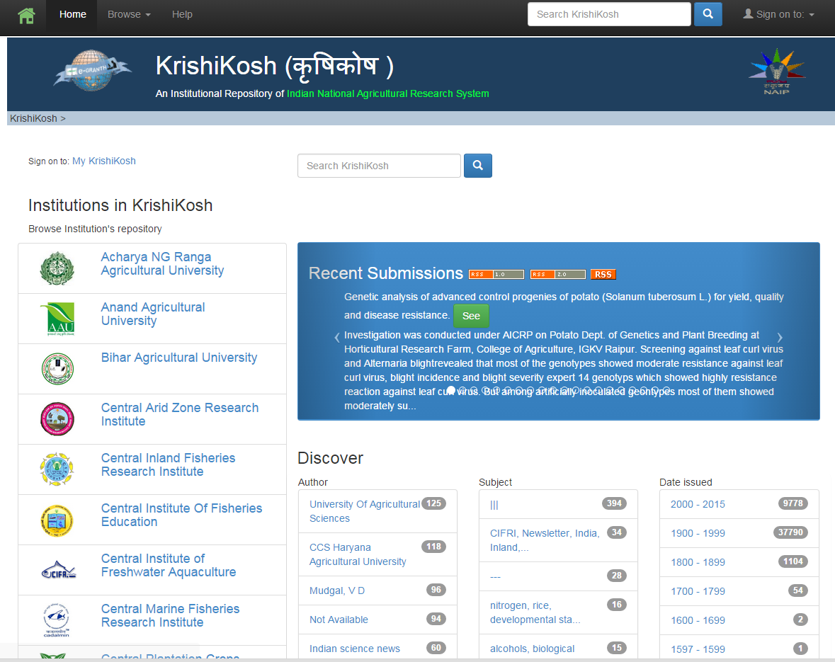
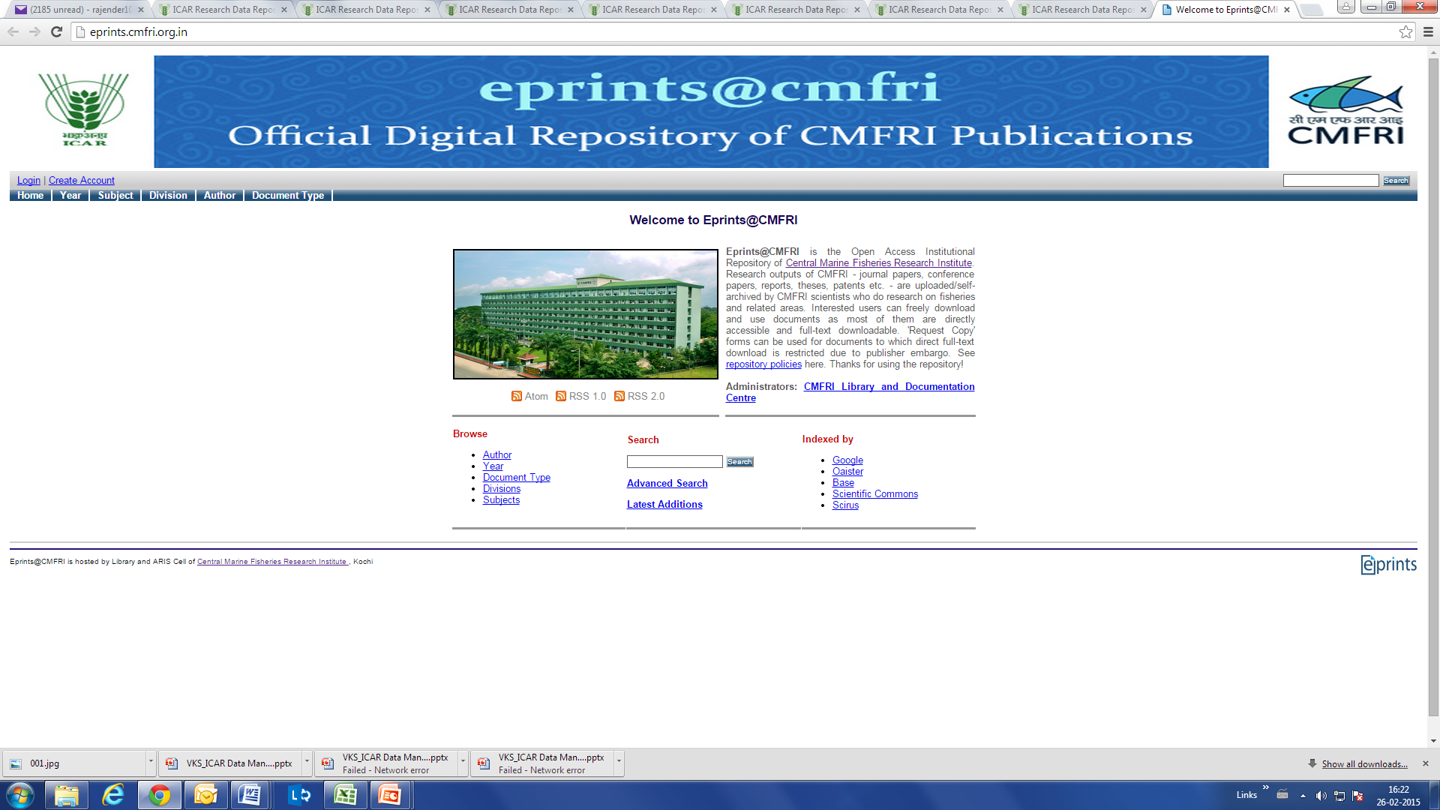
Publication Repositories

Slide 44
Progress Made
Geo-portal (http://krishi.icar.gov.in/geoportal/index.php)
Initial Layers to be provided on Geo-portal:
Base layers of India, States and District Boundaries;
ICAR Institutes/Regional Centres locations
Soil maps (1:1 million); Agro-ecological regions and sub-regions of NBSS&LUP, Nagpur;
Vulnerability map and climate layers created by CRIDA;
Wind Erosion Map by CAZRI;
Area, production and productivity of major crops;
Livestock data (Crop Residue State wise by NIANP, Bengaluru);
Fisheries data;
Looking forward for Thematic maps for (i) Soil Salinity from CSSRI, Karnal; (ii) Cropping Systems Pointwise maps from IIFSR, Modipuram; (iii) Weed species maps from DWR, Jabalpur
Identify more thematic maps

Slide 45
Progress Made
Geo-portal (http://krishi.icar.gov.in/geoportal/index.php)
Presently being developed using Open Source Technologies;
Uses Open Source Base layer till street level details (www.openstreetmap.org/);
For Base layers: SOI is being contacted for Digital Vector Database Entire Country (OVLMF/1M/32) vector type with multiple users on a scale of 1:1 Million;
Need expertise of agencies involved in developing web applications through Open Source Technologies;

Slide 46
ICAR Geo-Portal Features
Handles all type of spatial data:
Raster , Vector ( point, line, polygon)
Highly configurable
Extended functionalities
Compatibility across platforms
Provides Web Map Services (WMS)
Overlay State and district boundaries on any map
Uses Open Source Base layer till street level details (www.openstreetmap.org/)
Allow users to upload their data directly through Geo-portal
Upcoming Updates
An updated interface
Two panels: Selection/ information Panel, Map view panel
Display of metadata of each loaded spatial layer
Visualization of selected data as Graphs at any location
Structured handling of users and their spatial data

Slide 48
Progress Made

Slide 49
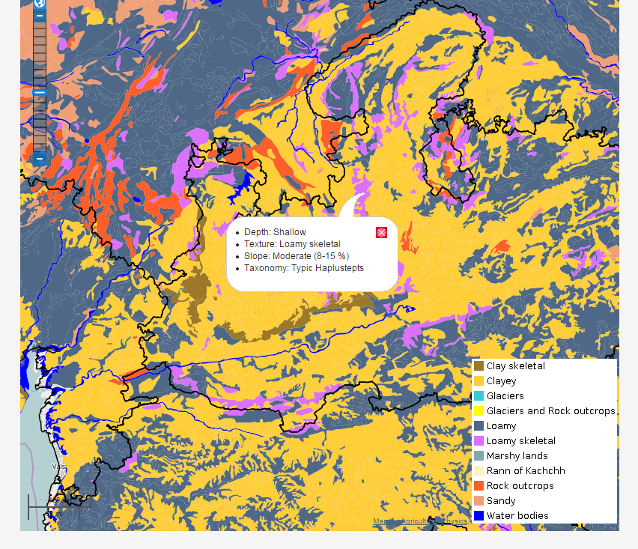
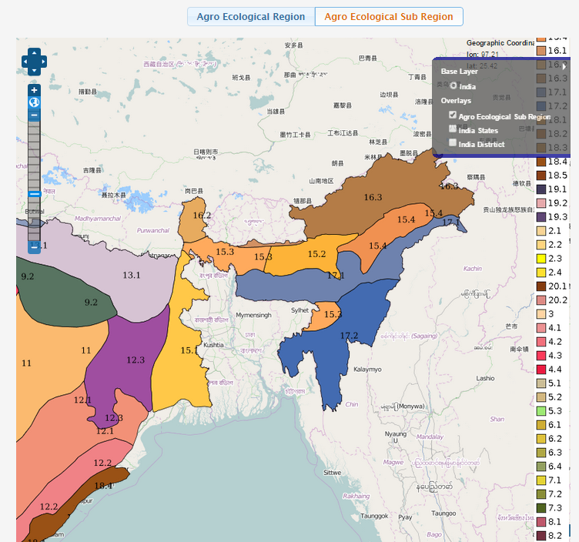
Progress Made

Slide 50
Way forward for Implementation
Mandatory to provide links of all online resources from ICAR Institutions/ZPDs for showcasing the ICT initiatives of ICAR institutes through KRISHI Portal;
Provide the URLs along with brief details about ICT initiatives by your institute from time to time. Keep the data/information up-to-date on these online resources (some already ~ to remove old dated links);
Mandatory research data submission for all ICAR funded projects: keep data/ information up to date on these links;
Institutes to develop and maintain Institute level repositories (funds under Head, Information Technology may be used): {Some Institutes reported new initiatives}
PME cell should also maintain proper indexing of data about type, location, extent of availability and the source of data.
Bureau to continue with their Genetic Resources Data Repositories within their budget;

Slide 51
Way forward for Implementation
In “No Dues proforma” on superannuation or transfer of scientists/technical officers, information regarding the data available with the person and to whom it has been handed over (next PI/Nodal Officer/PME Cell) should be included;
Nodal Officers to sensitize the researchers that data generated belongs to the Council and as far as possible, all data generated be geo-referenced;
Keep data updated in existing Central Repositories;
Digital copy of all publications to be available with Institutes;
In order to depict the geographical spread of Institutional Resources, Send the latitude-longitude of the Institute (including regional stations) in DDMMSS format e.g. Latitude: 28°61’23.5’’N ; Longitude: 78°12’09.2”E;
Complete names of All Regional Stations and Regional Centres;

Slide 52
Way forward for Implementation
Single Window Access for all central repositories;
Different levels of authentication of users;
Online Proforma for Technology Database Repositories;
Finalization of Standard formats for other repositories (suggestions invited to develop these formats);
Reports to be generated for different repositories;
Policy for providing priced publications….??
Requirement Analysis Workshops and Training programmes once Central Data Repositories
Discussion on categorization of data, cooling periods…
Presentation by participants

Slide 53
Thank You

Slide 54
ICAR Open Access Policy
Each ICAR institute to setup an Open Access Institutional Repository.
ICAR shall setup a central harvester to harvest the metadata and full-text of all the records from all the OA repositories of the ICAR institutes for one stop access to all the agricultural knowledge generated in ICAR.
All the meta-data and other information of the institutional repositories are copyrighted with the ICAR. These are licensed for use, re-use and sharing for academic and research purposes. Commercial and other reuse requires written permission.

Slide 55
ICAR Open Access Policy
All publications (research articles, popular articles, monographs, catalogues, conference proceedings, success stories, case studies, annual reports, newsletters, pamphlets, brochures, bulletins, summary of the completed projects, speeches, and other grey literatures) available with the institutes to be placed under Open Access.
Institutes are free to place their unpublished reports in their open access repository. They are encouraged to share their works in public repositories like YouTube and social networking sites like Facebook ®, Google+, etc. along with appropriate disclaimer.
Authors of the scholarly articles produced from the research conducted at the ICAR institutes have to deposit immediately the final authors version manuscripts of papers accepted for publication (pre-prints and post-prints) in the institute’s Open Access repository.

Slide 56
ICAR Open Access Policy
Scientists and other research personnel of the ICAR working in all ICAR institutes or elsewhere are encouraged to publish their research work with publishers which allow self- archiving in Open Access Institutional Repositories.
The authors of the scholarly literature produced from the research funded in whole or part by the ICAR or by other Public Funds at ICAR establishments are required to deposit the final version of the author's peer-reviewed manuscript in the ICAR institute’s Open Access Institutional Repository.
Scientists are advised to mention the ICAR’s Open Access policy while signing the copyright agreements with the publishers and the embargo, if any, should not be later than 12 months.

Slide 57
ICAR Open Access Policy
M.Sc. and Ph.D. thesis/dissertations (full contents) and summary of completed research projects to be deposited in the institutes open access repository after completion of the work.
The metadata (e.g., title, abstract, authors, publisher, etc.) be freely accessible from the time of deposition of the content and their free unrestricted use through Open Access can be made after an embargo period not more than 12 months.
All the journals published by the ICAR have been made Open Access. Journals, conference proceedings and other scholarly literature published with the financial support from ICAR to the professional societies and others, to be made Open.

Slide 58
ICAR Open Access Policy
Documents having material to be patented or commercialised, or where the promulgations would infringe a legal commitment by the institute and/or the author, may not be included in institute’s Open Access repository.
However, the ICAR scientists and staff as authors of the commercial books may negotiate with the publishers to share the same via institutional repositories after a suitable embargo period.

Slide 59
ICAR Open Access Policy
Implementation
The DKMA to function as nodal agency for implementation of the ICAR Open Access policy. The DKMA will organize advocacy workshops and capacity building of scientific & technical personnel, repository administrators, editors and publishers on Institutional Repositories, application and usage of Free and Open Source Software.
End Note
OA initiative is not a single event. It is a process and expects full compliance over a period of three years. Therefore, the proposed modest policy is a first step in the journey towards formal declaration of openness and then after reviews progress, compliance and impact periodically.

