Slide 1


REVIEW WORKSHOP
Attracting & Retaining Youth in Agriculture under Zone-II, Jodhpur
S. K. Singh & M.S. Meena
ICAR-Agricultural Technology Application Research Institute,
Zone-II, Jodhpur - 342 005 (Rajasthan)
Website: www.atarijodhpur.res.in
Presented during Review Workshop on ARYA on 16th June 2020 through video-conferncing.

Slide 2
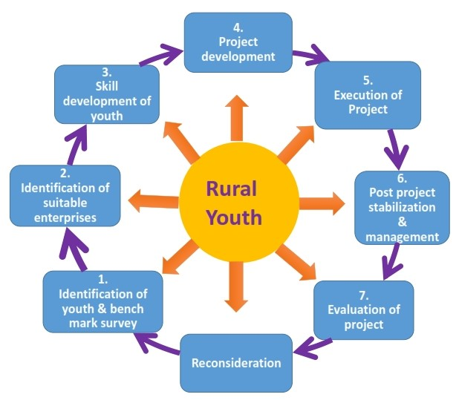
Project objectives:
To attract & empower youth in Rural Areas to take up various agriculture, allied and service sector enterprises for sustainable income & gainful employment in selected districts.
To enable farm youth to establish network groups to take up resource & capital intensive activities like processing, value addition and marketing, and
To demonstrate the functional linkage with different institutions & stakeholders for convergence of opportunities available under various schemes/program for sustainable development of youth.

Slide 3


ARYA implementing KVKs of Zone-II
Rajasthan
Banswara
Jaipur-I
Alwar-I
Udaipur-I
Bundi
Jhalawar
Barmer-II
Haryana
Gurugram
Ambala
Mahendergarh
Haryana
Rajasthan

Slide 4
Enterprises Promoted by KVKs (2015-16 to 2019-20)
KVKs
 | Nursery Management | Poultry | Goatery | Value Addition | Protected cultivation | Mushroom Production | Vermi-Compost | Bee-Keeping | Piggery
Phase-I (2015-16)
Banswara (Rajasthan)
Gurugram (Haryana)
Phase-II (2018-19)
Jaipur-I (Rajasthan)
Alwar-I (Rajasthan)
Udaipur-I (Rajasthan)
Bundi (Rajasthan)
Jhalawar (Rajasthan)
Barmer-II (Rajasthan)
Ambala (Haryana)
Mahendergarh (Harayana)
Total KVKs | 7 | 7 | 7 | 7 | 2 | 3 | 5 | 3 | 1

Slide 5
Youth Trained and Units Establishment (2015-16 to 2019-20)

Slide 6
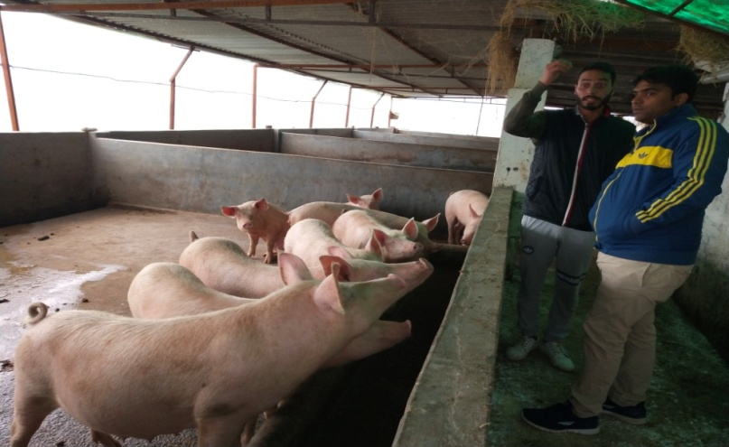
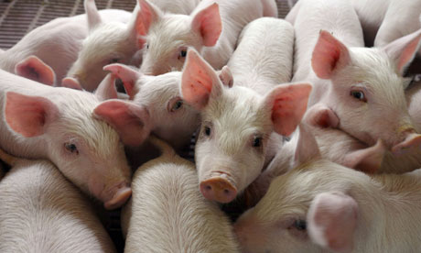
1. Piggery (KVK, Ambala)
Youth VPO/Block District /State Education /Age KVK WhatsApp group Youth to youth extension YouTube channel Linkage/convergence/ collaboration | Sh. Ranjod Singh Lohgarh / Ambala Ambala/ Haryana Graduation/ 28 Years 69 youth and experts 5 youth from village started piggery Numberdaar shab (https:// youtu.be/aFJEhZ6Eqhs) Lala Lajpat University of Veterinary & Animal Sciences, Hisar Disease Investigation Lab/ Pashu Vigyan Kendra, Ambala City National Dairy Research Institute, Karnal Haryana Veterinary Training Institute, Uchani Department of Animal Husbandry, Ambala PDO: Pure Yorkshire breed, vaccines and advisory
Unit Size | Produce (Year 2019) | Rate (Rs/Piglet) | Additional income (Fish& Manure) | Gross Returns (Rs.) | Expenses (Rs.) | Net Returns (Rs.)
50+5 | 323 Piglets | 2500 (2 month/ 12kg) Fattener – 110/kg | 50,000 | 8,57,500 | 2,92,000 | 5,65,000

Slide 7
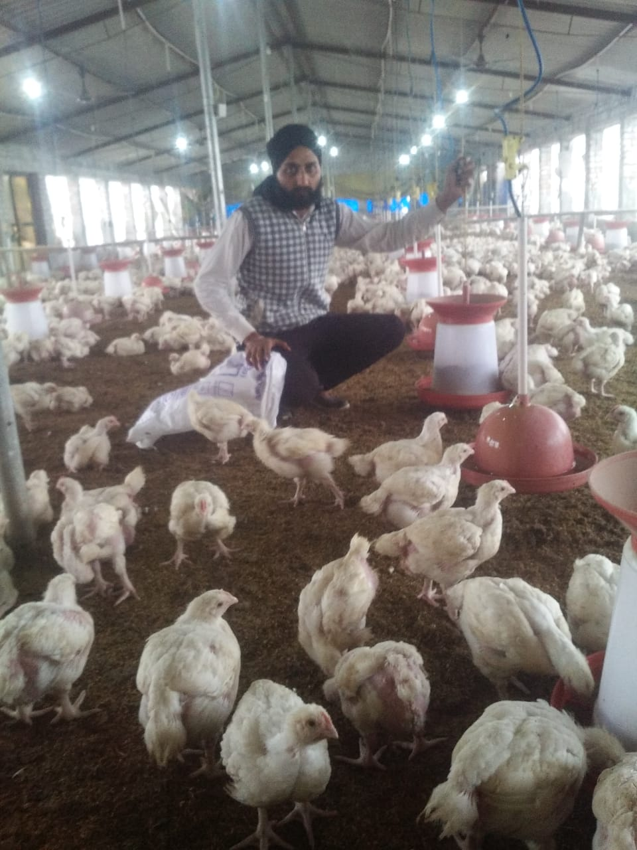
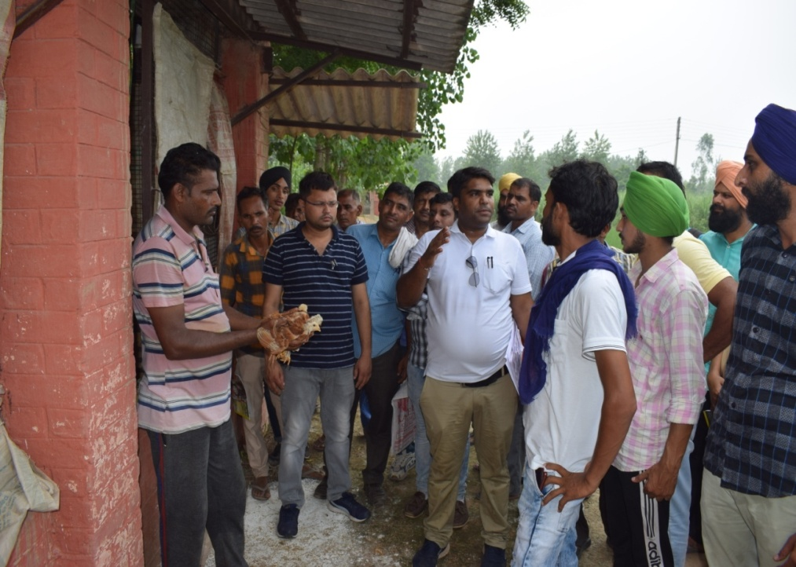
2. Poultry (KVK, Ambala)
Youth VPO / Block District /State Education /Age KVK WhatsApp group Youth to youth extension YouTube channel Linkage/convergence/ collaboration | Sh. Malkit Singh Sherpur Salkhani /Barara Ambala /Haryana 10+2 /28 Years 79 youth and experts ----- ------ 1. Sugna Pvt. Limited, Hyderabad 3 years contract for technical guidance, supply of birds, feed and medical facilities Buyback facilities Motivating youths Provide Rs. 7/- per kg benefit to farmer from market price and upto 50% more commission/ benefit to youths 2. Central Poultry Development, Chandigarh 3. LLUVAS, Hisar ------
Unit Size | Contract farming with Sugna Pvt .ltd. | Gross Returns (Rs.) /6 month | Expenses (Rs.) | Net Returns (Rs.)
2500 birds (Broiler) | @ 40000 p.m. | 2,40,000 | 82,500 | 1,57,500

Slide 8
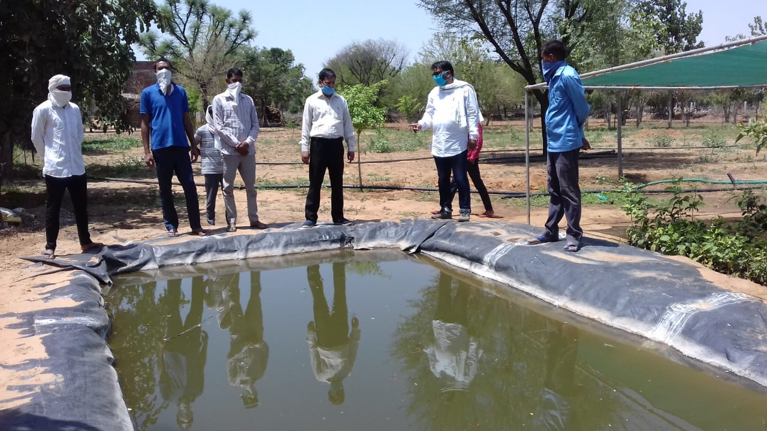
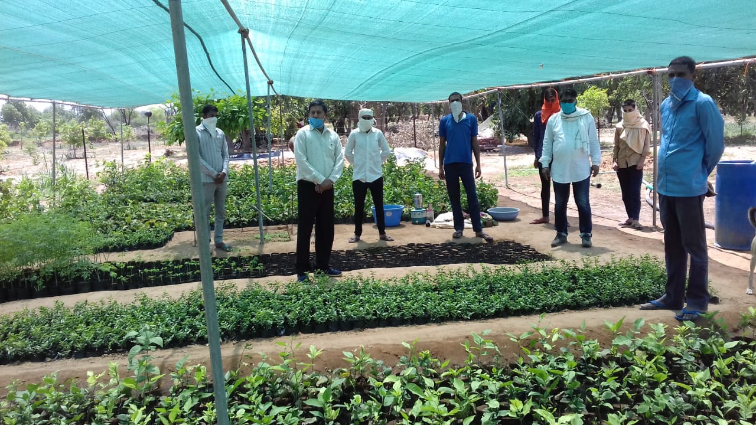
3. Nursery Management (KVK, Jaipur-I)
Youth VPO / Block District /State Education /Age KVK WhatsApp group Youth to youth extension YouTube channel Linkage/convergence/collaboration | Sh. Sanwar Mal Saini Vishanpura Charanwas /Govindgarh Jaipur/ Rajasthan 34 Years 20 youths & experts 27 farmers contacted for establishing orchard at their field WhatsApp group (50 youth) IARI PUSA-Exhibition Pvt. Nursery-interactions Pvt. Company/TNAU--Seeds RARI Durgapura farms
Year of establishment | Area under nursery | Expenditure upto May-2020 | Plant sold in May-2020 | Income from plants | Plants available for sell
2019 | 0.2 ha. | 1.5 Lakhs | 39,500 | 1,63,000 | Bael: 1900, Karonda: 1400, Moringa: 6000, Guava: 200

Slide 9

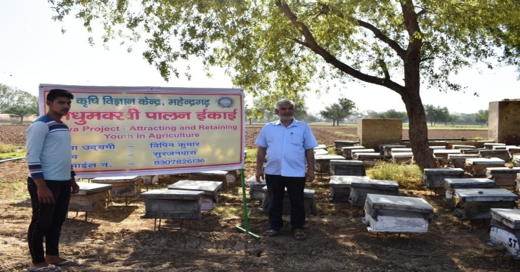
4. Bee Keeping (KVK, Mahendergarh)
Youth VPO / Block District /State Education /Age KVK WhatsApp group Youth to youth extension YouTube channel Linkage Scheme convergence/ collaboration | Sh. Vipin Kumar Surjanwas/Kanina Mahendergarh/Haryana 10+2/ 19 Years KVK Bee Keepers WhatsApp group with 21 youth and 5 experts 3 youth established units Hasn’t started yet NABARD, Dept. of Horticulture National Horticulture Mission, Integrated Bee Keeping Development Centre
No. of Boxes | Produce (kg) | Rate (Rs/kg) | Gross Returns (Rs.) | Expenses (Rs.) | Net Returns (Rs.)
50 | 1700 | 90 | 1,53,000 | 47,000 | 1,06,000

Slide 10
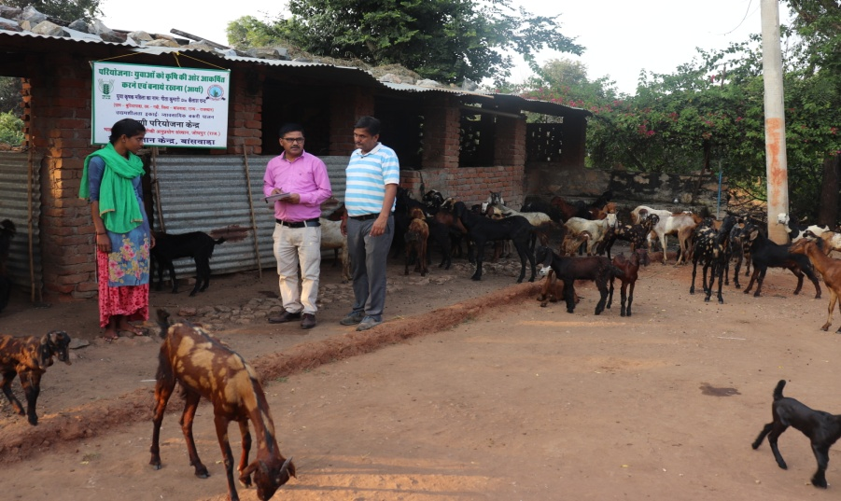
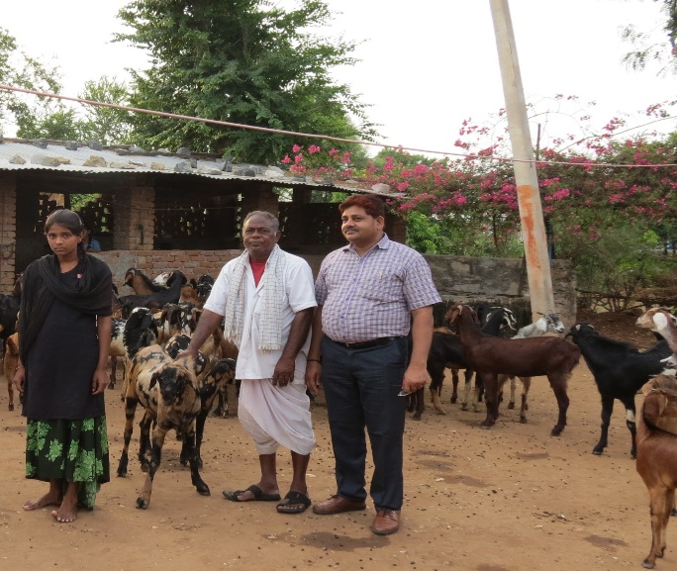
5. Goat Farming (KVK, Banswara)
Name VPO / Block District /State Education /Age KVK WhatsApp group Youth to youth extension YouTube channel Linkage Scheme convergence/ collaboration | Ms. Geeta Kumari Butiyada/ Garhi Banswara/ Rajasthan 10+2/ 22 Years 41 youths & experts 4 youth from village started goatry during 2018 ----- Livestock Research Station, Bojunda, Chittaurgarh-Training and technical know-how 1. Reliance Foundation, Banswara-Supplied one goat 2. Jhambukhad Kishan Agro Producer Company- Supplied Feed.
Unit size | Produce (year 2019) | Average Rate (Rs./Buck) | Gross return (Rs.) | Expenses (Rs.) | Net return (Rs.)
43 + 5 | 42 Bucks (Male) 27 Goat (Female) | 6500/buck | 2,60,000 | 1,15,000 | 1,45,000

Slide 11
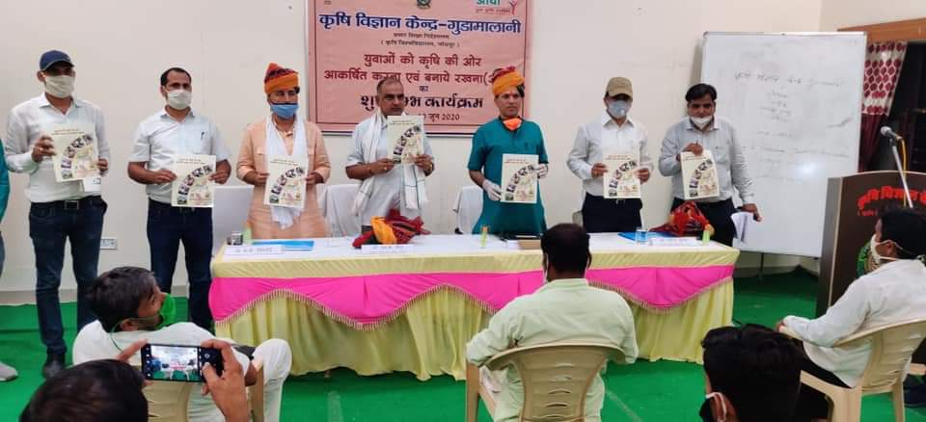
New ARYA Implementing KVK: KVK-Barmer-II

Slide 12
Budget Utilization
Particulars | Opening balance as on 01-04-2019 (in lakh) | Amount released during 2019-20 (in lakh) | Expenditure incurred during 2019-20 | Unspent balance as on 31-03-2020
Capital | 24.32 | 75.50 | 74.50 | 25.32
General | 27.77 | 89.75 | 89.66 | 27.85
Total | 52.10 | 1.65 crore | 1.64 crore | 53.18
* Unspent of amount Rs. 5318168 is due to COVID-19.

Slide 13
Action Plan for 2020-21
1. Total 70 trainings are scheduled to be organised by 10 ARYA implementing KVKs during 2020-21 to develop entrepreneurial skills among 1200 youth in Rajasthan & Haryana state.
2. Youth to Youth extension (Y2Y) is being promoted. Model youths are identified to act as resource persons and for extension at village level.
3. All trained youth is to be linked with mobile apps being developed in all enterprises. Mobile apps on goatery is ready, while on other enterprises are under process.
4. Social media—WhatsApp groups are formed by ATARI and KVKs to connect youth and experts to address the youth’s problems. All SMSs are looking after the activities of ARYA at KVK level, however, this aspects will be addressed.
5. Youths are being mobilised for formation and registration of SHGs and FPOs.
6. Success cases are documented through short videos, YouTube and other means of ICTs. Concerted efforts will be taken by KVKs to address this issue.
7. Doordarshan, FM Radio and local channels are also linked for interactions with ARYA youth and to exchange their experiences to motivate fellow farmers in the nearby areas and same will be followed.
8. Success cases are being documented at ATARI level to illustrate efforts of KVKs and contribution of ARYA youth.
9. KVKS are being motivated for convergence with other government schemes like TSP, ATMA, RKVY etc. This aspect will be taken on TOP priority.
10. Functional linkages are established for trainings, advisory, consultancy, etc. with line departments and other organisations. However, it will be strengthened.

