Slide 1
Krishi Vigyan Kendra Chitradurga UAHS, Shivamogga
Action Plan 2015-16

Slide 2
Major Crops & Thrust areas of the District
Kharif
Thrust Areas
Finger millet, Groundnut, Maize, Red gram, green gram, Onion , Cotton , Castor
Improved Variety and Hybrids
Salt affected soils & wastelands
Water Management
Soil and water conservation
Nutrient Management
Integrated Pest and Disease Management
Post Harvest and Value Addition
Farm Mechanization Techniques
Crop diversification
Animal nutrition
Market Intelligence
Rabi
Sorghum, Sunflower, Safflower , Chick pea
ter
Fruit & Plantation Crops
Coconut, Arecanut, Pomegranate, Mango, Sapota , Banana, Papaya, Citrus

Slide 3
Operational Area Details
Crop/ Enterprise | Prioritized problems | Area (ha) affected | Cluster Villages | FLD/OFT/Trainings
Foxtail millet | Low yielding varieties | 12,266 | Taluku | OFT, Training
Finger millet | Lack of suitable variety for neck blast . Lack of awareness on processing and value addition | 35,867 | Madadakere | FLD, Training
Groundnut | Low plant population and poor yield and old variety. | 1,25,000 | Taluku | FLD, Training
Fodder crops | Low milk yield, Non availability of green fodder Imbalance nutrition | 12,000 | Kodihally | FLD, Training
Red gram | Leaf Webber and Pod borer | 3,800 | Kodihally | FLD, Training
Bengal gram | Pod borer and wilt | 7,600 | Kodihally | FLD, Training
Areca nut | Spindle bug, Scales, mites and leaf spot | 6,000 | T. Nulenur | FLD, Training

Slide 4
Contd..
Crop /Enterprise | Prioritized problems | Area affected (ha) | Cluster Villages | OFT, FLD, Training
Field Bean | Monocropping, Depletion of soil fertility Weed Problem in Arecanut in early stage | 3,500 | Sirigere | FLD, Training
Integrated Farming System | Poor diversity , non conversion of on farm Resources. Lack of integration of components | - | Kodihally, Sirigere, T Nulenur | FLD, Training
Dairy | Balanced feed | 2,56,000 No. | Dharmapura | FLD, Training
Onion | Non availability of quality seed material Dependency on other states Higher seed cost | 7,520 | Muddapura | FLD, Training,
Watermelon | Fruit cracking, Imbalanced nutrient application Wilt disease | 275 | Taluku | FLD, Training
Pomegranate | Bacterial blight | 6,500 | Kodihally | OFT, FFS, FLD, Training

Slide 5
Abstract of Activities
Title | No’s
On Farm Testing | 01
Front Line Demonstrations | 14
Entrepreneurship Development Programme | 01
Integrated Farming System | 01
Farmers Field School | 01
Trainings Programmes | 54
Innovative Farmers Meet | 01
Preparation of Village Soil Fertility Map and Recommendations | 01
Extension literature | 25
Electronic Media(Radio/TV programme) | 15

Slide 6
ON FARM TESTING

Slide 7
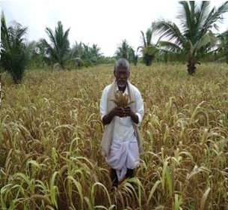
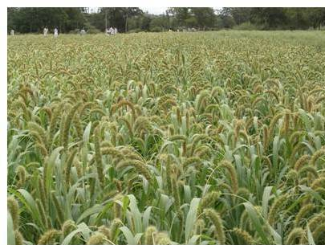
Assessment of foxtail millet varieties for higher yield
OFT-1
Prioritized problem:
Low yielding varieties
Susceptible to pest and diseases
Potential Yield:13 q/ha
Average yield: 7 q/ha
Yield gap : 6 q/ha
Area: 12, 266 ha
Treatment Details | Source | Critical Inputs | Units (kg) | Cost/input (Rs.) | Total cost
T1:SIA-2644 T2:HMT-100-1 | UAS (R) UAS (D) | Seeds Rhizobium PSB Trichoderma ZnSO₄ | 20 3 16 | 50 100 60 | 1000 300 960
Total |  |  |  |  | 2,260
Area: 1.6 ha
No of trials: 2
Parameter to be recorded:
Germination percentage, plant height (cm), panicle length (cm), % disease incidence , yield Kg/ha fodder yield and economics.

Slide 8
FRONT LINE
DEMONSTRATIONS

Slide 9
Introduction of ML-365 finger millet variety for higher yield
FLD 1
Prioritized problem:
Low yield
Varieties are susceptible to neck blast
Potential Yield:30 q/ha
Average yield: 24 q/ha
Area : 35867 ha
Technology Intervention | Plots | Critical Inputs | Units (kg) | Cost/ Unit (Rs.) | Total cost (Rs.)
Introduction of new variety –ML-365 Seed treatment with Biofertilizers- Azospirillum and PSB,@ 4 g/kg. Biopesticide -Trichoderma @ 4 g/kg FYM: 7.5 t/ha RDF-50:40:25 NPK/ha Micronutrients (ZnSO₄ 10 kg/ha ) | Demo (ML-365) Check | Seed Azospirillum PSB Trichoderma ZnSO₄ | 25 7.5 20 | 50 100 60 | 1250 750 1200
Total |  |  |  |  | 3,200
Area :2 ha
No. of Demo : 5
Source: UAS B
Parameter to be recorded:
Germination percentage, plant height (cm), No. of effective tillers/ plant, No. of fingers/ear head, Test wt., Yield Kg/ha and economics

Slide 10
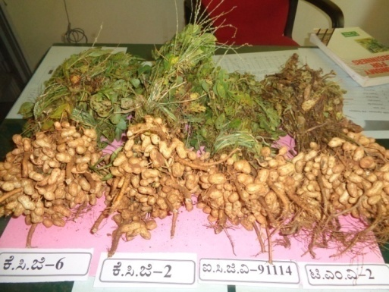
Integrated Crop Management in Groundnut
FLD 2
Prioritized problem:
Plant population
Low yields of existing varieties
Imbalanced nutrient management
Source: UAS B
Potential Yield: 15 q/ha,
Average yield: 6-8 q/ha
Yield gap : 7-9 q/ha
Technology Intervention | Plots | Critical Inputs | Units (kg) | Cost/unit (Rs.) | Total cost (Rs.)
Introduction of new variety-KCG-6 Biofertilizer- Rhizobium, PSB, @ 375 g /ha Trichoderma Chloropyriphos @ 15 ml/kg Mechanized seed drill FYM : 7.5 t/ha RDF : 25:50:25 NPK kg /ha Micronutrients (10 kg ZnSO₄ and 0.1% borax Gypsum-500 kg/ha | Demo Check | Seeds Rhizobium, PSB Trichoderma Captan Chloropyriphos ZnSO₄ | 150 15 2.5 5.0 litre 20 | 80 100 450 250 60 | 12000 1500 1125 1250 1200
Total |  |  |  |  | 17,075
Observations: Germination percentage, no. of pods/plant, 100 seed wt, shelling %, yield, percentage damage due to pest and disease and B:C ratio
Area :2 ha
No. of Demo : 5

Slide 11
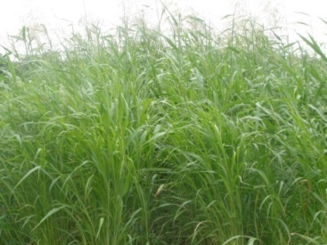
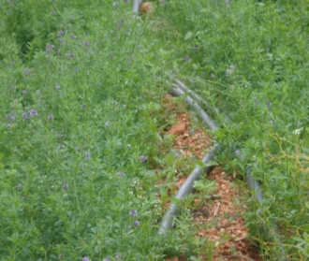
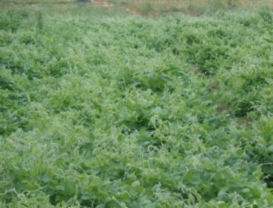
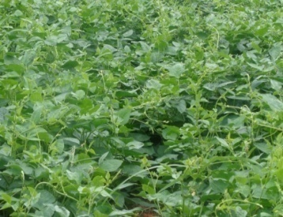
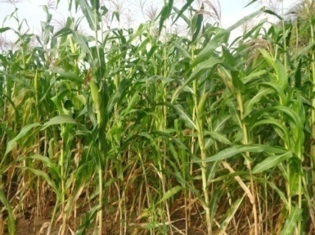
Technology demonstration module in fodder crops
FLD 3
Prioritized problem
Non availability of green fodder varieties
Imbalance nutrition
Technology Intervention | Components of demo plot | Source | Critical Inputs | Cost/unit(Rs.) | Total cost (Rs.)
Introduction of new fodder varieties Biofertilizer- Rhizobium, PSB, Trichoderma @ 4 g/kg | Lucerne Fodder sorghum Fodder cowpea Horse gram Fodder maize | Local TNAU Local Local UASD | Seed Azospirillum/ Rhizobium PSB Trichoderma | 3000 300 | 15,000 1500
Total |  |  |  |  | 16,500
Area : 1 ha
Parameter to be recorded: fodder yield (t/ha) and Palatability
No. of Demo : 5
Fodder Sorghum
Lucerne
Horsegram
Cowpea
Fodder maize

Slide 12
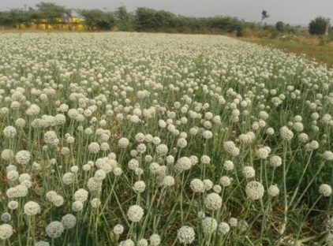
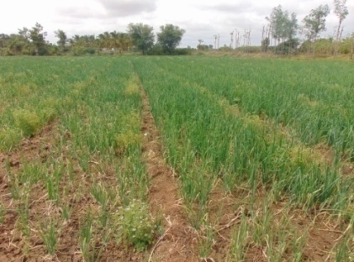
Farmers Participatory Seed Production in Onion
FLD 4
Prioritized problem
Non availability of quality seed material
Dependency on other states
Higher seed cost
Imbalanced nutrient management in bulb production
Technology Intervention | Critical Inputs | Quantity (kg) | Cost/ Demo(Rs.) | Total cost(Rs)
RDF: 125:75:125 FYM : 25 t/ha Soil test based RDF application Quality bulb production of Bheema super in kharif season Seed production technology in rabi season | Bhima Super Breeder seed Bio inputs: Trichoderma, Azospirillum, PSB (1 kg/acre) | 5 7.5 | 2000 | 10,000
Source: DOGR, Pune
Area : 1 ha
No. of Demo : 5
Parameters to be recorded:
Germination percentage, Bulb Yield/ ha in kharif, Seed yield in rabi, Net Returns

Slide 13
Integrated Crop Management in Watermelon
FLD 5
Prioritized problem | Technology to be demonstrated | Source
Fruit cracking, Imbalanced nutrient application Wilt disease | Balanced application of nutrients (RDF) FYM: 25 t/ha Micronutrients: Foliar spray of Arka Vegetable Special application Bio-inputs: Soil application of Trichoderma, PSB, Pseudomonas | IIHR, Bangalore
Name of critical input | Qty per Demo | Cost per Demo | Total cost (Rs.)
Arka Vegetable Special Bio inputs: PSB, Pseudomonas, Trichoderma | 6 kg 1.5 kg | 1,350 | 6,750
Area : 1 ha
No. of Demo : 5
Parameters to be studied: No of fruits/vine, % fruit cracking, Yield/ha, incidence of pest& diseases, B:C ratio

Slide 14
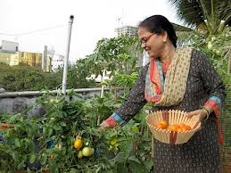
Terrace gardening for Nutrition security of urban population
FLD 6
Prioritized problem
Pesticide contaminated vegetables.
Lack of knowledge on terrace gardening.
Conversion of kitchen waste material
Source: IIHR, Hesaragatta
Technology to be demonstrated:
Crop plan for Terrace gardening and Recycling of waste material.
No. of Demo : 3
Observations:
Consumption of vegetables (ICMR stds)
Availability of vegetables throughout the year.
Nutritional status before and after
The technology will be compared with the Neighbouring household.
Sl. No | Name of the vegetables
1 | Veg. Amaranth
2 | Palak
3 | Tomato
4 | Brinjal
5 | Chilli
6 | Okra
7 | Cowpea
8 | Radish
9 | French bean
10 | Ridge gourd
Critical input | Qty per Demo | Cost per Demo | No. of Demo | Total cost
Vegetable seed kit Vegetable pres ervator (CRIDA model) Protrays Fibre pots | 3 kits 1 unit 3 10 | 300 1500 60 1500 | 3 | 10,080/-

Slide 15
Contd…
Name of critical input | Qty per Demo | Cost per Demo | Total cost (Rs.)
Packaging Material (Al standing pouch) Food Labels, Sealing Machine Electronic weighing scale | 2 *200 2 *200 1 No 1 No | 2000 2000 2500 5000 | 23,000/-
Observations:
Economics and Consumer preference
No. of Demo : 2
The Technology will be compared with other SHG which is not adopting value addition.

Slide 16
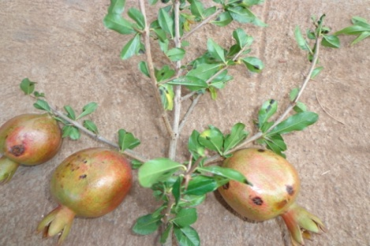
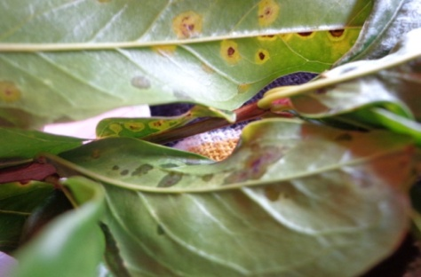
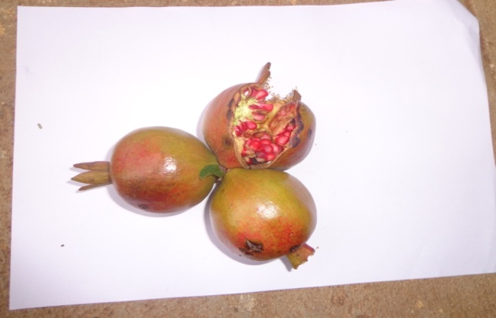
Bacterial blight management in Pomegranate
FLD 7
Problems : Bacterial blight, lack of knowledge on bio inputs, indiscriminate spraying schedule , Residue problem in fruits
Area under cultivation: 15000 ha.
Extent of area affected: 6000 ha.
Technology to be demonstrated
Alternate practice - 1 | Source
Bordeaux mixture – 1% | NRC on Pomegranate, Solapur
Copper oxy chloride - 2.5 g/l, Copper hydroxide 2 g/l
Carbendazim – 1 g/l., Captan - 2.5 g/l
Thiophenate methyl – 1 g/l
Bronopol – 0.5 g/l , Streptocycline – 0.5 g/l
Micronutrients – 1 g/l , Pseudomonas fluorescens - 4 g/l
Trichoderma viridae – 25 g/plant
VAM– 25 g/plant

Slide 17
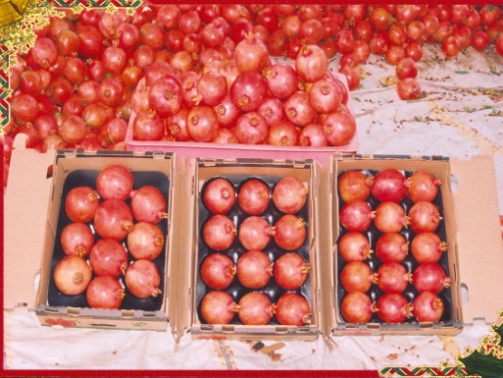
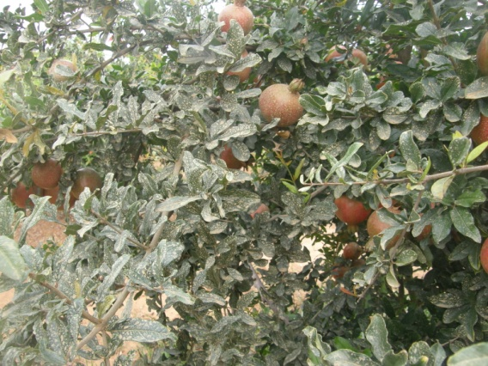
Critical inputs:
Details | Area (ha) | Quantity (kg) | Amount (Rs.)
Pseudomonas fluorescens | 0.15 | 4 | 400
Trichoderma viridae |  | 2 | 200
Mycorrhiza (VAM) |  | 2 | 200
Neem cake |  | 13 | 300
Micronutrients |  | 0.5 | 500
Residue analysis |  |  | 5000
Total No of Demo:3 Amount: 19,800 |  |  | 6, 600
Parameters to be studied:
No. of fruits per plant and yield per plant
Percent incidence of disease,
Residue analysis in the fruits

Slide 18
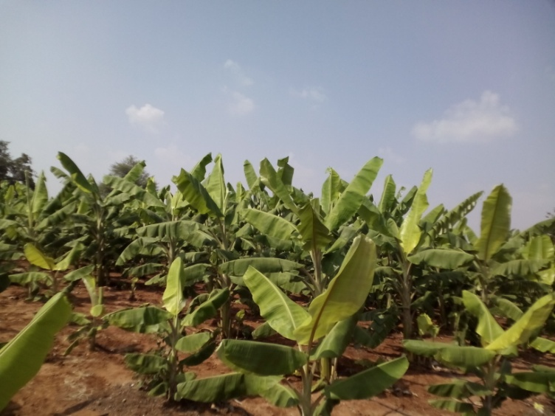
Improved Management practices for higher yield in Banana
FLD 8
Area : 8,500 ha
Prioritised problem:
Imbalanced application of major nutrients, fruit cracking
Lower bunch yields
Source: IIHR
Rationale for selection: To increase the bunch yields of banana through balanced nutrient management
Potential Yield : 18 kg
Present Yield : 8 -10 kg
Yield Gap : 10-12 kg
Variety: Local. Putta Bale

Slide 19
Details of the FLD
Technology Intervention | Source | Area (ha) | No. of trials | Critical Inputs(qty) | Units | Cost/unit(Rs.) | Total cost (Rs.)
Split application of Major nutrients Foliar application of micronutrients (Banana Special after 5th month till harvest) Foliar application of Potassium sulphate @ 2% for bunches Bunch feeding with ammonium sulphate and Potassium nitrate Water Management Pest and disease management Bunch cover | IIHR Bangalore | 0.4 | 5 | Arka Banana special @ 20 kg/ha | 40 kg | 200 | 8000
Total |  | 2 ha | 5 |  | 40 kg | 200 | 8000
Parameters to be recorded:
Average weight of 10 bunches, Bunch Yield per ha

Slide 20
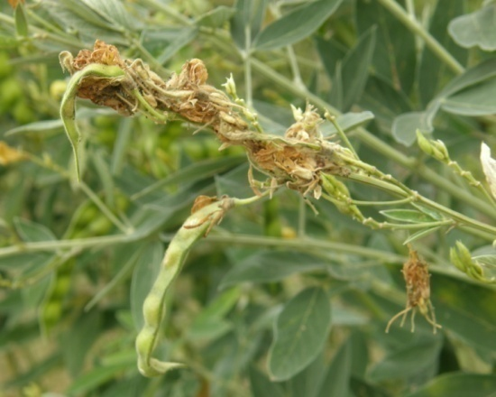
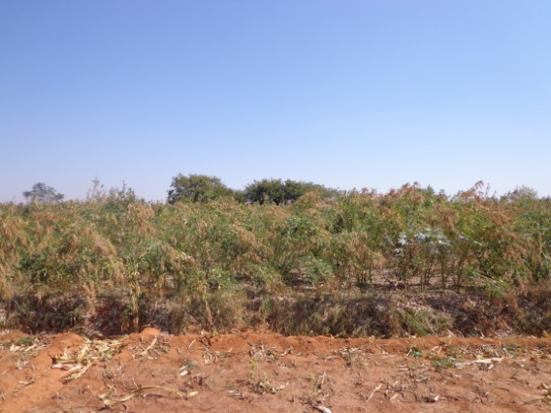
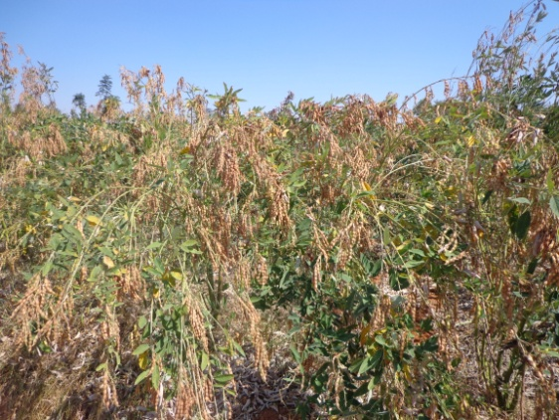
Integrated Crop Management in Red gram
FLD 9
Problems : Leaf webber, Pod borer & low yield.
Area : 8122 ha.
Area affected: 3700 ha.
Source: UAS B
Technology Intervention
FYM – 7.5 t./ha., RDF – N:P:K – 25:50:25, Zinc sulphate- 15 kg, Gypsum – 150 kg/ha.
Bio inputs: Trichoderma 5 g/kg seeds, Rhizobium – 500 g per ha. PSB – 500 g per ha
IPDM measures
Critical inputs:
Inputs | Area(ha) | Quantity | Amount (Rs.)
Seeds | 2 ha. | 30 kg | 2700
Trichoderma |  | 200 g | 20
Rhizobium |  | 1 kg | 100
PSB |  | 1 kg | 100
Pheromone traps |  | 20 No. | 600
Lures |  | 60 No. | 1800
HaNPV |  | 1.5 l | 3450
Total |  |  | 8770
Parameters to be studied:
No. of larva per plant, No. of pods per plant, Yield

Slide 21
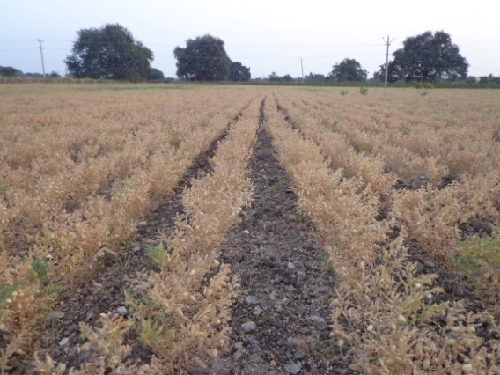
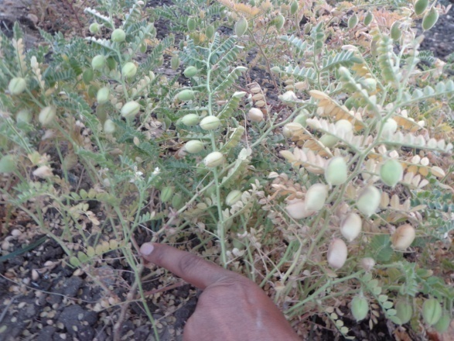
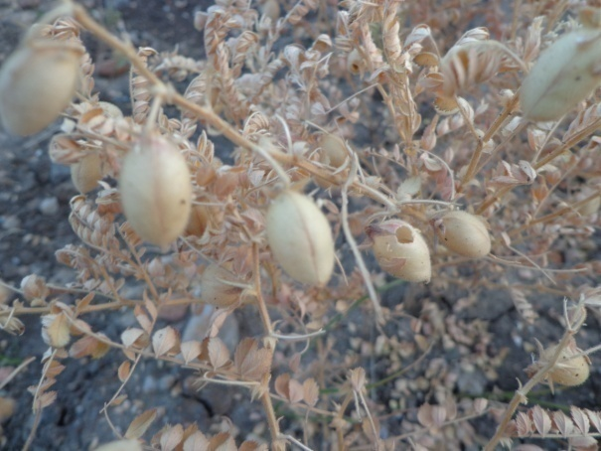
Integrated crop Management in Bengal gram
FLD 10
Problems : Pod borer ,Wilt and low yield.
Source: UAS B
Area : 21914 ha.
Area affected: 7800 ha.
Technology Intervention
FYM – 7.5 t./ha., RDF – N:P:K – 13:25:25,
Bio inputs: Trichoderma 5 g/kg seeds, Rhizobium – 500 g per ha. PSB – 500 g per ha
JG-11 variety and IPDM measures
Critical inputs:
Inputs | Area (ha) | Quantity | Amount (Rs.)
JG-11 Seed | 2 ha. | 125 kg | 9375
Trichoderma |  | 1 kg | 100
Rhizobium |  | 1 kg | 100
PSB |  | 1 kg | 100
Pheromone traps |  | 20 No. | 600
Lures |  | 60 No. | 1800
HaNPV |  | 1 l | 2300
Total |  |  | 14375
Parameters to be studied: No. of pods per plant,
No. of larva per plant, Yield

Slide 22
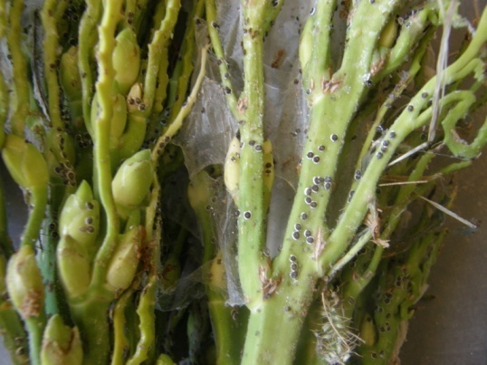
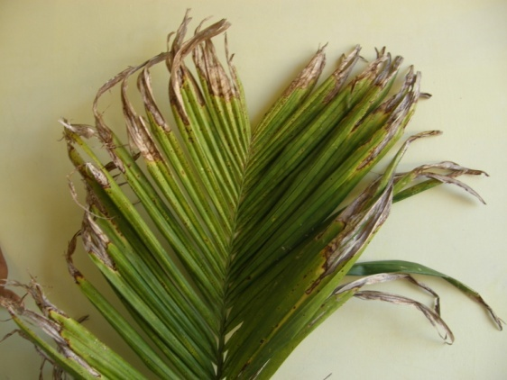
Integrated crop management in Arecanut
FLD 11
Problems : Yield loss due to imbalanced nutrient management, incidence of spindle bug, scales, mites and leaf spot disease in Areca nut
Source:UASB
Area : 20000 ha.
Area affected:7500 ha.
Technology to be demonstrated
Technology Intervention
FYM – 20 kg/tree, RDF – N:P:K – 100:40:140 g per tree, Borax – 20g./tree
Bio inputs: Trichoderma viridae 50 g/tree
IPDM measures
Critical inputs:
Inputs | Area (ha) | Quantity | Amount (Rs.)
Trichoderma viridae | 2 ha. | 10 kg | 1000
Dicofol 18.5 EC |  | 7.5 l | 3000
Dimethoate 30 EC |  | 5 l | 2000
Mancozeb 75 WP |  | 5 kg | 2000
Total |  |  | 8000
Parameters to be studied:
No. of mites per 2 sq. cm. area, No. of bugs/ plant,
No. of scales per leaf, Percent disease incidence & Yield

Slide 23
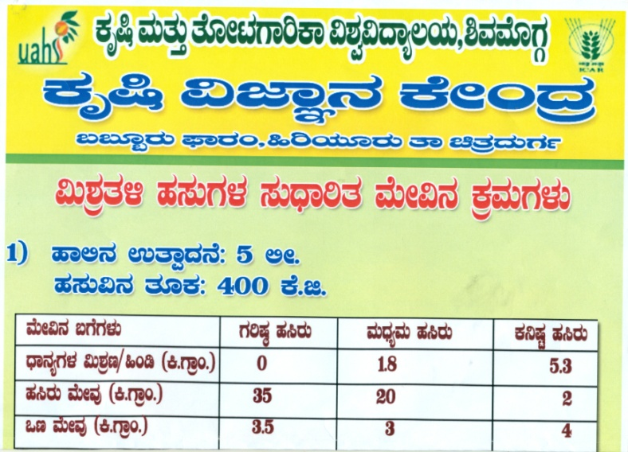
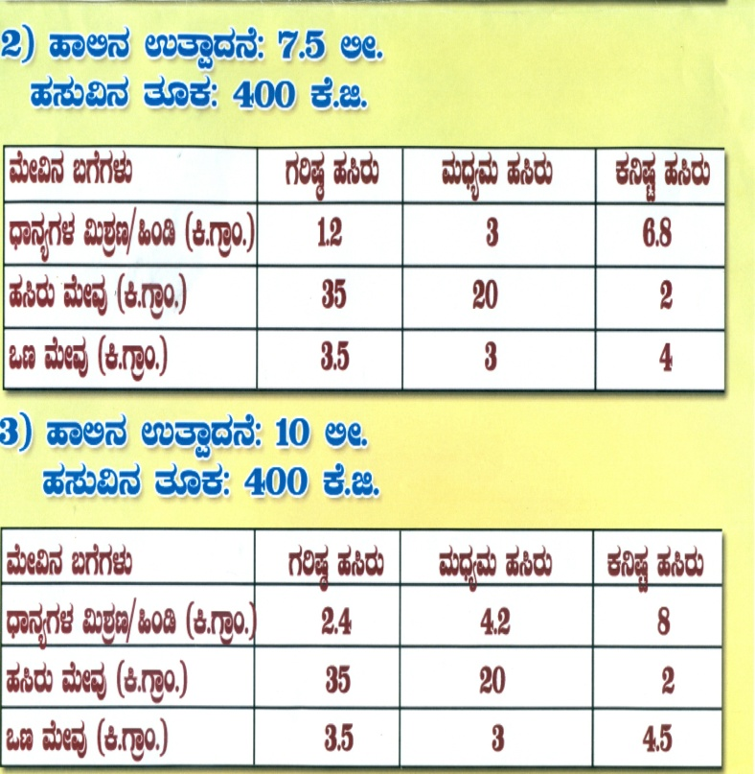
Demonstration on balanced feed formulation for cross breed cattle
FLD 12
Proiterised problem:
Non availability of good quality and quantity fodder
Imbalanced nutrition feeding to livestock
Economic and Balanced feed for enhancing milk yield
Source: NIANP, Bengaluru
Population : 2,56,000
Technology Intervention | Area (ha) | No of trials | Critical Inputs | Cost/ unit | Total cost
Introduction of new fodder varieties Dry fodder Mineral mixture balanced Feed concentrates RDF application | 0.5 | 5 | COFS 29 Concentrate feed dry fodder Mineral mixture | 3,648 | 18,240
Parameter to be Recorded: Milk yield, Fat content , Palatability

Slide 24
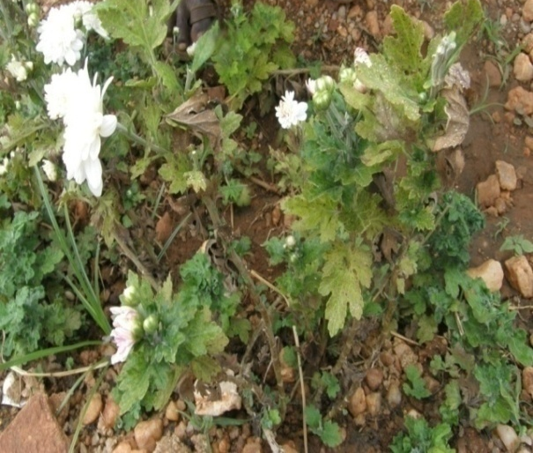
Integrated Crop Management in Chrysanthemum
FLD 13
Prioritized problem
Imbalanced nutrient management
Flower malformation, sucking pest , bud borer and leaf blight
Source: UAS B
Area(ha): 510
Area affected (ha) :275
Technology to be demonstrated
Soil test based RDF,
FYM-25 t/ha
Micronutrients: Soil application of ZnSO4and Borax
Use of Bio-inputs: Soil application of Trichoderma, PSB, Pseudomonas
Chemical spray of Methyl parathion 1ml/l and chlorothalonil 2g/l.
Parameters to be Studied
No. of flower picking, flower yield / ha, incidence of pest & diseases, B:C Ratio
Critical Input | Area | Qty per Demo (kg) | Cost per Demo | No. of Demo | Total cost for the Demo (Rs.)
ZnSO4 Borax PSB, Pseudomonas, Trichoderma, | 1ha | 4 1 4 4 4 | 1,600 | 5 | 8,000

Slide 25
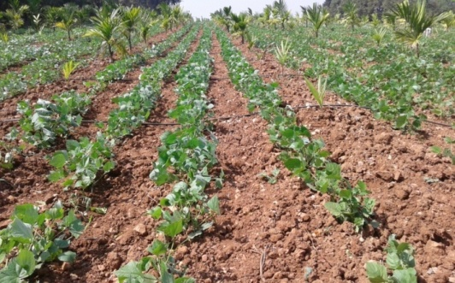
Demonstration of Hebbal Avere-4 as an intercrop in Arecanut
FLD 14
Prioritized problem:
Mono cropping
Depletion of soil fertility
Weed Problem
Area: 20,757 ha
Technology to be demonstrated:
RDF, FYM 15 t/ha
Demonstration of Hebbal Avare-4 intercrop in Arecanut at 45 cm x 15 cm
Use of Bio-inputs: Soil application of Trichoderma, PSB
Critical Input | Qty per Demo | Cost per Demo(Rs.) | Total cost for the Demo (Rs.)
Hebbal Avara-4 seed | 6 kg | 900 | 4500
Area : 2ha
Source: UASB
No of Demo:05
Parameters to be recorded:
Pre and post harvest soil status, Weed count/sq m , Sole crop yield and intercrop yield, CEY

Slide 26
Entrepreneurship Development Programme

Slide 27
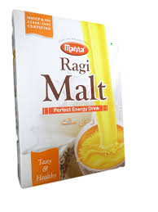
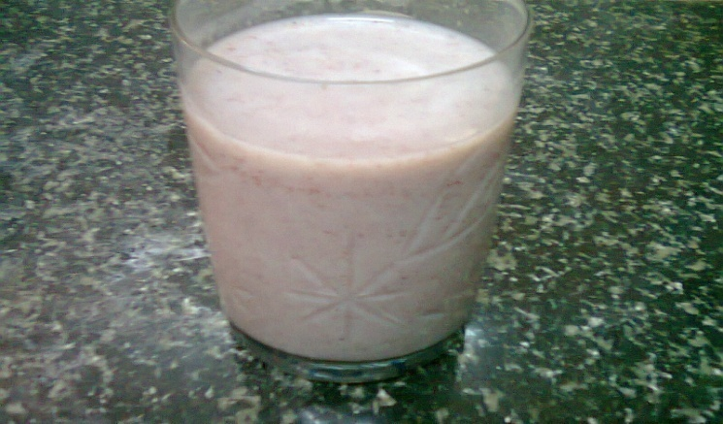
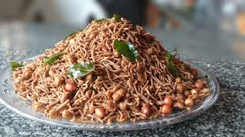
Branding and Market Linkages to Finger millet Value Added Products under EDP mode
Prioritized problem :Low income due to Lack of knowledge on processing , value addition and Branding
Source: UAS(B) and FSSAI, 2006
Technology to be demonstrated
Method Demonstration on Preparation of Finger Millet Mixture and Malt.
Branding, Nutrition Labeling, packaging and Registration under FSSAI .

Slide 28
Integrated Farming System

Slide 29
Integrated Farming System Demonstration
Prioritized problem
Low & unsustainable income realization due to lack of knowledge on Integration of Farming System
Inefficient Utilization of Bio- Resources
Mono cropping
Limited allied enterprise combination
Location specific demonstration
Area : 0.4 ha
No of Demo: 05
Technology Intervention | Critical Inputs | Cost
Introduction of new Ragi variety ML 365 Introduction of new fodder variety Introduction of floriculture Apiculture Azola unit Fishery Vermicompost unit Multi purpose trees Mineral mixture | Ragi variety ML 365 Flower crop Apiculture Azola unit Fishery Vermicompost unit Multi purpose trees Grafts Mineral mixture Others | 50,000
Parameter to be Recorded:
Cost of Production, Efficient Utilization of Bio- Resources, BC Ratio

Slide 30
FARMER FIELD SCHOOL

Slide 31
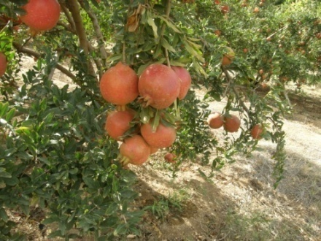
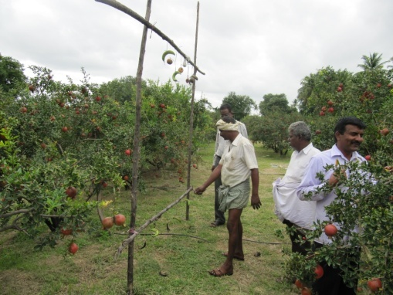
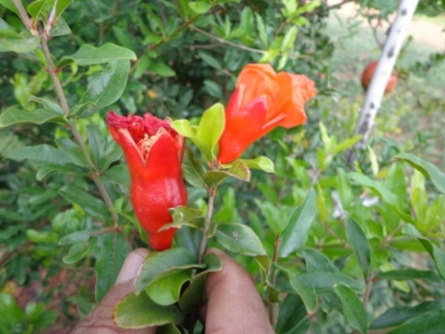
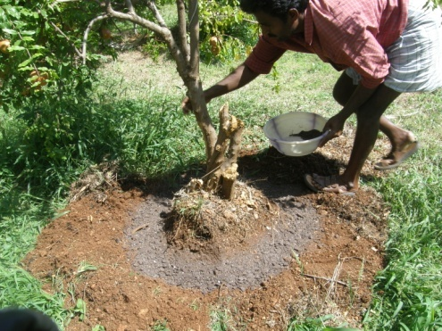
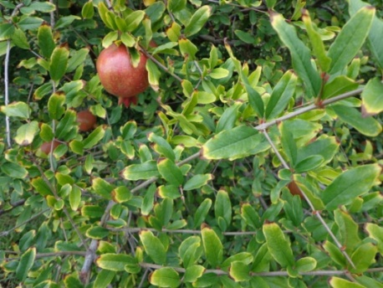
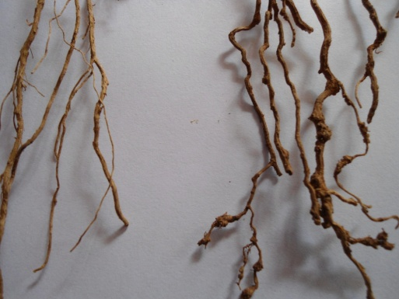
Nutriment management and Plant Protection in Pomegranate
Crop : Pomegranate
Place: Kodihally, Hiriyur taluk
Sl. No. | Session schedule
1 | Site selection
2 | Ballot box test
3 | Soil and water quality analysis
4 | Nutrient management through fertigation
5 | Management of Pomegranate under sodic soils
6 | Use of bioinputs
7 | Pruning techniques
8 | Bahar treatments
9 | AESA
10 | Pest management
11 | Disease management
12 | Market dynamics
LTE:T1: Fertigation, T2: Soil application, T3:Farmer Practice

Slide 32
Innovative Programme of KVK
Problems:
Sodic soils and sodic underground water in Hiriyur taluka
Around 2300 ha of land is affected due to such causes.
Lack of awareness on management of sodic soils and poor quality water
Imbalanced application of nutrients
Process:
Soil Test based fertilizer recommendation for crops
Mapping of the soil fertility status through GIS
Ground water quality assessment and preparation of GIS map and recommendations
Issue of Fertilizer Recommendation cards to farmers

Slide 33
Front Line Demonstrations proposed for 2015-16 under NFSM
Sl.No | Name of the Crop | Variety | Technology | Village/Taluk | No of demo plots | Budget per demo(Rs.) | Total (Rs.)
1 | Redgram | BRG-2 | Integrated Crop Management | Taluku , Challakere | 10 | 3000 | 30000
2 | Bengal gram | JG -11 | Integrated Crop Management | Ghananayakanahally, Hiriyur | 10 | 3000 | 30000
3 | Millets | ML-365 | Introduction of variety and ICM | Karehally Hosadurga | 10 | 2000 | 20000
4 | Cotton | Bt Cotton | Integrated Crop Management and sodic soil management | Pampapura, Holalkare | 10 | 2800 | 28000
Total |  |  |  |  | 40 |  | 1,08,000

Slide 34
Training Programmes

Slide 35
Training for Farmers/ Farm women
Sl No. | Name of the on campus Training
Crop Production
1. | High yielding green fodder varieties for increased milk yield
2. | Higher yield through ICM in groundnut
Soil Science and Water Conservation
1. | Micro nutrient management in banana and onion
2. | Management of salt affected soil
3. | Water quality and its management for horticulture crops
4. | Nutrient management through fertigation in pomegranate
Home Science
1. | Higher income through value addition of millet
2. | Terrace gardening for nutrition security
Plant Protection
1 | Integrated pest and disease management in Bengal gram
2 | Bacterial disease management for quality fruits production
3 | Integrated management of pest and diseases in Areca nut for higher nut yield

Slide 36
Contd..
Sl. No. | Title of the Training
Horticulture
1 | Balanced nutrition and pest/disease management for higher bulb yield
2 | Balanced fertigation in watermelon for higher yield
3 | Pruning techniques and IPDM practices in Pomegranate for quality fruits production
Capacity Building
1 | Market led Production System
2 | Commercial dairy farming
3 | Livelihood security through IFS
4 | Access To Advanced Market information through Web Based Extension Channels

Slide 37
Training for Rural Youth
Sl. No. | Title of the Training
1. | Seed production aspects in onion for higher income/returns
2. | Bio inputs in quality fruit production
3. | Mushroom cultivation for self employment generation
4. | Apiculture as subsidiary activity
Vocational and Sponsored trainings
Sl. No. | Title of the Training
1. | Skill development in Horticulture for self employment
2. | Bakery training for self employment generation
3. | FOCT- Palm climbing and plant protection

Slide 38
Training for Extension Personnel
Sl. No. | Title of the Training
1. | Recent Agronomic practices in Finger millet production
2. | Information Communication Technology and Programme Planning and Management
3. | Protected cultivation of capsicum under shade nets for quality production
4. | Integrated pest and disease management in agricultural crops
5 | Integrated pest and disease management in horticultural crops
6 | Nutrition education with special reference to mother
7 | Micro nutrient management in banana and onion
8 | Management of salt affected soil
9 | Water quality and its management for horticulture crops
10 | Nutrient management through fertigation in pomegranate

Slide 39
Off Campus Training
Sl No. | Name of the off campus Training
Crop Production
1. | Improved agronomic practices for fodder production
2. | Integrated crop management in groundnut
3. | Improved production practices in finger millet production
Horticulture
1. | Improved onion cultivation practices
2. | Seed production techniques in onion
3. | Improved production techniques in pomegranate
4. | Cropping system in Arecanut
5. | Improved production technology in watermelon
Plant Protection
1. | Integrated Management of pod borer in Redgram
2. | Management of spindle bug in Arecanut
3. | Management of diseases in Groundnut
4. | Preparation of NSKE for pest management
5. | Management of diseases in Banana

Slide 40
Contd..
Sl No. | Name of the off campus Training
Home Science
1. | Management of Diabetes through diet
2. | Processing and value addition in millets
3. | Processing and value fruits and vegetables
4. | Role of terrace gardening
Capacity Building
1. | Integrated Farming System Development
2. | lack of awareness on ICT tools Access To Advanced Market information through Web Based Extension Channels

Slide 41
Extension Programme/ Activity
Extension Programme/ Activity | No. of programmes or activities | Expected number of participants
Advisory Services | 50 | 25000
Diagnostic Visits | 24 | 24
Field Day | 19 | 950
Group Discussions | 29 | 800
Kisan Gosthi | 10 | 450
Film Show | 10 | 500
Self -Help Groups | 5 | 150
Kisan Mela | 3 | 15000
Exhibition | 6 | 500000
Scientists' Visit to Farmers Field | 50 | 150
Plant/Soil Health/Animal Health Camps | 2 | 160
Farm Science Club | 5 | 65
Ex-Trainees Sammelan | 10 | 450
Farmers' Seminar/Workshop | 6 | 1000
Method Demonstrations | 28 | 900
Celebration of Important Days | 5 | 650
Special Day Celebration | 5 | 700
Exposure Visits | 12 | 400
Technology Week | 1 | 250
Farmers Field School (FFS) | 1 | 25
Farm Innovators Meet | 1 | 25
Awareness Programs | 2 | 500

Slide 42
Extension Literatures
Nutrient Management in Banana
Management of Salt Affected soils and poor quality waters
Tank Silt Management
Pomegranate production technologies
Management of diabetes mellitus
Processing and value addition of maize
Drudgery reduction tools in agriculture
Low cost nutritious diets
IPDM in Bengal gram
Improved Agronomic practices maize production
Central and State Government Schemes in Agriculture and Allied Subject
Clean Milk Production

Slide 43
Demonstration Units
Category | Details of technologies
Crop cafeteria | Onion varieties demonstrations
Units | Vermi-composting
 | Azolla
 | Nursery
 | Millet Processing
 | Piggery
Lab Analytical Services | Soil and water analysis
 | Plant Health Clinic

Slide 44
Technological Products
Category | Name of the Product | Quantity (q)
Seeds | Bhima Super onion variety | 10.00 (Certified seeds )
 | Foxtail millet | 10.00
 | Chick pea | 20.00
 | Red gram | 25.00
 | Same, Baragu, Araka, Korle and Bajra. | 01.5
Planting materials | Sapota Cricket ball grafts, | 1000 No.
 | Mango Mallika grafts | 1000 No.
 | Drumstick seedlings | 2500 No.
Bio Agents | Pseudomonas | 15.00 q
 | Trichoderma | 05.00 q

Slide 45
Innovative farmers meet
Plan of activities
General Details
Identification and Documentation of outstanding Innovations made by farmers
Farmer to farmer interaction
Farmers to scientists interaction
Assistance to patent
Identifying and Creating social Identity to the innovators
Involvement of them in Extension Activities
Technology dissemination through print and electronic media
Coverage Area: Chitradurga District
Farmers Type: Innovative Farmers
Expected Number: 25
Month of Meet: May
Budget : Rs. 25,000

Slide 46
Village adoption for sustainable resource management
Transfer of Agriculture Technology
Demonstrations on IFS
Post harvest and Value addition
Water Management
Wasteland management
Land use systems
Animal health
Children and women health
Awareness on Farm Mechanization to school children

Slide 47
Details of Budget Estimate (2015-16) based on proposed action plan
Sl.No. | Particulars | BE 2015-16 proposed (Rs.)
25.1 | Recurring Contingencies
25.1.1 | Pay & Allowances | 10350000
25.1.2 | Traveling allowances | 275000
25.1.3 | Contingencies
A | Stationery, telephone, postage and other expenditure on office running, publication of Newsletter and library maintenance (Purchase of News Paper & Magazines) | 450000
B | POL, repair of vehicles, tractor and equipments | 375000
C | Meals/refreshment for trainees (ceiling up to Rs.75 for on campus and Rs. 40/- for off campus/trainee be maintained) | 250000
D | Training material (posters, charts, demonstration material including chemicals etc. required for conducting the training) | 200000
E | Frontline demonstration except oilseeds and pulses (minimum of 30 demonstration in a year) | 140090
F | On farm testing (on need based, location specific and newly generated information in the major production systems of the area) | 2260
G | Training of extension functionaries | 50000
H | Maintenance of buildings | 275000
I | Library | 20000
J | IFS | 25000
K | Extension activities | 145000
L | Entrepreneurship Development Programme | 23000
M | FFS | 50000
25.1 | TOTAL Recurring Contingencies | 12630350
25.2 | Non-Recurring Contingencies
25.2.1 | Works (Staff Quarters) | 20450000
25.2.2 | Equipments including SWTL & Furniture | 600000
25.2.3 | Vehicle (Four wheeler: Jeep) | 1400000
25.2.4 | Library (Purchase of assets like books & journals) | 100000
25.2 | TOTAL Non-Recurring Contingencies | 22550000
25.3 | GRAND TOTAL | 3,51,80,350

Slide 48
KVK Farm plan for the year 2015-16
Sl. No. | Particulars | Area (ha)
1 | Integrated Farming System (Agri-Horti-Silvi-Pastoral and Animal Husbandry) | 1
2 | Seed production (BRG-2, JG-11) | 4
3 | Horti-forestry (Curry leaf+ Teak+ Mango) | 2
4 | Rain water harvesting | 1
5 | Chilli seed production | 3
6 | Demo plots (onion raised bed, Castor, Safflower, Chickpea and Millets) | 7
7 | Nursery ( Sapota Grafts, Drumstick, Citrus (lemon) and Curry leaf seedlings | 1
8 | Infrastructure ( Administrative building, Farmers Hostel, Ware house and Quarters) | 1
Total Area |  | 20

Slide 49
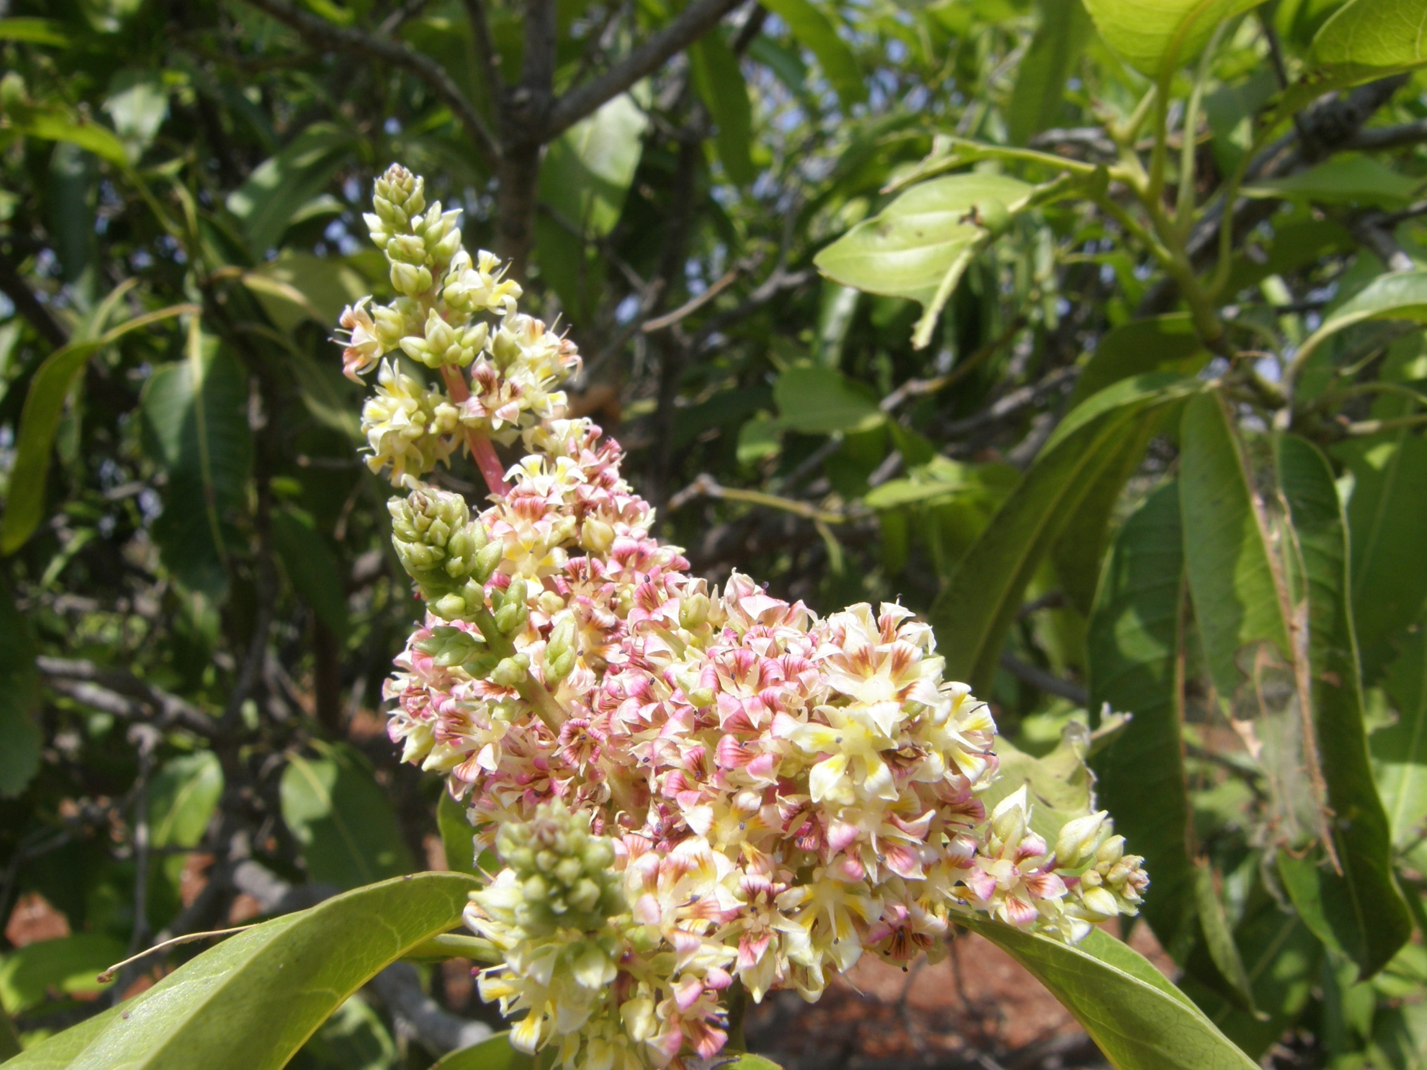
Thank You

Slide 54
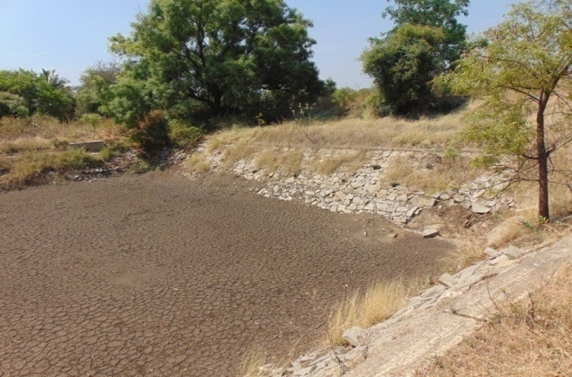
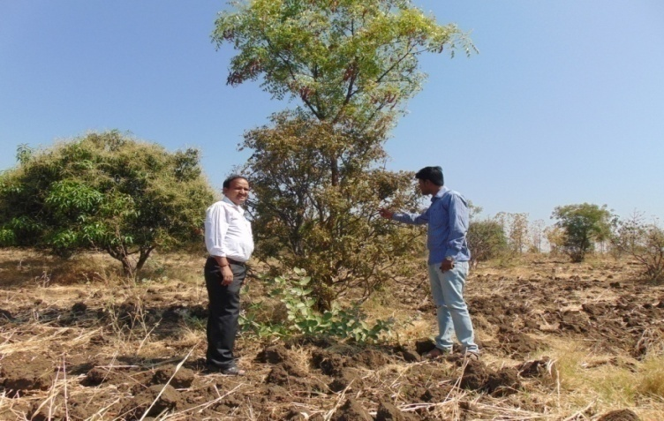
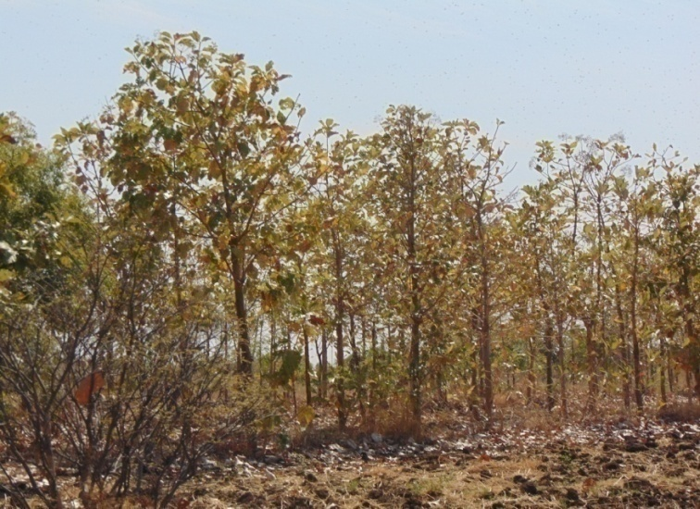
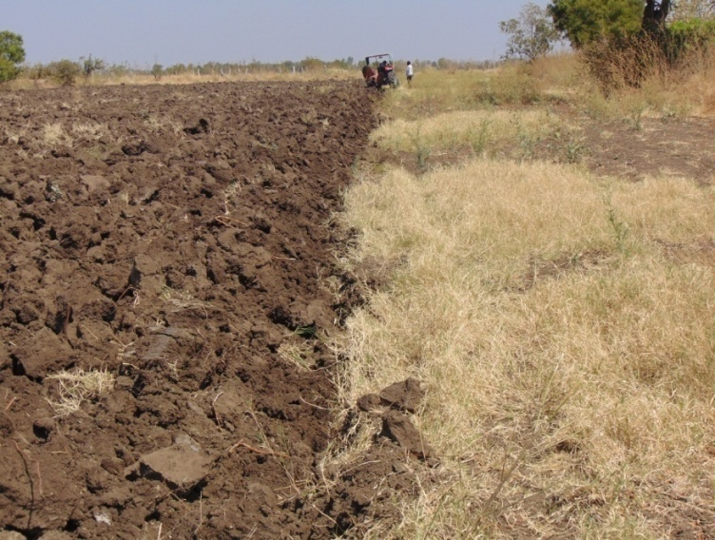
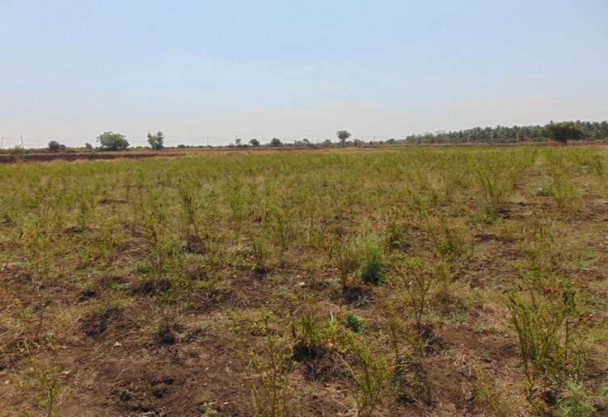
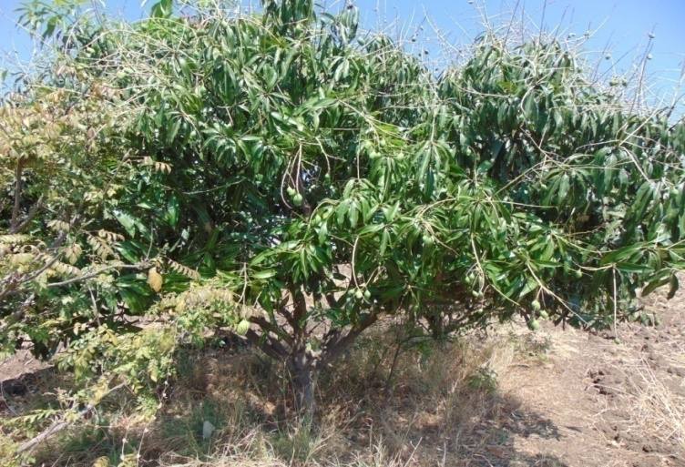
KVK Farm

Slide 55
Rainfall during 2014 compared with Normal at Babbur farm, Hiriyur
 | JAN | FEB | MAR | APR | MAY | JUN | JUL | AUG | SEP | OCT | NOV | DEC | TOTAL
Normal | 33.35 | 3.93 | 6.23 | 26.8 | 79.8 | 54.8 | 46.2 | 57.8 | 134 | 116 | 33 | 7.58 | 569
2014 | 0 | 0 | 0 | 14.6 | 87.6 | 32.8 | 86 | 184 | 68.2 | 313 | 65.4 | 0 | 852
% Deviation | -100 | 25 | 50 | 107 | -31 | -31 | -60 | -72 | 161 | -45 | -100 | -100 | 7

Slide 56
Weather report for 2014

Slide 57
Significant Achievements
Introduction of BRG 2 in pigeon pea & DCS-9 in castor, wilt resistant Chickpea variety JG -11
Nutrient management in banana, citrus and mango
Participatory Seed Production of onion Arka Kalyan variety
Farm Mechanisation: Tractor drawn seed cum fertiliser drill in groundnut, cycle weeder, coconut climbing machine
ICM in Bt Cotton
Introduction of Fodder varieties: CO-3,COFS-29
Compost production
Value addition, branding and marketing of millets through SHG

Slide 58
Expectations
Proposed cluster of KVKs to be formed for sharing knowledge/expertise, resources and activities
SHIVAMOGGA
DAVANGERE
TUMKUR
KVK
Chitradurga
Dairy Management and Fish cultivation
SHG Formation and Strengthening Effective Management
Improved Maize Production Technology
Documentation and Presentation
Micronutrients
Seeds/Planting materials
Intend to share
INM in Banana
PHT of Millets
INM in Cotton
IPM in Coconut

Slide 59
Revolving Fund
Opening balance as on 01.04.2014 (Rs.in Lakh) | Expenditure incurred during 2014-15 (Rs.in Lakh) | Receipts during 2014-15 (Rs.in Lakh) | Closing balance as on 31.01.2015 (Rs.in Lakh) | Expected closing balance by 31.03.2015 (Including value of material in stock/ likely to be produced)
11.11 | 5.30 | 5.88 | 11.70 | 12.85

