Slide 1
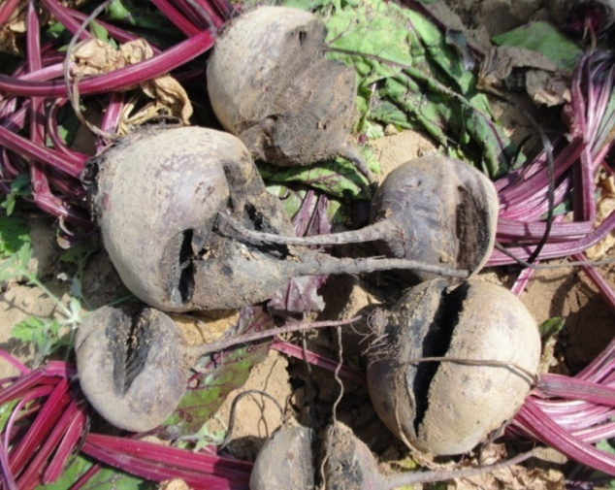
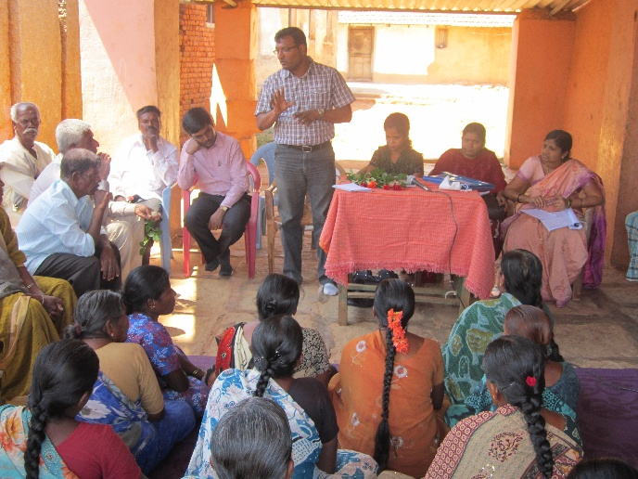
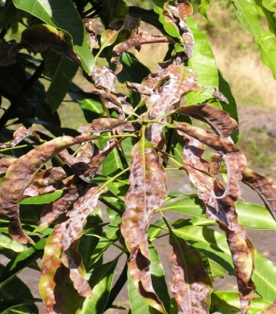
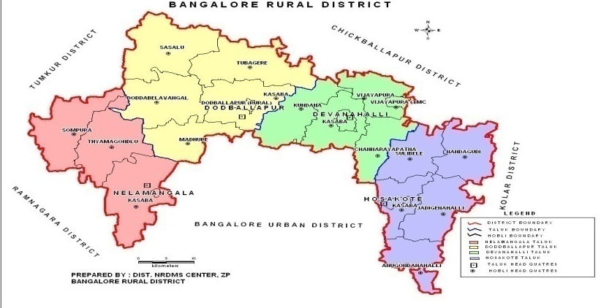
Krishi Vigyan Kendra
Bangalore Rural District
Action Plan 2014-15
Presentation by
Dr. K. N. Srinivasappa
Programme Coordinator

Slide 2
KRISHI VIGYAN KENDRA, BANGALORE RURAL
District Features
Agro-climatic zone | Eastern Dry Zone
No. of Taluks | 04
No. of Villages | 1,980
No. of Holdings | 1,60,483
Gross Cropped Area (ha) | 1,30,519
Area under irrigation (%) | 21.44 % 27,980 ha
Sources of irrigation | Tanks, Bore well
Major Soil Types | Medium deep, red clayey soils Deep lateritic clayey soils
Major crops in Kharif | Finger millet, Redgram, Maize, Groundnut, Sunflower, Vegetables, Banana, Field bean
Major crops in Rabi | Maize, Groundnut, Chickpea, Vegetables, Banana, Horse gram
Major Perennial Crops | Grapes, Mango, Jack, Sapota, Rose, Drumstick, Fodder, Arecanut
Major Livestock | Cattle, Buffaloes, Sheep, Goats, Pigs, Poultry

Slide 3
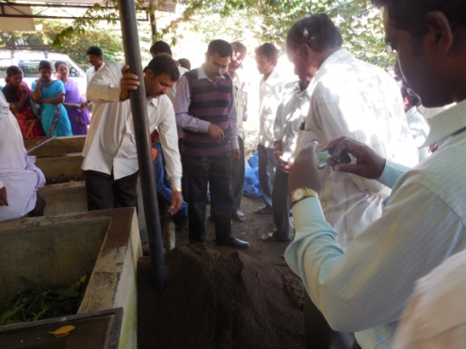
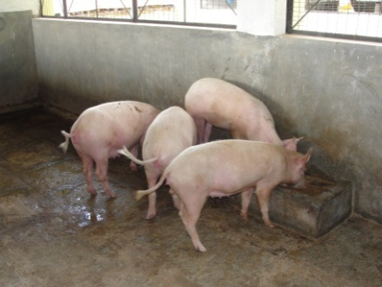
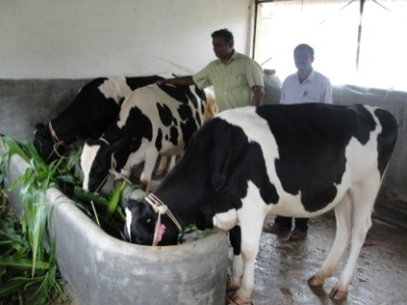
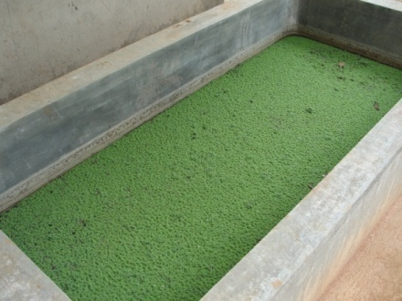
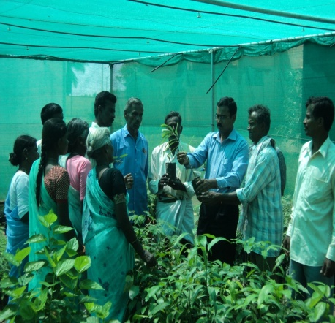
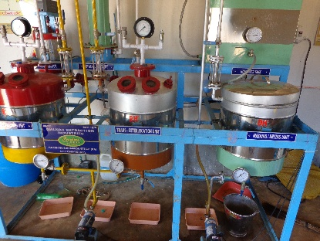
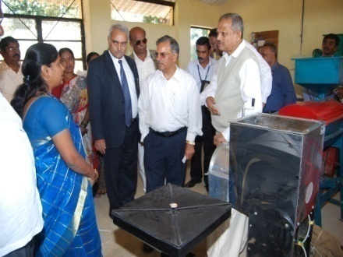
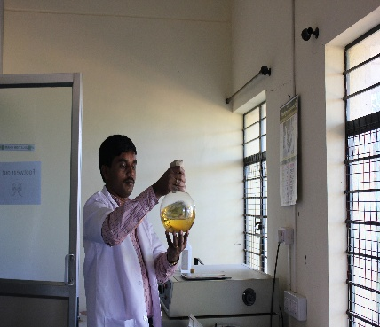
KVK Manpower and facilities
Manpower PC No. of SMSs in position No. of Programme Assistants in position Supporting staff | 01 06 03 04
Farm details Total Area (ha) Cultivated Area (ha) | 21.28 13.67
Demonstration Units 1. Vermicomposting Unit Piggery Unit Dairy Unit Fodder Unit Azolla Unit Model Horticulture Nursery I&D Centre on Biofuel Millet Processing Unit | 18 m² 58 m² 53 m² 0.2 ha 3.5 m² 720 m² 80 m² 51 m²
Production Units Bio control Agents Unit Vegetable Special Unit | 60 m² 40 m²
Laboratories 1. Soil & Water Testing Laboratory 2. Plant Health Clinic | 50 m² 30 m²
Vermicomposting Unit
Piggery Unit
Dairy Unit
Azolla Unit
Model Horticultural Nursery
I & D Centre on Biofuel
Millet Processing Unit
Bio control Agents Unit

Slide 4
Details of OFTs for the KVK
Title | No. of trials | Treatments | Budget (Rs.)
Assessment of Bengal gram variety for wilt and drought resistance | 05 (1 ha) | T1- A-1 – UAS, Dharwad (1990) T2-JG-11 – JNKVV, Jabalpur (2003) T3-JAKI-9218 – JNKVV & ICRISAT (2009) | 13000
Assessment of Multi-cut Fodders for yield and quality | 05 (0.4 ha) | T1- Napier grass (NB-21) – PAU, Ludhiana (1988) T2-Hybrid Bajra Napier (Co-3) – TNAU, Coimbatore (2001) T3-BH-18 – UAS, Bangalore (1998) T4-Dharwad Hybrid Napier (DHN-6) – IGFRI, Regional station – Dharwad (2011) | 30000
Assessment on Management of Late Blight in Potato | 05 (2 ha) | T1- Mancozeb (0.2%), Dimethomorph (0.1%) + Mancozeb (0.2%), CoC(0.3%), Fenamidone + Mancozeb Metalaxyl + Mancozeb (0.2%), Cymoxanil + Mancozeb (0.3%), Copper Hydroxide (0.2%), Propineb (0.2%), Chlorothalonil (0.2%) T2-Prophylactic Mancozeb (0.2%) 2 times Dimethomorph + Mancozeb (0.2%) Cymoxanil + Mancozeb (0.3%) (UHS, Bagalkot, 2009) T3-Soil application of Trichoderma and Pseudomonas, Prophylatic–Mancozeb (0.2%), Fenamidone+mancozeb(0.3%) Cymoxanil + Mancozeb (0.3%) (CPRI, Shimla, 2011) | 36800

Slide 5
Details of OFTs for the KVK
Title | No. of trials | Treatments | Budget (Rs.)
Effective management practices of panama wilt in Banana | 05 (1 ha) | T1- Soil drenching with carbendazim@1 gm/lt T2-Rhizome injection with 2% carbendazim @ 10 ml/plant (bimonthly) (UHS, Bagalkot, 2009) T3-Soil drenching with 0.2% carbendazim during 2nd and 5th month after planting followed by application of Trichoderma viridae and Pseudomonas fluroscens @30g/plant during 4nd and 6th month (NRC Banana, 2010) | 21500
Arecanut Intercropping Systems for Additional Remuneration | 05 (1.5 ha) | T1- Mono cropping T2-Arecanut + Cowpea (Rabi) (UHS, Bagalkot, 2008) T3-Arecanut + French bean ( Arka Suvidha) (CPCRI, 2010) | 23600
Standardization of Fertilizer Requirement in Pole Bean | 02 (0.4 ha) | T1-300:215:00 kg/ ha T2-93.75:125:112.5 kg/ ha (150% N & K and 125% P of RDF for French Bean (RDF:62.5:100:75 - (UASB, 2008) T3-90:100:90 kg/ ha (150% N & K and 125% P of RDF for French Bean (RDF:60:80:60 - IIHR, 2012) | 4900

Slide 6
Details of OFTs for the KVK
Title | No. of trials | Treatments | Budget (Rs.)
Suitability and Acceptability of Underutilized Greens for Nutrition Security | 01 (1 SHG) | T1- No adoption T2- Poustik Roti with fenugreek leaves (UASD, 2004) T3-Selection of underutilized greens (Beetroot, Knol khol, Carrot, Cauliflower, Radish) (SAU, Udaipur,2010) Processing of greens (blanching & drying) Product development (RTP products– Idli mix, Dosa mix and Upma mix), Bakery products (Bread, Biscuits, Soup stick) Consumer acceptability through organoleptic evaluation, Analysis of nutrients and storage study | 13000
Efficacy of Different Education Methods to Combat Anemia among Adolescent Girls | 01 (40 adole scents) | T1- Midday meal + Iron and Folic acid Tablets (given in School) T2- T1+Additional teaching and extension materials (Anganwadi Scheme, DWCW, 2010) T3- T1+ Method demonstration on preparation of enriched foods using local resources (UASD, 2004) (Education Method followed for pregnant women) T4-T1 + family counseling (mother & adolescent girl) (UASD, 2006) (Education Method followed for Diabetic women) | 14000
8 OFTs – Budget Rs.1,56,800/-

Slide 7
Details of FLDs for the KVK
Title | No. of demos | Technological Components to be demonstrated | Sources of technology component | Budget (Rs.)
Redgram variety BRG-5 for Wilt Resistance | 10 (3 ha) | Seeds, Rhizobium, PSB Sodium molybdate Sulphur, Zinc sulphate | UAS(B) (2013) | 12000
Photo Insensitive Field bean variety HA-4 for Enhanced Returns | 10 (2 ha) | Seeds PSB Rhizobium | UAS(B) (2009) | 10000
Addressing Drought and Blast Vulnerability through ML 365 Ragi Variety (2nd year) | 25 (10 ha) | Seeds Azospirillum Potash | UAS(B) (2009) | 12000
Multi Cut Fodder Sorghum Variety COFS 29 for Assured Nutrition | 10 (1 ha) | Seed materials Phorate Potash | TNAU (2008) | 7000

Slide 8
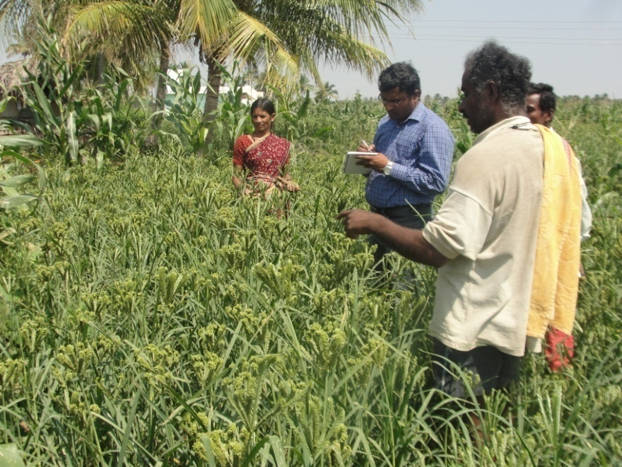
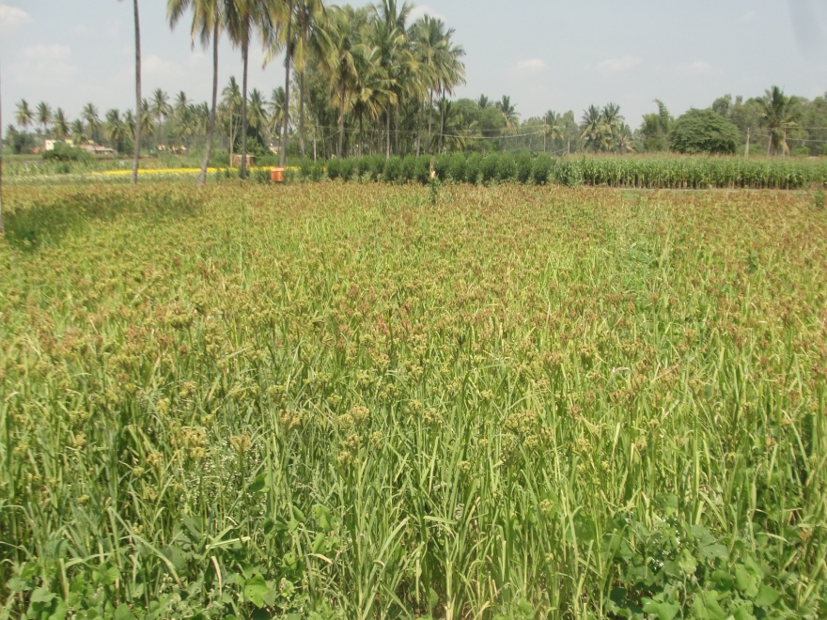
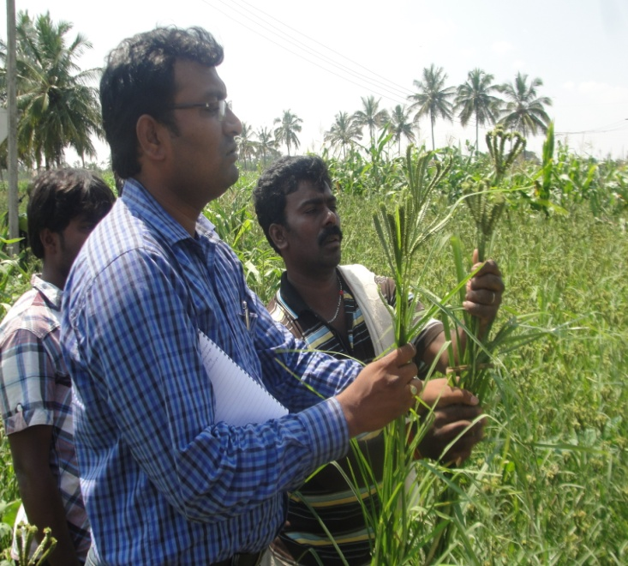
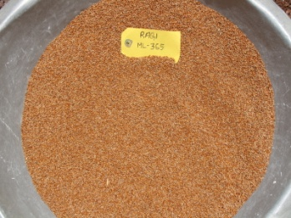
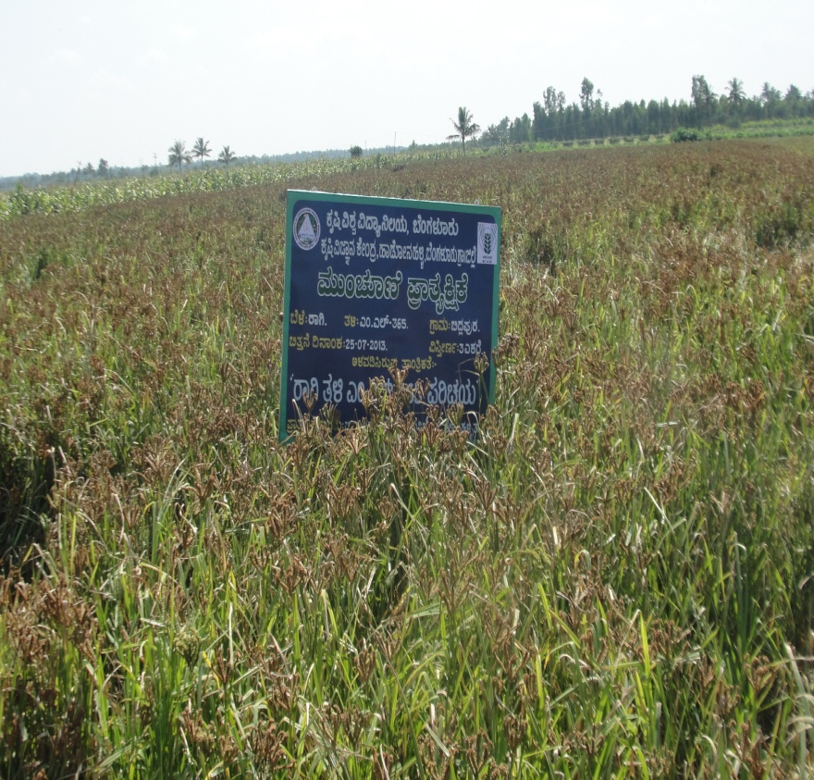
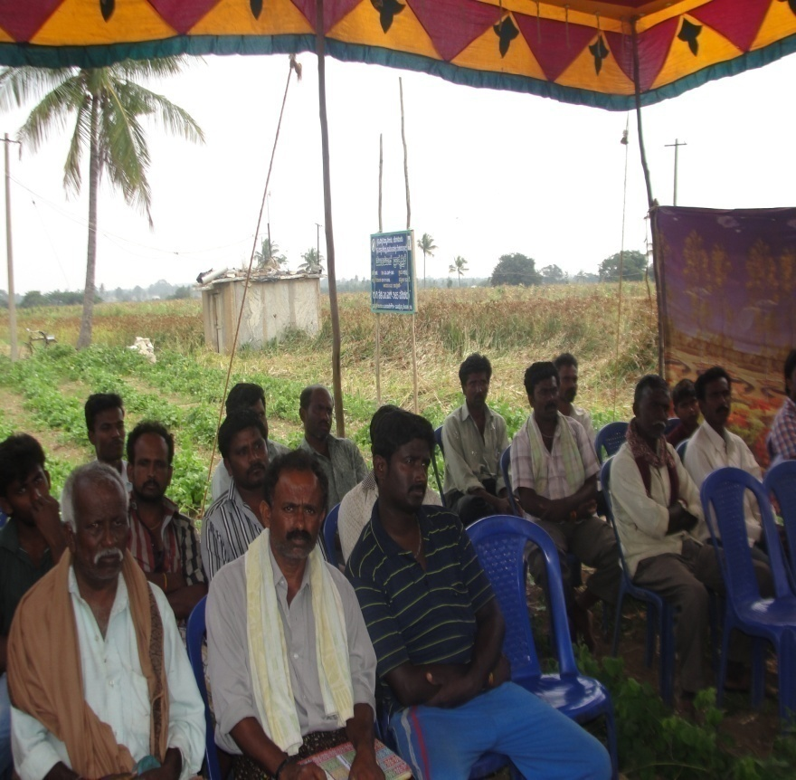
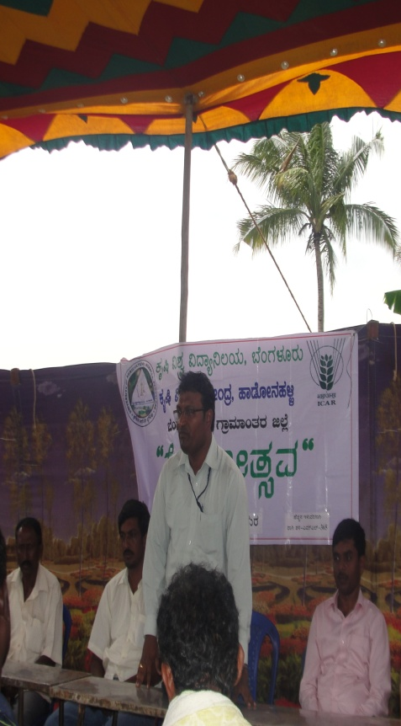
Finger millet ML 365 variety

Slide 9
Results of 1st year
Parameters | Demo Plot (ML 365) | Check Plot (GPU 28)
Germination and Establishment | 95 | 93
Plant Height cm) | 110 | 103
Days taken to 50 % flowering | 62 | 62
Productive tillers | 6 | 5
Number of Panicles | 8 | 7
Number of spikelets | 5 | 5
Grain Yield q/ha | 48.32 | 43.50
Grain Yield increase in (% & q/ha) | 9.41 % & 4.82 q/ha | -
Straw yield (t/ha) | 54.14 | 51.8
Straw Yield increase in (% & t/ha) | 4.32 % & 2.34 t/ha | -
Benefits
Grain Yield increase q/ha 4.82 x Rs. 1,800 = Rs. 8,676/-
Straw Yield increase t/ha 2.34 x Rs. 2,000 = Rs. 4,680/-
Total net income = 13,356/-
Feed back
Withstood moisture stress during grain filling stage
Uniform maturity
Straw was green even at harvest

Slide 10
Title | No. of demos | Technological Components to be demonstrated | Sources of technology component | Budget (Rs.)
Moisture Conservation and Weed Control through Plastic Mulching in Tomato (2nd year) | 05 (1 ha) | Plastic mulch film | IIHR (2010) | 30000
Eco-friendly Management of Diamond Back Moth and Black Rot in Cauliflower | 05 (1 ha) | Mustard seeds, DBM traps, Neem soap, Bt, Pongamia soap, Novaluron, Amamectin benzoate, Pesticide Residue Analysis, Copper hydroxide, Streptocycline, CoC | IIHR (2010) | 29000
Effective Management of Pests & Diseases in Mango | 10 (2 ha) | Healer & Sealer, Fruit fly traps, Imidacloprid, Lambda cylothrin, Dichlorvos, CoC, Wettable sulphur, Carbendazim | IIHR (2011) | 40000
Management of Late Blight in Tomato | 05 (2 ha) | Metalaxyl + Mancozeb Fenamidone + Mancozeb Fosetyl Al, Dimethomorph Mancozeb, Trichoderma Pseudomonas | UAS (B) (2014) | 39100

Slide 11
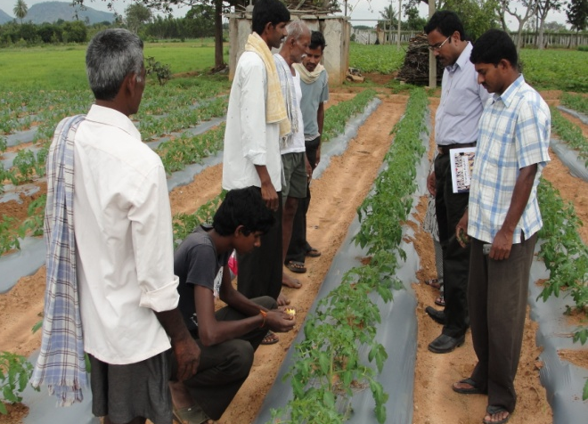
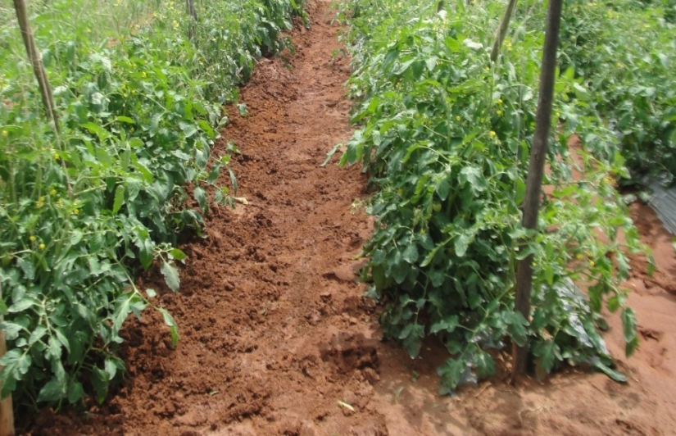
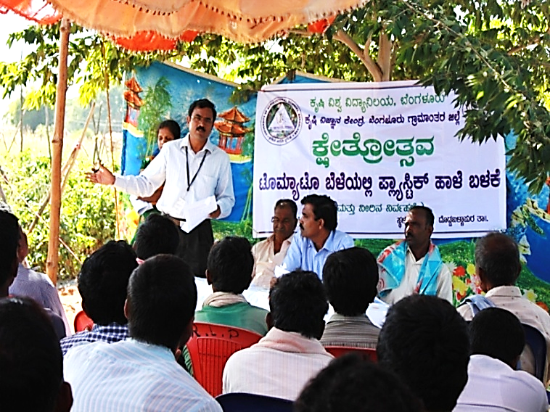
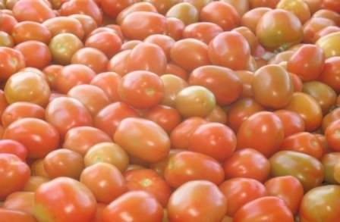
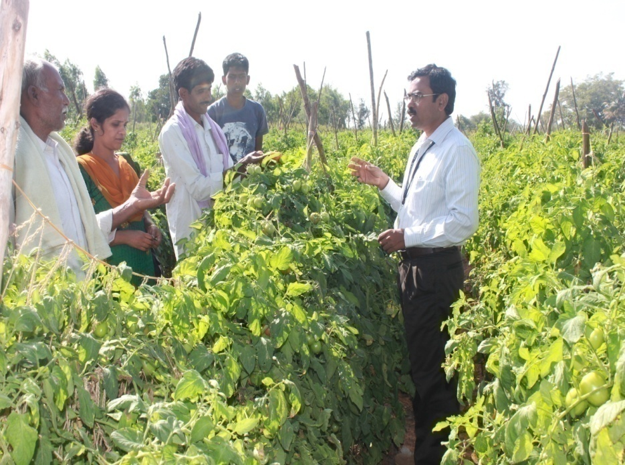
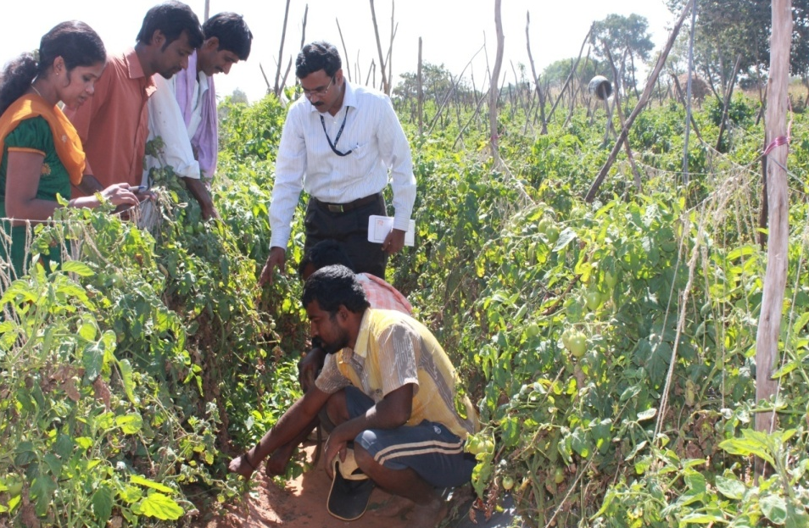
Plastic Mulching in Tomato - Activities
Cont.…

Slide 12
Results of 1st year
Parameters | Demo Plot | Check Plot | Cost of the technology/acre – Rs. 9,960/-
Plant Height (cm) | 121 | 117 | Benefits Labour saving on weeding 26 Nos. X Rs. 250 = Rs. 6,500/- Water saving 10 lakh lt @ Rs. 75/- for 3,000 lt = Rs. 25,000/- Addl. yield 2 t @ Rs. 6,000 / t = Rs. 12,000/- More crop/unit of water Two acres can be irrigated instead of one
No. of branches | 6 | 6
No. of fruits/plant | 61 | 59
Weight of fruit (gm) | 53 | 48
Weed count | 2 | 12
Labour employed for weeding | 6 | 32
% water saving | 48 | -
Yield / acre (t) | 26 | 24
B:C Ratio | 2.86 | 2.65
Treatments | N | P₂O₅ | K₂O
 | (Kg/ha)
Before | 298 | 32 | 239
After-Without Mulch (check) | 296 | 31 | 237
After-With Mulch (Demo) | 302 | 34 | 244
Feedback
Water saved (50%)
Family labour could manage weeding without external labour
Harvested more yield and good quality fruits

Slide 13
Title | No. of demos | Technological Components to be demonstrated | Sources of technology component | Budget (Rs.)
Enhancing Beetroot quality through Boron | 10 (2 ha) | Boron Urea | IIHR (2013) | 3000
Improvement of berry size and quality through Grape Special | 10 (2 ha) | Grape Special | IIHR (2013) | 6000
Quality Enhancement in Ridge gourd through AMC & Vegetable Special | 10 (2 ha) | Arka Microbial Consortia Vegetable Special | IIHR (2013) | 12000
Integrated Dairy Calf Management | 30 calves | Doramectin injection Vitamins & mineral mixture Vaccination | KVAFSU (2009) | 8550
Infertility Management in Cross Bred Dairy Animals | 15 animals | Doramectin injection Vitamin – A, Vitamin E with selenium, Curry leaves & Sprouted Horse gram | KVAFSU (2009) | 12000
Management of Foot-rot/Soft Hoof in Dairy Animals | 30 animals | Zinc sulphate, NSAID injection, OTC-LA injection, DoramectIn injection, B-complex, Herbal spray | TANUVAS (2010) | 17000

Slide 14
Title | No. of demos | Technological Components to be demonstrated | Sources of technology component | Budget (Rs.)
Nutritional intervention with Urea Molasses Mineral Block (UMMB lick) in Goats | 20 goat kids | UMMB | KVAFSU (2008) | 3000
Oral Pellet Vaccine against Ranikhet Disease in Backyard Poultry | 05 (250 birds) | Day old chicks Vaccination Deworming | TANUVAS (2011) | 6000
Vegetable Terrace Gardening for Nutrition Security | 10 | Vegetable seed kit Plastic crates Vermi compost Vegetable special Neem oil, Neem cake, Cocopeat | UAS(B) (2013) | 45000
Promotion of Fruits & Vegetable Preservator in Small Scale Institutions | 07 | Fruits & Vegetable preservator | CRIDA (2005) | 28000

Slide 15
Title | No. of demos | Technological Components to be demonstrated | Sources of technology component | Budget (Rs.)
Thresher cum pearler in Finger millet for Resource Poor farmers | 2 SHGs | Thresher cum pearler | VPKAS, Almora (2009) | 30000
Linking SHGs to markets through Maize Value Addition & Branding | 2 SHGs | Packaging materials 2 products x 1000 covers @ Rs.2 Labels - 2 products x 1000 labels @ Rs.2 Hand sealing machine Weighing balance | UAS(B) (2013) | 30000
20 FLDs – Budget Rs 3,79,650

Slide 16
Major crops/enterprises : Ragi, Redgram, Bengal gram, Cabbage, Tomato, Arecanut, Pole bean, Mango, Dairy, Poultry
Activities calendar for cluster village 1 :
(Doddaballapura – Karepura, Iyanahalli Doddahejjaji and Gulya)
_{Crop/ enterprise} | _{Problem (Quantify)} | Availability of Technologies and the Sources | _{Nature /mode of intervention}
Cabbage | Current yield – 20 t/ha Potential yield – 28 t/ha Non adoption of integrated approaches in management of nutrients, pests and diseases | Integrated Crop Management | FFS
Finger millet | Current yield – 19 q/ha Potential yield – 45 q/ha Intermittent drought and blast incidence | Use of ML-365 Ragi variety resistant to blast and drought Source : UAS(B) | FLD/ Training/ Field Day
 | Problem of threshing | Thresher cum pearler in Finger millet Source : VPKAS, Almora | FLD/ Training/ Field Day
Bengal gram | Current yield – 6.45 q/ha Potential yield – 15 q/ha Low yield due to wilt incidence Moisture stress during crop growth | JAKI-9218 – Resistance to wilt and drought Source: JNKVV & ICRISAT | OFT/ Training/ Field Day
Arecanut | Current yield – 1.5 t/ha Potential yield – 2 t/ha No intercropping resulting in inefficient land use, weed menace and low soil fertility | Arecanut + French bean (Akra Suvidha) Source : CPCRI | OFT/ Training/ Field Day

Slide 17
Activities calendar for cluster village 1 :
(Doddaballapura – Karepura, Iyanahalli Doddahejjaji and Gulya)
Crop/ enterprise | Problem (Quantify) | Availability of Technologies and the Sources | Nature /mode of intervention
Pole bean | Current yield –20 t/ha Potential yield –28 t/ha Low productivity, Imbalanced nutrition No fertilizer recommendation in POP | T2 - 93.75:125:112.5 kg/ ha (150% N & K and 125% P of RDF for French Bean (RDF:62.5:100:75) (UASB) T3 - 90:100:90kg/ ha (100% N & K and 125% P of RDF for French Bean (RDF:60:80:60) Source : IIHR | OFT/ Training/ Field Day
Tomato | Current yield – 55 t/ha Potential yield – 70 t/ha Water scarcity, Weed problem | Use of plastic film (30 micron) for mulching in Tomato Source : IIHR | FLD/ Training/ Field Day
Mango | Current yield – 5 t/ha Potential yield – 10 t/ha 40% infestation of Mango hoppers, stem borer, fruit fly, powdery mildew and anthracnose | Installation of fruit fly traps Use of healer and sealer Use of plant protection chemicals Source : IIHR | FLD/ Training/ Field Day

Slide 18
Activities calendar for cluster village 1 :
(Doddaballapura – Karepura, Iyanahalli Doddahejjaji and Gulya)
Crop/ enterprise | Problem (Quantify) | Availability of Technologies and the Sources | Nature /mode of intervention
Dairy | Population – 1,97,570 Disease incidence – 20% Foot rot Lameness Low productivity Secondary bacterial infections | Feeding of zinc sulphate at 10 mg/kg body wt, NSAID injection OTC-LA injection, Doramectin injection @ 1ml/50 kg body wt, Vitamin B complex injection and herbal spray Source : TANUVAS | FLD/ Training/ Field Day
Poultry | Population – 51,20,991 Disease – 30% Mortality due to Ranikhet disease Handling stress | Oral Pellet Vaccine Dewormers Source : TANUVAS | FLD/ Training/ Field Day

Slide 19
Activities calendar for cluster village 1 :
(Doddaballapura – Karepura, Iyanahalli Doddahejjaji and Gulya)
Crop/ enterprise | Problem (Quantify) | Availability of Technologies and the Sources | Nature /mode of intervention
Malnourishment | 70% Anemia in rural adolescent girls | T1- Midday meal + Iron and Folic acid Tablets (given in School) T2- T1+Additional teaching and extension materials (Anganwadi Scheme, DWCW, 2010) T3- T1+ Method demonstration on preparation of enriched foods using local resources (UASD, 2004) (Education Method followed for pregnant women) T4-T1 + family counseling (mother & adolescent girl) (UASD, 2006) (Education Method followed for Diabetics women) | OFT/ Training/ Field Day
Terrace gardening | Nutritional deficiency symptoms in the families Less consumption of vegetables in daily diet | Ensuring availability of vegetables from terrace gardening Source – UAS(B) | FLD/ Training/ Field Day
Fruits & Vegetables | 30% Spoilage of fruits & vegetables due to improper storage | Use of low cost fruit & vegetable preservator (CRIDA Model), Temperature 8-10⁰c, RH 80-85%, Extension of shelf life by 10-12 days Source : CRIDA | FLD/ Training/ Field Day

Slide 20
Major crops/enterprises : Ragi, Redgram, Beetroot, Carrot, Cauliflower, Grapes, Dairy
Activities calendar for cluster village 2
(Devanahalli – Akkupet, Bommavara , Savakkanahalli and Shettyhalli)
Crop/ enterprise | Problem (Quantify) | Availability of Technologies and the Sources | Nature /mode of intervention
Under utilized greens | Nutrition insecurity Micro nutrient (vitamins & minerals) malnutrition | Selection, Processing and Product Development in underutilized greens (Beetroot, Knol khol, Carrot, Cauliflower, Radish) Source : SAU, Udaipur | OFT/ Training/ Field Day
Multi cut Fodder | Current yield – 40 t/ha Potential yield – 120 t/ha Low productivity, more pubescent, Less palatability | BH-18 and Dharwad Hybrid Napier (DHN-6) Source : IGFRI Regional station, Dharwad | OFT / Training/ Field Day
 | Non availability of nutritious fodder Lower milk quality (SNF and fat) | Short interval multi cut with palatable and quality green fodder COFS 29 variety Source : TNAU | FLD/ Training/ Field Day
Cauliflower | Current yield – 20 t/ha Potential yield – 28 t/ha DBM and black rot infestation by more than 42% | Mustard intercrop (25:1), traps (DBM)- 10/ha, Neem soap, Bt, pongamia soap, Novaluron, Amamectin benzoate, Copper hydroxide, Streptocycline, COC Source : IIHR | FLD/ Training/ Field Day

Slide 21
Activities calendar for cluster village 2 :
(Devanahalli – Akkupet, Bommavara , Savakkanahalli and Shettrahalli)
Crop/ enterprise | Problem (Quantify) | Availability of Technologies and the Sources | Nature /mode of intervention
Beet root | Current yield – 19 t/ha Potential yield – 30 t/ha Poor quality due to boron deficiency >20% Variation in root size & splitting of roots | Use of Boron as foliar spray Source : IIHR | FLD/ Training/ Field Day
Grapes | Current yield – 10 t/ha Potential yield – 18 t/ha >20% Uneven berry size, non-uniform maturity, non-uniformity in colour and loose bunches due to deficiency of micro nutrients | Use of Grape Special as nutrient mixture (Zn and Bo) Source : IIHR | FLD/ Training/ Field Day

Slide 22
Major crops/enterprises : Ragi, Maize, Redgram, Sesamum, Ridge gourd, Potato, Banana, Dairy
Activities calendar for cluster village 3:
(Nelamangala – Hasiruvalli, Chikkanahalli, Jakkanahalli and Byranayakanahalli)
Crop/ enterprise | Problem (Quantify) | Availability of Technologies and the Sources | Nature /mode of intervention
Maize | Current Income – 62,000 Potential Income – 77,500 Low income due to lack of awareness on value addition, branding and market linkages | Packaging & labeling of value added products (Maize savory snacks – Noodles & Crispies) 25% additional income through value addition FSSAI licensing and good packaging Branding and providing market linkage Source : UAS(B) | FLD/ Training/ Field Day
Redgram | Current yield – 12 q/ha Potential yield – 15 q/ha >20% wilt incidence | Seeds, Rhizobium, PSB, Sodium molybdate, Sulphur and Zinc sulphate Source : UAS(B) | FLD/ Training/ Field Day
Potato | Current yield – 18 t/ha Potential yield – 25 t/ha Severe incidence of late blight | Soil application of Trichoderma and Pseudomonas, Prophylatic-Mancozeb Cymoxanil + Mancozeb Source : CPRI | OFT/ Training/ Field Day

Slide 23
Activities calendar for cluster village 3:
(Nelamangala – Hasiruvalli, Chikkanahalli, Jakkanahalli and Byranayakanahalli)
Crop/ enterprise | Problem (Quantify) | Availability of Technologies and the Sources | Nature /mode of intervention
Banana | Current yield – 32 t/ha Potential yield – 40 t/ha Yield loss due to panama wilt (5-8 t/ha yield loss) | Soil drenching with 0.2% carbendazim during 2nd and 5th month after planting followed by Application of Trichoderma viridae or Pseudomonas fluroscense @30g per plant during 4nd and 6th month Source : IIHR | OFT/ Training/ Field Day
Ridge gourd | Current yield – 8 t/ha Potential yield – 12 t/ha Malformation and variation in fruit sizes, Wilt incidence, Reduced flower and fruit setting | Use of Arka Microbial Consortia (combination of Pseudomonas, PSB and Azotobacter) Vegetable Special (Micro Nutrient Mixture) Source : IIHR | FLD/ Training/ Field Day
Dairy | Population – 1,97,570 Reduced growth – 30% Improper growth in Calves Ecto & endo parasites infestation Delayed onset of heat | Use of doramectin as a dewormer, Supplementation of vitamins and mineral mixture, Concentrate feeding, Prophylactic vaccination Source : KVAFSU | FLD/ Training/ Field Day

Slide 24
Major crops/enterprises : Ragi, Potato, Field bean, Tomato, Fruits, Dairy, Goat rearing
Activities calendar for cluster village 4:
(Hosakote – Sulibele, Arasanahalli, Ankonahalli and Rampura)
Crop/ enterprise | Problem (Quantify) | Availability of Technologies and the Sources | Nature /mode of intervention
Field bean | Current yield – 7.95 q/ha Potential yield – 12 q/ha Low yield due to local variety (Dabbe Avare) | Seeds, PSB and Rhizobium Source : UAS(B) | FLD/ Training/ Field Day
Tomato | Current yield – 55 t/ha Potential yield – 70 t/ha > 48% incidence of late blight in tomato , 15 t/ha loss in yield | Metalaxyl+Mancozeb, Fenamidone+Mancozeb Fosetyl Al, Dimethomorph, Mancozeb, Trichoderma, Pseudomonas Source : IIHR | FLD/ Training/ Field Day
Dairy | Population – 1,97,570 Infertility – 40% Failure in conception rate Increased inter calving period | Deworming using Doramectin anthelmintic, Vitamin-A, E with Selenium injection, Feeding of curry leaves for 10 days from the day of insemination, Feeding of sprouted horse gram Source : KVAFSU | FLD/ Training/ Field Day
Goat rearing | Population – 94,542 Poor growth – 65% Poor weight gain | Supplementation of Urea Molasses Mineral Block (UMMB lick) for 30 minutes/ day for a period of 3 months (3-6 months of age) Source : KVAFSU | FLD/Training/ Field Day

Slide 25
Activities calendar of PC-Horticulture
Village | Crop/ enterprise | Activity as leader | Other members of the team | Budget proposed
Karepura | Tomato | FLD-Moisture Conservation and Weed Control through Plastic Mulching in Tomato | SMS-Soil Science | 30000-00
Karepura | Tomato | Training- Management of water and weeds through plastic mulching in Tomato | SMS-Soil Science SMS-Agril. Extn | 2000-00
Doddhejjaji | Tomato | Training-Mulching techniques in Tomato | SMS-Soil Science SMS-Agril. Extn | 2000-00
KVK Farm and Revolving Fund utilization by the PC-Horticulture
Demo/ Production Units/ Labs | Crop/ enterprise/ activity | Physical Target for the year | Approximate Expenditure (Rs.) | Approximate Revenue (Rs.)
Horticulture Nursery | Grafts / seedling production | 18,000 Nos. | 1,65,000-00 | 3,80,000-00

Slide 26
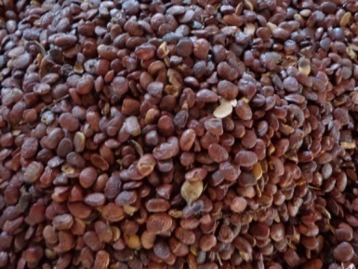
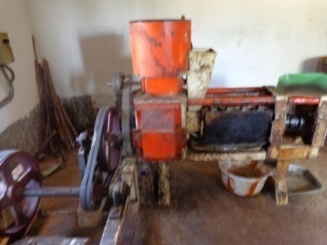
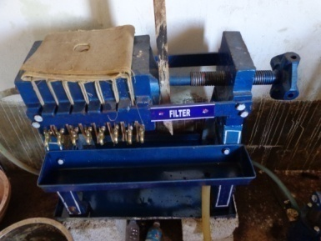
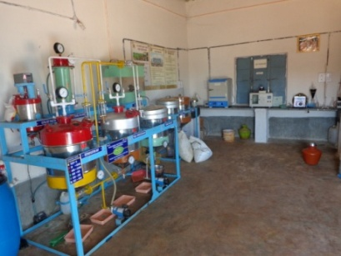
Other activities of PC-Horticulture
Crop/ enterprise | Activity | Members of the team
Biofuel | Establishment of Information & Demonstration Centre on Biofuels - conducting Training programmes on Nursery development, Planting techniques, Oil expelling & use of byproducts, Trans esterification & use of biodiesel and Value addition to byproducts Awareness camps – 20 No. Trainings – 20 No. | PC-Horticulture SMS-Agronomy

Slide 27
Activities calendar of SMS (Agronomy)
Village | Crop/ enterprise | Activity as leader | Other members of the team | Budget proposed
Doddahejjaji | Bengal gram | OFT-Assessment of Bengal gram variety for wilt and drought resistance | SMS-Plant Protn | 13000-00
Bommavara | Fodder | OFT-Assessment of multi-cut fodders for yield and quality | SMS-Animal Sc. | 30000-00
Hasiruvalli | Redgram | FLD-Redgram variety BRG-5 for wilt resistance | SMS-Soil Science SMS-Plant Protn | 12000-00
Arasanahalli | Field bean | FLD-Photo insensitive Field bean variety HA-4 for enhanced returns | PC-Horticulture SMS-Agril. Extn | 10000-00
Karepura | Finger millet | FLD- Addressing drought and blast vulnerability through Finger millet variety ML 365 | SMS-Home Sc. SMS-Plant Protn | 12000-00
Akkupet | Fodder | FLD-Multi cut fodder Sorghum variety COFS 29 for Assured Nutrition | SMS-Animal Sc. | 7000-00
Doddahejjaji | Bengalgram | Training-Production technology in Bengal gram | SMS-Plant Protn | 2000-00

Slide 28
Activities calendar of SMS (Agronomy)
Village | Crop/ enterprise | Activity as leader | Other members of the team | Budget proposed
Bommavara | Fodder | Training-Scientific cultivation of fodder crops | SMS-Animal Sc. | 2000-00
Hasiruvalli | Redgram | Training-Selection of suitable varieties and advances in agronomic practices for Redgram production | SMS-Soil Sc | 2000-00
Arasanahalli | Field bean | Training-Selection suitable varieties and advances in agronomic practices for different season in Field bean and its production | PC-Horticulture SMS-Agril. Extn | 2000-00
Karepura | Finger millet | Training-Advances in production technologies for Ragi | SMS-Home Sc. | 2000-00
Akkupet | Fodder | Training-Scientific cultivation of fodder sorghum | SMS-Animal Sc. | 2000-00

Slide 29
KVK Farm and Revolving Fund utilization by the SMS-Agronomy
Demo/ Production Units/ Labs | Crop/ enterprise/ activity | Physical Target for the year | Approximate Expenditure (Rs.) | Approximate Revenue (Rs.)
Vermi compost | Organic manure | 6 t | 3500-00 | Farm use (22,000-00)
Seed production | Finger millet (ML 365 & KMR 301) | 45 q | 40,000-00 | 76,000-00
Seed production | Redgram (BRG-5) | 20 q | 38,000-00 | 80,000-00

Slide 30
Activities calendar of SMS (Plant Protection)
Village | Crop/ enterprise | Activity as leader | Other members of the team | Budget proposed
Hasiruvalli | Potato | OFT-Assessment on management of late blight in Potato | SMS-Home Science | 36800-00
Chikkanahalli | Banana | OFT-Effective management practices of panama wilt in Banana | SMS-Soil Science | 21500-00
Akkupet | Cauliflower | FLD-Eco-friendly management of diamond back moth and black rot in Cauliflower | SMS-Agronomy | 29000-00
Karepura | Mango | FLD-Effective management of pests & diseases in Mango | PC-Horticulture SMS-Ag. Extension | 40000-00
Sulibele | Tomato | FLD-Management of late blight in Tomato | SMS-Soil Science | 39100-00
Hasiruvalli | Potato | Training-Monitoring pest & disease surveillance in Potato and value addition | SMS-Home Science | 2000-00
Chikkanahalli | Banana | Training-Disease and INM management in Banana | SMS-Soil Science | 2000-00
Akkupet | Cauliflower | Training-IPM in Cauliflower | SMS-Agronomy | 2000-00

Slide 31
Activities calendar of SMS (Plant Protection)
Village | Crop/ enterprise | Activity as leader | Other members of the team | Budget proposed
Karepura | Mango | Training-Plant protection in Mango | PC-Horticulture | 2000-00
Sulibele | Tomato | Training-Monitoring pests & disease surveillance in Tomato | SMS-Soil Science | 2000-00
Akkupet | Cauliflower | Training-IDM in Cauliflower | SMS-Agronomy | 2000-00
Hasiruvalli | Redgram | Training-Cultural and biological control for pod borer management in Redgram | SMS-Agril. Extn SMS-Agronomy | 2000-00
Gulya | Redgram | Training-Chemical and biological control for pod borer management in Redgram | SMS-Agril. Extn SMS-Agronomy | 2000-00
KVK Farm and Revolving Fund utilization by the SMS-Plant Protection
Demo/ Production Units/ Labs | Crop/ enterprise/ activity | Physical Target for the year | Approximate Expenditure (Rs.) | Approximate Revenue (Rs.)
Plant Health Clinic | Trichoderma | 100 kg | 5200-00 | 8,000-00

Slide 32
Other activities of SMS (Plant Protection)
Village | Crop/ enterprise | Activity as leader | Other members of the team | Budget proposed
Hasiruvalli | Vegetables & other crops | Plant Health Campaign – Diagnosis, analysis & recommendation for problematic plant specimens of the cropping season | SMS-Agril. Extn PC-Horticulture | 2000-00
Karepura | Method demonstration | Preparation of neem seed kernel extract and NPV | SMS-Agronomy SMS-Agril.Extn SMS-SS&AC | 4000-00
Akkupet | Method demonstration | Preparation of spray solution | PC-Horticulture | 2000-00
Akkupet | Method demonstration | Enrichment of compost with bio pesticide and bio fertilizer | PC-Horticulture | 2000-00
Doddaballapur | Celebration of important day | World Environment day | PC-Horticulture SMS-Agril. Extn SMS-Home Sc. SMS-SS&AC SMS-Agronomy | 2000-00

Slide 33
Activities calendar of SMS (Soil Science)
Village | Crop/ enterprise | Activity as leader | Other members of the team | Budget proposed
Karepura | Arecanut | OFT-Arecanut intercropping systems for additional remuneration | SMS-Agronomy | 23600-00
Doddahejjaji | Pole bean | OFT-Standardization of fertilizer requirement in Pole bean | PC-Horticulture SMS-Crop Protn | 4900-00
Akkupet | Beetroot | FLD-Enhancing Beetroot quality through Boron | PC-Horticulture | 3000-00
Bommavara | Grape special | FLD-Improvement of berry size and quality through Grape special | PC-Horticulture | 6000-00
Hasiruvalli | Ridge gourd | FLD-Quality enhancement in Ridge gourd through AMC & vegetable special | PC-Horticulture SMS-Plant Protn | 12000-00
Karepura | Arecanut | Training-Role of different intercrops in management of soil fertility status | SMS-Agronomy | 2000-00
Doddahejjaji | Pole bean | Training-Role of nutrients in vegetable crop production | PC-Horticulture SMS-Crop Protn | 2000-00

Slide 34
Activities calendar of SMS (Soil Science)
Village | Crop/ enterprise | Activity as leader | Other members of the team | Budget proposed
Akkupet | Beetroot | Training-Role of micro nutrients (Boron) in root crops | PC-Horticulture SMS-Plant Prot | 2000-00
Bommavara | Grape special | Training-Role of macro and micro nutrients for enhanced quality and yield in Grapes | PC-Horticulture SMS-Plant Prot | 2000-00
Hasiruvalli | Ridge gourd | Training-Importance of soil testing and balance nutrient application in vegetable crop production | PC-Horticulture SMS-Agronomy | 2000-00
Hasiruvalli | Ridge gourd | Training-Role of biofertilizers and foliar nutrition in maintaining soil health and fertility | PC-Horticulture SMS-Agronomy | 2000-00
Bommavara | Grape spl. | Training-Nutrient scheduling based on soil test values in Grapes | PC-Horticulture SMS-Plant Prot | 2000-00
Akkupet | Beetroot | Training-Improved production technologies in Beetroot | PC-Horticulture SMS-Plant Prot | 2000-00

Slide 35
KVK Farm and Revolving Fund utilization by the SMS-Soil Science
Demo/ Production Units/ Labs | Crop/ enterprise/ activity | Physical Target for the year | Approximate Expenditure (Rs.) | Approximate Revenue (Rs.)
Soil, Plant & Water analysis lab | Soil fertility and health management | 1200– Soil samples 800 – Water samples | 25,000=00 | 76,000-00
Vegetable Special | Nutrient mixture | 01 t | 54,000-00 | 1,50,000-00

Slide 36
Other activities of SMS (Soil Science)
Village | Crop/ enterprise | Activity as leader | Other members of the team | Budget proposed
Karepura | Soil health and fertility | Soil health campaign | PC-Horticulture | 2000-00
Akkupet | Soil health and fertility | Soil health campaign | PC-Horticulture | 2000-00
Arasanhalli | Soil health and fertility | Soil health campaign | PC-Horticulture | 2000-00
Hasiruvalli | Soil health and fertility | Soil health campaign | PC-Horticulture | 2000-00
Karepura | Method demonstration | Seed treatment with bio fertilizer | PC-Horticulture SMS-Crop Protn | 2000-00
Akkupet | Method demonstration | Compost enrichment technique with bio fertilizers and bio pesticides | PC-Horticulture SMS-Crop Protn | 2000-00
Bommavara | Method demonstration | Nutrient mixture preparation – spray solution | PC-Horticulture | 2000-00
Karepura | Method demonstration | Soil sampling technique | PC-Horticulture | 2000-00
Doddaballapur | Celebration of important day | Women in Agriculture | PC-Horticulture SMS-Home Sc. | 2000-00
Bommavara | Soil health and fertility | Soil & Water Analysis of FLD & OFT | Lab Technician | Included in OFT/FLD budget

Slide 37
Activities calendar of SMS (Animal Science)
Village | Crop/ enterprise | Activity as leader | Other members of the team | Budget proposed
Hasiruvalli | Dairy | FLD-Integrated Dairy Calf Management | SMS-Agronomy | 8550-00
Arasanahalli | Dairy | FLD-Infertility management in cross bred dairy animals | SMS-Soil Science | 12000-00
Karepura | Dairy | FLD-Management of foot-rot/ Soft Hoof in dairy animals | SMS-Plant Protection | 17000-00
Arasanahalli | Goat rearing | FLD-Nutritional Intervention with Urea Molasses Mineral Block (UMMB lick) in Goats | SMS-Home Science | 3000-00
Karepura | Poultry | FLD-Oral Pallet Vaccine against Ranikhet disease management in backyard poultry | SMS-Ag. Extension | 6000-00
Doddahejjaji | Dairy | Training-Disease management in poultry & livestock | SMS-Agronomy | 2000-00
Jakkanahalli | Dairy | Training-Scientific Management of Calves | SMS-Agronomy SMS-Plant Protn | 2000-00

Slide 38
Activities calendar of SMS (Animal Science)
Village | Crop/ enterprise | Activity as leader | Other members of the team | Budget proposed
Arasanahalli | Dairy | Training-Disease management in Calves | PC-Horticulture SMS-Agronomy | 2000-00
Gulya | Poultry | Training-Management of backyard poultry rearing | PC-Horticulture SMS-Agronomy | 2000-00
Karepura | Dairy | Training-Scientific dairy cattle management | PC-Soil Science SMS-Plant Protn | 2000-00
KVK Farm and Revolving Fund utilization by the SMS-Animal Science
Demo/ Production Units/ Labs | Crop/ enterprise/ activity | Physical Target for the year | Approximate Expenditure (Rs.) | Approximate Revenue (Rs.)
Dairy | Heifer production | 04 – calves | 32,000-00 | 80,000-00
Piggery | Piglets production | 40 – Piglets | 40,000-00 | 65,000-00
Azolla | Azolla production | 100 kg | No cost | Dairy use and samples are given free of cost to farmers

Slide 39
Other activities of SMS (Animal Science)
Village | Crop/ enterprise | Activity as leader | Other members of the team | Budget proposed
Doddaballapur, Devanahalli, Hosakote & Nelamangala | Dairy | FMD campaign - taluk wise 4 programmes | PC-Horticulture All SMS | 20,000-00
 | Dairy | Animal health camps – 4 Nos. | PC-Horticulture All SMS | 20,000-00
Karepura | Method demonstration | Ration balancing in dairy animals | PC-Horticulture SMS-Plant Prot | 2000-00
Karepura | Method demonstration | Azolla production for live stock | PC-Horticulture All SMS | 2000-00
Doddahejjaji | Method demonstration | Ranikhet vaccination | PC-Horticulture SMS-Agronomy | 2000-00
Karepura | Method demonstration | Deworming in calves | PC-Horticulture SMS-Plant Prot | 2000-00

Slide 40
Activities calendar of SMS (Home Science)
Village | Crop/ enterprise | Activity as leader | Other members of the team | Budget proposed
Akkupet | Under utilized greens | OFT-Suitability and acceptability of underutilized greens for nutrition security | PC-Horticulture SMS-Soil Science | 13000-00
Doddaballapur | Adolescent girls | OFT-Efficacy of different education methods to combat anemia among adolescent girls | PC-Horticulture SMS-Agril. Extn | 14000-00
Doddaballapur | Terrace gardening | FLD-Vegetable terrace gardening for nutrition security | PC-Horticulture All SMS | 45000-00
Doddaballapur | Fruits & Vegetables | FLD-Promotion of fruits & vegetables preservator in small scale institutions | PC-Horticulture | 28000-00
Karepura | Thresher cum pearler | FLD-Thresher cum pearler in finger millet for resource poor farmers | SMS-Agronomy | 30000-00
Hasiruvalli | Maize | FLD-Linking SHGs to market through maize value addition & branding | SMS-Agril. Extn. SMS-Agronomy | 30000-00

Slide 41
Activities calendar of SMS (Home Science)
Village | Crop/ enterprise | Activity as leader | Other members of the team | Budget proposed
Doddaballapur | Adolescent girls | Training-Health and nutrition among adolescent girls | PC-Horticulture SMS-Soil Science SMS-Agril. Extn | 2000-00
Akkupet | Under utilized greens | Training-Use of underutilized greens in daily diet for nutritional benefits | PC-Horticulture SMS-Soil Science | 2000-00
Karepura | Fruits & Vegetables | Training-Enhancement of shelf life of fruits & vegetable through storage techniques | PC-Horticulture SMS-Agril. Extn | 2000-00
Doddaballapur | Terrace gardening | Training-Ensuring availability of vegetables through terrace garden for health benefits | PC-Horticulture All SMSs | 2000-00
Doddaballapur | Thresher cum pearler | Training-Scientific threshing techniques in finger millet & value addition | SMS-Agronomy | 2000-00
Hasiruvalli | Maize | Training-Value addition in Maize – Branding and market linkage | SMS-Agril. Extn. SMS-Agronomy | 2000-00
KVK Farm and Revolving Fund utilization by the SMS-Home Science
Demo/ Production Units/ Labs | Crop/ enterprise/ activity | Physical Target for the year | Approximate Expenditure (Rs.) | Approximate Revenue (Rs.)
Millet Processing Unit | Finger millet | Cleaning & milling-600 kg Malt – 20 kg, Papad – 20 kg Mixture – 20 kg | 6,000-00 | 12,600-00

Slide 42
Other activities of SMS (Home Science)
Village | Crop/ enterprise | Activity as leader | Other members of the team | Budget proposed
Karepura | Nutrition | Child health camp | PC-Horticulture SMS Agril Extn | 4000-00
Doddahejjaji | Method demonstration | Use of Groundnut decorticator | PC-Horticulture SMS Soil Science | 2000-00
Hasiruvalli | Method demonstration | Use of Maize sheller | PC-Horticulture SMS Plant protn | 2000-00
Hasiruvalli | Method demonstration | Use of cycle weeder | PC-Horticulture SMS-Agronomy | 2000-00
Karepura | Celebration of important days | National Nutrition week | PC-Horticulture SMS Agril Extn | 2000-00
Karepura | Celebration of important days | World food day | PC-Horticulture SMS Agril Extn | 2000-00

Slide 43
Activities calendar of SMS (Agril. Extn.) – Trainings [Farmers]
Village | Crop/ enterprise | Activity as leader | Other members of the team | Budget proposed
On Campus | Agriculture | Integrated Crop Management of field crops | SMS-Plant Protection SMS-Agronomy SMS-Soil Science | 10625-00
 | Horticulture | Integrated Crop Management of fruit crops | SMS-Plant Protection SMS-Agronomy SMS-Soil Science | 10625-00
 | Horticulture | Integrated Crop Management of vegetable crops | SMS-Plant Protection SMS-Agronomy SMS-Soil Science | 10625-00
 | Dairy | Scientific Dairy Management practices | SMS-Animal Science SMS Agronomy | 10625-00
 | Agriculture | Integrated Nutrient Management in Agriculture | SMS-Soil science | 10625-00
 | Agriculture | Integrated Pest Management and safe & judicious use of pesticides | SMS-Plant Protection | 10625-00
 | Horticulture | Post Harvest Technology in Fruits & Vegetables | SMS-Home Science PC-Horticulture | 10625-00
 | Agriculture | Integrated Water Management practices for field crops | SMS-Agronomy | 10625-00
 | Animal husbandry | Scientific sheep and goat management practices | SMS-Animal Science SMS -Agronomy | 10625-00
 | Farming system | Integrated farming systems for enhancing resource-use efficiency and livelihood security of small and marginal farmers | SMS-Agronomy | 10625-00

Slide 44
Activities calendar of SMS (Agril. Extn.) – Trainings [Farm Women]
Village | Crop/ enterprise | Activity as leader | Other members of the team | Budget proposed
On Campus | Agriculture | Drudgery reduction through farm mechanization | SMS-Home Science SMS-Agronomy | 10625-00
 | Agriculture | Vermicompost and scientific compost making | SMS-Soil Science SMS-Agronomy | 10625-00
 | Agriculture | Entrepreneurship development of SHGs | SMS-Home Science | 10625-00
 | Animal husbandry | Goat rearing and poultry for livelihood improvement | SMS-Animal Science SMS-Agronomy | 10625-00
 | Agriculture | Handling and Safe Storage of Food Grains | SMS Agronomy SMS Home Science | 10625-00
 | Agriculture | Empowerment of women through income generating activities in agriculture | SMS-Home Science PC-Horticulture | 10625-00

Slide 45
Activities calendar of SMS(Agril. Extn.) – Trainings [Extension Personnel]
Village | Crop/ enterprise | Activity as leader | Other members of the team | Budget proposed
On Campus | Agriculture | Diagnosis of field, INM and IPM techniques in Agriculture | SMS-Plant Protection SMS-Soil Science | 14000-00
 | Animal husbandry | Scientific animal husbandry practices | SMS-Animal Science | 14000-00
 | Weather | Climate change and its impact on crop production | SMS-Agronomy | 14000-00
 | Horticulture | Promotion of Post Harvest Technology and Value Addition in Horticulture crops | SMS-Home Science | 14000-00
 | Extension | Innovative Extension Approaches | PC-Horticulture | 14000-00
 | Extension | Effective Communication and Stress Management | PC-Horticulture | 14000-00
 | Extension | Professional skills for Trainers of Extension Institutes of line departments | PC-Horticulture | 14000-00
 | Gender studies | Gender Sensitization for the Extension Functionaries | SMS -Home Science | 14000-00
 | CBOs | Development and sustainability of Farmer Producer Organizations | SMS-Home Science PC-Horticulture | 14000-00
 | Market linkage | Linking farmers to Markets | SMS-Home Science | 14000-00

Slide 46
Activities calendar of SMS (Agril. Extn.) – Trainings [Rural Youth]
Village | Crop/ enterprise | Activity as leader | Other members of the team | Budget proposed
On Campus | Poultry | Entrepreneur Development Programme (EDP) on “Backyard poultry" | SMS-Animal Science Farm Manager | 17375-00
 | Sheep & Goat | EDP on “Sheep and Goat rearing” | SMS-Animal Science | 17375-00
 | Horticulture | EDP on “Propagation of quality planting material “ | PC-Horticulture Farm Manager | 17375-00
 | Bee keeping | EDP on “Bee keeping for income generation” | PC-Horticulture | 17375-00
 | Electronic | Electric motor rewinding and pumpset maintenance (in collaboration with RUDSET, Nelamangala) | PC-Horticulture SMS-Agronomy | 17375-00
 | Bakery | Bakery and confectionery technology | SMS-Home Science PC-Horticulture | 17375-00
 | Agriculture | Skill Development & Employment through Value addition and Secondary Agriculture | SMS-Home Science PC-Horticulture | 17375-00
 | Equipments | Tillage equipments | SMS-Agronomy | 17375-00
Activities calendar of SMS-Agril. Extn. –Innovative Approach
Village | Crop/ enterprise | Activity as leader | Other members of the team | Budget proposed
Bidganahalli | Grapes | Innovative Approach for Marketing of Grapes | PC – Horticulture SMS-Plant Protection | 70000-00

Slide 47
Activities calendar of Farm Manager
Blocks / Production units / Demo units in the farm |  | Crop/ activity in Kharif | Crop/ activity in Rabi / Summer | Cropping intensity | Approximate Expenditure (Rs.) | Approximate Revenue (Rs.)
Block & Plot | Ha
Block 1 Plot A1 & A2 Block 2-Plot A | 2.78 | Redgram | - | 20.34 | 35000 | 144500
Block 1 Plot A,A3,E,E1&E2 Block 2-Plot J | 2.68 | Ragi | - | 19.60 | 47000 | 110900
Block 1 Plot B | 0.02 | Fodder Maize | Fodder Maize | 0.30 | 1500 | 6000*
Block 1 Plot C & G2 | 0.05 | Fodder | Fodder | 0.74 | 2500 | 25500*
Block 1 Plot G3 Block 2 Plot J | 0.04 | Fox tail millet | - | 0.29 | 950 | 2100
Block 1 Plot D | 0.16 | Green manure | - | 1.17 | 1500 | 4480
Block 1 Plot H Block 2 Plot B, C, D, E, G, H, I | 6.94 | Horticulture | - | 50.77 | 61000 | Grafts to be planted
Block 1 Plot G & G1 | 1.00 | Crop demo Block | - | 7.32 | - | -
* Use for farm dairy

Slide 48
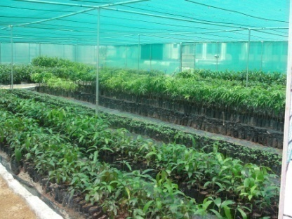
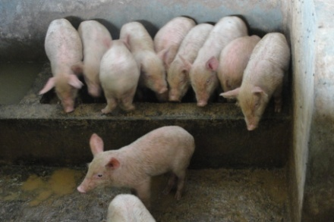
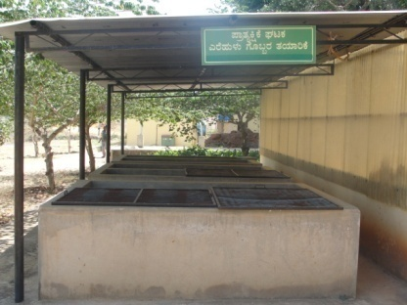
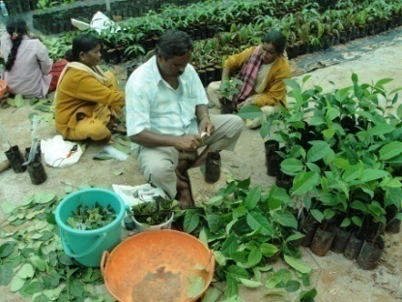
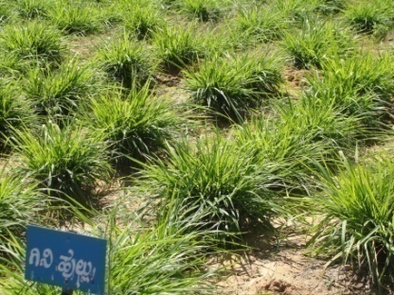
Sl.No | Demo Production units /lab | Crop / Enterprise | Target for the year | Approximate Expenditure (Rs.) | Approximate Revenue (Rs.) | Members involved
1 | Model Horticulture Nursery Unit | Grafts / Seedlings | 18000 | 165000 | 380000 | FM PC-Hort.
2 | Piggery Unit | Piglets Pigs-Manure | 40 Nos. 2 t | 40000 - | 65000 Farm Use | FM SMS-Animal Sc
3 | Vermicompost Demo Unit | Organic manure | 6t | 3500 | Farm Use | FM, SMS-SS&AC SMS-Agron
4 | Azolla Demo Unit | Azolla | 100 kg | 350 | Dairy Use | FM, SMS-Animal Sc
5 | Dairy Demo Unit | Heifer production Dairy – FYM | 4 calves 10 t FYM | 32000 - | 80000 Farm Use | FM, SMS-Animal Sc

Slide 49
Activities calendar of Lab Technician/Training Assistant
Name of Laboratory | Target for no. of samples for testing/ analysis | Approx. Exp. (Rs.) | Approx Revenue (Rs.) | Expected output / outcome | Members associated
Soil, plant and water testing Laboratory | Soil – 1200 Water – 800 | 25,000=00 | 76,000-00 | Development of Soil Fertility Map Soil Test based Recommendations | SMS-SS&AC
Plant Health Clinic | Trichoderma – 100 kg | 5200-00 | 8000-00 | Diagnosis based IPM recommendations | SMS-PP
Millet processing Unit | Cleaning & milling – 600 kg Malt – 20 kg Papad – 20 kg Mixture – 20 kg | 6,000-00 | 12,600-00 | Empowering SHGs in production and marketing of Value Added Products | SMS-HS
Assisting in organizing Trainings / Seminars / Workshops / Method Demonstrations / Celebration of Important events/days. Any other work entrusted by the Programme Coordinator and Scientists
Activities other than the above:

Slide 50
Activity calendar for Programme Assistant(Computer)
Name of Database/ Website/ KMAS etc. | Frequency of data input and updating | Other members of the team | Reports to be generated | Frequency of report generation
Database : Reports Reports to ZPD Reports to DE Reports to Editor Quarterly Reports Half Yearly Reports Annual Reports SAC Reports EPCB/EEC/ZREP Reports | Twice a Month Twice a Month Monthly Quarterly Hal f Yearly Annual Half Yearly Annual | All SMS | MPR MR SA QR HYR AR Half Yearly Annual | Monthly Monthly Monthly Quarterly Hal f Yearly Annual Half Yearly Annual
Budget Database | Twice a Week | NA | BS | Fortnightly
Farmers Database | Weekly | All SMS | NA | NA
KMAS | Thrice a Week | All SMS | SMSR | Monthly
Soil test database | Twice a Week | SMS-SS&AC | STR | Monthly
Website www.kvkbrd.org | Twice a Month | SMS–Ag.Extn | NA | NA
Action plan | Annual | All SMS | Action plan | Monthly
Activities other than the above:
MPR-Monthly Progress Report; MR-Monthly Report; SA-Significant Achievements; QR-Quarterly Report;
HYR-Half Yearly Report; AR- Annual Report; BS-Budget Status; SMSR-SMS Report; STR-Soil Tested Report

Slide 51
Other Activities of Programme Assistant(Computer)
Assisting in conducting the Group discussion meetings/lectures with Line Departments.
Attending E-mails received from various Govt. departments/schemes/offices/ institutions, etc.
Attending day-to-day computer related work such as preparation of letters, statements, charts, Power Point slides, data management, etc.
Creation and maintenance of relevant database system for KVK
Updating the new technologies released in respect of agriculture/horticulture crops through internet browsing.
Managing and maintenance of the Computers with accessories and Printers
Assisting in Office Administration and Accounts
Any other work entrusted by the Programme Coordinator and Scientists

Slide 52
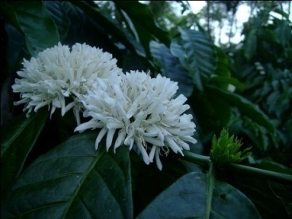
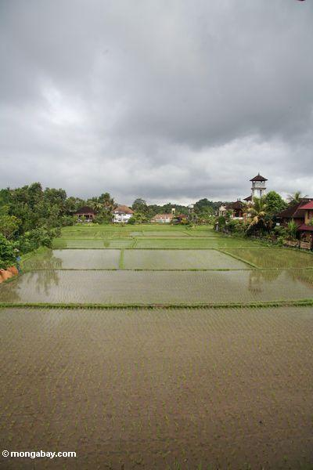
Farmers Field School

Slide 53
FFS on Integrated Crop Management in Cabbage
Non adoption of integrated approaches in management of nutrients, pests and diseases
Prioritized Problem
Steps in Conducting FFS
Area | Dist. Avg. yield | Pot. Yield
1,000 ha | 20 t/ha | 25 t/ha
1. Ground working activities
2. Training to facilitators
3. Establishment & running of FFS
Selection of villages
Collection of secondary information
Discussion with local body
Gramsabha - Entry point activity
Group formation
Base line information
Developing curriculum
Collaborator selection
4. Data analysis – Interpretation - Economic analysis
5. Field day / Sharing event
6. Graduation
7. Farmer-run FFS
Particulars | Amount (Rs.)
Critical inputs | 8,000/-
FFS Sessions | 6,000/-
Field day | 6,000/-
Training material | 8,000/-
Miscellaneous | 2,000/-
Total | 30,000/-
Taluk : Karepura / Doddaballapur Tq.

Slide 54
National Initiative on Fodder Technology Demonstration (NIFTD)
2014-15

Slide 55
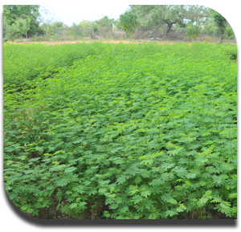
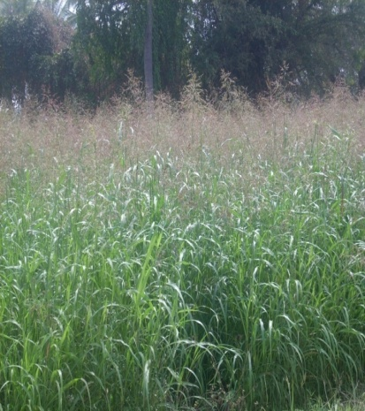
I. Technology Demonstration Module (TDM)-I
Sl. No | Technologies | No. of Demonstrations | Approximate budget
1 | Forage on bunds – Hedge Lucerne | 05 | 20,000
2 | Round the year forage production - Forage sorghum (COFS 29) | 05 | 20,000
Total Area -2.0 ha
Hedge Lucerne
COFS - 29

Slide 56
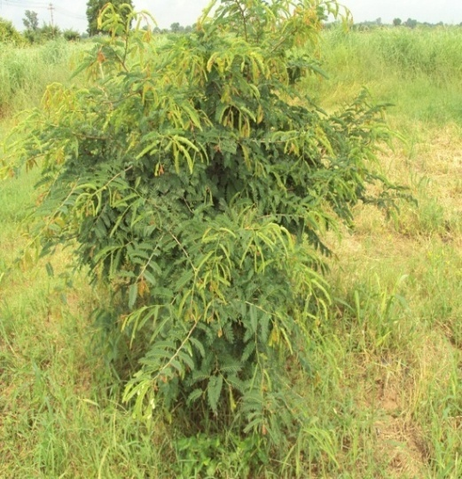
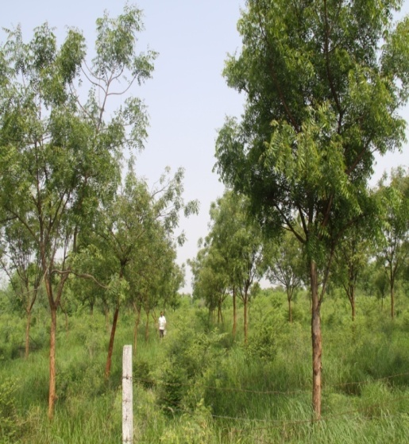
II. Technology Demonstration Module(TDM)-II
Sl. No | Technologies | No. of Demonstrations | Approximate budget
1 | Horti Pasture – Mango / Arecanut + Stylo | 03 | 15,0000
2 | Silvipasture – Milia Dubia (tree) + Guinea grass + multi cut bajra | 02 | 10,000
Stylo
Milia dubia
Guinea grass
Bajra Multicut
Total Area - 1.0 ha

Slide 57
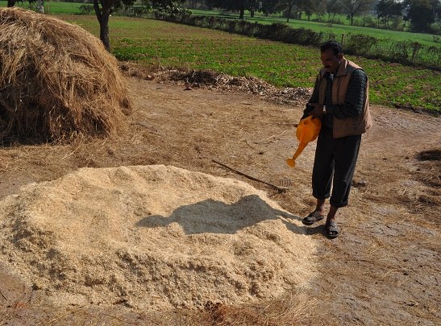
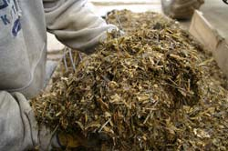
III. Technology Demonstration Module (TDM)-III
Sl. No | Technologies | No. of Demonstrations | Approximate budget
1 | Urea treatment | 03 | 15,000
2 | Silage making | 03 | 15,000
3 | Area specific mineral mixture | 04 | 20,000
Spraying of urea solution on straw
Wet conservation as silage

Slide 58
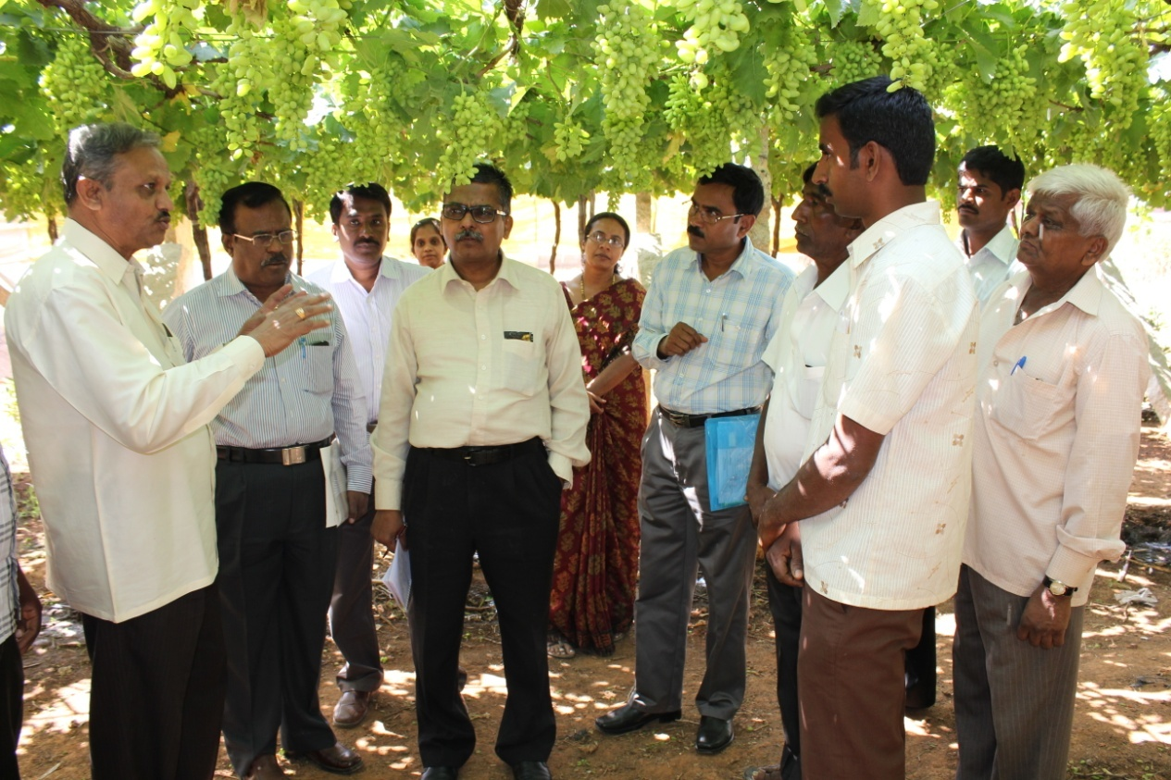
Innovative approach
Market LINKAGES IN Grapes
For minimizing the wide gap between farm gate price and retail Price
Budget Rs.70,000/-

Slide 59
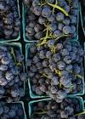
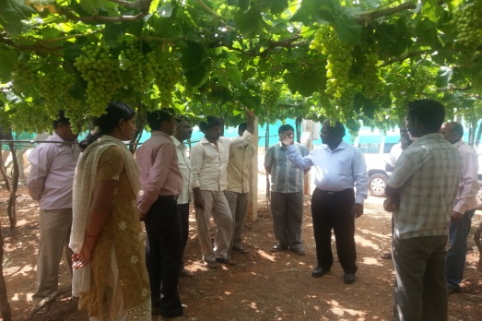
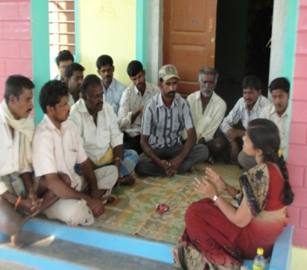
Proposed Market Approach for Grapes
CBO
Formation of Grape Growers Association
Capacity building
Good Agricultural Practices
Harvesting Techniques
Hands on Trainings
Grading
Packaging
Labeling
Transporting
Distribution
Approach for New Market Avenues
Malls
Apartments
Adhoc Kiosks
Grapes Mela
Hopcoms
University / Factory stores
Grape Farm Tourism
Marketing Campaign, etc
2013-14
2013-14
2014-15

Slide 60
Integrated Farming System

Slide 61
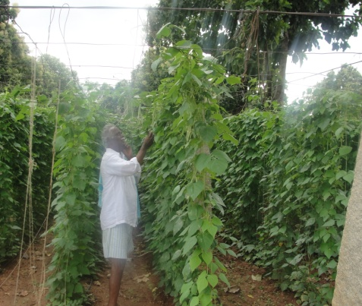
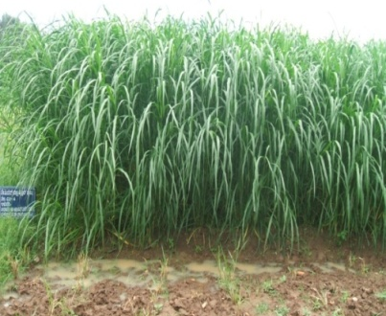
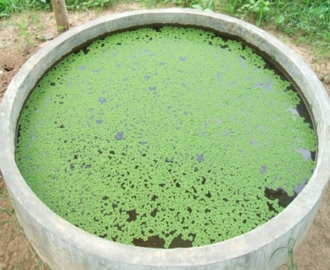
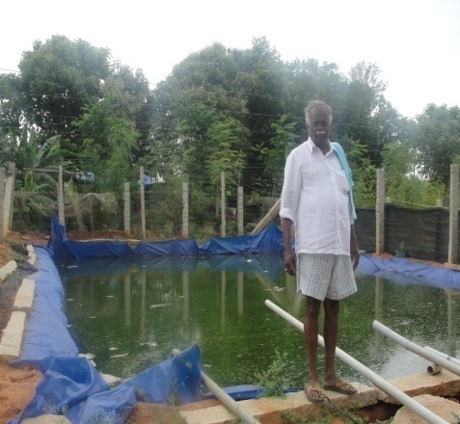
Integrated Farming System
Sri Jairam, Byradenahalli, Devanahalli Tq.
Sri Lakkappa, Hadonahalli, Doddaballapura Tq.
Sri Govindappa, Akkathammanahalli, Doddaballapura Tq.
Sri Gangaswamy, K R Pura Colony, Nelamangala Tq.
Sri Prasad, Tippur, Doddaballapura Tq.

Slide 62
Production of :
Seed
Planting material
Animals
Bio-control agents
Value Added Millet Products

Slide 63
Seed Production
Sl. No. | Crop | Variety | Type of seed | Quantity
1. | Ragi | ML 365 & KMR 301 | TL | 45 q
2. | Redgram | BRG-5 | TL | 20 q
Planting material
Sl. No. | Crop | Variety | Type - Seedling / Grafts | Quantity
1. | Jack | Tubgere selection | Grafts | 18,000 Nos.
2. | Mango | Alphonso / Mallika | Grafts
3. | Jamun | Hosakote Sel. | Grafts
4. | Papaya | Solo | Seedlings
5. | Guava | Alahabad Safed | Grafts
6. | Amla | NA-7 | Grafts
7. | Drumstick | Bhagya | Seedlings
8. | Curry leaf | Suvasini | Seedlings
9. | Lime, pomegranate, Amruthballi, Tulasi, Doddapatre, Fodder slips, etc | Ruling varieties | Seedlings

Slide 64
Animal components
Sl. No. | Animal | Breed | Quantity
1. | Heifer production | HF | 04 calves
2. | Piglets | Yorkshire | 40 piglets
Bio-control agents
Sl. No. | Name | Type | Quantity
1. | Trichoderma | Talc based bio fungicide | 100 kg
2. | Vermi compost | Organic | 06 t
3. | Vegetable Special – nutrient mixture | Micro nutrient based | 01 t
Soil, Water and Plant Analysis
Sl. No. | Analysis | Quantity
1. | Soil | 1200 samples
2. | Water | 800 samples
Value Added Millet Products
Sl. No. | Analysis | Quantity
1. | Cleaning & milling | 600 kg
2. | Malt | 20 kg
3. | Papad | 20 kg
4. | Mixture | 20 kg

Slide 65
Other activities
Integrated Farming System Demonstration (IFSD – RKVY)
Information and Demonstration Centre on Biofuel

Slide 66
Integrated Farming System Demonstration
(IFSD-RKVY)
Promotion and Strengthening of Two Commodity Based Organizations
(Bale Belegarara Sangha and Jola Belegarara Sangha)
Training
Exposure visit to related production / processing / marketing
Critical inputs (HYVs/hybrids, Biofertilizers, Micro nutrients, Bio-pesticides, Bio control materials, etc)
Field days
Providing farm appliance services under Agro Service Centre (Equipments for land preparation / post-sowing operations, Maize sheller, Ragi thresher, chaff cutter, etc)
Model Stakeholders (15) (Cycle weeder, Storage bin, Cow mat, Cement Ring, Gutter sprayer, Coconut dehusker, Fodder cafeteria, Apiary, etc)
Programme covering 2450 Farm families

Slide 67
Information and Demonstration Centre on Biofuel
Programmes | No. of activities planned
Awareness programmes | 20
Training programmes | 20
Seeds procurement | 20-25 t
Production of Nursery plants | 2,000 No.
Information dissemination
Information about Bio-fuels will be provided during the scheduled programmes.

Slide 68
Plan for up-scaling/ out-scaling of the recent successful interventions of the KVK
Names of successful interventions of the KVK during the last 3 years | Approaches to up-scale | Approaches to out-scale
Commodity Based Associations for Market Linkage | Formed nine commodity based associations (CBA) Conducted 330 training programmes for CBA members 816 members of nine CBA made a turnover of around One crore which resulted in greater impact on socio-economic status of the farmers. Two CBOs : (Banana and Corn Growers) have been registered and KVK is facilitating their CBA activities. In addition, 12 CBOs have been planned during this year | Use of electronic media for publishing the success stories of CBOs. Through website
Integrated Farming System | Model Farmer : Mr. Sadananda Through IFSD, the annual income from 2.14 acre has increased significantly from 5.31 lakh to 10.2 Lakh in 5 years Established two IFSD Models in similar lines of Mr. Sadananda IFSD is being strengthened with 2500 stakeholders in the 18 adopted villages of KVKBRD 15 farmers have been motivated to be Model IFS stakeholders of the district. | Promotion of IFS Model in the other parts of rural dist. neighboring districts through Farmer -to- Farmer extension, exposure visits, seminars etc.

Slide 69
Plan for up-scaling/ out-scaling of the recent successful interventions of the KVK
Names of successful interventions of the KVK during the last 3 years | Approaches to up-scale | Approaches to out-scale
OFT & FLD on Mango Harvester (KVK BRD Model) | The KVK-BRD modified mango harvester was accepted & included in the package of practice (UASB, 2010) The technology has reached more than 25% of the mango growers of the district. The post harvest damage and losses reduced up to 12% Income of over Rs. 2.0 crore was generated from the spread of technology by saving 1000 tones of fruits Planned to Produce and publicize the technology through PPP mode | Planned to promote Mango harvester through Schemes of Department of Horticulture Through website
OFT on Intercropping in French bean | Technology accepted for inclusion in the POP Increase in yield by 30 % Reduced disease incidence (rust ) to 7% in baby corn Additional revenue generation of 30-40% over sole crop Satisfaction with regard to the reduced disease spread, additional profits generated out of border & inter crop of baby corn and the nutritious fodder from baby corn | Planned to popularize intercropping in field bean through Dept. of Horticulture and through KVK training programmes

Slide 70
Names of successful interventions of the KVK during the last 3 years | Approaches to up-scale (within the system) | Approaches to out-scale (outside the system)
Value added products of finger millet OFT on Gelatinized Papad FFS – Mixture | Technology accepted for inclusion in the POP Organised Six vocational trainings and 37 one day trainings Two SHGs earned an average of Rs.35000/year/ group Techn. adopted by 13 SHGs 18 SHG’s earning on an average of Rs.2,47,200 / yr. Planned to develop entrepreneurs through hands on training | Planned to popularize gelatinized papad through SHGs under Dept. of women and child welfare & Mid day meal programme in schools Planned to popularize finger millet mixture among SHGs under dept. of women and child welfare, Department of Agriculture and linking with city commercial markets
FLD on Micronutrient Mixture for Vegetable Crops | Produced and provided over 1650 kg of Vegetable special to the farmers Planned to produce over two tons of Vegetable special (over 750 farmers) Planned to popularize through FLD on Vegetables to the farmers and KVK trainees | Planned to popularize use of vegetable special through rural youth trainees, other KVKs, and department of Horticulture.

Slide 71
Details of Budget (2013-14) sanctioned by ZPD, Zone-VIII
Sl.No | Particulars | BE 2012-13
A | Recurring Contingencies
1 | Pay & Allowance | 43,00,000
2 | TA | 1,75,000
3 | Contingencies
A | Stationery, telephone, postage and other expenditure on office running, publication of Newsletter | 2,35,000
B | POL, repair of vehicles, tractor and equipments | 2,10,000
C | Meals/refreshment for trainees | 90,000
D | Training material (need based materials and equipments for conducting the training) | 80,000
E | Frontline demonstration | 4,00,000
F | On farm testing (on need based, location specific and newly generated information in the major production systems of the area) | 75,000
G | Training of extension functionaries | 25,000
H | Maintenance of building | 50,000
I | Extension activities | 50,000
J | Farmer’s Field School | 30,000
K | Library (Purchase of Journal, Periodicals, News Paper & Magazines) | 5,000
 | TOTAL CONTINGENCY | 12,50,000
 | TOTAL(A) | 57,25,000
B. | Non – Recurring Contingencies
1 | Works | 0
2 | Equipments & Furniture | 0
3 | Vehicles | 0
4 | Library | 0
 | TOTAL(B) | 0
C. | Revolving Fund (C) | -
 | GRAND TOTAL(A+B+C) | 57,25,000

Slide 72
Details of Budget Estimate (2014-15) based on proposed action plan
Sl.No | Particulars | BE 2014-15 proposed
A | Recurring Contingencies
1 | Pay & Allowance | 81,00,000
2 | TA | 1,80,000
3 | Contingencies
A | Stationery, telephone, postage and other expenditure on office running, publication of Newsletter | 3,00,000
B | POL, repair of vehicles, tractor and equipments | 3,00,000
C | Meals/refreshment for trainees | 1,00,000
D | Training material (need based materials and equipments for conducting the training) | 1,00,000
E | Frontline demonstration | 3,79,650
F | On farm testing (on need based, location specific and newly generated information in the major production systems of the area) | 1,56,800
G | Training of extension functionaries | 40,000
H | Maintenance of building | 80,000
I | Establishment of Soil, Plant & Water Testing Laboratory | -
J | Library (Purchase of Journal, Periodicals, News Paper & Magazines) | 10,000
K | National Incentive on Fodder technology Demonstration (NIFTD) | 1,15,000
 | TOTAL CONTINGENCY | 15,81,450
 | TOTAL(A) | 98,61,450
B. | Non – Recurring Contingencies
1 | Works : (a) Road formation: 10.00 lakh and (b) Micro irrigation systems : 2.00 lakhs) | 12,00,000
2 | Equipments & Furniture : (a) Farm implements-5.00 lakhs, (b)Computers-2.00 lakhs (c)Generator-5.00 lakhs | 12,00,000
3 | Vehicles : Jeep (Four wheeler) | 10,00,000
4 | Library | 25,000
 | TOTAL(B) | 34,25,000
C. | Revolving Fund (C) | -
 | GRAND TOTAL(A+B+C) | 132,86,450

Slide 73
THANK YOU

