Slide 1
Krishi Vigyan Kendra, Bangalore Rural district
District Features
Agro-climatic zone | Eastern Dry Zone
No. of Taluks | 04
No. of Villages | 1,980
No. of Holdings | 1,60,483
Gross Cropped Area (ha) | 1,30,519
Area under irrigation (%) | 21.44 % 27,980 ha
Sources of irrigation | Tanks, Bore well
Major Soil Types | Medium deep, red clayey soils Deep lateritic clayey soils
Major crops in Kharif | Finger millet, Redgram, Maize, Groundnut, Sunflower, Vegetables, Banana, Field bean
Major crops in Rabi | Maize, Groundnut, Chickpea, Vegetables, Banana, Horse gram
Major Perennial Crops | Grapes, Mango, Jack, Sapota, Rose, Drumstick, Fodder, Arecanut
Major Livestock | Cattle, Buffaloes, Sheep, Goats, Pigs, Poultry

Slide 2
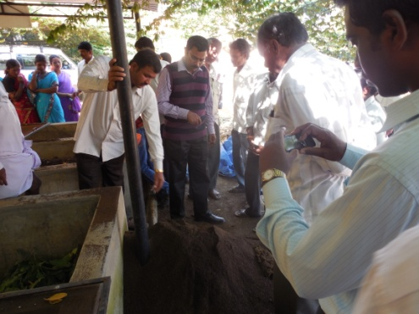
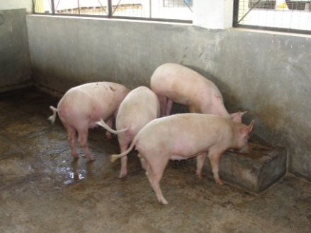
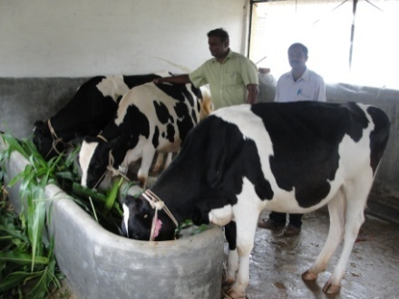
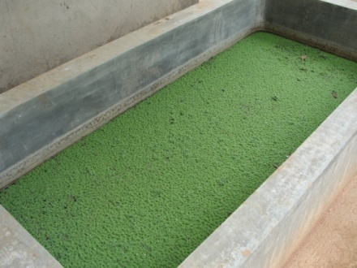
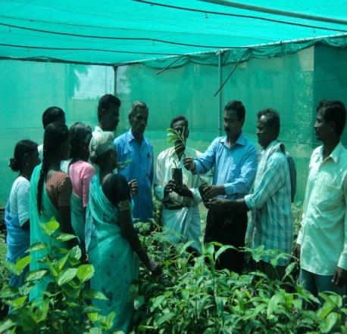
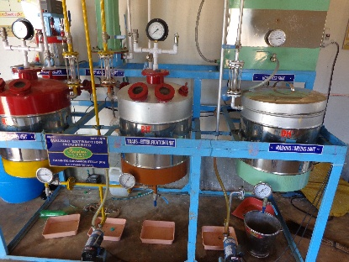
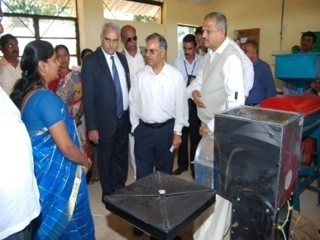
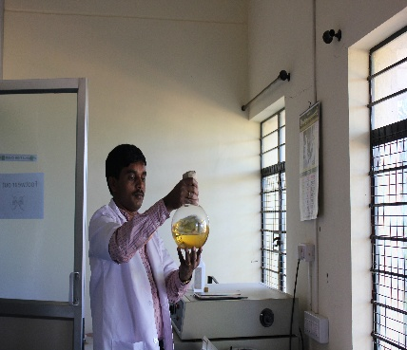
KVK Manpower and facilities
Manpower Programme Coordinator No. of SMSs in position No. of Programme Assistants in position Supporting staff | 01 06 03 04
Farm details Total Area (ha) Cultivated Area (ha) | 21.28 13.67
Demonstration Units 1. Vermicomposting Unit Piggery Unit Dairy Unit Fodder Unit Azolla Unit Model Horticulture Nursery I&D Centre on Biofuel Millet Processing Unit Sheep-cum-Poultry unit | 18 m² 58 m² 53 m² 0.2 ha 3.5 m² 720 m² 80 m² 51 m² 9 m²
Production Units Bio control Agents Unit Vegetable Special Unit | 60 m² 40 m²
Laboratories 1. Soil & Water Testing Laboratory 2. Plant Health Clinic | 50 m² 30 m²
Vermicomposting Unit
Piggery Unit
Dairy Unit
Azolla Unit
Model Horticultural Nursery
I & D Centre on Biofuel
Millet Processing Unit
Bio control Agents Unit

Slide 3
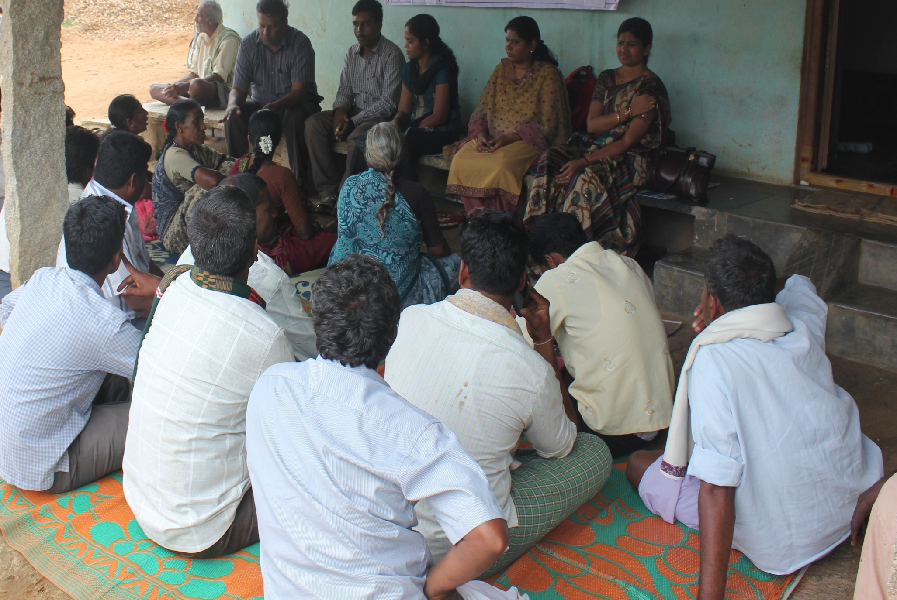
Gap Identification and Technology Prioritization
in clusters through
Participatory Rural Appraisal (PRA)

Slide 4
Prioritized Problems in Bengaluru Rural
Crop | Prioritized Problem
Finger millet | Intermittent drought and blast incidence, threshing
Maize | Pure crop in > 95% area, Weed menace in initial stages
Redgram | 30% wilt incidence, pod borer, SMD
Fodder crops | Low productivity, more pubescence, less palatability Non-availability round the year
Dairy enterprise | Anemia, lice, ticks and fleas infestation, Ruminal acidosis Fibrosis of the udder, Imbalanced nutrition High cost of milk production, Low milk quality (SNF & fat %)
Cabbage | DBM and Black Moth infestation
Tomato | Late blight disease
Pole beans & Capsicum | Imbalanced nutrition, pests and diseases
Potato | Incidence of late blight and poor quality of tuber
Arecanut | Nut splitting
Rose | Pests and diseases and poor flower quality
Storage | Perishability of fruits, unhygienic drying, low income during glut
Nutrition | Less consumption of vegetables Poor knowledge about kitchen waste management

Slide 5
Gap Identification and Technology Prioritization
Cluster – 1 : Doddaballapura taluk
Cluster of villages | Nagashettihalli, Cheelenahalli, Thippur, Vanigrahalli, Gundasandra
Major crops | 1. Fodder crops
Extension gap | Lack of awareness about BH-18 & DHN-6 varieties
Adoption gap | Non-application of P&K nutrients Split application of nutrients not practiced No irrigation at critical stages Ridge & furrow method not practiced
Yield gap | NB-21 – 40 t/ha (PY-120 t/ha, AY- 80 t/ha) Co-3 – 20 t/ha (PY-130 t/ha, AY- 110 t/ha) BH-18 – 30 t/ha (PY - 150 t/ha, AY – 120 t/ha ) DHN-6 – 50 t/ha (PY-180 t/ha, AY – 130 t/ha)
Reasons for adoption gap, yield gap / Major problems for low productivity | Lack of awareness about BH-18 & DHN-6 fodder varieties More pubescence, less palatability and low yield in existing varieties Non-application of P&K and nutrients in split doses No irrigation at critical stages Ridge & furrow method not practiced

Slide 6
Gap Identification and Technology Prioritization
Cluster – 1 : Doddaballapura taluk
Technological options to overcome the problems identified | Introduction of BH-18 & DHN-6 Application of P&K nutrients Practice of split application of nutrients, ridge & furrow method cultivation Irrigation at critical stages (drip method)
Most appropriate option by KVK to increase productivity in phases | Introduction of BH-18 & DHN-6 Assessment of their performance against existing NB-21 & Co-3 Adoption of Integrated Fodder Production Technologies
Extension approach to implement the chosen option | OFT - Assessment of multi-cut fodders for yield and quality
Potential youth as entrepreneurs | Sri Byregowda S/o Ramaiah, Cheelenahalli
Potential farmer as local resource person | Sri Nagaraj S/o Krishnappa, Cheelenahalli
Potential for post harvest processing | Silage preparation
Potential to form CBA and market avenues | Strengthening of existing MPCS members

Slide 7


Abstract of activities (2015-16)
Sl. No | Particulars | Total budget (Rs.)
1. | On Farm Testing – 5 Nos. | 60,045/-
2. | Front Line Demonstration – 15 Nos. | 3,19,355/-
3. | Farmers Field School – Precision Farming in Tomato – 1 No. | 30,000/-
4. | National Initiative on Fodder Technology Demonstration (NIFTD) – 3 Models | 50,000/-
5. | Integrated Farming System – 5 Nos. | 50,000/-
6. | Innovative Activity– 1 No. | 50,000/-
TOTAL Rs. |  | 5,59,400/-

Slide 8
Abstract – Assessment and Refinement through OFTs
Sl. No | Technology to be assessed / refined | No. of trials | Budget ( )
1. | Assessment of Multi-cut Fodders for Yield and Quality | 04 (0.4ha) | 4,000-00
2. | Assessment on Management of Late Blight in Potato | 07 (1 ha) | 19,365-00
3. | Assessment on Foliar Spray of Micronutrients in Rose (var. Cherishma) | 06 (0.4ha) | 6,880-00
4. | Assessment of Jack fruit Residue as Silage in Dairy animals | 10(20 animals) | 21,000-00
5. | Solar drying – A hygienic technique for value addition in Jack | 01(KVK farm) | 8,800-00
TOTAL (Rs.) |  |  | 60,045-00

Slide 9


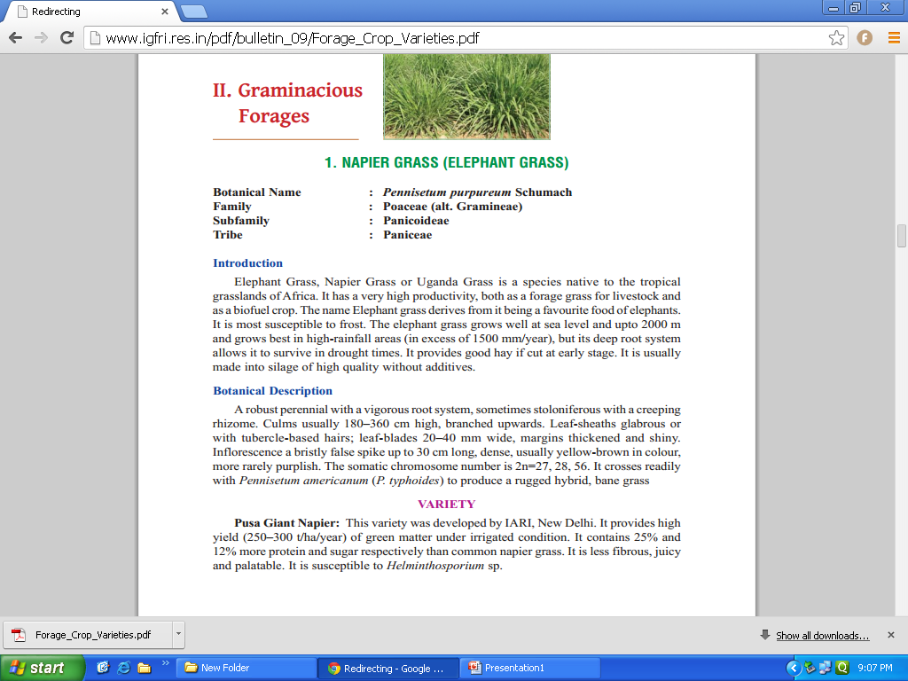
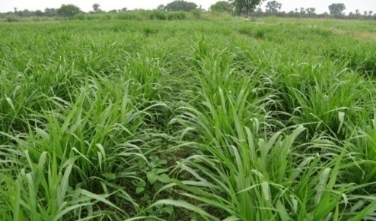
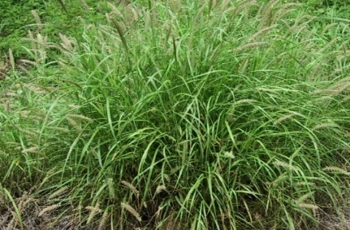
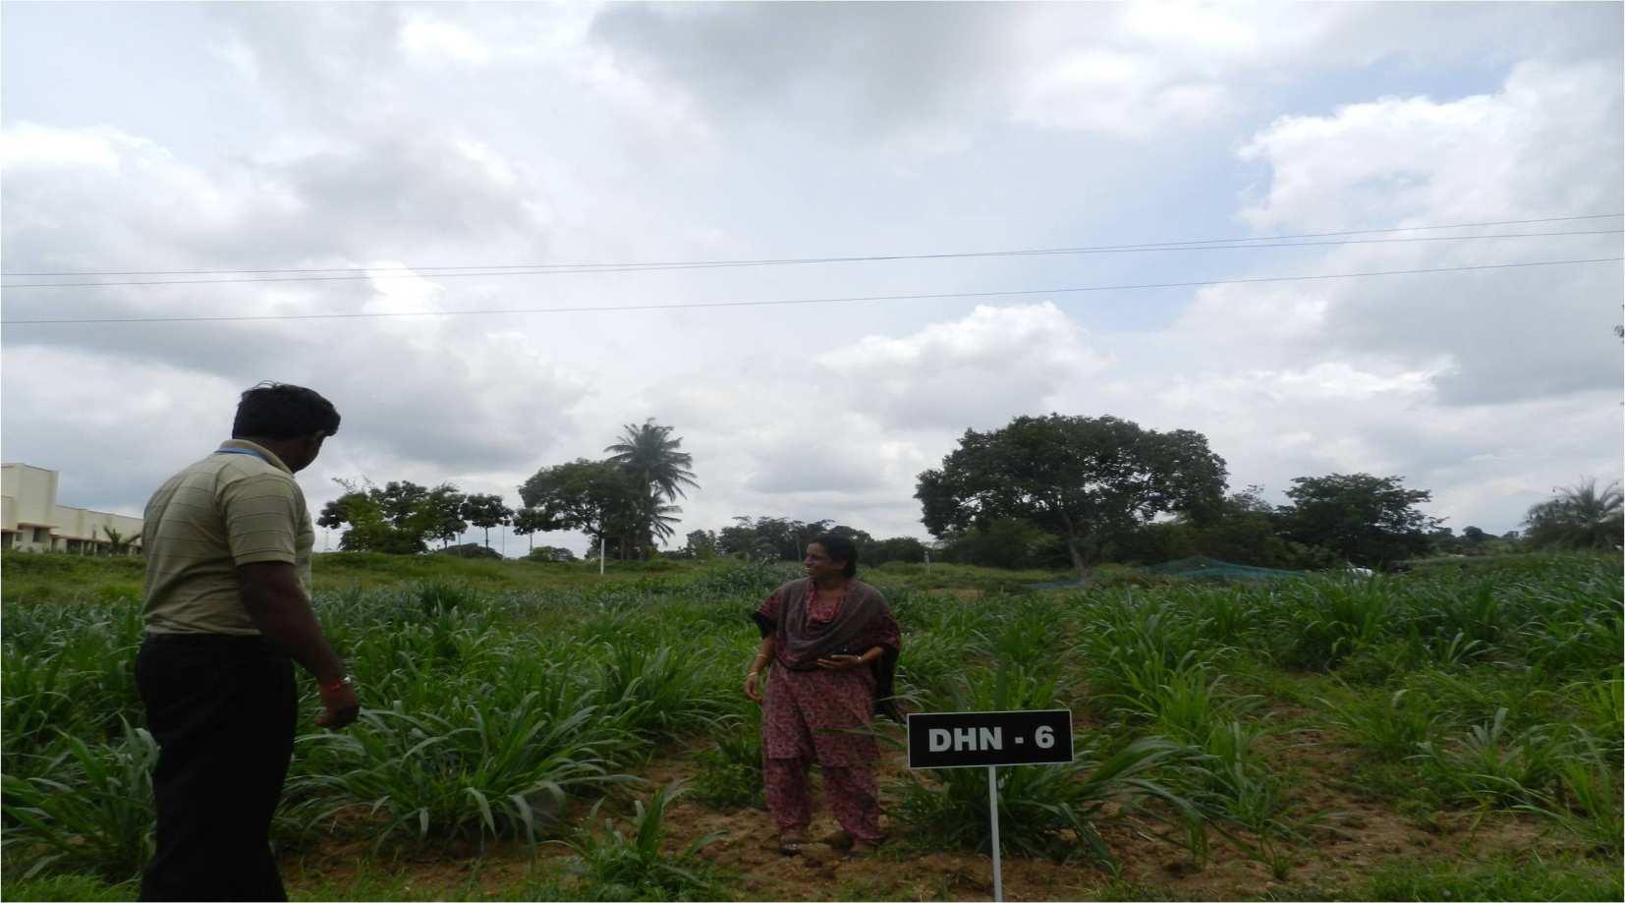
1. Assessment of Multi-cut Fodders for Yield and Quality
OFT
Cont..
Prioritized Problem
Low productivity, more pubescence
Less palatability
IGFRI- Regional station, Dharwad
FP | RP | AP - 1 | AP - 2
Napier grass (NB-21) | Hybrid Bajra Napier (Co-3) | Bajra Hybrid (BH-18) | Dharwad Hybrid Napier (DHN-6)
Less pubescent More Oxalic acid (3%) Yield – 80 t/ha | Moderate pubescence Mod. oxalic acid (2.5%) Yield – 110 t/ha | Moderate pubescence Mod. Oxalic acid (2.5%) Pot. Yield – 160 t/ ha | No pubescence Low Oxalic acid (1.9%) Pot. Yield–180 t/ ha
NB-21
Co-3
BH-18
DHN-6
Parameters
Soil fertility status (pre & post)
Palatability & Yield (t/cut)
Cumulative Yield (t/yr) & B : C ratio
Trials : 04
Cost Rs. 4,000

Slide 10
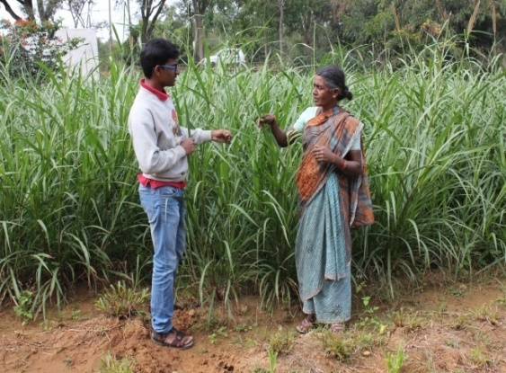
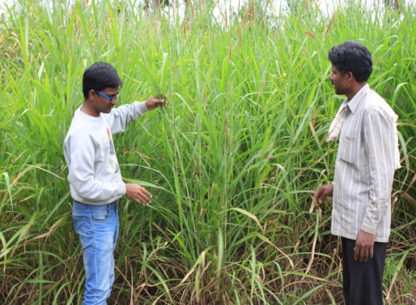
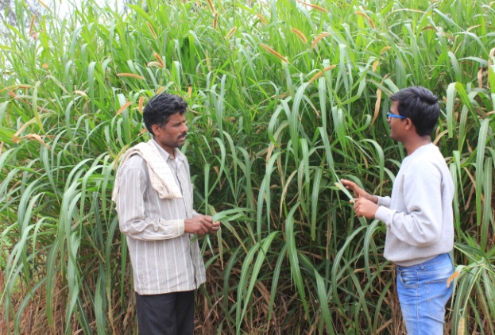
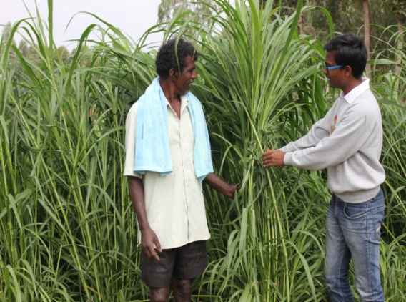

1st year Result
Farmer No | Yield (t/ha)
 | Plant height (cm) |  |  |  | 1st Cut |  |  |  | 2nd cut |  |  |  | 3rd Cut
 | NB-21 | Co-3 | BH-18 | DHN-6 | NB-21 | Co-3 | BH-18 | DHN-6 | NB-21 | Co-3 | BH-18 | DHN-6 | NB-21 | Co-3 | BH-18 | DHN-6
1 | 110.60 | 139.00 | 188.00 | 184.00 | 15.60 | 18.90 | 18.90 | 22.60 | 18.50 | 19.50 | 25.90 | 26.30 | 23.40 | 26.80 | 27.30 | 38.40
2 | 121.00 | 138.00 | 169.00 | 155.00 | 15.30 | 18.00 | 23.10 | 21.90 | 21.60 | 20.40 | 20.60 | 24.50 | 22.60 | 24.90 | 30.20 | 36.20
3 | 120.00 | 116.00 | 175.00 | 146.00 | 14.10 | 19.20 | 19.50 | 23.40 | 17.80 | 22.80 | 26.10 | 22.80 | 21.20 | 22.70 | 32.10 | 29.80
4 | 129.00 | 129.00 | 192.00 | 178.00 | 12.40 | 18.00 | 20.90 | 19.80 | 19.30 | 24.10 | 24.80 | 25.90 | 20.80 | 28.30 | 34.60 | 37.10
5 | 112.00 | 139.00 | 185.00 | 163.00 | 14.30 | 18.50 | 21.80 | 20.40 | 15.40 | 20.80 | 23.20 | 27.80 | 22.60 | 26.50 | 28.40 | 33.60
6 | 103.00 | 120.00 | 176.00 | 168.00 | 13.60 | 16.00 | 18.70 | 24.60 | 18.30 | 27.60 | 26.80 | 29.40 | 28.00 | 30.10 | 26.50 | 38.00
Ave | 115.93 | 130.17 | 180.83 | 165.67 | 14.22 | 18.10 | 20.48 | 22.12 | 18.48 | 22.53 | 24.57 | 26.12 | 23.10 | 26.55 | 29.85 | 35.52
Technology | Oxalic acid (%) | Protein (%) | Palatability (%) | Increase in Palatability (%)
NB-21 | 3.0 | 4.3 | 75 | -
Co-3 | 2.3 | 4.5 | 80 | 6.25
BH-18 | 2.0 | 7.4 | 94 | 20.21
DHN-6 | 1.9 | 7.1 | 92 | 18.47
NB-21
Co-3
DHN-6
BH-18

Slide 11
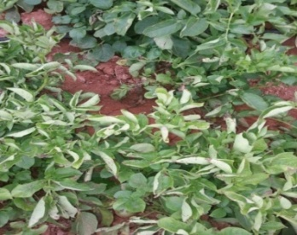
2. Assessment on Management of Late Blight in Potato
OFT
Cont..
Area | Disease Severity
927 ha | > 37 %
Prioritized Problem
Incidence of late blight
CPRI
FP | RP | AP - 1 | AP - 2
Mancozeb (0.2%), Dimethomorph (0.1%) + Mancozeb (0.2%), CoC(0.3%), Fenamidone + Mancozeb Metalaxyl + Mancozeb (0.2%), Cymoxanil + Mancozeb (0.3%) Copper Hydroxide (0.2%), Propineb (0.2%), Chlorothalonil (0.2%) | Prophylactic Mancozeb (0.2%) 2 times Cymoxanil + Mancozeb (0.3%) | Soil application of Trichoderma and Pseudomonas Prophylactic–Mancozeb (0.2%) Fenamidone+mancozeb (0.3%) Dimethomorph (0.1%) + Mancozeb (0.2%), Cymoxanil + Mancozeb (0.3%) | AP1+ Iprovalicarb + Propineb (0.4%)
 |  | Prophylactic spray followed by curative methods and biocontrol agents

Slide 12
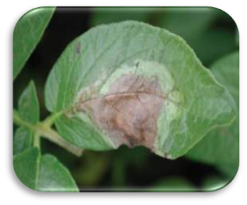
Critical inputs
Particulars | Qty. (kg/ha) | Cost /kg (Rs.) | Total Cost (Rs.)
Fenamidone + Mancozeb | 1.2 kg | 2825 | 3,390/-
Dimethomorph + Mancozeb | 0.7kg +2.5kg | 5750 380 | 4,025/- 950/-
Trichoderma | 12.5 kg | 170 | 2,125/-
Pseudomonas | 12.5 kg | 230 | 2,875/-
Iprovalicarb + Propineb | 1.0 kg | 2000 | 2,000/-
Total cost / ha |  |  | 15,365/-
Village : K.R.Pura
Taluk : Nelamangala
SMS : PP
No. of trials : 07 (1 ha)
Total Cost : Rs. 15,365
+ 4000 FD + B
Parameters
Soil fertility status (pre & post)
% Late blight incidence
No. of Fungicide sprays
Cost of sprays
Yield, B:C ratio

Slide 13
1st year Result
Trial No. | Observations on per cent disease severity
 | 30 DAT |  |  | 40 DAT |  |  | 50 DAT |  |  | 60 DAT |  |  | 70 DAT |  |  | 80 DAT
 | FP | RP | AP | FP | RP | AP | FP | RP | AP | FP | RP | AP | FP | RP | AP | FP | RP | AP
1 | 10.23 | 9.95 | 6.89 | 22.43 | 15.33 | 10.16 | 37.95 | 25.35 | 14.83 | 40.5 | 32.65 | 19.56 | 28.5 | 15.56 | 10.16 | 21.93 | 12.75 | 7.95
2 | 13.45 | 10.54 | 5.14 | 19.76 | 12.55 | 10.73 | 32.5 | 24.15 | 12.75 | 42.65 | 27.95 | 21.73 | 25.95 | 21.73 | 10.73 | 17.67 | 10.76 | 8.4
3 | 14.6 | 7.35 | 6.35 | 23.76 | 15.6 | 9.53 | 35.75 | 24.5 | 17.45 | 41.85 | 29.85 | 22.19 | 29.85 | 17.19 | 9.53 | 23.56 | 13.56 | 7.35
4 | 12.9 | 8.45 | 5.65 | 18.63 | 16.5 | 12.65 | 34.25 | 23.25 | 11.55 | 44.55 | 27.65 | 19.5 | 27.65 | 19.5 | 12.65 | 19.23 | 17.25 | 9.45
5 | 13.65 | 7.95 | 5.35 | 24.25 | 14.75 | 10.49 | 36.65 | 26.5 | 14.9 | 43.25 | 32.5 | 18.2 | 26.5 | 18.2 | 10.49 | 18.75 | 15.45 | 8.95
6 | 12.5 | 8.65 | 4.15 | 22.9 | 18.5 | 9.25 | 38.15 | 22.5 | 15.65 | 42.75 | 30.75 | 18.25 | 28.75 | 15.25 | 9.5 | 21.89 | 13.75 | 6.85
7 | 11.65 | 11.95 | 5.75 | 25.76 | 14.8 | 8.45 | 39.25 | 20.1 | 16.95 | 45.25 | 29.25 | 15.25 | 26.35 | 15.25 | 8.45 | 25.15 | 12.65 | 8.8
Cost of technology /ha – Rs.10,000/-
Benefits Additional yield over RP - 2.01 t/ha Additional returns - Rs. 30,000/-
DAT | % disease severity
 | FP (T1) | RP (T2) | AP (T3)
30 | 12.71 | 9.26 | 5.61
40 | 22.50 | 15.40 | 10.18
50 | 36.35 | 23.76 | 14.87
60 | 42.97 | 30.08 | 19.24
70 | 27.65 | 17.53 | 10.22
80 | 21.17 | 13.74 | 8.25
Avg | 27.23 | 18.30 | 11.40
Yield (t/ha)
Trial No. | FP (T1) | RP ( T2) | AP (T3)
1 | 18.50 | 21.25 | 23.50
2 | 19.85 | 22.50 | 24.25
3 | 20.75 | 21.95 | 23.95
4 | 19.50 | 22.65 | 24.50
5 | 20.10 | 21.50 | 23.85
6 | 19.65 | 22.35 | 24.45
7 | 20.35 | 21.95 | 23.65
Avg | 19.81 | 22.01 | 24.02
Feedback
Reduced cost of production (20%)
Reduced no. of fungicide sprays
(4 against 8)
Additional income (10%)
Healthy plants

Slide 14
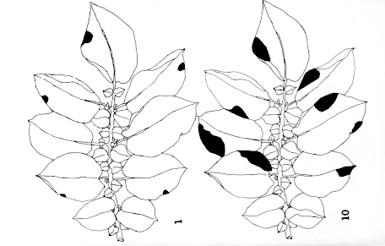
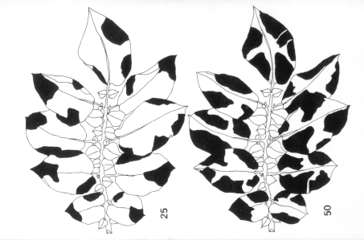
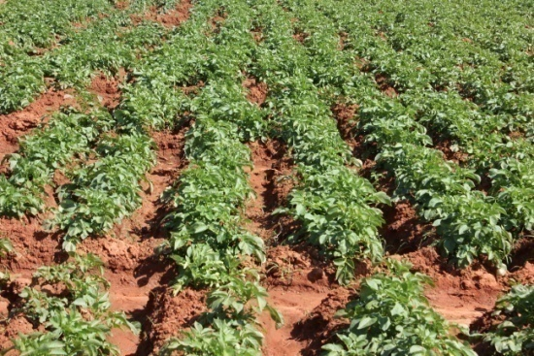
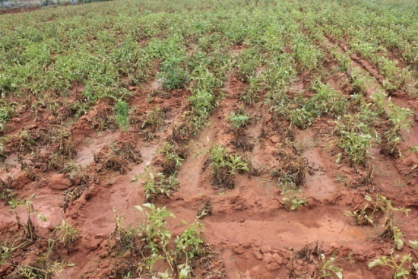
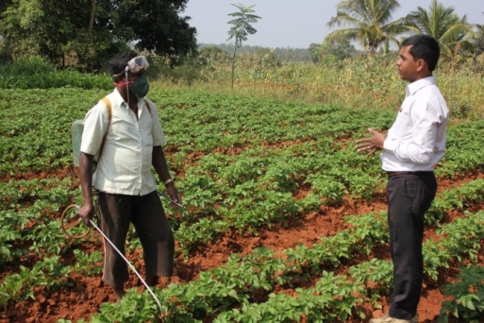
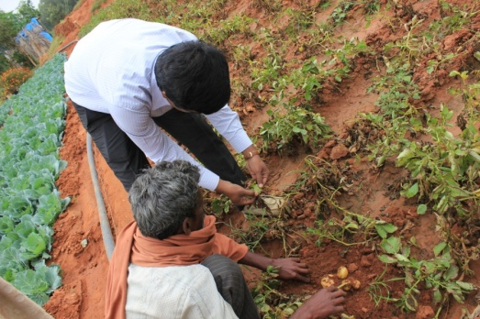
Disease Severity Scale described by James
Blight (%) Nature of infection
0 No disease observed.
0.1 A few scattered plants blighted; not more than 1 or 2 spots in 12-yard radius.
1 Up to 10 spots per plant; or general light infection.
5 About 50 spots per plant; up 1 to 10 leaflets infected.
25 Nearly every leaflet infected, field looks green although every plant is affected.
50 Every plant affected and about 50% of leaf area destroyed; field appears green.
75 About 75% of leaf area destroyed; field appears neither predominantly brown nor green.
95 Only a few leaves on plants, but stems are green.
100 All leaves dead, stems are dead or dying.

Slide 15
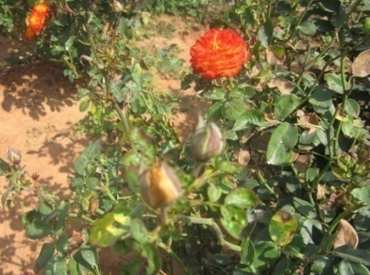
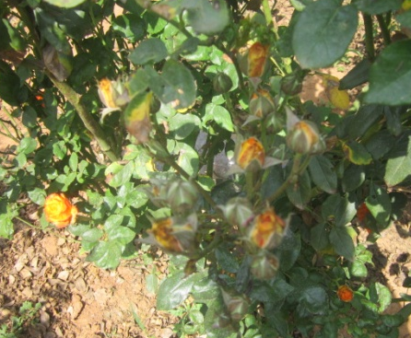
Critical Inputs :
3. Assessment on Foliar Spray of Micronutrients in Rose
(var. Cherishma)
OFT
Parameters | Details
Area | 1050 ha
Dist. avg. yield | 6.5 t/ha
Potential yield | 12 t/ha
Prioritized Problems | Uneven opening of buds Poor flower quality
FP | AP-1 | AP-2
No foliar spray | (Boron 0.5% + Iron 50 ppm) + (Urea 1%) - 2 sprays | Micro nutrient mixture (MnSo4 + FeSo4 + MgSo4 +B) 0.2% - 2 sprays
 | 1st spray : After pruning & appearance of fresh flush 2nd spray : After bud initiation
IIHR
TNAU

Slide 16
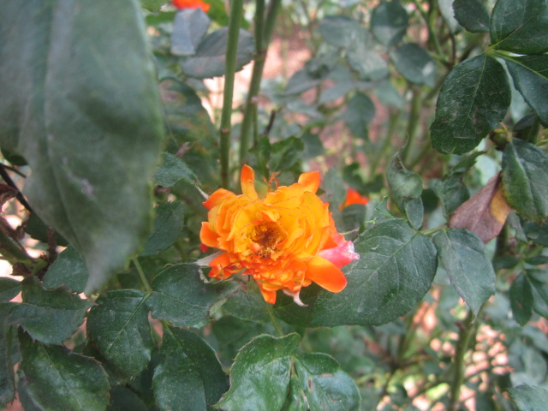
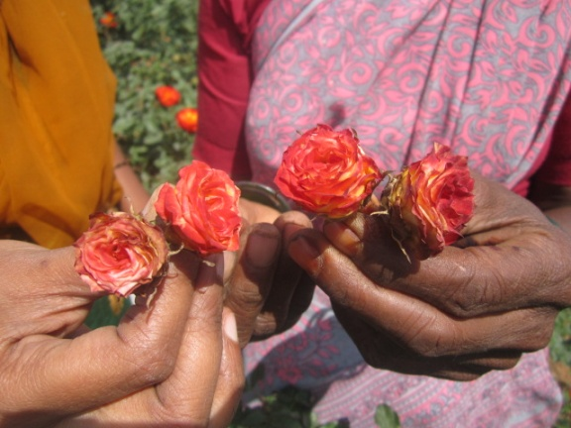

Critical inputs
Village : Alappanahalli
Taluk : Hosakote Tq
SMS : SS&AC
Particulars | Qty. (0.4 ha) | Cost/kg (Rs.) | Total Cost (Rs.)
Boric Acid | 6 kg | 180 | 1,080/-
Ferrous sulphate | 6 kg | 50 | 300/-
Nutrient mixture | 6 kg | 250 | 1500/-
Total |  |  | 2,880/-
No. of trials : 06 (0.4 ha)
Total cost : Rs. 2,880/-
+ 4000 FD + B
Parameters
Soil fertility status (pre & post)
Quality of irrigation water
Size of the flower
Quality of the flower
Yield
B:C ratio

Slide 17
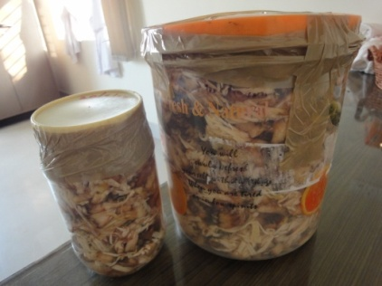
4. Assessment of Jack fruit Residue as Silage for Dairy Animals
OFT
Parameters | Details
Animal Population | 2 lakh
Reduction in Milk Yield | 25%
Prioritized Problems | High cost of milk production Non-availability of green fodder
FP | RP | AP (NIANP)
Imbalanced feeding | Balanced Feeding of dry fodder, green fodder, concentrates | Replacement (25%) of green forages with the Jackfruit residue (silage)
Nutrient composition of Jackfruit residue | Dry Matter : 20-25%, Crude protein : 7-8% TDN : 70% , NDF : 60%
Trials (Animals) | 10

Slide 18
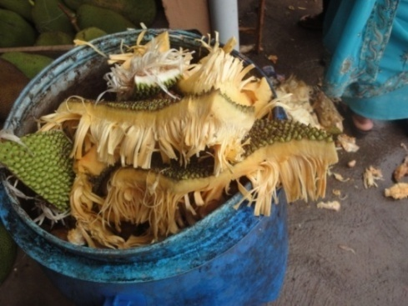
Villages : Ojenahalli, Nelamangala Tq.
Cheelenahalli, Doddaballapur Tq.
SMS : AS. Hort, Agron
Critical inputs
Particulars | Quantity | Each Cost (Rs.) | Total Cost (Rs.)
Drums | 20 Nos. | 700 | 14,000/-
Feeding buckets | 20 Nos. | 150 | 3,000/-
Total |  |  | 17,000/-
No. of trials : 10
No. of animals : 20
Total Cost : Rs. 17,000/-
+ 4000 FD + B
Parameters
Milk yield
SNF
Fat %
Incidence of metabolic disorders (Acidosis, Bloat)
B:C ratio

Slide 19
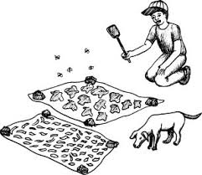
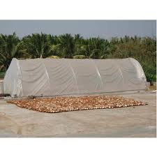
5. Solar drying - A Hygienic Technique for Value Addition in Jack
OFT
Parameters | Details
Area | 187 ha
Production | 6,130 mt
Prioritized Problems | Poor storage due to perishable nature Unhygienic drying Low income during glut
FP | RP | AP (RVSCET, Coimbatore)
Fresh jack fruit | Direct sun drying | Solar drying
Products fom Dehydrated jack bulbs | Chips, Papad, Vegetable
Unhygienic drying
Hygienic drying

Slide 20
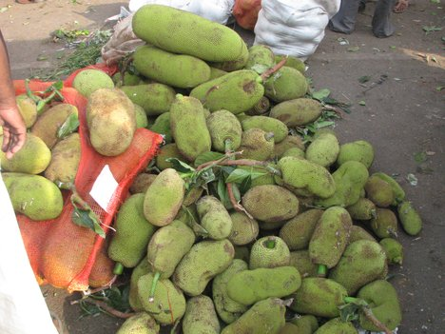
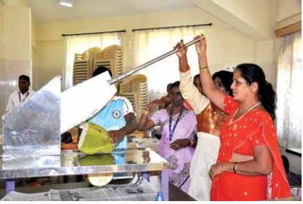
Critical inputs
Particulars | Cost (Rs.)
Silpaulin sheet (4 Nos.) | 2,800/-
Jackfruit chopper | 1,000/-
Moisture meter | 4,000/-
Packaging material | 1,000/-
Total | 8,800/-
No. of trials : 01
Total Cost : Rs. 7,800
Parameters
Taluk : Doddaballapur
SMS : HS, Ag. Extn. PC
Jackfruit Dry yield Drying period Economics Keeping quality (days) Acceptability Microbial load

Slide 21
Abstract : Front Line Demonstrations
Sl. No | Title of the Technology | No. of Demo | Area (ha) | Total budget (Rs.)
1. | Addressing drought and blast in Finger millet (NFSM) | 30 | 12 | 60,000
2. | Integrated Crop Management in Redgram (NFSM) | 15 | 06 | 45,000
3. | Promotion of fodder cafeteria for regular green fodder availability | 05 | 01 | 14,650
4. | Intercropping of Fodder Cowpea in grain Maize (NFSM) | 15 | 06 | 30,000
5. | Eco-friendly Management of Diamond Back Moth and Black Rot in Cabbage | 05 | 01 | 14,375
6. | Integrated management of Late Blight in Tomato | 05 | 01 | 24,000
7. | Integrated Crop Management in Capsicum | 05 | 01 | 13,450
8. | Integrated Crop Management in Pole Beans | 05 | 01 | 19,950
9 | Bio-fertilizers and SOP for enhanced yield in Potato | 05 | 01 | 10,400
10 | Management of nut splitting in Arecanut | 05 | 01 | 8,280
11 | Integrated Nutrional interventions in Dairy Animals | 20 animal | 20 farmers | 17,450
12 | Management of Mastitis at sub-clinical stage in Dairy Animals | 20 animal | 20 farmers | 21,000
13 | Integrated Management of Endo & Ecto-parasites in Dairy animals | 10 animal | 10 farmers | 14,000
14 | Vegetable roof gardening and eco friendly management of kitchen waste for Health Security | 04 | - | 18,000
15 | Osmotic dehydration of Fruit Bits for enhanced income – EDP Mode | 1 | - | 8,800
TOTAL |  |  |  | 3,19,355

Slide 22
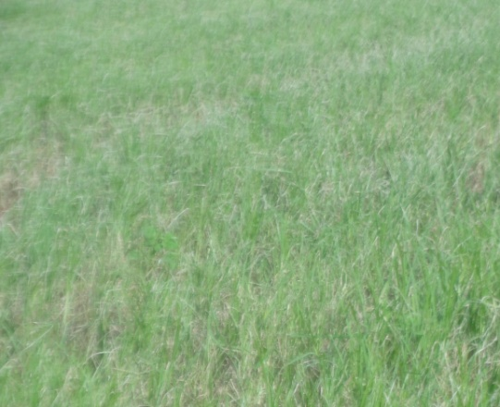
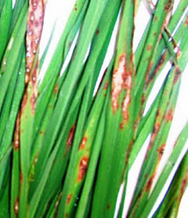
1. Addressing Drought and Blast in Finger millet (NFSM)
FLD
Parameters | Details
Area | 47,238 ha
Dist. Avg. Yield | 16 q/ha
Potential Yield | 35 q/ha
Prioritized Problem | Intermittent drought, blast incidence, threshing
Technology (UAS, B) | ML-365 Variety – Blast resistant & drought tolerant Seed treatment (Azospirillum) INM & IPM Mechanization
Drought affected field
Blast infestation
Critical inputs
No. of Demo : 30
Total Cost : Rs. 60,000/-
Parameters
Particulars (per demo/acre) | Cost (Rs.)
Seeds | 200/-
Azospirillum – 1 kg | 250/-
Trichoderma – 10 kg | 1550/-
Total cost / ha | 2,000/-
Soil fertility status (pre & post)
Germination & establishment
No. of effective tillers/plant
Yield, B:C ratio
Village : Cheelenahalli
Taluk : Doddaballapura
SMS : PP, HS

Slide 23
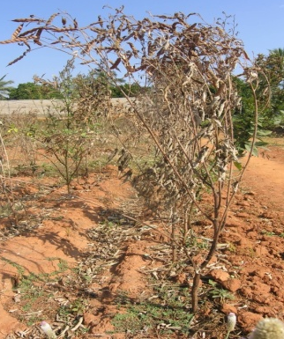
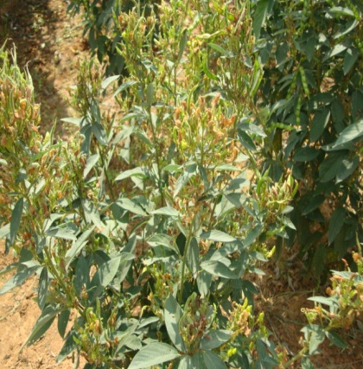
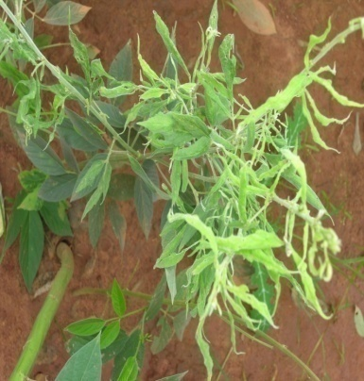
2. Integrated Crop Management in Redgram (NFSM)
FLD
Parameters | Details
Area | 1,640 ha
Dist. Avg. Yield | 8 q/ha
Potential Yield | 15 q/ha
Prioritized Problems | > 30% Wilt incidence, Pod borer, SMD
Technology (UAS, B) | Use of variety BRG-5 (wilt resistant) Seed treatment (Rhizobium & PSB) Moisture conservation & inter cultivation IPM practices
Sterility Mosaic Virus
Critical inputs
Particulars (per demo/acre) | Cost (Rs.)
Seeds | 600/-
Rhizobium –1 kg | 250/-
PSB – 1 kg | 250/-
Pheromone traps – 4 Nos | 250/-
NPV – 0.2lts | 200/-
Spinosad– 75 ml | 1200/-
Profenophos – 0.4 litre | FC
Dicofol – 0.6 lt
Calcium chloride – 0.5 kg | 250/-
Total cost per ha | 3000/-
Parameters
Phyllody
Fusarium wilt
No. of Demo : 15
Cost : Rs. 45,000/-
Village : K R Pura
Taluk : Nelamangala
SMS : SSAC, PP
Soil fertility status (pre & post)
Germination & establishment
Days to 50% flowering
No. of pods/plant
% incidence of wilt & pod borer incidence
Yield, B:C ratio

Slide 24
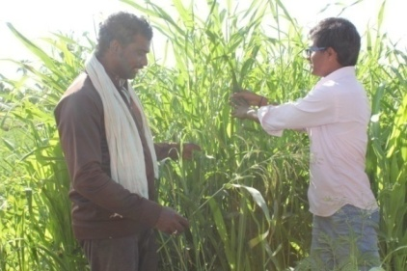
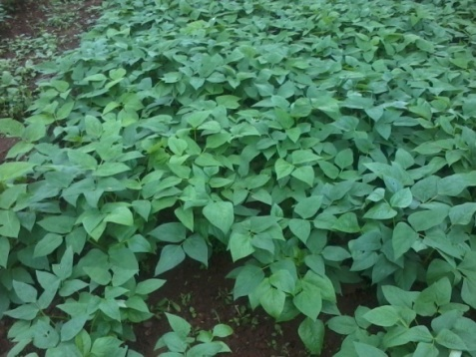
FLD
3. Promotion of fodder cafeteria for regular green fodder availability
Cont.
Crop | Prioritized Problem | Technology | Source
Fodder crop | Non availability of nutrit1ive fodder and scarcity during drought Lower milk quality (SNF and fat) | Promotion of new fodder varieties – cerelas, legumes, perennials | UAS (B)
Critical Inputs
Name | Qty/ha | Input cost (Rs.)
Fodder sorghum var.COFS-29 seeds Fodder cowpea M.dubia seedlings | 7kg 30 kg seeds, 25 Nos. | 7,000 3,000 650
 | Total cost /ha | 10,650
CoFS-29
No. of Demo : 05 / 01 ha
Total Cost : Rs. 10,650/-
+ 4000/- (B & FD)
Village : Bidaluru
Taluk : Devanahalli Tq
SMS : Agron, AS
Parameters
Soil fertility status (pre & post)
Plant height
Yield t/cut
Quantity of fodder left over
Milk yield
Quality parameters
Fodder cowpea

Slide 25

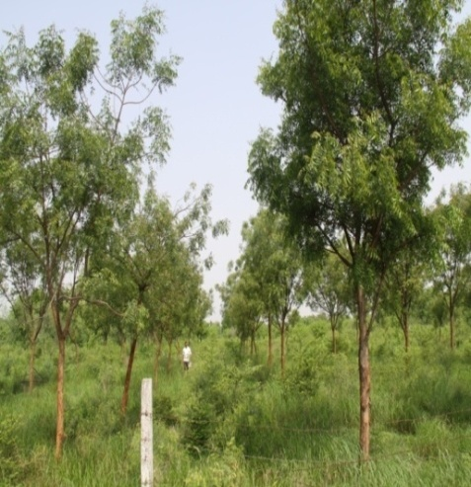
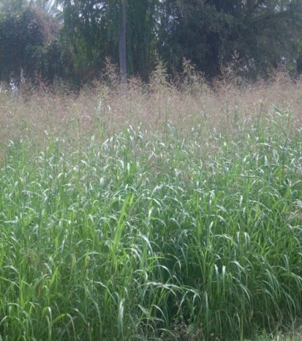
1st year Results
Farmer | CoFS-29 (t/ha) |  |  |  | Fodder Cowpea (t/ha) | Melia dubia
 | 1st Cut | 2nd Cut | 3rd Cut | Avg.
1 | 158.6 | 130.2 | 129.6 | 139.47 | 32.4 | Under progress
2 | 142.2 | 138.6 | 123.2 | 134.67 | 33.5
3 | 149.6 | 140.3 | 124.6 | 138.17 | 34.2
4 | 146.3 | 139.6 | 139.2 | 141.70 | 36.1
5 | 139.4 | 126.2 | 131.4 | 132.33 | 30.3
Fodder cowpea
Melia dubia
CoFS - 29

Slide 26
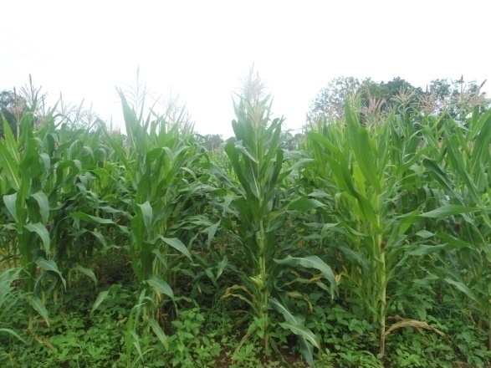
4. Intercropping of Fodder Cowpea in grain Maize (NFSM)
FLD
Parameters | Details
Area | 10,511 ha
Dist. Avg. Yield | 32 q/ha
Potential Yield | 45 q/ha
Prioritized Problems | Pure crop of Maize in > 95% area Weed menace in the initial stage
Technology (UAS, D) | Intercropping of Fodder cowpea (DFC-1/MFC-08-14)
Pure crop with weeds
Parameters
Critical inputs
No. of Demo: 15
Cost : Rs. 30,000/-
Village : Ojenahalli
Taluk : Nelamangala
SMS : Agron, AS
Soil fertility status (pre & post)
Yield- Fodder of Cowpea
Yield- Grain Maize
Weed index & weed control efficiency
B:C ratio
Particulars (per demo/acre) | Cost (Rs.)
Maize/Cowpea Seeds | 1250/-
Azospirillum – 1 kg | 250/-
Rhizobium – 1 kg | 250/-
PSB – 1 kg | 250/-
Total cost/ha | 2,000/-

Slide 27
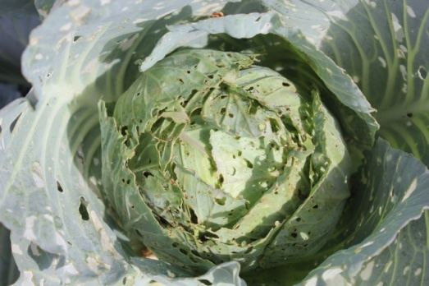
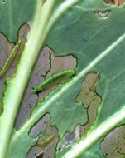
5. Eco-friendly Management of Diamond Back Moth and
Black Rot in Cabbage
FLD
Parameters | Details
Area | 789 ha
Disease incidence | > 42%
Prioritized Problem | DBM and Black Rot Infestation
Technology (IIHR) | Mustard intercrop (25:1) Traps (DBM) - 10/ha Neem soap, Bt, Pongamia soap Novaluron, Amamectin benzoate
Critical inputs
(per demo) | Cost (Rs.)
Mustard seeds – ½ kg | 150
DBM Traps+lures – 5 No+5 No. | 475
Neem & Pongamia soap – 2 kg each | 650
Bt – 200 gm | 800
Amamectin benzoate- 100 ml | FC
Copper hydroxide – 500 gm
Streptocycline – 100 gm
Total cost / demo | 2,075
No. of Demo : 05 / 01 ha
Total Cost : Rs.10,375/- + 4000/- (B & FD)
Village : K R Pura
Taluk : Nelamangala
SMS : PP, Hort
Parameters
Soil fertility status (pre & post)
% DBM & black rot incidence
Yield & B:C ratio

Slide 28
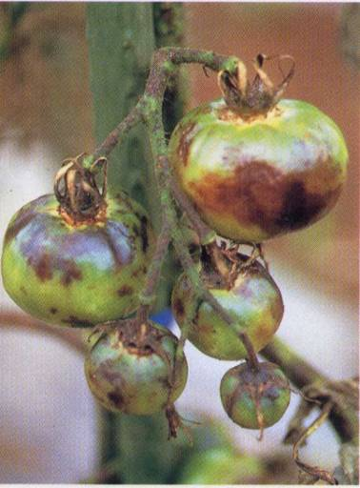
6. Management of Late Blight in Tomato through Integrated Approach
FLD
Cont.
Parameters | Details
Area | 2,248 ha
Disease incidence | > 48%
Prioritized Problem | Late blight disease
Technology (UAS, B) | Use of Biocontrol Agents Use of Plant Protection Chemicals
No. of Demo : 05 (1 ha)
Total Cost : Rs. 20,000+ 4,000/- (B&FD)
Village : Cheelenahalli
Taluk : Doddaballapura
SMS : PP & SSAC
Details of critical Inputs
Name | Qty./ Demo | Cost (Rs.) /kg | Cost/ Demo
Mancozeb | 1 kg | Farmer contribution
Metalaxyl +Mancozeb | 0.5 kg
Fosetyl AL | 0.5 kg
Dimethomorph | 0.5 kg
Trichoderma | 10 kg | 170 | 1700
Pseudomonas | 10 kg | 230 | 2300
Total cost / demo |  |  | 4000
Critical inputs
Parameters
Soil fertility status (pre & post)
% Late blight incidence
Yield
B:C ratio

Slide 29
Percent disease severity data of OFT conducted on Integrated Management
of late blight of Tomato
Trial No. | Observations on per cent disease severity |  |  |  |  |  | 90 DAT
 | 30 DAT | 40 DAT | 50 DAT | 60 DAT | 70 DAT | 80 DAT
 | Disease severity(%) | Disease severity(%) | Disease severity(%) | Disease severity(%) | Disease severity(%) | Disease severity(%) | Disease severity(%)
1 | 6.95 | 10.25 | 13.58 | 13.21 | 10.16 | 7.95 | 6.29
2 | 6.40 | 8.89 | 12.25 | 13.33 | 10.73 | 8.40 | 5.74
3 | 5.35 | 9.35 | 12.75 | 14.65 | 9.53 | 7.35 | 5.85
4 | 8.45 | 10.65 | 11.45 | 15.95 | 12.65 | 9.45 | 6.15
5 | 7.95 | 11.35 | 13.35 | 14.5 | 10.49 | 8.95 | 5.50
DAT | % disease severity
 | Check | Demo
30 | 20.56 | 7.02
40 | 25.33 | 10.1
50 | 34.14 | 12.68
60 | 39.728 | 14.33
70 | 44.72 | 10.71
80 | 27.69 | 8.42
90 | 20.33 | 5.91
Avg. | 30.35 | 9.88
Yield (t/ha)
Trial No. | Check | Demo
1 | 61.56 | 64.62
2 | 60.26 | 67.84
3 | 59.33 | 64.96
4 | 60.82 | 63.28
5 | 61.81 | 65.44
Avg. | 60.76 | 65.23
 | % Disease severity | Production (t/ha) | B:C Ratio
Check | 30.35 | 60.76 | 2.85
Demo | 9.88 | 65.23 | 3.64
Cost of technology /ha – Rs.10,000/-
Benefits Additional yield over RP (t/ha) – 4.47 Additional returns - Rs. 35,760/-
Feedback
Reduced cost of production (20%)
Reduced no of sprays (4 against 10)

Slide 30
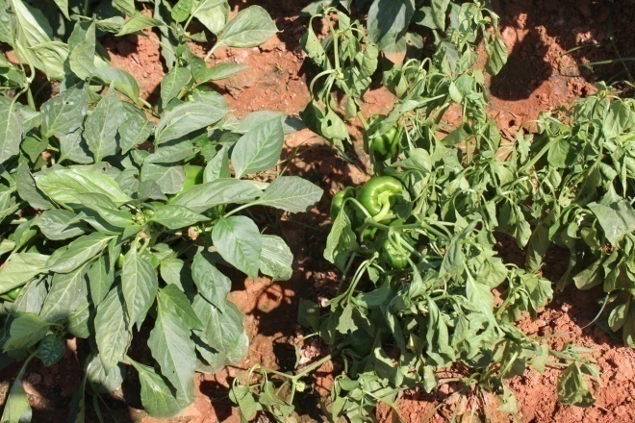
7. Integrated Crop Management in Capsicum
FLD
Parameters | Details
Area | 560 ha
Dist. Avg. yield | 12 t/ha
Potential yield | 20 t/ha
Wilt affected field
Prioritized Problem | Imbalanced nutrition Non-adoption of fertigation and soil & water conservation practices Wilt incidence, thrips & mites infestation
Technology (IIHR) | Vegetable special + Fertigation + Mulch Biological & chemical control for wilt & mites

Slide 31
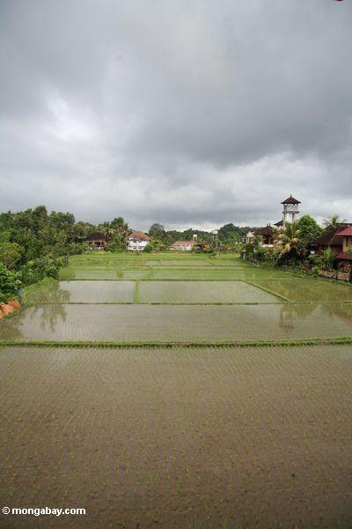
No. of Demo :05 / 01 ha
Total Cost :Rs 9,450/- + 4000/- (B & FD)
Village : Bidaluru
Taluk : Devanahalli
SMS : SSAC, Hort, PP,
Critical inputs
Particulars (per ha) | Cost (Rs.)
Trichoderma + Pseudomonas - 15 lt | 4,500
Vegetable special – 15 kg | 2,250
Potassium nitrate – 60 kg | FC
Calcium nitrate – 60 kg
Mulch film – 70 kg
Propargite– 1.5 ltr(Mites) | 1,200
Fipronil – 1.5 ltr (Thrips) | 1,500
Total cost / ha | 9,450
Parameters
Soil fertility status (pre & post)
Quality parameters
Yield parameters
Yield and B:C ratio

Slide 32


8. Integrated Crop Management in Pole Beans
FLD
Parameters | Details
Area | 958 ha
Dist. Avg. yield | 19 t/ha
Disease incidence | > 50%
Prioritized Problem | Imbalanced nutrition, Low FUE YMV, Rust, Anthracnose
Technology (IIHR) | Fertigation once in 3 days from 15 DAP (25 fertigations) (200 kg 19 All + 50 kg Pot. Nitrate + 80 kg Mono Amm. phosphate ) Bio control agents & PP Chemicals
Yellow Mosaic Virus
Leaf miner

Slide 33
Critical inputs
No. of Demo : 5 (1 ha)
Total Cost: Rs. 15,950 + 4000/- (B & FD)
Village : Nagashettihalli
Taluk : Doddaballapur
SMS : SSAC, Hort & PP
Details
 | Qty./ demo | Cost (Rs.) /kg | Cost/ demo
19 :19:19 | 200 kg | Farmers contribution
Pot. nitrate | 50 kg
Mono Amm. phosphate | 80 kg
Imidacloprid (YMV) | 500ml
Propiconazole (Rust) | 250ml
Thiomethoxam | 0.1kg | 4400 | 440
Sticky Traps+lures | 4+4 Nos | 188 | 750
Trichoderma | 5 kg | 170 | 850
Pseudomonas | 5 kg | 230 | 1150
Total cost per demo |  |  | 3,190
Soil fertility status (pre & post)
Nutrient uptake
% pest incidence
% disease incidence
Yield
B:C ratio
Parameters

Slide 34


9. Bio-fertilizer and SOP for enhanced yield in Potato
FLD
Parameters | Details
Area | 1,540 ha
Dist. Avg. yield | 14 t/ha
Potential yield | 25 t/ha
Prioritized Problem | Soil born pathogens Variation in Tuber Size
Technology (IIHR) | Use of biofertilizer (Actino Bacterial Consortia) Sulphate of potash
Tuber size variation
No. of Demo : 05 / 01 ha
Total Cost :Rs. 6,400/- + 4000/- (B & FD)
K.R.Pura / Nelamangala Tq
SMS – SSAC, PP, PC
Potato field
Critical inputs
Parameters
Particulars (per ha) | Cost (Rs.)
Actino Bacterial Consortia – 15 kg | 1,200
Sulphate of potash – 200 kg (50%FC) | 5,200
Total cost / ha | 6,400
Soil fertility status (pre & post)
Weight of the tuber
Bacterial wilt incidence
Yield
B:C ratio

Slide 35


10. Management of Nut splitting in Arecanut
FLD
Parameters | Details
Area | 977 ha
Dist. Avg. yield | 12 q/ha
Potential yield | 20 q/ha
Prioritized Problem | Severe nut splitting leading to yield loss No application of micro nutrients
Technology (CPCRI) | Application of FYM 12 kg/tree + RDF 100:40:140 NPK – 2 splits Borax 40 g/tree + Calcium 40 g/tree– 2 splits
No. of Demo : 05 / 01 ha
Total Cost : Rs. 4,280/- + 4000/- (B & FD)
Village : K.R.Pura
Taluk : Nelamangala
SMS : SSAC, PP, Hort
Split nuts
Critical inputs
Particulars (per ha) | Cost (Rs.)
Borax – 27 kg | 2,160
Potash – 130 kg (50% FC) | 1,250
Calcium - 27 kg | 870
Total cost / ha | 4,280
Parameters
Soil fertility status (pre & post)
No of Nut drop
Nut splitting (%)
Yield
B:C ratio

Slide 36




11. Integrated Nutritional interventions in Dairy Animals
FLD
New
Prioritized Problem
Population | Reduced milk yield(%)
2 lakh | 25
Imbalanced nutrition
Incidence of ruminal acidosis
Lower milk quality (fat %, SNF)
Technology
KVAFSU
Urea enrichment of crop residues
Chaff cutting
Total Mixed Ration (TMR)
Mineral mixture
Ration balancing (TDN, CP, Ca & P)
Silage
No. of Farmers:20
No. of Animals:20
Total Cost : Rs. 13,450/- + 4000/- (B & FD)
SMS : Animal Science, Agronomy
Gundasandra & Cheelenahalli, DBP Tq
Bidaluru, Devanahalli Tq
K.R.Pura & Ojenahalli, Nelamangala Tq
Alappanahalli, Hosakote Tq.
Critical inputs
Particulars (20 animals) | Cost (Rs)
Silpaulin sheet | FC
Sprayer | 850/-
Silage bags/drums | 9,000/-
Mineral mixture | 3,600/-
Total cost | 13,450/-
Parameters
Milk yield
Milk fat %
Milk SNF

Slide 37



FLD
12. Management of Mastitis at sub-clinical stage in Dairy Animals
New
Prioritized Problem
Population | Reduced milk yield(%)
2 lakh | 25
Fibrosis of the udder
Lower milk yield
Lower milk quality
Technology
KVAFSU
Post milking disinfectant spray to udder
KMNO4 crystals disinfection of cow shed
California Mastitis Kit (CMK)
Critical inputs
Particulars (20 animals) | Cost (Rs.)
California Mastitis Kits | 10,000/-
Povidone iodine liquid | 3,000/-
Antibiotic intra mammary tubes | 4,000/-
Total cost | 17,000/-
No. of Farmers:20
No. of Animals:20
Total Cost : Rs. 17,000 + 4000/- (B & FD)
SMS : AS, PP
Gundasandra & Cheelenahalli, DBP Tq
Bidaluru, Devanahalli Tq
K.R.Pura & Ojenahalli, Nelamangala Tq
Alappanahalli, Hosakote Tq.
Parameters
Milk yield
Incidence of mastitis
B:C Ratio

Slide 38
FLD
13. Integrated Management of Endo & Ecto-parasites in Dairy animals
Population | Reduced milk yield(%)
2 lakh | 25
New
Prioritized Problem
Lice, ticks and fleas infestation
Anemia
Milk yield
Technology
KVAFSU
Flumethrin liquid application
Doromectin injection
Disinfection of cow shed with KMNO4 crystals
No. of Farmers : 10
No. of Animals : 10
Total Cost : Rs. 10,000 + 4000/- (B & FD)
SMS : AS, PP
Ojenahalli, Nelamangala Tq
Alappanahalli, Hosakote Tq.
Critical inputs
Particulars (10 animals) | Cost (Rs./ha)
Flumethrin liquid | 5,000/-
Doromectin injection | 5,000/-
Total cost | 10,000/-
Parameters
Incidence of Ectoparasitic infestation
Hemoglobin & RBC count
TLC count

Slide 39



14. Vegetable Roof Gardening and Eco friendly
Management of Kitchen Waste for Health Security
FLD
Cont..
Parameters | Details
Prioritized Problems | Less consumption of vegetables in daily diet Lack of knowledge on kitchen waste management
Technology (UAS, B) | Ensuring availability of vegetables from roof gardening Education on segregation of types of garbage Use of daily dump kit for composting (4 q/family/yr)
Roof garden
Particulars | Cost (Rs.)
Poly Bags – 20 No | FC
Vermi compost
Cocopeat
Hand sprayer
Vegetable special | 150
Vegetable seed kit | 120
Neem oil | 330
Neem cake | 400
Daily dump kit | 3,500
Total cost / demo | 4,500
No. of Demo : 04
Total Cost : Rs.18,000/-
Place : Devanahalli & Doddaballapur
SMS : HS, PC & All SMS
Kitchen waste
Critical inputs
Savings
Cost economics
Compost yield
Quantification
Economics
Savings
Parameters
Daily Dump Kit

Slide 40




Results
Name | Family Size | Before TG Monthly Expenditure |  | After TG Production at terrace garden |  | After TG Monthly Expenditure |  | Amt saved | % saving | Amt e earned through selling (Rs.)
 |  | Qty | Rs | Qty | Rs | Qty | Rs | Rs | Rs
Mallamma | 3 | 17kg | 435 | 24kg | 600 | 8kg | 200 | 235 | 54 | 375
Shardamma | 7 | 29kg | 723 | 25kg | 625 | 12kg | 300 | 423 | 58.5 | 200
Raziya begum | 7 | 27kg | 681 | 15kg | 375 | 10kg | 265 | 416 | 61 | -
Mangalgowri | 5 | 25kg | 638 | 19kg | 475 | 11kg | 290 | 348 | 54.5 | 125
Average | 5.5 | 24.5 | 619 | 20.75 | 518.75 | 10.25 | 263.75 | 355.5 | 57 | 175
Feedback:
50-60% savings in purchase of vegetables
Happy to consume fresh and organically grown vegetables
Shared with friends and relatives
Good experience and willing to continue for next season

Slide 41




Osmotic dehydration of fruit bits for enhanced income
– EDP Mode
EDP
Parameters | Details
Banana | Area - 1,665 ha, Production – 33,513 mt
Papaya | Area - 197 ha, Production – 14,345 mt
Jack | Area - 187 ha, Production – 6,130 mt
Prioritized Problem | Lack of technology for drying 20-40% post harvest loss Lack of awareness on osmotic dehydration Low income during glut
Technology (IIHR) | Preparation of Dry fruit bits by osmotic dehydration followed by solar drying (Banana, Jack, Papaya)
No. of Demo | 1 SHG
Parameters | Dry yield & Drying period Cost economics & Keeping quality (days) Consumer Acceptability & Microbial load
Critical inputs
Particulars | Cost (Rs.)
Silpaulin sheet (4 Nos.) | 2,800
Sugar and preservatives | FC
Refractometer | 4,000
Packing and labelling material | 2,000
Total Cost | 8,800

Slide 42



Integrated Crop Management in Rose
FFS
Parameters | Details
Area | 1,050 ha
Disease incidence | > 35%
Prioritized Problem | Thrips, Aphids, Black spot, DM, PM
Technology (IIHR) | Use of Plant Protection Chemicals
Steps in Conducting FFS
1. Ground working activities
2. Training to facilitators
3. Establishment & running of FFS
    Selection of villages
    Collection of secondary information
    Discussion with local body
    Gramsabha - Entry point activity
    Group formation
    Base line information
    Developing curriculum
    Collaborator selection
  4. Data analysis – Interpretation - Economic analysis
  5. Field day / Sharing event
  6. Graduation
  7. Farmer-run FFS
Particulars | Amount (Rs.)
Critical inputs | 8,000/-
FFS Sessions | 6,000/-
Field day | 6,000/-
Training material | 8,000/-
Miscellaneous | 2,000/-
Total | 30,000/-
Taluk : Alappanahalli / HosakoteTq.

Slide 43




National Initiative on Fodder Technology Demonstration (NIFTD) 2015-16
Technologies | No. of Demo. | Budget
Module – I (1.0 ha)
Forage on bunds – Hedge Lucerne | 03 | 9,000
Round the year forage production - Forage sorghum (CoFS-29) | 03 | 8,000
Module – II (1.0 ha)
Horti Pasture – Mango / Arecanut + Stylo | 02 | 8,000
Silvipasture – Milia Dubia (tree) + Guinea grass + multi cut bajra | 01 | 4,000
Module - III
Urea treatment | 02 | 8,000
Silage making | 02 | 5,000
Area specific mineral mixture | 03 | 8,000
Budget : 50,000/-
Hedge Lucerne
Multicut Bajra
Urea enrichment
Visit by RGFRI scientist

Slide 44









Innovative Activity
Soil and Moisture Conservation Practices in Dryland Farming
Broad bed furrow (BBF)
Dead furrows, conservation furrows
Compartment bunding, microcatchment and
graded bunds
Intercropping (cereal/pulse)
Green manuring
Dryland Horticulture
Mulching
Perennial fodder on bunds
Broad bed furrow
Mulching
Budget – Rs. 50,000/-
Compartment bunding
Perennial fodder on bunds
Microcatchment
Intercropping
Green manuring

Slide 45




Integrated Farming System
IFS
S. Jayaram
Dairy Enterprise Based Farming
Smt. Roopa
Vegetables Based Farming
A. Govindappa
Poultry
Based Farming
K. Shivaprasad
Vegetables
Based Farming
Gangaswamy
Plantations
Based Farming
Enterprise | Existing practices | Critical Interventions
 |  | 2013-14 | 2014-15 | 2015-16
Animals | HF cows Ramblet sheep | 1 Bandur Male sheep | Mineral Mixture | Azolla Silpaulin sheet Mastitis Kit Balanced Feed Chart Swarnadhara birds
Fodder | Green fodder round the year Sprinkler & Drip | Fodder cafeteria CoFS-29, SA-Tall, Fodder cowpea, Stylosanthes | - | Silage bag
Finger millet Redgram Field bean Coconut | Domestic purpose | - | Finger millet – ML 365 Redgram - BRG - 2 Field bean – HA – 4 Vegetable Seed Kit Tender Coconut Opener Cycle weeder | Coconut dehusker Apiary
Bitter gourd Bottle gourd Ridge gourd Tomato Cabbage Potato Coriander | STCR not practiced No Micronutrients and Biofertilizers | AMC Vegetable special | - | Vermicompost Liquid formulations - IIHR Growth promoters, Biofertilizers
 | Chemical methods of plant protection | Trichoderma Pseudomonas Plant Protection Kit | WOTA traps, Pheromone traps, Neem Oil, Neem & Pongamia soap | NPV, Bt products, Fruit fly traps Knapsack sprayer
 | Weed and water problem | Plastic mulching | - | -
Budget : 50,000/-

Slide 46
Training Programmes
TRG
On campus trainings | No.
Farmers & Farm women
Integrated Crop Management | 4
Management of farm animals | 1
Terrace gardening | 1
Farm produce Storage techniques | 1
Extension Functionaries
Horticulture | 2
Agriculture | 2
Animal Husbandry | 2
Women & Child Welfare | 2
Non-Government Organizations | 2
Fisheries | 1
Sericulture | 1
On campus trainings | No.
Rural Youth (Vocational Training - EDP)
Backyard Poultry |  | 1
Bakery and Confectionery Technology |  | 1
Mushroom cultivation |  | 1
Friends of Coconut Tree (FOCT) |  | 1
Off campus trainings | No.
Integrated Pest Management | 6
Nutrient management techniques | 6
Management of farm animals | 4
Production techniques in field crops | 5
Fodder production techniques | 3
Value Addition | 3
Terrace gardening | 2
Total trainings - 76

Slide 47
Production Activities at KVK
PRD
Material | Quantity
Seeds
Ragi ML 365 & MR 6 (TL) | 40 q
Redgram BRG-2 and BRG-5 (TL) | 35 q
Planting material
Jack, Mango, Jamun, Papaya , Guava, Amla, Drumstick, Curry leaf, Lime, pomegranate, Amruthballi, Tulasi, Doddapatre, Fodder slips, etc | 20,000 No.
Animal components
Heifer production (HF) | 04 calves
Piglets (Yorkshire) | 20 piglets
Bio-control agents/ Micronutrient mixture
Trichoderma (Talc based bio fungicide) | 100 kg
Vermi compost (Organic) | 6 t
Vegetable Special – nutrient mixture (Micro nutrient based) | 1 t
Sample Analysis
Soil | 1200 samples
Water | 800 samples
Value Addition
Cleaning & milling | 1000 kg
Malt, Papad, Mixture | 60 kg

Slide 48















Integrated Farming System Demonstration (RKVY)
Banana and Corn Growers Association
Dhana Dhanya Lakshmi Agricultural Resource Centre
Dhana Dhanya Lakshmi Agro Service Centre
Information and Demonstration Centre on Biofuel
Programmes | No.
Awareness programmes | 20
Training programmes | 20
Seeds procurement | 20-25 t

Slide 49


Activities Calendar for Cluster Villages

Slide 50
Major crops/enterprises : Ragi, Redgram, Bengal gram, Cabbage, Tomato, Arecanut, Pole bean, Fodder, Jackfruit, Mango, Dairy, Poultry
Activities calendar for cluster village 1 :
(Doddaballapura – Cheelenahalli and Nagashettihalli)
_{Crop/ enterprise} | _{Problem (Quantify)} | Availability of Technologies and the Sources | _{Nature /mode of intervention}
Tomato | Current yield – 55 t/ha Potential yield – 70 t/ha Late Blight | Use of Biocontrol Agents Use of Plant Protection Chemicals Source : UAS(B) | FLD/ Training/ Field Day
Multi cut Fodder | Current yield – 80 t/ha Potential yield – 110 t/ha Low productivity, more pubescent, Less palatability | BH-18 and Dharwad Hybrid Napier (DHN-6) Source : IGFRI Regional station, Dharwad | OFT / Training/ Field Day
Jackfruit | High cost of milk production Non-availability of green fodder | Replacing green forages with the Jackfruit residue (in Silage form) – 25% Source : NIANP | OFT/ Training/ Field Day

Slide 51
Activities calendar for cluster village 1 :
(Doddaballapura – Cheelenahalli, Gundasandra and Nagashettihalli)
Crop/ enterprise | Problem (Quantify) | Availability of Technologies and the Sources | Nature /mode of intervention
Finger millet | Current yield – 19 q/ha Potential yield – 35 q/ha Intermittent drought and blast incidence | Use of ML-365 Ragi variety resistant to blast and drought Source : UAS(B) | FLD/ Training/ Field Day
Pole beans | Current yield – 7 t/ha Potential yield – 10 t/ha Reduced growth and yield – imbalanced nutrition Low fertilizer use efficiency | Fertigation once in 3 days from 15 DAP (25 fertigations) (200 kg 19 All + 50 kg Potassium nitrate + 80 kg Mono amonium phosphate ) Source : IIHR | FLD/ Training/ Field Day
 | YMV, Rust, Anthracnose, Root rot, Leaf minor, Red mites | Use of Bio control agents Use of Plant Protection Chemicals Source : IIHR | FLD/ Training/ Field Day

Slide 52
Major crops/enterprises : Ragi, Redgram, Beetroot, Carrot, Cauliflower, Fodder, Grapes, Dairy
Activities calendar for cluster village 2
(Devanahalli – Bidaluru)
Crop/ enterprise | Problem (Quantify) | Availability of Technologies and the Sources | Nature /mode of intervention
Fodder cafeteria | Current yield – 80 t/ha Potential yield – 110 t/ha Non availability of nutrit1ive fodder and scarcity during drought Lower milk quality (SNF and fat) | Popularization of new fodder varieties – cereals, legumes, perennials Source : UAS(B) | FLD/ Training/ Field Day
Carrot | Current yield – 14 t/ha Potential yield – 20 t/ha Poor quality due to boron deficiency 20% Variation in root size & splitting of roots | Use of Boron as foliar spray Source : IIHR | FLD/ Training/ Field Day
Capsicum | Current yield – 14 t/ha Potential yield – 20 t/ha Imbalanced nutrition Non adoption of fertigation Wilt incidence and mites infestation | Fertigation + use of vegetable special Wilt incidence and mites infestation Source : IIHR | FLD/ Training/ Field Day

Slide 53
Major crops/enterprises : Ragi, Maize, Redgram, Cabbage, Ridge gourd, Potato, Jackfruit, Dairy
Activities calendar for cluster village 3:
(Nelamangala – K.R.Pura and Ojenahalli)
Crop/ enterprise | Problem (Quantify) | Availability of Technologies and the Sources | Nature /mode of intervention
Potato | Current yield – 14 t/ha Potential yield – 25 t/ha Incidence of late blight | Soil application of Trichoderma and Pseudomonas Prophylactic–Mancozeb (0.2%) Fenamidone+mancozeb (0.3%) Dimethomorph (0.1%)+Mancozeb(0.2%) Cymoxanil + Mancozeb (0.3%) Source : CPRI | OFT/ Training/ Field Day
 | Soil born pathogens Variation in Tuber Size | Use of biofertilizer (Actino bacterial consortia) Sulphate of potash Source : IIHR | FLD/ Training/ Field Day
Redgram | Current yield – 12 q/ha Potential yield – 15 q/ha > 30% Wilt incidence | Use of BRG-5 Redgram variety Source : UAS(B) | FLD/ Training/ Field Day
Tomato | Current yield – 55 t/ha Potential yield – 70 t/ha Non adoption of integrated approaches in management of nutrients, pests and diseases | Integrated Crop Management | FFS

Slide 54
Activities calendar for cluster village 3:
(Nelamangala – K.R.Pura and Ojenahalli)
Crop/ enterprise | Problem (Quantify) | Availability of Technologies and the Sources | Nature /mode of intervention
Maize + Fodder Cowpea | Current yield – 32 q/ha Potential yield – 45 q/ha > 95% of land cropping on sole maize | Intercropping of Fodder cowpea (DFC-1) Source : UAS(D) | FLD Training/ Field Day
Cabbage | Current yield – 20 t/ha Potential yield – 28 t/ha DBM and Black Rot Infestation | Mustard intercrop (25:1), traps (DBM)- 10/ha Neem soap, Bt, Pongamia soap Novaluron, Amamectin benzoate Source : IIHR | FLD/ Training/ Field Day
Arecanut | Current yield – 9 q/ha Potential yield – 15 q/ha Severe nut splitting leading to yield loss No application of micro nutrients | Application of FYM 12 kg/tree + RDF 100:40:140 NPK – 2 split Borax 30 g/tree – 2 split Source : CPCRI | FLD/ Training/ Field Day

Slide 55
Major crops/enterprises : Ragi, Pole beans, Potato, Field bean, Tomato, Rose, Dairy
Activities calendar for cluster village 4:
(Hosakote – Alappanahalli)
Crop/ enterprise | Problem (Quantify) | Availability of Technologies and the Sources | Nature /mode of intervention
Rose | Current yield – 2414 lakh fl./ha Un even opening of buds reduced flower quality | Micro nutrient mixture (MnSo4 + FeSo4 + MgSo4 +B) = 0.2%) 2 sprays, 1st spray: after pruning and appearance of fresh flush 2nd spray: after bud initiation stage Source : TNAU | OFT/ Training/ Field Day
 | Thrips, Aphids, PM, Black spot, DM | Use of Plant Protection Chemicals Source : IIHR | FFS/ Training/ Field Day

Slide 56
Integrated Farming System Demonstration
(IFSD-RKVY)
Promotion and Strengthening of Two Commodity Based Organizations
(Bale Belegarara Sangha and Jola Belegarara Sangha)
Training
Exposure visit to related production / processing / marketing
Critical inputs (HYVs/hybrids, Biofertilizers, Micro nutrients, Bio-pesticides, Bio control materials, etc)
Field days
Providing farm appliance services under Agro Service Centre (Equipments for land preparation / post-sowing operations, Maize sheller, Ragi thresher, chaff cutter, etc)
Model Stakeholders (15) (Cycle weeder, Storage bin, Cow mat, Cement Ring, Gutter sprayer, Coconut dehusker, Fodder cafeteria, Apiary, etc.)
Programme covering 2450 Farm families

Slide 57

Information and Demonstration Centre on Biofuel
Programmes | No. of activities planned
Awareness programmes | 20
Training programmes | 20
Seeds procurement | 20-25 t
Production of Nursery plants | 2,000 No.
Information dissemination
Information about Bio-fuels will be provided during the scheduled programmes.

