Slide 1
ICAR - Krishi Vigyan Kendra
Bengaluru Rural District
Action Plan
2017-18
Presentation by
Dr. K. N. Srinivasappa
Programme Coordinator

Slide 2
Bengaluru Rural District Features
Agro-climatic zone | Eastern Dry Zone
No. of Taluks | 04
No. of Villages | 1,980
No. of Holdings | 1,60,483
Gross Cropped Area (ha) | 1,11,836
Area under irrigation | 22.86 % 25,581 ha
Sources of irrigation | Tanks, Wells, Tube wells, Lift irrigation
Major Soil Types | Medium deep, red clayey soils Deep lateritic clayey soils
Major crops in Kharif | Finger millet, Redgram, Vegetables (Tomato, Cucumber, Cabbage, Potato, Pole beans), Ginger Banana, Flowers (Marigold, Chrysanthemum, Rose), Mulberry
Major crops in Rabi | Chickpea, Vegetables (Potato, Cabbage) Banana, Horse gram
Major Perennial Crops | Mango, Guava, Jack, Rose, Drumstick, Fodder, Arecanut
Major Livestock | Cattle, Buffaloes, Sheep, Goats, Pigs, Poultry

Slide 3
Details of Bengaluru Rural district
Crop | Area (ha) | Production (t) | Productivity (kg/ha)
Mango | 7,030 | 66,563 | 9.47
Grapes
Guava | 701 | 13,695 | 19.54
Jack | 21 | 703 | 33.49
TOTAL FRUITS | 12,710 | 1,67,663 | 13.19
Potato | 1,794 | 23,922 | 13.33
Tomato | 1,838 | 58,822 | 32.00
Beans | 655 | 12,120 | 18.50
Cabbage | 441 | 11,887 | 26.96
Cauliflower | 350 | 5,091 | 14.55
Cucumber | 232 | 3,700 | 15.95
TOTAL VEGETABLES | 8,821 | 1,65,234 | 18.73
Ginger | 169 | 1,715 | 10.14
TOTAL SPICES | 567 | 3,119 | 5.50
Chrysanthemum | 129 | 1,092 | 8.47
Rose | 418 | 2,446 | 5.85
TOTAL FLOWERS | 871 | 3,038 | 3.49
TOT. HORTICULTURE | 26,642 | 3,41,051 | 12.80
SERICULTURE | 6,217 | 5115 t | -
Bengaluru Rural district – 4 Taluks
Crop | Area (ha) | Production (t) | Productivity (kg/ha)
Finger millet | 35,961 | 1,00,846 | 2,470
Maize | 14,558 | 66,985 | 4,846
TOTAL CEREALS AND MILLETS | 51,185 | 1,73,203 | 3,082
Redgram | 1,554 | 1,014 | 647
Horse gram | 1,677 | 1,021 | 771
Field bean | 1,615 | 3,447 | 1,218
Cowpea | 620 | 629 | 764
Bengal gram | 270 | 123 | 426
TOTAL PULSES | 5,091 | 6,240 | 911
TOT. AGRICULTURE | 56,276 | 1,79,443
Animals/Birds | No. | Avg. Productivity
Cattle | 1,58,820 | 5 lt/animal/day
Sheep | 1,24,870 | -
Goats | 80,740 | -
TOTAL LIVESTOCK | 4,25,085
Poultry | 81,65,758 | -

Slide 4
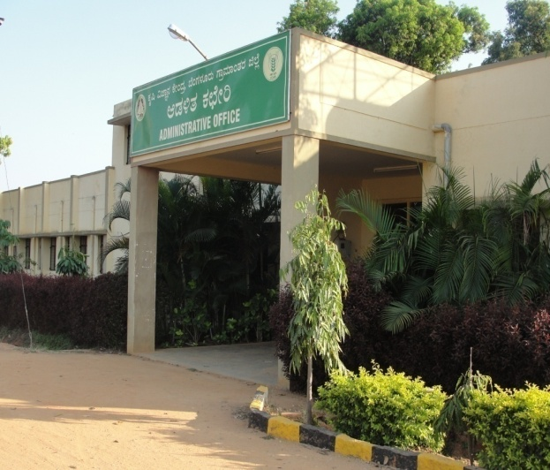
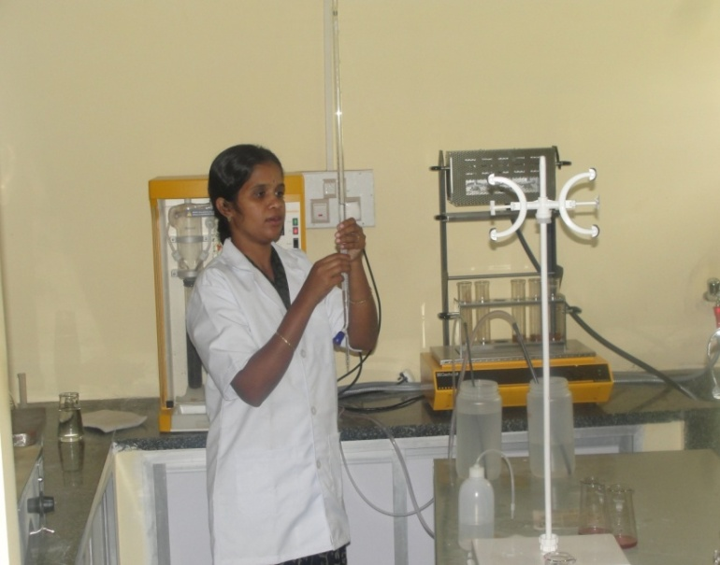
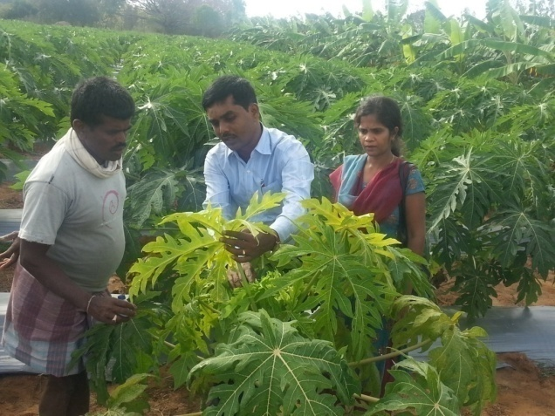
KVK Manpower and Facilities
Manpower Programme Coordinator No. of SMS in position No. of Programme Assistants in position Supporting staff | 01 05 03 04
Farm details Total Area (ha) Cultivated Area (ha) | 21.28 13.67
Production Units Vegetable Special Unit | 40 m²
Laboratories Soil & Water Testing Laboratory Plant Health Clinic | 50 m² 30 m²
Office building
Soil & Water Testing Laboratory
Plant Health Clinic

Slide 5
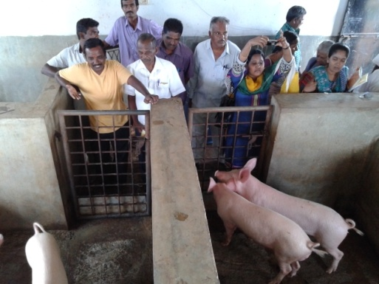
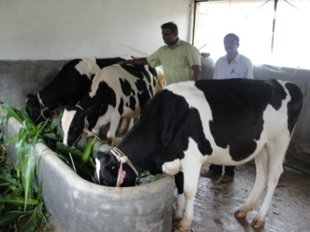
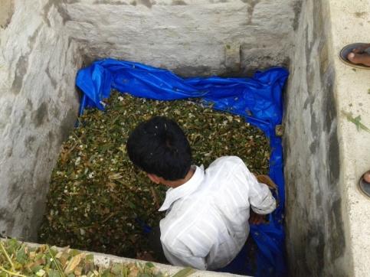
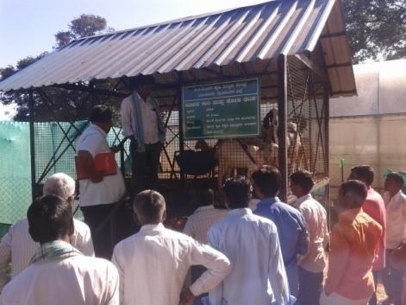
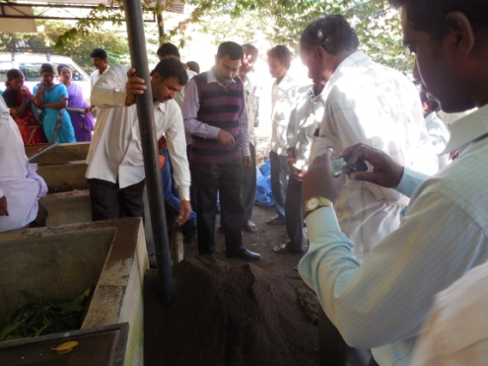
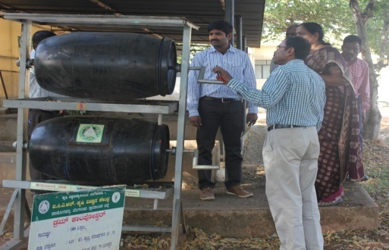
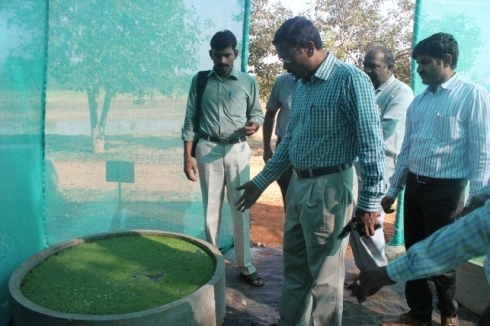
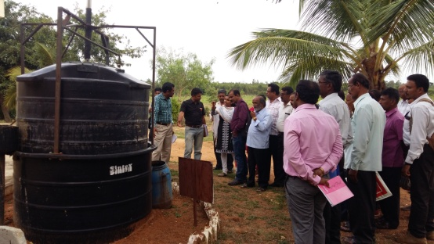
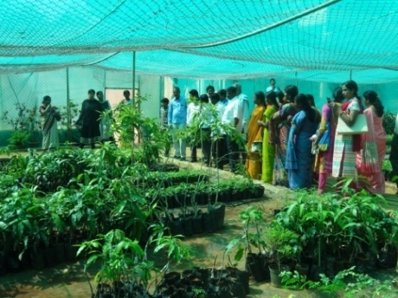
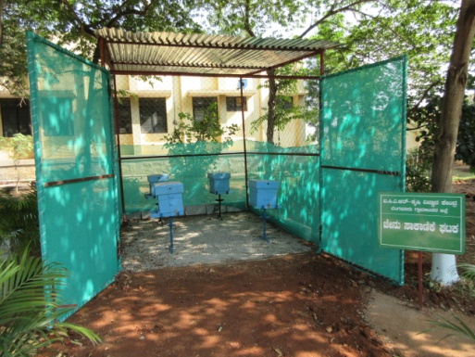
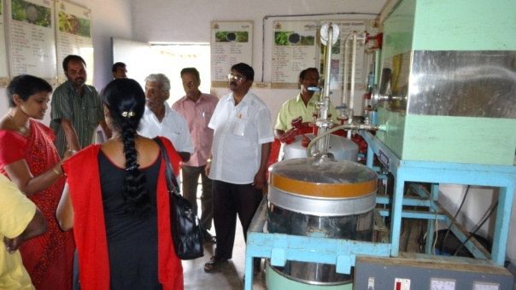
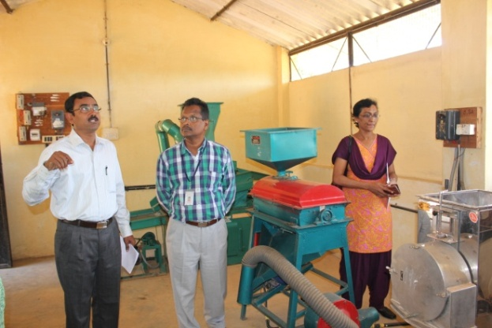
KVK Demonstration Units
Piggery Unit (58 m² )
Dairy Unit (53 m²)
Sheep cum Poultry Unit (8.78 m²)
Silage Unit (2.25 m²)
Vermicomposting Unit (18 m²)
Biogas Unit (2 m²)
Drum Composter
Azolla Unit (2 m²)
Model Horticultural Nursery (678 m²)
Apiculture (9 m²)
I & D Centre on Biofuel
(72 m²)
Millet Processing Unit (32 m²)

Slide 6
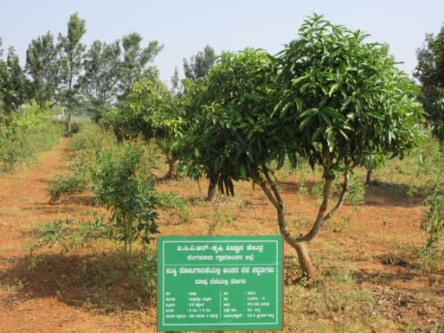
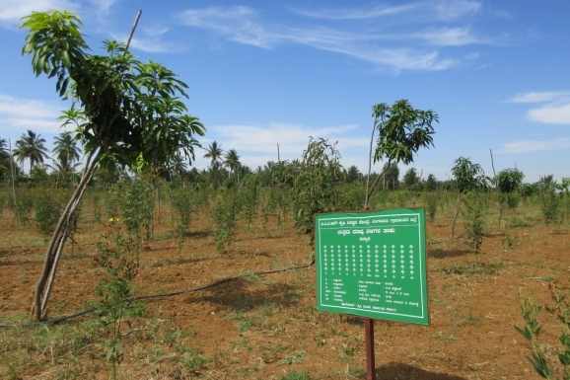
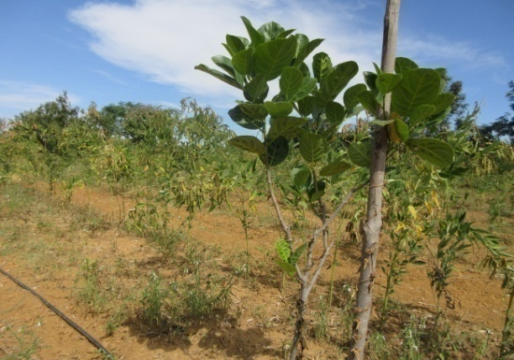
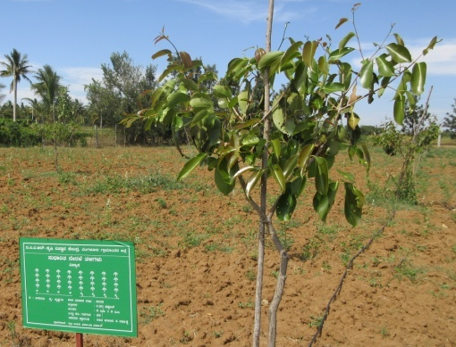
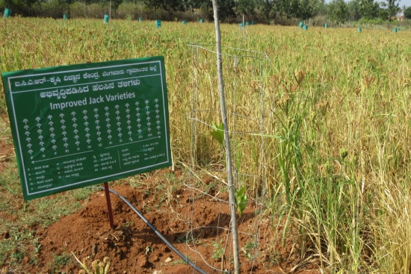
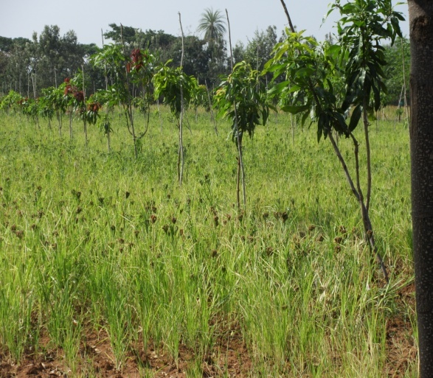
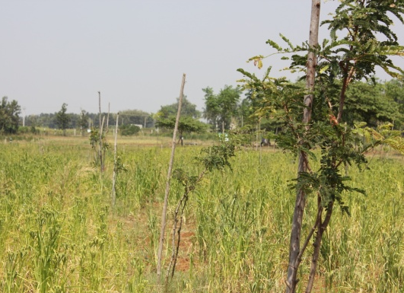
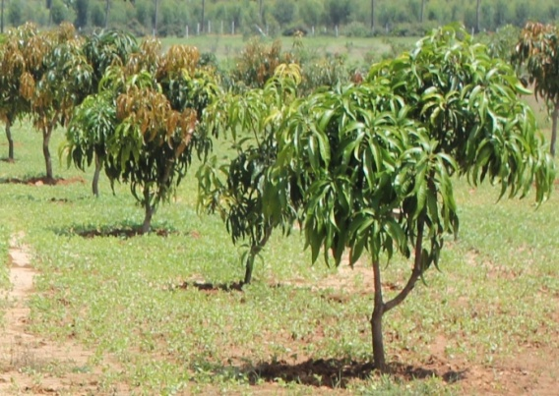
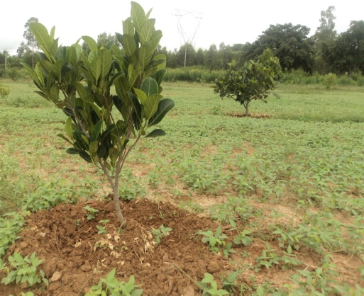
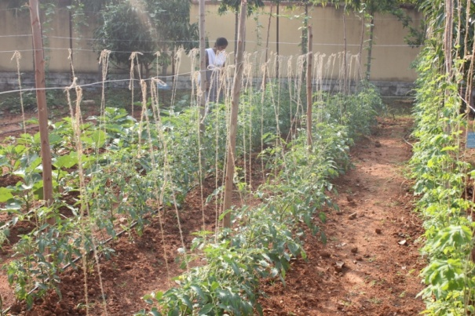
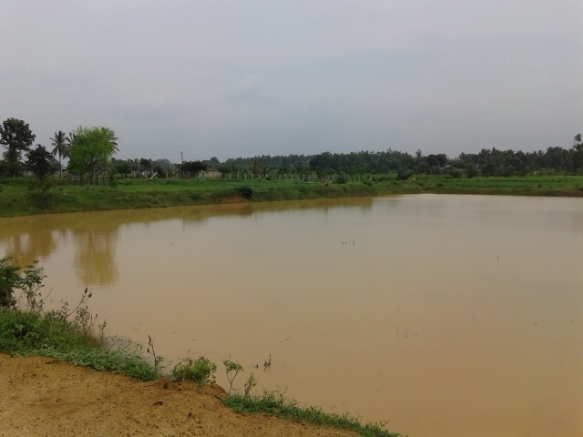
KVK Demonstration Plots
Horticulture Mother Plants Unit (1 ha)
Mango Varieties Unit (0.30 ha)
Special Jack Varieties Unit (0.25 ha)
Improved Jamun Varieties Unit (0.20 ha)
Developed Jack Varieties Unit (0.78 ha)
High density curry leaf (0.12 ha)
Dryland hort- system Mango + Ragi (0.75 ha)
Dryland hort- system Tamarind + Ragi (0.6 ha)
Dryland hort- system Mango (1 ha)
Dryland hort- system Mango, Jack, Jamun (1 ha)
Kitchen garden Unit
(240 m²)
Farm Pond (6724 m²)

Slide 7
Cross-learning across KVKs
Name of the KVK proposed | Specific learning areas
Within ring : KVK, Tumkur b) KVK, Chikballapura c) KVK, Ramanagara | Quality seeds and planting materials. Nutrient mixture, Exposure visits & farmers interaction Climate Resilient Agriculture practices and Concept of Village Development - Exposure visits Exposure visits, farmers interaction
Within the zone : a) KVK, Pattanantitta, Kerala b) KVK, Kannur, Kerala c) KVK, Namakkal, Tamil Nadu | Resource conservation technologies, Processing and value addition, market linkages. Exposure visits, farmers & Scientists interaction Technician groups, value addition, market linkages. Exposure visits, farmers & Scientists interaction Animal related Demonstration units, Exposure visits, farmers interaction
Out side zone : KVK, Bharamati, Maharashtra b) KVK, Mehsana, Ahmadabad c) KVK, Ahmadnagar, Maharastra | Modern farm technologies and method demonstrations Rain Harvesting Technology Functioning of Community Radio Station

Slide 8
Devanahalli Cluster
Cluster villages – Bannimangala, Sunnaghatta, Bachahalli
Devanahalli taluk
Cluster villages
Bannimangala
Satellite image of Bannimanga village

Slide 9
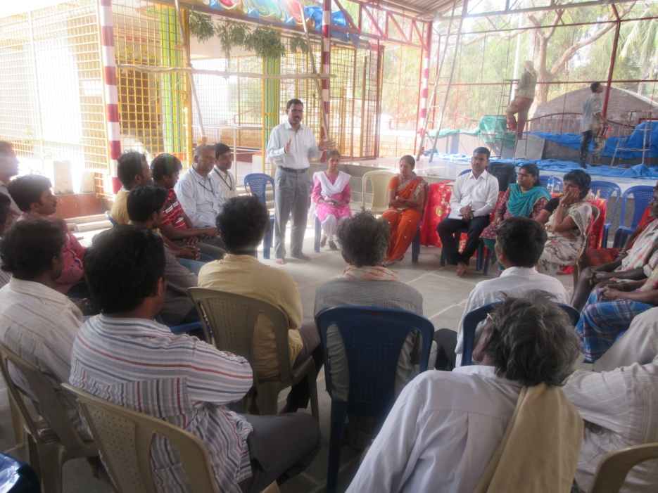
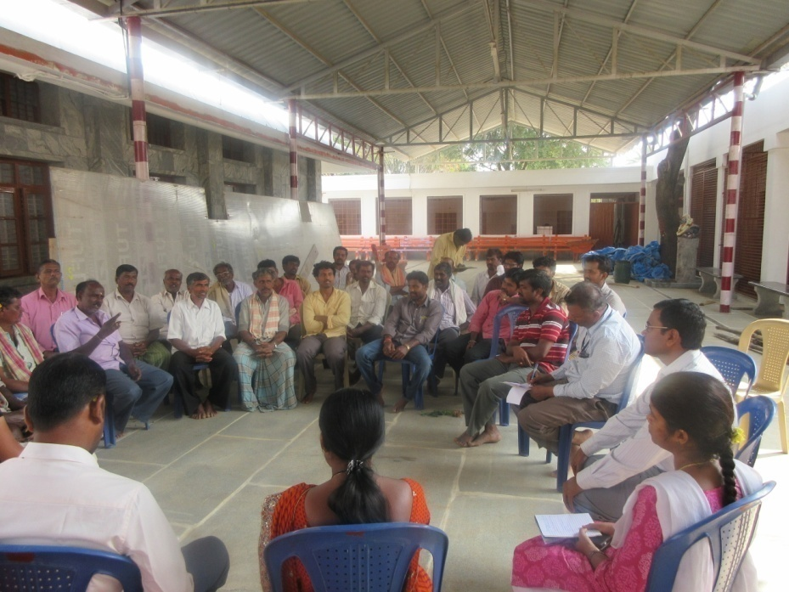
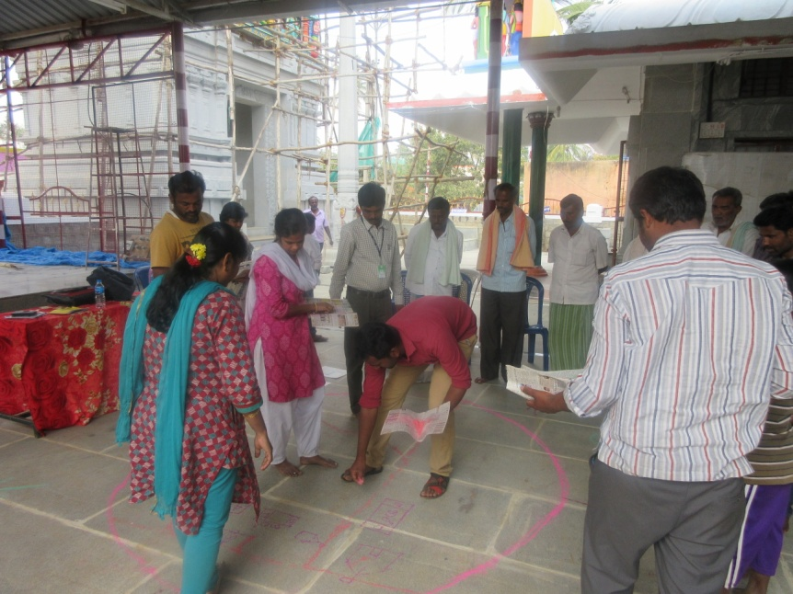
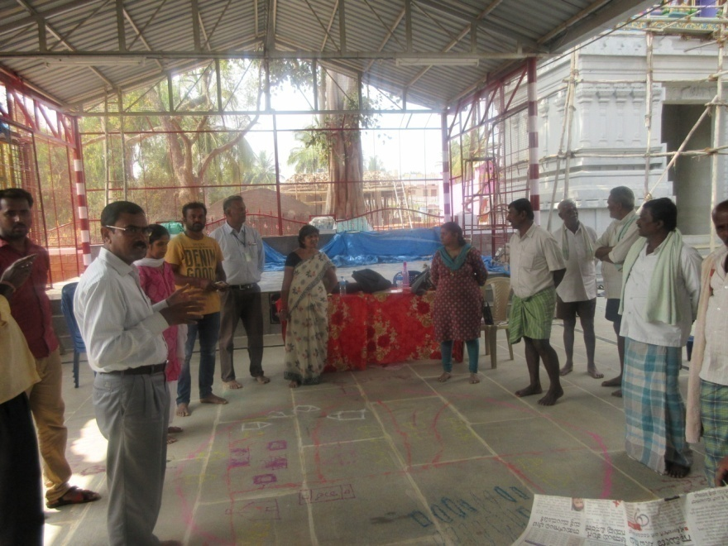
Participatory Rural Appraisal (PRA)
Explanation of PRA Objectives
Briefing of Village Agriculture Situations
Drawing of Resource Map
Explanation of Resource Map

Slide 10
Problems identified in DEVANAHALLI Cluster
Problems
1 | Finger millet - Intermittent drought and blast incidence
2 | Dairy animals - Lower peak milk production, decreased reproductive efficiency after calving, inefficient reproductive management practices, Incidence of post parturient milk fever, Delayed onset of oestrus
3 | Ginger - Low yield due to local varieties, susceptible to soft rot
4 | Rose - Thrips, Aphids, Black spot, DM, PM, Root rot, mites
5 | Pole beans - Micronutrient deficiency, yellowing of leaves, Yellow mosaic virus, Rust, root rot, Leaf miner, mites, Low Price
6 | Sheep - Lower meat yield due to imbalanced nutrition
7 | Minor millets – More demand, less production, no value addition
8 | Water and power related problems
9 | Fluctuations in market prices

Slide 11
Gap Identification and Technology Prioritization – Devanahalli Cluster
Crop | Average Yield | Potential Yield | Technological gap | Extension Gap | Technological Intervention
Ginger | 10 t/ha | 23 t/ha | Low yield due to local varieties, susceptible to soft rot | Lack of awareness about new variety and ICM practices | OFT - Assessment of Ginger Varieties for Bengaluru Rural District
Finger Millet | 24 q/ha | 50 q/ha | Intermittent drought and blast incidence | Lack of awareness about drought and blast resistant variety | FLD- Addressing Drought and Blast Vulnerability through var. ML 365/ML322
Rose | 5.8 t/ha | 15 t/ha | Thrips, Aphids, Black spot, DM, PM, Root rot, mites | Lack of awareness about IPM practices | FLD- Management of Pests and diseases in Rose
Foxtail millet | 4.2 q/ha | 22 q/ha | Intermittant drought, low yield, less income by selling the grains without processing | Lack of awareness about improved variety and importance of value addition | FLD - Production and Value Addition of Foxtail millet Var. DHFT-109-3
Pole beans | 25 t/ha | 40 t/ha | Micronutrient deficiency, yellowing of leaves, YMV, Rust, root rot, Leaf miner, mites | Lack of awareness about integrated crop management practices | FFS - Integrated Crop Management in Pole beans

Slide 12
Gap Identification and Technology Prioritization – Devanahalli taluk Cluster
Crop | Average Yield | Potential Yield | Technological gap | Extension Gap | Technological Intervention
Dairy animals | 5 lt/day/ animal | 12 lt/day/ animal | Lower peak milk production, decreased reproductive efficiency after calving, inefficient reproductive management practices Lower milk yield due to green fodder scarcity | Lack of awareness about management practices of dairy animals during the transition and reproductive phases Lack of of awareness of contingent green fodder technologies | FLD - Bypass fat as an energy source during the transition phase in dairy animals FLD - Integrated approach for the Reproductive management of Anoestrus in Heifers FLD - Management of Milk Fever (Post Parturient Hypocalcimea
Sheep | - | - | Lower meat yield due to imbalanced nutrition | Lack if integrated nutritional and disease management interventions | FLD - Integrated nutritional and disease management interventions in sheep

Slide 13
Doddaballapura Cluster
Cluster villages –Rameshwara, C hosahalli, Hadripura, M hosahalli
Doddaballapura taluk
Rameshwara
Satellite image of cluster villages
Satellite image of Rameshwara village
Cluster villages

Slide 14
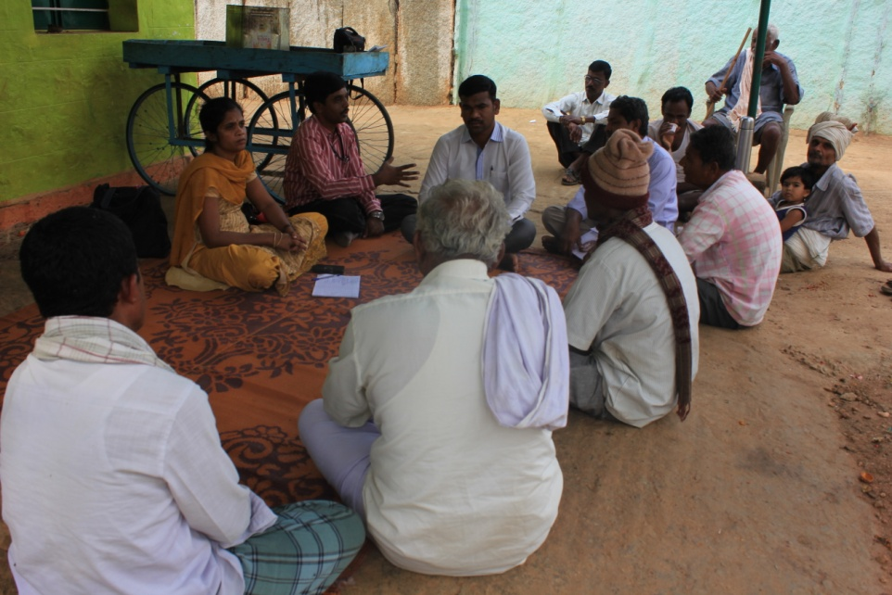
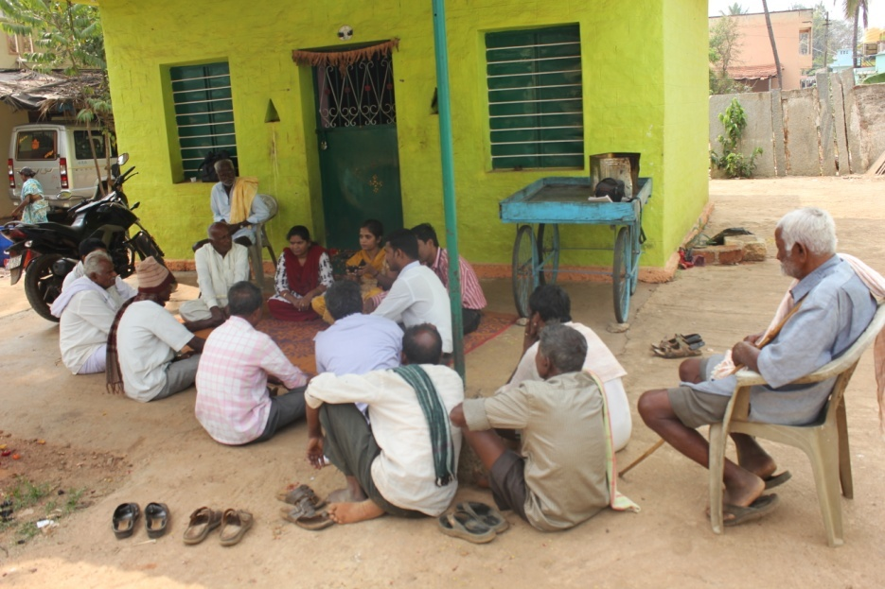
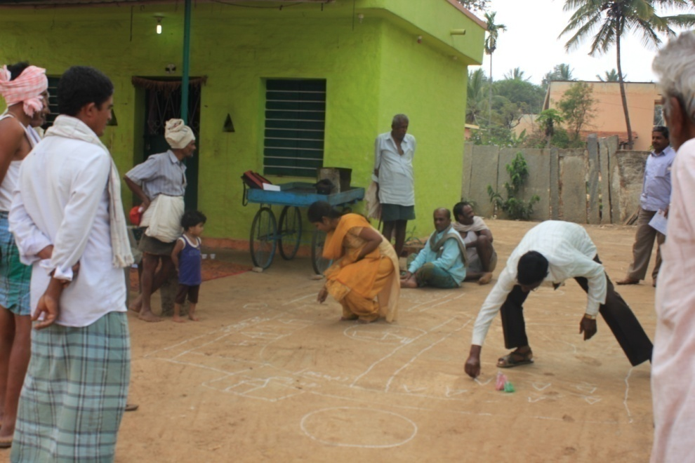
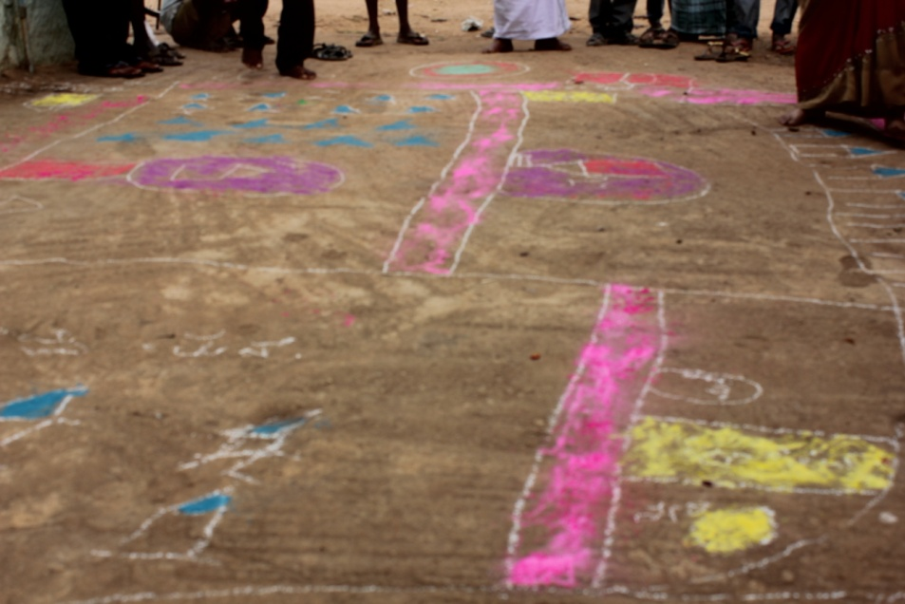
Participatory Rural Appraisal (PRA) DODDABALLAPURA Cluster
Explanation of PRA Objectives
Briefing of Village Agriculture Situations
Drawing of Resource Map
Explanation of Resource Map

Slide 15
Problems identified in DODDABALLAPURA Cluster
Problems
1 | Maize - Downy mildew and stem borer incidence
2 | Finger millet - Intermittent drought and blast incidence
3 | Field bean - Lack of year round cultivation varieties, long duration of local variety, pod borer incidence
4 | Cabbage - Diamond Back Moth infestation
5 | Cucumber - Wilt incidence, higher flower drop, imbalanced nutrition
6 | Dairy animals - Lower peak milk production, decreased reproductive efficiency after calving, inefficient reproductive management practices, Incidence of post parturient milk fever, Delayed onset of oestrus
7 | Sheep - Lower meat yield due to imbalanced nutrition
8 | Nutrition garden - Nutrition insecurity, Malnourishment in children , Non availability & high cost of vegetables
9 | Finger millet - Less acceptability of value added products from existing varieties due to brown colour
10 | Minor millets – More demand, less production, no value addition
11 | Water and power related problems
12 | Fluctuations in market prices

Slide 16
Gap Identification and Technology Prioritization – Doddaballapura Cluster
Crop | Average Yield | Potential Yield | Technological gap | Extension Gap | Technological Intervention
Cabbage | 32 t/ha | 85 t/ha | Diamond Back Moth infestation | Lack of awareness about integrated pest management practices | OFT - Assessment on Management of Diamond backmoth in cabbage
Maize | 5 q/ha | 12 q/ha | >30% Downy mildew and stem borer incidence | Lack of awareness about integrated disease management practices | FLD - Management of Downy mildew and stem borer in Maize
Field bean | 12 q/ha | 45 q/ha | Lack of year round cultivation varieties, long duration of local variety, pod borer incidence | Lack of awareness about photoinsensitive variety with shorter duration | FLD- Use of HA 4 variety of Field bean for early harvest

Slide 17
Gap Identification and Technology Prioritization – Doddaballapura Cluster
Crop | Average Yield | Potential Yield | Technological gap | Extension Gap | Technological Intervention
Cucumber | 16 t/ha | 20 t/ha | Wilt incidence, higher flower drop, imbalanced nutrition | Lack of awareness about micronutrients | FLD- Yield and quality enhancement in cucumber through micronutrients
Nutrition garden | - | - | Nutrition insecurity, Malnourishment in children , Non availability & high cost of vegetables | Lack of awareness about nutrition garden and nutrition security | FLD - Nutrition Garden in Schools
Finger millet | - | - | Less acceptability of value added products from existing varieties due to brown colour | Lack of awareness about white colour finger millet | FLD – Production of Value addition of Finger millet Variety KMR 340
Foxtail millet | 4.2 q/ha | 22 q/ha | Intermittant drought, low yield, less income by selling the grains without processing | Lack of awareness about improved variety and importance of value addition | FLD - Production and Value Addition of Foxtail millet Var. DHFT-109-3

Slide 18
Gap Identification and Technology Prioritization – Doddaballapura Cluster
Crop | Average Yield | Potential Yield | Technological gap | Extension Gap | Technological Intervention
Dairy animals | 5 lt/day/ animal | 12 lt/day/ animal | Lower peak milk production, decreased reproductive efficiency after calving, inefficient reproductive management practices Lower milk yield due to green fodder scarcity | Lack of awareness about management practices of dairy animals during the transition and reproductive phases Lack of of awareness of contingent green fodder technologies | FLD - Bypass fat as an energy source during the transition phase in dairy animals FLD - Integrated approach for the Reproductive management of Anoestrus in Heifers FLD - Management of Milk Fever (Post Parturient Hypocalcimea
Sheep | - | - | Lower meat yield due to imbalanced nutrition | Lack if integrated nutritional and disease management interventions | FLD - Integrated nutritional and disease management interventions in sheep

Slide 19
Nelamangala Cluster
Cluster villages -
Ballagere, Kenchanapura, Tadsighatta, Vadakunte
Nelamangala
Satellite image of Ballagere village
Cluster villages

Slide 20
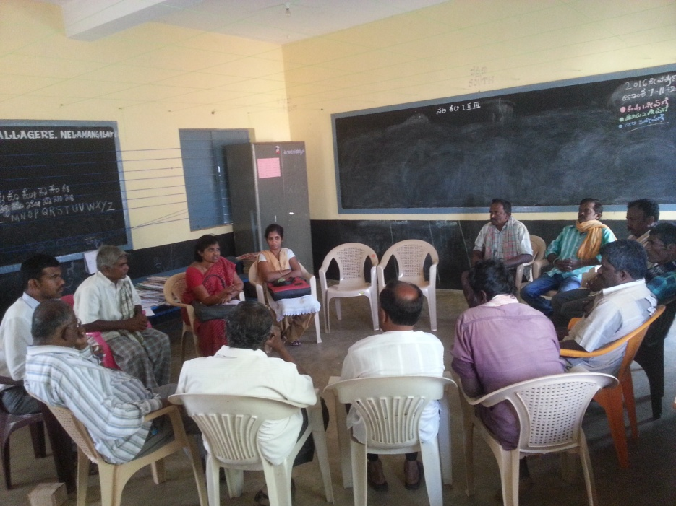
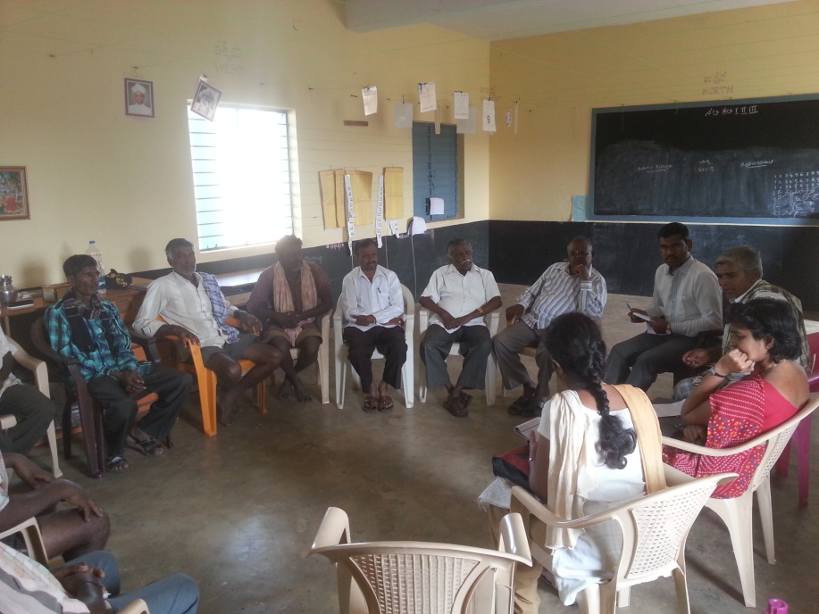
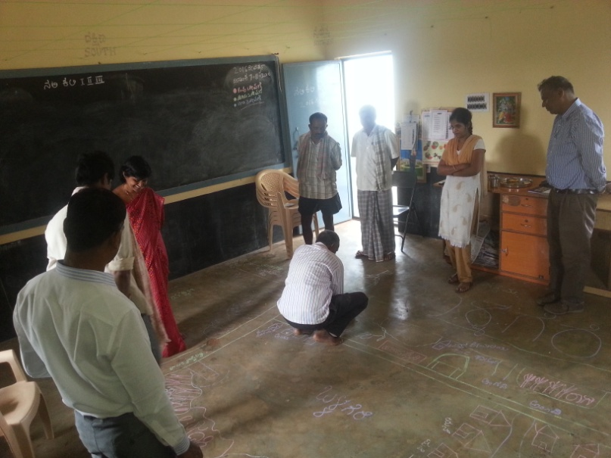
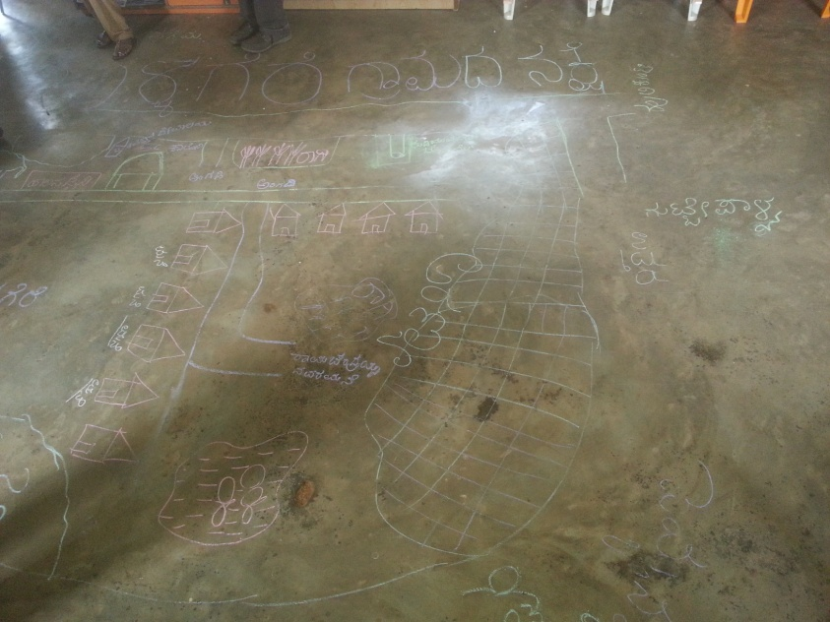
Participatory Rural Appraisal (PRA) NELAMANGALA Cluster
Explanation of PRA Objectives
Explanation of Village Agriculture Situations
Drawing of Resource Map
Explanation of Resource Map

Slide 21
Problems identified in NELAMANGALA Cluster
Problems
1 | Cucmber - Severe incidence of downy mildew
2 | Finger millet - Intermittent drought and blast incidence
3 | Bengal gram - Low yield due to Wilt incidence, Sterility mosaic disease , Imbalanced Nutrition
4 | Tomato - Indiscriminate use of water soluble fertilizer due to lack of recommended schedule, incidence of ToLCV, Fusarium wilt, Early blight, Late blight, leaf miner
5 | Potato - Severe infestation of light blight
6 | Dairy animals - Lower peak milk production, decreased reproductive efficiency after calving, inefficient reproductive management practices, Incidence of post parturient milk fever, Delayed onset of oestrus
7 | Sheep - Lower meat yield due to imbalanced nutrition
8 | Nutrition garden - Nutrition insecurity, Malnourishment in children , Non availability & high cost of vegetables
9 | Finger millet - Less acceptability of value added products from existing varieties due to brown colour
10 | Water and power related problems
11 | Fluctuations in market prices

Slide 22
Gap Identification and Technology Prioritization – Nelamangala Cluster
Crop | Average Yield | Potential Yield | Technological gap | Extension Gap | Technological Intervention
Cucumber | 16 t/ha | 20 t/ha | Incidence of downy mildew (>33%) | Lack of awareness about integrated disease management practices | OFT – Assessment of management of downy mildew in cucumber
Tomato | 32 t/ha | 85 t/ha | Indiscriminate use of water soluble fertilizer due to lack of recommended schedule, incidence of ToLCV, Fusarium wilt, Early blight, Late blight, leaf miner | Lack of awareness about recommended schedules for fertigation, IPDM practices | FLD- Fertigation in tomato for higher yields FLD - Integrated Management of Major Pests and Diseases in Tomato
Potato | 10 t/ha | 15 t/ha | Severe infestation of light blight | Lack of knowledge about IPM | FLD- Management of Late Blight in Potato through Integrated Approach

Slide 23
Gap Identification and Technology Prioritization – Nelamangala Cluster
Crop | Average Yield | Potential Yield | Technological gap | Extension Gap | Technological Intervention
Nutrition garden | - | - | Nutrition insecurity, Malnourishment in children , Non availability & high cost of vegetables | Lack of awareness about nutrition garden and nutrition security | FLD - Nutrition Garden in Schools
Finger millet | - | - | Less acceptability of value added products from existing varieties due to brown colour | Lack of awareness about white colour finger millets | FLD – Production and Value addition in Finger millet Variety KMR 340

Slide 24
Gap Identification and Technology Prioritization – Nelamangala Cluster
Crop | Average Yield | Potential Yield | Technological gap | Extension Gap | Technological Intervention
Dairy animals | 5 lt/day/ animal | 12 lt/day/ animal | Lower peak milk production, decreased reproductive efficiency after calving, inefficient reproductive management practices Lower milk yield due to green fodder scarcity | Lack of awareness about management practices of dairy animals during the transition and reproductive phases Lack of of awareness of contingent green fodder technologies | FLD - Bypass fat as an energy source during the transition phase in dairy animals FLD - Integrated approach for the Reproductive management of Anoestrus in Heifers FLD - Management of Milk Fever (Post Parturient Hypocalcimea
Sheep | - | - | Lower meat yield due to imbalanced nutrition | Lack if integrated nutritional and disease management interventions | FLD - Integrated nutritional and disease management interventions in sheep

Slide 25
Details of Hoskote Cluster
Cluster villages –Sonnallipura, Lakkondahalli, Hasigala, Vapasandra, Thimmasandra
Hosakote
Cluster villages
Satellite image of Sonnallipura village

Slide 26
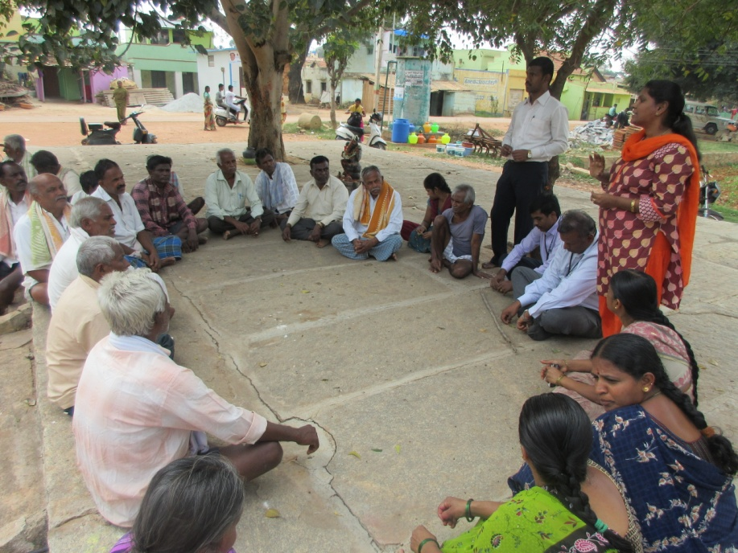
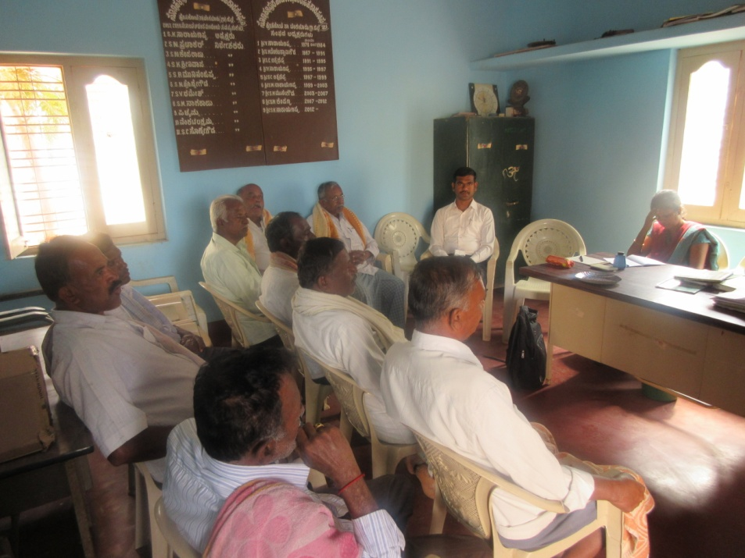
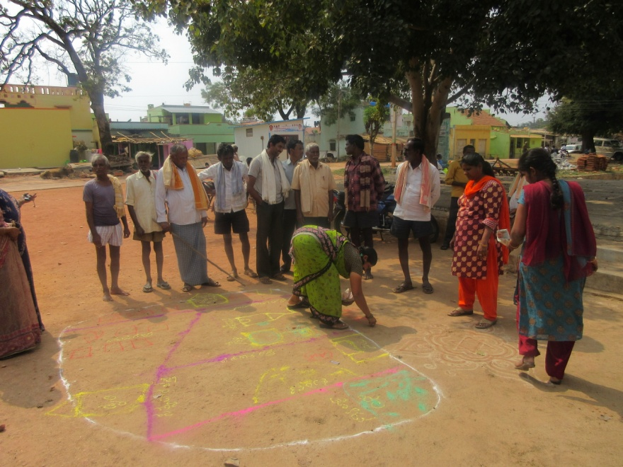
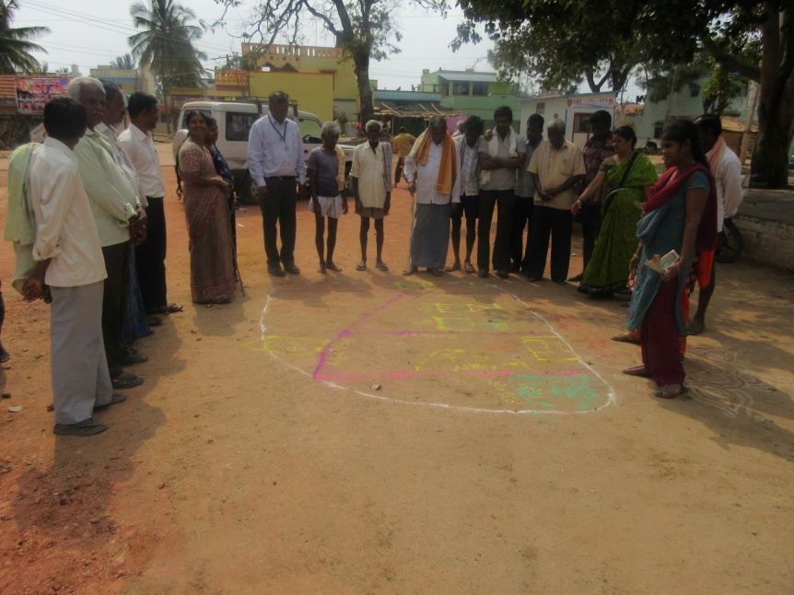
Participatory Rural Appraisal (PRA) HOSAKOTE Cluster
Explanation of PRA Objectives
Explanation of Village Agriculture Situations
Drawing of Resource Map
Explanation of Resource Map

Slide 27
Problems identified in HOSAKOTE Cluster
Problems
1 | Bengal gram - Wilt incidence, pod borer menace, dry root rot and collar rot
2 | Finger millet - Intermittent drought and blast incidence
3 | Mulberry – Low nutrition & yields, poor keeping quality of leaves
4 | Dairy animals - Lower peak milk production, decreased reproductive efficiency after calving, inefficient reproductive management practices, Incidence of post parturient milk fever, Delayed onset of oestrus
5 | Sheep - Lower meat yield due to imbalanced nutrition
6 | Water and power related problems
7 | Fluctuations in market prices

Slide 28
Gap Identification and Technology Prioritization – Hosakote Cluster
Crop | Average Yield | Potential Yield | Technological gap | Extension Gap | Technological Intervention
Bengalgram | 8 q/ha | 24 q/ha | Wilt incidence, pod borer menace, dry root rot and collar rot | Lack of awareness about wilt, dry root rot and collar rot resistant variety and ICM practices | OFT - Assessment of Bengalgram Varieties for Wilt and Drought conditions FLD- Integrated Crop Management in Bengalgram JAKI 9218
Mulberry | 20 t/ha | 25 t/ha | Imbalanced nutrition Non use of secondary and micronutrients | Lack of awareness about micronutrient management and INM practices | FLD– Nutrient Management in Mulberry

Slide 29
Gap Identification and Technology Prioritization – Hosakote Cluster
Crop | Average Yield | Potential Yield | Technological gap | Extension Gap | Technological Intervention
Dairy animals | 5 lt/day/ animal | 12 lt/day/ animal | Lower peak milk production, decreased reproductive efficiency after calving, inefficient reproductive management practices Lower milk yield due to green fodder scarcity | Lack of awareness about management practices of dairy animals during the transition and reproductive phases Lack of of awareness of contingent green fodder technologies | FLD - Bypass fat as an energy source during the transition phase in dairy animals FLD - Integrated approach for the Reproductive management of Anoestrus in Heifers FLD - Management of Milk Fever (Post Parturient Hypocalcimea
Sheep | - | - | Lower meat yield due to imbalanced nutrition | Lack if integrated nutritional and disease management interventions | FLD - Integrated nutritional and disease management interventions in sheep

Slide 30
Abstract of activities (2017-18)
S. No | Particulars | Total budget (Rs.)
1. | On Farm Testing – 4 Nos. (2 contd…) | 1,21,900
2. | Front Line Demonstration – 16 Nos. | 3,46,567
3. | NFSM (Two FLDs) | 1,43,750
4. | FFS – Integrated Crop Management in Cabbage | 30,000
5. | Innovative Activity - Community Approach for Preparation of Balanced Animal Feed from Local Resources | 30,000
TOTAL Rs. |  | 6,91,417

Slide 31
Abstract – On Farm Testing
S. No | Technology to be assessed / refined | No. of trials | Budget
1. | Assessment of Bengalgram Varieties for Wilt and Drought conditions | 05 (2 ha) | 22,700
2. | Assessment of Ginger Varieties for Bengaluru Rural District | 03 (0.3 ha) | 41,000
3. | Assessment on management of downy mildew in cucumber | 05 (1 ha) | 28,400
4. | Assessment on management of Diamond backmoth in cabbage | 05 (1 ha) | 29,800
 | GRAND TOTAL |  | 1,21,900

Slide 32
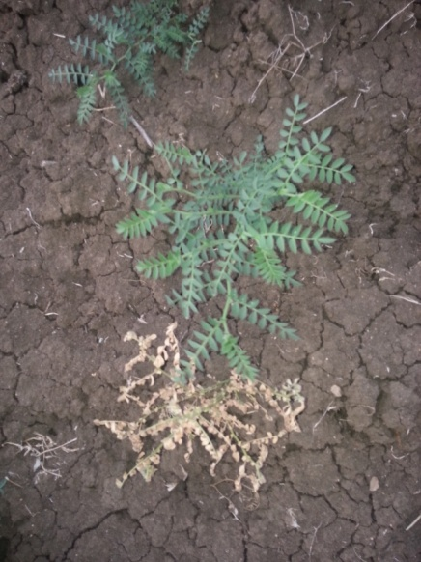
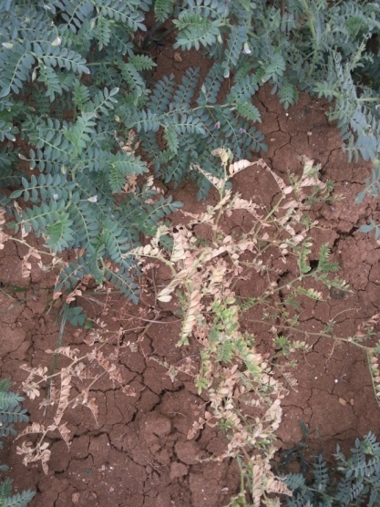
1. Assessment of Bengalgram Varieties for Wilt and Drought conditions
OFT
2nd yr
Problem
Dist. Area | Dist. Avg. Yield | Potential Yield
750 ha | 8 q/ha | 24 q/ha
Wilt susceptible and drought intolerance
Moisture stress during crop growth period
Low yield
Technological Options :
TO2: JG – 11 variety (Breakdown of wilt – 20%) - FP
TO3: JAKI – 9218 variety (Resistant to wilt ) – ICRISAT
TO4: GBM-2 variety (Resistant to wilt & high yield) - UAS, R
Wilt in black soils
Wilt in red soils

Slide 33
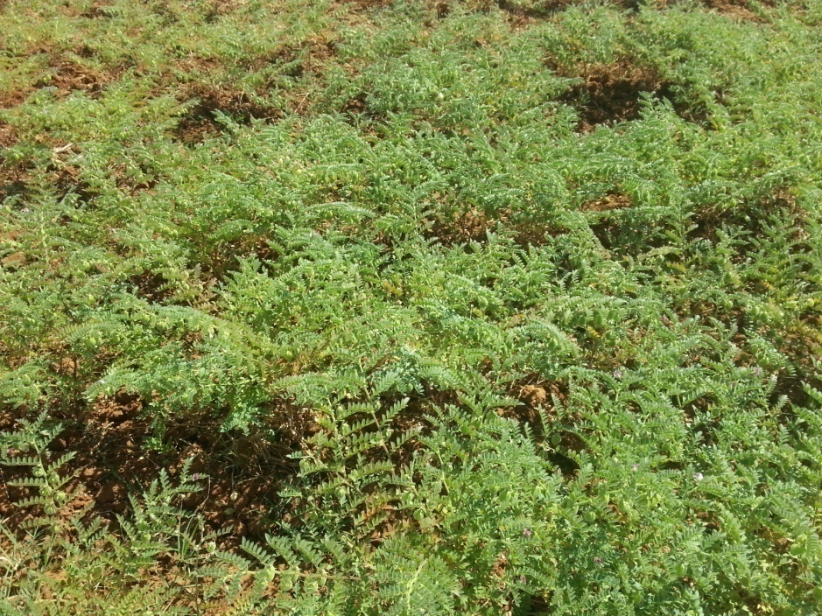
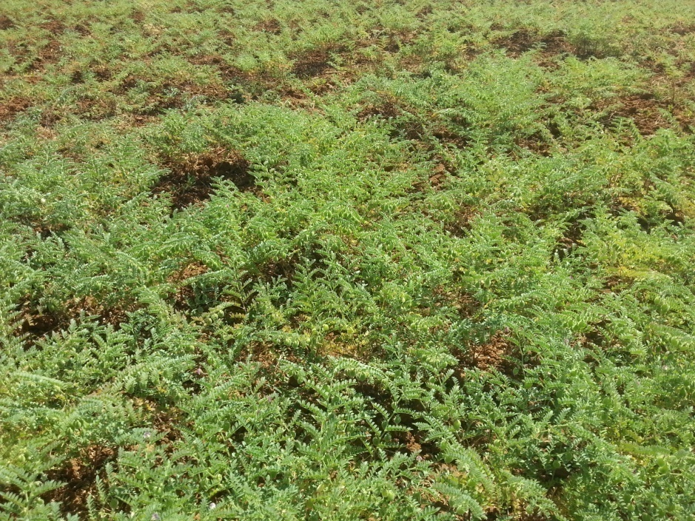
Moisture stress condition
JAKI
JG 11

Slide 34
05 Trials , 2.0 ha, Rs. 22,700, Hasigala, Hosakote tq, SMS : Agro, PP
Critical Input (per trial) | Cost (Rs.)
Seeds – 25 Kg | 1,500
Coriander seeds – 1 kg | 90
Rhizobium – 0.5 kg | 50
NPV – 100 ml | 280
Traps & Lures - 4 Nos. | 320
Spinosad (Microbial) – 75 ml | 1,300
Total | 3,540
Soil fertility status (pre & post), Germination & establishment, Days to 50% flowering, % Wilt Incidence, Yield, B:C ratio
Distribution of Soil Health Cards

Slide 35
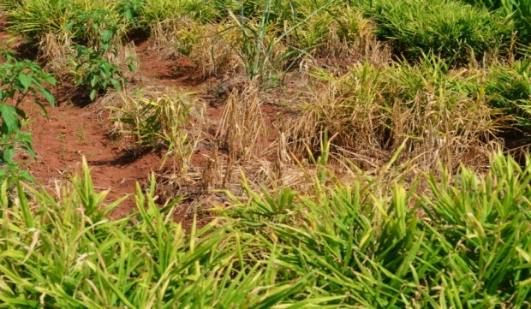
OFT
2. Assessment of Ginger Varieties for Bengaluru Rural District
Problem
Dist. Area | Dist. Avg. Yield | Potential Yield
169 ha | 10 t/ha | 30 t/ha
Low yield of existing variety, soft rot incidence
(25-30%)
03 trials (0.3 ha), Rs. 41000, Bannimangala, DVN,
SMS : Hort (PC), SS, PP
Technological Options:
TO1 : Rio de Generio
TO2 : Maran
TO3 : IISR – Varada, tolerant to soft rot
Distribution of Soil Health Cards
Critical Inputs | Qty./ trial | Unit Cost (Rs.) | Cost/ trial
Rio de Generio | 60 kg | 50 | FC
Maran | 60 kg | 100 | 6000
IISR- Varada | 60 kg | 100 | 6000
Total |  |  | 12000
Soil fertility status (pre & post), Soft rot incidence (%), Growth and yield parameters, Yield (t/ha), B:C ratio
Soft rot incidence

Slide 36
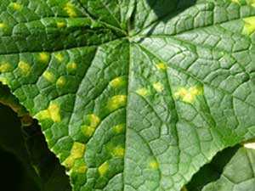
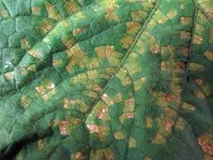
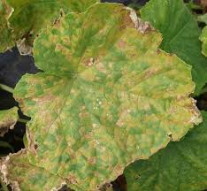
OFT
3. Assessment on Management of Downy mildew in Cucumber
Problem
2nd yr
Dist. Area | Dist. Avg. Yield | Pot. Yield
332 ha | 16 t/ha | 20 t/ha
Incidence of Downy mildew (> 33%)
 | Technological Options:
TO1 | Spray the crop with Metalaxyl + Mancozeb (0.2%) and Cymoxanil+ Mancozeb (0.2%) - UAS (B) & UHS, Bagalkote
TO2 | Seed treatment with Captan (2g/kg seeds)
 | Spray of Mancozeb (0.2%) & Cymoxanil+Mancozeb (0.2%) IIHR, Bengaluru
TO3 | Seed treatment with Metalaxyl (2g/kg seeds)
 | Trichoderma harzianum enriched Farm Yard Manure (@ 1 kg / 100 kg FYM) application
 | Prophylactic Spray with Mancozeb (0.25%) followed by Spraying of Metalaxyl+ Mancozeb (0.25%) and Dimethomorph (0.1%)+ Mancozeb (0.2%) - IIVR, Varanasi
Initial stage of DM
Discoloration of leaves
Seed Treatment & Application of Bio-control Agents followed by prophylactic and curative methods
Advanced stage of DM

Slide 37
05 Trials (1 ha) , Rs. 28,400, Ballagere, Nelamangala tq., SMS : PP, Hort (PC)
Critical Input | Qty./trial | Unit Cost (Rs.) | Cost/ trial
Trichoderma harzianum | 10 kg | 200 | 2000
Metalaxyl | 0.1 kg | 250 | 250
Metalaxyl+ Mancozeb | 0.5 kg | 800 | 800
Dimethomorph+ Mancozeb | 0.2kg+1.0 kg | 1,630 | 1,630
Total |  |  | 4680
Soil fertility status (pre & post), Disease severity (%), No. & cost of sprays, Yield, B:C ratio
Trail | % disease severity
 | RP (T1) | AP1 (T2) | AP2 (T3)
1 | 17.5 | 11.71 | 4.61
2 | 16.85 | 10.5 | 5.98
3 | 15.32 | 9.36 | 5.22
4 | 17.65 | 11.57 | 5.24
5 | 18.75 | 10.65 | 7.25
Avg. | 17.21 | 10.75 | 5.66
Yield (t/ha)
Trial No. | RP (T1) | AP1 (T2) | AP2 (T3)
1 | 14.5 | 17.01 | 18.51
2 | 15.1 | 16.95 | 18.84
3 | 14.9 | 15.82 | 18.73
4 | 15.2 | 16.91 | 18.67
5 | 14.8 | 16.79 | 18.95
Avg. | 14.9 | 16.69 | 18.74
Results of 1st yr
Technology Assessed | % Disease severity | Prodn. (t/ha) | B:C Ratio
T1 | 17.21 | 14.90 | 1.65
T3 | 10.75 | 16.69 | 1.91
T4 | 5.66 | 18.74 | 2.21
Distribution of Soil Health Cards

Slide 38
OFT
4. Assessment on Management of Diamond backmoth in cabbage
Problem
Dist. Area | Dist. Avg. Yield | Pot. Yield
441 ha | 24 t/ha | 35 t/ha
DBM infestation (>40%)
 | Technological Options:
TO1 | Intecropping with Mustard (25:2), Spray the crop with Dichlorvos (0.05%) and 5% NSKE – UAS (B)
TO2 | Intercropping with Mustard (trap crop)
 | Installation of light traps
 | Spraying of Neem Soap (10g/l)
 | Spraying of Novaluron (0.075%) or Indocarb (0.05%) – IIHR, (B)
TO3 | Intercropping with Mustard (trap crop) (25:2)
 | Installation of WOTA-T traps (DBM traps)
 | Use of Sticky traps
 | Spray of Bt (1g/l), Neem Soap (5g/l), Entomopathogenic fungi (Beauveria bassiana) (0.2%)
 | Emamectin benzoate 5 SG (0.05%), Chlorfenapyr 10SC (0.1%), Spinosad 2.5 SC (0.15)%, - IIVR, Varanasi
DBM larva
DBM damage

Slide 39
05 Trials (1 ha) , Rs. 29, 800, Rameshwara, Doddaballapur tq., SMS : PP, Hort (PC)
Critical Input | Qty./trial | Cost/ trial
Mustard seeds | ½ kg | 150
DBM Traps | 5 No | 500
Sticky traps | 10 No | 560
Neem & Pongamia soap | 2 kg each | 650
Bt | 200 gm | 700
Beauveria bassiana | 500 ml | 650
Spinosad (microbial) | 50 ml | 950
Chlorfenapyr | 300 ml | 800
Total |  | 4,960
Soil fertility status (pre & post)
DBM incidence (%), No. & cost of sprays, Yield , B:C ratio
Distribution of Soil Health Cards

Slide 40
Summary of OFTs
Title | No. of trials | Treatments |  | Budget (Rs.)
Assessment of Bengal gram variety for wilt and drought conditions | 05 (2 ha) | TO1- JG - 11 – Farmers practice TO2- JAKI-9218 – ICRISAT TO3- GBM-2 – UAS, Raichur |  | 22700
Assessment on management of downy mildew in cucumber | 05 (1 ha) | TO1 | Spray the crop with Metalaxyl + Mancozeb (0.2%) and Cymoxanil+ Mancozeb (0.2%) - UAS (B) | 28400
 |  | TO2 | Seed treatment with Captan (2g/kg seeds); Spray of Mancozeb (0.2%) & Cymoxanil+Mancozeb (0.2%) IIHR, Bengaluru
 |  | TO3 | Seed treatment with Metalaxyl (2g/kg seeds); Trichoderma harzianum enriched Farm Yard Manure (@ 1 kg / 100 kg FYM) application; Prophylactic Spray with Mancozeb (0.25%) followed by Spraying of Metalaxyl+ Mancozeb (0.25%) and Dimethomorph (0.1%)+ Mancozeb (0.2%) - IIVR, Varanasi

Slide 41
Summary of OFTs
Title | No. of trials | Treatments |  | Budget (Rs.)
Assessment of Ginger Varieties for Bengaluru Rural District | 03 (0.3 ha) | TO1 : Ginger Variety –Rio de Generio – Farmers’ Practice TO2 : Ginger var. Maran (Yield potential – 25 t/ha) TO3 : Ginger var. IISR - Varada (Yield potential – 23 t/ha, tolerant to soft rot – IISR, Calicut |  | 41000
Assessment on management of Diamond backmoth in cabbage | 05 (1 ha) | TO1 | Intecropping with Mustard (25:2), Spray the crop with Dichlorvos (0.05%) and 5% NSKE – UAS (B) | 29800
 |  | TO2 | Intercropping with Mustard (trap crop); Installation of light traps; Spraying of Neem Soap (10g/l) ; Spraying of Novaluron (0.075%) or Indocarb (0.05%) – IIHR, Bengaluru
 |  | TO3 | Intercropping with Mustard (trap crop) (25:2); Installation of WOTA-T traps (DBM traps); Use of Sticky traps; Spray of Bt (1g/l), Neem Soap (5g/l), Entomopathogenic fungi (Beauveria bassiana) (0.2%); Emamectin benzoate 5SG (0.05%), Chlorfenapyr 10SC (0.1%), Spinosad 2.5SC (0.15)% - IIVR, Varanasi

Slide 42
Abstract : Front Line Demonstrations
S. No | Title of the Technology | No. of Demo | Area (ha) | Budget (Rs.)
1. | Addressing Drought and Blast Vulnerability in Finger millet through var. ML 365 | 25 | 10 | 15,000
2. | Use of HA 4 variety of Field bean for early harvest | 5 | 2 | 19,600
3. | Nutrient Management in Mulbery | 5 | 1 | 18,200
4. | Yield and quality enhancement in cucumber for higher returns | 5 | 1 | 8,575
5. | Fertigation in tomato for enhanced yields | 5 | 0.4 | 17,250
6. | Management of Late Blight in Potato through Integrated Approach | 5 | 1 | 29,900
7. | Management of Downy mildew and Stem Borer in Maize (NFSM) | 10 | 2 | 19,000
8. | Integrated Management of Major Pests and Diseases in Tomato | 5 | 1 | 29,200
9. | Management of Pests and Diseases in Rose | 5 | 1 | 28,800
10. | Bypass fat as an energy source during the transition phase in dairy animals | 20 cows | - | 35,400
11. | Integrated approach for the Reproductive management of Anoestrus in Heifers | 40 cows | - | 20,000
12. | Management of Milk Fever (Post Parturient Hypocalcimea) | 20 cows | - | 17,280
13. | Integrated Management Interventions in Sheep farming | 40 sheep | - | 22,514
14. | Nutrition Garden in Schools | 4 Schools | - | 27,000
15. | Demonstration and Value Addition of Finger millet Var. KMR 340 | 2 SHG | - | 23,250
16. | Demonstration and Value Addition of Foxtail millet Var. DHFT-109-3 | 10 | 4 | 15,600
 | Sub total (1) |  |  | 3,46,567
1. | Demonstration of BRG 5/ BRG 3 to augment wilt and SMD (NFSM) | 25 | 10 | 70,500
2. | Integrated Crop Management in Bengalgram var. JG 11 / JAKI 9218 (NFSM) | 25 | 10 | 73,250
 | Sub total (2) |  |  | 1,43,750
GRAND TOTAL |  |  |  | 4,90,317

Slide 43
FLD
Addressing Drought and Blast Vulnerability using Finger millet var.
ML 365 / ML 322
Problem
New
Dist. Area | Dist. Avg. Yield | Potential Yield
35,961 ha | 24 q/ha | 50 q/ha
Intermittent drought & blast incidence
Technology: UAS(B) 2012
Moisture conservation furrows (every 12 rows)
Use of blast resistant var. ML 365 / ML 322
Seed treatment with Azospirillum
Soil fertility status (pre & post), Germination & establishment, No. of effective tillers/plant, Yield, B:C ratio
25 Demos (10 ha) , Rs. 15,000, Bannimangala, Sunnaghatta, Devanahalli tq., SMS – Agronomy, PP
Particulars (per demo) | Cost (Rs.)
Seeds (ML 365/322) 5 kg | 350
Azospirillum 0.5 kg | 50
Total | 400
Blast incidence
Distribution of Soil Health Cards

Slide 44
FLD
2. Demonstration of BRG 5/ BRG 3 to augment wilt and SMD
Problem
NFSM
New
Area | Dist. Avg. yield | Potential yield
1,554 ha | 6.5 q/ha | 15 q/ha
Wilt incidence (30 %)
Sterility mosaic disease (35 %)
Imbalanced Nutrition
Technology: UAS(B) 2013
Use of wilt and sterility mosaic disease resistant var. BRG 5 / BRG 3
Formation of Ridges and furrows
Seed treatment with biofertilizers
Soil test based nutrient application
Use of Pulse Magic (UAS, Raichur)
Spray of need based pp measures
Fusarium wilt
Sterility mosaic disease
Critical inputs (per demo) | Cost
Seeds – 6 Kg | 700
Rhizobium – 0.5 kg | 50
Pulse Magic | 600
Pheramone Traps+lures | 320
Profenophos – 500 ml | FC
Spinosad (Microbial) -50 ml | 950
Total | 2,620
Soil fertility status (pre & post),Wilt incidence and sterility mosaic disease (%), Growth & Yield, B:C ratio
25 Demos (10 ha), Rs. 70,500, Ballagere, Kenchanapura, Nelamangala tq., SMS – Agronomy, PP
Distribution of Soil Health Cards

Slide 45
FLD
3. Integrated Crop Management in Bengalgram var. JG 11 /JAKI 9218
Problem
NFSM
Dist. Area | Dist. Avg. Yield | Pot. Yield
270 ha | 4.26 q/ha | 10 q/ha
Wilt incidence (20%)
Pod borer menace (38%)
Dry Root rot and collar rot (17%)
New
Technology: UAS(B)
Use of wilt, dry root rot and collar rot resistant var. JG 11 / JAKI 9218
Seed treatment with biofertilizers (Rhizobium)
Intercropping with coriander (6:1)
Pheramone traps
Use of need based PP measures
Fusarium wilt
Pod borer
25 Demos (10 ha), Rs. 73,250, Hasigala, Sonnahallipura, Hoskote tq., SMS – Agronomy, PP
Particulars (per demo) | Cost (Rs.)
Seeds – 20 kg | 2360
Coriander seeds - 1kg | FC
Rhizobium – 0.5 kg | 50
Traps & Lures - 4 Nos. | 320
Spinosad (Microbial) – 50 ml | FC
Total | 2,730
Soil fertility status
(pre & post)
Pod borer incidence, Wilt incidence , Dry root rot and collar rot (%)
Yield, B:C ratio
Distribution of Soil Health Cards

Slide 46
4. Use of HA 4 variety of Field bean for early harvest
FLD
Problem
Dist. Area | Dist. Avg. Yield | Potential Yield
1615 ha | 12 q/ha | 45 q/ha
Photo sensitive varieties
Longer duration (130-140 days)
Low yield (Dabbe Avare)
Pod borer incidence
Technology : UAS(B)
Photo insensitive var. HA 4
Use of Bio pesticides
Dabbe avare
5 Demos (2 ha), Rs. 19,600 , Chunchegowdana Hosahalli, Doddaballapura tq., SMS : Agronomy, PP
Soil fertility status (pre & post) , Germination & establishment, Days to 50% flowering, Pod borer incidence (%), Yield & B:C ratio
Critical inputs (per demo) | Cost (Rs.)
HA 4 Seeds – 12 Kg | 1920
Rhizobium – 500 gm | 50
Spinosad (microbial) | 950
Total | 2,920
Distribution of Soil Health Cards

Slide 47
FLD
5. Nutrient Management in Mulberry
Dist. Area | Dist. Avg. Yield | Pot. Yield
617 ha | 40 t/ha/yr | 60 t/ha/yr
Problem
Low quality leaf - Imbalanced nutrition
Existing NPKS status – 119(L):35(M):123(L):6.2(L)
Technology : CSR&TI, Mysore
RDF 350:140:140:30 Kg/ha (5 splits)
70:28:28:6 kg/ha per split
Foliar spray of Seriboost @2ml/lt (2 sprays 20th and 30th day)
Particulars | Qty per demo | Cost (Rs.)
Sulphate of potash | 11 kg | 860
Mono ammonium phosphate | 9 kg | 900
Urea | 28 kg | FC
Seriboost @ 2ml/lt | 0.5 lt | 880
Total |  | 2640
5 Demos (1 ha) , Rs. 18200, Sonnalipura, Hosakote tq., SMS : SS, PP, FM
Soil fertility status (pre & post), Growth parameters, plant height at 40th day, Yield parameters - leaf yield at 40th day, Cocoon yield/100 dfl, B:C ratio
Distribution of Soil Health Cards

Slide 48
FLD
6. Yield and quality enhancement in cucumber for higher returns
Dist. Area | Dist. Avg. Yield | Potential Yield
232 ha | 16 t/ha | 20 t/ha
Problem
15-20% yield reduction due to imbalanced nutrition and flower drop
Existing NPKB – 154(L):42(M):98(L):0.15(L)
Wilt incidence (15%)
Technology : IIHR, Bengaluru
RDF 60:50:80 kg/ha
Foliar spray of Boric acid + Salicylic acid (50ppm)
3 sprays : 1st spray - After transplanting
2nd spray - Before flower bud initiation
3rd spray - After 2nd picking
Appln. of Arka Microbial Consortium 15 kg/ha with FYM
Particulars | Qty per demo | Cost (Rs.)
Boric acid | 100 g | 140
Salicylic acid | 100 g | 200
Arka Microbial Consortia | 3 kg | 375
Total |  | 715
5 Demos (1 ha), Rs. 8,575, C. Hosahalli, Doddaballapura tq., SMS : SS, Hort (PC), PP
Soil fertility status (pre & post), No of flowers per vine, Percent flower drop, Length of the fruit (cm), Percent wilt incidence, B:C ratio
Distribution of Soil Health Cards

Slide 49
FLD
7. Fertigation in tomato for enhanced yield & returns
Problem
Indiscriminate use of Water Soluble Fertilizers and lack of recommended schedule
Existing NPK – 143(L):28(M):117(L)
Technology : IIHR, Bengaluru
RDF – 60:45:60 kg/acre
20% RDF as Basal fertilizer application
80% RDF through Fertigation (WSF once in 3 days)
Dist. Area | Dist. Avg. Yield | Potential Yield
751 ha | 32 t/ha | 85 t/ha
Fertigation schedule
Crop stage | No. of Fertigations | Qty. of fertilizer ( kg/fertigation /acre)
 |  | 19:19:19 | KNO3 | CN
0-20 days (Pre-Vegetative) | - | No. of fertigation
21-36 days (Vegetative) | 6 | 6 | - | -
39-57 days (Vegetative, flowering and harvesting) | 7 | 4 | 2 | 1
60-129 days( Vegetative, flowering and harvesting) | 24 | 13 | 5 | 6
Total | 37 | 23 | 7 | 7

Slide 50
Particulars | Qty per demo | Cost (Rs.)
19:19:19 | 76 kg | FC
KNO3 | 21 kg | 2450
Calcium Nitrate - | 33 kg | FC
Total cost |  | 2450
Soil fertility status (pre & post), Plant height (cm), No of fruits /plant, Weight of the fruit (kg), Yield (t/ha), B:C ratio
5 Demos (1 ha), Rs. 17,250, Ballagere, Nelamangala tq., SMS : SS, Hort (PC), PP
Distribution of Soil Health Cards
Fertigation

Slide 51
FLD
8. Management of Late Blight in Potato through Integrated Approach
Dist. Area | Dist. Avg. Yield | Potential Yield
927 ha | 13 t/ha | 25 t/ha
Problem
Severity of late blight disease (>40% )
Technology: UAS (B)
Soil application of Trichoderma harzianum and Pseudomonas fluorescens through farm yard manure Tuber treatment with Mancozeb (2.0 g / kg) Prophylactic spray – Mancozeb (2.5 g /l) – 5 weeks after planting followed by Sprays of Fenamidone + Mancozeb (3.0 g/l), Iprovalicarb + Propineb (3.0 g/l) and Dimethomorph (1.0 g/l)+ Mancozeb (2.0 g/l) based on disease severity at 7th, 9th and 11th weeks after planting

Slide 52
Particulars (per demo) | Quantity | Cost (Rs.)
Trichoderma harzianum | 5kg | 1,000
Pseudomonas fluorescens | 5 kg | 1,150
Fenamidone + Mancozeb | 600 g | FC
Dimethomorph+ Mancozeb | 0.2kg+1.0 kg | 1,630
Iprovalicarb + Propineb | 600 g | 1,200
Total |  | 4,980
5 Demos (1 ha), Rs. 29,900, Kenchanapura Nelamangala tq., SMS : PP, Hort (PC), SS
Soil fertility status (pre & post), % Late blight incidence, Yield, B:C ratio
Distribution of Soil Health Cards

Slide 53
FLD
9. Management of Downy mildew and Stem Borer in Maize
New
Problem
Downy mildew incidence (38%)
Stem borer incidence (23%)
Technology : UAS (B)
Seed treatment with Metalaxil M + Mancozeb (4g/kg of seeds)
Granular application of Carbofuron 3G for stem borer
Stem borer
Downy mildew
Dist. Area | Dist. Avg. Yield | Potential Yield
16045 ha | 40 q/ha | 70 q/ha
10 Demos (2 ha), Rs. 19,000 , C. Hosahalli, Doddaballapura tq., SMS : PP, Hort (PC), SS
Particulars (per demo) | Cost (Rs.)
Metalaxyl+Mancozeb – 100g | 300
Carbofuran – 10 kg | 1,100
Total | 1,400
Soil fertility status (pre & post), % Stem borer & DM incidence, Yield, B:C ratio
Distribution of Soil Health Cards

Slide 54
FLD
10. Integrated Management of Major Pests and Diseases in Tomato
Problem
Dist. Area | Dist. Avg. Yield | Pot. Yield
1,838 ha | 32 t/ha | 85 t/ha
Incidence of ToLCV, Fusarium wilt, Early blight, Late blight, leaf miner (> 38%)
New
Technology : UAS (B)
Soil application of Trichoderma harzianum and Pseudomonas fluorescens through farm yard manure
Growing of Triple disease Resistant Hybrid – Arka Rakshak
(Farmers’ feedback about Arka Rakshak - ToLCV incidence 10%, Less market preference due to uneven size of fruits)
Use of Sticky & Wota-T Traps
Use of need based Plant Protection Chemicals
Late blight
Leaf miner
Leaf curl virus
Early blight

Slide 55
Soil fertility status (pre & post),
% pest incidence, % disease incidence, Yield, B:C ratio
Inputs | Qty./ demo | Cost/ demo
Trichoderma harzianum (Fusarium wilt & Late blight) | 5 kg | 1,000
Pseudomonas fluorescens (Late blight) | 5 kg | 1,150
Wota – T traps +lures (Leaf miner) | 4+4 | 500
Sticky traps | 10 | 560
Dimethomorph + Mancozeb (late blight) | 0.2 kg | 1,250 380
Total cost |  | 4,840
5 Demo (1 ha), Rs. 29,200, Ballagere, Nelamangala tq., SMS – PP, PC (Hort) & SS
Distribution of Soil Health Cards

Slide 56
FLD
11. Management of Pests and Diseases in Rose
Problem
Incidence of Thrips, Aphids, Black spot, DM, PM, Root rot, mites (>35% )
Technology : IIHR, Bengaluru
Bio-pesticides, Sticky traps, Use of Plant Protection Chemicals
Particulars (per demo) | Cost (Rs.)
Trichoderma harzianum – 10 kg (RR) | 2,000
Sticky traps (T) | 560
Acephate – 500 g (A) | FC
Imidacloprid – 500 ml (A) | 800
Propiconazole – 500 ml (BS) | 700
Fosetyl –Al – 500 g (DM) | FC
Hexaconazole– 500 g (PM) | 700
Dinocap – 500 ml (M) | FC
Total cost | 4,760
5 Demo (1 ha), Rs. 28,800, Bannimangala, Devanahalli tq., SMS – PP, Hort (PC), SS
Soil fertility status (pre & post), % Disease incidence, % Pest incidence, Yield and B:C ratio
Dist. Area | Dist. Avg. Yield | Pot. Yield
1,838 ha | 5.8 t/ha | 15 t/ha
Distribution of Soil Health Cards

Slide 57
FLD
12. Bypass fat as an energy source during the transition phase in dairy animals
Problem
Feeding Duration : 21 days before and 21 days after calving (Total 42 days)
Lower peak milk production & persistency of lactation
Decreased reproductive efficiency after calving - delayed onset of oestrus and oestrus demonstration symptoms
Increased calving accidents - dystocia, septic metritis and increased incidence of metabolic disorders such as ruminal acidosis & ketosis
20 animals , Rs. 35,400, Rameshwara (DBP), Bannimangala (DVN), Sonnahallipura (Hosakote), Ballagere (NLM), SMS : AS, SS
Technology : NDDB
Supplementation of Rumen protected fat
Supplementation of chelated Mineral mixture
Total Mixed Ration (TMR)
Milk yield, Onset of heat (Oestrus), Post calving, Conception %, No. of AI for conception, Body weight, Milk fat % & SNF, Incidence of ROP, Septic metritis, Metabolic acidosis, Milk fever
Particulars (per animal) | Cost (Rs.)
Bypass fat supplement @ 150 g/animal/day or 15 g/lt of milk production | 1,200
Chelated mineral mixture @ 50 g/animal/day | 420
Total | 1,620
Post partum negative energy balance

Slide 58
FLD
13. Integrated approach for the Reproductive management of Anoestrus in Heifers
Problem
Delayed onset of oestrus (30%)
Anoestrus (15%)
Juvenile genitalia (10%)
Smooth ovaries (5%)
Anoestrous heifer
Technology : KVAFSU
Deworming using Albendazole bolus at the rate of 10 mg/kg body weight in two doses at an interval of 15 days
Supplementation of chelated minerals @ 50 g/animal/day for the period of 30 days
Feeding of 100 g/day/animal of curry leaves for 30 days
Feeding of sprouted horse gram @ 100 g/day/animal
Particulars (per animal) | Cost (Rs.)
Albendazole bolus | 100
Chelated minerals (trace minerals ) | 300
Total | 400
40 animals , Rs. 20,000, Rameshwara (DBP), Bannimangala (DVN), Sonnahallipura (Hosakote), Ballagere (NLM), SMS : AS, SS
Onset of oestrus, No of AI /conception, Conception rate

Slide 59
FLD
14. Management of Milk Fever (Post Parturient Hypocalcimea)
Problem
> 20%Incidence of post parturient milk fever
Lower milk yield
Delayed onset of oestrus
Demo period : 6 months
Technology : NDDB
Deworming with fenbendazole one month before and after calving
Syrup of calcium magnesium boroglucanate @ 100 ml /day /cow one month before and after calving
Particulars (20 animals) | Per demo | Cost (Rs)
Fenbendazole @1.5 g bolus/cow once before and after calving | 64 | 1280
Syrup of calcium, magnesium boroglucanate | 600 | 12000
Total cost | 664 | 13280
20 cows (20 farmers), Rs. 17280, Rameshwara (DBP), Bannimangala (DVN), Sonnahallipura (Hosakote), Ballagere (NLM), SMS : AS, AE
% milk fever incidence, Milk yield, Post partum onset of Oestrus

Slide 60
FLD
15. Integrated Management Interventions in Sheep farming
Problem
Lower meat yield due to imbalanced nutrition and incidence of bacterial and viral diseases
Technology : NIANP
Urea enrichment of crop residues
Slow release polymer coated urea supplementation in the concentrates
Chaff cutting of forages
Mineral mixture supplementation
Ration balancing (TDN, CP, Ca & P) using forages & concentrates
Vaccination against viral and bacterial diseases
Deworming using Ivermectin injection
Particulars (40 animals) | Cost per 5 sheep (one demo)
Slow Release Nitrogen Product (Polymer coated urea) @ 2% added in concentrate/maize powder - (6 g/sheep/day) | 648
Sprayer (5 L - 1 No. for demonstration) | 106
Ivermectin injection 100ml vial - 2 No. | 60
Mineral mixture @ 10 g/sheep/day | 300
Zinc copper and cobalt mixture | 1200
Total cost | 2314
Body weight, Disease incidence of ecto and endo parasites, BC ratio
40 sheep (5 sheep /farmer - 8 farmers/demo), Rs. 22,512, Rameshwara (DBP), Bannimangala (DVN), Sonnahallipura (Hosakote), Ballagere (NLM), SMS : AS, AE
Demo period : 6 months (3-9 months)

Slide 61
FLD
16. Nutrition Garden in Schools
Problem
Nutrition insecurity
Malnourishment in children
Non availability of vegetables
High cost of vegetables
Under eating
Unhygienic methods of handling foods
Lack of knowledge on nutrition
Non utilization of the existing biomass
Technology : IIHR, Bengaluru
Establishment of nutritional garden in schools on a scientific basis
Particulars | Cost (Rs.)
Vegetable seed kits | 500
Fruit and vegetable seedlings | 2,500
Vegetable special | 150
Neem based pestiides | 500
Neem cake (20 Kg) | 700
Tricoderma (1 kg) | 150
Decomposer (10Kg) | 1000
Total | 5,500
04 Demos, Rs. 27,000, Doddaballapur and Nelamangala cluster , SMS : HS, PC & All SMS
Production of vegetables (Yield), Production of compost , Health status

Slide 63
FLD
17. Demonstration and Value Addition of Finger millet Var. KMR 340
Dist. Area | Dist. Avg. Yield | Potential Yield
47,238 ha | 19 q/ha | 40 q/ha
Problem
Less acceptability of value added products from existing varieties due to brown colour
Technology : UAS, B (2016)
Introduction of Variety KMR-340 (Blast tolerant, early variety , high protein (11.98 gm) and calcium (392 mg)
Seed treatment with biofertilizers
Suitable for value addition ( Malt, Mixture, Papad, Laddu)
KMR 340 seeds
02 SHGs (10 demos), Rs. 23,250 Doddaballapur and Nelamangala clusters, SMS : HS, PC & All SMS
Particulars | Cost (Rs.)
Seeds (KMR–340) - 25 kg per SHG | 875
Azospirillum - 2.5 kg per SHG | 250
Packing material | 2,000
Labeling material | 6,000
Total | 9,125
Yield parameters, Cost economics & Keeping quality (days), Consumer Acceptability & Market linkage
Distribution of Soil Health Cards

Slide 64
FLD
18. Demonstration and Value Addition of Foxtail millet
Var. DHFT-109-3
Problem
Dist. Area | Dist. Avg. Yield | Potential Yield
123 ha | 4.2 q/ha | 22 q/ha
Intermittant drought, low yield, less income by selling the grains without processing
Technology : UAS (D), 2014
Introduction of Variety DHFT-109-3
Seed treatment with biofertilizers
Processing and Value addition
Foxtail millet
10 demo (4 ha), Rs. 15,600 Doddaballapura and Devanahalli, SMS : HS, PC & All SMS
Particulars | Qty per demo | Cost (Rs.)
Seeds | 4 kg | 200
Azospirillum | 200 g | 30
PSB | 200 g | 30
Packing material | - | 200
Labeling material | - | 600
Total |  | 1060
Yield parameters, Cost economics & Market linkage
Distribution of Soil Health Cards

Slide 65
Summary of FLDs
Title | No. of demos | Technological Components to be demonstrated | Sources of technology component | Budget (Rs.)
Addressing Drought and Blast Vulnerability through Finger millet Variety ML 365 | 25 (10 ha) | Seeds, Azospirillum | UAS(B) (2012) | 15000
Demonstration of BRG 5/ BRG 3 to augment wilt and SMD (NFSM) | 25 (10 ha) | Seeds, Rhizobium, Pulse magic, Traps & lures, Profenophos, Spinosad | UAS(B) (2013) | 70500
Integrated Crop Management in Bengalgram JG 11/ JAKI 9218 (NFSM) | 25 (10 ha) | JG-11 /JAKI 9218 seeds, Coraiander seeds, Rhizobium, Traps & lures, Spinosad | UAS(B) | 73250
Use of HA 4 variety of Field bean for early harvest | 05 (2 ha) | HA 4 seeds, Rhizobium, Spinosad | UAS(B) | 19600
Nutrient Management in Mulberry | 05 (1 ha) | Sulphate of potash, Mono ammonium phosphate (MAP) , Urea, Seriboost | CSR&TI, Mysore | 18200

Slide 66
Title | No. of demos | Technological Components to be demonstrated | Sources of technology component | Budget (Rs.)
Yield and quality enhancement in cucumber for higher returns | 05 (1 ha) | Boric acid, Salicylic acid, Arka Microbial Consortia | IIHR | 8575
Fertigation in tomato for enhanced yields | 05 (0.4 ha) | 19:19:19, KNO3, Calcium Nitrate | IIHR | 17250
Management of Late Blight in Potato through Integrated Approach | 05 (1 ha) | Trichoderma harzianum, Pseudomonas fluorescens. Fenamidone + Mancozeb, Dimethomorph+ Mancozeb, Iprovalicarb + Propineb | UAS (B) | 29900
Management of Downy mildew and Stem Borer in Maize | 10 (2 ha) | Metalaxyl+Mancozeb, Carbofuran | UAS (B) | 19000
Integrated Management of Major Pests and Diseases in Tomato | 05 (1 ha) | Trichoderma harzianum, Pseudomonas fluorescens, WOTA T traps +lures, sticky traps, Dimethomorph + Mancozeb | UAS (B) | 29200

Slide 67
Title | No. of demos | Technological Components to be demonstrated | Sources of technology component | Budget (Rs.)
Management of Pests and Diseases in Rose | 05 (1 ha) | Trichoderma harzianum, Sticky traps, Acephate, Imidacloprid , Propiconazole, Fosetyl –Al, Hexaconazole, Dinocap | IIHR | 28800
Bypass fat as an energy source during the transition phase in dairy animals | 20 animals | Bypass fat supplement, Chelated mineral mixture | NDDB & NIANP | 35400
Integrated approach for the Reproductive management of Anoestrus in Heifers | 40 animals | Albendazole bolus , Chelated minerals | KVAFSU | 20000
Management of Milk Fever (Post Parturient Hypocalcimea) | 20 animals | Fenbendazole, Syrup of calcium, magnesium boroglucanate | NDDB & NIANP | 17280
Integrated Management Interventions in Sheep farming | 40 sheep | Slow Release Nitrogen Product, Sprayer, Ivermectin injection, Mineral mixture, Zinc copper and cobalt mixture | NDDB & NIANP | 22512

Slide 68
Title | No. of demos | Technological Components to be demonstrated | Sources of technology component | Budget (Rs.)
Nutrition Garden in Schools | 4 schools | Vegetable seed kits, Fruit and vegetable seedlings, Vegetable special, Neem oil, Neem cake, Trichoderma, Decomposer | IIHR | 27000
Production and Value Addition of Finger millet Var. KMR 340 | 2 SHG | Seeds (KMR–340), Azospirillum, Packing material, Labeling material | UAS (B) | 23250
Production and Value Addition of Foxtail millet Var. DHFT-109-3 | 10 (4 ha) | Seeds, Azospirillum, PSB, Packing material, Labeling material | UAS (B) | 15600

Slide 69
FFS - Integrated Crop Management in Pole beans
Rationale
Area | Dist. Avg. yield | Pot. Yield
958 ha | 25 t/ha | 40 t/ha
YMV
Rust
Leaf miner
Technology Selection Matrix for Problem Analysis
Source : IIHR
Problems faced by farmers | Existing farmers’ practices | Scope for new technologies | Reasons for Non adoption of these technologies | Topic for FFS
Micronutrient deficiency Yellowing of leaves Flower drop | Non application of micronutrients, MOP | Integrated Nutrient Management Soil Test based fertilizer recommendation Spraying of micronutrients (Fe, B, Mg & Mn) | Lack of awareness about these technologies | ICM in Pole beans
Yellow mosaic virus, Rust, anthracnose, root rot, Leaf miner, mites | Indiscriminate use of pesticides | Integrated Pest & disease Management
Low Price | Harvesting of uneven, broken, pest damage | Grading & Marketing

Slide 70
Session Plan
Soil Test
Ballot Box Test
Plot Layout, Awareness about ICM practices
Seed treatment
AESA, INM in Pole beans
AESA, IDM in Pole beans
AESA, Biological practices in IPM
AESA, Mechanical practices in IPM
AESA, Imp. of Micronutrients, Appln. of Veg. Special
AESA, Integrated Water Management
AESA, Appln. of Need Based Chemicals
AESA, Grading and Marketing practices
Field day and Impact Analysis
Expenditure
Particulars | Amount (Rs.)
Critical inputs | 8,000
FFS Sessions | 6,000
Field day | 6,000
Training material | 8,000
Miscellaneous | 2,000
Total | 30,000
Veg. Special
Vill : Bannimangala, DVN Tq.
SMS : PP, SS, AE, Hort (PC)

Slide 71
Innovative Farmer’s Practice – Self Preparation of Balanced Feed
Ingredients of Feed Mixture
300 kg bengal gram cake
10 kg mineral mixture (sedimen)
750 kg wheat bran
250 kg bengal gram husk powder
500 kg rice bran
1000 kg maize brokens
450 kg groundnut cake
Advantages :
Awareness among farmers about
ingredients of feed
importance of each ingredient
care needed while preparing the feed
Healthy cattle and less susceptible to diseases
Increased milk yield
Reduction in cost towards feed
Outcome :
Increase in milk yield by 1-1.5 lt/day/animal
Reduction in feed cost @ Rs. 500/animal/month
Increase in SNF
Savings of feed cost – Rs. 1.80 lakh / annum
Additional income obtained from milk - Rs.2.42 lakh /yr
Maintainence of 30 milch animals using this method

Slide 72
Innovative Activity - Community Approach for Preparation of Balanced Animal Feed from Local Resources
Problem
Source : NIANP, Bengaluru
High cost of feed
Imbalanced animal nutrition
Non utilization of locally produced material
Compromise in quality and quantity of the feed
Involvement of Corn Growers Association
Stacking of feed material
Procurement of corn seeds from farmers/
members of CBA
Procurement all the material
Preparation of balanced feed
Sale to the farmers by the CBA
Ingredients of Feed material | %
Maize seed powder | 37
Groundnut cake | 15
Cotton seed cake | 15
Paddy bran | 15
Wheat bran | 10
Pulse seed husk powder | 5
Common salt | 1
Mineral mixture | 2
TOTAL | 100
Particulars | Amount (Rs.)
Awareness Sessions | 14,000
Training material | 10,000
Field day | 4,000
Miscellaneous | 2,000
Total | 30,000
SMS : AE, AS, Hort (PC)

Slide 73
Training Programmes
TRG
On campus trainings | No.
Farmers & Farm women
Integrated Crop Management | 4
Management of farm animals | 2
Kitchen Waste Management | 2
Extension Functionaries
Horticulture | 2
Agriculture | 2
Animal Husbandry | 2
Women & Child Welfare | 2
Non-Government Organizations | 2
Fisheries | 1
Sericulture | 1
On campus trainings | No.
Rural Youth (Vocational Training - EDP)
Bakery and Confectionery Technology |  | 1
Mushroom cultivation |  | 3
Backyard Poultry Farming |  | 2
Paid trainings |  | 5
Off campus trainings | No.
Integrated Pest Management | 12
Nutrient management techniques | 12
Management of farm animals | 8
Production techniques in field crops | 10
Fodder production techniques | 6
Value Addition | 6
Kitchen Waste Management | 4
Total trainings - 84

Slide 74
Employment and Livelihood Security for Rural Youth through Innovative Entrepreneurship Models (ARYA)
Objectives :
Establishment of network groups of Farm Youth
Capacity building in Production and Marketing
Establishment of linkages on entrepreneurship mode
Activity | Progress
Identification of cluster villages based on enterprises | Finger millet – Peramagondanahalli cluster Jack – Kachahalli cluster Mushroom – Bachchahalli cluster
Registration of three Commodity Based Organizations | Sri Annapurneshwari Finger millet Growers and Processors Association ® Sri Kalpavruksha Jack Growers and Processors Association Bachchahalli Mushroom Growers and Processors Association
Organization of capacity building programmes | Introduction and objectives of ARYA project Guidelines & Byelaws of CBAs
Capacity building - Production, Processing and Marketing Activities | Under progress
Establishment of Production and Marketing Units in cluster villages
Marketing and linkages

Slide 75
I. Finger millet Based Enterprise
DBPura tq.
Peramagondanahalli cluster
Registration certificate
Identification of cluster villages
PRA & selection of Rural Youth
Selection of Office bearers of Association
Formation and Registration of Sri Annapurneshwari Finger millet Growers and Processors ‘ Association
Pushpa, Vice president
Muniraju, President
Geethalakshmi, Treasurer
Keshava, Secretary
Awareness programme
Training : CBA Guidelines

Slide 76
Peramagondanahalli village
Processing unit - Under establishment
Proposed Equipments
Cleaning machine
Pulveriser
Roaster
Vermicelli machine
Proposed Products
Mixture
Malt
Papad
Energy mix
Vermicelli

Slide 77
II. Jack Based Enterprise
DBPura tq.
Kachahalli cluster
Identification of cluster villages
PRA & selection of Rural Youth
Selection of Office bearers of Association
Susheela, President
Formation of Sri Kalpavruksha Jack Growers and Processors ‘ Association
Registration of Sri Kalpavruksha Jack Growers and Processors ‘ Association - Under progress
Pramod, Treasurer
Ashok, Secretary
Awareness programmes
Training : CBA Guidelines

Slide 78
Kachahallli village
and
Jack Processing unit
Proposed Equipments
Papad maker
Dryer
Cutter
Foil sealer
Sealer
Proposed Products
Chips
Papad
RTS Beverage
Halwa
Mixture

Slide 79
III. Mushroom Based Enterprise
DBPura tq.
Bachchahalli cluster
Identification of cluster villages
PRA & selection of Rural Youth
Selection of Office bearers of Association
Mamatha, President
Formation of Bachchahalli Mushroom Growers and Processors ‘ Association
Registration of Bachchahalli Mushroom Growers and Processors ‘ Association - Under progress
Naveen , Treasurer
Chetan, Secretary
Awareness programmes
Training : CBA Guidelines

Slide 80
Bachchahallli village
and
Mushroom Processing unit
Proposed Equipments
Weighing machine
Autoclave
Incubator
Proposed Products
Button mushroom
Oyster mushroom
Papad
Powder
Soup mix

Slide 81
Activities Calendar of Clusters

Slide 82
Major crops/enterprises : Finger millet, Redgram, Ginger, Rose, Pole beans, minor millets, Fodder, Dairy, Sheep rearing
Activities Calendar - Cluster 1
Devanahalli Tq.– Bannimangala, Sunnaghatta, Bachahalli
Crop/ enterprise | Problem (Quantify) | Availability of Technologies and the Sources | Nature /mode of intervention
Ginger | Current yield – 10 t/ha Potential yield – 30 t/ha Low yield due to local varieties, soft rot incidence (25-30%) | Assessment of Ginger Varieties for Bengaluru Rural District Rio de Generio and Maran varieties – FP, IISR – Varada, tolerant to soft rot – IISR, Calicut | OFT/ Training/ Field Day
Finger millet | Current yield – 24 q/ha Potential yield – 50 q/ha Intermittent drought and blast incidence | Use of ML-365 Finger millet variety resistant to blast and drought Source : UAS(B) | FLD/ Training/ Field Day
Rose | Current yield – 5.8 t/ha Potential yield – 15 t/ha Incidence of Thrips, Aphids, Black spot, DM, PM, Root rot, mites (>35% ) | Trichoderma harzianum, Sticky traps, Acephate, Imidacloprid , Propiconazole, Fosetyl –Al, Hexaconazole, Dinocap Source : IIHR | FLD/ Training/ Field Day
Foxtail millet | Current yield – 4.2 q/ha Potential yield – 22 q/ha Intermittent drought, low yield, less income by selling the grains without processing | Use of DHFT-109-3 Foxtail millet variety resistant to blast and drought Source : UAS(D) | FLD/ Training/ Field Day

Slide 83
Major crops/enterprises : Finger millet, Redgram, Ginger, Rose, Pole beans, minor millets, Fodder, Dairy, Sheep rearing
Activities Calendar - Cluster 1
Devanahalli Tq.– Bannimangala, Sunnaghatta, Bachahalli
Crop/ enterprise | Problem (Quantify) | Availability of Technologies and the Sources | Nature /mode of intervention
Pole beans | Current yield – 25 t/ha Potential yield – 40 t/ha Micronutrient deficiency, yellowing of leaves, YMV, Rust, root rot, Leaf miner, mites, Low price | Integrated Crop Management in Pole beans - Soil Test based fertilizer recommendation, INM, Use of micronutrients (Fe, B, Mg & Mn), IPM, Grading & Marketing Source : IIHR | FFS/ Field Day
Dairy animals | Lower peak milk production & persistency of lactation, Decreased reproductive efficiency after calving such as delayed onset of oestrus and oestrus demonstration symptoms, Increased calving accidents such as dystocia, septic metritis and increased incidence of metabolic disorders such as ruminal acidosis Delayed onset of oestrus, Anoestrus, Juvenile genitalia, Smooth ovaries, ketosis & milk fever, Incidence of post parturient milk fever, Lower milk yield | Bypass fat as an energy source during the transition phase in dairy animals (Bypass fat supplement, Chelated mineral mixture Source : NDDB & NIANP Integrated approach for the Reproductive management of Anoestrus in Heifers (Albendazole bolus, Chelated minerals) Source : KVAFSU Management of Milk Fever (Post Parturient Hypocalcimea) (Fenbendazole, Syrup of calcium, magnesium boroglucanate) Source : NDDB & NIANP | FLD/ Training/ Field Day
Sheep | Lower meat yield due to imbalanced nutrition and incidence of bacterial and viral diseases (FMD, HS, ET, PPR, BT) | Slow Release Nitrogen Product, Sprayer, Ivermectin injection, Mineral mixture, Zinc copper and cobalt mixture Source : NDDB & NIANP | FLD/ Training/ Field Day

Slide 84
Major crops/enterprises : Finger millet, Redgram, Maize, Field bean, Cabbage, Cucumber, minor millets, Fodder, Dairy, Sheep rearing
Activities Calendar for Cluster 2 :
(Doddaballapura Tq.– Rameshwara, Chunchegowdanahosahalli, Hadripura, Maduranahaosahalli)
Crop/ enterprise | Problem (Quantify) | Availability of Technologies and the Sources | Nature /mode of intervention
Cabbage | Current yield – 27 t/ha Potential yield – 35 t/ha > 42% DBM infestation | Intercropping with Mustard, Installation of WOTA-T traps, Sticky traps, Spray of Bt (1g/l), Neem Soap (5g/l), Entomopathogenic fungi (0.2%), Emamectin benzoate 5SG (0.05%), Chlorfenapyr 10SC (0.1%), Spinosad 2.5SC (0.15)% Source : IIVR, Varanasi | OFT/ Training/ Field Day
Field bean | Current yield – 12 q/ha Potential yield – 45 q/ha Lack of year round cultivation varieties, long duration of local variety, pod borer incidence | Use of HA 4 variety of Field bean for early harvest Source : UAS(B) | FLD/ Training/ Field Day
Cucumber | Current yield – 16 t/ha Potential yield – 20 t/ha 10-12% yield reduction due to imbalanced nutrition and flower drop, Wilt incidence (15%) | Boric acid, Salicylic acid, Arka Microbial Consortia Source : IIHR, Bengaluru | FLD/ Training/ Field Day
Maize | Current yield – 40 q/ha Potential yield – 70 q/ha >30% Downy mildew incidence >23% Stem borer incidence | Seed treatment with Metalaxil M + Mancozeb (4g/kg of seeds), Granular application of Carbofuron 3G Source : UAS(B) | FLD/ Training/ Field Day

Slide 85
Major crops/enterprises : Finger millet, Redgram, Maize, Field bean, Cabbage, Cucumber, minor millets, Fodder, Dairy, Sheep rearing
Activities Calendar for Cluster 2 :
(Doddaballapura Tq.– Rameshwara, Chunchegowdanahosahalli, Hadripura, Maduranahaosahalli)
Crop/ enterprise | Problem (Quantify) | Availability of Technologies and the Sources | Nature /mode of intervention
Finger millet | Less acceptability of value added products from existing varieties due to brown colour | Introduction of Variety KMR-340 (Blast tolerant, early variety , high protein and calcium, Seed treatment with biofertilizers, Suitable for value addition (Malt, Mixture, Papad, Laddu) Source : UAS(B) | FLD/ Training/ Field Day
Foxtail millet | Current yield – 4.2 q/ha Potential yield – 22 q/ha Intermittent drought, low yield, less income by selling the grains without processing | Use of DHFT-109-3 Foxtail millet variety resistant to blast and drought Source : UAS(D) | FLD/ Training/ Field Day
Nutrition garden | Nutrition insecurity, Malnouris -hment in children, Non availability of vegetables, High cost of vegetables, Under eating, Unhygienic methods of handling foods, Lack of knowledge on nutrition | Establishment of nutritional garden in schools on a scientific basis Source : IIHR | FLD/ Training/ Field Day

Slide 86
Major crops/enterprises : Finger millet, Redgram, Maize, Field bean, Cabbage, Cucumber, minor millets, Fodder, Dairy, Sheep rearing
Activities Calendar for Cluster 2 :
(Doddaballapura Tq.– Rameshwara, Chunchegowdanahosahalli, Hadripura, Maduranahaosahalli)
Crop/ enterprise | Problem (Quantify) | Availability of Technologies and the Sources | Nature /mode of intervention
Dairy animals | Lower peak milk production & persistency of lactation, Decreased reproductive efficiency after calving such as delayed onset of oestrus and oestrus demonstration symptoms, Increased calving accidents such as dystocia, septic metritis and increased incidence of metabolic disorders such as ruminal acidosis Delayed onset of oestrus, Anoestrus, Juvenile genitalia, Smooth ovaries, ketosis & milk fever, Incidence of post parturient milk fever, Lower milk yield | Bypass fat as an energy source during the transition phase in dairy animals (Bypass fat supplement, Chelated mineral mixture Source : NDDB & NIANP Integrated approach for the Reproductive management of Anoestrus in Heifers (Albendazole bolus , Chelated minerals ) Source : KVAFSU Management of Milk Fever (Post Parturient Hypocalcimea) (Fenbendazole, Syrup of calcium, magnesium boroglucanate) Source : NDDB & NIANP | FLD/ Training/ Field Day
Sheep | Lower meat yield due to imbalanced nutrition and incidence of bacterial and viral diseases (FMD, HS, ET, PPR, BT) | Slow Release Nitrogen Product, Sprayer, Ivermectin injection, Mineral mixture, Zinc copper and cobalt mixture Source : NDDB & NIANP | FLD/ Training/ Field Day

Slide 87
Major crops/enterprises : Finger millet, Redgram, Cucumber, Tomato, Potato, Fodder, Dairy, sheep rearing
Activities Calendar for Cluster 3
(Nelamangala Tq. – Ballagere, Kenchanapura, Tadsighatta, Vadakunte)
Crop/ enterprise | Problem (Quantify) | Availability of Technologies and the Sources | Nature /mode of intervention
Cucumber | Current yield – 16 t/ha Potential yield – 20 t/ha Incidence of downy mildew (>33%) | Seed treatment with Metalaxyl, Trichoderma enriched FYM (@ 1 kg / 100 kg FYM) application, Prophylactic Spray with Mancozeb (0.25%) followed by Spraying of Metalaxyl+ Mancozeb (0.25%) and Dimethomorph (0.1%)+ Mancozeb (0.2%) - Source : IIVR, Varanasi | OFT/ Training/ Field Day
Redgram | Current yield – 6.5 q/ha Potential yield – 15 q/ha Imbalanced nutrition, wilt and pod borer incidence | Use of BRG-5 variety resistant to wilt, Seed treatment with biofertilizers, Installation of pheramone traps, Spray of HNPV, Use of Pulse Magic (UAS, Raichur) Spray of need based pp chemicals Source : UAS(B) | FLD/ Training/ Field Day
Tomato | Current yield – 32 t/ha Potential yield – 85 t/ha Indiscriminate use of water soluble fertilizer due to lack of recommended schedule, incidence of ToLCV, Fusarium wilt, Early blight, Late blight, leaf miner | RDF – 60:45:60 kg/acre, 20% RDF as Basal fertilizer application, 80% RDF through Fertigation (WSF once in 3 days) Soil application of Trichoderma and Pseudomonas through FYM, Hybrid – Arka Rakshak, Sticky & WOTA-T Traps, Need based Plant Protection Chemicals Source : IIHR, & UAS, B | FLD/ Training/ Field Day

Slide 88
Major crops/enterprises : Finger millet, Redgram, Cucumber, Tomato, Potato, Fodder, Dairy, sheep rearing
Activities Calendar for Cluster 3
(Nelamangala Tq. – Ballagere, Kenchanapura, Tadsighatta, Vadakunte)
Crop/ enterprise | Problem (Quantify) | Availability of Technologies and the Sources | Nature /mode of intervention
Potato | Current yield – 13 t/ha Potential yield – 25 t/ha Severity of late blight disease (>40% ) | Soil application of Trichoderma and Pseudomonas through FYM, Tuber treatment with Mancozeb (2.0 g / kg), Prophylactic spray – Mancozeb (2.5 g /l), Sprays of Fenamidone + Mancozeb (3.0 g/l), Iprovalicarb + Propineb (3.0 g/l) and Dimethomorph (1.0 g/l)+ Mancozeb (2.0 g/l) Source : UAS, B | FLD/ Training/ Field Day
Finger millet | Less acceptability of value added products from existing varieties due to brown colour | Introduction of Variety KMR-340 (Blast tolerant, early variety , high protein and calcium, Seed treatment with biofertilizers, Suitable for value addition (Malt, Mixture, Papad, Laddu) Source : UAS(B) | FLD/ Training/ Field Day
Nutrition garden | Nutrition insecurity, Malnouris -hment in children, Non availability of vegetables, High cost of vegetables, Under eating, Unhygienic methods of handling foods, Lack of knowledge on nutrition | Establishment of nutritional garden in schools on a scientific basis Source : IIHR | FLD/ Training/ Field Day

Slide 89
Major crops/enterprises : Finger millet, Redgram, Cucumber, Tomato, Potato, Fodder, Dairy, sheep rearing
Activities Calendar for Cluster 3
(Nelamangala Tq. – Ballagere, Kenchanapura, Tadsighatta, Vadakunte)
Crop/ enterprise | Problem (Quantify) | Availability of Technologies and the Sources | Nature /mode of intervention
Dairy animals | Lower peak milk production & persistency of lactation, Decreased reproductive efficiency after calving such as delayed onset of oestrus and oestrus demonstration symptoms, Increased calving accidents such as dystocia, septic metritis and increased incidence of metabolic disorders such as ruminal acidosis Delayed onset of oestrus, Anoestrus, Juvenile genitalia, Smooth ovaries, ketosis & milk fever, Incidence of post parturient milk fever, Lower milk yield | Bypass fat as an energy source during the transition phase in dairy animals (Bypass fat supplement, Chelated mineral mixture Source : NDDB & NIANP Integrated approach for the Reproductive management of Anoestrus in Heifers (Albendazole bolus , Chelated minerals ) Source : KVAFSU Management of Milk Fever (Post Parturient Hypocalcimea) (Fenbendazole, Syrup of calcium, magnesium boroglucanate) Source : NDDB & NIANP | FLD/ Training/ Field Day
Sheep | Lower meat yield due to imbalanced nutrition and incidence of bacterial and viral diseases (FMD, HS, ET, PPR, BT) | Slow Release Nitrogen Product, Sprayer, Ivermectin injection, Mineral mixture, Zinc copper and cobalt mixture Source : NDDB & NIANP | FLD/ Training/ Field Day

Slide 90
Major crops/enterprises : Finger millet, Redgram, Bengal gram, Mango, Dairy, Sheep rearing
Activities Calendar for Cluster 4 : Hosakote Tq.
(Sonnallipura, Lakkondahalli, Hasigala, Vapasandra, Thimmasandra)
Crop/ enterprise | Problem (Quantify) | Availability of Technologies and the Sources | Nature /mode of intervention
Bengal gram | Current yield – 8 q/ha Potential yield – 24 q/ha Wilt and drought susceptible variety Annigeri – 1, Moisture stress during crop growth period, Low yield > 20% Wilt incidence > 38% Pod borer menace > 17%Dry Root rot & collar rot | JAKI – 9218 variety Source : JNKVV & ICRISAT Use of wilt, dry root rot and collar rot resistant var. JG 11 / JAKI 9218 Seed treatment with biofertilizers Intercropping with coriander (6:1) , Pheramone traps, Need based PP chemicals Source : UAS(B) | OFT/FLD/ Training/ Field Day
Mulberry | Current yield – 40 t/ha/yr Potential yield – 60 t/ha/yr Low quality leaf - Imbalanced nutrition | RDF 350:140:140:30 kg/ha (5 splits), Foliar spray of Seriboost @2ml/lt | FLD/ Training/ Field Day

Slide 91
Major crops/enterprises : Finger millet, Redgram, Bengal gram, Mango, Dairy, Sheep rearing
Activities Calendar for Cluster 4 : Hosakote Tq.
(Sonnallipura, Lakkondahalli, Hasigala, Vapasandra, Thimmasandra)
Crop/ enterprise | Problem (Quantify) | Availability of Technologies and the Sources | Nature /mode of intervention
Dairy animals | Lower peak milk production & persistency of lactation, Decreased reproductive efficiency after calving such as delayed onset of oestrus and oestrus demonstration symptoms, Increased calving accidents such as dystocia, septic metritis and increased incidence of metabolic disorders such as ruminal acidosis Delayed onset of oestrus, Anoestrus, Juvenile genitalia, Smooth ovaries, ketosis & milk fever, Incidence of post parturient milk fever, Lower milk yield | Bypass fat as an energy source during the transition phase in dairy animals (Bypass fat supplement, Chelated mineral mixture Source : NDDB & NIANP Integrated approach for the Reproductive management of Anoestrus in Heifers (Albendazole bolus , Chelated minerals ) Source : KVAFSU Management of Milk Fever (Post Parturient Hypocalcimea) (Fenbendazole, Syrup of calcium, magnesium boroglucanate) Source : NDDB & NIANP | FLD/ Training/ Field Day
Sheep | Lower meat yield due to imbalanced nutrition and incidence of bacterial and viral diseases (FMD, HS, ET, PPR, BT) | Slow Release Nitrogen Product, Sprayer, Ivermectin injection, Mineral mixture, Zinc copper and cobalt mixture Source : NDDB & NIANP | FLD/ Training/ Field Day

Slide 92
Activities Calendar of KVK Personnel

Slide 93
Activities Calendar of PC (Horticulture)
Village | Crop/ enterprise | Activity as leader | Other members of the team | Budget proposed
Bannimangala | Ginger | OFT – Assessment of Ginger varieties | SS, PP | 41000
C. Hosahalli | Cucumber | Training- ICM in Cucumber | SS | 2000
Ballagere | Tomato | Training-Scientific cultivation in Tomato | SS, PP | 2000
Kenchanapura | Potato | Training-ICM in Potato | SS, PP | 2000
Bannimangala | Rose | Training-ICM in Rose | SS, PP | 2000
Ballagere |  | Training -Nutrition Garden in Schools | HS | 2000
KVK Farm and Revolving Fund utilization by the PC-Horticulture
Demo/ Production Units/ Labs | Crop/ enterprise/ activity | Physical Target for the year | Approximate Expenditure (Rs.) | Approximate Revenue (Rs.)
Horticulture Nursery | Grafts / seedling production | 22,000 Nos. | 1,20,000-00 | 3,50,000-00

Slide 94
Other activities of PC-Horticulture
Crop/ enterprise | Activity | Members of the team
ARYA project | Formation of Commodity Based Rural Youth Groups, Organization of Skill Oriented Capacity Development Programmes on Production, Processing, Value Addition and Marketing of Finger millet, Jack and Mushroom, Establishment of Processing and Value Addition Units (PVAU) for marketing | All SMS
Biofuel | Establishment of Information & Demonstration Centre on Biofuels - conducting Training programmes on Nursery development, Planting techniques, Oil expelling & use of byproducts, Trans esterification & use of biodiesel and Value addition to byproducts Awareness camps – 20 No. Trainings – 20 No. | SMS (AE)

Slide 95
Activities Calendar of SMS (Agronomy)
Village | Crop/ enterprise | Activity as leader | Other members of the team | Budget proposed
Bannimangala Sunnaghatta | Finger millet | FLD – Addressing drought and blast vulnerability using finger millet var. ML 365 | PP | 15000
Ballagere Kenchanapura | Redgram | FLD- Introduction of BRG 5 to augment wilt and sterility mosaic disease | PP | 70500
Hasigala, Sonnahallipura | Bengalgram | FLD- Integrated crop management in bengalgram var. JAKI 9218 | PP | 73250
Chunchegowdana Hosahlli | Field bean | FLD-Use of HA 4 variety of field bean for early harvest | PP | 19600
Hasigala | Bengalgram | OFT-Assessment of bengalgram varieties for wilt and drought conditions | PP | 22700

Slide 96
KVK Farm and Revolving Fund utilization by the
SMS-Agronomy
Demo/ Production Units/ Labs | Crop/ enterprise/ activity | Area (ha) | Physical Target for the year | Approximate Expenditure (Rs.) | Approximate Revenue (Rs.)
Seed production | Finger millet ( ML 365) | 3.5 | 40 q | 48,000 | 1,40,000
Seed production | Redgram (BRG-5 ) | 3.2 | 35 q | 42,000 | 1,45,000

Slide 97
Activities Calendar of SMS (Soil Science)
Village | Crop/ enterprise | Activity as leader | Other members of the team | Budget proposed
Bannimangala | Ginger | OFT –Assessment of Ginger varieties for Bangalore rural district (Soil Health Cards) | PC (Hort ), PP | 41000
C.Hosahalli | Cucumber | FLD – Yield and quality enhancement in cucumber for higher retuns | PC (Hort ), PP | 8575
Balagere | Tomato | FLD – Fertigation in Tomato for enhanced yield. | PC (Hort ), PP | 28350
Sonnalipura | Mulberry | FLD – Nutrient management in Mulberry | PC (Hort ), PP | 19330
Bannimangala | Ginger | Training –Soil Health Camp and Issue of Soil Health Cards | PC (Hort ) | 4000
C.Hosahalli | Cucumber | Training –Soil Health Camp and Issue of Soil Health Cards | PC (Hort ) | 4000
Balagere | Tomato | Training –Soil Health Camp and Issue of Soil Health Cards | PC (Hort) | 4000

Slide 98
Activities Calendar of SMS (Soil Science)
Village | Crop/ enterprise | Activity as leader | Other members of the team | Budget proposed
Sonnalipura | Mulberry | Training –Soil Health Camp and Issue of Soil Health Cards | PC (Hort) | 4000
Bannimangala | Ginger | Training –Role of Major nutrients in ginger nutrition Training –Method demonstration on use of ginger special(micro nutrient mixture) as foliar spray Training – Role of Bio-fertlizers (Arka microbial consortia ) in Soil Health Management | PC (Hort) | 2000 2000 2000
C.Hosahalli | Cucumber | Training – Role of major and micro nutrients in cucumber nutrition Training- Importance of Arka microbial consortia in managing wilt incidence. Training – MD - Enrichment of FYM with Bio fertilizers | PC (Hort) | 2000 2000 2000

Slide 99
Activities Calendar of SMS (Soil Science)
Village | Crop/ enterprise | Activity as leader | Other members of the team | Budget proposed
Balagere | Tomato | Training – Role of major and micro nutrients in Production of tomato . Training –Advantage of using water soluble fertilizer(WSF) over conventional fertilizer. Training – MD - Use of Vegetable Special(micro nutrient mixture) as foliar spray. Training – Importance of fertigation schedule and its stages in tomato. | PC (Hort) | 2000 2000 2000 2000
Sonnalipura | Mulberry | Training – Role of major and micro nutrients in Mulberry nutrition Training- Importance of Arka microbial consortia in Soil health status. Training – MD - Enrichment of FYM with Bio fertilizers | PC (Hort) | 2000 2000 2000

Slide 100
Activities Calendar of SMS (Soil Science)
Village | Crop/ enterprise | Activity as leader | Other members of the team | Budget proposed
Bannimangala | Method demonstration | Soil sample collection Enrichment of FYM with AMC Preparation of foliar spray solution (micro nutrient mixture) | PC (Hort ), PP | 2000
C.Hosahalli | Method Demonstration | Preparation of foliar spray solution (micro nutrient mixture) | PC (Hort ), PP | 2000
Balagere | Method Demonstration | Soil sample collection Use of WSF for fertigation | PC (Hort) | 2000
Sonnalipura | Method Demonstration | Soil sample collection Enrichment of FYM with Bio Fertilizer | PC (Hort ) | 2000
Cluster villages | Soil health and fertility | Soil & Water Analysis of FLD & OFT | Lab Technician | OFT/FLD budget
Bannimangala | Celebration of important days | World Environmental Day World Soil Health day | PC-Hort All SMS | 5000 5000
Balagere | Celebration of important days | Women in Agriculture Day Parthenium Awareness week | PC-Hort All SMS | 5000 5000

Slide 101
Activities Calendar of SMS (Plant Protection)
Village | Crop/ enterprise | Activity as leader | Other members of the team | Budget proposed
Krishnarjapura | Cucumber | OFT - Assessment on management of downy mildew in cucumber | PC (Hort) | 28400
Rameshwara | Cabbage | OFT - Assessment on Management of Diamond backmoth in cabbage | PC (Hort) | 29800
Kenchanapura | Potato | FLD – Management of Late Blight in Potato through Integrated Approach | PC (Hort), SS | 29900
C. Hosahlli | Maize | FLD - Management of Downy mildew and Stem Borer in Maize | PC (Hort), SS | 19000
Ballagere | Tomato | FLD - Integrated Management of Major Pests and Diseases in Tomato | PC (Hort), SS | 29200
Bannimangala | Rose | FLD – Management of Pests and Diseases in Rose | PC (Hort), SS | 28800
Ballagere | Pole beans | FFS - ICM in Cabbage | PC (Hort), SS, AE | 30000

Slide 102
Activities Calendar of SMS (Plant Protection)
Village | Crop/ enterprise | Activity as leader | Other members of the team | Budget proposed
Rameshwara | Cabbage | Training-IPM in Cabbage | PC (Hort) | 2000
Ballagere | Tomato | Training-Monitoring pests & disease surveillance in Tomato | PC (Hort) | 2000
Ballagere | Tomato | Training-Management of Late Blight in Tomato | PC (Hort) | 2000
Krishnarajapura | Cucumber | Training-IDM in Cucumber | PC (Hort) | 2000
Bannimangala | Rose | Training-IPDM in Rose | PC (Hort) | 2000
Ballagere | Potato | Training-IDM in Potato | PC (Hort), SS | 2000
Rameshwara | Maize | Training-Management of stem borer and downy mildew in Maize | SS | 2000
Ballagere | Pole Beans | Training-IPDM in Pole Beans | SS | 2000

Slide 103
Activities Calendar of SMS (Plant Protection)
Village | Crop/ enterprise | Activity as leader | Other members of the team | Budget proposed
K.R.Pura | Vegetables & other crops | Plant Health Campaign – Diagnosis, analysis & recommendation for problematic plant specimens of the cropping season | PC (Hort), AE | 2000
C.Hosahalli | Method demonstration | Preparation of neem seed kernel extract and NPV | Agron, AE, SS | 2000
Kenchanapura | Method demonstration | Preparation of spray solution | PC (Hort) | 2000
Ballagere | Method demonstration | Enrichment of compost with bio pesticide and bio fertilizer | PC (Hort) | 2000
Rameshwrara | Celebration of important days | Technology Week | All SMS | 2000

Slide 104
Activities Calendar of SMS (Animal Science)
Village | Crop/ enterprise | Activity as leader | Other members of the team | Budget proposed
Ballagere, Bannimangala, Rameshwara and Sonnahallipura | Dairy | FLD-Bypass fat as an energy source during the transition phase in dairy animals | PC (Hort), AE | 35,400
Ballagere, Bannimangala, Rameshwara and Sonnahallipura | Dairy | FLD-integrated approach for the reproductive management of anoestrus in heifers | PC (Hort), PP | 20,000
Ballagere, Bannimangala, Rameshwara and Sonnahallipura | Sheep | FLD-integrated management approach in sheep farming | PC (Hort), HS | 22,512
Ballagere, Bannimangala, Rameshwara and Sonnahallipura | Dairy | FLD- Management of milk fever (Post Parturient hypocalcaemia ) | PC (Hort), SS | 17,280
Ballagere | Dairy | Training-Reproductive management of dairy heifers | SS, PP | 2000
Bannimangala | Dairy | Training- Sprouted fodder production | PP, HS | 2000

Slide 105
Activities Calendar of SMS (Animal Science)
Rameshwara | Dairy | Training-Importance of green forages and ration balancing programme in dairy animals | PP, HS | 2000
Sonnanahalli | Dairy | Training- Clean milk production | PP, SS | 2000
Ballegere | Dairy | Training- Integrated management approaches in sheep farming | PP, HS | 2000
Doddaballapur, Devanahalli, Hosakote & Nelamangala | Dairy | FMD and Brucellosis awareness campaign - taluk wise 1 programme | PC (Hort) All SMS | 24,000
Doddaballapur, Devanahalli, Hosakote & Nelamangala | Dairy, sheep and goats | Animal health camps – 4 Nos. | PC (Hort) All SMS | 60,000

Slide 106
Activities Calendar of SMS (Animal Science)
Village | Crop/ enterprise | Activity as leader | Other members of the team | Budget proposed
Bellagere | Method demonstrations | Sprouted fodder production and total mixed ration and use of slow release polymer coated urea in dairy feed | PC (Hort), PP | 2,000
Bannimangala | Method demonstrations | Sprouted fooder production, mastitis control using povidone iodine spray post milking | PC (Hort), All SMS | 2,000
Sonnenahalli | Method demonstrations | Sprouted fodder production Use of slow release coated urea in dairy animals | PC (Hort), Agron | 2,000
Rameshwara | Method demonstrations | Total mixed ration, ration balancing programme and sprouted fodder production | PC (Hort), PP | 2,000
Ballagere | Dairy | Training-Preparation of silage and mastitis in dairy animals, reproductive management in dairy heifers | PC (Hort), PP, SS | 2000
Bannimangala | Dairy | Training-Urea enrichment of crop residues, management of dairy animals during transition period | PC (Hort), PP, HS | 2000

Slide 107
Activities Calendar of SMS (Home Science)
Village | Crop/ enterprise | Activity as leader | Other members of the team | Budget proposed
Nelmangala cluster | Fruits & vegetables | FLD –Nutrition garden in schools | PC-Hort SMS-SS, PP | 27000
Doddaballapur cluster | Fruits & vegetables | FLD –Nutrition garden in schools | PC-Hort All SMS
Doddaballapur cluster | Finger millet | FLD –Finger millet var. KMR 340 for value addition | PC-Hort All SMS | 23250
Nelmangala cluster | Finger millet | FLD –Finger millet var. KMR 340 for production and value addition | PC-Hort All SMS
Doddaballapur cluster | Foxtail millet | FLD –Foxtail millet var. DHFT-109-3 for production and value addition | PC-Hort All SMS | 15600
Devanahalli cluster | Foxtail millet | FLD –Foxtail millet var. DHFT-109-3 for production and value addition | PC-Hort All SMS

Slide 108
Activities Calendar of SMS (Home Science)
Village | Crop/ enterprise | Activity as leader | Other members of the team | Budget proposed
Doddaballapur | Jackfruit | Training-Jackfruit value addition | PC (Hort), SS, AE | 2000
Cluster villages | Fruits & Vegetables | Training-Establishment of Nutrition garden and importance of vegetables in daily diet | PC (Hort), SS | 2000
Doddaballapur | Roof gardening | Training-Ensuring availability of vegetables through terrace garden for health benefits | PC (Hort), All SMS | 2000
Nelmangla cluster | Kitchen waste | Training- Kitchen waste management for composting in schools | SS, PP | 2000
Doddaballapur | Finger millet | Training- Value addition to White Ragi and demonstration | PC (Hort), SS, AE | 2000
Doddaballapur | Kitchen waste | Training-Segregation of kitchen waste and its management | SS, PP | 2000
Cluster villages | Minor millets | Training-Importance of minor millets for health benefits and demonstration | PC (Hort), AE | 2000

Slide 109
Activities Calendar of SMS (Home Science)
Village | Crop/ enterprise | Activity as leader | Other members of the team | Budget proposed
Doddaballapura cluster | Nutrition | Child health camp | PC (Hort), AE | 4000
Nelmangla cluster | Method demonstration | Composting (kitchen waste management) | PC (Hort), SS | 2000
Hoskpte cluster | Method demonstration | Nutrition camp | PC (Hort), PP | 2000
Devanahalli cluster | Method demonstration | Use of cycle weeder | PC (Hort), Agron | 2000
Doddaballapura cluster | Celebration of important days | National Nutrition Week | PC (Hort), AE | 2000
Nelmangla cluster | Celebration of important days | World Food Day | PC (Hort), AE | 2000

Slide 110
Activities Calendar of SMS (Agril. Extn.)
Village | Crop/ enterprise | Activity as leader | Other members of the team | Budget proposed
Hosahalli | Animal Feed | Innovative Activity - Community Approach for Preparation of Balanced Animal Feed from Local Resources | SMS-AS, PC | 30000
On Campus | Fodder | Important production techniques in fodder crops | PP, AGRO, SS | 8000
 | Livestock | Feed and fodder management technologies in livestock | PP, AGRO, AS | 8000
 | Horticulture | Moisture conservation techniques | PP, AGRO, SS | 8000
 | Agriculture | IPM in agriculture and safe use of pesticides | PC (Hort), PP, SS | 8000
 | Poultry | Entrepreneur Development Programme on Backyard Poultry | AS, FM | 8000
 | Bakery | Bakery and Confectionery Technology | HS | 8000
 | Mushroom | EDP on Mushroom cultivation | PC (Hort), HS | 8000

Slide 111
Activities Calendar of SMS(Agril. Extn.) – Trainings [Extension Personnel]
Village | Crop/ enterprise | Activity as leader | Other members of the team | Budget proposed
On Campus | Horticulture | Precision farming in Horticulture | PC (Hort), SS | 8000
 | Agriculture | Important production technologies of field crops | PC (Hort), Agron | 8000
 | Soil & Water | Soil and water conservation and management practices | PC (Hort), SS | 8000
 | Dairy | Importance of ration balancing in dairy nutrition | PC (Hort), AS | 8000
 | Sericulture | Important techniques in mulberry cultivation and silkworm rearing | PC (Hort), SS, Agron | 8000
 | Trainers | Participatory Training Management | PC (Hort), SS, PP | 8000
 | Health | Health & nutrition education for Anganwadi workers | PC (Hort), HS | 8000
 | NGOs | Group dynamics, Group formation & management | PC (Hort), HS | 8000

Slide 112
Activities Calendar of Lab Technician/Training Assistant
Name of Laboratory | Target for no. of samples for testing/ analysis | Approx. Exp. (Rs.) | Approx Revenue (Rs.) | Expected output / outcome | Members associated
Soil, plant and water testing Laboratory | Soil – 3000 Water – 800 | 85000 | 200000 | Development of Soil Fertility Map Soil Test based Recommendations | SS
Millet processing Unit | Cleaning & milling – 1100 kg Malt – 25 kg Papad – 25 kg Mixture – 25 kg | 8000 | 15000 | Empowering SHGs in production and marketing of Value Added Products | HS
Assisting in organizing Trainings / Seminars / Workshops / Method Demonstrations / Celebration of Important events/days. Any other work entrusted by the Programme Coordinator and Scientists
Activities other than the above:

Slide 113
Activity Calendar for Programme Assistant(Computer)
Name of Database/ Website/ KMAS etc. | Frequency of data input and updating | Other members of the team | Reports to be generated | Frequency of report generation
Database : Reports Reports to ZPD Reports to DE Reports to Editor Quarterly Reports Half Yearly Reports Annual Reports SAC Reports EPCB/EEC/ZREP Reports | Twice a Month Twice a Month Monthly Quarterly Hal f Yearly Annual Half Yearly Annual | All SMS | MPR MR SA QR HYR AR Half Yearly Annual | Monthly Monthly Monthly Quarterly Hal f Yearly Annual Half Yearly Annual
Budget Database | Twice a Week | NA | BS | Fortnightly
Farmers Database | Weekly | All SMS | NA | NA
KMAS | Thrice a Week | All SMS | SMSR | Monthly
Website www.kvkbrd.org | Twice a Month | SMS–Ag.Extn | NA | NA
Action plan | Annual | All SMS | Action plan | Monthly
MPR-Monthly Progress Report; MR-Monthly Report; SA-Significant Achievements; QR-Quarterly Report;
HYR-Half Yearly Report; AR- Annual Report; BS-Budget Status; SMSR-SMS Report; STR-Soil Tested Report

Slide 114
Activities Calendar of Programme Assistant(Computer)
Attending E-mails received from various Govt. departments/schemes/offices/ institutions, etc.
Attending day-to-day computer related work such as preparation of letters, statements, charts, Power Point slides, data management, etc.
Creation and maintenance of relevant database system for KVK
Updating the new technologies released in respect of agriculture/horticulture crops through internet browsing.
Managing and maintenance of the Computers with accessories and Printers
Assisting in conducting the Group discussion meetings/lectures with Line Departments.
Assisting in Office Administration and Accounts
Any other work entrusted by the Programme Coordinator and Scientists

Slide 115
Proposed Activities of KVK Farm

Slide 116
Abstract of Crop Plan (2017-18)
Block | Plot No | Area (ha) | Crop | Variety | Kind of Seed
1 | A | 0.48 | Redgram | BRG - 5 | FS/CS
1 | A1 & A2 | 1.00 | Ragi Varietal trails | MR-1, MR-6, KMR 301, KMR 204, ML 365 | FS/CS
 |  |  | Farm Trails | - | -
 |  |  | Agro-forestry (Jack, Jamun, Tamarind) + Ragi | Tubgere selection, Hoskote, Urgam + ML 365 | Scion bank FS/CS
 |  |  | Agro-Horticulture (Sapota &Mango) + Ragi | Kalipatti & Alphanso, Mallika + ML 365 | Scion bank FS/CS
1 | A3 | 0.60 | Mango + Redgram | BRG 5 | Scion bank FS/CS
1 | B | 0.52 | Aerobic Paddy | MAS 26 | FS/CS
1 | C | 0.16 | Fodder | Guinea Grass | Bulk
1 | D | 0.16 | Curry leaf Fodder | Suvasini CoFS-29 | Bulk
1 | E | 0.20 | Redgram+ Jamun | BRG 5 + Krishnagiri | Scion bank FS/CS
1 | E1 | 0.36 | Redgram+ Tamarind | BRG 5+ Urgam | Scion bank FS/CS
1 | E2 | 0.24 | Redgram+ Tamarind | BRG 5+ Urgam | Scion bank FS/CS
1 | F | 0.20 | Multipurpose forest trees | - | -
1 | G | 1.08 | Krishi Bhagya model Mango + Ragi | (Alphanso-Mallika-Dasher-Thotapuri-Aishwarya)+ ML 365 | Scion bank FS/CS
 |  |  | Jack + Ragi | (Lalbagh Madhura- Gumless- Seed less- Sarvaruthu)+ ML 365 | Scion bank FS/CS
 |  |  | Jamun + Redgram | (Krishnagiri) + BRG 3 | Scion bank FS/CS
 |  |  | Avare | HA-4 | TL
 |  |  | Ragi + Avare (1:1) Ragi + Groundnut (8:1) Ragi + Cowpea (1:1) Ragi + Redgram (8:2) | ML-365+ HA4 ML-365+ GKVK 5 ML-365+ C-152 ML 365+ BRG-5 | FS/CS
1 | H | 1.00 | Mango | Alphanso, Mallika | Scion bank
 |  |  | Sapota | Cricketball, Kalipatti
 |  |  | Jamun | Rajamandri
 |  |  | Pomegranate | Bagwa, Kesar, Mrudula
 |  |  | Custard apple | Rubi, Sahana
 |  |  | + Horse gram | PHG-9 | TL
 | Total | 6.00

Slide 117
Contd…
Block | Plot No | Area (ha) | Crop | variety | Kind of Seed
2 | A | 1.82 | Ragi | ML 322 | FS/CS
2 | B | 1.08 | Mango Jack Jamun + Cowpea Intercrop | Alphanso, Mallika Tubagere selection GKVK-1 + C-152 | Scion bank FS/CS
2 | C | 1.00 | Mango + Redgram Intercrop | Alphanso + BRG 3 | Scion bank Bulk
2 | D | 1.00 | Mango + Redgram Intercrop | Amarapalli, Dasheri & Mallika BRG 3 | Scion bank TL
2 | E | 1.00 | Horse gram | PHG-9 | FS/CS
2 | F | 0.80 | Mahagani | Local | Bulk
2 | H | 0.80 | Jack | Local | -
2 | I | 1.00 | Drumstick + Foxtail millet | Local + HMT 100-1 | -
2 | J | 1.00 | Ragi | ML 322 | FS/CS
2 | K | 0.80 | Drum stick | Local | -
 | Total | 10.30

Slide 118
Proposed Farm Expenditure and Returns
Blocks / Production units / Demo units in the farm |  | Crop/ activity in Kharif | Crop/ activity in Rabi / Summer | Cropping intensity | Approximate Expenditure (Rs.) | Approximate Revenue (Rs.)
Block & Plot | Ha
Block 1 A ,A3, E, E1, E2, &E3 Block 2 B, J | 4.42 | Redgram | - | 27.1 | 42000 | 145000
Block 1 A1, A2 & G Block 2 | 4.62 | Ragi | - | 28.3 | 48000 | 140000
Block 2 I | 1.00 | Foxtail millet | - | 6.1 | 3000 | 20000
Block 1 C | 0.20 | Fodder | Fodder | 1.2 | 2500 | 25500*
Block 1 G 2 Block 2 C | 1.00 | Cowpea | - | 6.1 | 2000 | 5500
Block 1 H Block 2 E | 2.00 | Horsegram | - | 12.3 | 3000 | 5000
Block 1 G 1 | 0.50 | Avare | - | 9.2 | 2500 | 5000
Block 1 B | 0.50 | Aerobic Rice |  | 9.2 | 4500 | 10000
* Use for farm dairy

Slide 119
Proposed Expenditure and Returns from Demonstration Units
S.No | Demo Production units /lab | Crop / Enterprise | Existing status | Target for the year | Approximate Expenditure (Rs.) | Approximate Revenue (Rs.) | Members involved
1 | Model Horticulture Nursery Unit | Grafts / Seedlings | 40378 Nos. | 22000 Nos. | 120000 | 350000 | FM PC-Hort.
2 | Piggery Unit | Piglets Pig-Manure | 1:3 (Male : Female) | 20 Nos. 2 t | 26000 - | 45000 Farm Use | FM, SMS-AS
3 | Vermicompost Demo Unit | Organic manure | 5 t | 6t | 3700 | Farm Use | FM, SMS-SS&AC, Agron
4 | Azolla Demo Unit | Azolla | 65 kg | 75 kg | 1100 | Dairy Use | FM, SMS-AS
5 | Dairy Demo Unit | Heifer production Dairy – FYM | 4 Heifers 6 t FYM | 4 Heifers 6 t FYM | 13000 - | 95000 Farm Use | FM, SMS-AS
6 | Sheep cum Poultry unit | Lambs production & Giriraja Birds | 2:9 (Male : Female) 25 birds | 4 lambs 75 birds | 1500 6000 | 16000 9000 | FM, SMS-AS

Slide 120
Contd…
Sl.No | Demo Production units /lab | Crop / Enterprise | Existing status | Target for the year | Approximate Expenditure (Rs.) | Approximate Revenue (Rs.) | Members involved
7 | Soil, Water and Plant Analysis | Soil | 1560 samples | 3000 samples | 37500 | 1,50,000 | SMS-SS
 |  | Water | 615 samples | 500 samples | 18000 | 60000 | SMS-SS
8 | Micro nutrient based | Vegetable Special – nutrient mixture | 245 kg | 500 kg | 22500 | 75000 | SMS (SS&AC)
9 | Value Added Millet Products | Cleaning & milling | 2000 kg | 2500 kg | - | - | SMS - HS FM
 |  | Ragi Products | 25 kg | 25 kg | - | 2000 | SMS - HS SHG groups
 |  | Jack Products | 25 kg | 25 kg | -

Slide 121
Plans for up-scaling/ out-scaling of successful KVK interventions

Slide 122
Plan for up-scaling/ out-scaling of the recent successful interventions of the KVK
Names of successful interventions of the KVK during the last 3 years | Approaches to up-scale | Approaches to outscale
Commodity Based Associations for Production and Market Linkage | Formed nine commodity based associations (CBA) Two CBAs : (Banana and Corn Growers) have been registered & KVK is facilitating their activities. In addition, coordination with NABARD to work with FPOs | Use of electronic media for publishing the success stories of CBAs
Management of Late Blight in Tomato | POP for management of late blight of tomato (Combination of biological and chemical methods) assessed and refined Accepted & included in POP (UASB, 2014) Technology reached > 25% of tomato growers of the district Decrease in economic damage upto 28% due to IPM measures | Demonstrations planned in remaining villages of the district and Dept. of Horticulture.
Micronutrient Mixture for Vegetables | Produced 1,650 kg of Vegetable special for the farmers Planned to popularize through FLD on Vegetables to the farmers and KVK trainees | Planned to popularize through rural youth trainees, other KVKs, and Dept. of Horticulture.

Slide 123
Plan for up-scaling/ out-scaling of the recent successful interventions of the KVK
Names of successful interventions of the KVK during the last 3 years | Approaches to up-scale | Approaches to out-scale
Finger millet variety ML 365 | Introduction of Blast resistant and drought tolerant variety ML-365 Increase in yield by 30 % Reduced disease incidence (blast) Additional revenue generation | Planned to upscale the variety through Dept. of Agriculture by inclusion in seed chain
ICM in Redgram | Introduction of wilt resistant variety BRG-5 Best suited for late sowing and dhal making Additional revenue generation | Planned to upscale the variety through Dept. of Agriculture by inclusion in seed chain
Integrated Farming System | IFS is being strengthened with 2450 stakeholders in the 18 adopted villages of KVK BRD 15 farmers have been motivated to be Model IFS stakeholders of the district | Promotion of IFS Model in the other parts of dist. through Farmer -to- Farmer extension
Value added products of jackfruit | Organized vocational and one day trainings Two SHGs earned an average of Rs. 55000 /yr/SHG Techn. adopted by 6 SHGs Planned to develop entrepreneurs through hands on training | Planned to popularize through SHGs under Dept. of Women and Child Welfare & linking with city commercial markets

Slide 124
Details of Budget Estimate (2017-18)
Sl.No | Particulars | BE 2017-18 proposed
A | Recurring Contingencies
1 | Pay & Allowance | 1,46,00,000
2 | TA | 3,00,000
3 | Contingencies
A | Stationery, telephone, postage and other expenditure on office running, publication of Newsletter | 4,50,000
B | POL, repair of vehicles, tractor and equipments | 4,50,000
C | Meals/refreshment for trainees | 2,00,000
D | Training material (need based materials and equipments for conducting the training) | 2,00,000
E | Frontline demonstration | 4,90,317
F | On farm testing | 1,21,900
G | Integrated Farming System | 75,000
H | Training of extension functionaries | 75,000
I | Extension activities including Krishimela | 4,00,000
J | Farmers Field School | 30,000
K | EDP/Innovative activity | 30,000
L | Soil & Water testing & Issue of Soil Health Cards | 75,000
M | Display boards | 20,000
N | Maintenance of building | 2,00,000
O | Library (Purchase of Journal, Periodicals, News Paper & Magazines) | 10,000
 | TOTAL CONTINGENCY | 28,32,217
 | TOTAL(A) | 1,77,32,217
B. | Non – Recurring Contingencies
1 | Works : (a) Office automation (Computer & its accessories) b) Bund former/Digger/Duck foot cultivator, etc | 5,00,000
2 | Equipments & Furniture : | 2,00,000
3 | Library | 0
 | TOTAL(B) | 7,00,000
C. | Revolving Fund (C) | -
 | GRAND TOTAL(A+B+C) | 1,84,32,217

