Slide 1
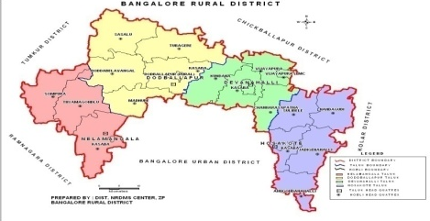
ICAR - Krishi Vigyan Kendra
Bengaluru Rural District
Action Plan
2019-20
Presentation by
Dr. A.P. Mallikarjuna Gowda
Senior Scientist & Head

Slide 2
Profile of Bengaluru Rural District
Agro-climatic zone | Eastern Dry Zone
No. of Taluks | 04
No. of Villages | 1,051
No. of Holdings | 1,60,483
Gross Cropped Area | 1,07,560 ha
Area under irrigation | 23,794 ha (22.86 %)
Sources of irrigation | Tanks, Wells, Tube wells, Lift irrigation
Major soil types | Medium deep to very deep, Red clayey soils, Lateritic clayey soils
Major crops in Kharif | Maize, Finger millet, Pigeonpea, Field bean, Cowpea, Vegetables (Tomato, Cucumber, Cabbage, Cauliflower, Pole bean, French bean, Ridge gourd, Capsicum), Ginger, Flowers (Marigold, Chrysanthemum)
Major crops in Rabi | Chickpea, Horse gram, Vegetables (Potato, Cabbage)
Major perennial crops | Drumstick, Mango, Banana, Guava, Sapota, Jack, Arecanut, Fodder crops, Rose
Major Livestock | Cattle, Buffaloes, Sheep, Goats, Pigs, Poultry birds

Slide 3
Crop Details of Bengaluru Rural District
Crop | Area (ha) | Production (t) | Productivity (t/ha)
Mango | 6753 | 63928 | 9.47
Banana | 1525 | 32933 | 21.60
Grapes | 2218 | 36678.52 | 17
Sapota | 1022 | 8895 | 8.70
Guava | 766 | 14762 | 19.27
Jack | 20 | 695.29 | 34.76
TOTAL FRUITS | 12,304 | 1,57,891.81 | -
Potato | 1504 | 20615 | 13.71
Tomato | 1960 | 61210.42 | 31.23
Beans | 671 | 12867 | 19.18
Cabbage | 447 | 12063 | 26.99
Cauliflower | 330 | 4800 | 14.55
Cucumber | 235 | 3688.70 | 15.70
Other vegetables | 95 | 1085.51 | 11.43
TOTAL VEGETABLES | 5,242 | 1,16,329.63 | -
Ginger | 133 | 1343.20 | 10.10
TOTAL SPICES | 133 | 1343.20
Chrysanthemum | 187 | 1720.57 | 9.20
Rose | 508 | 2790 | 5.49
Others | 28 | 44 | 1.56
TOTAL FLOWERS | 723 | 4,554.57 | -
TOT. HORTICULTURE | 18,402 | 2,80,119.21 | -
SERICULTURE | 6,217 | 5115 | -
Bengaluru Rural District – 4 Taluks
Crop | Area (ha) | Production (t) | Productivity (kg/ha)
Finger millet | 38,884 | 95632 | 2,460
Maize | 14,867 | 25247 | 1,698
TOTAL CEREALS AND MILLETS (Major) | 53,751 | 1,20,879 | -
Redgram | 1416 | 814 | 575
Horse gram | 1730 | 1135 | 656
Field bean | 1702 | 1377 | 810
Cowpea | 660 | 608 | 920
Bengal gram | 87 | 184 | 2115
TOTAL PULSES | 5595 | 4118 | -

Slide 4
Livestock Details of Bengaluru Rural District
Animals/Birds | No. | Avg. Productivity
Cattle & buffaloes | 1,83,201 | 5 lt/animal/day
Sheep | 1,24,870 | -
Goats | 80,740 | -
Pigs | 6052 | -
Others | 30,223 | -
TOTAL LIVESTOCK | 4,25,086 | -
Poultry | 81,65,758 | -

Slide 5
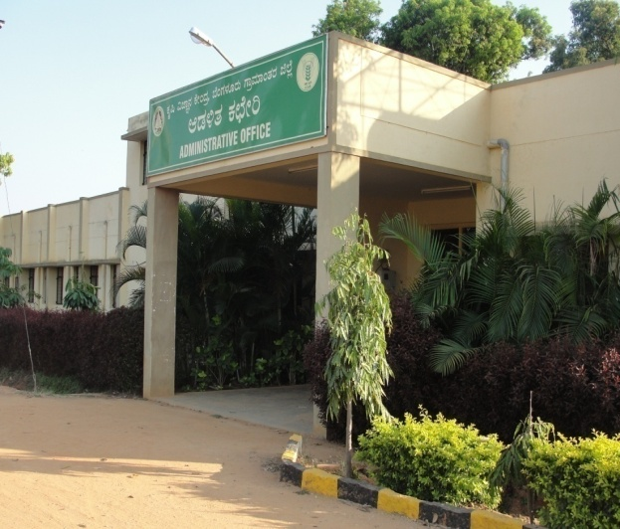
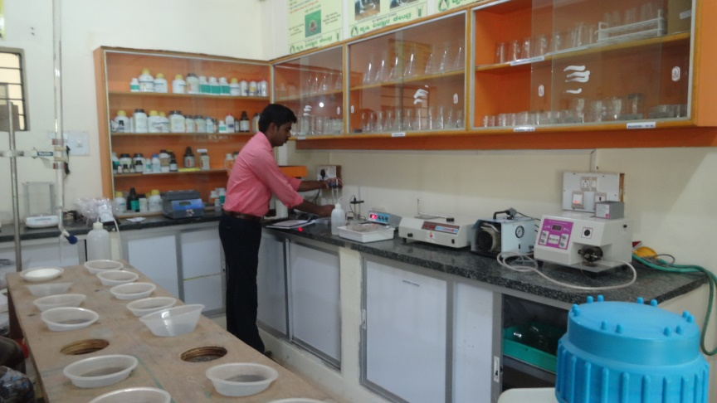
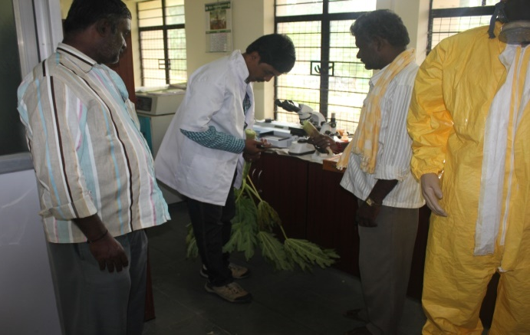
KVK Manpower and Facilities
Manpower Senior Scientist & Head No. of Scientists in position No. of Programme Assistants in position Supporting staff | 01 03 02 04
Farm details Total Area (ha) Cultivated Area (ha) | 21.28 16.30
Production Units Vegetable Special Unit, Vermicompost unit, Nursery unit, NADEP composting unit, Livestock unit, Azolla unit, Silage unit, Apiary etc. | 1308 m²
Laboratories Soil & Water Testing Laboratory Plant Health Clinic | 50 m² 30 m²
Office building
Soil & Water Testing Laboratory
Plant health clinic

Slide 6
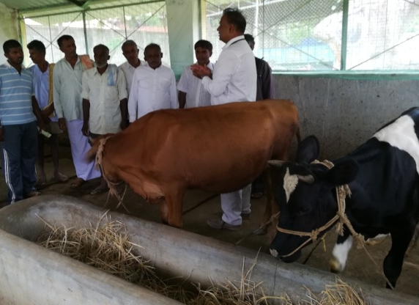
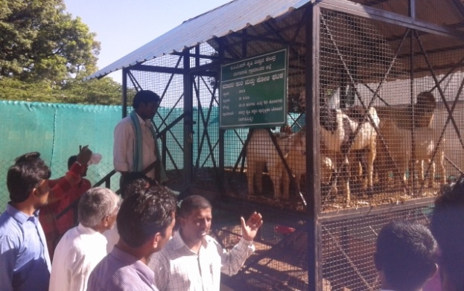
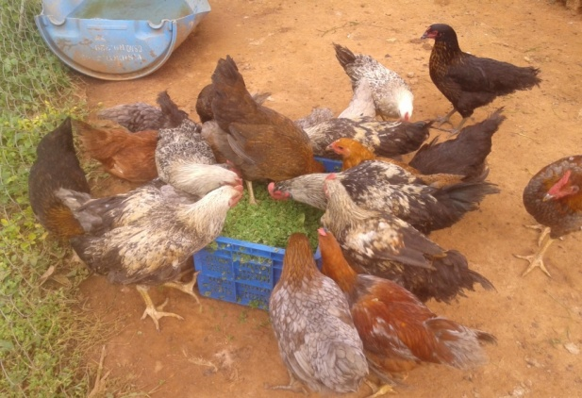
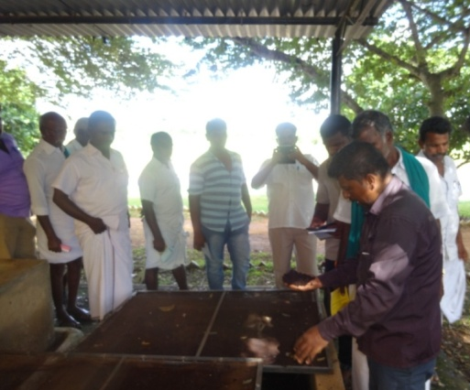
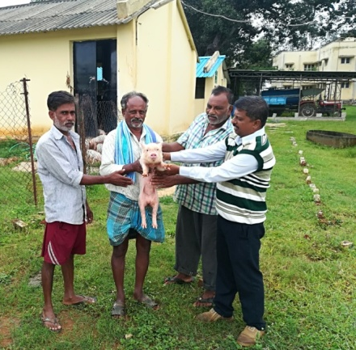
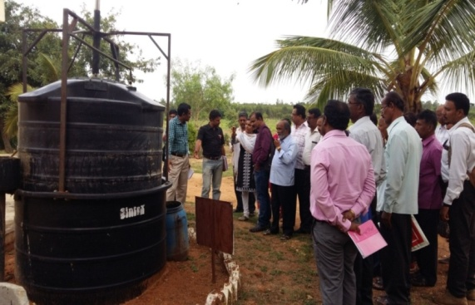
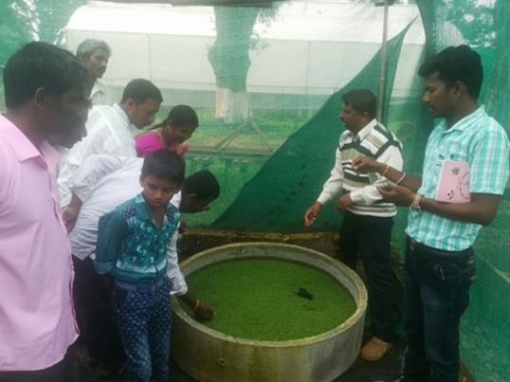
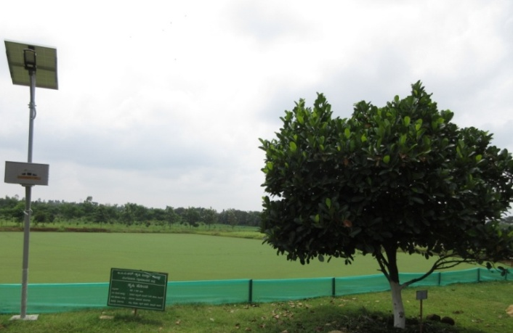
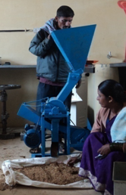
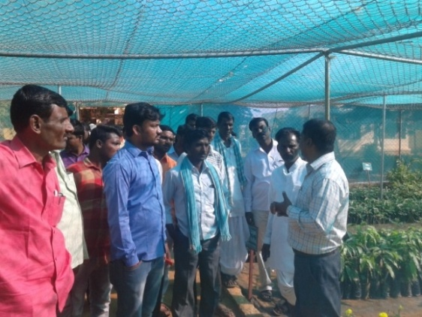
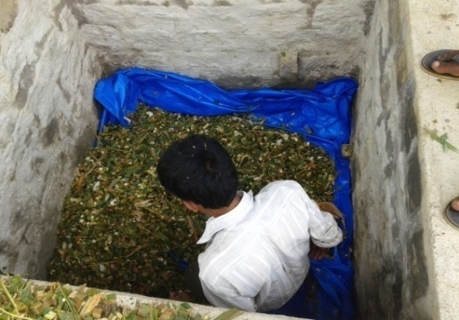
KVK Demonstration Units
Apiary unit (9 m²)
Dairy Unit (53 m²)
Sheep cum Poultry Unit (8.78 m²)
Vermicomposting Unit (18 m²)
Biogas Unit (2 m²)
Piggery Unit (58 m² )
Azolla Unit (2 m²)
Model Horticultural Nursery (678 m²)
Silage Unit (2.25 m²)
Farm Pond (6724 m²)
Millet Processing Unit (32 m²)

Slide 7
Cross-learning across KVKs
Name of the KVK proposed | Specific learning areas
a) KVK, Mysuru b) KVK, Pathanamthitta, Kerala | To know the innovative technologies developed, adopted and cropping pattern followed To know the different technologies adopted and popularised Exposure visits, scientist & farmers interaction
Cluster KVK’s
Name of the KVK included in the cluster | Knowledge/expertise | Resources (facilities and products) | Activities
KVK, Tumakuru-II | Improved Agriculture & Horticulture practices, Market Linkage & value addition technology through Commodity based associations | Quality seeds and planting materials. Nutrient mixture | Interaction with scientists & progressive farmers and visit to progressive farmers fields
KVK, Chikkaballapura | Improved sericulture practices, Quality cashew and other Planting Materials | Planting materials, sericulture based products | Scientists & farmers interaction and visit to cocoon market and reeling factory
KVK, Ramanagara | Integrated crop management in mango and mulberry, post harvesting technology in mango | Different demo units in KVK, Improved practices in mango and Sericulture | Scientists & farmers interaction and Exposure visit to mango orchards

Slide 8
1. DFI Strategy- Crop Productivity
OFT/FLD/FFS | Cluster | No. of Farmers
OFT - Assessment of Redgram Varieties for Terminal Drought conditions | Doddaballapura | 5
OFT - Assessment of nutrient management in potato | Hosakote | 5
OFT - Assessment on management of yellow mosaic virus in pole bean through integrated approach | Nelamangala | 5
OFT - Assessment on management of mosaic virus in ridge gourd through integrated approach | Devanahalli | 5

Slide 9
DFI Strategy- Crop Productivity
OFT/FLD/FFS | Cluster | No. of Farmers
FLD - Addressing Drought and Blast Vulnerability through Finger millet var. ML 365 under double cropping system | Hosakote | 20
FLD - Introduction of Foxtail millet Var. DHFT-109-3 for higher yield and marketability | Doddaballapura | 10
FLD - Demonstration of multicut fodder sorghum: COFS-31 for green fodder and silage | Hosakote | 20
FLD- Improved Production Technologies in Castor | Doddaballapura | 05
FLD - Intercropping in Arecanut | Nelamangala | 05
FLD - Fertigation in tomato for enhancement of yield and quality | Hosakote | 05
FLD - Integrated Nutrient Management in Pole bean | Nelamangala | 05

Slide 10
DFI Strategy- Crop Productivity
OFT/FLD/FFS | Cluster | No. of Farmers
FLD - Soil test based nutrient management for tissue culture banana | Doddaballapura | 05
FLD - Integrated crop management in Maize | Doddaballapura Nelamangala | 10
FLD - Integrated crop management in Tomato | Nelamangala | 05
FLD- Integrated Crop Management in Cauliflower | Devanahalli | 05
FLD- Integrated Crop Management in Brinjal | Doddaballapura | 05
FFS- Integrated crop management in rose | Hosakote | 01
FLD- Ration Balancing through Integrated Approach in Dairy Animals | Doddaballapura Nelamangala Hosakote Devanahalli | 20

Slide 11
2. DFI Strategy-Reduction in cost of cultivation
OFT/FLD/FFS | Cluster | No. of Farmers
OFT - Assessment on management of yellow mosaic virus in pole bean through integrated approach | Nelamangala | 5
OFT - Assessment on management of mosaic virus in ridge gourd through integrated approach | Devanahalli | 5
FLD - Fertigation in tomato for enhancement of yield and quality | Hosakote | 05
FLD - Integrated Nutrient Management in Pole bean | Nelamangala | 05
FLD - Integrated crop management in Maize | Doddaballapura Nelamangala | 10
FLD - Integrated crop management in Tomato | Nelamangala | 05
FLD- Integrated Crop Management in Cauliflower | Devanahalli | 05
FLD- Integrated Crop Management in Brinjal | Doddaballapura | 05
FFS- Integrated crop management in rose | Hosakote | 01

Slide 12
3. DFI Strategy- Crop diversity
OFT/FLD/FFS | Cluster | No. of Farmers
FLD - Addressing Drought and Blast Vulnerability through Finger millet var. ML 365 under double cropping system | Hosakote | 20
FLD - Demonstration of multicut fodder sorghum: COFS-31 for green fodder and silage | Hosakote | 20
FLD- Improved Production Technologies in Castor | Doddaballapura | 05
FLD - Intercropping in Arecanut | Nelamangala | 05
FLD - Nutrition garden for farm families | Doddaballapura Nelamangala Hosakote Devanahalli | 25
FLD - Popularization of Kadaknath poultry bird | Doddaballapura Nelamangala Hosakote Devanahalli | 25

Slide 13
4. DFI Strategy- Value addition & Market linkage
OFT/FLD/FFS | Cluster | No. of Farmers
FLD - Introduction of Foxtail millet Var. DHFT-109-3 for higher yield and marketability | Doddaballapura | 10
FLD - Demonstration of multicut fodder sorghum: COFS-31 for green fodder and silage | Hosakote | 20
FLD - Popularization of Kadaknath poultry bird | Doddaballapura Nelamangala Hosakote Devanahalli | 25
Jack fruit : value addition, branding and market linkage | Doddaballapura | 05

Slide 14
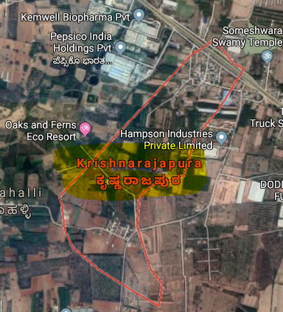
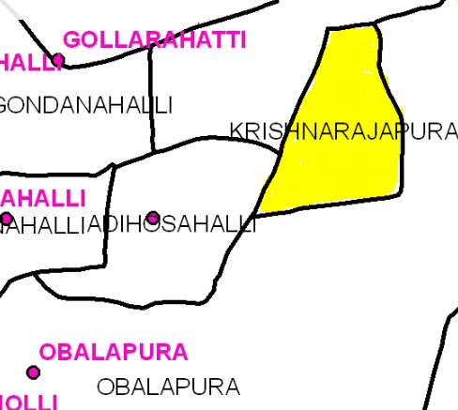
Nelamangala Cluster
Cluster villages -
Krishnarajapura, Adihosalli, Obalapura
Nelamangala Taluk
Cluster villages
Satellite image of Krishnarajapura village

Slide 15
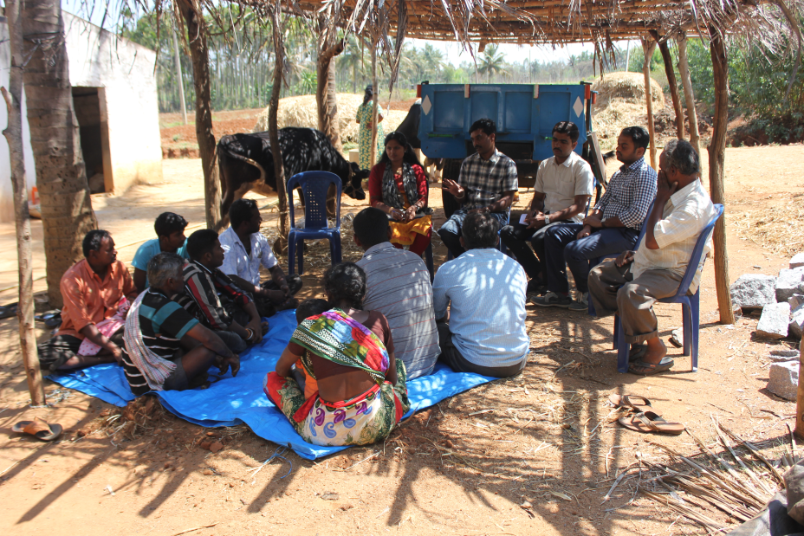
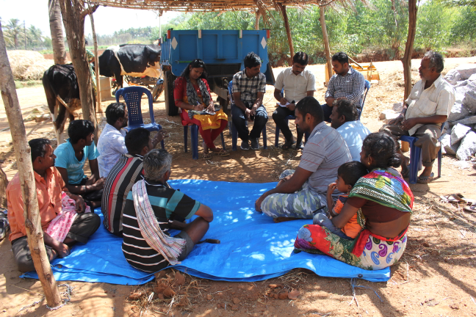
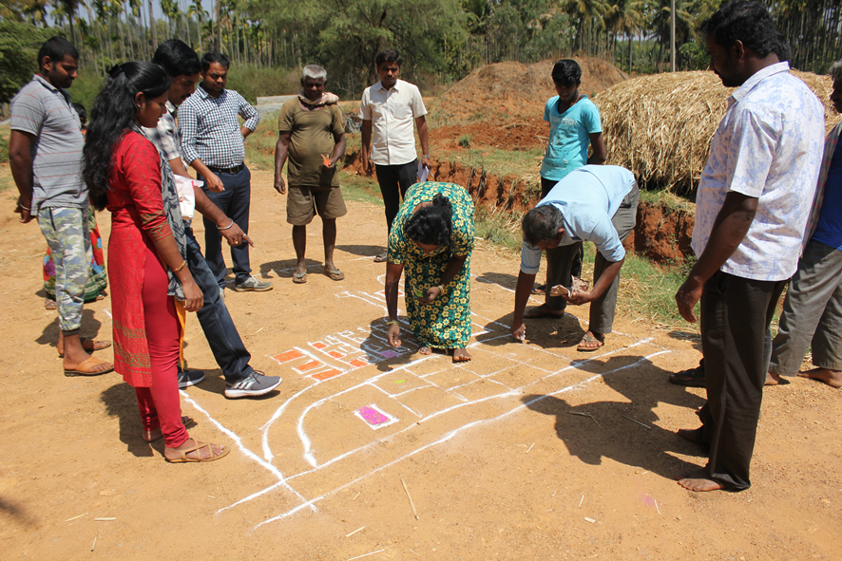
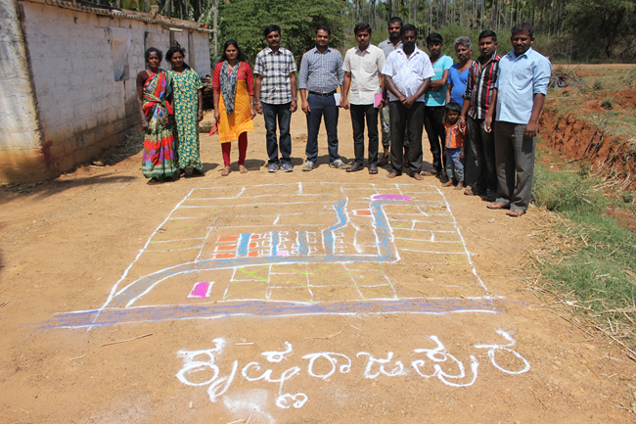
Participatory Rural Appraisal (PRA) - Nelamangala Cluster
Explaining PRA Objectives
Briefing of Village Agriculture Situations
Drawing of Resource Map
Village Resource Map

Slide 16
Problems identified in Nelamangala Cluster
Problems
1 | Maize - No application of K & micro nutrients, Fall army worm, Stem borer, downy mildew and Turcicum leaf blight
2 | Finger millet - Intermittent drought and blast
3 | Red gram - Low yield due to imbalanced nutrition, wilt, sterility mosaic disease, Phyllody and pod borer
4 | Tomato - Indiscriminate use of fertilizers due to lack of knowledge on recommended schedules, ToLCV, Bacterial wilt, early blight, late blight, Blossom end rot, leaf miner, thrips and fruit borer
5 | Cabbage – Imbalanced nutrition, DBM and black rot
6 | Pole Beans – Imbalanced nutrition, severe incidence of yellow mosaic virus, rust, leaf miner, anthracnose and pod borer
7 | Arecanut - Imbalanced nutrition , no intercropping system and falling of nuts
8 | Dairy animals – Non availability of green fodder through out the year, low milk production, decreased reproductive efficiency after calving, inefficient reproductive management practices, delayed onset of oestrus
9 | Nutrition garden - Nutrition insecurity and lack of knowledge on importance of nutrition garden
10 | Sheep - Low meat yield due to imbalanced nutrition, local breed
11 | Poultry birds - Lack of awareness on improved backyard poultry, Lack of awareness about meat, egg and health issues, Lower productivity and income

Slide 17
Gap Identification and Technology Prioritization – Nelamangala Cluster
Crop | Average Yield | Potential Yield | Technological gap | Extension Gap | Technological Intervention
Maize | 52 q/ha | 70 q/ha | No application of K & micro nutrients Fall army worm, Stem borer, Downy mildew and turcicum leaf blight | Lack of awareness about integrated nutrient, pest and disease management practices | FLD - Integrated crop management in Maize
Redgram | 6.4 q/ha | 12.5 q/ha | Imbalanced nutrition, wilt, sterility mosaic disease, phyllody and pod borer | Lack of awareness about integrated crop management practices | FLD - Integrated crop management in Redgram
Pole bean | 25 t/ha | 40 t/ha | Severe incidence of Yellow Mosaic Virus | Lack of awareness about IDM practices | OFT – Assessment on management of yellow mosaic virus in pole beans
Arecanut | 1.5 t/ha | 1.87 t/ha | Improper utilization of inter-space and weed menace in Arecanut gardens | Lack of awareness about intercropping | FLD- Intercropping in Arecanut

Slide 18
Gap Identification and Technology Prioritization – Nelamangala Cluster
Crop | Average Yield | Potential Yield | Technological gap | Extension Gap | Technological Intervention
Pole bean | 25 t/ha | 40 t/ha | No K application, Micronutrients application is not followed | Lack of awareness about nutrient management practices | FLD - Integrated Nutrient Management in Pole bean
Tomato | 64 t/ha | 75 t/ha | No application of micro nutrients, indiscriminate use of fungicides, ToLCV, wilt, early blight, late blight, leaf miner and fruit borer | Lack of awareness about IPDM practices, use of vegetable special | FLD - Integrated crop management in tomato
Nutrition garden | - | - | Nutrition insecurity and lack of knowledge on importance of nutrition garden | Lack of awareness about nutrition garden and nutrition security | FLD – Nutrition Garden for Farm families

Slide 19
Gap Identification and Technology Prioritization – Nelamangala Cluster
Crop | Average Yield | Potential Yield | Technological gap | Extension Gap | Technological Intervention
Poultry birds | 1 kg | 1.75 kg | Lack of awareness about improved backyard poultry, Lower productivity and income | Lack of awareness about kadaknath | EDP – Popularization of Kadaknath poultry bird
Dairy animals | 8.70 lt | 10.5 lt | Lower milk yield, Lower milk quality (fat%, SNF) and Ruminal acidosis | Lack of awareness about integrated nutrient management practices | FLD - Ration Balancing through Integrated Approach in Dairy Animals

Slide 20
Activities in Nelamangala cluster Cluster villages - Krishnarajapura, Adihosalli, Obalapura
DFI Strategy | Activity
Crop Productivity | OFT - Assessment on management of yellow mosaic virus in pole bean through integrated approach
 | FLD - Integrated crop management in Maize
 | FLD - Intercropping in Arecanut
 | FLD - Integrated Nutrient Management in Pole bean
 | FLD - Integrated Nutrient Management in tomato
 | FLD- Ration Balancing through Integrated Approach in Dairy Animals
Reduction in cost of cultivation | OFT - Assessment on management of yellow mosaic virus in pole bean through integrated approach
 | FLD - Integrated crop management in Maize
 | FLD - Integrated Nutrient Management in Pole bean
 | FLD - Integrated Crop Management in Tomato

Slide 21
Activities in Nelamangala cluster Cluster villages - Krishnarajapura, Adihosalli, Obalapura
DFI Strategy | Activity
Crop Diversity | FLD - Intercropping in Arecanut
 | FLD - Nutrition garden for farm families
 | FLD - Popularization of Kadaknath poultry bird
Value addition and Market linkage | FLD - Popularization of Kadaknath poultry bird

Slide 22
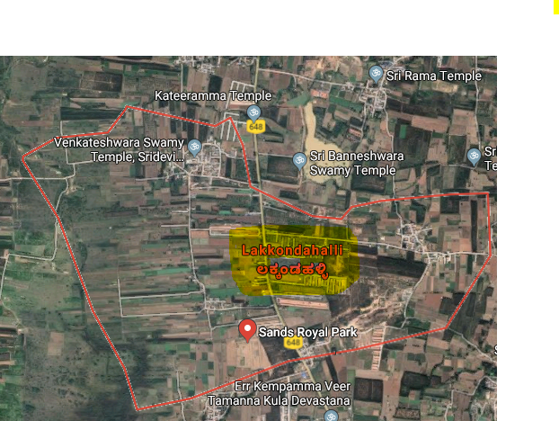
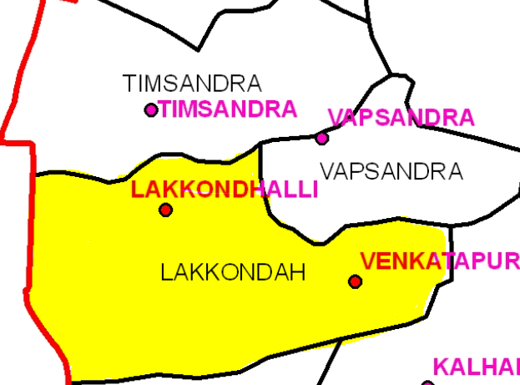
Details of Hosakote Cluster
Cluster villages – Lakkondahalli, Vapasandra,
Thimmasandra
Hosakote Taluk
Satellite image of Lakkondahalli village
Cluster villages

Slide 23
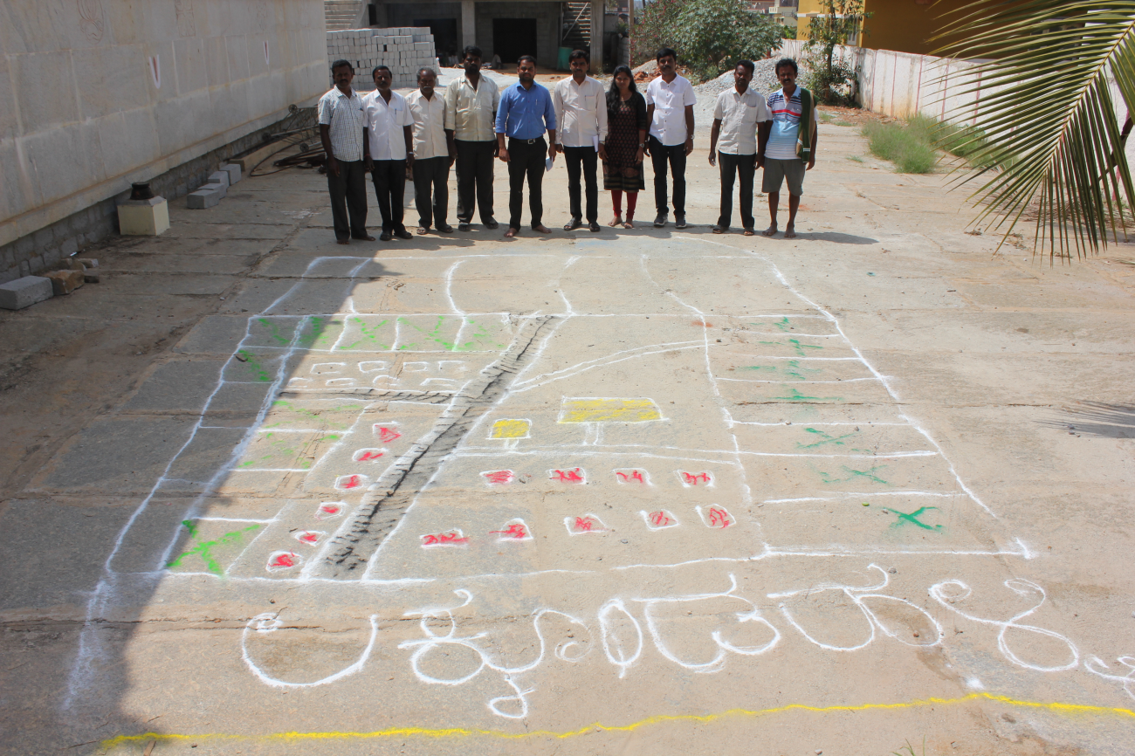
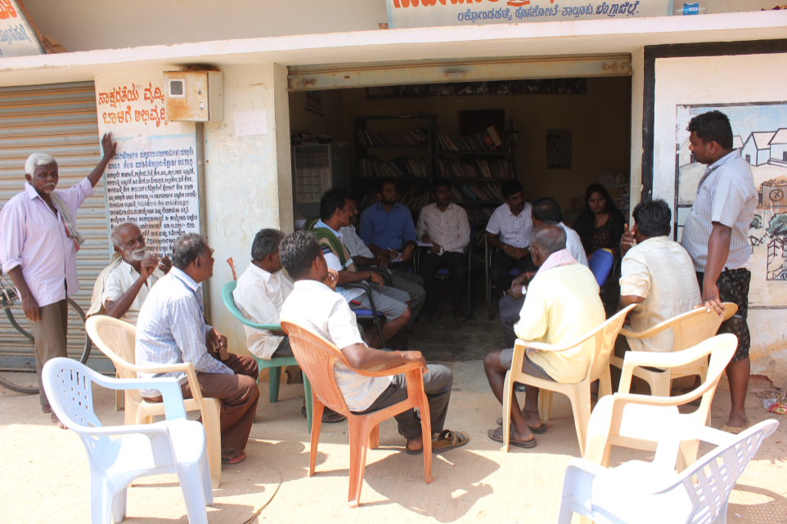
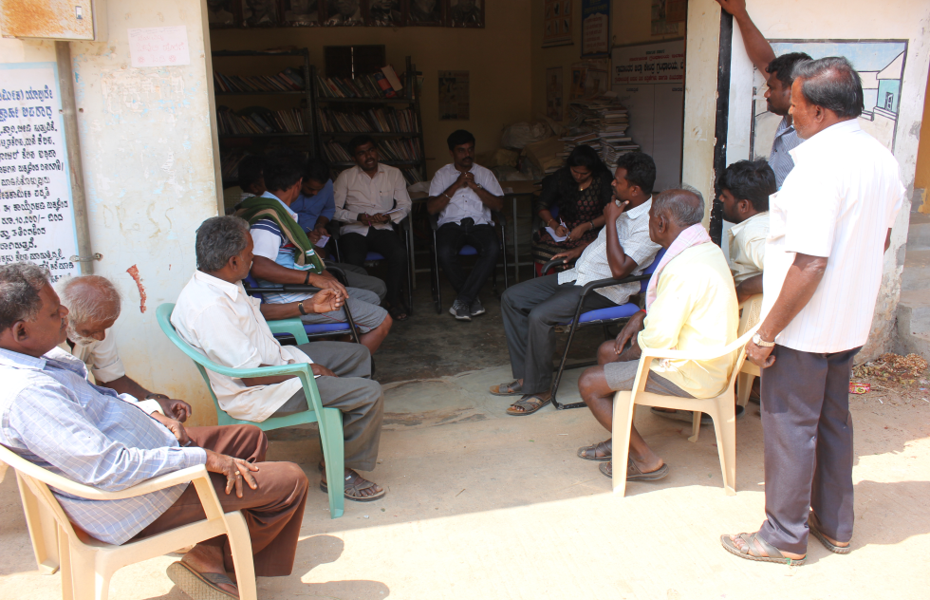
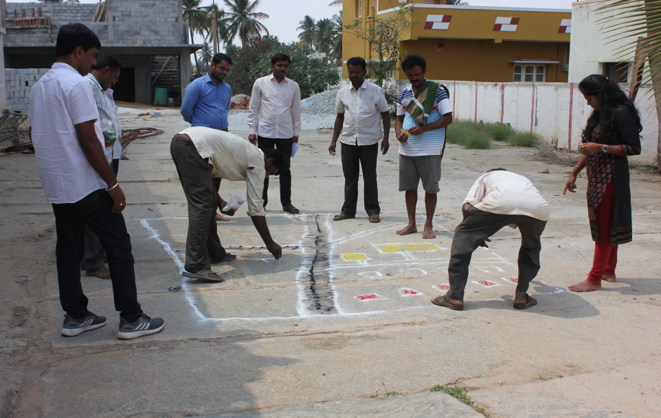
Participatory Rural Appraisal (PRA) - Hosakote Cluster
Explaining PRA Objectives
Briefing of Village Agriculture Situations
Drawing of Resource Map
Village Resource Map

Slide 24
Problems identified in Hosakote Cluster
Problems
1 | Maize- No application of K & micro nutrients, Fall army worm, Stem borer, Downy mildew and turcicum leaf blight
2 | Finger millet - Intermittent drought and blast
3 | Red gram - Low yield due to imbalanced nutrition, wilt, sterility mosaic disease, Phyllody and pod borer
4 | Bengal Gram – Low yield due to imbalanced nutrition, wilt, pod borer
5 | Fodder - Non availability of green fodder through out the year
6 | Tomato - Indiscriminate use of water soluble fertilizers due to lack of recommended schedules, ToLCV, Bacterial wilt, early blight, late blight, Blossom end rot, leaf miner, thrips and fruit borer
7 | Potato - Imbalanced fertilizers application, low yield and soft rot during storage
8 | Rose - Thrips, Aphids, mites, Bud borer, Black spot, DM, PM, Die back and Rust
9 | Nutrition garden - Nutrition insecurity and lack of knowledge on importance of nutrition garden
10 | Dairy animals – Non availability of green fodder through out the year, low milk production, decreased reproductive efficiency after calving, inefficient reproductive management practices, delayed onset of oestrus
11 | Poultry birds - Lack of awareness on improved backyard poultry and meat, egg and health issues, Lower productivity and income

Slide 25
Gap Identification and Technology Prioritization – Hosakote Cluster
Crop | Average Yield | Potential Yield | Technological gap | Extension Gap | Technological Intervention
Finger millet | 18.0 q/ha | 25.0 q/ha | Intermittent drought & blast | Lack of awareness about drought and blast resistant varieties | FLD - Addressing Drought and Blast Vulnerability using Finger millet var. ML 365 under double cropping system
Fodder sorghum | - | - | Non availability of high yielding multicut fodder varieties with more palatability | Unaware about the availability of suitable multicut fodder varieties | FLD - Demonstration of multicut fodder sorghum: COFS-31 for green fodder and silage
Potato | 18 t/ha | 25 t/ha | Imbalanced fertilizers application, Low yield, Soft rot during storage | Lack of awareness on balanced application of major & micro nutrients | OFT - Assessment of nutrient management in Potato

Slide 26
Gap Identification and Technology Prioritization –Hosakote Cluster
Crop | Average Yield | Potential Yield | Technological gap | Extension Gap | Technological Intervention
Tomato | 64 t/ha | 75 t/ha | Indiscriminate use of fertilizers due to lack of awareness on recommended schedules | Lack of awareness about recommended schedules for fertigation | FLD - Fertigation in tomato for enhancement of yield and quality
Rose | 5.49 t/ha | 12 t/ha | Imbalanced nutrition, Thrips, Aphids, mites, Bud borer, Black spot, DM, PM, Die back and Rust | Lack of awareness about nutrient, pest, disease management practices | FFS – Integrated Crop Management in Rose
Nutrition garden | - | - | Nutrition insecurity and lack of knowledge on importance of nutrition garden | Lack of awareness about nutrition garden and nutrition security | FLD – Nutrition garden for Farm families

Slide 27
Gap Identification and Technology Prioritization –Hosakote Cluster
Crop | Average Yield | Potential Yield | Technological gap | Extension Gap | Technological Intervention
Poultry birds | 1 kg | 1.75 kg | Lack of awareness about improved backyard poultry, Lower productivity and income | Lack of awareness about kadaknath | EDP – Popularization of Kadaknath poultry bird
Dairy animals | 8.70 lt | 10.5 lt | Lower milk yield, Lower milk quality (fat %, SNF) and Incidence of Ruminal acidosis | Lack of awareness about integrated nutrient management practices | FLD - Ration Balancing through Integrated Approach in Dairy Animals

Slide 28
Activities in Hosakote cluster Cluster villages-Lakkondahalli,Vapasandra,Thimmasandra
DFI Strategy | Activity
Crop Productivity | OFT - Assessment of nutrient management in potato
 | FLD - Addressing Drought and Blast Vulnerability through Finger millet var. ML 365 under double cropping system
 | FLD - Demonstration of multicut fodder sorghum: COFS-31 for green fodder and silage
 | FLD - Fertigation in tomato for enhancement of yield and quality
 | FFS- Integrated crop management in rose
 | FLD- Ration Balancing through Integrated Approach in Dairy Animals
Reduction in cost of cultivation | FLD - Fertigation in tomato for enhancement of yield and quality
 | FFS- Integrated crop management in rose

Slide 29
Activities in Hosakote cluster Cluster villages-Lakkondahalli,Vapasandra,Thimmasandra
DFI Strategy | Activity
Crop Diversity | FLD - Addressing Drought and Blast Vulnerability through Finger millet var. ML 365 under double cropping system
 | FLD - Demonstration of multicut fodder sorghum: COFS-31 for green fodder and silage
 | FLD - Nutrition garden for farm families
 | FLD - Popularization of Kadaknath poultry bird
Value addition and Market linkage | FLD - Demonstration of multicut fodder sorghum: COFS-31 for green fodder and silage
 | FLD - Popularization of Kadaknath poultry bird

Slide 30
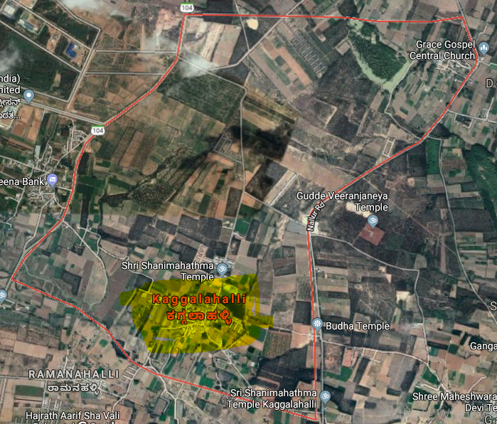
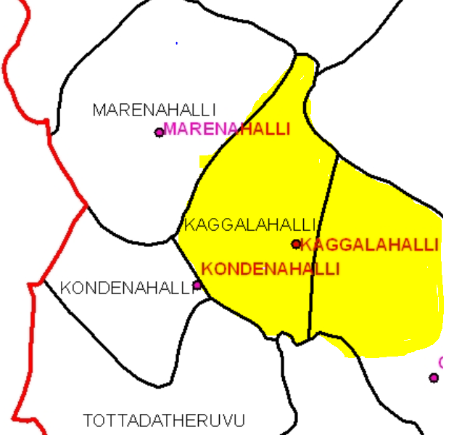
Devanahalli Cluster
Cluster villages – Kaggalahali, Marenahalli, Kondenahalli
Devanahalli Taluk
Satellite image of Kaggalahalli village
Cluster villages

Slide 31
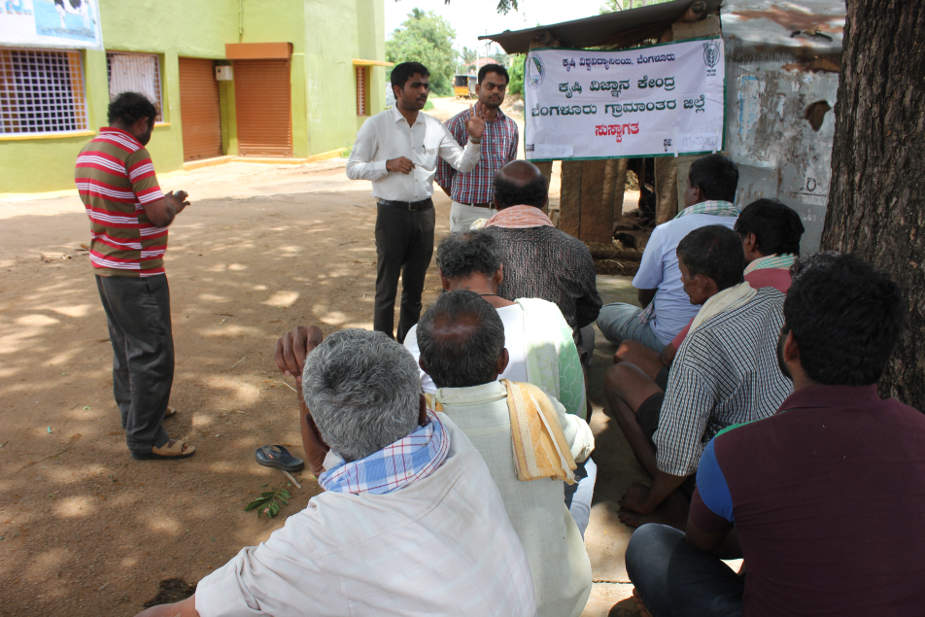
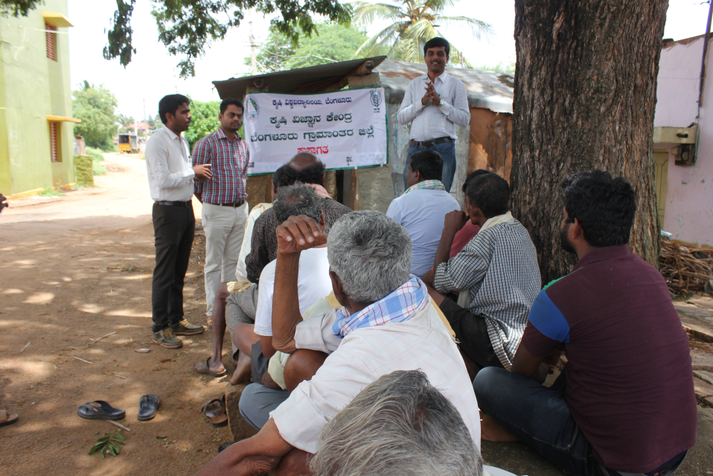
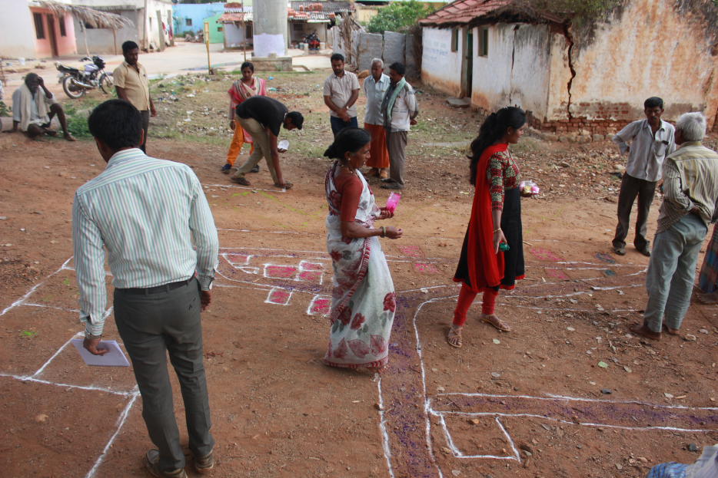
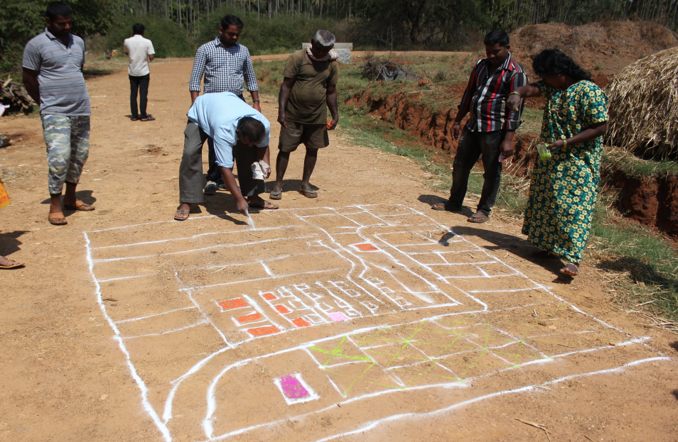
Participatory Rural Appraisal (PRA) - Devanahalli Cluster
Explaining PRA Objectives
Briefing of Village Agriculture Situations
Drawing of Resource Map
Village Resource Map

Slide 32
Problems identified in Devanahalli Cluster
Problems
1 | Finger millet - Intermittent drought and blast
2 | Red gram - Low yield due to imbalanced nutrition, wilt, sterility mosaic disease, Phyllody and pod borer
3 | Fodder - Non availability of green fodder through out the year
4 | Tomato - Indiscriminate use of fertilizers due to lack of knowledge on recommended schedules, ToLCV, Bacterial wilt, early blight, late blight, Blossom end rot, leaf miner, thrips and fruit borer
5 | Ridge gourd- Imbalanced fertilizers application, Severe incidence of mosaic virus
6 | Cauliflower - Imbalanced nutrition, severe incidence of Diamond backmoth
7 | Nutrition garden - Nutrition insecurity and lack of knowledge on importance of nutrition garden
8 | Dairy animals – Non availability of green fodder through out the year, low milk production, decreased reproductive efficiency after calving, inefficient reproductive management practices, delayed onset of oestrus
9 | Poultry birds - Lack of awareness on improved backyard poultry and about meat, egg and health issues, Lower productivity and income
10 | Fluctuations in market prices

Slide 33
Gap Identification and Technology Prioritization – Devanahalli Cluster
Crop | Average Yield | Potential Yield | Technological gap | Extension Gap | Technological Intervention
Ridge gourd | 8.51 t/ha | 11 t/ha | Severe incidence of Mosaic Virus | Lack of awareness about IDM practices | OFT – Assessment on management of mosaic virus in ridge gourd
Cauliflower | 36 t/ha | 48 t/ha | Imbalanced nutrition, DBM (>42%) infestation, poor quality curd | Lack of awareness about nutrient and pest management practices | FLD – Integrated crop management in cauliflower

Slide 34
Gap Identification and Technology Prioritization – Devanahalli Cluster
Crop | Average Yield | Potential Yield | Technological gap | Extension Gap | Technological Intervention
Nutrition garden | - | - | Nutrition insecurity and lack of knowledge on importance of nutrition garden | Lack of awareness about nutrition garden and nutrition security | FLD – Nutrition garden for Farm families
Poultry birds | 1 kg | 1.75 kg | Lack of awareness about meat, egg and health issues, lower productivity and income | Lack of awareness about kadaknath | EDP – Popularization of Kadaknath poultry bird
Dairy animals | 8.70 lt | 10.5 lt | Lower milk yield, Lower milk quality (fat %, SNF) and Incidence of Ruminal acidosis | Lack of awareness about integrated nutrient management practices | FLD - Ration Balancing through Integrated Approach in Dairy Animals

Slide 35
Activities in Devanahalli cluster Cluster villages - Kaggalahali, Marenahalli, Kondenahalli
DFI Strategy | Activity
Crop Productivity | OFT - Assessment on management of mosaic virus in ridge gourd through integrated approach
 | FLD- Integrated Crop Management in Cauliflower
 | FLD- Ration Balancing through Integrated Approach in Dairy Animals
Reduction in cost of cultivation | OFT - Assessment on management of mosaic virus in ridge gourd through integrated approach
 | FLD- Integrated Crop Management in Cauliflower
Crop Diversity | FLD - Nutrition garden for farm families
 | FLD - Popularization of Kadaknath poultry bird
Value addition and Market linkage | FLD - Popularization of Kadaknath poultry bird

Slide 36
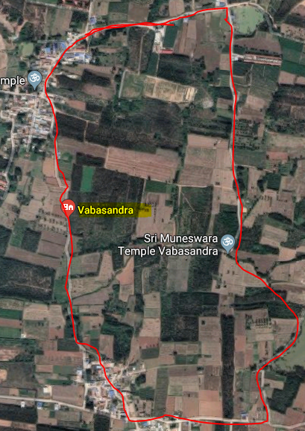
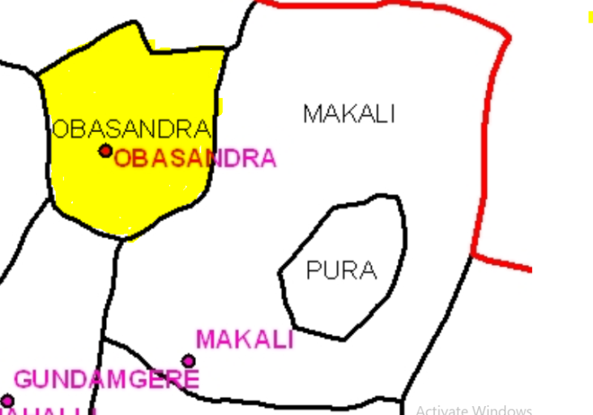
Doddaballapur Cluster
Cluster villages – Vabasandra, Gundamagere and Makali
Doddaballapura Taluk
Vabasandra
Satellite image of Vabasandra village
Cluster villages

Slide 37
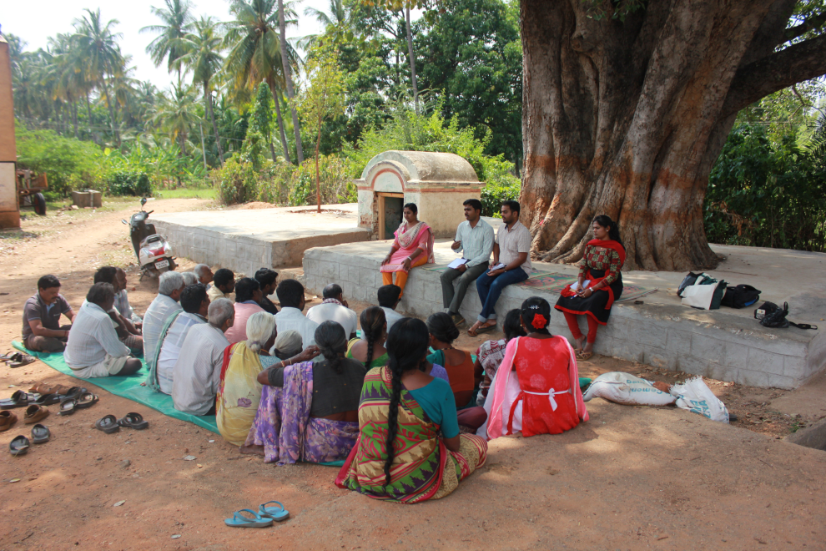
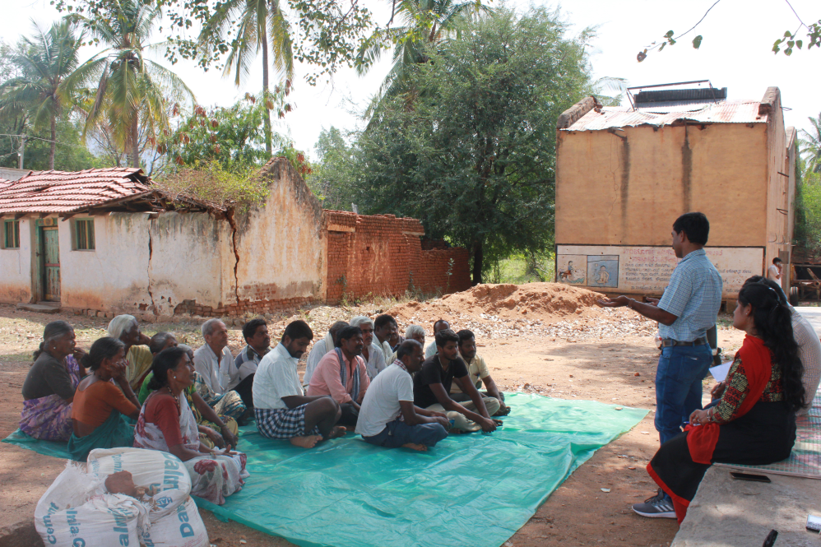
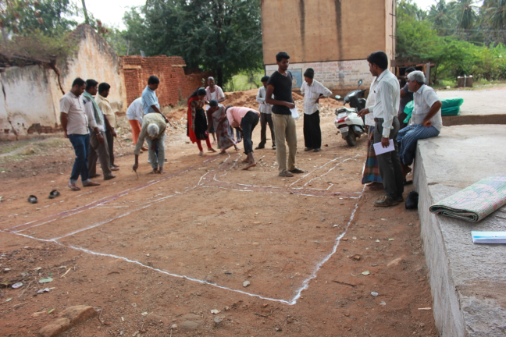
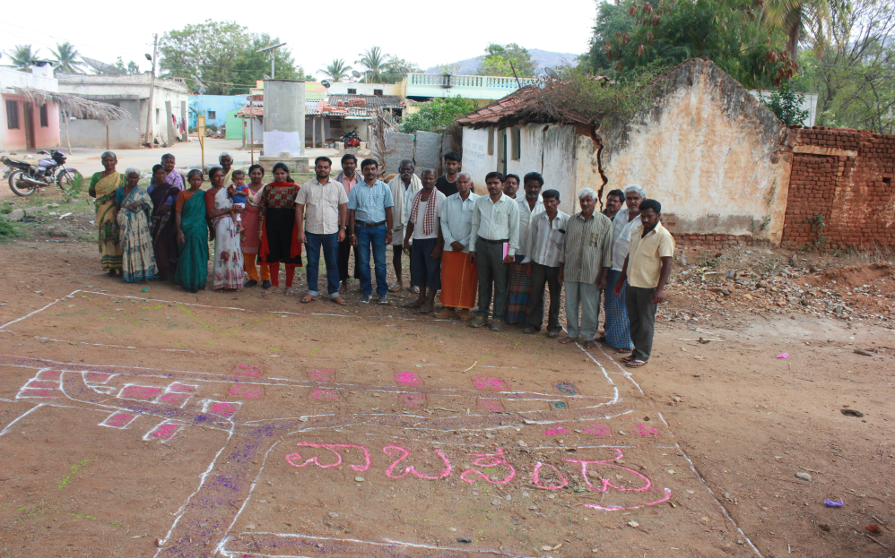
Participatory Rural Appraisal (PRA) - Doddaballapur Cluster
Explaining PRA Objectives
Briefing of Village Agriculture Situations
Drawing of Resource Map
Village Resource Map

Slide 38
Problems identified in Doddaballapur Cluster
Problems
1 | Maize - No application of K & micro nutrients, Fall army worm, Stem borer, Downy mildew and turcicum leaf blight
2 | Finger millet - Intermittent drought and blast
3 | Red gram - Low yield due to imbalanced nutrition, wilt, sterility mosaic disease, Phyllody and pod borer
4 | Foxtail millet - Low yield, Improper nutrient management, Less income by selling the grains without processing
5 | Fodder - Non availability of high yielding multicut fodder variety having more palatability
6 | Brinjal - Imbalanced nutrition, Shoot and fruit borer (31%) infestation, bacterial wilt, root rot, PM, poor quality fruit
7 | Jackfruit - Lack of knowledge on importance of labeling, packaging and branding of value added products for realizing higher profits.
8 | Banana - Imbalanced fertilizers application, No intercropping
9 | Dairy animals – Non availability of green fodder through out the year, low milk production, decreased reproductive efficiency after calving, inefficient reproductive management practices, delayed onset of oestrus
10 | Castor - lack of knowledge about improved production technologies
11 | Poultry birds - Lack of awareness on improved backyard poultry, Lack of awareness about meat, egg and health issues, Lower productivity and income

Slide 39
Gap Identification and Technology Prioritization – Doddaballapur Cluster
Crop | Average Yield | Potential Yield | Technological gap | Extension Gap | Technological Intervention
Maize | 52 q/ha | 70 q/ha | No application of K & micro nutrients Fall army worm, Stem borer, Downy mildew and turcicum leaf blight | Lack of awareness about integrated nutrient, pest and disease management practices | FLD - Integrated crop management in Maize
Foxtail millet | - | - | Low yield, Improper nutrient management, Less income due to no processing | Lack of awareness about processing techniques | FLD - Introduction of Foxtail millet Var. DHFT-109-3
Redgram | 9 q/ha | 12.5 q/ha | Drought at the end of reproductive stage, moisture stress due to low water retention in light red soils and Low yield | Lack of awareness on medium duration & terminal drought resistant varieties | OFT- Assessment of red gram varieties for terminal drought conditions

Slide 40
Gap Identification and Technology Prioritization – Doddaballapur Cluster
Crop | Average Yield | Potential Yield | Technological gap | Extension Gap | Technological Intervention
Castor |  |  | lack of knowledge about improved production technologies | lack of awareness about improved production technologies | FLD – Improved production technologies in castor
Fodder sorghum | - | - | Non availability of high yielding multicut fodder varieties with more palatability | Unaware about the availability of suitable multicut fodder varieties | FLD - Demonstration of multicut fodder sorghum: COFS-31 for green fodder and silage

Slide 41
Gap Identification and Technology Prioritization – Doddaballapur Cluster
Gap Identification and Technology Prioritization – Doddaballapur Cluster
Crop | Average Yield | Potential Yield | Technological gap | Extension Gap | Technological Intervention
Brinjal | 53.8 t/ha | 65 t/ha | Imbalanced nutrition, Shoot and fruit borer, bacterial wilt, root rot, PM, poor quality fruit | Lack of awareness about integrated crop management practices | FLD – Integrated crop management in brinjal
Banana | 21.60 t/ha | 29.80 t/ha | Imbalanced fertilizers application , Pest and disease incidence, Low yield | Lack of awareness about fertilizers and IPDM practices | FLD – Soil test based nutrient management for tissue culture banana
Jackfruit | 34.76 t/ha | 40 t/ha | 40% post harvest loss Lack of knowledge on importance of labeling, packaging and branding of jack value added products for realizing higher profits | Lack of awareness about value added products in jackfruit | EDP – Jackfruit :value addition, branding and market linkage

Slide 42
Gap Identification and Technology Prioritization – Doddaballapur Cluster
Crop | Average Yield | Potential Yield | Technological gap | Extension Gap | Technological Intervention
Nutrition garden | - | - | Nutrition insecurity and lack of knowledge on importance of nutrition garden | Lack of awareness about nutrition garden and nutrition security | FLD – Nutrition garden for Farm families
Poultry birds | 1 kg | 1.75 kg | Lack of awareness about meat, egg and health issues, Lower productivity and income | Lack of awareness about kadaknath | EDP – Popularization of Kadaknath poultry bird
Dairy animals | 8.70 lt | 10.5 lt | Lower milk yield, Lower milk quality (fat %, SNF) and Incidence of Ruminal acidosis | Lack of awareness about integrated nutrient management practices | FLD - Ration Balancing through Integrated Approach in Dairy Animals

Slide 43
Activities in Doddaballapur cluster Cluster villages-– Vabasandra, Gundamagere & Makali
DFI Strategy | Activity
Crop Productivity | OFT - Assessment of Redgram Varieties for Terminal Drought conditions
 | FLD - Introduction of Foxtail millet Var. DHFT-109-3 for higher yield and marketability
 | FLD- Improved Production Technologies in Castor
 | FLD - Soil test based nutrient management for tissue culture banana
 | FLD - Integrated crop management in Maize
 | FLD - Integrated crop management in Brinjal
 | FLD- Ration Balancing through Integrated Approach in Dairy Animals
Reduction in cost of cultivation | FLD - Integrated crop management in Maize
 | FLD - Integrated crop management in Brinjal

Slide 44
Activities in Doddaballapur cluster Cluster villages-– Vabasandra, Gundamagere & Makali
DFI Strategy | Activity
Crop Diversity | FLD- Improved Production Technologies in Castor
 | FLD - Nutrition garden for farm families
 | FLD - Popularization of Kadaknath poultry bird
 | FLD - Introduction of Foxtail millet Var. DHFT-109-3 for higher yield and marketability
Value addition and Market linkage | FLD - Popularization of Kadaknath poultry bird
 | FLD - Jack fruit : value addition, branding and market linkage

Slide 45
Abstract of activities (2019-20)
Sl. No | Particulars | Total budget (Rs.)
1. | On Farm Testing – 4 No. (2 contd…) | 140200
2. | Front Line Demonstration – 16 Nos. | 615850
3. | FFS – Integrated Crop Management in Rose | 30,000
TOTAL Rs. |  | 7,86,050

Slide 46
Abstract – On Farm Testing
Sl. No | Technology to be assessed / refined | No. of trials | Budget
1. | Assessment of Redgram Varieties for Terminal Drought conditions | 05 (2 ha) | 34000
2. | Assessment of nutrient management in potato | 05 (1.0 ha) | 11550
3. | Assessment on management of yellow mosaic virus in pole bean through integrated approach | 05 (1.0 ha) | 46825
4. | Assessment on management of mosaic virus in ridge gourd through integrated approach | 05 (1.0 ha) | 46825
 | GRAND TOTAL |  | 139200

Slide 47
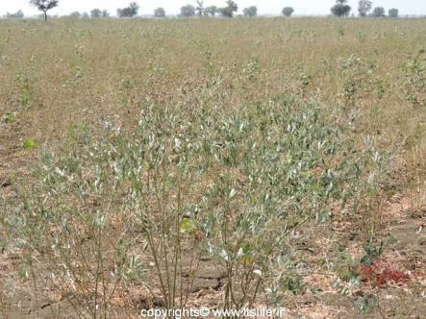
1. Assessment of Redgram Varieties for Terminal Drought conditions
2nd Year
Rationale
Dist. Area | Dist. Avg. Yield | Potential Yield
1275 ha | 6.4 q/ha | 12.5 q/ha
Drought at the end of reproductive stage
Moisture stress due to low water retention by light red soils
Low yield
 | Technological Options
TO1 | BRG-2 variety (150-170 days) - FP
TO2 | BRG-4 variety (140-150 days) - UAS (B)
TO3 | TS-3R variety (140-150 days) – UAS (R)
TO4 | Ujwala variety (130-140 days and resistant to terminal drought) – PJTSAU, Telangana
Redgram crop affected with terminal drought

Slide 48
Critical Inputs
Implementation
Trials : 05 (2ha)
Total Cost : Rs. 34,000 (B+FD)
Vill. : Rameshwara
Taluk : Doddaballapur
Scientists: Agron, SS and PP
Critical inputs (per demo) | Qty./trial | Cost (Rs.)
Seeds | 8 Kg | 800
Rhizobium | 1 kg | 100
Pulse Magic | 2 kg | 600
Pheramone Traps+lures | 5+5 | 500
Bt | 2 ltr | 1800
Profenophos | 500 ml | FC
Spinosad (Microbial) | 75 ml | 1600
Soil analysis | 1 | 200
Total |  | 5600
Cost for 5 trials |  | 28,000
Parameters
Soil fertility status
Plant height (cm)
Number of branches/plant
Days to 50 % flowering
Number of pods/ plant
Chaffiness %
Yield (q/ha)
B:C ratio
Distribution of Soil Health Cards

Slide 49
Table: Influence of different red gram varieties on growth, yield and economics
Technology Assessed | Plant height (cm) | Number of branches per plant | Days to 50 % flowering | Number of pods per plant | Days for harvesting | Chaffiness (%) | Yield (q/ha) | B:C ratio
BRG- 2 (FP) | 148.0 | 8.5 | 118.4 | 126.2 | 159.0 | 13.3 | 9.8 | 2.03
BRG-4 (UAS, B) | 138.5 | 8.2 | 108.0 | 118.5 | 148.0 | 11.0 | 9.4 | 1.95
TS-3R (UAS,R) | 98.0 | 7.4 | 97.8 | 105.8 | 141.0 | 7.2 | 8.8 | 1.86
Ujwala (PJTSAU, Telangana) | 95.0 | 7.2 | 90.4 | 94.5 | 133.0 | 4.8 | 8.6 | 1.82
BRG-2 has taken more number of days for harvesting with maximum yield as compared to other short duration varieties. However, Ujwala as being short duration variety may suitable for terminal drought conditions.

Slide 50
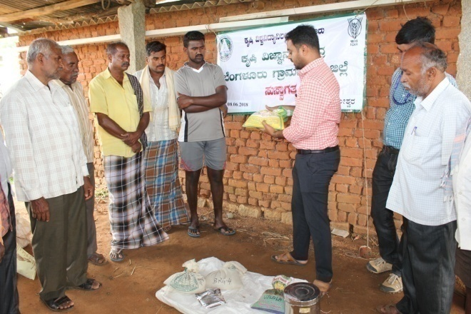
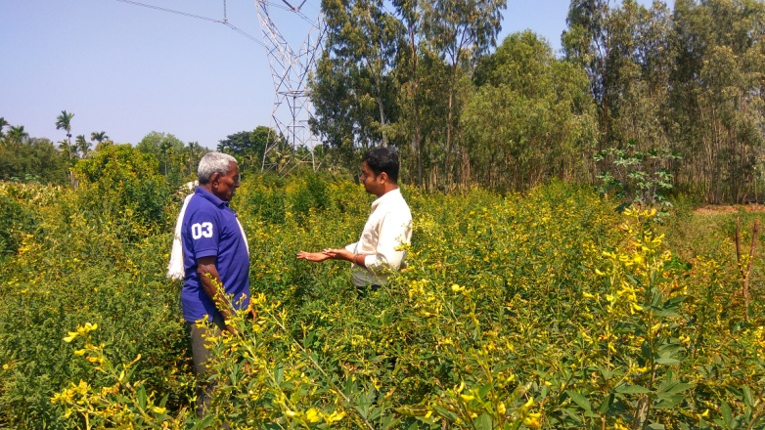
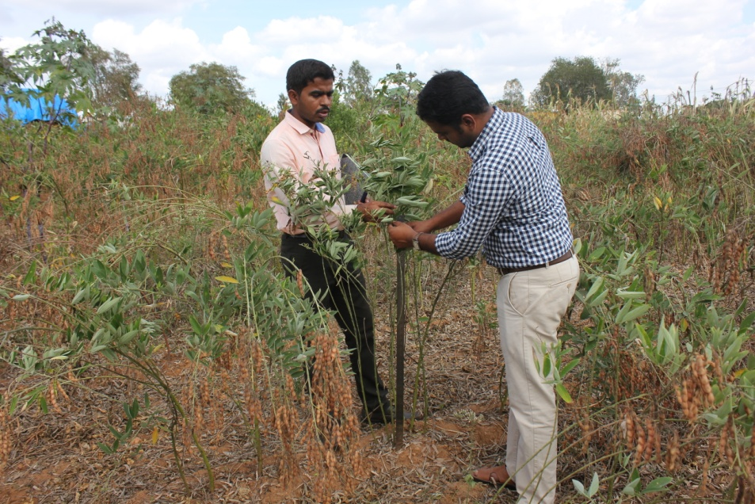
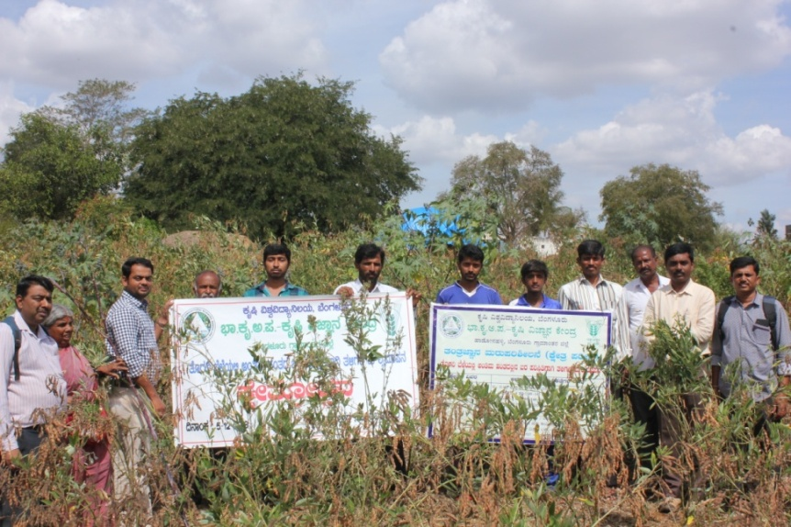
Explanation of varietal characters
Discussion with farmers
Recording observations
Field day

Slide 51
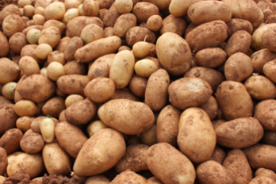
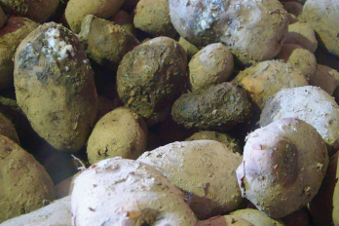
2. Assessment of nutrient management in potato
2nd year
Rationale
Dist. Area | Dist. Avg. Yield | Potential Yield
1504 ha | 13.75 t/ha | 20 t/ha
Imbalanced fertilizers application
Low yield
Soft rot during storage
 | Technological Options
TO1 | Indiscriminate use of DAP and MOP– Farmers practice
TO2 | FYM@ 25 t/ha, NPK: 125:100:125 kg/ha Soil test based nutrient application 50% N, 100% P&K as basal dose at the time of planting 50% N at 4 weeks after planting – UAS (B)
TO3 | FYM@ 15 t/ha, NPK-120:240:120 kg/ha, 2 kg Azospirillum, 2 kg Phosphobacterium and 60 kg/ha MgSO₄, 50% NPK and 100 % MgSO₄ at the time of planting, 50% NPK at 30 days after planting – TNAU, Coimbatore
TO4 | FYM@ 15 t/ha, NPK-140:60:60 kg/ha, Ca – 8 kg/ha and Sulphur 30 kg/ha, 2/3rd N, 100% P&K at the time of planting, 1/3rd of N at 25 days after planting – CPRI, Shimla

Slide 52
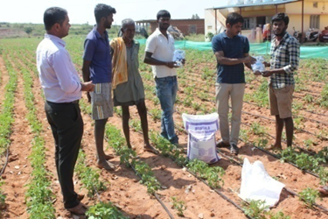
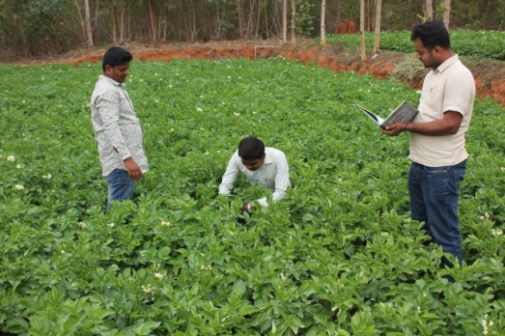
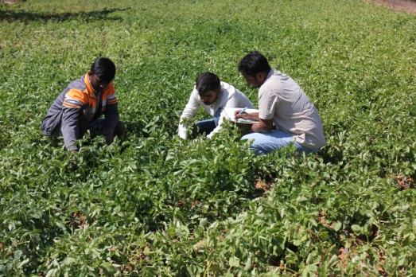
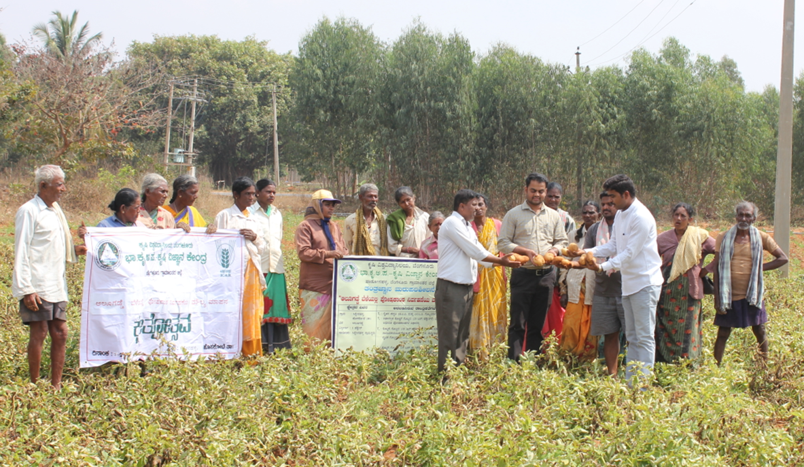
Discussion on nutrient management
Recording Observations
Field day

Slide 53
Table: Influence of different red gram varieties on growth, yield and economics
Technology Assessed | No. of tubers/plant | Tuber weight (gm/plant) | Tuber yield (t/ha) | Soft rot incidence (%) | B:C ratio
TO1: Indiscriminate use of DAP and MOP– FP | 4.2 | 125.2 | 17.67 | 12.05 | 1.42
TO2: FYM@ 25 t/ha, NPK: 125:100:125 kg/ha - UAS (B) | 5.7 | 190.8 | 21.50 | 8.11 | 2.72
TO3: FYM@ 15 t/ha, NPK-120:240:120 kg/ha, and 60 kg/ha MgSO₄,– TNAU | 6.2 | 204.5 | 23.50 | 5.11 | 2.51
TO4: FYM@ 15 t/ha, NPK-140:60:60 kg/ha, Ca – 8 kg/ha and S 30 kg/ha,– CPRI, Shimla | 5.5 | 198.6 | 22.15 | 5.03 | 2.63
Use of biofertilizers, calcium and sulphur reduced the soft rot incidence in TO4.

Slide 54
Critical Inputs
Implementation
Critical Input | Qty./trial | Cost/ trial
Calcium Chloride/CaCo₃ | 5 kg | 100
Ammonium Sulphate | 10 kg | 160
Magnesium sulphate | 12 kg | 270
Azospirillum | 1 kg | 90
Phosphobacterium | 1 kg | 90
Soil analysis | 2 | 400
Total |  | 1110
Cost for 5 trials |  | 5550
Demos : 05 (1 ha)
Total Cost : Rs. 11,550 (B+FD)
Vill. : Siddenahalli, Hosakote Tq
Scientists : SS, Agr & Hort (Sr.S&H)
Parameters
Soil fertility status
No. of tubers/plant
Tuber weight (g)
Tuber Yield (t/ha)
Soft rot incidence (%)
B:C ratio
Distribution of Soil Health Cards

Slide 55
3. Assessment on Management of Yellow Mosaic Virus in Pole bean through Integrated Approach
Rationale
New
Dist. Area | Dist. Avg. Yield | Potential Yield
671 ha | 25 t/ha | 40 t/ha
Severe incidence of YMV (> 42%)
 | Technological Options
TO1 | Imidacloprid 17.8 SL (0. 1%), Thiomethaxam 25 WG (0.05%), Acetamiprid 20%SP 0.1%, Diafenthiuron 500 SC (0.1%), Acephate 0.15%– Farmers’ Practice
TO2 | Seed treatment with imidacloprid (70 WG) – 5g/kg seeds, Sowing of border crop (SA Tall maize) – 35 -40 days before sowing of pole bean, Spraying of Imidacloprid 17.8 SL (30 DAS) & Thiomethaxam 25 WG (45 DAS) –UAS (B)

Slide 56
 | Technological Options
TO3 | Border cropping with Maize, soil application of carbofuran @1.5kg ai/ha, spraying with Acephate (0.15%), Imidachloprid (0.03%) and Neem seed kernal extract (2%) – IIHR, Bengaluru
TO4 | Seed treatment with Thiomethaxam 25 WG – 5g/kg seeds, Mulching with black silver mulch, Intercropping with two rows of border crops of maize , Soil application of Pseudomonas fluorescens along with neem cake, Installation of yellow sticky trap @ 10no/acre, Spraying of neem soap (5g/L), Salicyllic acid 2mM, seaweed extract (1.5ml/L), Entomopathogenic fungus Beauveria bassiana (2ml/L) Thiamethoxam 25% WG (0.5 g/L) and Imidacloprid 17.8 SL (0.5ml/L) - IIVR, Varanasi

Slide 57
Critical Inputs
Implementation
Critical Input | Qty./ trial | Cost/ trial
Pseudomonas fluorescens | 3 lt | 2,085
Yellow Sticky Traps | 10 | 600
Beauveria bassiana | 1 lt | 1,250
Salicylic Acid | 250 ml | 500
Neem soap | 2 kg | 530
Seaweed extract | 500ml | 2200
Thiomethaxam | 100 gm | 800
Soil Analysis | 1 | 200
Total |  | 8165
Cost for 05 trials |  | 40,825
Trials : 05 (1.0 ha)
Total Cost : Rs. 46,825 (B+FD)
Vill. : Krishnarajapura
Taluk : Nelamangala
Scientist: PP, Hort (SS & H) & AE.
Parameters
Soil fertility status
Plant height (cm), No. of pods/plant, pod length (cm)
Disease incidence (%)
No. & cost of sprays
Pod Yield
B:C ratio
Distribution of Soil Health Cards

Slide 58
4. Assessment on Management of Mosaic Virus in Ridge Gourd through Integrated Approach
New
Rationale
Dist. Area | Dist. Avg. Yield | Potential Yield
163 ha | 8.51 t/ha | 11 t/ha
Severe incidence of MV (> 31%)
 | Technological Options
TO1 | Imidacloprid 17.8 SL (0. 1%), Thiomethaxam 25 WG (0.05%), Acetamaprid 0.1%, Diafenthiuron 500 SC (0.1%), Acephate 0.15%, Spiromesifen 22.9% SC (0.1%)– Farmers’ Practice
TO2 | Spraying of Dimethoate 30 EC (0.2%) and Imidacloprid–17.8 S L (0.05%) - UAS (B)

Slide 59
 | Technological Options
TO3 | Border cropping with Maize, soil application of carbofuran @1.5kg ai/ha, spraying with Acephate (0.15%), Imidachloprid (0.03%) and Neem seed kernal extract (2%) – IIHR, Bengaluru
TO4 | Seed treatment with Thiomethaxam 25 WG – 5g/kg seeds, Mulching with black silver mulch, Intercropping with two rows of border crops of maize , Soil application of Pseudomonas fluorescens along with neem cake, Installation of yellow sticky trap @ 10no/acre, Spraying of neem soap (5g/L), Salicyllic acid 2mM, seaweed extract (1.5ml/L), Entomopathogenic fungus Beauveria bassiana (2ml/L) Thiamethoxam 25% WG (0.5 g/L) and Imidacloprid 17.8 SL (0.5ml/L) - IIVR, Varanasi

Slide 60
Critical Inputs
Implementation
Critical Input | Qty./ trial | Cost/ trial
Pseudomonas fluorescens | 3 lt | 2,085
Yellow Sticky Traps | 10 | 600
Beauveria bassiana | 1 lt | 1,250
Salicylic Acid | 250 ml | 500
Neem soap | 2 kg | 530
Seaweed extract | 500ml | 2200
Thiomethaxam | 100 gm | 800
Soil Analysis | 1 | 200
Total |  | 8165
Cost for 05 trials |  | 40,825
Trials : 05 (1.0 ha)
Total Cost : Rs. 46825 (B+FD)
Vill. : Kaggalahalli
Taluk : Devanahalli
Scientist: PP, Hort (SS & H) & AE.
Parameters
Soil fertility status
Plant height (cm), No. of fruits/plant, fruit length & girth (cm)
Disease incidence (%)
No. & cost of sprays
Yield
B:C ratio
Distribution of Soil Health Cards

Slide 61
Abstract : Front Line Demonstrations
Sl. No | Title of the Technology | No. of Demo | Area (ha) | Budget (Rs.)
1. | Addressing Drought and Blast Vulnerability through Finger millet var. ML 365 under double cropping system | 20 | 08 | 49200
2. | Introduction of Foxtail millet Var. DHFT-109-3 for higher yield and marketability | 10 | 04 | 10600
3. | Demonstration of multicut fodder sorghum: COFS-31 for green fodder and silage | 20 | 02 | 23000
4. | Improved Production Technologies in Castor | 05 | 01 | 18500
5. | Intercropping in Arecanut | 05 | 01 | 19000
6. | Fertigation in tomato for enhancement of yield and quality | 05 | 01 | 20250
7. | Integrated Nutrient Management in Pole bean | 05 | 01 | 14750
8. | Soil test based nutrient management for tissue culture banana | 05 | 1.25 | 21000
9. | Integrated crop management in Maize | 10 | 02 | 65300
10. | Integrated crop management in Tomato | 05 | 01 | 42100

Slide 62
Abstract : Front Line Demonstrations
Sl. No | Title of the Technology | No. of Demo | Area (ha) | Budget (Rs.)
11. | Integrated Crop Management in Cauliflower | 05 | 01 | 39000
12. | Integrated Crop Management in Brinjal | 05 | 01 | 42650
13. | Nutrition garden for farm families | 25 | - | 48500
14. | Ration Balancing through Integrated Approach in Dairy Animals | 20 | - | 71000
15. | Popularization of Kadaknath poultry bird | 25 | - | 81000
16. | Jack fruit : value addition, branding and market linkage | 05 | - | 56000
TOTAL |  |  |  | 621850

Slide 63
1. Addressing Drought and Blast Vulnerability through Finger millet var. ML 365 under double cropping system
Rationale
Crops | Dist. Area | Dist. Avg. Yield | Potential Yield
Finger millet | 36,463 ha | 18.0 q/ha | 25.0 q/ha
Cowpea | 327 ha | 3.5 q/ha | 5.0 q/ha
Finger millet as sole crop
Non utilization of pre-monsoon rainfall
Blast and Drought susceptibility in Finger millet
Technology: UAS(B)
Double cropping (Cowpea, Finger millet)
Moisture conservation furrows (every 12 rows)
Use of blast resistant var. ML- 365
Seed treatment with Rhizobium (for cowpea), Azospirillum (for finger millet)
Finger millet
Cowpea

Slide 64
Critical Inputs
Implementation
Particulars | Qty/ demo | Cost/ demo (Rs.)
Seeds (ML -365) | 10 kg | 600
Cowpea seeds IT38956-1 | 12 kg | 960
Rhizobium | 1 kg | 100
Azospirillum | 1 kg | 100
Soil analysis | 2 | 400
Total (per demo) |  | 2160
Cost for 20 demos |  | 43200
Demos: 20 (8 ha)
Total Cost: Rs. 49,200 (B+FD)
Vill.:Lakkondahalli, Hoskote Tq.
Scientists – Agronomy, SS &PP
Parameters
Soil fertility status
Plant height (cm) in both crops
No. of productive tillers/plant in fingermillet
No. of branches in cowpea
Blast severity (%) in fingermillet
Yield (q/ha) for both crops
B:C ratio
Distribution of Soil Health Cards

Slide 65
2. Introduction of Foxtail millet Var. DHFT-109-3 for higher yield and marketability
Rationale
Low yield, Improper nutrient management, Less income due to no processing
Technology : UAS (Dharwad)
DHFT-109-3 Variety
Seed treatment with Azospirillum
Nutrient management (40:40:0 kg/ha)
Processing of grains
Foxtail millet

Slide 66
Critical Inputs
Implementation
Demos: 10 (4 ha)
Total Cost: Rs. 10,600 (B+FD)
Vill.: Vabasandra, Doddaballapura Tq.
Krishnarajapura, Nelamangala Tq.
Scientists – Agronomy, SS & PP
Particulars | Qty/demo | Cost/demo (Rs.)
Seeds (DHFT-109-3) | 4 kg | 160
Azospirillum | 1 kg | 100
Soil analysis | 1 | 200
Total |  | 460
Cost for 10 demos |  | 4600
Parameters
Soil fertility status
Plant height (cm)
No. of productive tillers/plant
Grain Yield (q/ha)
Husk (%)
Seed to husk ratio
Foxtail rice yield (q/ha)
B:C ratio
Distribution of Soil Health Cards

Slide 67
3. Demonstration of multicut fodder: COFS-31 for green fodder and silage
Rationale
Conventional fodder crop – less yield (Maize single cut 40-50 t /ha)
Unaware about the availability of suitable multi-cut fodder
Lack of awareness on silage technology
Technologies to be demonstrated
High yielding multicut fodder variety CoFS-31: 180 t/ha/yr (6-7 cuts) with good palatability
Improved agro techniques-for multicut fodder production. Source- TNAU
Silage production technology in bags- Source- KVAFSU
Silage in bags

Slide 68
Critical Inputs
Implementation
Particulars | Qty/ demo | Cost/demo (Rs.)
Seeds –CoFS-31 | 1kg | 500
Silage bag of 1000 kg capacity | 1 | 1000
Soil analysis | 1 | 200
Total |  | 1700
Cost for 10 demos |  | 17,000
Demos:10(1 ha)
Total Cost: Rs. 23,000 (B+FD)
Vill.:Lakkondahalli, Hoskote Tq.
Scientists – Agronomy, SS &PP
Parameters
Plant height (cm)
No. of tillers/culm
Green Fodder Yield (q/ha)
Silage yield (q/ha)
Palatability (%)
Distribution of Soil Health Cards

Slide 69
4. Improved Production Technologies in Castor
Rationale
Use of local & old varieties
Low productivity
No nipping practices
Severity of Botrytis disease and semilooper
photo
Technology: UAS(B)
Hybrid : DCH 519 (12-15 q/ha)
Periodical Staggered Nipping
Spraying with Quinalphos @ 2 ml/ltr

Slide 70
Critical Inputs
Implementation
Demos : 5 (1 ha)
Total Cost : Rs. 18,500 (B+FD)
Vill. : Vabasandra, Doddaballapura Tq
Scientists: Agron, SS, PP
Particulars | Qty/demo | Cost / demo (Rs.)
Castor seeds | 5 kg | 1600
Quinolphos | 1 lit | 700
Soil Analysis | 1 | 200
Total |  | 2500
Cost for 5 demos |  | 12,500
Parameters
Plant height (cm)
No. of branches
Severity of Botrytis disease and semilooper
Yield (q/ha)
B:C ratio
Soil fertility status
Distribution of Soil Health Cards

Slide 71
5. Intercropping in Arecanut
Rationale
Improper utilization of inter-space and weed menace in Arecanut gardens
Area | Dist. Avg. yield | Pot. Yield
1190 ha | 1.6 t/ha | 2.2 t/ha
Technology: IIHR(B)
Beans as an intercrop to improve soil fertility and for space utilization
Seed treatment with Rhizobium
Vegetable Special- 2 g/lit at flower initiation and regular 15 days interval
Need based Plant Protection Chemical

Slide 72
Critical Inputs
Implementation
Particulars | Qty/demo | Cost / demo (Rs.)
Beans | 4 kg | 1500
Rhizobium | 1 kg | 100
Vegetable special | 3 kg | 600
Soil analysis | 2 | 400
Total |  | 2600
Cost l for 5 demos |  | 13,000
Demos : 5 (1 ha)
Total Cost : Rs. 19,000 (B+FD)
Vill. : Vabasandra, Doddaballapura Tq
Scientists: Agron, SS, PP
Parameters
Plant height (cm)
No. of pods / plant
Yield (q/ ha) in beans
Yield (t/ha) in Arecanut
B:C ratio
Soil fertility status

Slide 73
6. Fertigation in tomato for enhancement of yield and quality
Rationale
Indiscriminate use of Water Soluble Fertilizers.
Lack of knowledge on recommended fertilizer schedule.
Dist. Area | Dist. Avg. Yield | Potential Yield
1960 ha | 31.23 t/ha | 60.00 t/ha
Technology: IIHR, Bengaluru
RDF – 60:45:60 kg/acre
20% RDF as basal fertilizer application
80% RDF through Fertigation (Water soluble fertilizers once in 3 days)
Fertigation Schedule
Crop stage | No. of Fertigations | Qty. of fertilizer (kg/fertigation/acre)
 |  | 19:19:19 | KNO₃ | CN
0-20 days (Pre-Vegetative) | - | No. of fertigation
21-36 days (Vegetative) | 6 | 6 | - | -
39-57 days (Vegetative, flowering and harvesting) | 7 | 4 | 2 | 1
60-129 days (Vegetative, flowering and harvesting) | 24 | 13 | 5 | 6
Total | 37 | 23 | 7 | 7

Slide 74
Critical Inputs
Particulars | Qty/demo | Cost/demo (Rs.)
19:19:19 | 76 kg | FC
KNO₃ | 25 kg | 2450
Calcium Nitrate | 33 kg | FC
Soil Analysis | 2 | 400
Total |  | 2850
Cost for 5 demos |  | 14,250
Fertigation
Implementation
Parameters
Demos: 5 (1 ha)
Total Cost: Rs. 20,250 (B+FD)
Vil.: Lakkondahalli, Hosakote Tq.
Scientists: SS, Hort (Sr.S&H), Agron
Soil fertility status
Plant height (cm)
No of fruits /plant
Weight of the fruit (g)
Yield (t/ha)
B:C ratio
Distribution of Soil Health Cards

Slide 75
7. Integrated Nutrient Management in Pole bean
Rationale
No K application
Micronutrients application is not followed
Low yield and poor quality
Area | Dist. Avg. yield | Pot. Yield
671 ha | 25 t/ha | 40 t/ha
Technology: UAS, Bengaluru
PSB – 150 g for seed treatment
AMC – 5 kg for 500 kg FYM/Compost
FYM: 10 t/ha, RDF – 25:40:30 kg/acre
50% N, 100 % PK as basal and 50 % N as top dress after 4 WAS
Vegetable special (2 sprays: Flower bud initiation & 10-15 days after 1st spray)
Vegetable special

Slide 76
Critical Inputs
Implementation
Particulars | Qty /demo | Cost/ demo (Rs.)
PSB | 1 kg | 150
Vegetable special | 1 kg | 200
AMC powder | 5 kg | 1000
Soil analysis | 2 | 400
Total |  | 1750
Cost for 5 demos |  | 8,750
Demos: 5 (1 ha)
Total Cost: Rs. 14,750 (B+FD)
Vil.: Krishnarajapura, Nelamangala Tq
Scientists: SS, Hort (Sr.S&H) & Agron
Parameters
Soil fertility status
Plant height (cm)
No of branches/plant
No. of pods/plant
Length and girth of pod
Yield (t/ha)
B:C ratio
Distribution of Soil Health Cards

Slide 77
8. Soil test based nutrient management for tissue culture banana
Dist. Area | Dist. Avg. Yield | Pot. Yield
1525 ha | 21.60 t/ha | 29.80 t/ha
Rationale
Imbalanced fertilizers application
Low yield
Pest and disease incidence
Technology: UAS(B), IIHR (B) & NRC for Banana Tiruchirapalli
FYM@ 40 t/ha, NPK: 200:100:300 g/plant - UAS(B)
Pseudomonas fluorescens (90g), Azospirillum(30g), Phosphobacteria(30g), Neem cake (300g) and MgSO₄ (25 g) – NRC for Banana, Tiruchirapalli

Slide 78
Critical Inputs
Implementation
Particulars | Qty/demo | Cost/ demo (Rs.)
Pseudomonas | 7 kg | 700
Azospirillum | 7 kg | 700
Phosphobacteria | 7 kg | 700
MgSO₄ | 6 kg | 150
Banana special | 2 kg | 350
Soil analysis | 2 | 400
Total |  | 3000
Cost for 5 demos |  | 15,000
Demos : 05 (1.25 Acre)
Total Cost : Rs. 21,000 (B+FD)
Vill. : Vabasandra, Doddaballapura Tq
Scientists : SS, Agron & Hort (Sr.S&H)
Parameters
Soil fertility status
No. of fingers/bunch
Bunch weight (g)
Yield (t/ha)
Panama wilt incidence (%)
B:C ratio
Distribution of Soil Health Cards

Slide 79
9. Integrated crop management in Maize
Rationale
No application of K & micro nutrients
Fall army worm incidence (38%)
Downy mildew & TLB incidence (29%)
Dist. Area | Dist. Avg. Yield | Potential Yield
16045 ha | 52 q/ha | 70 q/ha
Technology: UAS(B)
Seed treatment
Zinc and boron application
Preparation of poison bait
Installation of pheramone traps
Spraying of EPN
Spraying of spinosad
Fall armyworm
Downy mildew

Slide 80
Critical Inputs
Implementation
Particulars | Qty/demo | Cost/demo (Rs.)
Metalaxyl M+Mancozeb | 100 g | 300
Spinosad (microbial) | 75 ml | 1,600
Zinc sulphate | 4 kg | 380
Borax | 2 kg | 200
Traps+lures | 10 no’s | 800
EPN | 5 kg | 2250
Soil sample analysis | 2 | 400
Total |  | 5930
Cost for 10 demos |  | 59300
Demos: 10 (4 ha)
Total cost: Rs. 65,300
Vill: K. R. Pura and Vabasandra, Nelamangala & Doddaballapura Tq.
Scientist : PP, Hort (SS & H), AE & SS
Parameters
Soil fertility status
Growth parameters
Fall armyworm , TLB & DM incidence (%)
Yield (t/ha)
B:C ratio
Distribution of Soil Health Cards

Slide 81
10. Integrated crop management in Tomato
Rationale
Dist. Area | Dist. Avg. Yield | Pot. Yield
1,838 ha | 64 t/ha | 75 t/ha
Micronutrients deficiency
High pest & disease incidence
Indiscriminate use of PP chemicals
Technology : UAS (B)
Use of enriched FYM with bio agents
Growing marigold as trap crop
Spray of Bt & Vegetable Special
Fertigation schedule
Use of sticky cards, WOTA-T traps and neem / pongamia soap
Need based PP chemicals
Late blight
Leaf minor

Slide 82
Critical inputs
Implementation
Particulars | Qty/ demo | Cost/ Demo (Rs.)
Trichoderma harzianum | 3 ltr | 1785
Pseudomonas fluorescens | 3 ltr | 1785
Wota – T traps +lures | 4+4 | 400
Yellow Sticky traps | 10 | 600
Blue sticky traps | 10 | 600
Bt | 1 ltr | 1250
Vegetable special | 2 kg | 400
Soil sample analysis | 2 | 400
Total |  | 7220
Cost for 5 demos |  | 36100
Demos: 5 (1 ha)
Total cost: Rs. 42,100
Vill: K. R. Pura, Nelamangala Tq.
Scientist : PP, Hort (SS & H) & AE
Parameters
Soil fertility status
Growth parameters
Disease & pest incidence (%)
Yield (t/ha)
B:C ratio
Distribution of Soil Health Cards

Slide 83
11. Integrated Crop Management in Cauliflower
Rationale
Dist. Area | Dist. Avg. Yield | Potential Yield
530 ha | 36 t/ha | 48 t/ha
DBM (>42%) infestation
Poor quality curd
Black rot
Poor nutrient management
Technology : UAS (B)
Timely application of RDF
Intercropping with Mustard (trap crop) (25:2), Installation of WOTA-T traps (DBM traps)
Use of Sticky traps, Spray of Bt (1ml/l), Neem Soap (5g/l)
Entomopathogenic fungi (Beauveria bassiana) (0.2%), Emamectin benzoate 5SG (0.05%), Chlorfenapyr 10SC (0.1%), Spinosad 2.5SC (0.15)%, veg.spl
Spraying of CoC + Streptocycline
DBM larva

Slide 84
Critical Inputs
Implementation
Particulars | Qty./demo | Cost/ Demo (Rs.)
Mustard seeds | 0.5 kg | 100
DBM Traps | 5 No | 400
Sticky traps | 10 No | 600
Neem soap | 2 kg | 530
Bt | 2 lt | 1320
Beauveria bassiana | 1 lt | 1250
Veg. spcl. | 2 kg | 400
Spinosad (microbial) | 75ml | 1600
Soil sample analysis | 2 | 400
Total |  | 6,600
Cost for 5 demos |  | 33000
Demos: 05 (1 ha)
Total cost: Rs. 39,000
Vill: Kaggalahalli, Devanahalli Tq.,
Scientist : Hort (SS & H), PP & AE
Parameters
Soil fertility status
DBM incidence (%)
Black rot incidence (%)
No. & cost of sprays
Yield (t/ha)
Quality parameters
B:C ratio
Implementation
Distribution of Soil Health Cards

Slide 85
12. Integrated Crop Management in Brinjal
Rationale
Dist. Area | Dist. Avg. Yield | Potential Yield
312 ha | 53.8 t/ha | 65 t/ha
Shoot and fruit borer (31%) infestation, bacterial wilt, root rot, PM, poor quality fruit
Technology : IIHR
FYM enrichment with Trichoderma harzianum and Pseudomonas fluorescens
Installation of Wota-T traps (10 no/acre)
Spraying of vegetable special
Spray of Bt (1g/l) & Neem Soap (5g/l)
Spraying of need based chemicals

Slide 86
Critical Inputs
Implementation
Particulars | Qty./demo | Cost/ demo (Rs.)
Trichoderma harzianum | 2 ltr | 1390
Pseudomonas fluorescens | 2 ltr | 1390
DBM Traps | 5 No | 400
Neem soap | 2 kg | 530
Bt | 2 lt | 1320
Vegetable special | 2 kg | 400
Thiacloprid | 300 g | 1500
Soil sample analysis | 2 | 400
Total |  | 7330
Cost for 5 demos |  | 36650
Demos: 05 (1 ha)
Total cost: Rs. 42,650
Vill: Vabasandra, DB pura tq.,
Scientist : Hort (SS & H), PP & AE
Parameters
Soil fertility status (pre & post), growth parameters
Shoot and fruit borer, Bacterial wilt, PM, root rot incidence (%)
No. & cost of sprays
Yield (t/ha)
B:C ratio
Distribution of Soil Health Cards

Slide 87
13. Nutrition garden for farm families
Rationale
Non-availability of the vegetables
across the season
Nutritional insecurity
Lack of knowledge on importance of nutrition garden
Technology : IIHR
Establishment of nutrition garden in backyard

Slide 88
Critical Inputs
Implementation
Particulars | Qty./demo | Cost/ demo (Rs.)
Vegetable seed kit | 1 | 200
Saplings and seedlings | 30 | 300
Vegetable special | 1kg | 200
Neem oil | 250ml | 400
Pongamia cake | 10kg | 400
AMC | 1kg | 200
Total |  | 1,700
Cost for 25 demos |  | 42500
Demos: 25
Total cost: Rs. 48,500
Vill: All cluster villages
Scientist : AE, Hort (SS & H) & PP
Parameters
Production of vegetables and fruits (kg)
Incremental rate of consumption
Consumption of vegetables & fruits(kg)
Sale

Slide 89
14. Ration Balancing through Integrated Approach in Dairy Animals
Rationale
Lower milk yield
Lower milk quality (fat %, SNF)
Ruminal acidosis (Sub clinical)
Dairy animal | Reduced milk yield (%)
1,97,570 | 35
Technology : NIANP& KVAFSU
Urea enrichment of crop residues
Chaff cutting of forages
Total Mixed Ration (TMR)
Mineral mixture
Azolla supplementation
Silage
Ration balancing programme (TDN, CP, Ca & P) using Feed Assist software

Slide 90
Critical Inputs
Implementation
Particulars | Qty./demo | Cost/ demo (Rs.)
Silpaulin sheet | 1 | 800
Silage bags/drums | 1 | 800
Azolla rings | 1 | 1500
Azolla | 1kg | 100
Feed chart | 1 | 50
Total |  | 3250
Cost for 20 demos |  | 65000
Total Cost (20 Animals) : Rs. 71,000 (B+FD)
Vill : All cluster villages
Scientist– AE, Hort (SS & H) & PP
Parameters
Milk yield, Milk fat %, Milk SNF & income

Slide 91
EDP

Slide 92
1. Popularization of Kadaknath poultry bird
Rationale
Lack of knowledge on improved backyard poultry
Less awareness on Kadaknath bird
Lower productivity and income
Technology : TANUVAS
Introduction of kadaknath poultry bird in rural sector for backyard rearing

Slide 93
Critical Inputs
Implementation
Particulars | Qty./demo | Cost/ demo (Rs.)
Kadaknath chicks | 20 | 2400
Vaccination | 3 | 600
Total |  | 3000
Cost for 25 demos |  | 75000
Demos: 25
Total cost: Rs. 81,000
Vill: All cluster villages
Scientist : AE, Hort (SS & H)& PP
Parameters
Body Weight
Egg production
Hatchability(%)
Mortality rate
Economics

Slide 94
2. Jack fruit : value addition, branding and market linkage
Rationale
40% post harvest loss
Lack of knowledge on value addition, labeling, packaging and branding of jack fruit
Dist. Area | Dist. Avg. Yield | Potential Yield
143 ha | 34.76 t/ha | 40 t/ha
Technology : UAS (B) & FSSAI
Chips, RTS, Halwa, Papad
Packing and labeling of value added jack fruit products
Branding and providing market linkage

Slide 95
Critical Inputs
Implementation
Particulars | Cost (Rs.)
Jack fruit chips cutter | 15000
Food grade packing material | 10000
Nutrition labelling | 2500
Aluminum foil cover | 2500
Weighing scale – 1 Unit | 5000
Crown corking machine -1 No. | 5000
Training material | 10000
Total | 50000
No. of demos: 01
Total Cost : Rs. 56,000
Vill : S. Nagenahalli, Doddaballapur Tq.
Scientist– AE, Hort (SS & H) & PP
Parameters
Organoleptic evaluation
Consumer acceptability
BCR
Note: FSSAI standards will be followed

Slide 96
Farmer Field School

Slide 97
1. Integrated Crop Management in Rose
Area | Dist. Avg. yield | Pot. Yield
508 ha | 5.49 t/ha | 12 t/ha
Rationale
Imbalanced nutrition, incidence of Thrips, Aphids, mites, Bud borer Black spot, DM, PM, Die back, Rust (>35% )

Slide 98
Technology Selection Matrix for Problem Analysis
Problems faced by farmers | Existing farmers’ practices | Scope for new technologies | Reasons for Non adoption of these technologies | Topic for FFS
Micronutrient deficiency Flower drop | Non application of micronutrients and MOP, indiscriminate use of DAP | Integrated Nutrient Management Soil Test based fertilizer application | Lack of awareness about these technologies | ICM in Rose
Thrips, Mites, Black Spot, PM, Die back | Indiscriminate use of pesticides | Integrated Pest & disease Management
Low Price | Non-timely harvesting, bulk marketing | Good harvesting practices, Grading & Marketing
Source : IIHR

Slide 99
Session Plan
Soil Test
Ballot Box Test
Plot Layout, Awareness about ICM practices
AESA, INM in Rose
AESA, IDM in Rose
AESA, IPM in Rose
AESA, Application of Need Based Chemicals
AESA, Grading and Marketing practices
Field day and Impact Analysis
Expenditure
Particulars | Amount (Rs.)
Critical inputs | 8,000
FFS Sessions | 6,000
Field day | 6,000
Training material | 8,000
Miscellaneous | 2,000
Total | 30,000
Implementation
Vill : Lakkondalli, HosakoteTq.
Scientist :PP, Hort(SS &H)& AE

Slide 100
Activity
Calendar of KVK Personnel

Slide 101
Calendar of activities for Scientist (Agronomy)
Village | Crop/ enterprise | Activity as leader | Other members of the team | Budget proposed
Lakkondahalli | Finger millet and cowpea | FLD – Addressing Drought and Blast Vulnerability through Finger millet var. ML 365 under double cropping system | PP & SS | 47,200
Vabasandra and Krishnarajapura | Foxtail millet | FLD- Introduction of Foxtail millet Var. DHFT-109-3 for higher yield and marketability | SS & PP | 10,600
Vabasandra | Castor | FLD -Improved Production Technologies in Castor | SS& PP | 18,500
Vabasandra | Arecanut and Frenchbean | FLD- Inter cropping in Arecanut | SS&PP | 19,000
Vabasandra, Krishnarajapura, | Fodder crop | FLD- Demonstration of multicut fodder: COFS-31 for green fodder and silage | SS & PP | 23,000
Rameshwara | Redgram | OFT- Assessment of Redgram Varieties for Terminal Drought conditions | SS & PP | 34,000

Slide 102
Calendar of activities for Scientist (Agronomy)
Village | Crop/ enterprise | Activity as leader | Other members of the team | Budget proposed
Lakkondahalli | Finger millet and cowpea | Training – Soil and moisture conservation practices in double cropping system in Rainfed condition Training – Integrated crop management in finger millet- cowpea cropping system | SS & PP | 2000 2000
Vabasandra and Krishnarajapura | Foxtail millet | Training- Integrated crop management in Foxtail millet Training- Processing technologies in minor millets | SS &PP | 2000 2000
Vabasandra | Castor | Training- Integrated crop management in castor | SS &PP | 2000
Vabasandra | Arecanut and Frenchbean | Training- Moisture conservation practices in gardens Training- Integrated crop management in Arecanut+ Frenchbean | SS &PP | 2000 2000

Slide 103
Village | Crop/ enterprise | Activity as leader | Other members of the team | Budget proposed
Vabasandra, Krishnarajapura, | Fodder crop | Training – production technogies for COFS 31 multi cut fodder sorghum Training – Silage making technology in fodder crops | SS& PP | 2000 2000
Rameshwara | Redgram | Training – Agronomic measures to mitigate terminal drought in redgram Training - Integrated crop management in redgram | PP, SS | 2000 2000

Slide 104
Calender of activities for Senior Scientist & Head (Horticulture)
Village | Crop/ enterprise | Activity as leader | Other members of the team | Budget proposed
Kaggalahalli | Ridge gourd | OFT - Assessment on management of mosaic virus in ridge gourd through integrated approach | PP & AE | 46,825
Kaggalahalli | Cauliflower | FLD – Integrated crop management in cauliflower | PP, AE & SS | 39,000
Vabasandra | Brinjal | FLD – Integrated crop management in brinjal | PP & AE | 42,650
Kaggalahalli | Ridge gourd | Training- Eco friendly approaches to manage mosaic virus in ridge gourd Training- Integrated approaches to combat mosaic virus in ridge gourd | PP & AE | 2000 2000

Slide 105
Calendar activities for Senior Scientist & Head (Horticulture)
Village | Crop/ enterprise | Activity as leader | Other members of the team | Budget proposed
Vabasandra | Brinjal | Training-ICM in brinjal Training – Integrated management of brinjal shoot and fruit borer & bacterial wilt in brinjal | PP & AE | 2000 2000
Kaggalahalli | Cauliflower | Training- Eco friendly approaches to manage diamond black moth in cauliflower Training- Enhancement of curd quality in cauliflower | PP, AE & SS | 2000 2000

Slide 106
Other activities of Senior Scientist & Head (Horticulture)
KVK Farm and Revolving Fund utilization by the Sr. S & H-Horticulture
Demo/ Production Units/ Labs | Crop/ enterprise/ activity | Physical Target for the year | Approximate Expenditure (Rs.) | Approximate Revenue (Rs.)
Model Horticulture Nursery Unit | Grafts / seedling production | 5,000 Nos. | 1,50,00-00 | 2,50,000-00
Crop/ enterprise | Activity | Members of the team
ARYA project | Formation of Commodity Based Rural Youth Groups, Organization of Skill Oriented Capacity Development Programmes on Production, Processing, Value Addition and Marketing of Finger millet & small millets and Jack. Establishment of Processing and Value Addition Units (PVAU) for marketing. Skill training on nursery techniques, bee keeping, vermicompost and coconut climbing | All Scientists & ARYA staff
Biofuel | Establishment of Information & Demonstration Centre on Biofuels - conducting Training programmes on Nursery development, Planting techniques, Oil expelling & use of byproducts, Trans esterification & use of biodiesel and Value addition to byproducts Awareness camps – 12 No. Trainings – 10 No. | Scientist (Agron) & Biofuel staff

Slide 107
Calendar activities for Scientist (Plant Protection)
Village | Crop/ enterprise | Activity as leader | Other members of the team | Budget proposed
Krishnarajapura | Pole bean | OFT – Assessment on management of yellow mosaic virus in pole bean through integrated approach | Sr.S& H & AE | 46, 825
Krishnarajapura & Vabasandra | Maize | FLD – Integrated crop management in Maize | Sr.S& H, AE & SS | 65,300
Krishnarajapura | Tomato | FLD – Integrated crop management in Tomato | Sr.S& H & AE | 42,100
Lakkondahalli | Rose | FFS - Integrated pest and disease management in rose | Sr.S& H, Agril. Extension & SS | 30000
All clusters | Plant Protection | Training - Safe and Judicious use of chemicals | Sr.S& H, Agril. Extension, SS & Agron | 28000

Slide 108
Calendar activities for Scientist (Plant Protection)
Village | Crop/ enterprise | Activity as leader | Other members of the team | Budget proposed
All clusters | Maize | Management of Fall armyworm in maize through integrated approach | Sr.S& H, AE & SS | 10000
Krishnarajapura | Pole bean | Training- Eco friendly approaches to manage yellow mosaic virus in pole bean Training- Integrated approaches to combat yellow mosaic virus in pole bean | Sr.S& H & AE | 2000 2000
Krishnarajapura and Vabasandra | Maize | Training-Management of stem borer and downy mildew in Maize Training- Integrated management of fall armyworm in maize | Sr.S& H, AE & SS | 2000 2000
Krishnarajapura | Tomato | Training-Management of diseases in tomato through integrated approach Training- Integrated pest management in tomato | Sr.S& H & AE | 2000 2000

Slide 109
Calendar activities for Scientist(Plant Protection)
Village | Crop/ enterprise | Activity as leader | Other members of the team | Budget proposed
Vabasandra | Vegetables & other crops | Plant Health Campaign – Diagnosis, analysis & recommendation for problematic plant specimens of the cropping season | Sr.S&H, Agril. Extension, SS & Agron | 2000
Kaggalahalli | Method demonstration | Enrichment of compost with bio pesticide and bio fertilizer | Sr.S&H, Agril. Extension, SS & Agron | 2000
Lakkondahalli | Method demonstration | Preparation of spray solution | Sr.S&H, Agril. Extension, SS & Agron | 2000
Krishnarajapura | Celebration of important days | Technology Week | Sr.S&H, Agril. Extension, SS & Agron | 2000

Slide 110
Calendar activities for Scientist (Agril. Extension )
Village | Crop/ enterprise | Activity as leader | Other members of the team | Budget proposed
All clusters | Nutrition garden | FLD – Nutrition garden for farm families | Sr.S &H, PP & SS | 48,500
S.Nagenahalli | Jack fruit | FLD - Jack fruit : value addition, branding and market linkage Processing and value addition in jack fruit | Sr.S & H & PP | 56,000
All clusters | Khadaknath poultry birds | FLD -Popularization of Kadaknath poultry bird | Sr.S &H & PP | 81,000
All clusters | Dairy animals | FLD - Ration Balancing through Integrated Approach in Dairy Animals | Sr.S &H & PP | 71,000

Slide 111
Calendar activities for Scientist (Agril. Extension)
Village | Crop/ enterprise | Activity as leader | Other members of the team | Budget proposed
All clusters | Nutrition garden | Training – Importance of Nutrition Garden for farm families to address nutrition insecurity | Sr.S&H, PP, SS & Agron | 10000
S. Nagenahalli | Jack fruit | Training- Processing and value addition in jack fruit Training- Strengthening of SHG through market linkages for value added jack fruit products | Sr.S & H & PP | 2000 2000
All clusters | Kadaknath poultry birds | Training- Rearing of Kadaknath poultry birds and its nutritional value Training- Market linkages for Kadaknath poultry birds | Sr.S & H & PP | 10000 10000
All clusters | Dairy animals | Training- Ration balancing through integrated approach in dairy animals Training- Urea enrichment, Azolla supplementation & Silage preparation | Sr.S&H & PP | 10000 10000

Slide 112
Calendar activities for Scientist(Agril. Extension)
Village | Crop/ enterprise | Activity as leader | Other members of the team | Budget proposed
S.Nagenahalli | Jack fruit | FSSAI registration and licensing for jack fruit | Sr.S&H & PP | 2000
Kaggalahalli | Dairy animals | Ration balancing programme (TDN, CP, Ca & P) using Feed Assist software | Sr.S&H & PP | 2000
Lakkondahalli | Method demonstration | Chaff cutting of forages & Azolla supplemenation | Sr.S&H, Agril. Extension, SS & Agron | 2000
Krishnarajapura | Celebration of important days | Technology Week | Sr.S&H, Agril. Extension, SS & Agron | 2000

Slide 113
Calendar activities for Scientist (Soil Science)
Village | Crop/ enterprise | Activity as leader | Other members of the team | Budget proposed
Siddenahalli | Potato | Training –Role of nutrients in potato production Training – Time and method of fertilizer application in potato | Sr.S&H (Hort) & PP | 2000 2000
Vabasandra | Banana | Training – Role of nutrients in banana production and nutrients deficiency in banana Training- Fertigation in banana and fertilizer application methods | Sr.S&H (Hort) & PP | 2000 2000
Krishnarajapura | Pole bean | Training –Integrated Plant Nutrients Supply in pole bean Training – Importance of micronutrients and vegetable special in pole bean | Agron, PP & FM | 2000 2000

Slide 114
Calendar activities for Scientist (Soil Science)
Village | Crop/ enterprise | Activity as leader | Other members of the team | Budget proposed
Lakkondahalli | Tomato | Training – Advantages of Fertigation over conventional fertilizers Training – Use of Vegetable Special (micro nutrient mixture) as foliar spray | Sr.S&H (Hort), PP, Agron | 2000 2000
Krishnarajapura | Method demonstration & Training | Soil sample collection Enrichment of FYM with AMC bioagents Identifying nutrient deficiency in crops Soil and water conservation practices | Sr.S&H (Hort), Agron & PP | 2,000
Lakkondahalli |  |  |  | 2,000
Siddenahalli |  |  |  | 2,000
Vabasandra |  |  |  | 2,000
Special events
Cluster villages | Soil health maintenance | Soil & Water Analysis of FLD & OFT |  | OFT/FLD budget
Lakkondahalli | Celebration of important days | World Environmental Day World Soil day | All Scientists, Sr.S & H | 5000 30000

Slide 115
On Campus trainings
Place | Crop/ enterprise | Title of the training programmes | Team members | Budget proposed
On Campus | Agriculture | IPM and IDM in field crops | Sr.S&H, PP, Agril. Extn., SS & Agron | 15000
 | Agriculture | INM and IWM in field crops | Sr.S&H, PP, Agril.Extn. & Agron | 10000
 | Soil & Water | Soil and water conservation and management practices | SS & Agron | 10000
 | Horticulture | IPM and IDM in horticulture crops | Sr.S&H, PP, Agril.Extn.,SS, Agron | 15000
 | Horticulture | INM and IWM in horticulture crops | Sr.S&H, PP, SS, Agron | 10000
 | Horticulture | Propagation techniques & Nursery management | Sr.S&H, PP, SS, Agron | 10000
 | Integrated Farming | Integrated farming system for doubling the farmers income | Sr.S&H, PP, SS, Agron | 20000

Slide 116
Contd..
Place | Crop/ enterprise | Title of the training programmes | Team members | Budget proposed
On campus | Polyhouse | Plant protection measures under protected cultivation | Sr.S& H, PP, Agril. Extn., SS & Agron | 10000
 | Apiary | Bee keeping | Sr.S&H, PP & Agril. Extn | 10000
 | Poultry birds | Khadaknath poultry birds | Sr.S&H, Agril. Extn., PP & SS | 15000
 | Dairy animals | Fodder and nutrient management | Sr.S&H, PP & Agril. Extn | 15000
 | Jack fruit | Value addition in Jack | Home Science, Agril. Extn., Sr.S&H, PP, SS & Agron | 20000
 | Millets | Nutri millets | Home Science, Sr.S&H, Agril. Extn., PP, SS, Agron | 15000
Total - 30 trainings |  |  |  | 1,75,000

Slide 117
Calendar Activities for Farm Manager
Name of Laboratory | Target | Approx. Exp. (Rs.) | Approx Revenue (Rs.) | Expected output / outcome | Members associated
Field crops | 14.42 ha | 1,56,000 | 2,38,000 | Seed production - Approximately 60 q of field crops | Sr.S&Head All Scientist & FM
Demo units | 9 Nos | 1,49,000 | 2,11,550 | Production of quality planting material, productive livestock's supply to the farming community | Sr.S&Head All Scientist & FM
Any other work entrusted by the Senior Scientist & Head
Activities other than the above:

Slide 118
Calendar activities for Programme Assistant (Lab)
Name of Laboratory | Target for no. of samples for testing/ analysis | Approx. Exp. (Rs.) | Approx Revenue (Rs.) | Expected output / outcome | Members associated
Soil and water testing Laboratory | Soil – 950 Water – 550 | 8,07,500 1,54,000 | 1,90,000 82,500 | Soil Test based Recommendations, address multi nutrient deficiency/toxicity for various crops | SS, Agron, PP, Sr.S&H
Assisting in organizing Trainings / Seminars / Workshops / Method Demonstrations / Celebration of Important events/days. Any other work entrusted by the Senior Scientist & Head and respective Scientists

Slide 119
Activity Calendar Programme Assistant (Computer )
Name of Database/ Website/ KMAS etc. | Frequency of data input and updating | Other members of the team | Reports to be generated | Frequency of report generation
Database : Reports Reports to ATARI Reports to DE Reports to Editor Quarterly Reports Half Yearly Reports Annual Reports SAC Reports EPCB/EEC/ZREP Reports PMO KVK Portal | Monthly Monthly Monthly Quarterly Hal f Yearly Annually Annually Annually Monthly Monthly | All Scientists | OLRS MR SA QR HYR AR SAC EPCB/EEC/ZREP PMO Online | Monthly Monthly Monthly Quarterly Hal f Yearly Annually Annually Annually Monthly Monthly
Farmers Database | Weekly |  | NA | NA
KMAS | Thrice a Week |  | SMSR | Monthly
Website www.kvkbrd.org | Monthly |  | NA | NA
Action plan | Annually |  | Action plan | Annaully
MPR-Monthly Progress Report; MR-Monthly Report; SA-Significant Achievements; QR-Quarterly Report;
HYR-Half Yearly Report; AR- Annual Report; BS-Budget Status; SMSR-SMS Report; STR-Soil Tested Report; OLRS- Online Reporting System

Slide 120
Activities Calendar of Programme Assistant (Computer)
Attending e-mails received from various Govt. departments/schemes/offices/ institutions, etc.
Attending day-to-day computer related work such as preparation of letters, statements, charts, Power Point slides, data management, etc.
Creation and maintenance of relevant database system for KVK
Updating the new technologies released in respect of agriculture/horticulture crops through internet browsing
Assisting in conducting the Group discussion meetings/lectures with Line Departments.
Any other work entrusted by the Programme Coordinator and Scientists

Slide 121
Thank you

