Slide 1
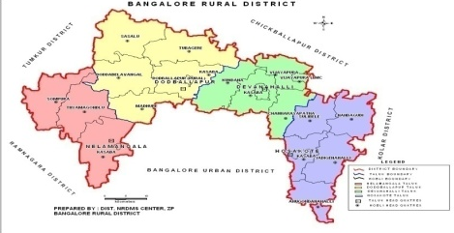
ICAR - Krishi Vigyan Kendra
Bengaluru Rural District
Action Plan
2020-21
Presentation by
Dr. A.P. Mallikarjuna Gowda
Senior Scientist & Head

Slide 2
Profile of Bengaluru Rural District
Agro-climatic zone | Eastern Dry Zone
No. of Taluks | 04
No. of Villages | 1,051
No. of Holdings | 1,60,483
Gross Cropped Area | 1,07,560 ha
Area under irrigation | 23,794 ha (22.86 %)
Sources of irrigation | Tanks, Wells, Tube wells, Lift irrigation
Major soil types | Medium deep to very deep, Red clayey soils, Lateritic clayey soils
Major crops in Kharif | Maize, Finger millet, Pigeonpea, Field bean, Cowpea, Vegetables (Tomato, Cucumber, Cabbage, Cauliflower, Pole bean, French bean, Ridge gourd, Capsicum), Ginger, Flowers (Marigold, Chrysanthemum)
Major crops in Rabi | Chickpea, Horse gram, Vegetables (Potato, Cabbage)
Major perennial crops | Drumstick, Mango, Banana, Guava, Sapota, Jack, Arecanut, Fodder crops, Rose
Major Livestock | Cattle, Buffaloes, Sheep, Goats, Pigs, Poultry birds

Slide 3
Crop Details of Bengaluru Rural District
Crop | Area (ha) | Production (t) | Productivity (kg/ha)
Finger millet (Rainfed) | 31781 | 50658.91 | 1594
Finger millet (Irrigated) | 312 | 364.03 | 1167
Maize (Rainfed) | 8306 | 12417.47 | 1495
Maize (Irrigated) | 819 | 2854.22 | 3485
Redgram (Rainfed) | 721 | 273.98 | 380
Redgram (Irrigated) | 180 | 74.25 | 413
Horse gram | 337 | 21.06 | 63
Field bean (Rainfed) | 1301 | 56919 | 438
Field bean (Irrigated) | 51 | 25.5 | 500
Cowpea (Rainfed) | 498 | 150.65 | 303
Cowpea (Irrigated) | 20 | 10 | 500
Bengal gram | 214 | 184 | 2115
TOTAL FOOD GRAINS | 47178 | 70461.86 | -
TOTAL PULSES | 3121 | 1124.625 | -
Crop | Area (ha) | Production (t) | Productivity (t/ha)
Mango | 6753 | 63928 | 9.47
Banana | 1525 | 32933 | 21.60
Grapes | 2218 | 36678 | 17
Sapota | 1022 | 8895 | 8.70
Guava | 766 | 14762 | 19.27
Jack | 20 | 695 | 34.76
Potato | 1504 | 20615 | 13.71
Tomato | 1960 | 61210 | 31.23
Beans | 671 | 12867 | 19.18
Cabbage | 447 | 12063 | 26.99
Cauliflower | 330 | 4800 | 14.55
Cucumber | 235 | 3689 | 15.70
Other vegetables | 3391 | 45070 | 13.29
Ginger | 133 | 1343.20 | 10.10
Chrysanthemum | 187 | 1720.57 | 9.20
Rose | 508 | 2790 | 5.49
Others | 334 | 676 | 20.00
Source: Department of Agriculture, Bengaluru Rural District,
2018-19
Source: Department of Horticulture, Bengaluru Rural District,
2018-19

Slide 4
Livestock Details of Bengaluru Rural District
Animals/Birds | No. | Avg. Productivity
Cattle & buffaloes | 1,83,201 | 5 lt/animal/day
Sheep | 1,24,870 | -
Goats | 80,740 | -
Pigs | 6052 | -
Others | 30,223 | -
TOTAL LIVESTOCK | 4,25,086 | -
Poultry | 81,65,758 | -

Slide 5
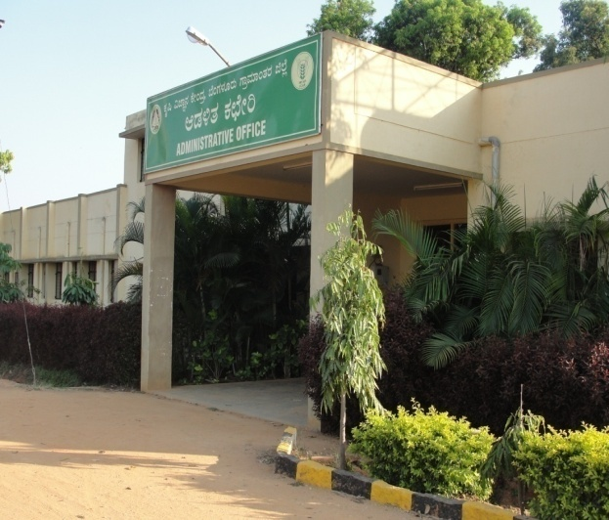
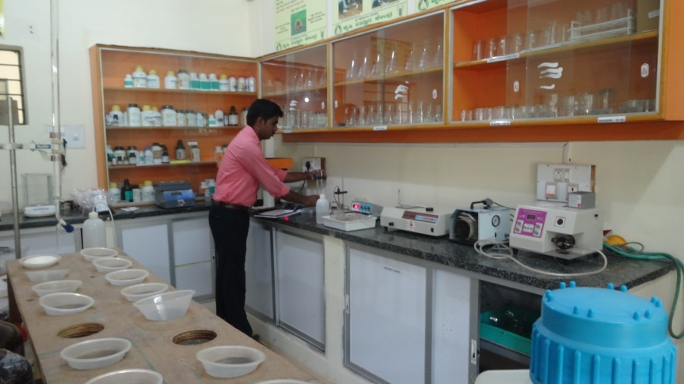
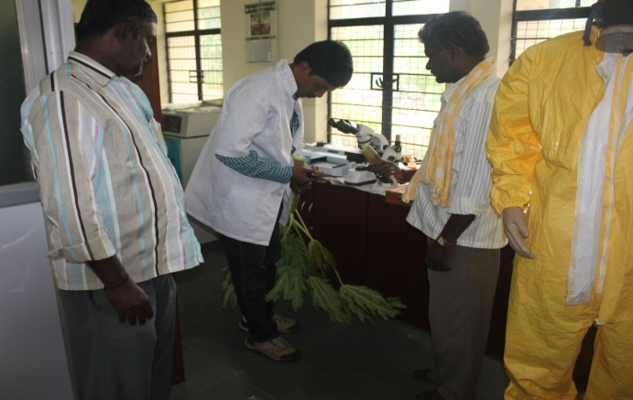
KVK Manpower and Facilities
Manpower Senior Scientist & Head No. of Scientists in position No. of Programme Assistants in position Supporting staff | 01 03 02 02
Farm details Total Area (ha) Cultivated Area (ha) | 21.28 16.30
Production Units Vegetable Special Unit, Vermicompost unit, Nursery unit, NADEP composting unit, VAT composting unit, Livestock unit, Azolla unit, Silage unit, Apiary etc. | 1308 m²
Laboratories Soil & Water Testing Laboratory Plant Health Clinic | 50 m² 30 m²
Office building
Soil & Water Testing Laboratory
Plant health clinic

Slide 6
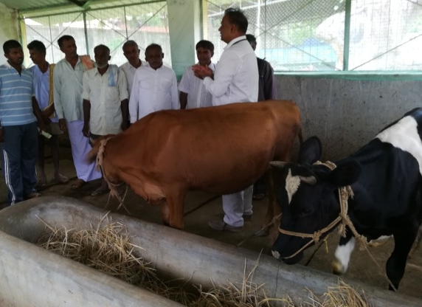
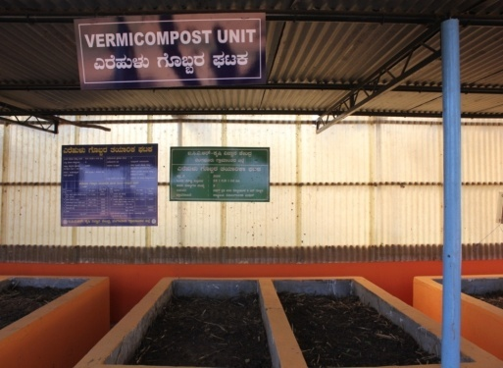
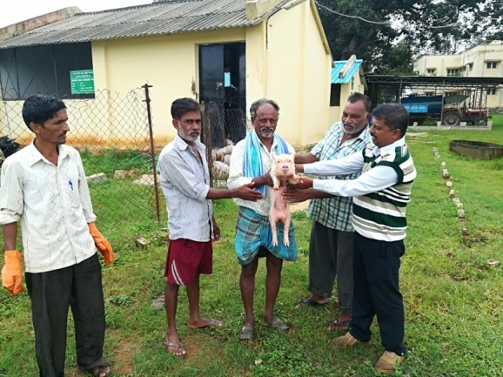
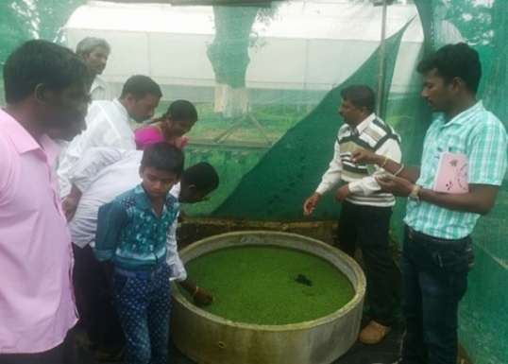
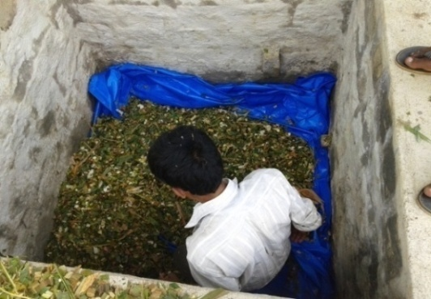
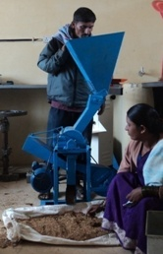
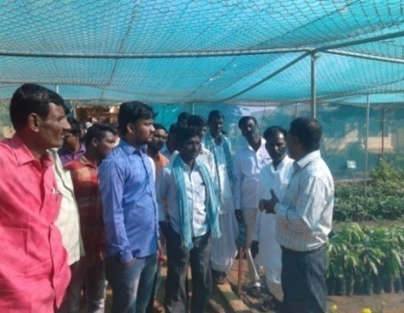
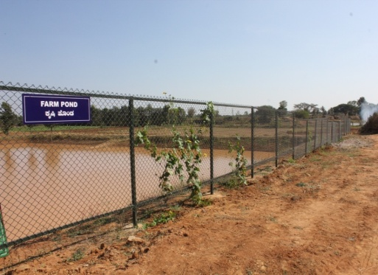
KVK Demonstration Units
Apiary unit
Vermicomposting Unit
Dairy Unit
Piggery Unit
Silage Unit
Azolla Unit (2 m²)
Model Horticultural Nursery
Farm Pond
Millet Processing Unit

Slide 7
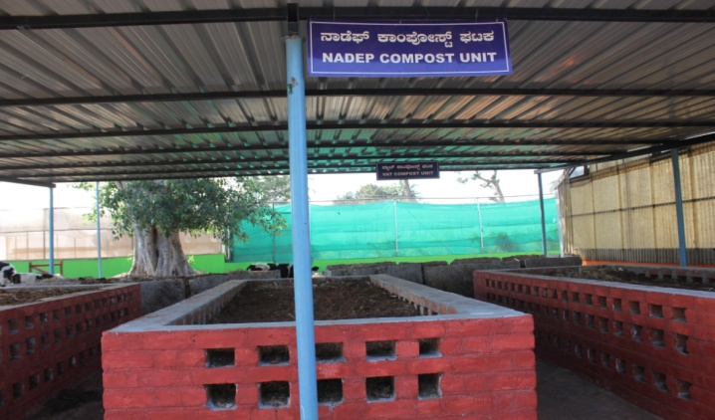
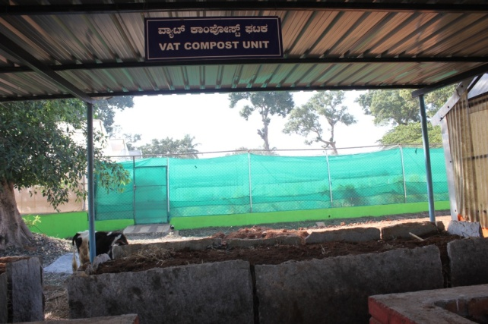
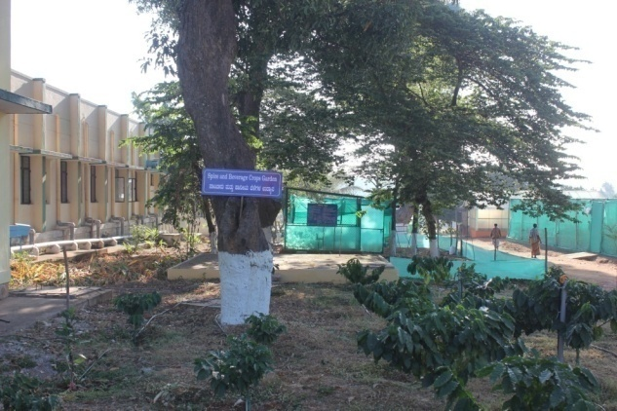
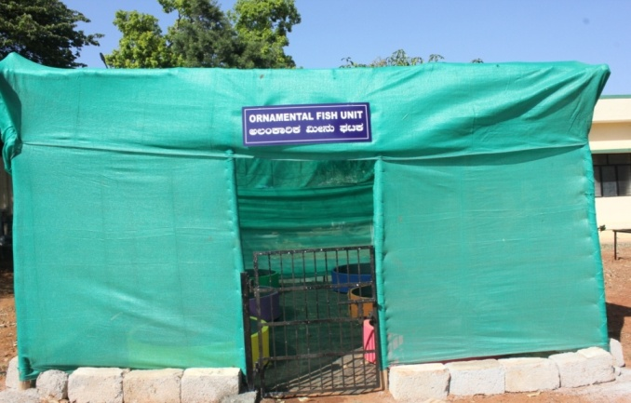
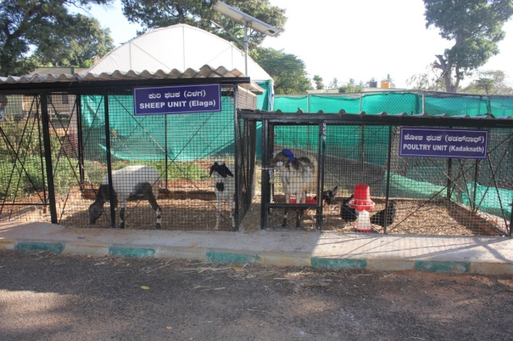
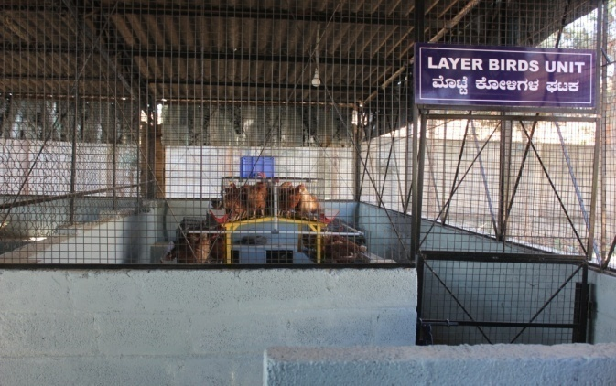
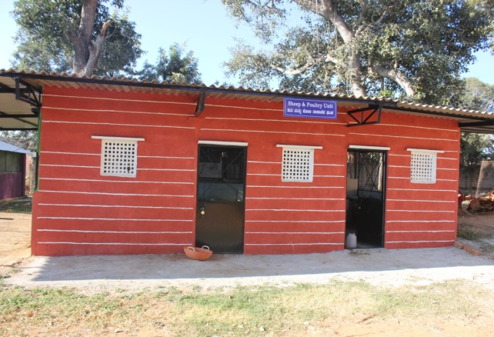
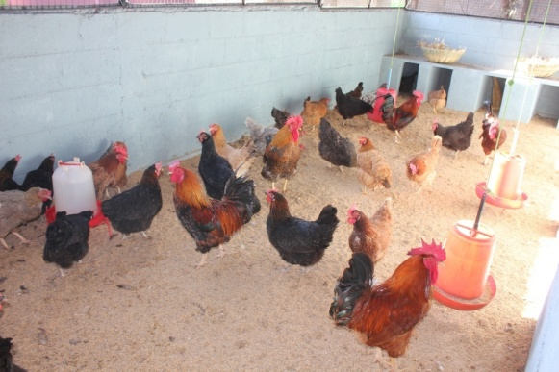
Nadep method composting unit
VAT methof composting unit
Spice garden
Ornamental fish unit
Goat and poultry unit
Layer birds unit
Sheep and poultry unit
Local poultry birds unit

Slide 8
Cross-learning across KVKs
Name of the KVK proposed | Specific learning areas
a) KVK, Mysuru b) KVK, Pathanamthitta, Kerala | To know the innovative technologies developed, adopted and cropping pattern followed To know the different technologies adopted and popularised Exposure visits, scientist & farmers interaction
Cluster KVK’s
Name of the KVK included in the cluster | Knowledge/expertise | Resources (facilities and products) | Activities
KVK, Tumakuru-II | Improved Agriculture & Horticulture practices, Market Linkage & value addition technology through Commodity based associations | Quality seeds and planting materials. Nutrient mixture | Interaction with scientists & progressive farmers and visit to progressive farmers fields
KVK, Chikkaballapura | Improved sericulture practices, Quality cashew and other Planting Materials | Planting materials, sericulture based products | Scientists & farmers interaction and visit to cocoon market and reeling factory
KVK, Ramanagara | Integrated crop management in mango and mulberry, post harvesting technology in mango | Different demo units in KVK, Improved practices in mango and Sericulture | Scientists & farmers interaction and Exposure visit to mango orchards

Slide 9
1. DFI Strategy- Crop Productivity
OFT/FLD/FFS | Cluster | No. of Farmers
OFT - Assesment of suitable redgram varieties for vegetable purpose | Nelamangala | 3
OFT - Assessment on management of mosaic virus in ridge gourd through integrated approach | Devanahalli | 5
OFT - Assessment of nutrient management in potato | Hosakote | 5
FLD – Management of yellow mosaic virus in pole beans through integrated approach | Nelamangala | 5
FLD- Integrated Crop Management in Redgram BRG-3 | Hosakote | 5
FLD- Demonstration of multicut fodder sorghum: COFS-31 for green fodder and silage | Doddaballapura Nelamangala | 10

Slide 10
DFI Strategy- Crop Productivity
OFT/FLD/FFS | Cluster | No. of Farmers
FLD- Demonstration of Popcorn as alternative crop for finger millet under rainfed situation | Doddaballapura | 05
FLD- Integrated Crop Management in Tomato | Nelamangala | 05
FLD-Integrated Crop Management in Rose | Hosakote | 05
FLD- Eco-friendly management of fall army worm in Maize | Hosakote | 05
FLD- Integrated Crop Management in Brinjal | Doddaballapura | 05
FLD- Addressing Drought and Blast Vulnerability through Finger millet var. ML 365 under double cropping system | Devanahalli | 10

Slide 11
DFI Strategy- Crop Productivity
OFT/FLD/FFS | Cluster | No. of Farmers
FLD- Fertigation in tomato for enhancement of yield and quality | Hosakote | 05
FLD- Integrated Nutrient Management in Pole bean | Nelamangala | 05
FLD-Soil test based nutrient management for tissue culture banana | Doddaballapura | 05
FLD- Ration Balancing through Integrated Approach in Dairy Animals | Doddaballapura Nelamangala Hosakote Devanahalli | 20
FFS- Management of Diamond back moth in Cabbage | Nelamangala | 01

Slide 12
2. DFI Strategy-Reduction in cost of cultivation
OFT/FLD/FFS | Cluster | No. of Farmers
OFT - Assessment of suitable redgram Varieties for vegetable purpose | Nelamangala | 3
OFT - Assessment on management of mosaic virus in ridge gourd through integrated approach | Devanahalli | 5
FLD- Management of yellow mosaic virus in pole beans through integrated approach | Nelamangala | 5
FLD - Fertigation in tomato for enhancement of yield and quality | Hosakote | 05
FLD - Integrated Nutrient Management in Pole bean | Nelamangala | 05
FLD - Integrated crop management in Tomato | Nelamangala | 05

Slide 13
DFI Strategy-Reduction in cost of cultivation
OFT/FLD/FFS | Cluster | No. of Farmers
FLD - Integrated crop management in Rose | Hosakote | 05
FLD-Eco-friendly management of fall army worm in Maize | Hosakote | 05
FLD- Integrated Crop Management in Brinjal | Doddaballapura | 05
FFS- Management of Diamond back moth in Cabbage | Nelamangala | 01

Slide 14
3. DFI Strategy- Crop diversity
OFT/FLD/FFS | Cluster | No. of Farmers
OFT - Assessment of suitable Redgram Varieties for vegetable purpose | Nelamangala | 3
FLD - Addressing Drought and Blast Vulnerability through Finger millet var. ML 365 under double cropping system | Devanahalli | 10
FLD - Demonstration of multicut fodder sorghum: COFS-31 for green fodder and silage | Doddaballapura Nelamangala | 10
FLD- Demonstration of Popcorn as alternative crop for finger millet under rainfed situation | Doddaballapura | 05

Slide 15
4. DFI Strategy- Value addition & Market linkage
OFT/FLD/FFS | Cluster | No. of Farmers
OFT- Assesment of suitable redgram varieties for vegetable purpose | Nelamangala | 03
FLD - Demonstration of multicut fodder sorghum: COFS-31 for green fodder and silage | Doddaballapura Nelamangala | 10
FLD- Demonstration of Popcorn as alternative crop for finger millet under rainfed situation | Doddaballapura | 05
FLD- Integrated Crop Management in Rose | Hosakote | 05
FLD- Ration Balancing through Integrated Approach in Dairy Animals | Doddaballapura Nelamangala Hosakote Devanahalli | 20 dairy animals

Slide 16
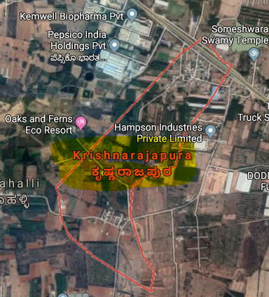
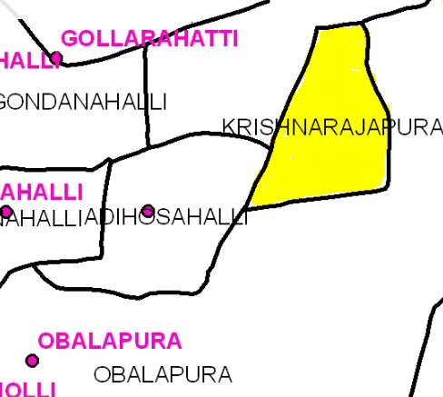
Nelamangala Cluster
Cluster villages -
Krishnarajapura, Adihosalli, Obalapura
Nelamangala Taluk
Cluster villages
Satellite image of Krishnarajapura village

Slide 17
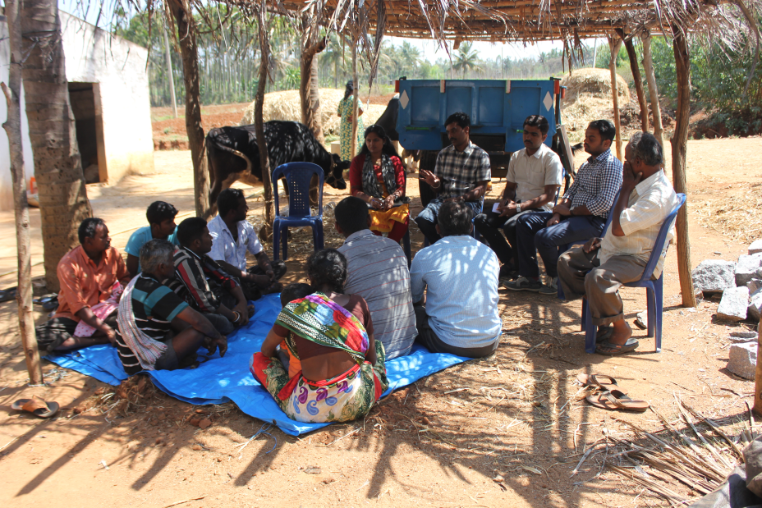
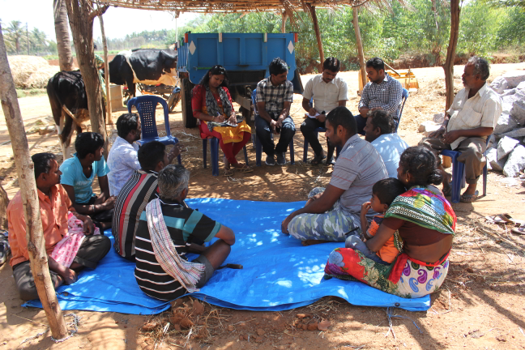
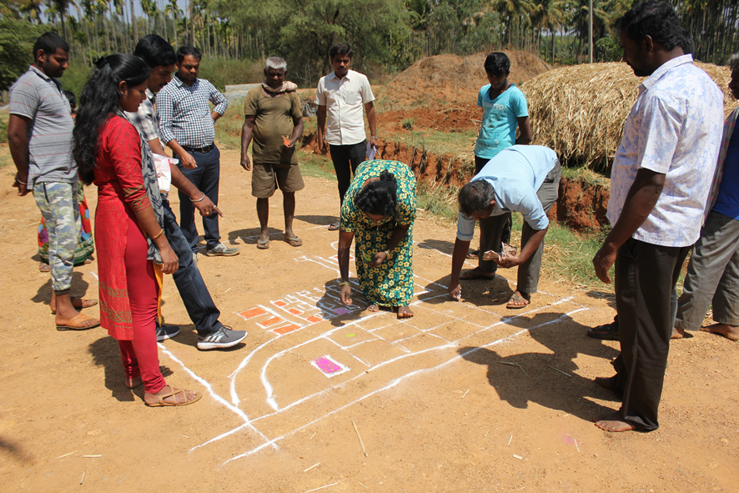
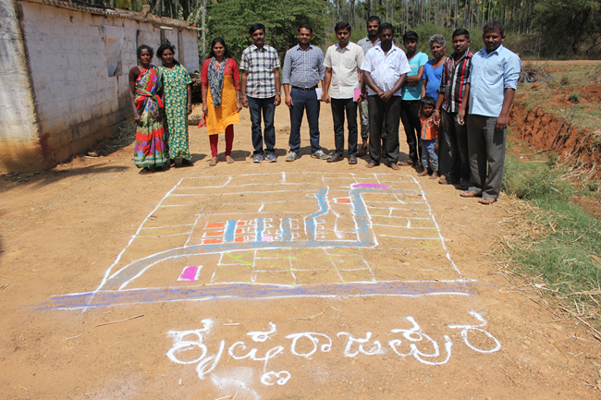
Participatory Rural Appraisal (PRA) - Nelamangala Cluster
Explaining PRA Objectives
Briefing of Village Agriculture Situations
Drawing of Resource Map
Village Resource Map

Slide 18
Problems identified in Nelamangala Cluster
Problems
1 | Maize - No application of K & micro nutrients, Fall army worm, Stem borer, downy mildew and Turcicum leaf blight
2 | Finger millet - Intermittent drought and blast
3 | Red gram - Low yield due to imbalanced nutrition, wilt, sterility mosaic disease, Phyllody and pod borer
4 | Tomato - Indiscriminate use of fertilizers due to lack of knowledge on recommended schedules, ToLCV, Bacterial wilt, early blight, late blight, Blossom end rot, leaf miner, thrips and fruit borer
5 | Cabbage – Imbalanced nutrition, DBM and black rot
6 | Fodder - Non availability of green fodder through out the year
7 | Pole Beans – Imbalanced nutrition, severe incidence of yellow mosaic virus, rust, leaf miner, anthracnose and pod borer
8 | Arecanut - Imbalanced nutrition , no intercropping system and falling of nuts
9 | Dairy animals – Non availability of green fodder through out the year, low milk production, decreased reproductive efficiency after calving, inefficient reproductive management practices, delayed onset of oestrus
10 | Nutrition garden - Nutrition insecurity and lack of knowledge on importance of nutrition garden

Slide 19
Gap Identification and Technology Prioritization – Nelamangala Cluster
Crop | Average Yield | Potential Yield | Technological gap | Extension Gap | Technological Intervention
Redgram | 27 q/ha | 50 q/ha | Lower market price during peak season Low yield due to terminal end drought | Lack of awareness about early duration variety | OFT-Assessment of suitable redgram varieties for vegetable purpose
Pole bean | 25 t/ha | 35 t/ha | Severe incidence of Yellow Mosaic Virus | Lack of awareness about IDM practices | FLD- Management of yellow mosaic virus in pole beans through integrated approach
Fodder sorghum | - | - | Non availability of high yielding multicut fodder varieties with more palatability | Unaware about the availability of suitable multicut fodder varieties | FLD - Demonstration of multicut fodder sorghum: COFS-31 for green fodder and silage

Slide 20
Gap Identification and Technology Prioritization – Nelamangala Cluster
Crop | Average Yield | Potential Yield | Technological gap | Extension Gap | Technological Intervention
Pole bean | 25 t/ha | 35 t/ha | No K application, Micronutrients application is not followed | Lack of awareness about nutrient management practices | FLD - Integrated Nutrient Management in Pole bean
Tomato | 64 t/ha | 75 t/ha | No application of micro nutrients, indiscriminate use of fungicides, ToLCV, wilt, early blight, late blight, leaf miner and fruit borer | Lack of awareness about IPDM practices, use of vegetable special | FLD - Integrated crop management in tomato
Nutrition garden | - | - | Nutrition insecurity and lack of knowledge on importance of nutrition garden | Lack of awareness about nutrition garden and nutrition security | Nutrition Garden for Farm families

Slide 21
Gap Identification and Technology Prioritization – Nelamangala Cluster
Crop | Average Yield | Potential Yield | Technological gap | Extension Gap | Technological Intervention
Dairy animals | 8.70 lt | 10.5 lt | Lower milk yield, Lower milk quality (fat%, SNF) and Ruminal acidosis | Lack of awareness about integrated nutrient management practices | FLD - Ration Balancing through Integrated Approach in Dairy Animals

Slide 22
Activities in Nelamangala cluster Cluster villages - Krishnarajapura, Adihosalli, Obalapura
DFI Strategy | Activity
Crop Productivity | OFT - Assessment of suitable Redgram Varieties for vegetable purpose
 | FLD – Management of yellow mosaic virus in pole beans through integrated approach
 | FLD- Demonstration of multicut fodder sorghum: COFS-31 for green fodder and silage
 | FLD- Integrated Crop Management in Tomato
 | FLD - Integrated Nutrient Management in Pole bean
 | FLD- Ration Balancing through Integrated Approach in Dairy Animals
 | FFS- Management of Diamond back moth in Cabbage

Slide 23
Activities in Nelamangala cluster Cluster villages - Krishnarajapura, Adihosalli, Obalapura
DFI Strategy | Activity
Reduction in cost of cultivation | OFT - Assessment of suitable Redgram Varieties for vegetable purpose
 | FLD - Management of yellow mosaic virus in pole beans through integrated approach
 | FLD - Integrated Nutrient Management in Pole bean
 | FLD - Integrated crop management in Tomato
 | FFS- Management of Diamond back moth in Cabbage
Crop Diversity | OFT - Assessment of suitable Redgram Varieties for vegetable purpose
 | FLD - Demonstration of multicut fodder sorghum: COFS-31 for green fodder and silage

Slide 24
DFI Strategy | Activity
Value addition and Market linkage | OFT - Assessment of suitable Redgram Varieties for vegetable purpose
 | FLD - Demonstration of multicut fodder sorghum: COFS-31 for green fodder and silage
 | FLD - Ration Balancing through Integrated Approach in Dairy Animal

Slide 25
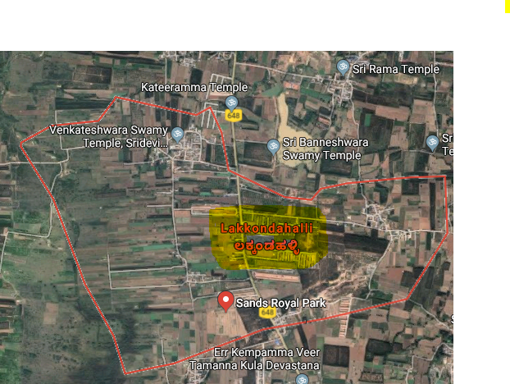
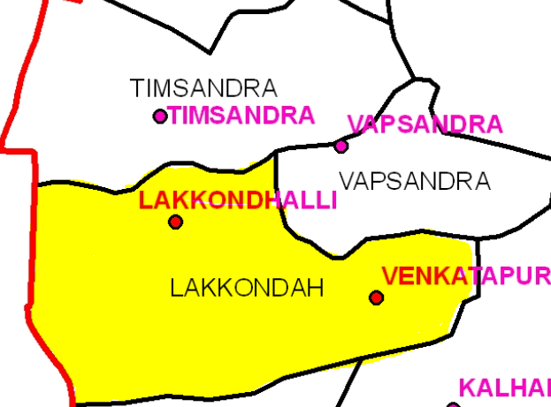
Details of Hosakote Cluster
Cluster villages – Lakkondahalli, Vapasandra,
Thimmasandra
Hosakote Taluk
Satellite image of Lakkondahalli village
Cluster villages

Slide 26
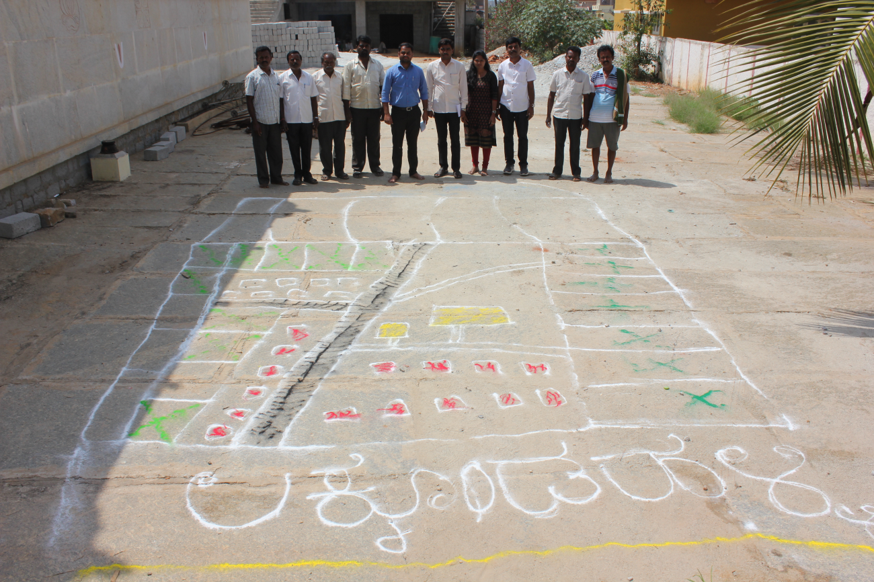
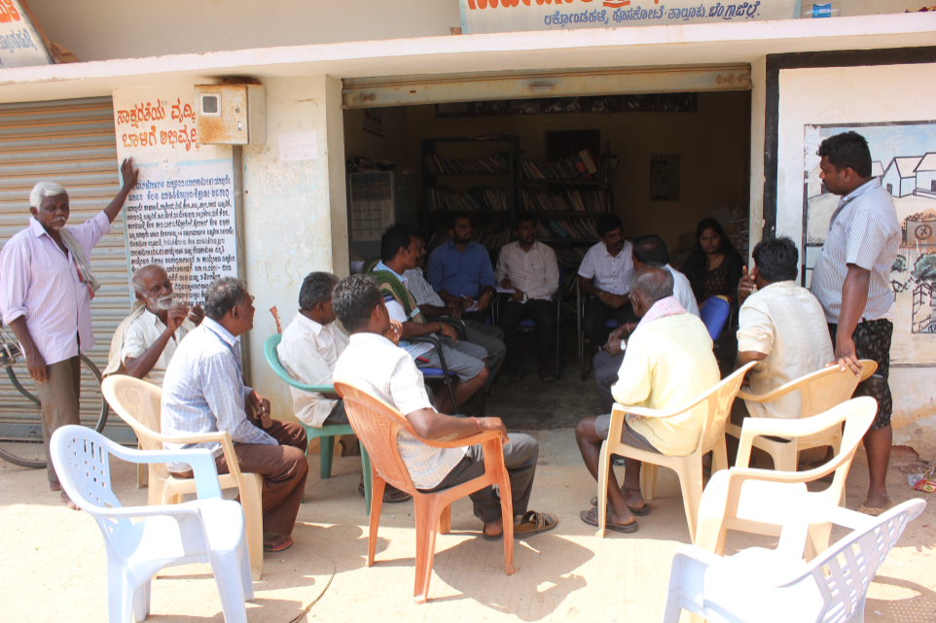
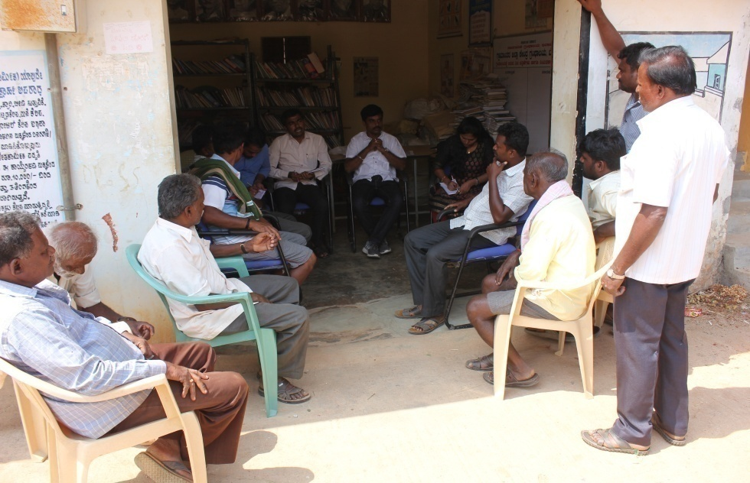
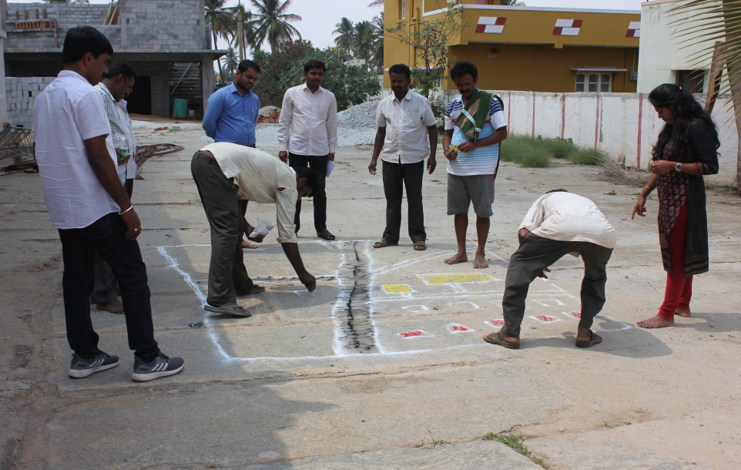
Participatory Rural Appraisal (PRA) - Hosakote Cluster
Explaining PRA Objectives
Briefing of Village Agriculture Situations
Drawing of Resource Map
Village Resource Map

Slide 27
Problems identified in Hosakote Cluster
Problems
1 | Maize- No application of K & micro nutrients, Fall army worm, Stem borer, Downy mildew and turcicum leaf blight
2 | Finger millet - Intermittent drought and blast
3 | Red gram - Low yield due to imbalanced nutrition, wilt, sterility mosaic disease, Phyllody and pod borer
4 | Bengal Gram – Low yield due to imbalanced nutrition, wilt, pod borer
5 | Fodder - Non availability of green fodder through out the year
6 | Tomato - Indiscriminate use of water soluble fertilizers due to lack of recommended schedules, ToLCV, Bacterial wilt, early blight, late blight, Blossom end rot, leaf miner, thrips and fruit borer
7 | Potato - Imbalanced fertilizers application, low yield and soft rot during storage
8 | Rose - Thrips, Aphids, mites, Bud borer, Black spot, DM, PM, Die back and Rust
9 | Nutrition garden - Nutrition insecurity and lack of knowledge on importance of nutrition garden
10 | Dairy animals – Non availability of green fodder through out the year, low milk production, decreased reproductive efficiency after calving, inefficient reproductive management practices, delayed onset of oestrus

Slide 28
Gap Identification and Technology Prioritization – Hosakote Cluster
Crop | Average Yield | Potential Yield | Technological gap | Extension Gap | Technological Intervention
Potato | 18 t/ha | 25 t/ha | Imbalanced fertilizers application, Low yield, Soft rot during storage | Lack of awareness on balanced application of major & micro nutrients | OFT - Assessment of nutrient management in Potato
Redgram | 6.4 q/ha | 12.5 q/ha | Wilt incidence Sterility mosaic disease, Imbalanced Nutrition | Lack of knowledge about wilt resistant var. BRG-3 | FLD- Integrated crop management in Redgram BRG-3
Rose | 5.49 t/ha | 12 t/ha | Imbalanced nutrition, Thrips, Aphids, mites, Bud borer, Black spot, DM, PM, Die back and Rust | Lack of awareness about nutrient, pest, disease management practices | FLD – Integrated Crop Management in Rose

Slide 29
Gap Identification and Technology Prioritization –Hosakote Cluster
Crop | Average Yield | Potential Yield | Technological gap | Extension Gap | Technological Intervention
Maize | 52 q/ha | 70 q/ha | No application of K & micro nutrients Fall army worm, Stem borer, Downy mildew and turcicum leaf blight | Lack of awareness about integrated nutrient, pest and disease management practices | FLD - Eco-friendly management of fall army worm in Maize
Tomato | 64 t/ha | 75 t/ha | Indiscriminate use of fertilizers due to lack of awareness on recommended schedules | Lack of awareness about recommended schedules for fertigation | FLD - Fertigation in tomato for enhancement of yield and quality
Nutrition garden | - | - | Nutrition insecurity and lack of knowledge on importance of nutrition garden | Lack of awareness about nutrition garden and nutrition security | Nutrition garden for Farm families

Slide 30
Gap Identification and Technology Prioritization –Hosakote Cluster
Crop | Average Yield | Potential Yield | Technological gap | Extension Gap | Technological Intervention
Dairy animals | 8.70 lt | 10.5 lt | Lower milk yield, Lower milk quality (fat %, SNF) and Incidence of Ruminal acidosis | Lack of awareness about integrated nutrient management practices | FLD - Ration Balancing through Integrated Approach in Dairy Animals

Slide 31
Activities in Hosakote cluster Cluster villages-Lakkondahalli,Vapasandra,Thimmasandra
DFI Strategy | Activity
Crop Productivity | OFT - Assessment of nutrient management in Potato
 | FLD- Integrated crop management in Redgram BRG-3
 | FLD – Integrated Crop Management in Rose
 | FLD - Eco-friendly management of fall army worm in Maize
 | FLD - Fertigation in tomato for enhancement of yield and quality
 | FLD- Ration Balancing through Integrated Approach in Dairy Animals
Reduction in cost of cultivation | FLD - Fertigation in tomato for enhancement of yield and quality
 | FLD- Integrated crop management in rose

Slide 32
DFI Strategy | Activity
Value addition and Market linkage | FLD- Integrated Crop Management in Rose
 | FLD - Ration Balancing through Integrated Approach in Dairy Animal

Slide 33
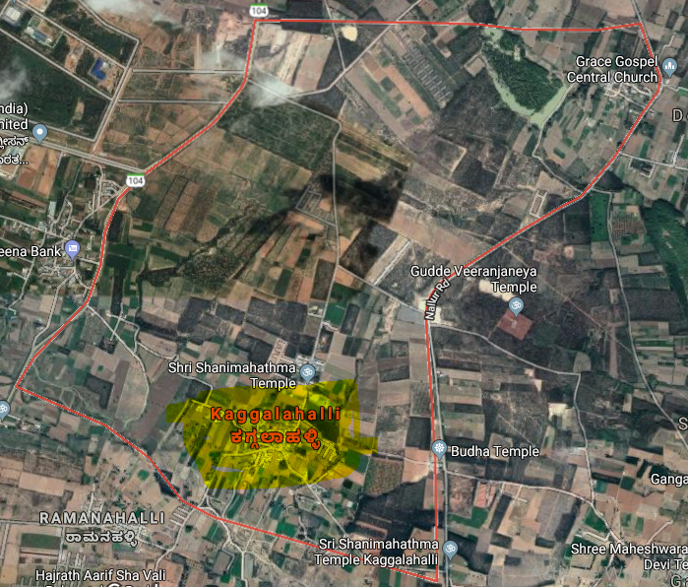
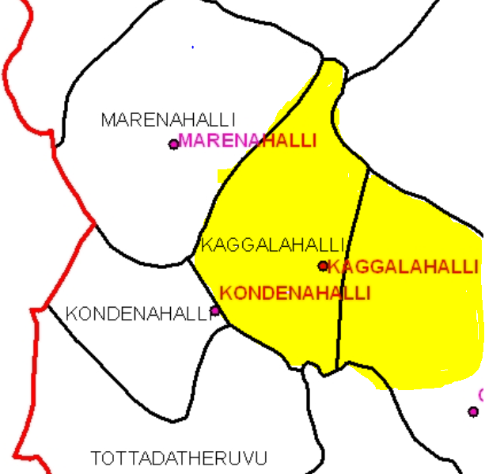
Devanahalli Cluster
Cluster villages – Kaggalahali, Marenahalli, Kondenahalli
Devanahalli Taluk
Satellite image of Kaggalahalli village
Cluster villages

Slide 34
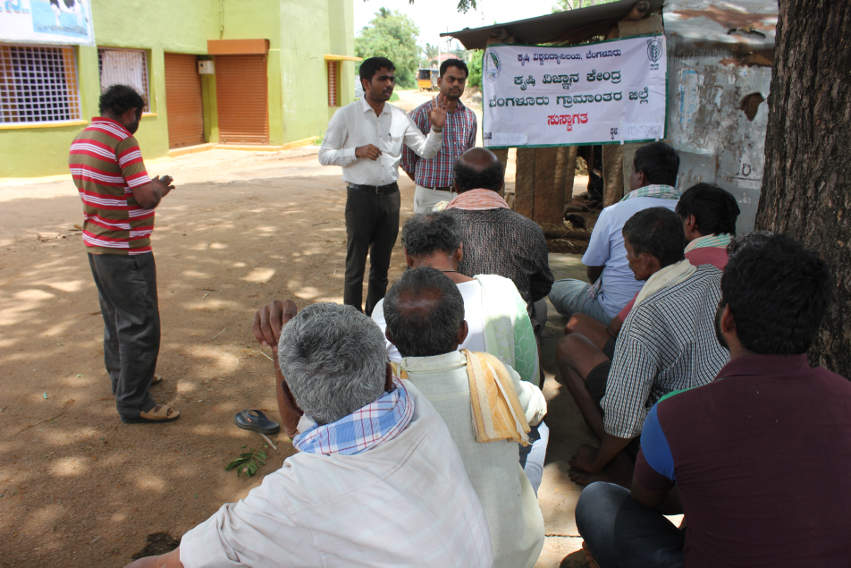
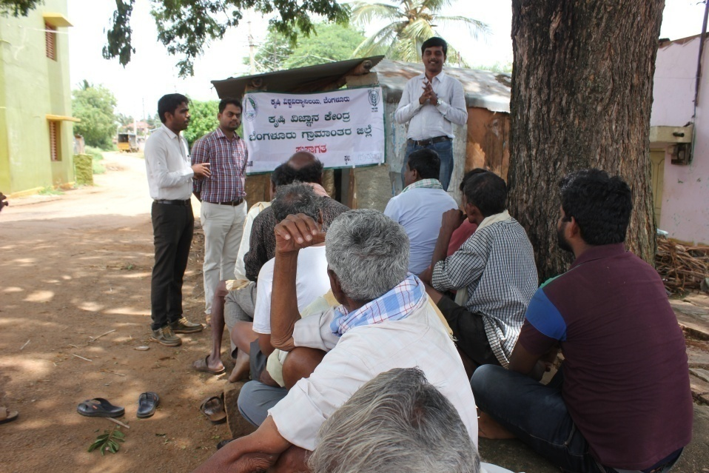
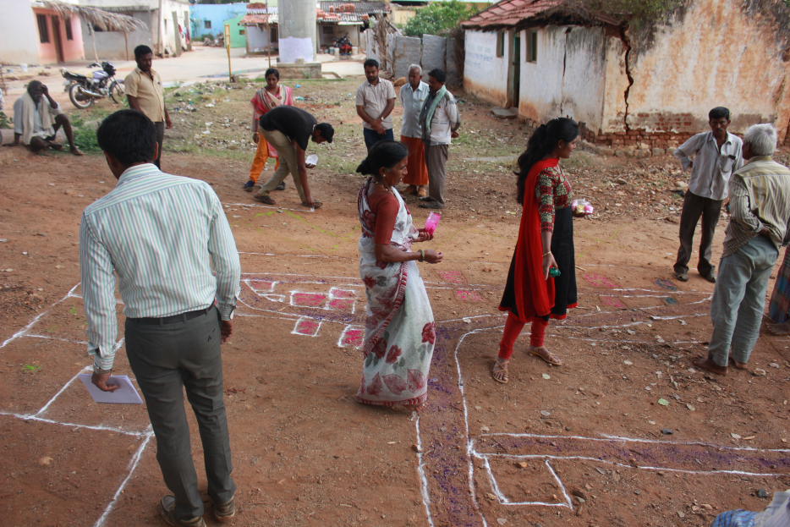
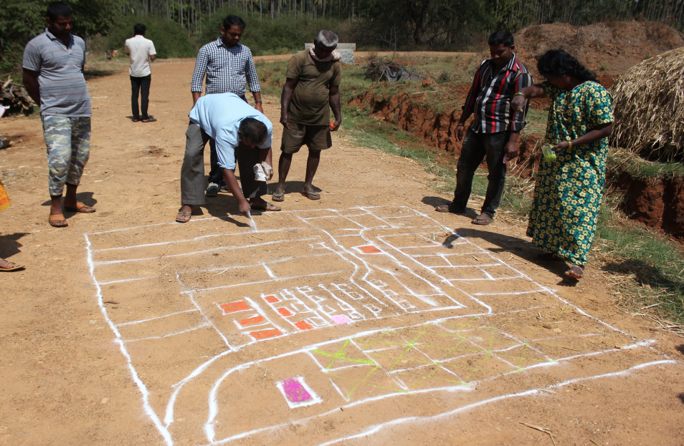
Participatory Rural Appraisal (PRA) - Devanahalli Cluster
Explaining PRA Objectives
Briefing of Village Agriculture Situations
Drawing of Resource Map
Village Resource Map

Slide 35
Problems identified in Devanahalli Cluster
Problems
1 | Finger millet - Intermittent drought and blast
2 | Red gram - Low yield due to imbalanced nutrition, wilt, sterility mosaic disease, Phyllody and pod borer
3 | Fodder - Non availability of green fodder through out the year
4 | Tomato - Indiscriminate use of fertilizers due to lack of knowledge on recommended schedules, ToLCV, Bacterial wilt, early blight, late blight, Blossom end rot, leaf miner, thrips and fruit borer
5 | Ridge gourd- Imbalanced fertilizers application, Severe incidence of mosaic virus
6 | Cauliflower - Imbalanced nutrition, severe incidence of Diamond backmoth
7 | Nutrition garden - Nutrition insecurity and lack of knowledge on importance of nutrition garden
8 | Dairy animals – Non availability of green fodder through out the year, low milk production, decreased reproductive efficiency after calving, inefficient reproductive management practices, delayed onset of oestrus
9 | Poultry birds - Lack of awareness on improved backyard poultry and about meat, egg and health issues, Lower productivity and income
10 | Fluctuations in market prices

Slide 36
Gap Identification and Technology Prioritization – Devanahalli Cluster
Crop | Average Yield | Potential Yield | Technological gap | Extension Gap | Technological Intervention
Ridge gourd | 27 t/ha | 38 t/ha | Severe incidence of Mosaic Virus | Lack of awareness about IDM practices | OFT – Assessment on management of mosaic virus in ridge gourd
Finger millet | 18 q/ha | 25 q/ha | Non utilization of pre monsoon rainfall Blast and drought susceptibility | Lack of awareness about double cropping system and blast resistant var. ML. 365 | FLD – Addressing Drought and Blast Vulnerability through Finger millet var. ML 365 under double cropping system

Slide 37
Gap Identification and Technology Prioritization – Devanahalli Cluster
Crop | Average Yield | Potential Yield | Technological gap | Extension Gap | Technological Intervention
Nutrition garden | - | - | Nutrition insecurity and lack of knowledge on importance of nutrition garden | Lack of awareness about nutrition garden and nutrition security | Nutrition garden for Farm families
Dairy animals | 8.70 lt | 10.5 lt | Lower milk yield, Lower milk quality (fat %, SNF) and Incidence of Ruminal acidosis | Lack of awareness about integrated nutrient management practices | FLD - Ration Balancing through Integrated Approach in Dairy Animals

Slide 38
Activities in Devanahalli cluster Cluster villages - Kaggalahali, Marenahalli, Kondenahalli
DFI Strategy | Activity
Crop Productivity | OFT – Assessment on management of mosaic virus in ridge gourd
 | FLD – Addressing Drought and Blast Vulnerability through Finger millet var. ML 365 under double cropping system
 | FLD- Ration Balancing through Integrated Approach in Dairy Animals
Reduction in cost of cultivation | OFT - Assessment on management of mosaic virus in ridge gourd through integrated approach
Crop Diversity | FLD – Addressing Drought and Blast Vulnerability through Finger millet var. ML 365 under double cropping system
Value addition and Market linkage | FLD - Ration Balancing through Integrated Approach in Dairy Animal

Slide 39
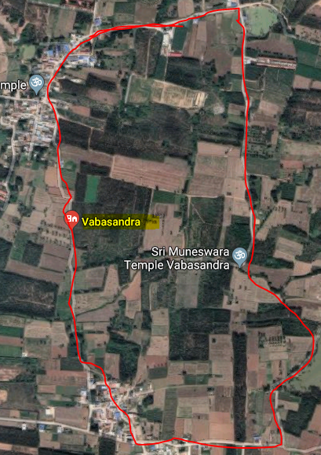
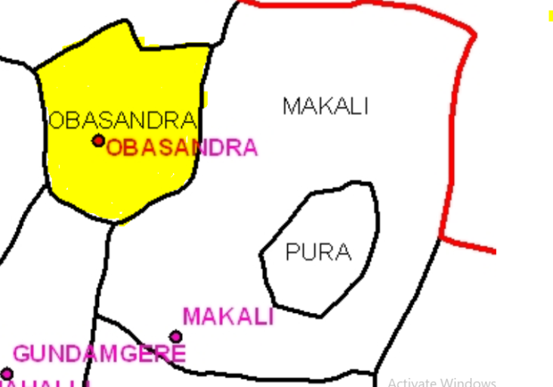
Doddaballapura Cluster
Cluster villages – Vabasandra, Gundamagere and Makali
Doddaballapura Taluk
Vabasandra
Satellite image of Vabasandra village
Cluster villages

Slide 40
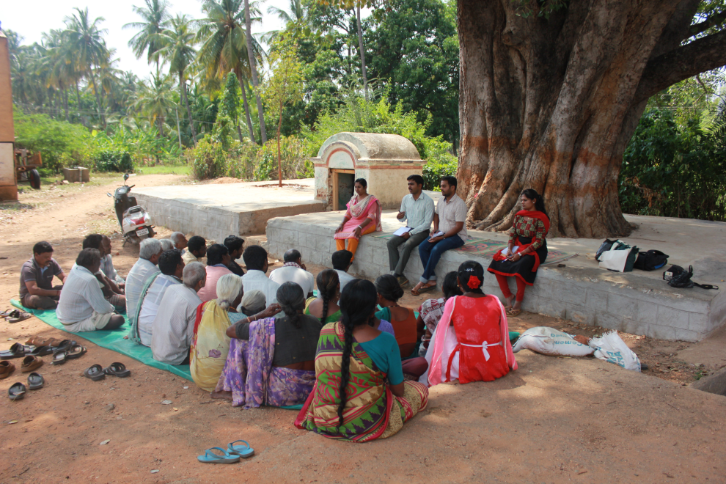
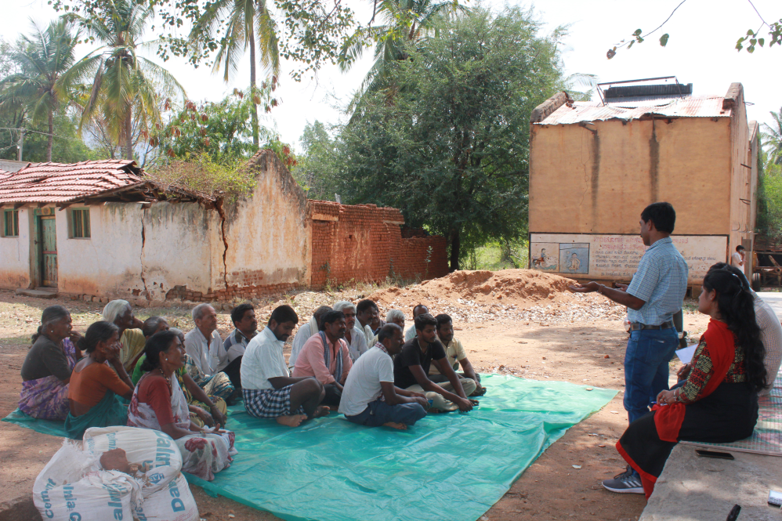
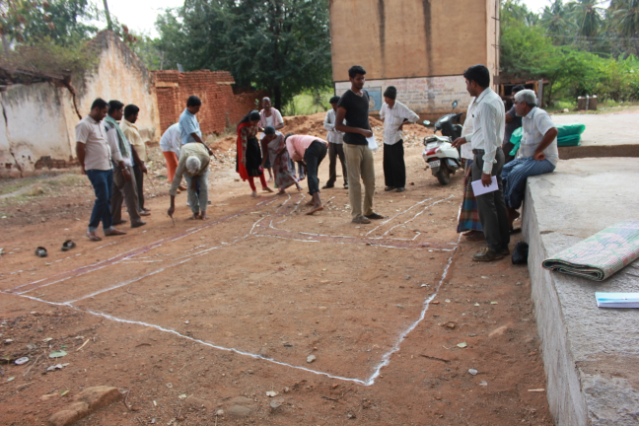
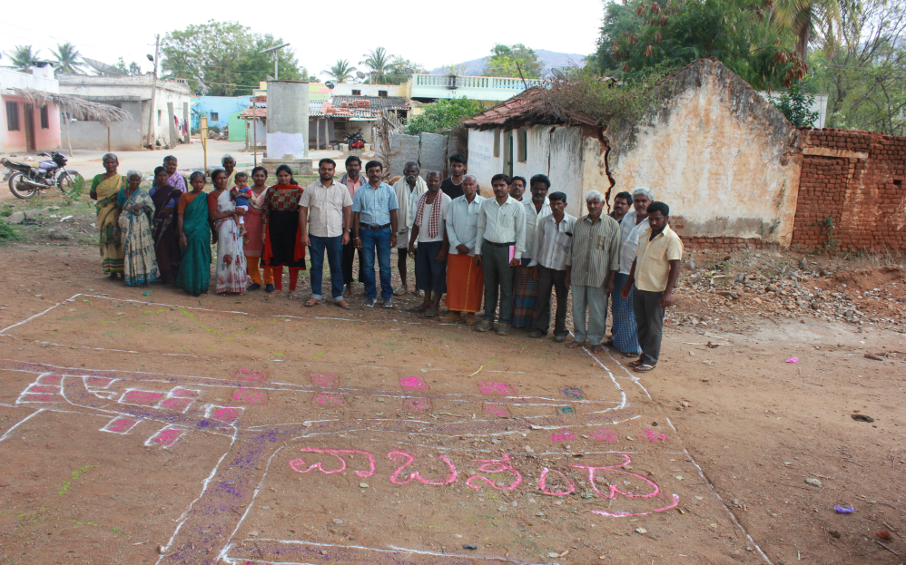
Participatory Rural Appraisal (PRA) - Doddaballapura Cluster
Explaining PRA Objectives
Briefing of Village Agriculture Situations
Drawing of Resource Map
Village Resource Map

Slide 41
Problems identified in Doddaballapura Cluster
Problems
1 | Maize - No application of K & micro nutrients, Fall army worm, Stem borer, Downy mildew and turcicum leaf blight
2 | Finger millet - Intermittent drought and blast
3 | Red gram - Low yield due to imbalanced nutrition, wilt, sterility mosaic disease, Phyllody and pod borer
4 | Popcorn – lack of awareness about its economic benefits
5 | Fodder - Non availability of high yielding multicut fodder variety having more palatability
6 | Brinjal - Imbalanced nutrition, Shoot and fruit borer (31%) infestation, bacterial wilt, root rot, PM, poor quality fruit
7 | Banana - Imbalanced fertilizers application, No intercropping
8 | Dairy animals – Non availability of green fodder through out the year, low milk production, decreased reproductive efficiency after calving, inefficient reproductive management practices, delayed onset of oestrus
9 | Castor - lack of knowledge about improved production technologies
10 | Chrysanthemum – Pest and disease incidence, indiscriminate use of plant protection chemicals

Slide 42
Gap Identification and Technology Prioritization – Doddaballapura Cluster
Crop | Average Yield | Potential Yield | Technological gap | Extension Gap | Technological Intervention
Fodder sorghum | - | - | Non availability of high yielding multicut fodder varieties with more palatability | Unaware about the availability of suitable multicut fodder varieties | FLD - Demonstration of multicut fodder sorghum: COFS-31 for green fodder and silage
Popcorn | 18 q/ha | 25 q/ha | Replacement of high value crop to finger millet, indiscriminate use of chemical fertilizers | Lack of awareness about its economical benefits | FLD - Demonstration of Popcorn as alternative crop for finger millet under rainfed situation

Slide 43
Gap Identification and Technology Prioritization – Doddaballapura Cluster
Crop | Average Yield | Potential Yield | Technological gap | Extension Gap | Technological Intervention
Brinjal | 30 t/ha | 38 t/ha | Imbalanced nutrition, Shoot and fruit borer, bacterial wilt, root rot, PM, poor quality fruit | Lack of awareness about integrated crop management practices | FLD – Integrated crop management in brinjal
Banana | 21.60 t/ha | 29.80 t/ha | Imbalanced fertilizers application , Pest and disease incidence, Low yield | Lack of awareness about fertilizers and IPDM practices | FLD – Soil test based nutrient management for tissue culture banana

Slide 44
Gap Identification and Technology Prioritization – Doddaballapura Cluster
Crop | Average Yield | Potential Yield | Technological gap | Extension Gap | Technological Intervention
Nutrition garden | - | - | Nutrition insecurity and lack of knowledge on importance of nutrition garden | Lack of awareness about nutrition garden and nutrition security | Nutrition garden for Farm families
Dairy animals | 8.70 lt | 10.5 lt | Lower milk yield, Lower milk quality (fat %, SNF) and Incidence of Ruminal acidosis | Lack of awareness about integrated nutrient management practices | FLD - Ration Balancing through Integrated Approach in Dairy Animals

Slide 45
Activities in Doddaballapura cluster Cluster villages-– Vabasandra, Gundamagere & Makali
DFI Strategy | Activity
Crop Productivity | FLD - Demonstration of multicut fodder sorghum: COFS-31 for green fodder and silage
 | FLD - Demonstration of Popcorn as alternative crop for finger millet under rainfed situation
 | FLD - Integrated crop management in Brinjal
 | FLD - Soil test based nutrient management for tissue culture banana
 | FLD- Ration Balancing through Integrated Approach in Dairy Animals
Reduction in cost of cultivation | FLD - Integrated crop management in Brinjal

Slide 46
Activities in Doddaballapura cluster Cluster villages– Vabasandra, Gundamagere & Makali
DFI Strategy | Activity
Crop Diversity | FLD - Demonstration of multicut fodder sorghum: COFS-31 for green fodder and silage
 | FLD- Demonstration of Popcorn as alternative crop for finger millet under rainfed situation
Value addition and Market linkage | FLD - Demonstration of multicut fodder sorghum: COFS-31 for green fodder and silage
 | FLD- Demonstration of Popcorn as alternative crop for finger millet under rainfed situation
 | FLD- Ration Balancing through Integrated Approach in Dairy Animals

Slide 47
Abstract of activities (2020-21)
Sl. No | Particulars | Total budget (Rs.)
1. | On Farm Testing – 3 No. (2 contd…) | 79,550
2. | Front Line Demonstration – 13 Nos. | 4,64,625
3. | Nutrition Garden | 48,500
TOTAL Rs. |  | 5,92,675

Slide 48
Abstract – On Farm Testing
Sl. No | Technology to be assessed / refined | No. of trials | Budget
1. | Assessment of suitable redgram varieties for vegetable purpose | 03 (1.2 ha) | 22200
2. | Assessment on management of mosaic virus in ridge gourd through integrated approach | 05 (1.0 ha) | 45000
3. | Assessment of nutrient management in potato | 05 (1.0 ha) | 12550
 | GRAND TOTAL |  | 79,750

Slide 49
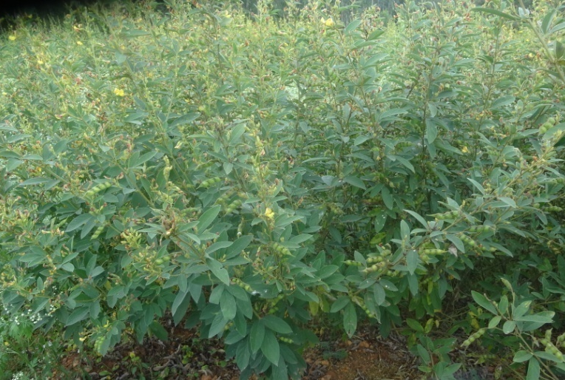
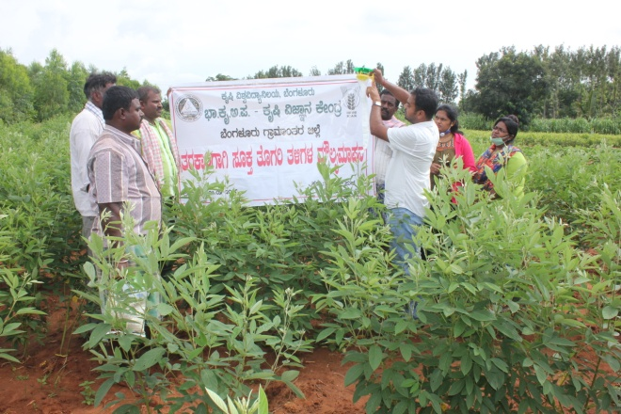
1. Assessment of suitable redgram varieties for vegetable purpose
New
Rationale
Dist. Area | Dist. Avg. Yield | Potential Yield
1275 ha | 27 q/ha | 50 q/ha
Lower market price during peak season
Low yield due to terminal end drought
 | Technological Options
TO1 | BRG-1 variety (150-170 days) - FP
TO2 | Transplanted BRG-1 variety (130-140 days) - UAS (B)
TO3 | Transplanted BRG-3 variety (140-150 days) – UAS (B)
TO4 | Ujwala variety (130-140 days) – PJTSAU, Telangana
Early duration Ujwala variety

Slide 50
Critical Inputs
Implementation
Trials : 03 (1.2 ha)
Total Cost : Rs. 22,200 (B+FD)
Vill. : Krishnarajapura
Taluk : Nelamangala
Scientists: Agron, SS and PP
Critical inputs (per demo) | Qty./trial | Cost /trial (Rs.)
Seeds | 8 Kg | 800
Rhizobium | 1 kg | 100
Pulse Magic | 2 kg | 600
Pheramone Traps+lures | 5+5 | 500
Bt | 2 ltr | 1800
Spinosad (Microbial) | 75 ml | 1600
Total |  | 5400
Cost for 3 trials |  | 16200
Parameters
Plant height (cm)
Number of branches/plant
Days to 50 % flowering
Number of pods/ plant
Green pods Yield (q/ha)
B:C ratio

Slide 51
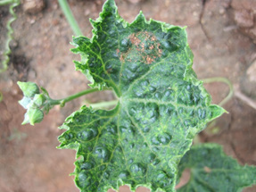
2. Assessment on Management of Mosaic Virus in Ridge Gourd through Integrated Approach
2nd year
Rationale
Dist. Area | Dist. Avg. Yield | Potential Yield
163 ha | 27 t/ha | 38 t/ha
Severe incidence of MV (> 31%)
Technological Options
TO1 | Imidacloprid 17.8 SL (0. 1%), Thiomethaxam 25 WG (0.05%), Acetamaprid 0.1%, Diafenthiuron 500 SC (0.1%), Acephate 75% SP (0.15%), Spiromesifen 22.9% SC (0.1%)– Farmers’ Practice
TO2 | Spraying of Dimethoate 30 EC (0.2%) and Imidacloprid–17.8 S L (0.05%) - UAS (B)

Slide 52
 | Technological Options
TO3 | Border cropping with maize, soil application of carbofuran @1.5kg ai/ha, spraying with Acephate 75% SP (0.15%), Imidachloprid 17.8 SL (0.03%) and Neem seed kernel extract (2%) – IIHR, Bengaluru
TO4 | Seed treatment with Thiomethaxam 25 WG – 5g/kg seeds, mulching with black silver mulch, intercropping with two rows of border crops of maize , soil application of Pseudomonas fluorescens along with neem cake, installation of yellow sticky trap @ 10no/acre, spraying of neem soap (5g/L), Seaweed extract (1.5ml/L), Thiamethoxam 25% WG (0.5 g/L) and Imidacloprid 17.8 SL (0.5ml/L) - IIVR, Varanasi

Slide 53
Critical Inputs
Implementation
Critical Input | Qty./ trial | Cost/ trial (Rs.)
Pseudomonas fluorescens | 5 kg | 1250
Neem cake | 100 kg | 2000
Yellow Sticky Traps | 10 | 600
Neem soap | 2 kg | 550
Seaweed extract | 300ml | 1600
Thiomethaxam | 100 gm | 800
Imidacloprid | 500 ml | 1000
Total |  | 7800
Cost for 05 trials |  | 39, 000
Trials : 05 (1.0 ha)
Total Cost : Rs. 45,000 (B+FD)
Vill. : Kaggalahalli
Taluk : Devanahalli
Scientist: Hort (SS & H) ,PP, Agron, SS & AE
Parameters
Plant height (cm), No. of fruits/plant, fruit length & girth (cm)
Disease incidence (%)
No. & cost of sprays
Yield
B:C ratio

Slide 54
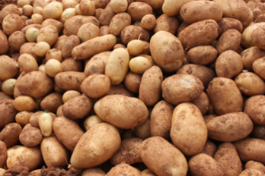
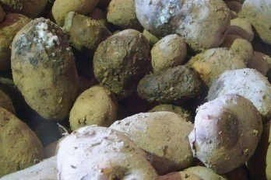
3. Assessment of nutrient management in potato
3rd year
Rationale
Dist. Area | Dist. Avg. Yield | Potential Yield
1504 ha | 13.75 t/ha | 20 t/ha
Imbalanced fertilizers application
Low yield
Soft rot during storage
 | Technological Options
TO1 | Indiscriminate use of DAP and MOP– Farmers practice
TO2 | FYM@ 25 t/ha, NPK: 125:100:125 kg/ha Soil test based nutrient application 50% N, 100% P&K as basal dose at the time of planting 50% N at 4 weeks after planting – UAS (B)
TO3 | FYM@ 15 t/ha, NPK-120:240:120 kg/ha, 2 kg Azospirillum, 2 kg Phosphobacterium and 60 kg/ha MgSO₄, 50% NPK and 100 % MgSO₄ at the time of planting, 50% NPK at 30 days after planting – TNAU, Coimbatore
TO4 | FYM@ 15 t/ha, NPK-140:60:60 kg/ha, Ca – 8 kg/ha and Sulphur 30 kg/ha, 2/3rd N, 100% P&K at the time of planting, 1/3rd of N at 25 days after planting – CPRI, Shimla

Slide 55
Critical Inputs
Implementation
Critical Input | Qty./trial | Cost/ trial (Rs.)
Calcium Chloride/CaCo₃ | 5 kg | 100
Ammonium Sulphate | 10 kg | 160
Magnesium sulphate | 12 kg | 270
Azospirillum | 1 kg | 90
Phosphobacterium | 1 kg | 90
Soil analysis | 2 | 600
Total |  | 1310
Cost for 5 trials |  | 6550
Demos : 05 (1 ha)
Total Cost : Rs. 12,550 (B+FD)
Vill. : Siddenahalli, Hosakote Tq
Scientists : SS, Agr & Hort (Sr.S&H)
Parameters
Soil fertility status
No. of tubers/plant
Tuber weight (g)
Tuber Yield (t/ha)
Soft rot incidence (%)
B:C ratio
Distribution of Soil Health Cards

Slide 56
Abstract : Front Line Demonstrations
Sl. No | Title of the Technology | No. of Demo | Area (ha) | Budget (Rs.)
1. | Addressing Drought and Blast Vulnerability through Finger millet var. ML 365 under double cropping system | 10 | 04 | 23600
2. | Integrated Crop Management in Redgram BRG-3 | 05 | 02 | 22500
3. | Demonstration of multicut fodder sorghum: COFS-31 for green fodder and silage | 10 | 01 | 21000
4. | Demonstration of Popcorn as alternative crop for finger millet under rainfed situation | 05 | 01 | 30500
5. | Fertigation in tomato for enhancement of yield and quality | 05 | 01 | 21250
6. | Integrated Nutrient Management in Pole bean | 05 | 01 | 15750
7. | Soil test based nutrient management for tissue culture banana | 05 | 1.25 | 22000

Slide 57
Abstract : Front Line Demonstrations
Sl. No | Title of the Technology | No. of Demo | Area (ha) | Budget (Rs.)
8. | Integrated Crop Management in Tomato | 05 | 01 | 46250
9. | Integrated Crop Management in Rose | 05 | 01 | 42750
10. | Eco-friendly management of fall army worm in Maize | 05 | 01 | 51375
11. | Integrated Crop Management in Brinjal | 05 | 01 | 44250
12. | Integrated crop management in pole beans | 05 | 01 | 45000
13. | Ration Balancing through Integrated Approach in Dairy Animals | 20 | - | 79000
TOTAL |  |  |  | 4,65,225

Slide 58
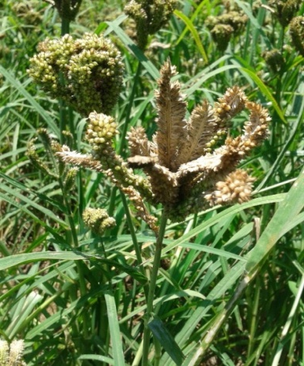
1. Addressing drought and blast vulnerability through fingermillet var. ML 365 under double cropping system
Rationale
Fingermillet as sole crop
Non utilization of pre monsoon rainfall
Blast and drought susceptibility in fingermillet
Technology: UAS(B)
Double cropping system (cowpea and fingermillet)
Moisture conservation furrows (every 12 rows) in finger millet
Use of blast resistant var. ML 365
Seed treatment with Rhizobium (for cowpea)and Azospirillum (For fingermillet)
Crops | District Area | Dist. Avg. yield | Potential yield
Finger millet | 36463 ha | 18 q/ha | 25 q/ha
Cowpea | 327 ha | 3.5 q/ha | 5.0 q/ha
Blast incidence
Cowpea (IT-38956-1)

Slide 59
Critical Inputs
Implementation
Particulars | Qty/ demo | Cost/demo (Rs.)
Ragi Seeds (ML -365) | 10 kg | 600
Cowpea seeds (IT 38956-1) | 12 kg | 960
Rhizobium | 1 kg | 100
Azospirillum | 1 kg | 100
Total |  | 1760
Cost for 10 demos |  | 17,600
Demos: 10 (4 ha)
Total Cost: Rs. 23,600 (B+FD)
Vill.: Lakkondahalli
Taluk: Hoskote Tq.
Scientists – Agronomy, SS & PP
Parameters
Plant height (cm) in both crops
No. of productive tillers/plant in finger millet
No. of branches in cowpea
Blast severity (%) in finger millet
Yield (q/ha) for both crops
B:C ratio

Slide 60
2. Integrated crop management in Redgram BRG-3
Rationale
Wilt incidence (>10 %)
Sterility mosaic disease (10-15%)
Imbalanced Nutrition
Area | Dist. Avg. yield | Potential yield
1,275 ha | 6.4 q/ha | 12.5 q/ha
Technology: UAS(B)
Use of wilt resistant var. BRG 3
Formation of Ridges and furrows
Seed treatment with Rhizobium
Installation of pheramone traps
Spray of Pulse Magic
Spray of need based pp chemicals
Fusarium wilt

Slide 61
Critical Inputs
Implementation
Demos: 5 (2 ha)
Total cost: Rs. 22,550 (B+FD)
Vil.: Lakkondahalli
Taluk: Hoskote Tq.
Scientists – Agron, SS & PP
Particulars | Qty/ demo | Cost/demo (Rs.)
Seeds (BRG-3) | 6 kg | 510
Rhizobium | 1 kg | 100
Pulse magic | 2 kg | 600
Pheramone traps and lures | 5 no. each | 500
Spinosad (microbial) | 75 ml | 1600
Total |  | 3310
Cost for 5 demos |  | 16,550
Parameters
Plant height (cm)
Number of branches/plant
Wilt severity (%)
Sterility mosaic disease severity (%)
Yield (q/ha)
B:C ratio

Slide 62
3. Demonstration of multicut fodder sorghum COFS-31
for green fodder and silage
Rationale
Conventional fodder sorghum crop (Kakmar)-less yield
Unaware about the availability of suitable multicut fodder
Lack of awareness about silage technology
Technology: TNAU, Tamil nadu
High yielding multicut fodder variety CoFS-31 :170-180 t/ha/yr (6-7 cuts) with good palatability
Improved agro techniques for multicut fodder production
Silage production technology in bags
CoFS-31

Slide 63
Critical Inputs
Implementation
Particulars | Qty/ demo | Cost/demo (Rs.)
Seeds (CoFS-31) | 1 kg | 500
Silage bags/drums | 1 | 1000
Total |  | 1500
Cost for 10 demos |  | 15000
Demos: 10 (1 ha)
Total cost: Rs.21, 000 (B+FD)
Vil.: Vabasandra & K.R.Pura
Taluk: Doddaballapur & Nelamangala
Scientists – Agron and SS
Parameters
Plant height (cm)
Number of tillers/culm
Green fodder Yield (t/ha)
Palatability (%)

Slide 64
4. Demonstration of Popcorn as alternative crop for finger millet under rainfed situation
Rationale
Dist. Area | Dist. Avg. Yield | Potential Yield
36463 ha | 18 q/ha | 25 q/ha
Replacement of high value crop to finger millet
Technology: UAS (B)
Replacement of finger millet by pop corn
Seed treatment
Installation of pheromone traps - 15/acre
Spraying of Spinosad – 0.4 ml/L
Pop corn

Slide 65
Critical Inputs
Implementation
Particulars | Qty/demo | Cost/demo (Rs.)
Metalaxyl+Mancozeb | 100 g | 300
Seeds | 6 kg | 1500
Traps+lures | 15 no’s | 1500
Spinosad (Microbial) | 75 ml | 1600
Total |  | 4900
Cost for 5 demos |  | 24500
Demos: 5(1 ha)
Total cost: Rs. 30, 500
Vill: Vabasandra
Taluk: Doddaballapura
Scientist : PP, Hort (SS & H),& SS
Parameters
Plant height (cm)
No. of cobs/plant
Yield (t/ha)
B:C ratio

Slide 66
5. Fertigation in tomato for enhancement of yield and quality
Rationale
Indiscriminate use of Water Soluble Fertilizers.
Lack of knowledge on recommended fertilizer schedule.
Dist. Area | Dist. Avg. Yield | Potential Yield
1960 ha | 31.23 t/ha | 60.00 t/ha
Technology: IIHR, Bengaluru
RDF – 60:45:60 kg/acre
20% RDF as basal fertilizer application
80% RDF through Fertigation (Water soluble fertilizers once in 3 days)
Fertigation Schedule
Crop stage | No. of Fertigations | Qty. of fertilizer (kg/fertigation/acre)
 |  | 19:19:19 | KNO₃ | CN
0-20 days (Pre-Vegetative) | - | No. of fertigation
21-36 days (Vegetative) | 6 | 6 | - | -
39-57 days (Vegetative, flowering and harvesting) | 7 | 4 | 2 | 1
60-129 days (Vegetative, flowering and harvesting) | 24 | 13 | 5 | 6
Total | 37 | 23 | 7 | 7

Slide 67
Critical Inputs
Particulars | Qty/demo | Cost/demo (Rs.)
19:19:19 | 76 kg | FC
KNO₃ | 25 kg | 2450
Calcium Nitrate | 33 kg | FC
Soil Analysis | 2 | 600
Total |  | 3050
Cost for 5 demos |  | 15,250
Implementation
Parameters
Demos: 5 (1 ha)
Total Cost: Rs. 21,250 (B+FD)
Vil.: Lakkondahalli, Hosakote Tq.
Scientists: SS, Hort (Sr.S&H), Agron
Soil fertility status
Plant height (cm)
No of fruits /plant
Weight of the fruit (g)
Yield (t/ha)
B:C ratio
Distribution of Soil Health Cards

Slide 68
6. Integrated Nutrient Management in Pole bean
Rationale
No K application
Micronutrients application is not followed
Low yield and poor quality
Area | Dist. Avg. yield | Pot. Yield
671 ha | 25 t/ha | 40 t/ha
Technology: UAS, Bengaluru
PSB – 150 g for seed treatment
AMC – 5 kg for 500 kg FYM/Compost
FYM: 10 t/ha, RDF – 25:40:30 kg/acre
50% N, 100 % PK as basal and 50 % N as top dress after 4 WAS
Vegetable special (2 sprays: Flower bud initiation & 10-15 days after 1st spray)

Slide 69
Critical Inputs
Implementation
Demos: 5 (1 ha)
Total Cost: Rs. 15,750 (B+FD)
Vil.: Krishnarajapura, Nelamangala Tq
Scientists: SS, Hort (Sr.S&H) & Agron
Particulars | Qty /demo | Cost/ demo (Rs.)
PSB | 1 kg | 150
Vegetable special | 1 kg | 200
AMC powder | 5 kg | 1000
Soil analysis | 2 | 600
Total |  | 1950
Cost for 5 demos |  | 9,750
Parameters
Soil fertility status
Plant height (cm)
No of branches/plant
No. of pods/plant
Length and girth of pod
Yield (t/ha)
B:C ratio
Distribution of Soil Health Cards

Slide 70
7. Soil test based nutrient management for tissue culture banana
Dist. Area | Dist. Avg. Yield | Pot. Yield
1525 ha | 21.60 t/ha | 29.80 t/ha
Rationale
Imbalanced fertilizers application
Low yield
Pest and disease incidence
Technology: UAS(B), IIHR (B) & NRC for Banana Tiruchirapalli
FYM@ 40 t/ha, NPK: 200:100:300 g/plant - UAS(B)
Pseudomonas fluorescens (90g), Azospirillum(30g), Phosphobacteria(30g), Neem cake (300g) and MgSO₄ (25 g) – NRC for Banana, Tiruchirapalli

Slide 71
Critical Inputs
Implementation
Particulars | Qty/demo | Cost/ demo (Rs.)
Pseudomonas | 7 kg | 700
Azospirillum | 7 kg | 700
Phosphobacteria | 7 kg | 700
MgSO₄ | 6 kg | 150
Banana special | 2 kg | 350
Soil analysis | 2 | 600
Total |  | 3200
Cost for 5 demos |  | 16,000
Demos : 05 (1.25 Acre)
Total Cost : Rs. 22,000 (B+FD)
Vill. : Vabasandra, Doddaballapura Tq
Scientists : SS, Agron & Hort (Sr.S&H)
Parameters
Soil fertility status
No. of fingers/bunch
Bunch weight (g)
Yield (t/ha)
Panama wilt incidence (%)
B:C ratio
Distribution of Soil Health Cards

Slide 72
8. Integrated Crop Management in Tomato
Rationale
Dist. Area | Dist. Avg. Yield | Pot. Yield
1,838 ha | 64 t/ha | 75 t/ha
Indiscriminate use of fertilizers due to lack of knowledge on recommended schedules
Early blight, Late blight, ToLCV , Tospo &bacterial wilt disease incidence (34%)
Leaf miner &Fruit borer incidence (29%)
Indiscriminate use of PP chemicals
Blossom end rot
Early blight
Technology : IIHR & UAS (B)
Arka Abedh hybrid
Marigold as trap crop (16:1)
Use of enriched FYM with bio agents
Fertigation schedule
Spraying of neem & pongamia soap (5g/L)
Spray of Bt (1g/L)
Installation of yellow & blue sticky cards (10/acre) & Wota-T traps (5/acre)
Spraying of vegetable special
Need based PP chemicals
Leaf curl virus
Late blight
Fruit borer

Slide 73
Critical Inputs
Implementation
Particulars | Qty./ demo | Cost/ demo (Rs.)
Arka Abedh seeds | 20 gm | 600
Trichoderma harzianum | 5 kg | 1000
Pseudomonas fluorescens | 5 kg | 1250
Blue Sticky cards | 10 No. | 600
Yellow Sticky cards | 10 No. | 600
Pongamia soap | 2 kg | 550
Neem soap | 2 kg | 550
Bt | 2 lt | 1800
Wota-T trap | 5 | 500
Vegetable special | 3 kg | 600
Total |  | 8,050
Cost for 5 demos |  | 40,250
Demos: 05 (1 ha)
Total cost: Rs. 46,250
Vill: Krishnarajapura
Taluk: Nelamangala Tq.,
Scientist : Hort (SS & H), PP, Agron, SS & AE
Parameters
Growth parameters
Disease incidence (%)
Pest incidence (%)
No. & cost of sprays
Yield (t/ha)
B:C ratio
Implementation

Slide 74
9. Integrated Crop Management in Rose
Rationale
Area | Dist. Avg. yield | Pot. Yield
508 ha | 5.49 t/ha | 12 t/ha
Improper pruning
Imbalanced use of fertilizers
Severe pest and disease incidence
Technology : IIHR
Soil test based RDF
Enrichment of FYM with bio agents
Timely Pruning
Use of sticky cards
Foliar spray of micronutrient mixture
Timely spraying of plant protection chemicals
Fe chlorosis
Thrips
Black spot
Powdery mildew

Slide 75
Critical Inputs
Implementation
Particulars | Qty./ demo | Cost/ demo (Rs.)
Trichoderma harzianum | 5 kg | 1000
Pseudomonas fluorescens | 5 kg | 1250
Pruning secateurs | 2 | 800
Rose mixture | 1 kg | 200
Blue Sticky cards | 10 No. | 600
Yellow Sticky cards | 10 No. | 600
Spinosad (Microbial) | 75 ml | 1600
Folicur | 500 ml | 1100
Total |  | 7,350
Cost for 5 demos |  | 36, 750
Demos: 05 (1 ha)
Total cost: Rs. 42,750
Vill: Lakkondahalli
Taluk: Hosakote
Scientist : Hort (SS & H), PP, Agron, SS & AE
Parameters
Plant height
No. of branches/plant, no. of flowers/plant,
Pest and disease incidence(%)
Yield (qt/ha), flower size, diameter & shelf life
B:C ratio

Slide 76
10. Eco-friendly management of Fall armyworm in Maize
Rationale
Fall army worm incidence (38%)
Dist. Area | Dist. Avg. Yield | Potential Yield
16045 ha | 52 q/ha | 70 q/ha
Technology: UAS (B) & NBAIR
Seed treatment
Release of Trichogramma chilonis – 2 card/acre
Spraying of Heterorhabditis indica 1% wp (5.1x10⁴ U/g) – 4 kg/acre
Spraying of Neem based azadirachtin 10000 ppm – 2ml/L
Spraying of Bt – 10ml/L
Spraying of Spinetoram (microbial) (0.5ml/L)
Preparation of poison bait
Installation of pheramone traps - 15/acre
Fall armyworm

Slide 77
Critical Inputs
Implementation
Particulars | Qty/demo | Cost/demo (Rs.)
Cyantraniliprole+ Thiomethaxam | 100 g | 600
Neemazal 10000 ppm | 500 ml | 900
Heterorhabditis indica | 4 kg | 2400
Bt | 2 litres | 1800
Spinetoram (microbial) | 180 ml | 2100
Traps+lures | 15 no’s | 1275
Total |  | 9,075
Cost for 5 demos |  | 45,375
Demos: 5(1 ha)
Total cost: Rs. 51, 375
Vill: Lakkondahalli
Taluk: Hosakote
Scientist : PP, Hort (SS & H), Agron, SS & AE
Parameters
Growth parameters
Fall armyworm incidence (%)
Yield (t/ha)
B:C ratio

Slide 78
11. Integrated crop management in Brinjal
Dist. Area | Dist. Avg. Yield | Potential Yield
312 ha | 30 t/ha | 38 t/ha
Rationale
Shoot and fruit borer (31%) infestation
Bacterial wilt incidence (18%)
Poor quality fruit
Technology : IIHR
FYM enrichment with Trichoderma harzianum and Pseudomonas fluorescens
Installation of Wota-T traps (10 no/acre)
Spray of Bt (1g/L) & Neem Soap (5g/L)
Spraying of Spinosad (microbial) – 0.5 ml/L
Vegetable special (3g/L)
Spraying of need based chemicals
Shoot & Fruit borer
Bacterial wilt

Slide 79
Critical Inputs
Implementation
Particulars | Qty./demo | Cost/ demo (Rs.)
Trichoderma harzianuim | 5 kg | 1000
Pseudomonas fluorescens | 5 kg | 1250
Wota - T traps | 10 No | 800
Neem soap | 2 kg | 550
Bt | 2 lt | 1800
Spinosad (microbial) | 75 ml | 1650
Vegetable special | 3 kg | 600
Total |  | 7650
Cost for 5 demos |  | 38,250
Demos: 05 (1 ha)
Total cost: Rs. 44, 250
Vill: Vabasandra
Taluk: Doddaballapura
Scientist : PP, Hort (SS & H), Agron, SS & AE
Parameters
Growth parameters
Shoot and fruit borer & wilt incidence (%)
Yield (t/ha)
B:C ratio
Implementation

Slide 80
12. Management of Yellow Mosaic Virus in Pole bean through Integrated Approach
Rationale
Dist. Area | Dist. Avg. Yield | Potential Yield
671 ha | 25 t/ha | 35 t/ha
Severe incidence of YMV (> 42%)
Technology : UAS (B)
Seed treatment with Thiomethaxam 25 WG – 5g/kg seeds
Mulching with black silver mulch
Intercropping with two rows of border crops of maize
Soil application of Pseudomonas fluorescens along with neem cake, installation of yellow sticky trap @ 10no/acre
Spraying of neem soap (5g/L), Seaweed extract (1.5ml/L), Thiamethoxam 25% WG (0.5 g/L) and Imidacloprid 17.8 SL (0.5ml/L)

Slide 81
Critical Inputs
Implementation
Critical Input | Qty./ trial | Cost / trial (Rs.)
Pseudomonas fluorescens | 5 kg | 1250
Neem cake | 100 kg | 2000
Yellow Sticky Traps | 10 | 600
Neem soap | 2 kg | 550
Seaweed extract | 300 ml | 1600
Thiomethaxam | 100 gm | 800
Imidacloprid | 500 ml | 1000
Total |  | 7800
Cost for 05 trials |  | 39,000
Trials : 05 (1.0 ha)
Total Cost : Rs. 45,000 (B+FD)
Vill. : Krishnarajapura
Taluk : Nelamangala
Scientist: PP, Hort (SS & H), Agron, SS & AE
Parameters
Plant height (cm), No. of pods/plant, pod length (cm)
Disease incidence (%)
No. & cost of sprays
Yield
B:C ratio

Slide 82
13. Ration Balancing through Integrated Approach in Dairy Animals
Rationale
Lower milk yield
Lower milk quality (fat %, SNF)
Ruminal acidosis (Sub clinical)
Dairy animal | Reduced milk yield (%)
1,97,570 | 35
Technology : NIANP& KVAFSU
Urea enrichment of crop residues
Chaff cutting of forages
Total Mixed Ration (TMR)
Mineral mixture
Azolla supplementation
Silage
Ration balancing programme (TDN, CP, Ca & P) using Feed Assist software

Slide 83
Critical Inputs
Implementation
Particulars | Qty./demo | Cost/ demo (Rs.)
Silpaulin sheet | 1 | 1000
Silage bags/drums | 1 | 1000
Azolla rings | 1 | 1500
Azolla | 1kg | 100
Feed chart | 1 | 50
Total |  | 3650
Cost for 20 demos |  | 73000
Total Cost (20 Animals) : Rs. 79,000 (B+FD)
Vill : All cluster villages
Scientist– AE, Hort (SS & H) & PP
Parameters
Milk yield, Milk fat %, Milk SNF & income

Slide 84
Nutrition Garden

Slide 85
1. Nutrition garden for farm families
Rationale
Non-availability of the vegetables
across the season
Nutritional insecurity
Lack of knowledge on importance of nutrition garden
Technology : IIHR
Establishment of nutrition garden in backyard

Slide 86
Critical Inputs
Implementation
Particulars | Qty./demo | Cost/ demo (Rs.)
Vegetable seed kit | 1 | 200
Saplings and seedlings | 30 | 300
Vegetable special | 1kg | 200
Neem oil | 250ml | 400
Pongamia cake | 10kg | 400
AMC | 1kg | 200
Total |  | 1,700
Cost for 25 demos |  | 42500
Demos: 25
Total cost: Rs. 48,500
Vill: All cluster villages
Scientist : AE, Hort (SS & H) & PP
Parameters
Production of vegetables and fruits (kg)
Incremental rate of consumption
Consumption of vegetables & fruits(kg)
Sale

Slide 87
Activity
Calendar of KVK Personnel

Slide 88
Calender of activities for Senior Scientist & Head (Horticulture)
Village | Crop/ enterprise | Activity as leader | Other members of the team | Budget proposed
Kaggalahalli | Ridge gourd | OFT – Assessment on management of mosaic virus in ridge gourd through integrated approach | Sr.S& H, Agron, SS & AE | 45,000
Krishnarajapura | Pole bean | FLD - Management of yellow mosaic virus in pole bean through integrated approach | PP, Agron, SS & AE | 45,000
Lakkondahalli | Maize | FLD – Eco-friendly management of fall army worm in Maize | Sr.S& H, Agron, SS & AE | 51,375
Krishnarajapura | Rose | FLD – Integrated crop management in rose | Sr.S& H, Agron, SS & AE | 42,750
Vabasandra | Brinjal | FLD – Integrated crop management in brinjal | Sr.S& H, Agron, SS & AE | 44,250

Slide 89
Calendar activities for Senior Scientist & Head (Horticulture)
Village | Crop/ enterprise | Activity as leader | Other members of the team | Budget proposed
Krishnarajapura | Tomato | FLD – Integrated crop management in tomato | PP, Agron, SS & Agril. Extn. | 46,250

Slide 90
Other activities of Senior Scientist & Head (Horticulture)
KVK Farm and Revolving Fund utilization by the Sr. S & H-Horticulture
Demo/ Production Units/ Labs | Crop/ enterprise/ activity | Physical Target for the year | Approximate Expenditure (Rs.) | Approximate Revenue (Rs.)
Model Horticulture Nursery Unit | Grafts / seedling production | 5,000 Nos. | 1,50,00-00 | 2,50,000-00
Crop/ enterprise | Activity | Members of the team
ARYA project | Formation of Commodity Based Rural Youth Groups, Organization of Skill Oriented Capacity Development Programmes on Production, Processing, Value Addition and Marketing of Finger millet & small millets and Jack. Establishment of Processing and Value Addition Units (PVAU) for marketing. Skill training on nursery techniques, bee keeping, vermicompost and coconut climbing | All Scientists & ARYA staff
Biofuel | Establishment of Information & Demonstration Centre on Biofuels - conducting Training programmes on Nursery development, Planting techniques, Oil expelling & use of byproducts, Trans esterification & use of biodiesel and Value addition to byproducts Awareness camps – 12 No. Trainings – 10 No. | Scientist (Agron) & Biofuel staff

Slide 91
Calendar activities for Scientist (Plant Protection)
Village | Crop/ enterprise | Activity as leader | Other members of the team | Budget proposed
Kaggalahalli | Ridge gourd | OFT – Assessment on management of mosaic virus in ridge gourd through integrated approach | Sr.S& H, Agron, SS & AE | 45,000
Krishnarajapura | Pole bean | FLD –Management of yellow mosaic virus in pole bean through integrated approach | Sr.S& H, Agron, SS & AE | 45,000
Lakkondahalli | Maize | FLD - Eco-friendly management of fall army worm in Maize | Sr.S& H, Agron, SS & AE | 51,375
Vabasandra | Brinjal | FLD - Integrated Crop Management in Brinjal | Sr.S& H, Agron, SS & AE | 44,250
Krishnarajapura | Cabbage | FFS – Management of Diamond back moth in Cabbage | Sr.S& H, Agron, SS & AE | 30,000

Slide 92
Calendar activities for Scientist (Plant Protection)
Village | Crop/ enterprise | Activity as leader | Other members of the team | Budget proposed
All clusters | Maize | Eco-friendly management of fall army worm in Maize | Sr.S& H, Agron, SS & Agril. Extension | 10000
Krishnarajapura | Pole bean | Training- Eco friendly approaches to manage yellow mosaic virus in pole bean Training- Integrated approaches to combat yellow mosaic virus in pole bean | Sr.S& H, Agron, SS & Agril. Extension | 2000 2000
Kaggalahalli | Ridge gourd | Training- Biological approaches to manage mosaic virus in ridge gourd Training- Integrated approaches to combat mosaic virus in ridge gourd | Sr.S& H, Agron, SS & Agril. Extension | 2000 2000
Lakkondahalli | Maize | Training-Management of stem borer and downy mildew in Maize Training- Integrated management of fall armyworm in maize | Sr.S& H, Agron, SS & Agril. Extension | 2000 2000

Slide 93
Calendar activities for Scientist(Plant Protection)
Village | Crop/ enterprise | Activity as leader | Other members of the team | Budget proposed
All clusters | Plant Protection | Training - Safe and Judicious use of chemicals | Sr.S& H, Agron, SS & Agril. Extension | 28000
Lakkondahalli | Vegetables & other crops | Plant Health Campaign | Sr.S& H, Agron, SS & Agril. Extension | 2000
Vabasandra | Brinjal | Training-Management of shoot and fruit borer in brinjal Training – Enrichment of FYM with bioagents | Sr.S& H, Agron, SS & Agril. Extension | 2000 2000

Slide 94
Calendar of activities for Scientist (Agronomy)
Village | Crop/ enterprise | Activity as leader | Other members of the team | Budget proposed
Kaggalahalli | Finger millet and cowpea | FLD – Addressing Drought and Blast Vulnerability through Finger millet var. ML 365 under double cropping system | PP & SS | 23,600
Vabasandra, Krishnarajapura, | Fodder crop | FLD - Demonstration of multicut fodder: COFS-31 for green fodder and silage | SS & PP | 21,000
Lakkondahalli | Red gram | FLD - Integrated crop management in Redgram BRG-3 | SS & PP | 22,550
Vabasandra | Pop corn | FLD-Demonstration of Popcorn as alternative crop for finger millet under rainfed situation | PP & SS | 30,500
Krishnarajapura | Redgram | OFT- Assessment of suitable redgram varieties for vegetable purpose | SS & PP | 22,200

Slide 95
Calendar of activities for Scientist (Agronomy)
Village | Crop/ enterprise | Activity as leader | Other members of the team | Budget proposed
Kaggalahalli | Finger millet and cowpea | Training – Soil and moisture conservation practices in double cropping system in Rainfed condition Training – Integrated crop management in finger millet- cowpea cropping system | SS & PP | 2000 2000
Lakkondahalli | Red gram | Training - Integrated crop management in Redgram BRG-3 Training - Soil and water conservation techniques in red gram | SS & PP | 2000 2000
Vabasandra, Krishnarajapura, | Fodder crop | Training – Production technogies for COFS 31 multi cut fodder sorghum Training – Silage making technology in fodder crops | SS& PP | 2000 2000
Krishnarajapura | Redgram | Training – Soil and water conservation techniques in red gram Training - Integrated crop management in redgram | PP, SS | 2000 2000
Vabasandra | Pop corn | Training – Seed treatment in pop corn Training - Integrated crop management in pop corn | PP, SS | 2000 2000

Slide 96
Calendar activities for Scientist (Soil Science)
Village | Crop/ enterprise | Activity as leader | Other members of the team | Budget proposed
Siddenahalli | Potato | OFT – Assessment of nutrient management in potato | Sr.S&H, Agr & PP | 12,550
Vabasandra | Banana | FLD – Soil test based nutrient management for tissue culture banana | Sr.S&H, Agr & PP | 22,000
Krishnarajapura | Pole bean | FLD – Integrated Nutrient Management in Pole bean | Sr.S&H, Agr & PP | 15,750
Lakkondahalli | Tomato | FLD - Fertigation in tomato for enhancement of yield and quality | Sr.S&H, Agr & PP | 21,250
All clusters | Soil Science | Training - Soil sampling, INM and foliar nutrient management techniques | Sr.S& H, SS & PP | 59,000

Slide 97
Calendar activities for Scientist (Soil Science)
Village | Crop/ enterprise | Activity as leader | Other members of the team | Budget proposed
Siddenahalli | Potato | Training – Nutrient Management in Potato Training – Nutrient deficiency identification and water management on potato | Sr.S&H (Hort) & PP | 2000 2000
Vabasandra | Banana | Training – Banana special and its advantages Training- Nutrient Management and identification of nutrient deficiency symptoms in banana | Sr.S&H (Hort) & PP | 2000 2000
Krishnarajapura | Pole bean | Training – Nutrient stewardship in pole bean Training – Micronutrients management in pole bean | Agron, PP & FM | 2000 2000

Slide 98
Calendar activities for Scientist (Soil Science)
Village | Crop/ enterprise | Activity as leader | Other members of the team | Budget proposed
Lakkondahalli | Tomato | Training –Fertigation schedule and its advantages Training – Use of Vegetable Special (micro nutrient mixture) as foliar spray | Sr.S&H (Hort), PP, Agron | 2000 2000
Krishnarajapura | Method demonstration & Training | Nutrient management and fertilizer application methods Soil sample collection Identifying nutrient deficiency in crops Soil and water conservation practices | Sr.S&H (Hort), Agron & PP | 2,000
Lakkondahalli |  |  |  | 2,000
Siddenahalli |  |  |  | 2,000
Vabasandra |  |  |  | 2,000
Special events
Cluster villages | Soil health maintenance | Soil & Water Analysis of FLD & OFT |  | OFT/FLD budget
Vabasandra | Celebration of important days | World Environmental Day World Soil day | All Scientists, Sr.S & H | 5000 30000

Slide 99
Calendar activities for Scientist (Agril. Extension )
Village | Crop/ enterprise | Activity as leader | Other members of the team | Budget proposed
All clusters | Nutrition garden | Nutrition garden for farm families | Sr.S &H, PP & SS | 48,500
Kaggalahalli | Dairy animals | Ration balancing programme (TDN, CP, Ca & P) using Feed Assist software | Sr.S&H & PP | 2000
Lakkondahalli | Method demonstration | Chaff cutting of forages & Azolla supplemenation | Sr.S&H, Agril. Extension, SS & Agron | 2000
Krishnarajapura | Celebration of important days | Technology Week | Sr.S&H, Agril. Extension, SS & Agron | 2000
All clusters | Dairy animals | FLD - Ration Balancing through Integrated Approach in Dairy Animals | Sr.S &H & PP | 79,000

Slide 100
Calendar activities for Scientist (Agril. Extension)
Village | Crop/ enterprise | Activity as leader | Other members of the team | Budget proposed
All clusters | Nutrition garden | Training – Importance of Nutrition Garden for farm families to address nutrition insecurity | Sr.S&H, PP, SS & Agron | 10000
All clusters | Dairy animals | Training- Ration balancing through integrated approach in dairy animals Training- Urea enrichment, Azolla supplementation & Silage preparation | Sr.S&H & PP | 10000 10000

Slide 101
On Campus trainings
Place | Crop/ enterprise | Title of the training programmes | Team members | Budget proposed
On Campus | Agriculture | IPM and IDM in field crops | Sr.S&H, PP, Agril. Extn., SS & Agron | 15000
 | Agriculture | INM and IWM in field crops | Sr.S&H, PP, Agril.Extn. & Agron | 10000
 | Soil & Water | Soil and water conservation and management practices | SS & Agron | 10000
 | Horticulture | IPM and IDM in horticulture crops | Sr.S&H, PP, Agril.Extn.,SS, Agron | 15000
 | Horticulture | INM and IWM in horticulture crops | Sr.S&H, PP, SS, Agron | 10000
 | Horticulture | Propagation techniques & Nursery management | Sr.S&H, PP, SS, Agron | 10000
 | Integrated Farming | Integrated farming system for doubling the farmers income | Sr.S&H, PP, SS, Agron | 20000

Slide 102
Contd..
Place | Crop/ enterprise | Title of the training programmes | Team members | Budget proposed
On campus | Polyhouse | Plant protection measures under protected cultivation | Sr.S& H, PP, Agril. Extn., SS & Agron | 10000
 | Apiary | Bee keeping | Sr.S&H, PP & Agril. Extn | 10000
 | Poultry birds | Khadaknath poultry birds | Sr.S&H, Agril. Extn., PP & SS | 15000
 | Dairy animals | Fodder and nutrient management | Sr.S&H, PP & Agril. Extn | 15000
 | Jack fruit | Value addition in Jack | Home Science, Agril. Extn., Sr.S&H, PP, SS & Agron | 20000
 | Millets | Nutri millets | Home Science, Sr.S&H, Agril. Extn., PP, SS, Agron | 15000
Total - 30 trainings |  |  |  | 1,75,000

Slide 103
Calendar of Activities for Farm Manager
Particulars | Target | Approx. Exp. (Rs.) | Approx Revenue (Rs.) | Expected output / outcome | Members associated
Field crops | 9.00 ha | 2,00,000 | 3,50,000 | Seed production - Approximately 64 q of field crops | Sr.S&Head All Scientist & FM
Vegetable crops | 1.0 ha | 1,50,000 | 3,00,000 | Commercial
Fruit crops | 2.0 ha | 2, 50,000 | - | New plantation
Nursery | 5000 No. | 1, 50,000 | 2,50,000 | Commercial fruit plants
Vegetable special | 1000 kg | 1,20,000 | 2,00,000 | -
Any other work entrusted by the Senior Scientist & Head

Slide 104
Calendar activities for Programme Assistant (Lab)
Name of Laboratory | Target for no. of samples for testing/ analysis | Approx. Exp. (Rs.) | Approx Revenue (Rs.) | Expected output / outcome | Members associated
Soil and water testing Laboratory | Soil – 950 Water – 550 | 8,07,500 1,54,000 | 1,90,000 82,500 | Soil Test based Recommendations, address multi nutrient deficiency/toxicity for various crops | SS, Agron, PP, Sr.S&H
Assisting in organizing Trainings / Seminars / Workshops / Method Demonstrations / Celebration of Important events/days. Any other work entrusted by the Senior Scientist & Head and respective Scientists

Slide 105
Activity Calendar Programme Assistant (Computer )
Name of Database/ Website/ KMAS etc. | Frequency of data input and updating | Other members of the team | Reports to be generated | Frequency of report generation
Database : Reports Reports to ATARI Reports to DE Reports to Editor Quarterly Reports Half Yearly Reports Annual Reports SAC Reports EPCB/EEC/ZREP Reports PMO KVK Portal | Monthly Monthly Monthly Quarterly Hal f Yearly Annually Annually Annually Monthly Monthly | All Scientists | OLRS MR SA QR HYR AR SAC EPCB/EEC/ZREP PMO Online | Monthly Monthly Monthly Quarterly Hal f Yearly Annually Annually Annually Monthly Monthly
Farmers Database | Weekly |  | NA | NA
KMAS | Thrice a Week |  | SMSR | Monthly
Website www.kvkbrd.org | Monthly |  | NA | NA
Action plan | Annually |  | Action plan | Annaully
MPR-Monthly Progress Report; MR-Monthly Report; SA-Significant Achievements; QR-Quarterly Report;
HYR-Half Yearly Report; AR- Annual Report; BS-Budget Status; SMSR-SMS Report; STR-Soil Tested Report; OLRS- Online Reporting System

Slide 106
Activities Calendar of Programme Assistant (Computer)
Attending e-mails received from various Govt. departments/schemes/offices/ institutions, etc.
Attending day-to-day computer related work such as preparation of letters, statements, charts, Power Point slides, data management, etc.
Creation and maintenance of relevant database system for KVK
Updating the new technologies released in respect of agriculture/horticulture crops through internet browsing
Assisting in conducting the Group discussion meetings/lectures with Line Departments.
Any other work entrusted by the Programme Coordinator and Scientists

Slide 107
Thank you

