Slide 1
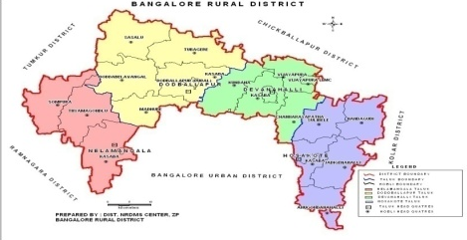
ICAR - Krishi Vigyan Kendra
Bengaluru Rural District
Action Plan
2021-22
Presentation by
Dr. A.P. Mallikarjuna Gowda
Senior Scientist & Head

Slide 2
Profile of Bengaluru Rural District
Agro-climatic zone | Eastern Dry Zone
No. of Taluks | 04
No. of Villages | 1,051
No. of Holdings | 1,60,483
Gross Cropped Area | 1,07,560 ha
Area under irrigation | 23,794 ha (22.86 %)
Sources of irrigation | Tanks, Wells, Tube wells, Lift irrigation
Major soil types | Medium deep to very deep, Red clayey soils, Lateritic clayey soils
Major crops in Kharif | Maize, Finger millet, Pigeonpea, Field bean, Cowpea, Vegetables (Tomato, Cucumber, Cabbage, Cauliflower, Pole bean, French bean, Ridge gourd, Capsicum), Ginger, Flowers (Marigold, Chrysanthemum)
Major crops in Rabi | Chickpea, Horse gram, Vegetables (Tomato, Potato, Cabbage)
Major perennial crops | Drumstick, Mango, Banana, Guava, Sapota, Jack, Arecanut, Fodder crops, Rose
Major Livestock | Cattle, Buffaloes, Sheep, Goats, Pigs, Poultry birds

Slide 3
Crop Details of Bengaluru Rural District
Crop | Area (ha) | Production (t) | Productivity (kg/ha)
Finger millet | 39817 | 63707 | 1600
Maize (Rainfed) | 7380 | 38376 | 5200
Maize (Irrigated) | 820 | 5330 | 6500
Redgram | 598 | 383 | 640
Horse gram | 477 | 30.05 | 63
Field bean (Rainfed) | 1250 | 6 | 438
Field bean (Irrigated) | 51 | 2.50 | 500
Cowpea (Rainfed) | 393 | 119.08 | 303
Cowpea (Irrigated) | 12 | 6 | 500
Bengal gram | 214 | 184 | 2115
Crop | Area (ha) | Production (t) | Productivity (t/ha)
Mango | 7701 | 78518 | 10.28
Grapes | 2427 | 48869 | 20.0
Banana | 1278 | 27771 | 21.73
Guava | 1008 | 19571 | 19.41
Sapota | 639 | 5678 | 8.88
Jack | 48.10 | 1532 | 31.86
Tomato | 1944 | 65150 | 33.52
Potato | 1353 | 18292 | 13.52
Beans | 572 | 10651 | 18.61
Cabbage | 411 | 11191 | 27.22
Cauliflower | 250 | 3630 | 14.51
Cucumber | 225 | 3496 | 15.54
Ginger | 192.34 | 2313 | 12.02
Chrysanthemum | 303.69 | 2753 | 9.07
Rose | 1216 | 4174.20 (Lakh) | 3.43 (Lakh)
Total vegetables | 7794.39 | 153273 | 19.66
Total fruit crops | 13517 | 193877 | 14.29
Source: Department of Agriculture, Bengaluru Rural District,
2019-20
Source: Department of Horticulture, Bengaluru Rural District,
2019-20

Slide 4
Livestock Details of Bengaluru Rural District
Animals/Birds | No. | Avg. Productivity
Cattle & buffaloes | 1,83,201 | 5 lt/animal/day
Sheep | 1,24,870 | -
Goats | 80,740 | -
Pigs | 6052 | -
Others | 30,223 | -
Total livestock | 4,25,086 | -
Poultry | 81,65,758 | -

Slide 5
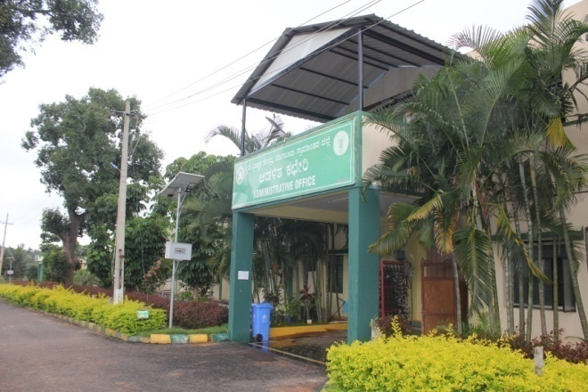
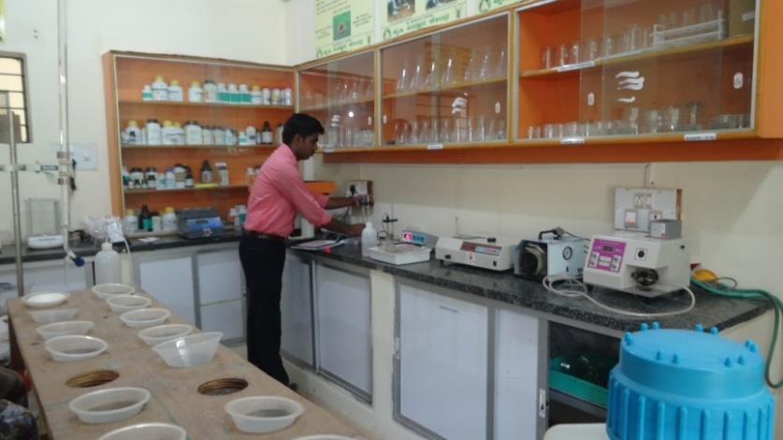
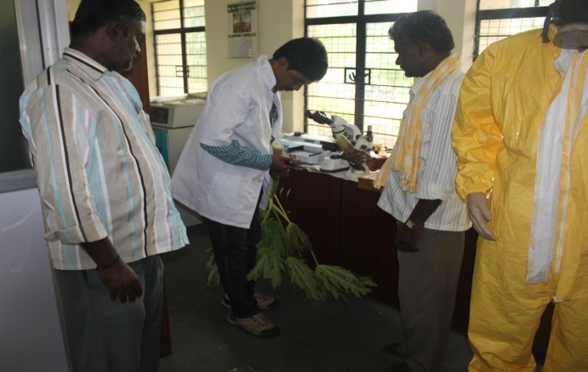
KVK Manpower and Facilities
Manpower Senior Scientist & Head No. of Scientists No. of Programme Assistants Administrative staff Supporting staff | 01 03 + 03 (Contr.) 03 02 (Contr.) 02 + 02 (Contr.)
Farm details Total Area (ha) Cultivated Area (ha) | 21.28 17.9
Production Units Vermicompost unit, Nursery unit, NADEP composting unit, VAT composting unit, Livestock unit, Azolla unit, Silage unit, Apiary, Ornamental fish unit etc. | 1308 m²
Laboratories Soil & Water Testing Laboratory Plant Health Clinic | 50 m² 30 m²
Office building
Soil & Water Testing Laboratory
Plant health clinic

Slide 6
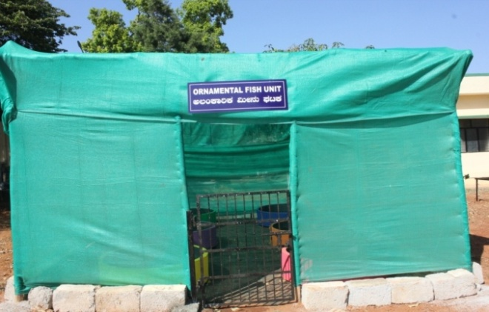
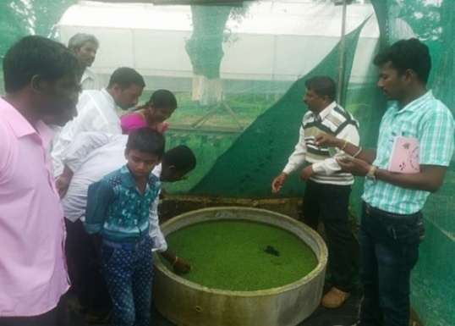
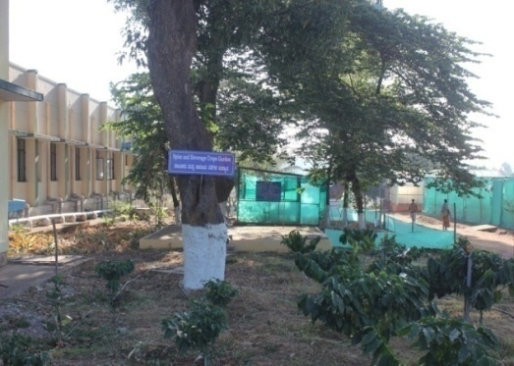
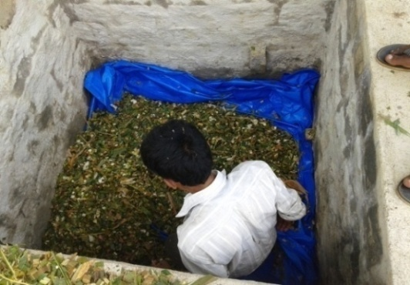
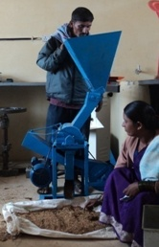
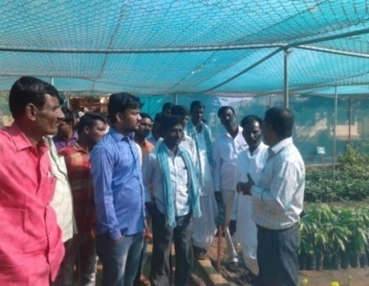
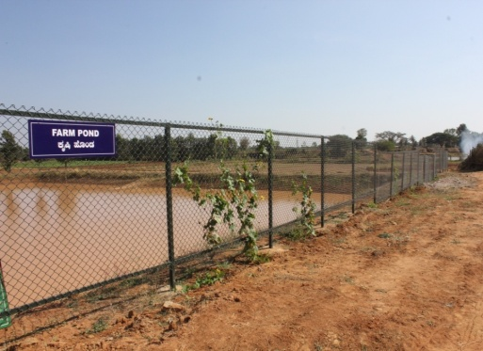
KVK Demonstration Units
Apiary unit
Azolla Unit (2 m²)
Ornamental fish unit
Silage Unit
Spice garden
Medicinal plants
Model Horticultural Nursery
Farm Pond
Millet Processing Unit

Slide 7
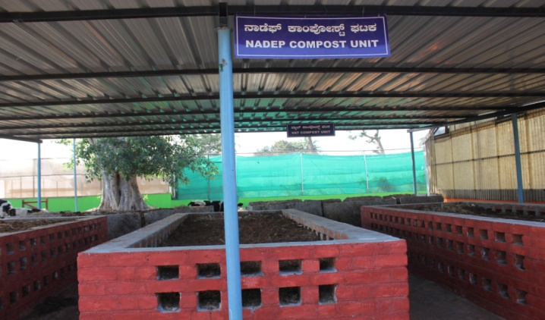
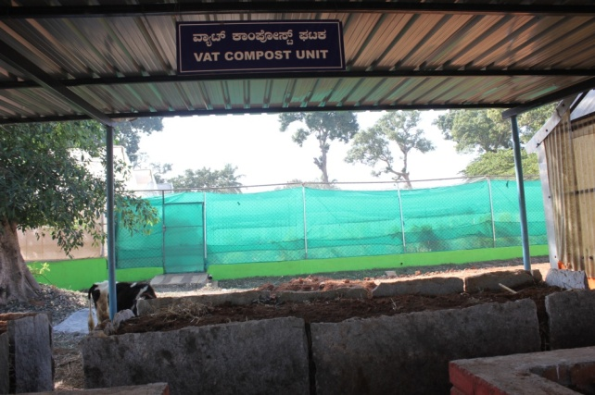
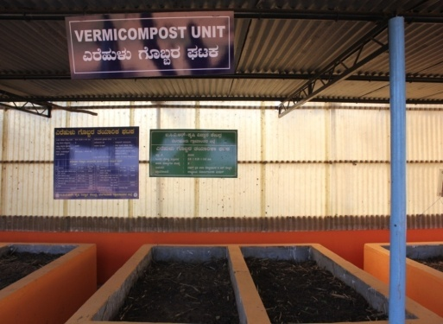
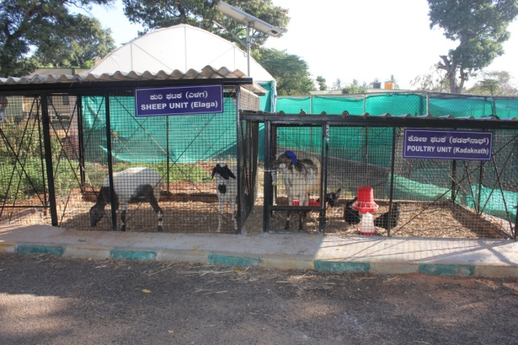
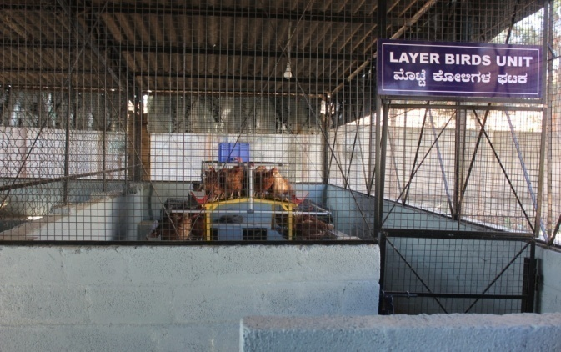
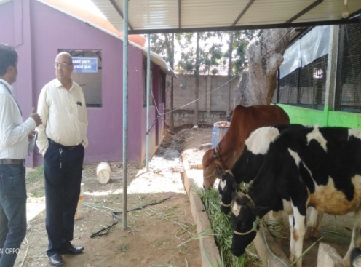
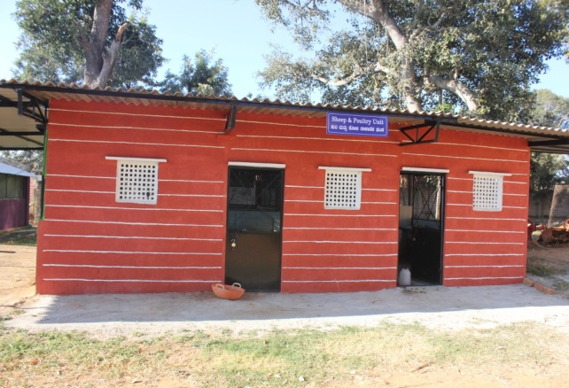
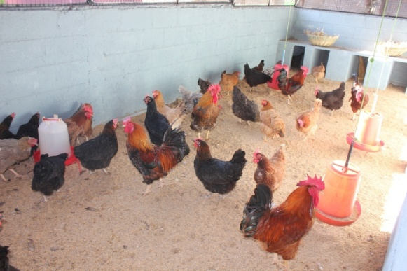
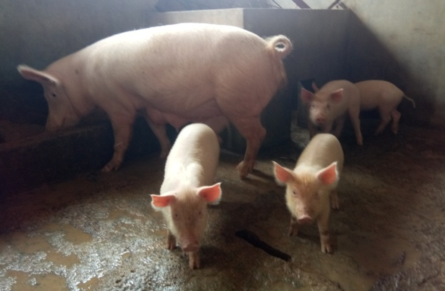
NADEP method composting unit
VAT method of composting unit
Vermi composting Unit
Dairy Unit
Goat and poultry unit
Layer birds unit
Sheep and poultry unit
Local poultry birds unit
Piggery unit

Slide 8
Cross-learning across KVKs
Name of the KVK proposed | Specific learning areas
a) KVK, Mysuru b) KVK, Pathanamthitta, Kerala | To know the innovative technologies developed, adopted and cropping pattern followed To know the different technologies adopted and popularised Exposure visits, scientist & farmers interaction
Cluster KVK’s
Name of the KVK included in the cluster | Knowledge/expertise | Resources (facilities and products) | Activities
KVK, Tumakuru-II | Improved Agriculture & Horticulture practices, Market Linkage & value addition technology through Commodity based associations | Quality seeds and planting materials. Nutrient mixture | Interaction with scientists & progressive farmers and visit to progressive farmers fields
KVK, Chikkaballapura | Improved sericulture practices, Quality cashew and other Planting Materials | Planting materials, sericulture based products | Scientists & farmers interaction and visit to cocoon market and reeling factory
KVK, Ramanagara | Integrated crop management in mango and mulberry, post harvesting technology in mango | Different demo units in KVK, Improved practices in mango and sericulture | Scientists & farmers interaction and Exposure visit to mango orchards

Slide 9
Proceedings of SAC meeting held on 29.01.2021
Sl. No. | Particulars
1 | Adopt one FPO to strengthen the functioning of FPO
2 | Propose OFT on the management of sucking pests in mulberry
3 | Propose FLD on Velvet beans
4 | Use neem seed pellet for the management of DBM in cabbage
5 | Impact studies for DAESI training
6 | Demonstration of Double cropping (Cow pea + Ragi) system in KVK instructional farm
7 | Link more number of farmers to m-kissan portal with the database available in the Department of Food and Civil Supplies
8 | Demonstration of Seed cum fertilizer drill in Ragi at KVK instructional farm
9 | Propagation and popularization of Nari Nirbeeja fodder crop in collaboration with Dept. of Animal Husbandry and Veterinary Services and distribute to the farmers
10 | Bore well recharge for two bore wells of KVK farm
11 | Training on organic based agriculture
12 | Demonstrations on seedling dip and seed treatment with Trichograma
13 | Register the farmers varieties under Protection of Plant Varieties and Farmers Rights Act - 2001
14 | Demonstration of vegetable cultivation under pendol system in KVK instructional farm

Slide 10
Abstract of OFTs
Sl. No. | OFT | Cluster | No. of Farmers
1. | Assessment of suitable redgram varieties for vegetable purpose | Nelamangala | 3
2. | Assessment of Nano fertilizers (N & Zn) on Growth and Yield of Maize | Hosakote | 5
3. | Assessment of nutrient management in marigold | Devanahalli | 5
4. | Assessment on management of mites and thrips in mulberry | Hosakote | 5

Slide 11
Abstract of FLDs
Sl. No. | FLD | Cluster | No. of Farmers
1. | Addressing drought and blast vulnerability through fingermillet under double cropping system | Doddaballapura | 10
2. | Integrated crop management in Redgram | Doddaballapur | 05
3. | Demonstration of multicut fodder sorghum COFS-31 for green fodder and silage | Nelamangala | 10
4. | Integrated Nutrient Management in Pole bean | Hosakote | 05
5. | Potassium Management in maize through Bio -K | Nelamangala | 05
6. | Integrated management of Fall armyworm in Maize | Doddaballapura | 05
7. | Eco friendly Management of Diamond backmoth in cabbage | Nelamangala | 03

Slide 12
Sl. No. | FLD | Cluster | No. of Farmers
8. | Integrated Pest and disease Management in Tomato | Devanahalli | 05
9. | Probiotics for optimum post-weaning growth in lambs | Hosakote | 05
10. | Demonstration of Swarnadhara chicks in backyard poultry | Doddaballapura | 40
11. | Ration Balancing through Integrated Approach in Dairy Animals | Hosakote | 10
12. | Demonstration of NARI Nirbeeja grafts of Subabul as nutritious fodder | Doddaballapura | 20
13. | Demonstration of grain amaranthus and its value addition | Doddaballapura | 5

Slide 13
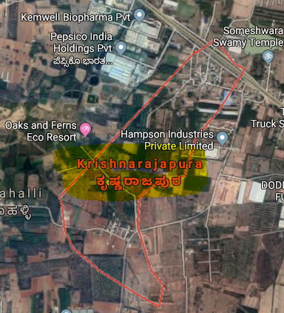
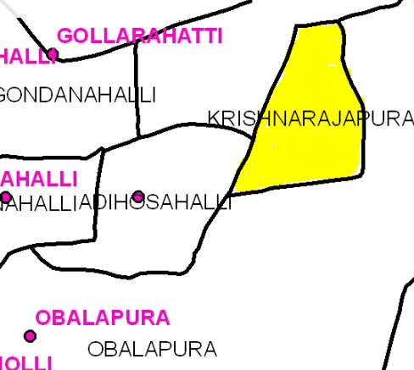
Nelamangala Cluster
Cluster villages -
Krishnarajapura, Adihosalli, Obalapura
Nelamangala Taluk
Cluster villages
Satellite image of Krishnarajapura village

Slide 14
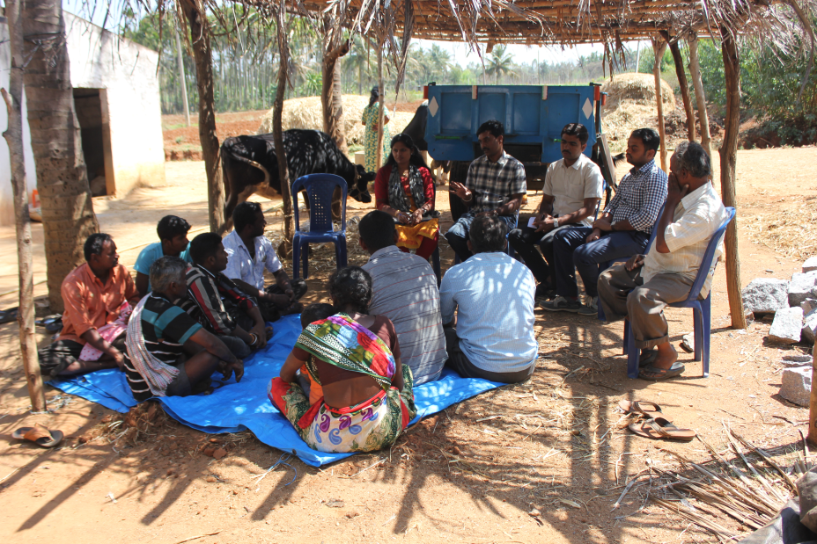
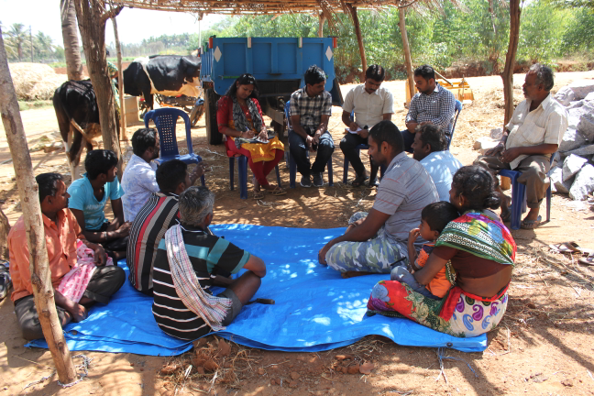
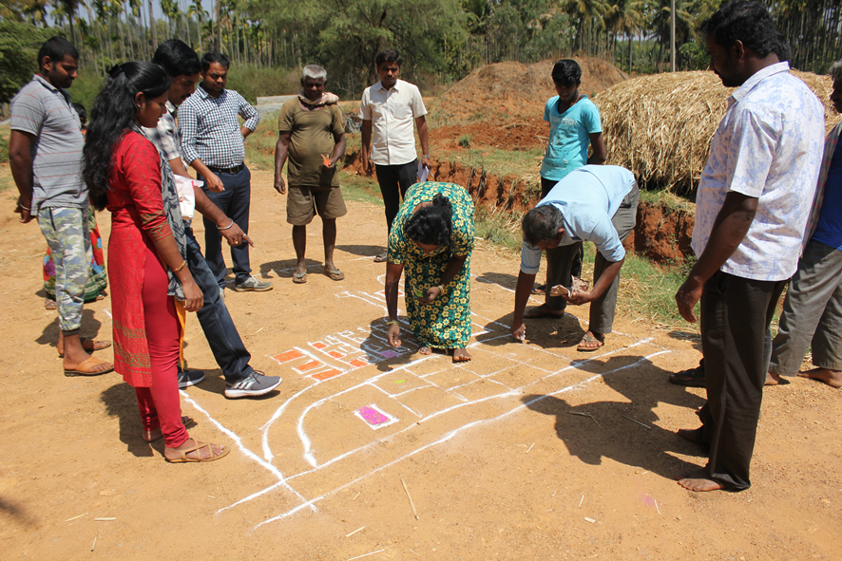
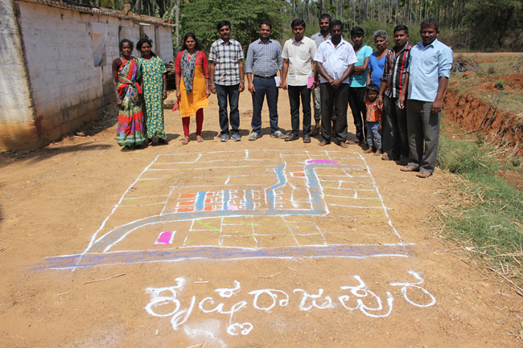
Participatory Rural Appraisal (PRA) - Nelamangala Cluster
Explaining PRA Objectives
Briefing of Village Agriculture Situations
Drawing of Resource Map
Village Resource Map

Slide 15
Problems identified in Nelamangala Cluster
Problems
1 | Maize - No application of K & micro nutrients, Fall army worm, Stem borer, downy mildew and Turcicum leaf blight
2 | Finger millet - Intermittent drought and blast
3 | Red gram - Low yield due to imbalanced nutrition, wilt, sterility mosaic disease and pod borer
4 | Tomato - Indiscriminate use of fertilizers due to lack of knowledge on recommended schedules, ToLCV, Bacterial wilt, early blight, late blight, Blossom end rot, leaf miner, thrips and fruit borer
5 | Cabbage – Imbalanced nutrition, DBM and black rot
6 | Fodder - Non availability of green fodder through out the year
7 | Pole Beans – Imbalanced nutrition, severe incidence of yellow mosaic virus, rust, leaf miner, anthracnose and pod borer
8 | Arecanut - Imbalanced nutrition , no intercropping system and falling of nuts
9 | Dairy animals – Non availability of green fodder through out the year, low milk production, decreased reproductive efficiency after calving, inefficient reproductive management practices, delayed onset of oestrus
10 | Nutrition garden - Nutrition insecurity and lack of knowledge on importance of nutrition garden

Slide 16
Gap Identification and Technology Prioritization – Nelamangala Cluster
Crop | Average Yield | Potential Yield | Technological gap | Extension Gap | Technological Intervention
Redgram | 27 q/ha | 45 q/ha | Lower market price during peak season Low yield due to terminal end drought | Lack of awareness about early duration varieties/technologies | OFT-Assessment of suitable redgram varieties for vegetable purpose
Fodder sorghum | - | - | Non availability of high yielding multicut fodder varieties with more palatability | Unaware about the availability of suitable multicut fodder varieties | FLD - Demonstration of multicut fodder sorghum COFS-31 for green fodder and silage
Maize | 52 q/ha | 70 q/ha | No/Low K application Micronutrients application is not followed Pest and disease due to potash imbalance | Lack of awareness on Bio-K | FLD - Potassium Management in maize through Bio –K
Cabbage | 36 t/ha | 48 t/ha | Severe DBM infestation (>42%) | Imbalanced nutrition, DBM and black rot | FLD-Eco friendly Management of Diamond backmoth in cabbage

Slide 17
Activities in Nelamangala cluster Cluster villages - Krishnarajapura, Adihosalli, Obalapura
DFI Strategy | Activity
Crop Productivity | OFT-Assessment of suitable redgram varieties for vegetable purpose
 | FLD - Demonstration of multicut fodder sorghum COFS-31 for green fodder and silage
 | FLD - Potassium Management in maize through Bio –K
 | FLD - Eco friendly Management of Diamond backmoth in cabbage

Slide 18
Activities in Nelamangala cluster Cluster villages - Krishnarajapura, Adihosalli, Obalapura
DFI Strategy | Activity
Reduction in cost of cultivation | FLD - Potassium Management in maize through Bio –K
 | FLD-Eco friendly Management of Diamond backmoth in cabbage
Crop Diversity | FLD - Demonstration of multicut fodder sorghum COFS-31 for green fodder and silage
Value addition and Market linkage | OFT-Assessment of suitable redgram varieties for vegetable purpose

Slide 19
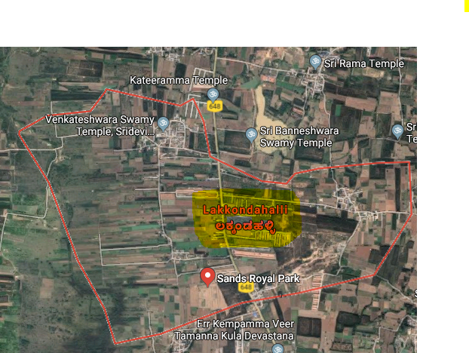
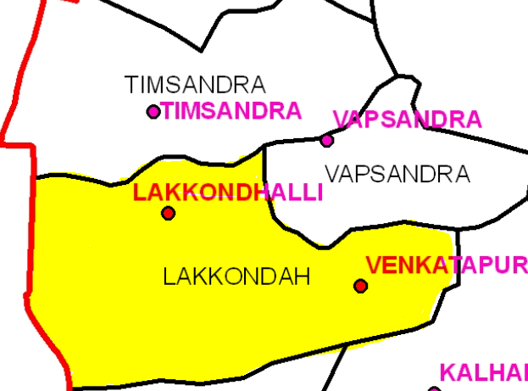
Details of Hosakote Cluster
Cluster villages – Lakkondahalli, Vapasandra,
Thimmasandra
Hosakote Taluk
Satellite image of Lakkondahalli village
Cluster villages

Slide 20
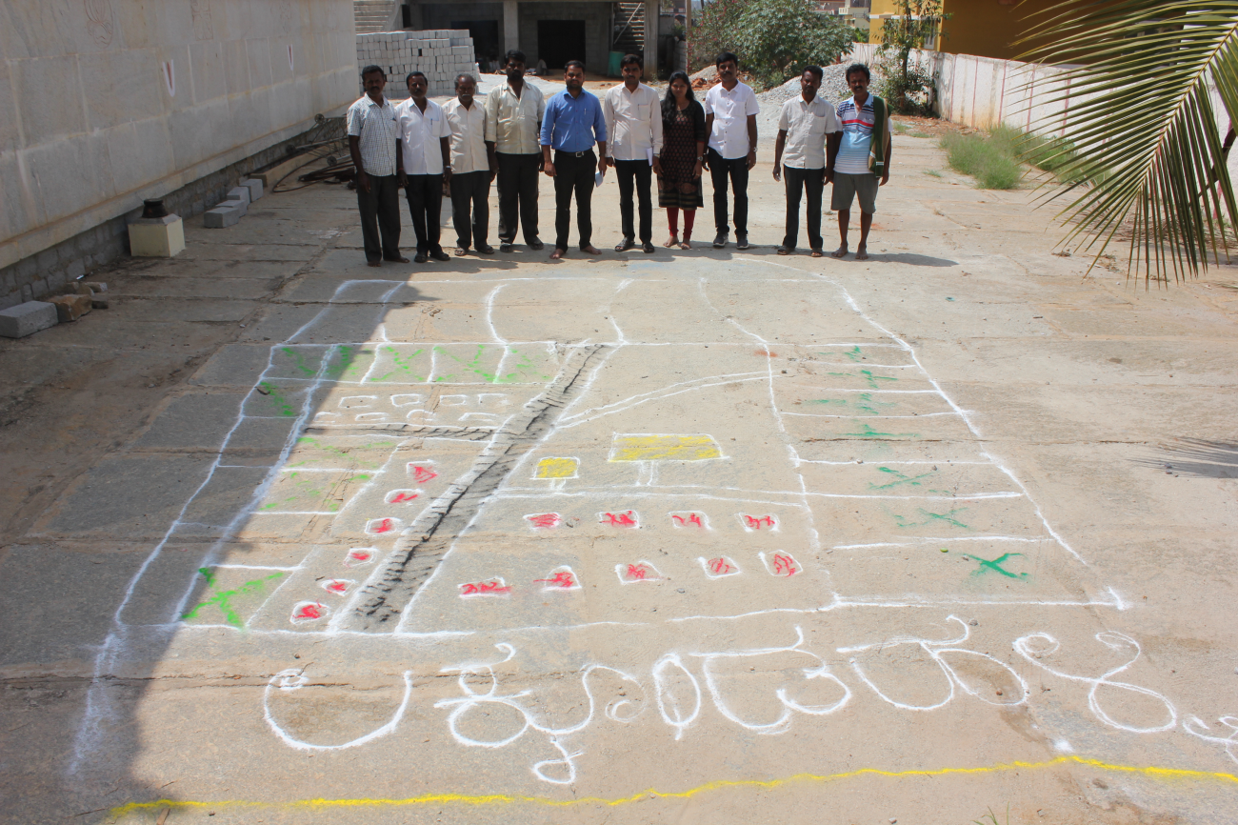
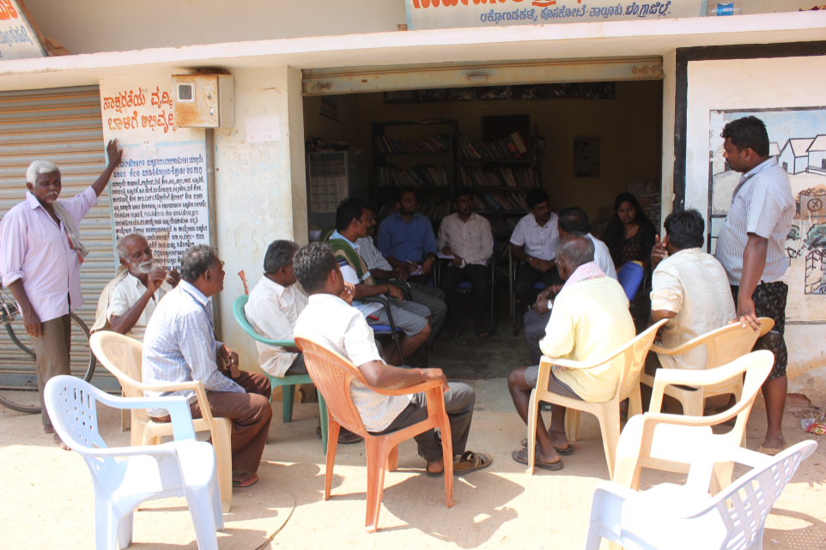
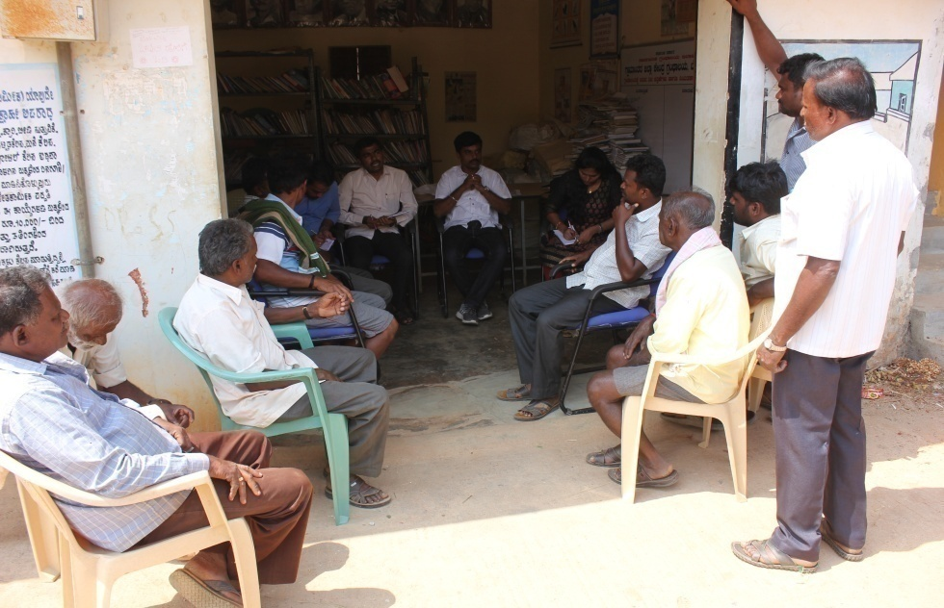
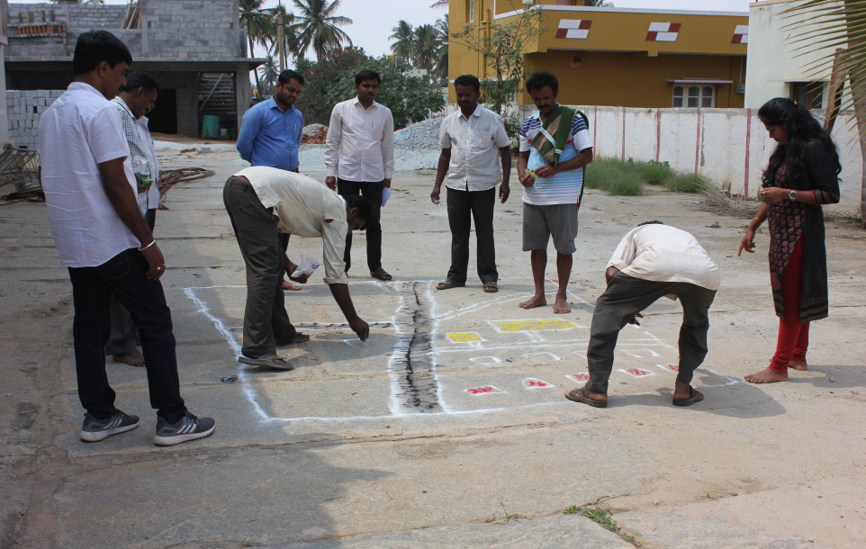
Participatory Rural Appraisal (PRA) - Hosakote Cluster
Explaining PRA Objectives
Briefing of Village Agriculture Situations
Drawing of Resource Map
Village Resource Map

Slide 21
Problems identified in Hosakote Cluster
Problems
1 | Maize- No application of K & micro nutrients, Fall army worm, Stem borer, Downy mildew and turcicum leaf blight
2 | Finger millet - Intermittent drought and blast
3 | Red gram - Low yield due to imbalanced nutrition, wilt, sterility mosaic disease, Phyllody and pod borer
4 | Bengal Gram – Low yield due to imbalanced nutrition, wilt, pod borer
5 | Fodder - Non availability of green fodder through out the year
6 | Tomato - Indiscriminate use of water soluble fertilizers due to lack of recommended schedules, ToLCV, Bacterial wilt, early blight, late blight, Blossom end rot, leaf miner, thrips and fruit borer
7 | Potato - Imbalanced fertilizers application, low yield and soft rot during storage
8 | Mulberry - Thrips, mites, leaf roller, Powdery mildew
9 | Nutrition garden - Nutrition insecurity and lack of knowledge on importance of nutrition garden
10 | Dairy animals – Non availability of green fodder through out the year, low milk production, decreased reproductive efficiency after calving, inefficient reproductive management practices, delayed onset of oestrus
11 | Sheep rearing – Improper feeding practices, increased managemental diseases

Slide 22
Gap Identification and Technology Prioritization – Hosakote Cluster
Crop | Average Yield | Potential Yield | Technological gap | Extension Gap | Technological Intervention
Maize | 52 q/ha | 70 q/ha | High cost of cultivation, High dose of fertilizer application, Low fertilizer use efficiency, Lack of knowledge on nano fertilizers | No application of K & micro nutrients, Fall army worm, Stem borer, Downy mildew and turcicum leaf blight | OFT – Assessment of Nano fertilizers (N & Zn) on Growth and Yield of Maize
Mulberry | - | - | Mites & thrips incidence (37%) | Incidence of Thrips, mites, leaf roller, Powdery mildew | OFT-Assessment on management of mites and thrips in mulberry
Pole bean | 25 t/ha | 35 t/ha | No K application, Micronutrients application is not followed | Lack of awareness about nutrient management practices | FLD - Integrated Nutrient Management in Pole bean

Slide 23
Gap Identification and Technology Prioritization –Hosakote Cluster
Crop | Average Yield | Potential Yield | Technological gap | Extension Gap | Technological Intervention
Sheep | - | - | Imbalance in rumen microflora leading to decreased growth rate | Limited resources on utility of probiotics in small ruminants | FLD-Probiotics for optimum post-weaning growth in lambs
Dairy animals | 8.70 lt | 10.5 lt | Lower milk yield, Lower milk quality (fat %, SNF) and Incidence of Ruminal acidosis | Lack of awareness about integrated nutrient management practices | FLD - Ration Balancing through Integrated Approach in Dairy Animals
Nutrition security | - | - | Non-availability of the vegetables across the season Nutritional insecurity Lack of knowledge on importance of nutrition garden | Nutrition insecurity and lack of knowledge on importance of nutrition garden | Nutri garden for farm families

Slide 24
Activities in Hosakote cluster Cluster villages-Lakkondahalli,Vapasandra,Thimmasandra
DFI Strategy | Activity
Crop Productivity | OFT – Assessment of Nano fertilizers (N & Zn) on Growth and Yield of Maize
 | OFT-Assessment on management of mites and thrips in mulberry
 | FLD - Integrated Nutrient Management in Pole bean
 | FLD-Probiotics for optimum post-weaning growth in lambs with
 | FLD - Ration Balancing through Integrated Approach in Dairy Animals
Reduction in cost of cultivation | OFT-Assessment on management of mites and thrips in mulberry
 | FLD - Integrated Nutrient Management in Pole bean
Value addition and Market linkage | Nutri garden for farm families

Slide 25
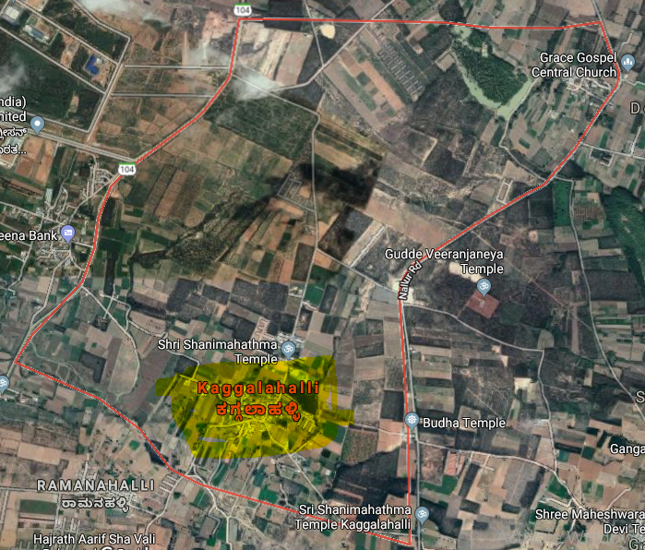
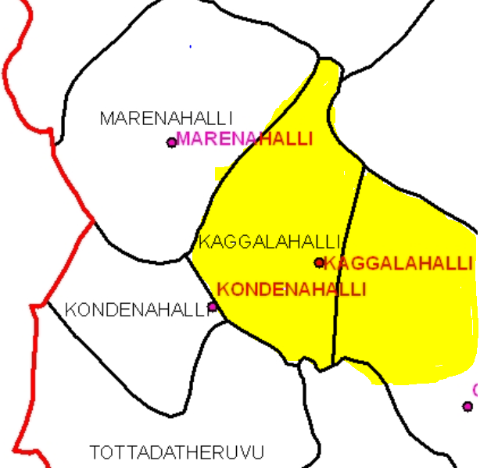
Devanahalli Cluster
Cluster villages – Kaggalahali, Marenahalli, Kondenahalli
Devanahalli Taluk
Satellite image of Kaggalahalli village
Cluster villages

Slide 26
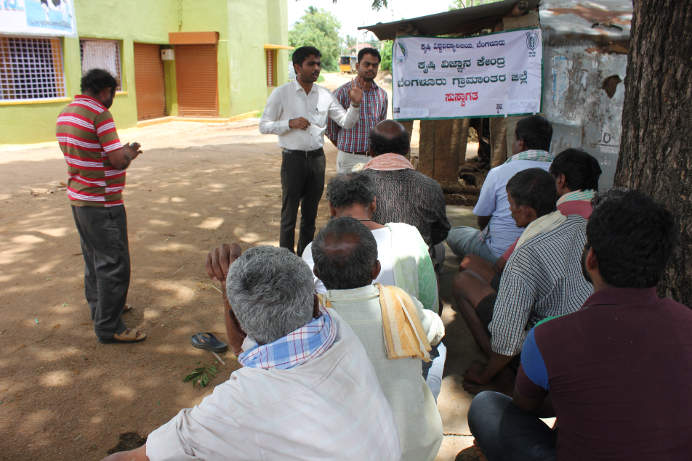
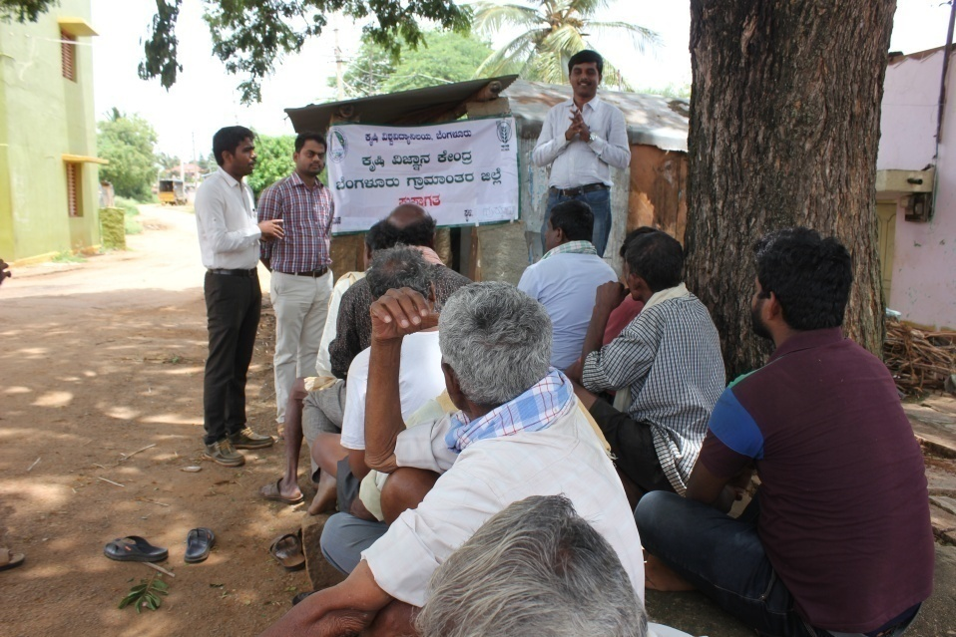
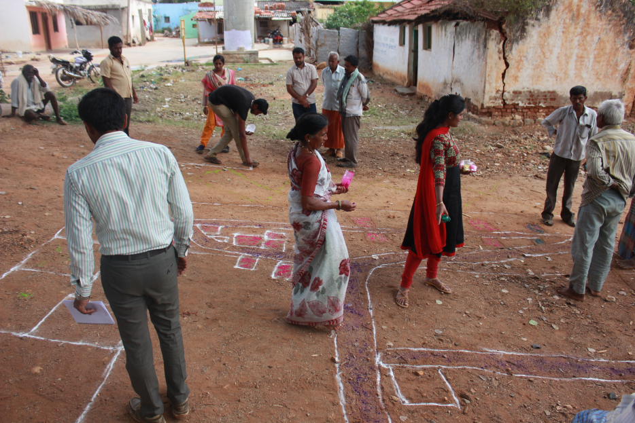
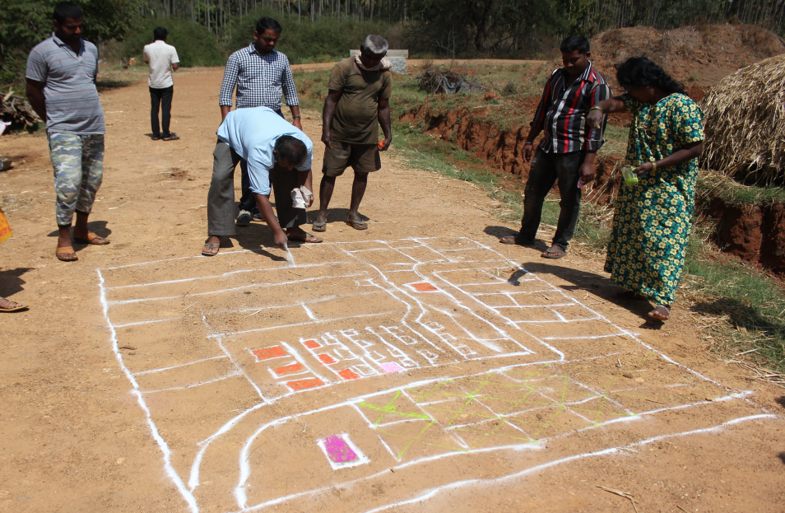
Participatory Rural Appraisal (PRA) - Devanahalli Cluster
Explaining PRA Objectives
Briefing of Village Agriculture Situations
Drawing of Resource Map
Village Resource Map

Slide 27
Problems identified in Devanahalli Cluster
Problems
1 | Finger millet - Intermittent drought and blast
2 | Red gram - Low yield due to imbalanced nutrition, wilt, sterility mosaic disease, Phyllody and pod borer
3 | Fodder - Non availability of green fodder through out the year
4 | Tomato - Indiscriminate use of fertilizers due to lack of knowledge on recommended schedules, ToLCV, Bacterial wilt, early blight, late blight, Blossom end rot, leaf miner, thrips and fruit borer
5 | Ridge gourd- Imbalanced fertilizers application, Severe incidence of mosaic virus
6 | Cauliflower - Imbalanced nutrition, severe incidence of Diamond backmoth
7 | Nutrition garden - Nutrition insecurity and lack of knowledge on importance of nutrition garden
8 | Dairy animals – Non availability of green fodder through out the year, low milk production, decreased reproductive efficiency after calving, inefficient reproductive management practices, delayed onset of oestrus
9 | Poultry birds - Lack of awareness on improved backyard poultry and about meat, egg and health issues, Lower productivity and income
10 | Mari gold – Imbalanced fertilizer application, micro nutrients deficiency and low yield

Slide 28
Gap Identification and Technology Prioritization – Devanahalli Cluster
Crop | Average Yield | Potential Yield | Technological gap | Extension Gap | Technological Intervention
Marigold | 8.15 t/ha | 10t/ha | Imbalanced fertilizer application Micronutrients application is not followed | Imbalanced fertilizer application, micro nutrients deficiency and low yield | OFT – Assessment of nutrient management in marigold
Tomato | 64 t/ha | 75 t/ha | Early blight, Late blight, ToLCV, Tospo &bacterial wilt disease incidence (34%) Leaf miner &Fruit borer incidence (29%) Indiscriminate use of PP chemicals | Indiscriminate use of water soluble fertilizers due to lack of recommended schedules, ToLCV, Bacterial wilt, early blight, late blight, Blossom end rot, leaf miner, thrips and fruit borer | FLD - Integrated Pest and disease Management in Tomato

Slide 29
Gap Identification and Technology Prioritization – Devanahalli Cluster
Crop | Average Yield | Potential Yield | Technological gap | Extension Gap | Technological Intervention
Nutrition security | - | - | Non-availability of the vegetables across the season Nutritional insecurity Lack of knowledge on importance of nutrition garden | Nutrition insecurity and lack of knowledge on importance of nutrition garden | Nutri garden for farm families

Slide 30
Activities in Devanahalli cluster Cluster villages - Kaggalahali, Marenahalli, Kondenahalli
DFI Strategy | Activity
Crop Productivity | OFT – Assessment of nutrient management in Marigold
 | FLD - Integrated Pest and disease Management in Tomato
Reduction in cost | FLD - Integrated Pest and disease Management in Tomato
Value addition and Market linkage | Nutri garden for farm families

Slide 31
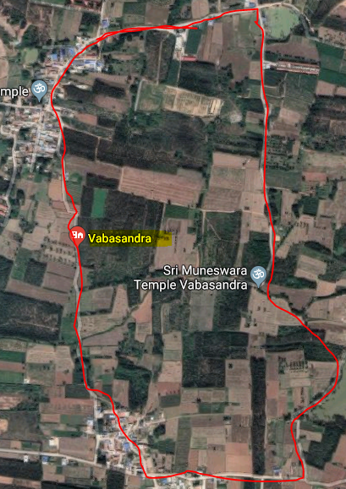
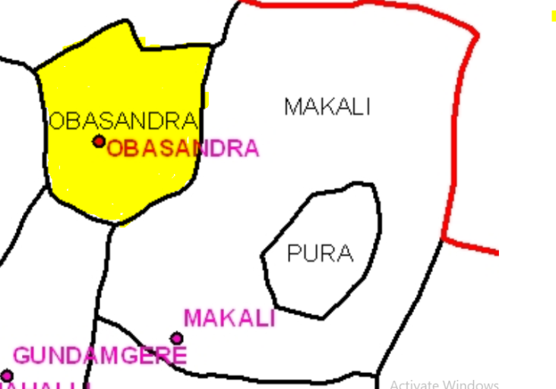
Doddaballapura Cluster
Cluster villages – Vabasandra, Gundamagere and Makali
Doddaballapura Taluk
Vabasandra
Satellite image of Vabasandra village
Cluster villages

Slide 32
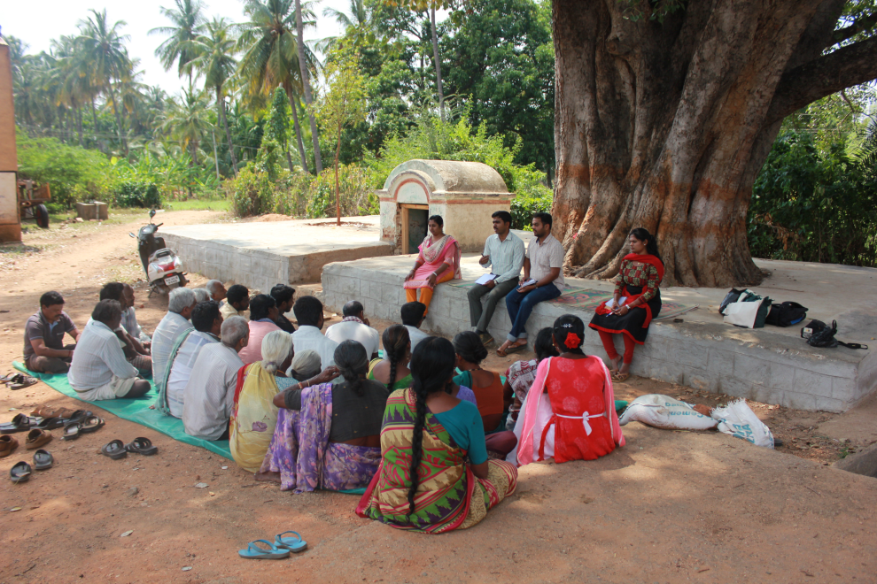
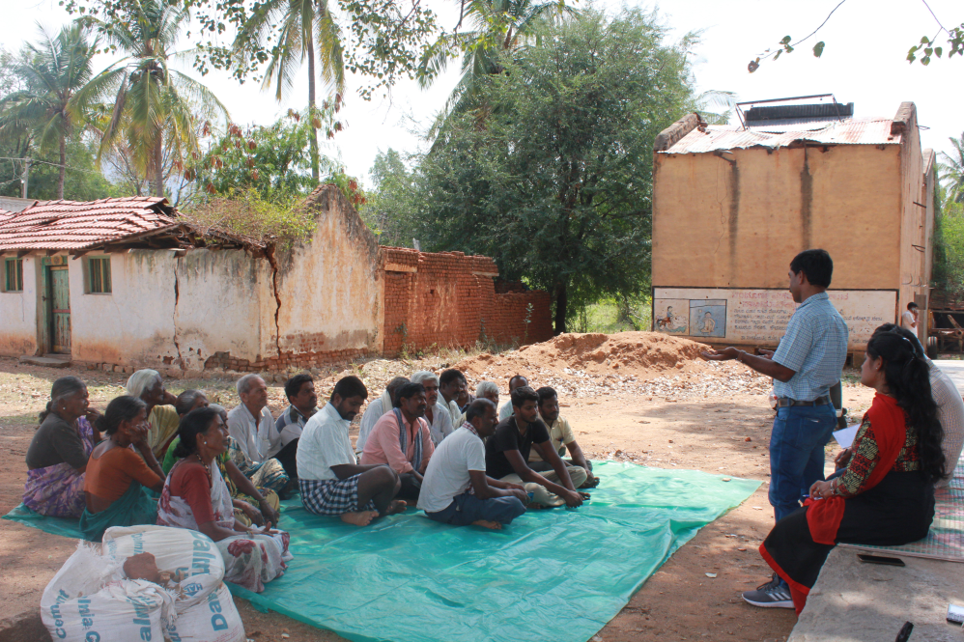
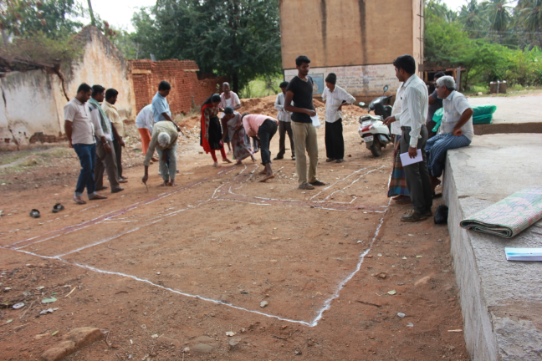
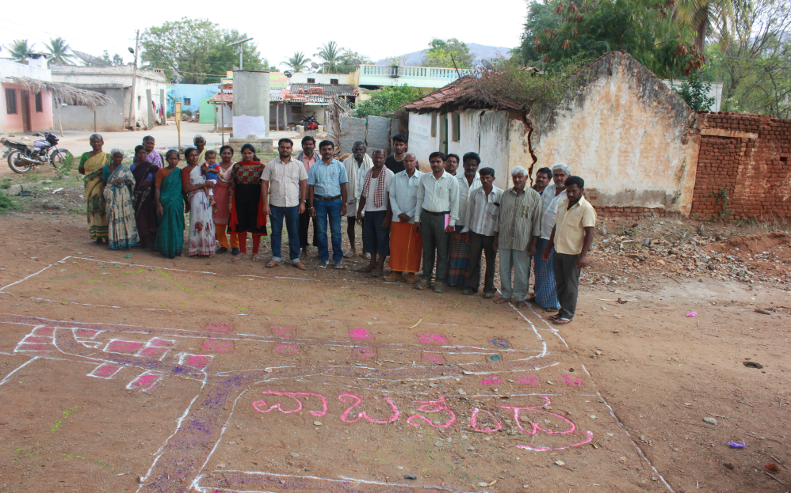
Participatory Rural Appraisal (PRA) - Doddaballapura Cluster
Explaining PRA Objectives
Briefing of Village Agriculture Situations
Drawing of Resource Map
Village Resource Map

Slide 33
Problems identified in Doddaballapura Cluster
Problems
1 | Maize - No application of K & micro nutrients, Fall army worm, Stem borer, Downy mildew and turcicum leaf blight
2 | Finger millet - Intermittent drought and blast
3 | Red gram - Low yield due to imbalanced nutrition, wilt, sterility mosaic disease, Phyllody and pod borer
4 | Popcorn – lack of awareness about its economic benefits
5 | Fodder - Non availability of high yielding multicut fodder variety having more palatability
6 | Brinjal - Imbalanced nutrition, Shoot and fruit borer (31%) infestation, bacterial wilt, root rot, PM, poor quality fruit
7 | Banana - Imbalanced fertilizers application, No intercropping
8 | Dairy animals – Non availability of green fodder through out the year, low milk production, decreased reproductive efficiency after calving, inefficient disease management practices, delayed onset of oestrus
9 | Castor - lack of knowledge about improved production technologies
10 | Poultry – Limited knowledge on new variety of backyard poultry

Slide 34
Gap Identification and Technology Prioritization – Doddaballapura Cluster
Crop | Average Yield | Potential Yield | Technological gap | Extension Gap | Technological Intervention
Finger millet | Finger millet 16 q/ha Cow pea 3.3 q/ha | Finger millet 25 q/ha Cow pea 5.0 q/ha | Non utilization of pre monsoon rainfall Blast and drought susceptibility in ragi | Lack of awareness about double cropping system and blast resistant var. ML. 365 | FLD - Addressing drought and blast vulnerability through fingermillet under double cropping system
Redgram | 6.4 q/ha | 12.5 q/ha | Wilt incidence Sterility mosaic disease, Imbalanced Nutrition | Lack of knowledge about wilt resistant var. BRG-3 | FLD- Integrated crop management in Redgram
Maize | 52 q/ha | 70 q/ha | No application of K & micro nutrients Fall army worm, Stem borer, Downy mildew and turcicum leaf blight | Lack of awareness about integrated nutrient, pest and disease management practices | FLD-Integrated management of Fall armyworm in Maize

Slide 35
Gap Identification and Technology Prioritization – Doddaballapura Cluster
Crop | Average Yield | Potential Yield | Technological gap | Extension Gap | Technological Intervention
Poultry | - | - | Lower growth rate in country chicken | Lack of knowledge and non availability of improved variety of chicks | FLD- Demonstration of Swarnadhara chicks in backyard poultry
Fodder | - | - | Susceptible to psyllids Low palatability | Seed shattering leads to weed menace | FLD-Demonstration of NARI Nirbeeja grafts of Subabul as nutritious fodder
Value addition | - | - | Under nourishment of protein and fibre in rural children and farm women’s | Lack of awareness in value addition of grain amaranthus | FLD-Demonstration of grain amaranthus and its value addition

Slide 36
Activities in Doddaballapura cluster Cluster villages-– Vabasandra, Gundamagere & Makali
DFI Strategy | Activity
Crop Productivity | FLD - Addressing drought and blast vulnerability through fingermillet under double cropping system
 | FLD – Integrated crop management in Redgram
 | FLD-Integrated management of Fall armyworm in Maize
 | FLD- Demonstration of Swarnadhara chicks in backyard poultry
 | FLD- Demonstration of NARI Nirbeeja grafts of Subabul as nutritious fodder
 | FLD- Demonstration of grain amaranthus and its value addition

Slide 37
Activities in Doddaballapura cluster Cluster villages– Vabasandra, Gundamagere & Makali
DFI Strategy | Activity
Reduction in cost of cultivation | FLD-Integrated management of Fall armyworm in Maize
Crop Diversity | FLD - Addressing drought and blast vulnerability through fingermillet under double cropping system
 | FLD- Demonstration of Swarnadhara chicks in backyard poultry
 | FLD- Demonstration of NARI Nirbeeja grafts of Subabul as nutritious fodder
 | FLD- Demonstration of grain amaranthus and its value addition
Value addition and Market linkage | FLD - Demonstration of grain amaranthus and its value addition

Slide 38
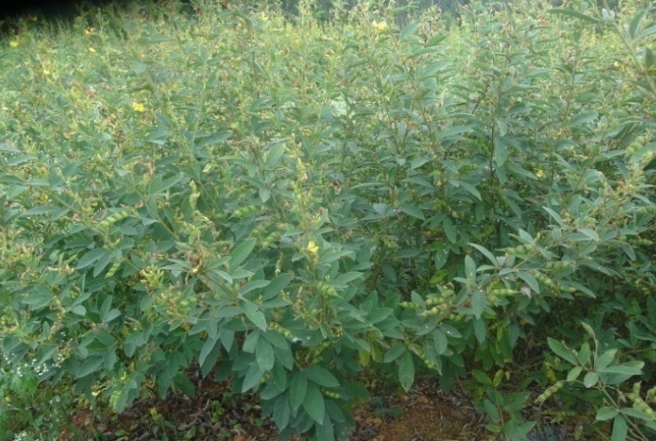
OFT 1. Assessment of suitable redgram varieties for vegetable purpose
2nd year
Rationale
Lower market price during peak season
Low yield due to terminal end drought
Dist. Area | Dist. Avg. Yield | Potential Yield
598 ha | 27 q/ha | 45 q/ha
 | Technological Options
TO1 | BRG-1 variety (180-190 days) - FP
TO2 | Transplanted BRG-1 variety (150-160 days) -UAS (B)
TO3 | Transplanted BRG-3 variety (130-140 days) – UAS (B)
TO4 | Ujwala variety (130-140 days) – PJTSAU, Telangana
Early duration Ujwala variety

Slide 39
Critical Inputs
Implementation
Critical inputs (per demo) | Qty./trial | Cost /trial (Rs.)
Seeds | 8 Kg | 800
Rhizobium | 1 kg | 100
Pulse Magic | 2 kg | 600
Pheramone Traps+lures | 10+10 | 1000
Bt | 2 ltr | 1800
Spinosad (Microbial) | 75 ml | 2000
Total |  | 6300
Cost for 3 trials |  | 18900
Board and field day |  | 6000
Total |  | 24900
Trials : 03 (1.2 ha)
Total Cost : Rs. 24900 (B+FD)
Vill. : Krishnarajapura
Taluk : Nelamangala
Scientists: Agron, SS and PP
Parameters
Plant height (cm)
Number of branches/plant
Number of pod/ plant
Green pods Yield (q/ha)
B:C ratio

Slide 40
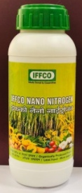
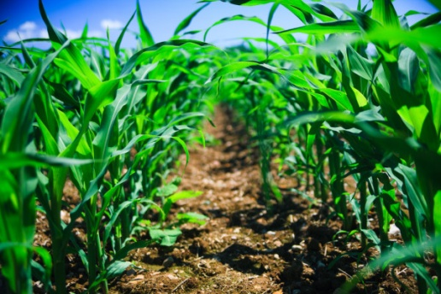
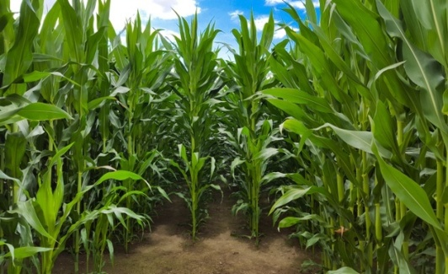
OFT 2. - Assessment of Nano fertilizers (N & Zn) on Growth and Yield of Maize
Rationale
New
Dist. Area | Dist. Avg. Yield | Potential Yield
8200 ha | 52 q/ha | 70 q/ha
High cost of cultivation,
High dose of fertilizer application,
Low fertilizer use efficiency,
Lack of knowledge on nano fertilizers
 | Technological Options
TO1 | Application of NP fertilizers as basal dose & top dressing with N fertilizer, no or low K fertilizer use FP
TO2 | RDF: 10 t/ha FYM, 100:50:25 NPK & 10 kg Zn/ha, 50% N & K, full P as basal, 25% N at 30 DAS, 25 & 50 % N at tasseling stage UAS(B)
TO3 | RDF: 12.5 t/ha FYM, 60:30:30 NPK kg/ha, 50% N, full P&K as basal, 50 % N at tasseling stage TNAU, Coimbatore
TO4 | RDF: 10 t/ha FYM, 50:50:25 NPK kg/ha, Application of 50 % N & full P, K as basal, N & Zn Nano fertilizer spray at 30 DAS (4 ml/l) & 20 days after first spray IFFCO-NBRC, Gujarath

Slide 41
Critical Inputs
Implementation
Critical Input | Qty./trial | Cost/ trial (Rs.)
N based nano fertilizer | 1 ltr | 500
Zn based nano fertilizer | 1 ltr | 500
ZnSO₄ | 2 kg | 150
Soil analysis | 2 | 600
Total |  | 1750
Cost for 5 trials |  | 8750
Board and Field day |  | 6000
Total |  | 14750
Trials : 05 (1 ha)
Total Cost : Rs. 14,750 (B+FD)
Vill. : Lakkondahalli, Hosakote Tq
Scientists : SS, Agr & Hort (Sr.S&H)
Parameters
Soil fertility status
Plant height (cm)
Cob weight (g)
Yield (q/ha)
B:C ratio
Distribution of Soil Health Cards

Slide 42
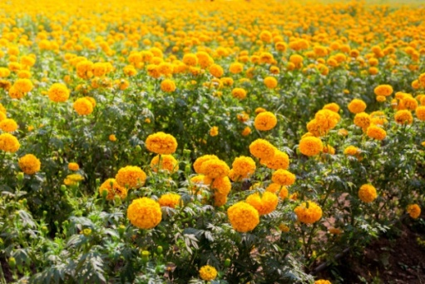
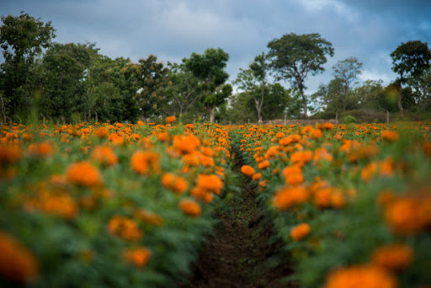
OFT 3. Assessment of nutrient management in marigold
New
Rationale
Dist. Area | Dist. Avg. Yield | Potential Yield
186.30 ha | 8.5 t/ha | 10 t/ha
Imbalanced fertilizer application
Micronutrients application is not followed
 | Technological Options
TO1 | 6 – 8 tons FYM/ha, Application of NP fertilizers as basal dose (DAP/Complex) & top dressing with N fertilizer and 19:19:19 (6 – 8 bags) - FP
TO2 | RDF: 20 t/ha FYM, 125:60:60 NPK kg/ha, 20% N & full PK as basal, & 80 % N at 30-45 DAP - UAS(B)
TO3 | RDF: 50 t/ha FYM, 90:90:75 NPK kg/ha, 50% N & full dose PK as basal, 50 % N top dressing @ 45 DAP. TNAU, Coimbatore
TO4 | RDF: 50 t/ha FYM, 90:90:75 NPK kg/ha, 50% NPK as basal, 50 % NPK through fertigation. 1.25 g MgSO₄, 1 g ZnSO₄ & 0.25 g borax for 1 litre foliar sprays (First spray at bud initiation and 2nd spray at opening of flower - IIHR, Bengaluru

Slide 43
Critical Inputs
Implementation
Critical Input | Qty./trial | Cost/ trial (Rs.)
Fertilizers | - | FC
MgSO₄ | 1 kg | 150
Borax | 1 kg | 100
ZnSO₄ | 1 kg | 75
Soil analysis | 2 | 600
Total |  | 925
Cost for 5 trials |  | 4,625
Board and Field day |  | 6000
Total |  | 10625
Trials : 05 (1 ha)
Total Cost : Rs. 10,625 (B+FD)
Vill. : Kaggalahalli, Devanahalli Tq
Scientists : SS, Agr & Hort (Sr.S&H)
Parameters
Soil fertility status
Plant height (cm)
No. of branches per plant
No. of flowers/plant
Yield (t/ha)
B:C ratio
Distribution of Soil Health Cards

Slide 44
OFT 4. Assessment on management of mites and thrips in mulberry
New
Rationale
Dist. Area | Dist. Avg. Yield (Cocoon) | Potential Yield (Cocoon)
6584 ha | 0.63 t/ha | 0.81 t/ha
Mites & thrips incidence (37%)
Mites infestation
Thrips infestation

Slide 45
Technological Options
TO1 | Spraying of Dichlorvos (0.2%), Dimethoate 30 EC (0.2%) at 12-15 DAP– Farmers’ Practice
TO2 | Spraying of Dimethoate 30% EC (0.2%) at 8 DAP & propargite 57 EC (0.15%) at 15 DAP – UAS (B)
TO3 | Spraying of Dimethoate 30% EC (0.3%) at 8 DAP & Fenzaquin (1.5 ml/l) (20 days)/ Cyenopyrafen (0.5 ml/l) (15 days) / wettable sulphur (80%) 3 g/l. (5 days) - CSRTI, Mysuru
TO4 | Spraying of Fungus (Shatpada-All rounder) - @ 20 gm/litre & Bacteria (Shatpada-Master Blaster) - @ 20 gm/litre -ICAR - NBAIR, Bengaluru
TO5 | Release of bioagents: Green lacewing (Chrysoperla sp.) and Blaptostheus pallascens (1000 eggs / ac) - CSRTI, Mysuru

Slide 46
Critical Inputs
Implementation
Particulars | Qty/demo | Cost/demo (Rs.)
Dimethoate | 1500 ml | 1350
Propargite | 1000 ml | 1700
Fenzaguin / Cyenopyrafen / wettable sulphur | 250 ml | 4500
Shatpada-All rounder | 16 kg | 3200
Shatpada-Master Blaster | 16 kg | 3200
Bioagents | 1000 eggs | 900
Total |  | 14850
Cost for 3 demos |  | 44550
Demos: 3(0.6) ha)
Total cost: Rs. 50550
Vill: Lakkondahalli
Taluk: Hosakote
Scientist : PP, Hort (SS & H), Agron, SS & AE

Slide 47
Parameters
Soil fertility status
Growth parameters
Mites incidence (%) & Thrips incidence (%)
No. & cost of sprays, Yield, B:C ratio
Biosafety Parameters
Silkworm larval mortality (%) from days after spray.
Effect of insecticides on larval duration (h) in 10 , 20, 30 & 40 days after spraying
Growth index (gm/larva)
Weight of single cocoon (gm)
Single shell weight (gm)
Shell ratio (%)
Effective rate of rearing (ERR %)
Silk Reeling Parameters
Filament weight (gm)
Filament length (cm)
Denier
Reeling breaks

Slide 48
Budget requirement for On Farm Testing
Sl. No | Technology to be assessed / refined | No. of trials | Budget
1. | Assessment of suitable redgram varieties for vegetable purpose (2nd year) | 03 (1.2 ha) | 24900
2. | Assessment of Nano fertilizers (N & Zn) on growth and yield of maize (New) | 05 (1.0 ha) | 14750
3. | Assessment of nutrient management in marigold (New) | 05 (1.0 ha) | 10625
4. | Assessment on management of mites and thrips in mulberry (New) | 03 (0.6 ha) | 50550
 | GRAND TOTAL |  | 100825

Slide 49
Frontline Demonstrations

Slide 50
FLD 1. Addressing drought and blast vulnerability through fingermillet under double cropping system
Rationale
Fingermillet as single crop
Blast and drought susceptibility in fingermillet
No effective use of Length of growing period
Technology: UAS(B)
Double cropping system (cowpea and fingermillet)
Moisture conservation furrows (every 12 rows) in finger millet
Use of blast resistant var. ML 365
Seed treatment with Rhizobium (for cowpea) and Azospirillum (For fingermillet)
Crops | District Area | Dist. Avg. yield | Potential yield
Finger millet | 39817 ha | 16 q/ha | 25 q/ha
Cowpea | 393 ha | 3.3 q/ha | 5.0 q/ha
Blast incidence
Cowpea (IT-38956-1)

Slide 51
Critical Inputs
Implementation
Particulars | Qty/ demo | Cost/demo (Rs.)
Ragi Seeds (ML -365) | 10 kg | 500
Cowpea seeds (IT 38956-1) | 12 kg | 1080
Rhizobium | 1 kg | 100
Azospirillum | 1 kg | 100
Total |  | 1780
Cost for 10 demos |  | 17,800
Board and Field day |  | 6000
Total |  | 23800
Demos: 10 (4 ha)
Total Cost: Rs. 23,800 (B+FD)
Vill.: Vabasandra
Taluk: DoddaballpuraTq.
Scientists – Agronomy, SS & PP
Parameters
Plant height (cm) in both the crops
No. of productive tillers/plant in finger millet
No. of branches in cowpea
Blast severity (%) in finger millet
Yield (q/ha) for both the crops
B:C ratio

Slide 52
FLD 2. Integrated crop management in Redgram
Rationale
Wilt incidence (>10 %)
Sterility mosaic disease (10-15%)
Imbalanced Nutrition
Area | Dist. Avg. yield | Potential yield
598 ha | 6.4 q/ha | 12.5 q/ha
Technology: UAS(B)
Use of wilt and SMD resistant var. BRG 3
Formation of Ridges and furrows
Seed treatment with Rhizobium
Installation of pheramone traps
Spray of Pulse Magic
Spray of need based pp chemicals
Fusarium wilt

Slide 53
Critical Inputs
Implementation
Demos: 5 (2 ha)
Total cost: Rs. 27,200 (B+FD)
Vil.: Vabasandra
Taluk: Doddaballapura Tq.
Scientists – Agron, SS & PP
Particulars | Qty/ demo | Cost/demo (Rs.)
Seeds (BRG-3) | 6 kg | 540
Rhizobium | 1 kg | 100
Pulse magic | 2 kg | 600
Pheramone traps and lures | 10+10 | 1000
Spinosad (microbial) | 75 ml | 2000
Total |  | 4240
Cost for 5 demos |  | 21200
Board and Field day |  | 6000
Total |  | 27200
Parameters
Plant height (cm)
Number of branches/plant
Wilt severity (%)
Sterility mosaic disease severity (%)
Yield (q/ha)
B:C ratio

Slide 54
FLD 3. Demonstration of multicut fodder sorghum COFS-31
for green fodder and silage
Rationale
Conventional fodder sorghum crop (Kakmar)-less yield
Unaware about the availability of suitable multicut fodder
Lack of awareness about silage technology
Technology: TNAU, Tamil nadu
High yielding multicut fodder variety CoFS-31 :170-180 t/ha/yr (6-7 cuts) with good palatability
Improved agro techniques for multicut fodder production
Silage production technology in bags
CoFS-31

Slide 55
Critical Inputs
Implementation
Particulars | Qty/ demo | Cost/demo (Rs.)
Seeds (CoFS-31) | 1 kg | 600
Silage bags/drums | 1 | 1200
Total |  | 1800
Cost for 10 demos |  | 18000
Board and Field day |  | 6000
Total |  | 24000
Demos: 10 (1 ha)
Total cost: Rs.24, 000 (B+FD)
Vil.: K.R.Pura
Taluk: Nelamangala
Scientists – Agron and SS
Parameters
Plant height (cm)
Number of tillers/culm
Green fodder Yield (t/ha)
Palatability (%)

Slide 56
FLD 4. Integrated Nutrient Management in Pole bean
Area | Dist. Avg. yield | Pot. Yield
572 ha | 28.61 t/ha | 40 t/ha
Rationale
No K application
Micronutrients application is not followed
Low yield and poor quality
Technology: UAS, Bangalore
PSB – For seed treatment
AMC – 5 kg for 500 kg FYM/Compost
FYM: 10 t/ha, RDF – 25:40:30 kg/acre
50% N, 100 % PK as basal and 50 % N as top dress after 4 WAS
Vegetable special (2 sprays: Flower bud initiation & 10-15 days after 1st spray)

Slide 57
Critical Inputs
Implementation
Demos: 5 (1 ha)
Total Cost: Rs. 14875 (B+FD)
Vil.: Lakkondahalli, HosakoteTq
Scientists: SS, Hort (Sr.S&H) & Agron
Particulars | Qty /demo | Cost/ demo (Rs.)
PSB | 1 kg | 150
Vegetable special | 1 kg | 200
AMC powder | 5 kg | 825
Soil analysis | 2 | 600
Total |  | 1775
Cost for 5 demos |  | 8875
Board and Field day |  | 6000
Total |  | 14875
Parameters
Soil fertility status
Plant height (cm)
No of branches/plant
No. of pods/plant
Length and girth of pod
Yield (t/ha)
B:C ratio
Distribution of Soil Health Cards

Slide 58
FLD 5. Potassium Management in maize through Bio -K
Dist. Area | Dist. Avg. Yield | Potential Yield
8200 ha | 52 q/ha | 70 q/ha
Rationale
No/Low K application
Micronutrients application is not followed
Pest and disease due to potash imbalance
Technology: UAS, Bangalore
Azospirillum and PSB as seed treatment
RDF: 10 t/ha FYM, 100:50:25 NPK & 10 kg Zn/ha,
50% N & 100% P and K (through-bio K) as basal,
25% N at 30 DAS, 25 % N at tasseling stage

Slide 59
Critical Inputs
Implementation
Demos: 5 (1 ha)
Total Cost: Rs. 11,500 (B+FD)
Vil.: Krishnarajapura, Nelamangala Tq
Scientists: SS, Hort (Sr.S&H) & Agron
Particulars | Qty /demo | Cost/ demo (Rs.)
PSB | 1 kg | 100
Azospirillum | 1 kg | 100
Bio - K | 45 kg | 225
ZnSO₄ | 1 kg | 75
Soil analysis | 2 | 600
Total |  | 1100
Cost for 5 demos |  | 5,500
Board and Field day |  | 6000
Total |  | 11,500
Parameters
Soil fertility status
Plant height (cm)
No. of cobs/plant
Length of cob (cm)
Yield (t/ha)
B:C ratio
Distribution of Soil Health Cards

Slide 60
FLD 6. Integrated management of Fall armyworm in Maize
Rationale
Fall army worm incidence (38%)
Dist. Area | Dist. Avg. Yield | Potential Yield
8200 ha | 52 q/ha | 70 q/ha
Technology: UAS (B) & NBAIR
Seed treatment with Cyantraniliprole + Thiomethaxam – 4ml/kg of seeds
Installation of pheromone traps - 15/acre
Release of Trichogramma chilonis – 4 card/acre
Spraying of Heterorhabditis indica 1% wp (5.1x10⁴ ij) – 4 kg/acre
Spraying of Neem based azadirachtin 10000 ppm – 1ml/L
Spraying of Bt – 2ml/L
Spraying of Spinetoram (microbial) (0.5ml/L)
Preparation of poison bait
Fall armyworm

Slide 61
Critical Inputs
Implementation
Particulars | Qty/demo | Cost/demo (Rs.)
Cyantraniliprole+ Thiomethaxam | 32 ml | 980
Neemazal 10000 ppm | 250 ml | 600
Heterorhabditis indica | 4 kg | 2320
Bt | 500 ml | 1250
Spinetoram (microbial) | 100 ml | 1200
Traps+lures | 15 no’s | 1350
Total |  | 7700
Cost for 5 demos |  | 38, 500
Board and Field day |  | 6000
Total |  | 44500
Demos: 5(1 ha)
Total cost: Rs. 44, 500
Vill: Vabasandra
Taluk: Doddaballapura
Scientist : PP, Hort (SS & H), Agron, SS & AE
Parameters
Growth parameters
Fall armyworm incidence (%)
Yield (t/ha)
B:C ratio

Slide 62
FLD 7. Eco friendly Management of Diamond backmoth in cabbage
Dist. Area | Dist. Avg. Yield | Potential Yield
411 ha | 36 t/ha | 48 t/ha
Rationale
DBM (>42%) infestation
Technology : IIHR, Bengaluru
Spraying of Neem seed powder pellets (30g/L) @ weekly interval
Spraying of Spinosad 2.5SC (0.25 ml/L) (One week before harvest)
DBM larva

Slide 63
Critical Inputs
Implementation
Particulars | Qty./demo | Cost/ Demo (Rs.)
Neem seed powder pellets | 40 kg | 10000
Spinosad (microbial) | 75ml | 2000
Total |  | 12000
Cost for 3 demos |  | 36000
Board and Field day |  | 6000
Total |  | 42000
Demos: 03 (0.6 ha)
Total cost: Rs 42000 (B+FD)
Vill: Krishnarajapura, Nelamangala Tq.,
Scientist : PP, Hort (SS & H), Agron, SS & AE
Parameters
DBM incidence (%)
Yield (t/ha)
Cost of sprays
No. of sprays
B:C ratio

Slide 64
FLD 8 . Integrated Pest and disease Management in Tomato
Rationale
Dist. Area | Dist. Avg. Yield | Pot. Yield
1944 ha | 64 t/ha | 75 t/ha
Early blight, Late blight, ToLCV , Tospo &bacterial wilt disease incidence (34%)
Leaf miner &Fruit borer incidence (29%)
Indiscriminate use of PP chemicals
Technology : UAS (B) & IIHR, Bengaluru
Arka Abedh hybrid
Marigold as trap crop (16:1)
Use of enriched FYM with bio agents
Spraying of neem & pongamia soap (10g/L)
Spray of Bt (2ml/L)
Installation of yellow & blue sticky cards (10/acre) & Wota-T traps (5/acre)
Spraying of Need based PP chemicals
Early blight
Late blight
Leaf curl virus
Fruit borer

Slide 65
Critical Inputs
Implementation
Particulars | Qty./ demo | Cost/ demo (Rs.)
Arka Abedh seeds | 20 gm | 600
Trichoderma harzianum | 5 kg | 1000
Pseudomonas fluorescens | 5 kg | 1250
Wota-T trap | 5 | 500
Blue Sticky cards | 10 No. | 600
Yellow Sticky cards | 10 No. | 600
Pongamia soap | 2 kg | 420
Neem soap | 2 kg | 530
Bt | 500 ml | 1250
Spinosad (microbial) | 75ml | 2000
Total |  | 8750
Cost for 5 demos |  | 43,750
Board and Field day |  | 6000
Total |  | 49750
Demos: 05 (1 ha)
Total cost: Rs. 49,750 (B+FD)
Vill: Kaggalahalli
Taluk: Devanahalli Tq.,
Scientist : PP, Hort (SS & H), Agron, SS & AE
Parameters
Growth parameters
Disease incidence (%)
Pest incidence (%)
No. & cost of sprays
Yield (t/ha)
B:C ratio
Implementation

Slide 66
FLD 9. Probiotics for optimum post-weaning growth in lambs
Rationale
Imbalance in rumen microflora leading to decreased growth rate
Technology: TANUVAS (Tamil Nadu)
Biobloom powder - Probiotic with bypass protein for better digestion and ruminal microflora
20-25g/day/animal

Slide 67
Critical Inputs
Implementation
Particulars | Qty/demo | Cost/demo (Rs.)
Biobloom powder | 6 kg | 3000
Total |  | 3000
Cost for 5 demos |  | 15,000
Board and Field day |  | 6000
Total |  | 21,000
Demos: 5
(Each demo have 3 lambs)
Total Cost: Rs. 21000 (B+FD)
Vill.: Lakkondalli
Taluk: Hoskote
Scientists – Animal Science and SS
Parameters
Body weight gain in lambs
Incidence of diarrhea
B:C ratio

Slide 68
FLD 11. Ration Balancing through Integrated Approach in Dairy Animals
Rationale
Dairy animals | Reduced milk yield (%)
1,97,570 | 35
Lower milk yield
Lesser fat and SNF
Ruminal acidosis (Sub clinical)
Technology : NIANP& KVAFSU
Urea enrichment of dry fodder
Chaff cutting of forages
Total Mixed Ration (TMR)
Mineral mixture
Azolla supplementation
Silage

Slide 69
Critical Inputs
Particulars | Qty./demo | Cost/ demo (Rs.)
Silpaulin sheet | 1 | 1000
Silage bags/drums | 1 | 1000
Azolla rings | 1 | 1500
Azolla | 1kg | 100
Feed chart | 1 | 50
Total |  | 3650
Cost for 10 demos |  | 36,500
Board and Field day |  | 6000
Total |  | 42500
Implementation
Demos: 10
Total Cost (10 Animals) : Rs. 42,500 (B+FD)
Vill. : Lakkondahalli
Taluk : Hosakote
Scientist– AE, AS, Hort (SS & H) & PP
Parameters
Milk yield, Milk fat %, Milk SNF & income

Slide 70
FLD 12. Demonstration of NARI Nirbeeja grafts of Subabul for nutritious fodder
Rationale
Less usage of leguminous fodder
Seed shattering leads to weed menace
Susceptible to psyllids
Low palatability
Technology : NARI (Nimbkar Agricultural Research Institute, Maharastra)
Psyllid resistant
Non seed producing thus reducing weed menace
High palatability & Digestibility
High Quality feed supplement (Dry matter 36-37%)
High yielding & fast growing (10kg of green foliage at every cutting of 12 weeks interval)

Slide 71
Critical Inputs
Implementation
Particulars | Qty/ demo | Cost/demo (Rs.)
Grafts/Plants | 20 (50 Rs./graft) | 1,000
Total |  | 1000
Cost for 20 demos |  | 20,000
Board and Field day |  | 6000
Total |  | 26,000
Demos: 20 (20 drafts/demo)
Total cost: Rs.26,000(B+FD)
Vill: Vabasandra
Taluk: Doddaballapur
Scientists – AE, Hort(SS & H), PP, AS, & HS
Parameters
Survival rate
Plant height (cm)
Green fodder Yield/cutting (t/ha)
Palatability (%)

Slide 72
Nutri garden for farm families
Rationale
Non-availability of the vegetables
across the season
Nutritional insecurity
Lack of knowledge on importance of
nutri garden
Technology : IIHR
Establishment of nutri garden in backyard

Slide 73
Critical Inputs
Implementation
Particulars | Qty./demo | Cost/ demo (Rs.)
Planting material | 45 | 450
Vegetable special | 1kg | 200
Neem oil | 250 ml | 400
Pongamia cake | 10kg | 450
AMC | 1kg | 165
Total |  | 1,665
Cost for 25 demos |  | 41,625
Board and Field day |  | 6000
Total |  | 47,625
Demos: 25
Total cost: Rs. 47,625 (B+FD)
Vill: Lakkondahalli, Hosakote Taluk
Kaggalahalli, Devanahalli Taluk
Scientist : HS, Sr.S & Head and All Scientists
Parameters
Production of vegetables and fruits (kg)
Consumption of vegetables & fruits(kg)
Sale
B:C ratio

Slide 74
Budget requirement for Front Line Demonstrations
Sl. No | Title of the Technology | No. of Demo | Area (ha) | Budget (Rs.)
1. | Addressing drought and blast vulnerability through fingermillet under double cropping system | 10 | 4.0 | 23800
2. | Integrated crop management in Redgram | 5 | 2 | 27200
3. | Demonstration of multicut fodder sorghum COFS-31 for green fodder and silage | 10 | 1 | 24000
4. | Integrated Nutrient Management in Pole bean | 5 | 1 | 14875
5. | Potassium Management in maize through Bio -K | 5 | 1 | 11500
6. | Integrated management of Fall armyworm in Maize | 5 | 1 | 44500
7. | Management of Diamond backmoth in cabbage through integrated approach | 3 | 0.6 | 42000

Slide 75
Budget requirement for Front Line Demonstrations
Sl. No | Title of the Technology | No. of Demo | Area (ha) | Budget (Rs.)
8. | Integrated Pest and disease Management in Tomato | 5 | 1 | 49750
9. | Probiotics for optimum post-weaning growth in lambs | 5 | - | 21000
10. | Demonstration of Swarnadhara chicks in backyard poultry | 40 | - | 37000
11. | Ration Balancing through Integrated Approach in Dairy Animals | 10 | - | 42500
12. | Demonstration of NARI Nirbeeja grafts of Subabul as nutritious fodder | 20 | - | 26000
13. | Demonstration of grain amaranthus and its value addition | 5 | 0.25 | 14375
TOTAL |  |  |  | 3,78,500

Slide 76
One District One Product Poultry meat
Poultry population : 81.6 Lakhs
Meat production: 15035 Tonnes
Egg production : 6058 Lakhs
Department of Animal Husbandry, Bangalore Rural district

Slide 77
Technological backstopping
Central Poultry Development Organization – Hesaraghatta
Southern Regional Station for poultry and duck breeding
Important varieties – Aseel, Kaveri, Chabro & Kalinga brown
B. Veterinary College Bangalore – Poultry Department
Established in 1973 for poultry breeding and extension
Important varieties – Giriraja & Swarnadhara

Slide 78
Secondary and Speciality Agriculture
Secondary Agriculture
a. Establishment of poultry slaughterhouse and processing facility
Hygienic and humane slaughtering of birds (HACCP model unit)
To produce wholesome dressed chicken
Town level poultry meat outlets for marketing packed meat

Slide 79
Secondary and Speciality Agriculture
b. Establishment of Byproduct processing unit
Feathers, blood and offal are important slaughterhouse byproducts
Blood and feather meal used as protein source in animal feed
Poultry manure is used as organic source in agriculture.

Slide 80
Secondary and Speciality Agriculture
B. Speciality Agriculture
a. Organic Chicken
Antibiotic free and solely raised on organic feed
Great demand in urban population
b. Value added chicken products
Chicken products such as sausages, nuggets, patties etc.
Increases consumer preference and health benefits
Economically beneficial for producers

Slide 81
Marketing opportunities
Domestic market
Increased popularity of organic chicken among urban population
Exclusive outlets to sale chicken and value-added products
Avenues like door delivery to apartments create new marketing channels
B. International market
Export of processed frozen meat
Greater demand for canned chicken products

Slide 82
KVK interventions
Popularization of improved chicken breeds to produce large scale organic chicken
Providing technical guidance on organic feed production
Market linkage through establishing exclusive organic chicken stalls
Proposed timeline:
1st year: Benchmark survey, popularization of improved chicken rearing, guidance on organic feed production, establishment of infrastructure.
2nd year: Production of organic chicken and its value addition, establishing market linkage

Slide 83
Activity
Calendar of KVK Personnel

Slide 84
Calender of activities for Senior Scientist & Head (Horticulture)
Village | Crop/ enterprise | Activity as leader | Other members of the team | Budget proposed
Lakkondahalli | Maize | OFT – Assessment of Nano fertilizers (N & Zn) on Growth and Yield of Maize | SS, Agr & Hort (Sr.S&H) | 14750
Kaggalahalli | Marigold | OFT - Assessment nutrient management in marigold | SS, Agr & Hort (Sr.S&H) | 10625
Lakkondahalli | Mulberry | OFT – Assessment on management of mites and thrips in mulberry | PP, Hort (SS & H), Agron, SS & AE | 37350
Lakkondahalli | Pole bean | FLD – Integrated Nutrient Management in Pole bean | SS, Hort (Sr.S&H) & Agron | 14875

Slide 85
Calendar activities for Senior Scientist & Head (Horticulture)
Village | Crop/ enterprise | Activity as leader | Other members of the team | Budget proposed
Krishnarajapura | Maize | FLD - Potassium Management in maize through Bio -K | SS, Hort (Sr.S&H) & Agron | 11500
Kaggalahalli | Tomato | FLD - Integrated Pest and disease Management in Tomato | PP, Hort (Sr.S & H), Agron, SS & AE | 49750
Lakkondahalli | Sheep | FLD – Probiotics for optimum post-weaning growth in lambs | AS, Sr.S& H, | 21000
Krishnarajapura | cabbage | FLD – Eco friendly Management of Diamond backmoth in cabbage | PP, Hort (SS & H), Agron, SS & AE | 42000
Vabasandra | Maize | FLD – Integrated management of Fall armyworm in Maize | PP, Hort (SS & H), Agron, SS & AE | 44500

Slide 86
Calendar activities for Senior Scientist & Head (Horticulture)
Village | Crop/ enterprise | Activity as leader | Other members of the team | Budget proposed
Lakkondahalli | Dairy animals | FLD - Ration Balancing through Integrated Approach in Dairy Animals | Sr.S &H, AS, PP & HS | 42500
Vabasandra | Fodder | FLD - Popularization of NARI Nirbeeja grafts of Subabul as nutritious fodder | Sr.S &H, AS, PP & HS | 26000
Vabasandra | Grain Amaranthus | FLD - Popularization of grain amaranthus and its value addition | HS, Sr.S &Head and All SMS | 14375
Lakkondahalli & Kaggalahalli | Nutri garden | Nutri garden for farm families | HS, Sr.S & Head and All SMS | 47,625

Slide 87
Other activities of Senior Scientist & Head (Horticulture)
KVK Farm and Revolving Fund utilization by the Sr. S & H-Horticulture
Demo/ Production Units/ Labs | Crop/ enterprise/ activity | Physical Target for the year | Approximate Expenditure (Rs.) | Approximate Revenue (Rs.)
Model Horticulture Nursery Unit | Grafts / seedling production | 2000 Nos. | 75000-00 | 1,50,000-00
Crop/ enterprise | Activity | Members of the team
ARYA project | Organization of Skill Oriented Capacity Development Programmes on Production, Processing, Value Addition and Marketing of Finger millet & small millets and Jack. Establishment of Processing and Value Addition Units (PVAU) for marketing. Skill training on nursery techniques, bee keeping, vermicompost and coconut climbing | All Scientists & ARYA staff
Biofuel | Establishment of Information & Demonstration Centre on Biofuels - conducting Training programmes on Nursery development, Planting techniques, Oil expelling & use of byproducts, Trans esterification & use of biodiesel and Value addition to byproducts Awareness camps – 12 No. Trainings – 10 No. | Scientist (Agron) & Biofuel staff

Slide 88
Calendar activities for Scientist (Plant Protection)
Village | Crop/ enterprise | Activity as leader | Other members of the team | Budget proposed
Lakkondahalli | Mulberry | OFT – Assessment on management of mites and thrips in mulberry | Sr.S& H, Agron, SS & AE | 37,350
Vabasandra | Maize | FLD - Integrated management of Fall armyworm in Maize | Sr.S& H, Agron, SS & AE | 44,500
Krishnarajapura | Cabbage | FLD - Management of Diamond backmoth in cabbage through integrated approach | Sr.S& H, Agron, SS & AE | 42,000
Kaggalahalli | Tomato | FLD - Integrated Pest and disease Management in Tomato | Sr.S& H, Agron, SS & AE | 49,750

Slide 89
Calendar activities for Scientist (Plant Protection)
Village | Crop/ enterprise | Activity as leader | Other members of the team | Budget proposed
All clusters | Maize | Training- Eco-friendly management of fall army worm in Maize | Sr.S & H, Agron, SS & Agril. Extension | 10000
Lakkondahalli | Mulberry | Training- Eco friendly approaches to manage mites and thrips in mulberry Training- Integrated approaches to combat mites and thrips in mulberry | Sr.S& H, Agron, SS & Agril. Extension | 2000 2000
Vabasandra | Maize | Training-Management of fall armyworm in Maize through biological approaches Training- Integrated management of fall armyworm in maize | Sr.S& H, Agron, SS & Agril. Extension | 2000 2000

Slide 90
Calendar activities for Scientist(Plant Protection)
Village | Crop/ enterprise | Activity as leader | Other members of the team | Budget proposed
Krishnarajapura | Cabbage | Training- Biological approaches to manage diamond backmoth in cabbage Training- Integrated approaches to manage diamond backmoth in cabbage | Sr.S& H, Agron, SS & Agril. Extension | 2000 2000
Kaggalahalli | Tomato | Training- Management of major pests in tomato Training – IPDM in tomato | Sr.S& H, Agron, SS & Agril. Extension | 2000 2000
All clusters | Plant Protection | Training - Safe and Judicious use of pesticides | Sr.S& H, Agron, SS & Agril. Extension | 28000
Kaggalahalli | Vegetables & other crops | Plant Health Campaign | Sr.S& H, Agron, SS & Agril. Extension | 2000

Slide 91
Calendar of activities for Scientist (Agronomy)
Village | Crop/ enterprise | Activity as leader | Other members of the team | Budget proposed
Krishnarajapura | Redgram | OFT- Assessment of suitable redgram varieties for vegetable purpose | SS & PP | 24,900
Vabasandra | Finger millet and cowpea | FLD – Addressing Drought and Blast Vulnerability through Finger millet var. ML 365 under double cropping system | PP & SS | 23,800
Vabasandra | Redgram | FLD – Integrated crop management in Redgram | SS & PP | 27,200
Krishnarajapura | Fodder crop | FLD - Demonstration of multicut fodder: COFS-31 for green fodder and silage | SS | 24,000

Slide 92
Calendar of activities for Scientist (Agronomy)
Village | Crop/ enterprise | Activity as leader | Other members of the team | Budget proposed
Vabasandra | Finger millet and cowpea | Training – Soil and moisture conservation practices in double cropping system in Rainfed condition Training – Integrated crop management in finger millet- cowpea cropping system | PP and SS | 2000 2000
Krishnarajapura | Fodder crop | Training – Production technologies for COFS 31 multi cut fodder sorghum Training – Silage making technology in fodder crops | SS | 2000 2000
Vabasandra | Redgram | Training – Seed treatment, Soil and water conservation techniques in red gram Training - Integrated crop management in redgram | PP, SS | 2000 2000

Slide 93
Calendar activities of Scientist (Soil Science)
Village | Crop/ enterprise | Activity as leader | Other members of the team | Budget proposed
Lakkondahalli | Maize | OFT - Assessment of Nano fertilizers (N & Zn) on Growth and Yield of Maize | Sr.S&H, Agr | 14,750
Krishnarajapura | Maize | FLD - Potassium Management in maize through Bio -K | SS, Hort (Sr.S&H) & Agron | 11,500
Lakkondahalli | Pole bean | FLD – Integrated Nutrient Management in Pole bean | Sr.S&H, Agr | 14,875
Kaggalahalli | Marigold | OFT -. Assessment of nutrient management in marigold | Sr.S&H, Agr | 10,625
All clusters | Soil Science | Training - Soil sampling, INM and Advantages of foliar nutrition in crops | Sr.S& H, SS & PP | 43,000

Slide 94
Calendar activities of Scientist (Soil Science)
Village | Crop/ enterprise | Activity as leader | Other members in the team | Budget proposed
Lakkondahalli | Maize | Training – Nutrient Management in maize Training – Importance of top dressing and role of Zn and boron in maize | Sr.S&H (Hort) & PP | 2000 2000
Kaggalahalli | Marigold | Training – Nutrient Management in marigold Training – Foliar nutrients application and their advantages | Sr.S&H (Hort) & PP | 2000 2000
Krishnarajapura | Maize | Training – Nutrient management in Maize Training- Identification of nutrient deficiency symptoms in Maize | Sr.S&H (Hort) & Agron | 2000 2000
Lakkondahalli | Pole bean | Training – Nutrient management in pole bean Training – Micronutrients management in pole bean | Agron, PP & FM | 2000 2000

Slide 95
Calendar activities of Scientist (Soil Science)
Village | Crop/ enterprise | Activity as leader | Other members of the team | Budget proposed
Turuvanahalli | Method demonstration & Training | Soil sample collection Soil and water conservation methods Fertilizer application methods Micronutrient management in crops | Sr.S&H (Hort), Agron & PP | 2,000
Lakkondahalli |  |  |  | 2,000
Krishnarajapura |  |  |  | 2,000
Vabasandra |  |  |  | 2,000
Kaggalahalli |  |  |  | 2,000
Special events
Cluster villages | Soil health maintenance | Soil & Water Analysis of FLD & OFT |  | OFT/FLD budget
Lakkondahalli | Celebration of important days | World Environmental Day World Soil day | All Scientists, Sr.S & H | 5000 30000

Slide 96
Calendar activities for Scientist (Agril. Extension )
Village | Crop/ enterprise | Activity as leader | Other members of the team | Budget proposed
Lakkondahalli | Dairy animals | FLD - Ration Balancing through Integrated Approach in Dairy Animals | Sr.S &H, AS, PP & HS | 42,500
Vabasandra | Fodder | FLD - Popularization of NARI Nirbeeja grafts of Subabul as nutritious fodder | Sr.S &H, AS, PP & HS | 30,500
All Clusters | Method demonstration | Training- Chaff cutting of forages & Azolla supplemenation | Sr.S &H, AS, PP & HS | 8000
Krishnarajapura | Celebration of important days | Technology Week | Sr.S&H, Agril. Extension, SS & Agron | 2000

Slide 97
Calendar activities for Scientist (Agril. Extension)
Village | Crop/ enterprise | Activity as leader | Other members of the team | Budget proposed
Lakkondahalli | Dairy animals | Training- Ration balancing through integrated approach in dairy animals Training- Urea enrichment, Azolla supplementation & Silage preparation | Sr.S&H , AS, PP & HS | 2,000 2,000
Vabasandra | Fodder | Training – Production technologies and importance of NARI Nirbeeja as nutritious fodder | Sr.S&H , AS, PP & HS | 2,000

Slide 98
On Campus trainings (Farmers and farm women)
Place | Crop/ enterprise | Title of the training programmes | Team members | Budget proposed
On Campus | Agriculture | IPM and IDM in field crops | Sr.S&H, PP, Agril. Extn., SS & Agron | 5000
 | Agriculture | INM and IWM in field crops | Sr.S&H, PP, Agril.Extn. & Agron | 4000
 | Soil & Water | Soil and water conservation and management practices | SS & Agron | 3500
 | Horticulture | IPM and IDM in horticulture crops | Sr.S&H, PP, Agril.Extn.,SS, Agron | 5000
 | Horticulture | INM and IWM in horticulture crops | Sr.S&H, PP, SS, Agron | 4000
 | Horticulture | Propagation techniques & Nursery management | Sr.S&H, PP, SS, Agron | 5000
 | Integrated Farming | Integrated farming system for doubling the farmers income | Sr.S&H, PP, SS, Agron | 4500

Slide 99
Contd..
Place | Crop/ enterprise | Title of the training programmes | Team members | Budget proposed
On campus | Polyhouse | Plant protection measures under protected cultivation | Sr.S& H, PP, Agril. Extn., SS & Agron | 5000
 | Apiary | Bee keeping | Sr.S&H, PP & Agril. Extn | 4500
 | Poultry birds | Popularization of Khadaknath poultry birds | Sr.S&H, Agril. Extn., PP & SS | 5000
 | Dairy animals | Fodder and nutrient management | Sr.S&H, PP & Agril. Extn | 3000
 | Jack fruit | Value addition in Jack | HS, Agril. Extn., Sr.S&H, PP, SS & Agron | 3500
 | Millets | Value addition in Nutri millets | HS, Sr.S&H, Agril. Extn., PP, SS, Agron | 4000
 | Webinar | Marketing strategies /opportunities for selling the Agricultural Produce | Sr.S& H, PP, Agril. Extn., SS & Agron | -
 | Webinar | Importance of Pseudo cereals | HS, Sr.S&H, Agril. Extn., PP, SS, Agron | -
Total – 15 trainings |  |  |  | 56,000

Slide 100
On Campus trainings (Rural Youth)
Place | Crop/ enterprise | Title of the training programmes | Team members | Budget proposed
On Campus | Agriculture | Vermicomposting | Sr.S&H, PP, Agril. Extn., SS & Agron | 5000
 | Agriculture | Recent advances in Bee Keeping | Sr.S&H, PP, Agril.Extn. & Agron | 4500
 | Soil & Water | Coconut climbing | SS & Agron | 3500
 | Horticulture | IPM and IDM in horticulture crops | Sr.S&H, PP, Agril.Extn.,SS, Agron | 5000
 | Horticulture | Value addition in Jack | Sr.S&H, Agril.Extn., HS,PP, SS, Agron | 4500
 | Horticulture | Value addition in Nutri millets | Sr.S&H, Agril.Extn., HS, PP, SS, Agron | 3000
 | Fisheries | Ornamental fish cultivation | Sr.S&H, AS, Agril.Extn., HS,PP, SS, Agron | 5000
 | Total – 07 trainings |  |  | 30,500

Slide 101
On Campus trainings (Extension personnel)
Place | Department | Title of the training programmes | Team members | Budget proposed
On Campus | Sericulture | Integrated pest and disease management in mulberry | Sr.S&H, PP, Agril. Extn., SS & Agron | 5000
 | Agriculture | management of fall army worm in Maize through integrated approach | Sr.S&H, PP, Agril.Extn. & Agron | 4000
 | Horticulture | Integrated nutrient management in potato | SS & Agron | 4500
 | Agriculture | Scientific Seed Production | Sr.S&H,SS, Agron | 5000
 | Horticulture | Eco friendly management of pests and diseases in horticultural crops | Sr.S&H, Agril.Extn., PP, SS, Agron | 3000
 | Animal husbandry | management of foot and mouth disease in Dairy animals | Sr.S&H, AS, Agril.Extn., PP, SS, Agron | 4000
 | Total – 06 trainings |  |  | 25,500

Slide 102
Off Campus trainings (Farmers and farm women)
Place | Crop/ enterprise | Title of the training programmes | Team members | Budget proposed
Off Campus | Agriculture | Importance of Nutri garden for farm families | Sr.S&H, HS, PP, Agril. Extn., SS & Agron | 2500
 | Dairy | Method demonstration on urea enrichment for dry fodder | Sr.S&H, PP, Agril.Extn. & Agron | 2000
 | Horticulture | Biological methods for control of YMV in pole beans | SS & Agron | 2000
 | Horticulture | Management of major pests and diseases in tomato | Sr.S&H, PP, Agril.Extn.,SS, Agron | 1500
 | Soil & water | Integrated Nutrient Management in rainfed crops | Sr.S&H, SS, Agron, PP | 2000
 | Dairy | Method demonstration on urea enrichment for dry fodder | Sr.S&H, Agril.Extn., AS, PP, SS, Agron | 2000
 | Integrated Farming | Demonstration of multicut fodder var. CoFS-31 & seed treatment in popcorn | Sr.S&H, Agron, PP, SS, | 3000
 | Total – 07 trainings |  |  | 15,000

Slide 103
Off Campus trainings (Rural Youth)
Place | Crop/ enterprise | Title of the training programmes | Team members | Budget proposed
Off Campus | Horticulture | Propagation techniques & Nursery management | Sr.S&H, PP, SS, Agron | 2000
 | Horticulture | Management of late blight and fruit borer in Tomato through integrated approach | Sr.S&H, PP, SS, Agron | 2500
 | Horticulture | Integrated pests and diseases management in rose | Sr.S&H, PP, Agril.Extn., SS, Agron | 2000
 | Horticulture | Post-harvest technology and value addition in tomato | Sr.S&H, PP, Agril.Extn., SS, Agron | 2000
 | Dairy | Scientific calf management | Sr.S&H, AS | 1500
 | Soil & water | Soil testing and water sample analysis | Sr.S&H, ss | 2000
 | Agriculture | Safe and judicious use of pesticides | Sr.S&H, PP, | 2000
 | Total – 07 trainings |  |  | 14,000

Slide 104
Off Campus trainings (Extension personnel)
Place | Crop/ enterprise | Title of the training programmes | Team members | Budget proposed
Off Campus | Integrated Farming | Integrated crop management in agricultural and horticultural crops | Sr.S&H, Agril.Extn., PP, SS, Agron | 2000
 | Horticulture | Integrated pest and disease management in vegetable crops | Sr.S&H, PP, Agril.Extn., | 2500
 | Agriculture | Demonstration of preparation of compost from organic waste | Sr.S&H, Agron, PP, SS, | 2000
 | Agriculture | Use of pulse magic, traps and chemicals in Redgram | Sr.S&H, AgronPP, SS, | 2000
 | Poultry | Improved practices in backyard poultry | Sr.S&H, AS | 2000
 | Horticulture | Management of banana pests & diseases through integrated approach | Sr.S&H, Agril.Extn., PP, SS, Agron | 2500
 | Agriculture | Integrated cultivation practices in maize | Sr.S&H, Agril.Extn., PP, SS, Agron | 2000
 | Agriculture | Value addition in nutri-millets | Sr.S&H, Agril.Extn., PP, SS, Agron | 2500
 | Total – 08 trainings |  |  | 17500

Slide 105
Calendar of activities for Scientist (Animal Science)
Village | Crop/ enterprise | Activity as leader | Other members of the team | Budget proposed
Vabasandra | Dairy | OFT- Assessment of ectoparasiticidal application in cattle | Agron & PP | 9200
Vabasandra | Backyard poultry | FLD – Popularization of Swarnadhara chicks in backyard poultry | Agron | 37,000
Lakkondalli | Sheep rearing | FLD – Probiotics for optimum Post-weaning growth in lambs | SS | 21,000

Slide 106
Calendar of activities for Scientist (Animal Science)
Village | Crop/ enterprise | Activity as leader | Other members of the team | Budget proposed
Vabasandra | Backyard poultry | Training – Importance of back yard poultry for regular income Training – Management of poultry feeding with locally available resources | Agron | 2000
Lakkondahalli | Sheep rearing | Training – Importance of disease management in sheep Training – Intensive farming as an alternate in sheep rearing | SS | 2000
Vabasandra | Dairy | Training – Management of tick born diseases Training – Effective use of ecto parasiticide in cattle | Agron & PP | 2000

Slide 107
Calendar activities for SMS (Home Science)
Village | Crop/ Enterprise | Activity as leader | Other members of the team | Budget proposed
Vabasandra | Grain amaranthus | FLD- Introduction of grain amaranthus and its value addition | Sr.S & Head and All Scientists | 14,375
Lakkodahalli and Kaggalahalli | Nutrition security | Nutri garden for farm families | Sr.S & Head and All Scientists | 47,625
Vabasandra | Grain amaranthus | Training- Cultivation aspects of grain amaranthus | Sr.S & Head and All Scientists | 2,000

Slide 108
Calendar activities for SMS(Home Science)
Village | Crop/ Enterprise | Activity as leader | Other members of the team | Budget proposed
Vabasandra | Grain amaranthus | Training-Value addition in grain amaranthus | Sr.S & Head and All Scientists | 2,000
Lakkodahalli | Nutrition garden | Training-Importance of fruits and vegetables | Sr.S & Head and All Scientists | 2,000
Kaggalahalli | Nutrition garden | Training-Importance of fruits and vegetables | Sr.S & Head and All Scientists | 2,000
Vabasandra | Grain amaranthus | Training- Preparation of compost from kitchen waste | Sr.S & Head and All Scientists | 2,000
All clusters | Nutrition | Training- Importance of low glycemic foods | Sr.S & Head and All Scientists | 10,000

Slide 109
Calendar of Activities for Farm Manager
Particulars | Target | Approx. Exp. (Rs.) | Approx Revenue (Rs.) | Expected output / outcome | Members associated
Field crops | 8.00 ha | 1,75,000 | 2,50,000 | Seed production - Approximately 80 q of field crops | Sr.S&Head All Scientist & FM
Fruit crops | 2.0 ha | 1, 50,000 | - | New plantation
Nursery | 2000 No. | 75,000 | 1,50,000 | Commercial fruit plants
Any other work entrusted by the Senior Scientist & Head

Slide 110
Calendar activities for Programme Assistant (Lab)
Name of Laboratory | Target for no. of samples for testing/ analysis | Approx. Exp. (Rs.) | Approx Revenue (Rs.) | Expected output / outcome | Members associated
Soil and water testing Laboratory | Soil – 900 Water – 500 | 7,65,000 1,40,000 | 2,70,000 1,00,000 | Soil Test based Recommendations, address multi nutrient deficiency/toxicity for various crops | SS, Agron, PP, Sr.S&H
Assisting in organizing Trainings / Seminars / Workshops / Method Demonstrations / Celebration of Important events/days. Any other work entrusted by the Senior Scientist & Head and respective Scientists

Slide 111
Activity Calendar Programme Assistant (Computer )
Name of Database/ Website/ KMAS etc. | Frequency of data input and updating | Other members of the team | Reports to be generated | Frequency of report generation
Database : Reports Reports to ATARI Reports to DE Reports to Editor Quarterly Reports Annual Reports SAC Reports EPCB/EEC/ZREP Reports PMO KVK Portal | Monthly Monthly Monthly Quarterly Annually Annually Annually Monthly Daily | All Scientists | OLRS MR SA QR AR SAC EPCB/EEC/ZREP PMO Online | Monthly Monthly Monthly Quarterly Annually Annually Annually Monthly Monthly
Farmers Database | Weekly |  | NA | NA
KMAS | Thrice a Week |  | NA | NA
Website www.kvkbrd.org | Monthly |  | NA | NA
Action plan | Annually |  | Action plan | Annually
MPR-Monthly Progress Report; MR-Monthly Report; SA-Significant Achievements; QR-Quarterly Report;
HYR-Half Yearly Report; AR- Annual Report; BS-Budget Status; SMSR-SMS Report; STR-Soil Tested Report; OLRS- Online Reporting System

Slide 112
Activities Calendar of Programme Assistant (Computer)
Attending e-mails received from various Govt. departments/schemes/offices/ institutions, etc.
Attending day-to-day computer related work such as preparation of letters, statements, charts, Power Point slides, data management, etc.
Creation and maintenance of relevant database system for KVK
Updating the new technologies released in respect of agriculture/horticulture crops through internet browsing
Assisting in conducting the Group discussion meetings/lectures with Line Departments.
Any other work entrusted by the Senior Scientist & Head and Scientists

Slide 113
Thank you

