Slide 1
ICAR - Krishi Vigyan Kendra
Bengaluru Rural District
Action Plan
2022-23

Slide 2
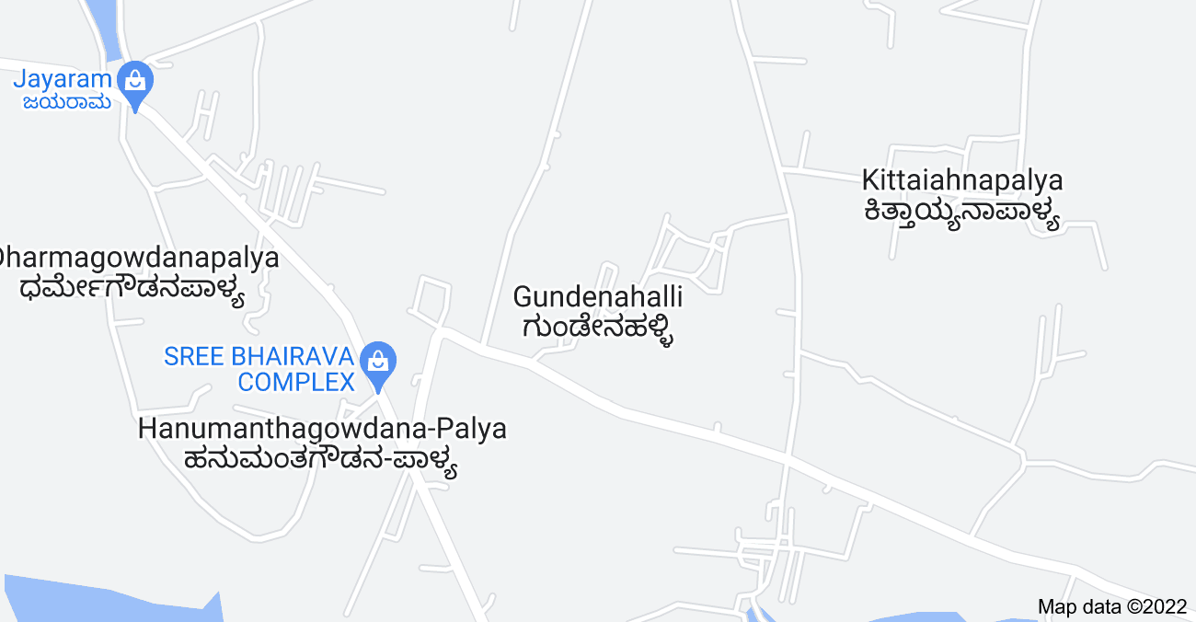
Nelamangala Taluk
Cluster villages -
Narasapura, Gundenahalli, Kittaiahnapalya, Isuvanahalli
Nelamangala Taluk
Satellite image of Narasapura village
Cluster villages

Slide 3
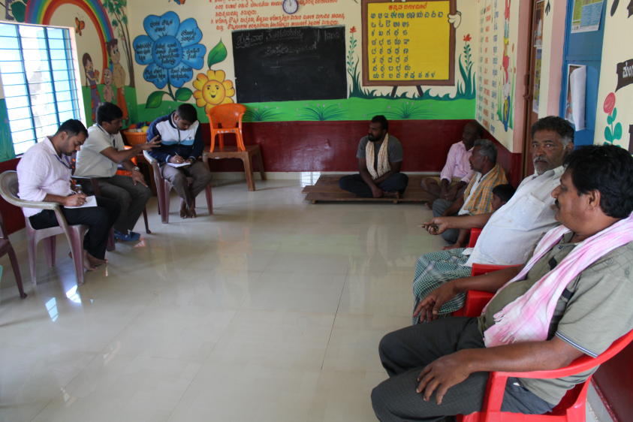
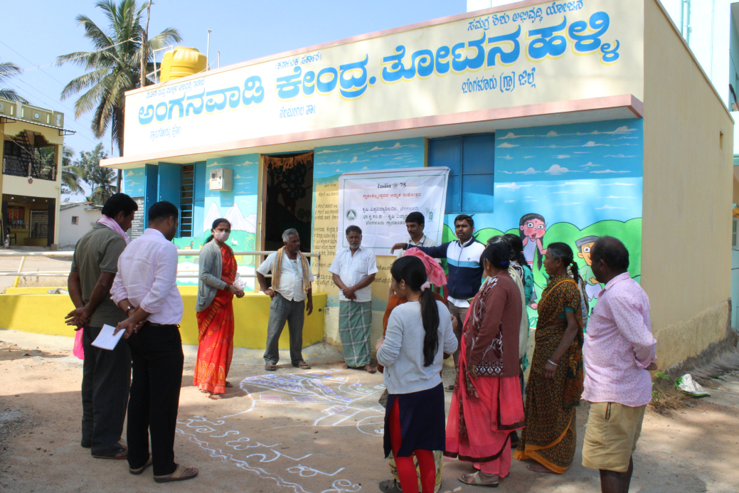
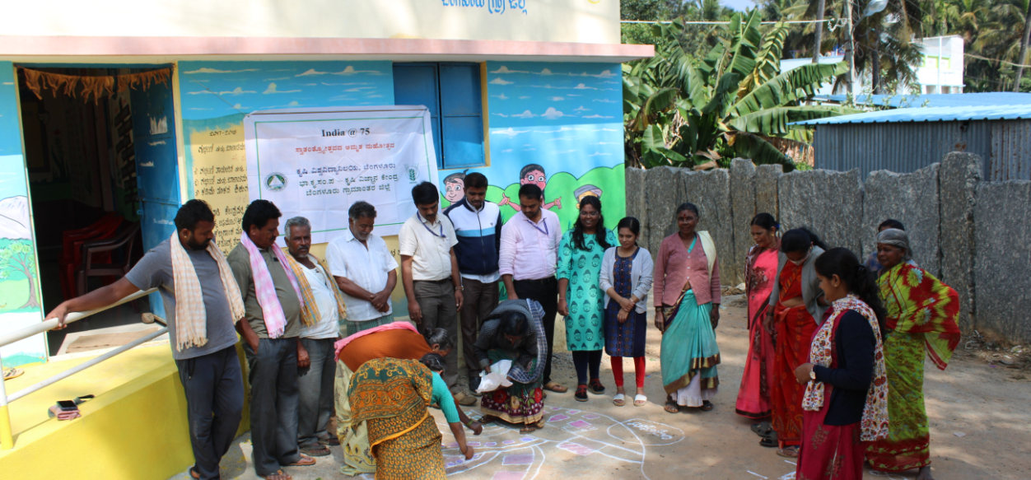
Participatory Rural Appraisal (PRA) - Narasapura Cluster
Explaining PRA Objectives
Recording Agricultural Situations
Village Resource Map

Slide 4
Problems identified in Narasapura Cluster
Problems
1 | Maize - No application of K & micro nutrients, Fall army worm, Stem borer, Downy mildew and Turcicum leaf blight
2 | Finger millet – Imbalanced nutrition leading to crop lodging, Intermittent drought and blast
3 | Foxtail millet – Low yield in local varieties, lack of knowledge on new varieties and value addition
4 | Tomato - Indiscriminate use of fertilizers due to lack of knowledge on recommended schedules, ToLCV, Bacterial wilt, early blight, late blight, Blossom end rot, leaf miner, thrips and fruit borer
5 | Cabbage – Imbalanced nutrition, DBM and black rot
6 | Fodder - Non availability of green fodder through out the year and lack of awareness on improved varieties
7 | Pole Bean – Imbalanced nutrition, severe incidence of yellow mosaic virus, rust, leaf miner, anthracnose and pod borer
8 | Arecanut - Imbalanced nutrition, nut drop, nut splitting and no intercropping system
9 | Dairy animals – Non availability of green fodder through out the year, low milk production, decreased reproductive efficiency after calving, inefficient reproductive management practices, delayed onset of oestrus
10 | Nutrition garden - Nutrition insecurity and lack of knowledge on importance of nutrition garden

Slide 5
Gap Identification and Technology Prioritization – Narasapura Cluster
Crop | Average Yield | Potential Yield | Diagnosed problem | Proposed activity
Finger millet | 16 q/ha | 25 q/ha | No / low potash application, Micronutrients application (Zn & B) is not followed, Lodging due to potash imbalance | FLD - Integrated Nutrient Management in Finger millet
Fodder sorghum | - | - | Lack of knowledge on improved varieties | FLD - Demonstration of Multicut Fodder Sorghum COFS-31 for green fodder
Maize | 52 q/ha | 70 q/ha | No/Low K application, Micronutrients application is not followed, Pest and disease due to potash imbalance | FLD – Potassium Management in Maize through Bio –K

Slide 6
Gap Identification and Technology Prioritization – Narasapura Cluster
Crop | Average Yield | Potential Yield | Diagnosed problem | Proposed activity
Pole bean | 29 t/ha | 40 t/ha | Severe incidence of yellow mosaic virus | FLD – Management of Yellow Mosaic Virus in Pole bean through Integrated approach
Foxtail Millet | 10 q/ha | 14 q/ha | Low yield in local varieties and lack of knowledge on value addition | FLD – Demonstration of Foxtail millet var. GPUF3 for value addition

Slide 7
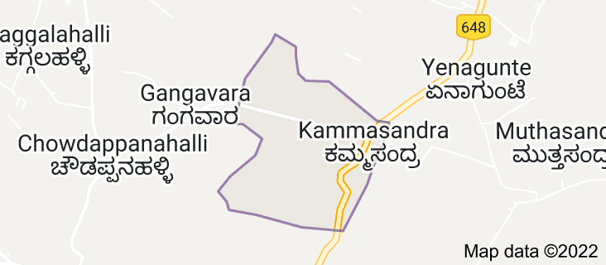
Hosakote Taluk
Cluster villages – Kammasandra, Gangavara, Chowdappanahalli
Hosakote Taluk
Cluster villages
Satellite image of Kammasandra village

Slide 8
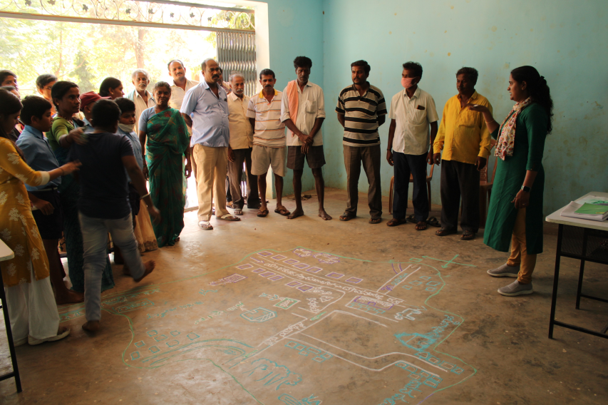
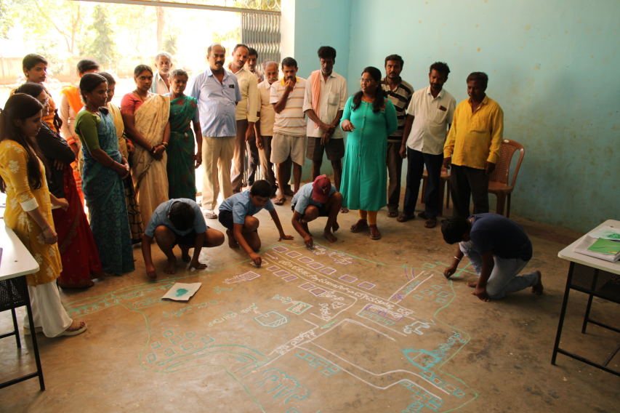
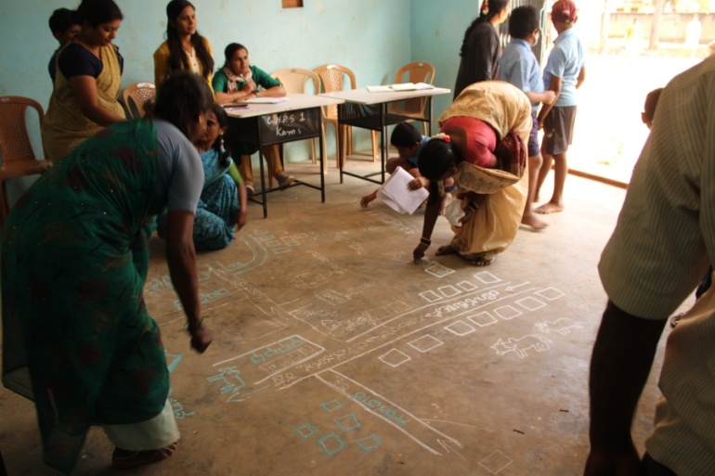
Participatory Rural Appraisal (PRA) - Kammasandra Cluster
Explaining PRA Objectives
Recording Agricultural Situations
Village Resource Map

Slide 9
Problems identified in Kammasandra Cluster
Problems
1 | Maize- Lack of knowledge about nano urea & nano zinc, No application of K & Zn, Fall army worm, Stem borer, Downy mildew and turcicum leaf blight
2 | Finger millet - Intermittent drought and blast
3 | Red gram – Poor weed management, Low yield due to imbalanced nutrition, wilt, sterility mosaic disease and pod borer
4 | Bengal Gram – Low yield due to imbalanced nutrition, wilt, pod borer
5 | Fodder - Non availability of green fodder through out the year
6 | Tomato - Indiscriminate use of water soluble fertilizers due to lack of recommended schedules, ToLCV, Bacterial wilt, early blight, late blight, Blossom end rot, leaf miner, thrips and fruit borer
7 | Potato - Imbalanced fertilizers application, low yield and soft rot during storage
8 | Pole bean – Improper nutrient management, Severe incidence of yellow mosaic virus, leaf miner, wilt and pod borer
9 | Mulberry – Thrips, mites, leaf roller, Powdery mildew and unscientific disposal of seri farm residue
10 | Nutrition garden – Nutrition insecurity and lack of knowledge on importance of nutrition garden
11 | Dairy animals – Non availability of green fodder through out the year, low milk production, decreased reproductive efficiency after calving, inefficient reproductive management practices, delayed onset of oestrus
12 | Sheep rearing – Improper feeding practices, Lack of awareness on post weaning nourishment

Slide 10
Gap Identification and Technology Prioritization – Kammasandra Cluster
Crop | Average Yield | Potential Yield | Diagnosed problem | Proposed activity
Maize | 52 q/ha | 70 q/ha | High cost of cultivation, High dose of fertilizer application, Low fertilizer use efficiency, Lack of knowledge on nano fertilizers | OFT – Assessment of Nano Urea and Nano Zinc on growth, yield and quality of Maize
Mulberry | 49 t/ha | 60 t/ha | Mites & thrips incidence, Unscientific disposal of seri farm residue | OFT-Assessment on management of mites and thrips in mulberry FLD-Demonstration of compost culture for quality compost production using Seri farm residue

Slide 11
Gap Identification and Technology Prioritization – Kammasandra Cluster
Crop | Average Yield | Potential Yield | Diagnosed problem | Proposed activity
Pole bean | 29 t/ha | 40 t/ha | No K application, Micronutrients application is not followed | FLD - Integrated Nutrient Management in Pole bean
Redgram | 6.4 q/ha | 12.5 q/ha | Wilt incidence, Sterility mosaic disease, Imbalanced Nutrition , poor weed management | FLD- Integrated Crop Management in Redgram
Sheep | - | - | Imbalance in rumen micro-flora leading to decreased growth rate due to improper post weaning nourishment | FLD - Pro-biotics for optimum post-weaning growth in lambs

Slide 12
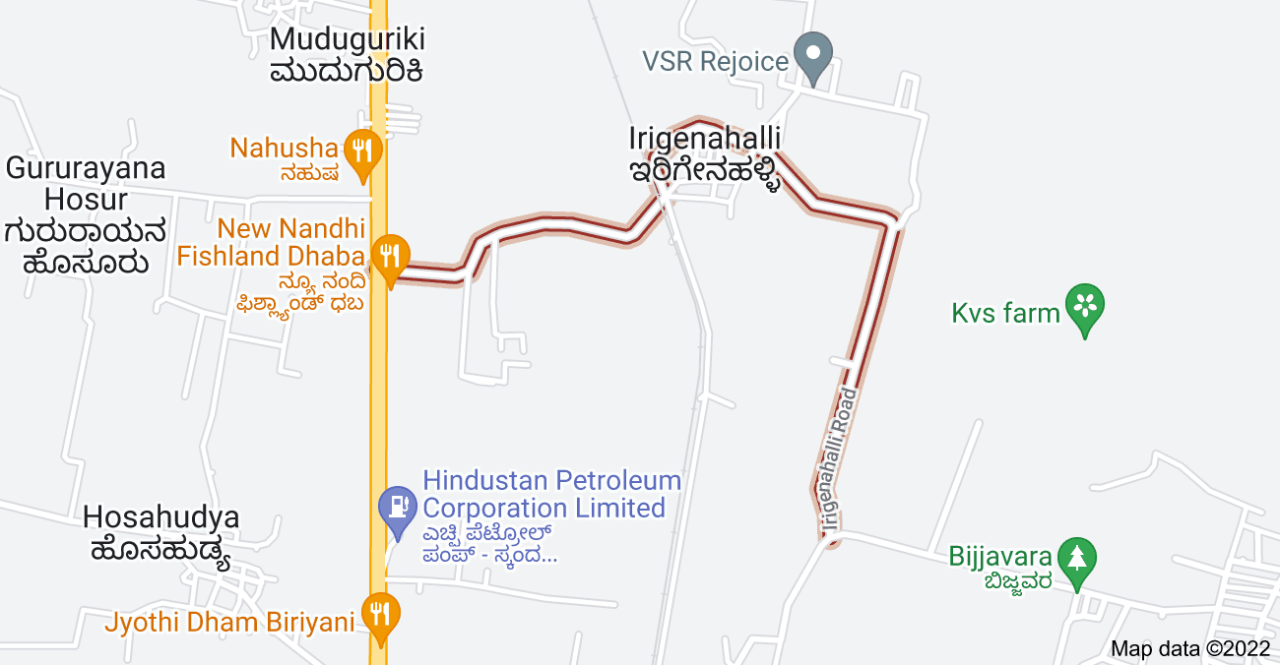
Devanahalli Taluk
Cluster villages – Irigenahalli, Bijjavara, Gururayana hosuru, Hosahudya
Devanahalli Taluk
Satellite image of Irigenahalli village
Cluster villages

Slide 13
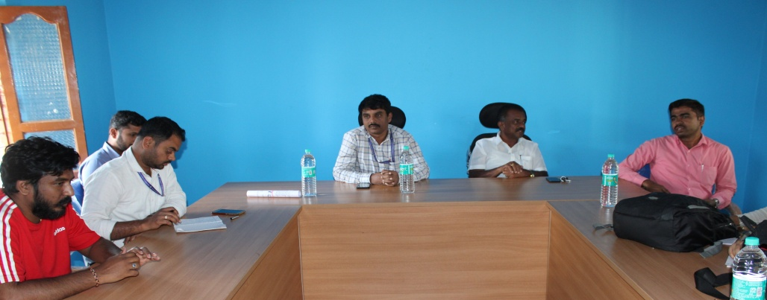
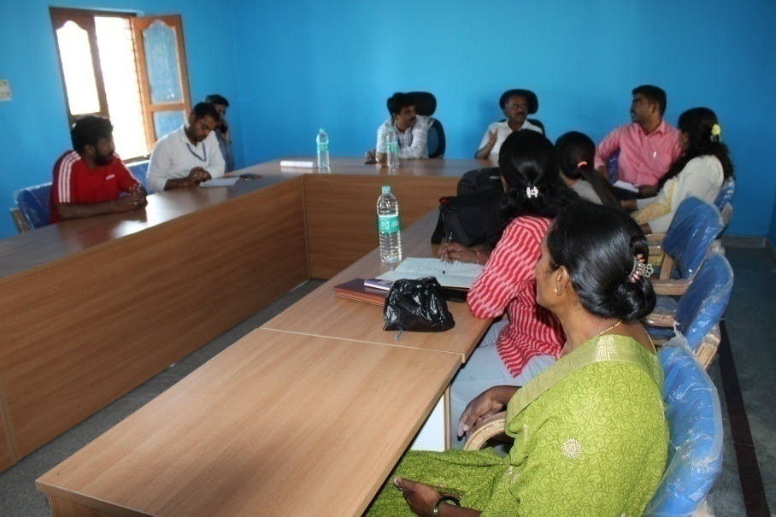
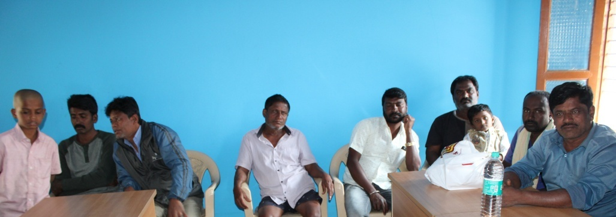
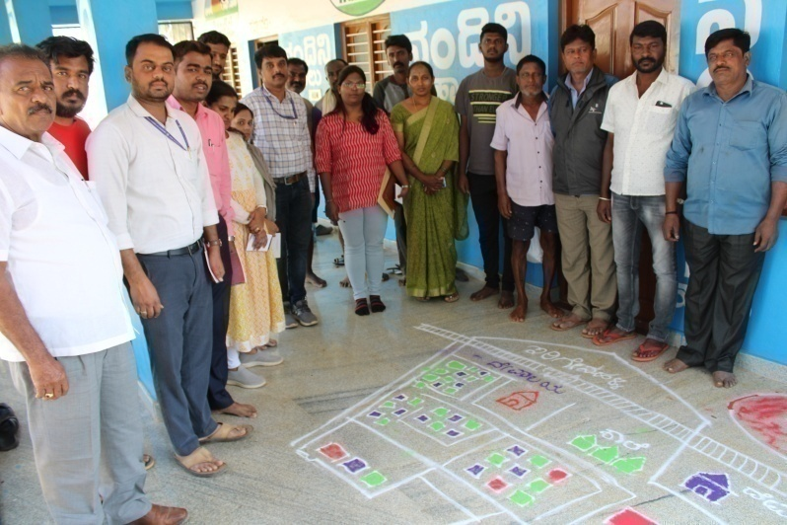
Participatory Rural Appraisal (PRA) - Irigenahalli Cluster
Explaining PRA Objectives
Recording Agricultural Situations
Village Resource Map

Slide 14
Problems identified in Irigenahalli Cluster
Problems
1 | Finger millet - Intermittent drought and blast
2 | Red gram - Low yield due to imbalanced nutrition, wilt, sterility mosaic disease, Phyllody and pod borer
3 | Fodder - Non availability of green fodder through out the year, lack of awareness on improved varieties and leguminous fodder crops
4 | Tomato - Indiscriminate use of fertilizers due to lack of knowledge on recommended schedules, ToLCV, Bacterial wilt, early blight, late blight, Blossom end rot, leaf miner, thrips and fruit borer
5 | Ridge gourd- Imbalanced fertilizers application, Severe incidence of mosaic virus
6 | Cauliflower - Imbalanced nutrition, severe incidence of Diamond back moth
7 | Nutrition garden - Nutrition insecurity and lack of knowledge on importance of nutrition garden
8 | Dairy animals – improper management of mastitis, Non availability of green fodder through out the year, low milk production, decreased reproductive efficiency after calving, inefficient reproductive management practices, delayed onset of oestrus
9 | Mari gold – Imbalanced fertilizer application, micro nutrients deficiency and low yield

Slide 15
Gap Identification and Technology Prioritization – Irigenahalli Cluster
Crop | Average Yield | Potential Yield | Diagnosed problem | Proposed activity
Hybrid Napier | 130 t/ha | 150 t/ha | Use of low yielding old varieties | OFT – Assessment of Napier hybrids for yield and quality
Dairy animals | 8.70 L | 10.5 L | Mastitis in dairy cattle after calving, Low milk yield, Expensive treatment | FLD – Demonstration to prevent mastitis in HF Cattle
NARI Nirbeeja | - | - | Seed shattering leads to weed menace, susceptible to psyllids, Low palatability, | FLD-Demonstration of NARI Nirbeeja Subabul grafts for nutritious fodder
Fish | - | - | Aqua culture is not followed in farm ponds | FLD – Demonstration of Genetically Improved Farmed Tilapia (GIFT) in farm ponds

Slide 16
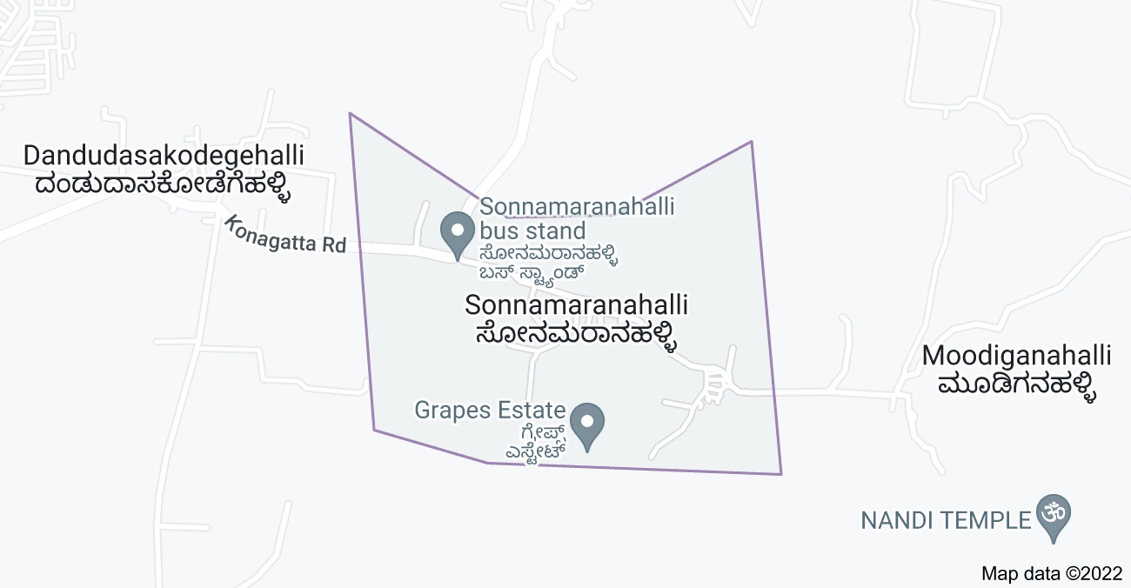
Doddaballapura Taluk
Cluster villages – Sonnamaranahalli, Dandudasakodigehalli and Gulya
Doddaballapura Taluk
Satellite image of Sonnamaranahalli village
Cluster villages

Slide 17
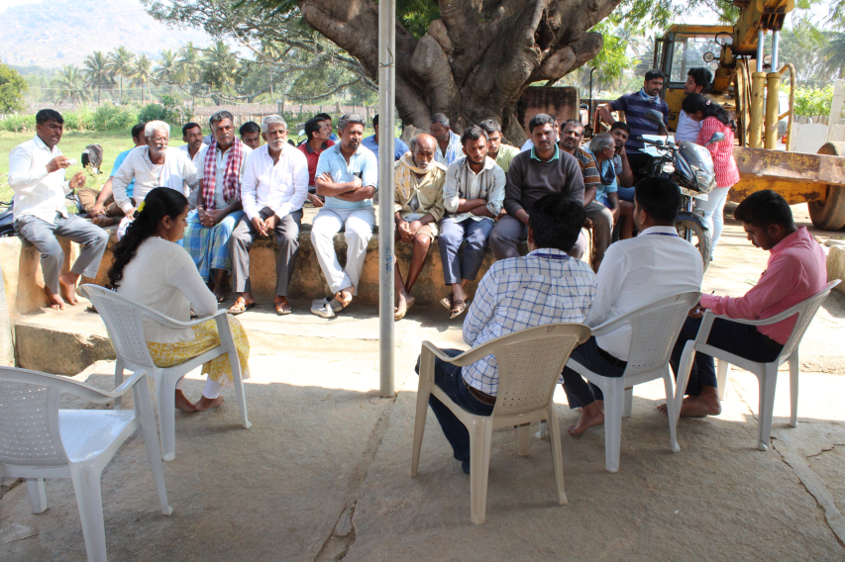
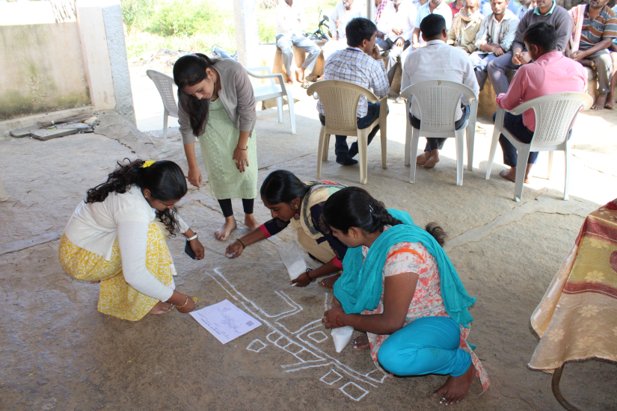
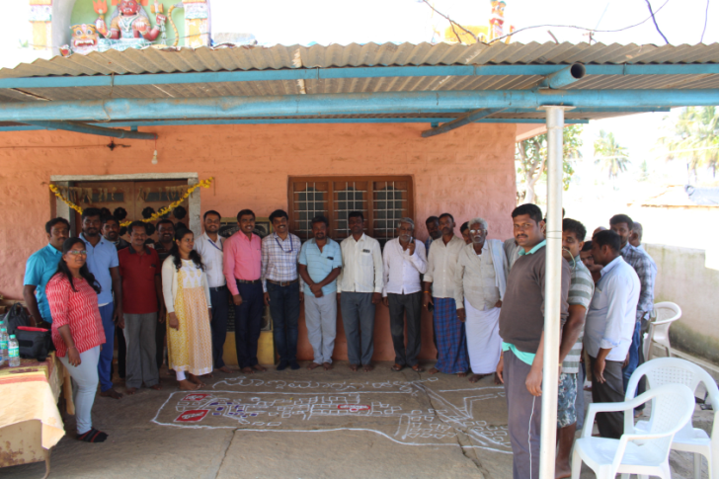
Participatory Rural Appraisal (PRA) - Sonnamaranahalli Cluster
Explaining PRA Objectives and Recording Agricultural Situations
Drawing of Resource Map
Village Resource Map

Slide 18
Problems identified in Sonnamaranahalli Cluster
Problems
1 | Maize - No application of K & micro nutrients, fall army worm, stem borer, downy mildew and turcicum leaf blight
2 | Finger millet – Lack of awareness about short duration varieties, intermittent drought and blast
3 | Red gram - Low yield due to imbalanced nutrition, wilt, sterility mosaic disease, phyllody and pod borer
4 | Cauliflower - Imbalanced nutrition, severe incidence of diamond back moth, aphids, leaf webber & black rot
5 | Fodder - Non availability of high yielding multicut fodder variety having more palatability
6 | Capsicum - Severe incidence of mites and thrips in polyhouse
8 | Tomato - Incidence of ToLCV, wilt, early blight, late blight, pin worm and fruit borer, indiscriminate use of fungicides
9 | Rose - Imbalanced nutrition, thrips, aphids, mites, bud borer, black spot, dm, pm, die back and rust, improper pruning, maturity indices
10 | Dairy animals – Non availability of green fodder through out the year, low milk production, lack of awareness on ration balancing and proper nourishment
11 | Nutrition garden - Nutrition insecurity and lack of knowledge on importance of nutrition garden

Slide 19
Gap Identification and Technology Prioritization – Sonnamaranahalli Cluster
Crop | Average Yield | Potential Yield | Diagnosed problem | Proposed activity
Finger millet | Finger millet 16 q/ha Cow pea 9 q/ha | Finger millet 25 q/ha Cow pea 12 q/ha | Not taking advantage of pre monsoon rainfall, Blast and drought susceptibility | FLD – Demonstration of short duration Finger millet var. KMR – 630 under double cropping system (Cowpea –Finger millet)
Tomato | 64 t/ha | 75 t/ha | Incidence of ToLCV, wilt, early blight, late blight, pin worm and fruit borer, Indiscriminate use of fungicides | FLD - Integrated pest & disease management in Tomato
Rose | 5.49 t/ha | 12 t/ha | Thrips, Aphids, mites, Bud borer, Black spot, DM, PM, Die back and Rust, imbalanced nutrition | FLD – Bio – intensive management of pest and diseases in Rose

Slide 20
Gap Identification and Technology Prioritization – Sonnamaranahalli Cluster
Crop | Average Yield | Potential Yield | Diagnosed problem | Proposed activity
Capsicum | 52 t/ha | 60 t/ha | Severe incidence of mites and thrips under poly house | FLD – Management of mites and thrips in Capsicum under polyhouse
Cauliflower | 36 t/ha | 48 t/ha | Severe incidence of Diamond back moth, aphids, leaf webber, & black rot, Imbalanced nutrition | FLD – Eco – friendly management of pest and diseases in Cauliflower
Dairy Animals | 8.70 L | 10.5 L | Lower milk yield & quality (fat %, SNF) and Incidence of Ruminal acidosis | FLD - Ration Balancing through Integrated Approach in Dairy Animals

Slide 21
Proceedings of SAC meeting held on 30.12.2021
Sl. No. | Particulars
1 | Demonstration of Integrated Farming System in KVK
2 | Take up fodders seed production in collaboration with NSP, GKVK, Bengaluru
3 | Conduct demonstration of potato cultivation through apical root cuttings
4 | Conduct demonstration of Nutri garden for farm women’s of FPO
5 | Promotion of Gir and other local breed by KVK
6 | Give more emphasis on Secondary agriculture like Post Harvest Management, Value addition and Market linkage
7 | Identify and promote the farmer who are practicing Natural farming
8 | Prepare taluk wise soil fertility status map based on soil analysis in KVK
9 | Conduct Frontline Demonstration on management of thrips and mites in horticulture crops under polyhouse
10 | Promote newly released Jackfruit varieties through commodity group/FPO
11 | Organize trainings on mitigation of malnutrition in collaboration with Dept. of Women and Child Welfare
12 | Conduct demonstration on Genetically Improved Farmed Tilapia (GIFT) in KVK in collaboration with Dept. of Fisheries and popularize among farmers
13 | Demonstration on tractor drawn combined seed drill in different crops at KVK farm

Slide 22
Proceedings of SAC meeting held on 30.12.2021
Sl. No. | Particulars
14 | Demonstration of newly released varieties and technologies from UASB at KVK
15 | Geo tagging of photographs / video recordings of FLD and OFT’s conducted by the KVKs
16 | Scientists should record their opinions and details in the register about farm trial during their visits
17 | Popularize the Siri Suvarna Technology through demonstrations
18 | Present the FLD and OFT photographs on different stages of both check and demo fields
19 | Present the on-going FLD and OFT details (Stages) in SAC meeting
20 | Record and present data / results of on-going FLD and OFT in consequent SAC meeting
21 | Include sericulture, animal husbandry and fishery in identified thrust areas
22 | Record and present number of entrepreneurs emerged after completion of DAESI programme
23 | Conduct demonstration on natural and organic farming in KVK farm
24 | Conduct demonstration on management of Rugose white flies in coconut crop
25 | Popularization and training programme on importance of sorted Sexed Semen in HF/Jersy in collaboration with Dept. of Animal husbandry

Slide 23
Abstract of On Farm Testing
Sl. No | Technology to be assessed / refined | No. of trials | Budget
1. | Assessment of Nano urea and Nano Zinc on growth, yield and quality of Maize | 5 | 13750
2. | Assessment of Napier Hybrids for yield and quality | 5 | 36000
3. | Assessment on management of mites and thrips in Mulberry | 3 | 46500
 | GRAND TOTAL |  | 96250

Slide 24
Abstract of Front Line Demonstrations
Sl. No | Title of the Technology | No. of Demo | Area (ha) | Budget (Rs.)
1. | Potassium Management in Maize through Bio –K | 5 | 1 | 16875
2. | Demonstration of short duration Finger millet var. KMR-630 under double cropping system ( Cowpea – Finger millet) | 10 | 4 | 32600
3. | Integrated Nutrient Management in Finger millet | 5 | 1 | 12375
4. | Demonstration of Foxtail millet var. GPUF3 for value addition | 5 | 1 | 17500
5. | Integrated Crop Management in Redgram | 5 | 2 | 34200
6. | Demonstration of Multicut Fodder Sorghum COFS-31 for green fodder | 10 | 1 | 12500
7. | Demonstration of NARI Nirbeeja Subabul grafts for nutritious fodder | 20 | - | 26000

Slide 25
Abstract of Front Line Demonstrations
Sl. No | Title of the Technology | No. of Demo | Area (ha) | Budget (Rs.)
8. | Integrated Nutrient Management in Pole bean | 5 | 1 | 17500
9. | Management of Yellow Mosaic Virus in Pole bean through Integrated Approach | 5 | 1 | 44500
10. | Integrated Pest and Disease Management in Tomato | 5 | 1 | 55500
11. | Eco – friendly management of pest and diseases in Cauliflower | 5 | 1 | 50000
12. | Management of mites and thrips in Capsicum under polyhouse | 5 | 1 | 41000
13. | Bio – intensive management of pest and diseases in Rose | 5 | 1 | 51750
14. | Demonstration of compost culture for quality compost production using Seri farm residue | 5 | - | 23000

Slide 26
Abstract of Front Line Demonstrations
Sl. No | Title of the Technology | No. of Demo | Area (ha) | Budget (Rs.)
15. | Ration Balancing through Integrated Approach in Dairy Animals | 10 | - | 50500
16. | Demonstration to prevent mastitis in HF cattle | 10 | - | 37500
17. | Pro-biotics for optimum post-weaning growth in lambs | 10 | - | 36000
18. | Demonstration of Genetically Improved Farmed Tilapia (GIFT) in farm ponds | 10 |  | 56000
Total |  |  |  | 6,15,300
Nutri garden for farm families | Hosakote and Doddaballapura Clusters -30 demos | 58500

Slide 27
On Farm Testing (OFT)

Slide 28
1: Assessment of Nano urea and Nano Zinc on growth, yield and quality of Maize
Contd..
Avg. Yield: 52 q/ha
Pot Yield: 70 q/ha
Place: Thimmasandra
Taluk: Hoskote
Season :Kharif/ Rabi
Rationale
Maize is the second most important crop after Finger millet in Bengaluru Rural District. Farmers are following conventional fertilizers based on soil test approach, LMH approach and blanket fertilizer application
IFFCO-NBRC has launched nano urea for foliar application to increase the nitrogen use efficiency and to reduce the usage of conventional urea.
However, the importance and efficacy of nano fertilizers is not known to farmers.
Therefore, it is need of the hour to assess the nano urea and nano zinc on growth, yield and quality of Maize.

Slide 29
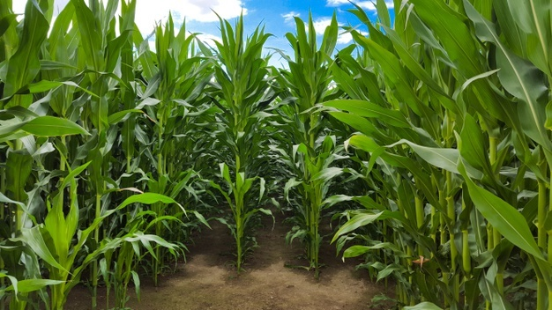
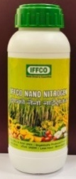
Objectives
To assess the effect of Nano urea and Nano zinc on growth, yield and quality of Maize
To workout the NUE and cost economics of Nano urea and Nano zinc in Maize
Hypothesis
Application of Nano urea and Nano zinc may reduce the cost on fertilizers and enhances the yield and quality of Maize.

Slide 30
Technological Interventions | Source (year)
T₁ - Application of NP fertilizers as basal dose & top dressing with N fertilizer, no or low K fertilizer use | Farmers practice
T₂ - RDF: 10 t/ha FYM, 100:50:25:10 NPK & Zn kg/ha, 50% N, full PK, Zn as basal, 25% N at 30 DAS, & 25 % N at tasseling stage | UAS (B), 2016
T₃ - RDF: 12.5 t/ha FYM, 60:30:30 NPK kg/ha, 50% N, full P&K as basal, 50 % N at tasseling stage | TNAU, Coimbatore , 2015
T₄ - Application of 25 % N as basal dose (25 kg N/ha) full PK as basal, 25% N at 25-30 DAS, Nano urea & Zn spray at 30 DAS (4 ml/l) & 20 days after first spray | IFFCO – NBRC, Gujarat, 2021
No. of Treatments: 04
No. of Replication: 05
Statistical design: RCBD
Statistical tool: ANOVA

Slide 31
Critical Inputs
Implementation
Critical Input | Qty./trial | Cost/ trial (Rs.)
Nano urea | 1 L | 500
Nano zinc | 0.5 L | 300
ZnSO₄ | 2 Kg | 150
Soil analysis | 2 No. | 600
Total (per trial) |  | 1550
Cost for 5 trials |  | 7750
Board and Field day |  | 6000
Total Cost |  | 13750
Area: 0.2 ha. per trial
No. of farmers: 05
Scientists : SS, Agr & Hort (Sr.S&H)
Parameters
Soil fertility status
Plant height (cm)
Cob length (cm)
Cob weight (g)
Grain yield (q/ha)
Stover yield (q/ha)
Test weight (g)
AUE (%)
B:C
Educational activities
Method Demonstration
Training
Farmer-Scientist interaction

Slide 32
2: Assessment of Napier Hybrids for yield and quality
Avg. Yield: 130 t/ha, Pot. Yield: 150t/ha
Rationale
Livestock is an important entrepreneurship in Bengaluru Rural District with 4.0 lakh cattle, sheep and goat.
Farmers are cultivating low yielding Co-3 napier hybrid (150-160 t/ha) with lower leaf to stem ratio (0.69) and crude protein (6-8 %).
Three new hybrids viz., BNH – 10, PBN -342 and Co-5 were reported as high yielders with good nutritional value.
Hence to assess their performance, On farm testing is planned during 2022.
Place: Irigenahalli
Taluk: Devanahalli
Season :Round the year
Objectives
To evaluate the performance of different napier hybrids for growth and yield
To assess the quality and to workout the economics of different napier hybrids

Slide 33
Hypothesis
Use of new napier hybrids may result in better fodder yield and quality
Technological interventions | Source (Year)
T₁ - Co-3: GFY-150-160 t/ha, leaf to stem ratio: 0.69, Crude protein:6-8 % | Farmers practice (1996)
T₂ - BNH-10: GFY-160-180 t/ha, leaf to stem ratio:0.67, Crude protein: 6 % | UAS (B) (2015)
T₃ - PBN-342: GFY-200-220 t/ha, leaf to stem ratio: 0.84, Crude protein: 8-10 % | PAU, Ludhiana (2017)
T₄ - CO-5: GFY-180-200 t/ha, leaf to stem ratio: 0.75, Crude protein: 6-7 % | TNAU, Coimbatore (2012)
No. of Treatments: 04
No. of Replication: 05
Statistical design: RCBD
Statistical tool: ANOVA

Slide 34
Critical Inputs
Implementation
Critical inputs (per trial) | Qty./trial | Cost (Rs.)
Co-3 | 500 slips | 1500
BNH-10 | 500 slips | 1500
PBN-342 | 500 slips | 1500
CO-5 | 500 slips | 1500
Total (Per trial) |  | 6000
Cost for 5 trials |  | 30000
Board and Field day |  | 6000
Total Cost |  | 36,000
Area: 0.1 ha. per demo
No. of farmers: 5
Scientists: Agron , AS and
Plant breeder (V.C Farm)
Parameters
Plant height (cm)
Number of tillers/plant
Leaf to stem ratio
Green fodder yield (t/ha)
Palatability (%)
Crude Protein (%)
Crude Fibre (%)
B:C
Educational activities
Method Demonstration
Training
Farmers – Scientists interaction

Slide 35
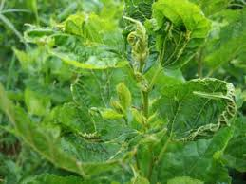
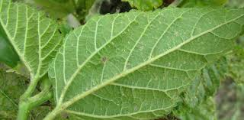
3: Assessment on management of mites and thrips in Mulberry
Contd..
Avg. Yield: 49 t/ha
Pot. Yield: 60 t/ha
Place: Thimmasandra
Taluk: Hosakote
Season :Kharif and Summer
Rationale
Sericulture is an important enterprise in Bengaluru Rural District comprising about 6400 ha. under moriculture.
Mites and thrips are severe pest in mulberry cultivation with an intensity of 35-40 % resulting in low leaf yield and poor quality.
Farmers are not able to control these pest inspite of using many chemicals with repeated sprays .
Therefore, it is necessary to assess different management practices to control mites and thrips in mulberry for better yield and quality in turn to get good cocoon yield.
Mites infestation
Thrips infestation

Slide 36
Objectives
To evaluate the performance of different management practices to control mites and thrips
To assess the different management practices on leaf yield, quality, cocoon yield and economics.
Hypothesis
Different management practices may control mites and thrips, thus improves the leaf yield and quality and in turn cocoon production.
No. of Treatments: 05
No. of Replication: 04
Statistical design: RCBD
Statistical tool: ANOVA

Slide 37
Technological Options | Source (year)
T₁ - Spraying of Dimethoate 30 EC (2ml/L)/Neem oil (2ml/L) at 12-15 DAP | Farmers’ Practice
T₂ - Spraying of Dimethoate 30% EC (2ml/L) at 8 DAP & propargite 57 EC (1.5 ml/L) at 15 DAP | UAS (B), 2010
T₃ - Spraying of Dimethoate 30% EC (3ml/L) at 8 DAP & Fenazaquin 10 EC (1.5 ml/L) (20 days)/ Cyenopyrafen 30 sc (0.5 ml/L) (15 days) / wettable sulphur 80% wp 3 g/L (5 days) | CSRTI, Mysuru, 2016
T₄ - Spraying of Bacteria (Shatpada-All rounder) - @ 20 g/L, 4 sprays at 5 days interval @ 15 days after pruning | ICAR - NBAIR, Bengaluru, 2020
T₅ - Spraying of Bacteria (Shatpada-Master Blaster) - @ 20 g/L, 4 sprays at 5 days interval @ 15 days after pruning | ICAR - NBAIR, Bengaluru, 2020

Slide 38
Critical Inputs
Implementation
Area: 0.2 ha. per trial
No. of Farmers: 03
Scientists : PP, Hort (SS & H), Agron & SS
Area: 0.2 ha. per trial
No. of Farmers: 03
Scientists : PP, Hort (SS & H), Agron & SS
Particulars | Qty./ trial | Cost/ trial (Rs.)
Propargite | 1000 ml | 1700
Fenzaquin | 500 ml | 1600
Wettable sulphur | 2 kg | 400
Cyenopyrafen | 200 ml | 3400
Shatpada-All rounder | 16 kg | 3200
Shatpada-Master Blaster | 16 kg | 3200
Total (per trial) |  | 13500
Cost for 3 trials |  | 40500
Board and Field day |  | 6000
Total Cost |  | 46500
Parameters
Leaf yield and quality
Mites incidence (%) & Thrips incidence (%)
No. & cost of sprays
Yield (q/ha)
B:C
Biosafety Parameters
Silkworm larval mortality (%)
Growth index (g/larva)
Weight of single cocoon (g)
Single shell weight (g)
Cocoon to shell ratio (%)
Effective rate of rearing (ERR %)

Slide 39
Silk Reeling Parameters
Filament weight (g)
Filament length (cm)
Denier
Reeling breaks
Educational activities
Method Demonstration
Training
Farmer’s Scientist interaction

Slide 40
Front Line Demonstrations

Slide 41
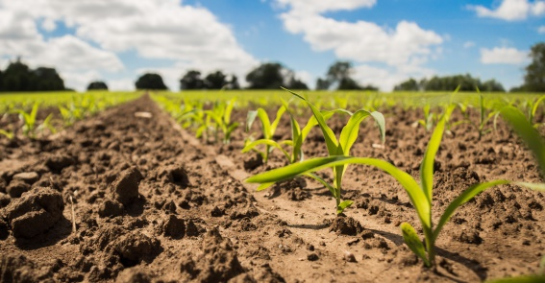
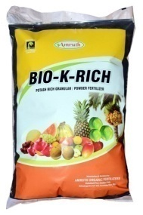
1: Potassium Management in Maize through Bio -K
Place: Narasapura
Taluk: Nelamangala
Season: Kharif
Rationale
Avg. Yield: 52 q /ha
Pot. Yield: 70 q/ha
About 30 to 40 per cent of soils in Bengaluru Rural District are low in available potassium content.
Improper and imbalanced K application to maize resulted in low yield and poor quality grains.
There is a need to address potassium management in maize through agro based by-products, which are eco-friendly.
Therefore, it was felt necessary to demonstrate potassium management in maize through Bio – K.
Source of Technology: UAS, Bengaluru, 2018
Azospirillum – 200 g & PSB – 200 g for seed treatment
RDF: 10 t/ha FYM, 100:50:25 NPK & 10 Zn kg/ha
50% N , full P & K as basal
25% N at 30 DAS, 25 % N at tasseling stage
Check: Farmer’s Practice

Slide 42
Implementation
Critical Inputs
Area: 0.2 ha. per demo
No of farmers: 05
Scientists: SS, Hort (Sr.S&H) & Agron
Particulars | Qty. /demo | Cost/ demo (Rs.)
PSB | 1 kg | 100
Azospirillum | 1 kg | 100
Bio - K | 50 kg | 1000
ZnSO₄ | 1 kg | 75
Soil analysis | 3 | 900
Total (per demo) |  | 2175
Cost for 5 demos |  | 10875
Board and Field day |  | 6000
Total Cost |  | 16875
Parameters
Soil fertility status
Plant height (cm)
No. of cobs/plant
Length of cob (cm)
Cob weight (g)
Test weight (g)
Grain yield (q/ha)
Stover yield (q/ha)
B:C
Statistical test: Two way ‘t’ test
Educational activities
Method Demonstration
Training
Field Day
Distribution of Soil Health Cards

Slide 43
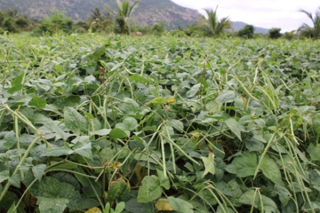
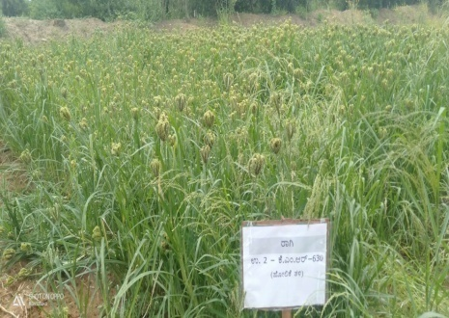
2: Demonstration of short duration Finger millet var. KMR-630 under double cropping system (Cowpea – Finger millet)
 | Avg. yield | Pot. Yield
Cow pea | 9.0 q/ha | 12.0 q/ha
Finger millet | 16.0 q/ha | 25.0 q/ha
Place: Sonnamaranahalli
Taluk: Doddaballapura
Season : Kharif
Rationale
Finger Millet is being grown as sole crop with blast susceptible varieties in an area of 40,000 ha in Bengaluru Rural District.
Farmers are not taking the advantage of bimodal distribution of rainfall from may to November to adopt double cropping system.
Therefore, it is essential to demonstrate double cropping system using short duration cowpea (KBC-9) and blast resistant Finger millet variety (KMR-630) for maximum productivity.

Slide 44
Source of Technology: UAS(B), 2020-21
Double cropping system (cowpea - Finger millet)
Moisture conservation furrows (every 12 rows) in Finger millet
Use of short duration var. KBC-9 in Cowpea and KMR- 630 (95-100 days) in Finger millet
Seed treatment with Rhizobium 200 g (cowpea) and Azospirillum 200 g (finger millet)
Check: Sole crop - Finger millet var. GPU - 28

Slide 45
Critical Inputs
Implementation
Area: 0.4 ha. per demo
No. of farmers: 10
Scientists : Agronomy and SS
Particulars | Qty./ demo | Cost (Rs.)
Finger millet Seeds (KMR-630) | 10 kg | 600
Cowpea seeds (KBC-9) | 12 kg | 960
Rhizobium | 1 kg | 100
Azospirillum | 1 kg | 100
Soil analysis | 3 | 900
Total (per demo) |  | 2660
Cost for 10 demos |  | 26600
Board and Field day |  | 6000
Total Cost |  | 32600
Parameters
Plant height (cm) in both crops
No. of productive tillers/plant in Finger millet
No. of branches per plant in cowpea
Blast severity (%) in Finger millet
Yield (q/ha) for both crops
Equivalent yield of Finger millet (q/ha)
Bio mass of cowpea added to soil (q/ha)
Soil analysis before and after harvest of crop
B:C
Statistical test: Two way ‘t’ test
Educational activities
Method Demonstration
Training
Field day

Slide 46
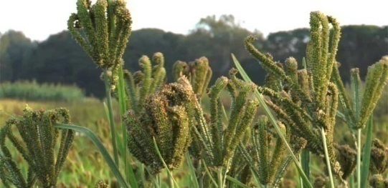
3: Integrated Nutrient Management in Finger millet
Rationale
Avg. Yield: 16 q/ha
Pot Yield: 25 q/ha
Place: Narasapura
Taluk: Nelamangala
Season : Kharif
Finger millet is a major field crop in Bengaluru Rural District covering an area of 40,000 ha. highly susceptible to lodging (50-60 %) mainly due to no or low potash application.
Farmers have not adopted integrated nutrient management practice to address the crop performance and soil fertility.
Therefore, it is optimum to demonstrate INM in Finger millet.
Source of Technology: UAS (B), 2015
Azospirillum – 150 g for seed treatment
RDF: 7.5 t/ha FYM, 50:37.5:40 NPK, 12.5 & 10 Zn & Borax kg/ha
Zn & Borax application before sowing
50% N and full P, K , Zn and B as basal
50 % N at 6 – 7 weeks after sowing
Check: Farmer’s Practice (N-87 Kg, P-46 Kg / ha.)

Slide 47
Critical Inputs
Implementation
Area: 0.2 ha per demo
No of farmers: 05
Scientists –SS, Agron & PP
Particulars | Qty. /demo | Cost/ demo (Rs.)
Fertilizers | - | FC
Azospirillum | 1 kg | 100
Borax | 1 kg | 150
ZnSO₄ | 1.5 kg | 125
Soil analysis | 3 | 900
Total (per demo) |  | 1275
Cost for 5 demos |  | 6375
Board and Field day |  | 6000
Total Cost |  | 12375
Parameters
Soil fertility status
Plant height (cm)
No. of tillers/hill
Grain Yield (q/ha)
Straw yield (q/ha)
B:C
Statistical test: Two way ‘t’ test
Educational activities
Method Demonstration
Training
Field Day

Slide 48
4: Demonstration of Foxtail millet Var. GPUF 3 for value addition
Rationale
Avg. Yield: 10 q/ha
Pot Yield: 14 q/ha
Place: Narasapura
Taluk: Nelamangala
Season :Kharif
Foxtail millet is the second most important millet rich in dietary fibre, minerals and B – Complex vitamins. Bengaluru Rural District is having more area under rainfed situation with vagaries of monsoon suitable for millet cultivation.
GoK is promoting millets under area expansion programme with monetary incentives to farmers.
Farmers are cultivating foxtail millet in Bengaluru Rural District, using local varieties and consuming without value addition.
Therefore, demonstration of new foxtail millet variety and its value addition is required.

Slide 49
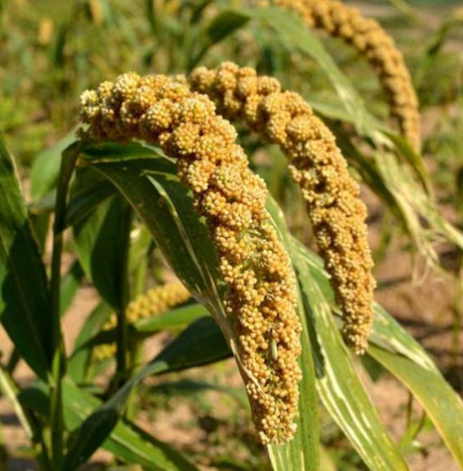
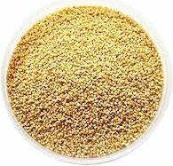
Source of Technology: UAS(B), 2021
GPUF3 variety
Seed treatment with Azospirillum
Processing and value addition: RTC foxtail millet rice, laddu, RTC upma mix etc.
Check: Farmer’s practice

Slide 50
Implementation
Critical Inputs
Area: 0.2 ha. per demo
No of farmers: 05
Scientists – HS, SS, Agron and AE
Particulars | Qty./ demo | Cost (Rs.)
Seeds (GPUF3) | 2 kg | 200
Azospirillum | 1 kg | 100
Value addition | - | 2,000
Total (per demo) |  | 2,300
Cost for 5 demos |  | 11,500
Board and Field Day |  | 6,000
Total Cost |  | 17,500
Parameters
Plant height (cm)
Number of Tillers / plant
Yield (q/ha)
Processing cost (Rs/q)
Sensory evaluation of value added products
Cost economics of value added products
Statistical test: Two way ‘t’ test
Educational activities
Method Demonstration
Training
Field Day

Slide 51
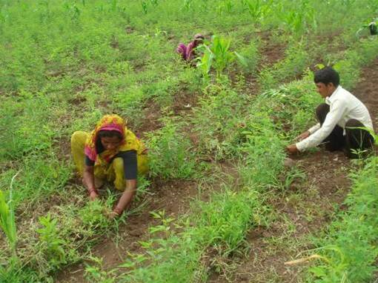
5: Integrated Crop Management in Redgram
Rationale
Avg. yield | 6.4 q/ha
Pot. Yield | 12.5 q/ha
Place: Kammasandra
Taluk: Hosakote
Season : Kharif
The existing varieties of redgram BRG -1 and BRG-2 are susceptible to wilt (>10%) and SMD (10-15%). Apart from this, weeds and pod borer menace (>20%) leads to severe yield loss in redgram.
Hence, it is necessary to demonstrate ICM in redgram for maximum yield.
Source of Technology: UAS(B), 2018
Variety – BRG 3
Seed treatment with Rhizobium- 200 g / ac
Use of pre - emergent herbicide – Pendimethalin 3.3ml / L
Use of post - emergent herbicide - Imazathapyr 2 ml/L @20-25 DAS
Inter-cultivation @ 40-50 DAS
Spraying of Pulse magic – 10g /L
Installation of pheromone traps 5 (10 no. / ac) and spraying of spinosad 0.25 ml/L
Check: BRG - 2

Slide 52
Implementation
Critical Inputs
Area: 0.4 ha. per demo
No. of farmers: 5
Scientists : Agron, SS & PP
Particulars | Qty./ demo | Cost (Rs.)
Seeds (BRG-3) | 6 kg | 540
Rhizobium | 1 kg | 100
Pendimethalin | 1000 ml | 800
Imazathapyr | 400 ml | 600
Pulse magic | 2 kg | 600
Pheramone traps and lures | 10+10 | 1000
Spinosad (microbial) | 75 ml | 2000
Total (per demo) |  | 5640
Cost for 5 demos |  | 28200
Board and Field day |  | 6000
Total Cost |  | 34200
Parameters
Plant height (cm)
Number of branches/plant
Weed intensity
Wilt and SMD incidence (%)
Pod borer incidence (%)
No. of pods/plant
Seed yield (q/ha)
B:C
Statistical test: Two way ‘t’ test
Educational activities
Method Demonstration
Training
Field day

Slide 53
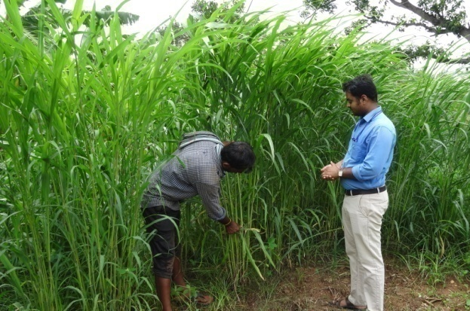
6: Demonstration of Multicut Fodder Sorghum COFS-31
for green fodder
Place: Narasapura
Taluk: Nelmangala
Season : round the year
Rationale
The local fodder sorghum variety kakmar and few other old fodder varieties in the district are yielding less with poor palatability (75 – 80%).
Farmers are not aware of high yielding multicut fodder sorghum varieties, which necessitated to demonstrate multicut fodder sorghum variety for higher green fodder yield and palatability.
Source of Technology: TNAU, Tamil Nadu, 2014
High yielding multicut fodder variety CoFS-31 :135-140 t/ha/yr (6-7 cuts) with good palatability
Improved agro - techniques for multicut fodder production
Check : Local Fodder sorghum var. Kakmar

Slide 54
Critical Inputs
Implementation
Area: 0.1 ha. per demo
No of farmers : 10
Scientists – Agron and SS
Particulars | Qty./ demo | Cost (Rs.)
Seeds (CoFS-31) | 1 kg | 650
Total (per demo) |  | 650
Cost for 10 demos |  | 6500
Board and Field day |  | 6000
Total Cost |  | 12500
Parameters
Plant height (cm)
Number of tillers/culm
Green fodder Yield (t/ha)
Palatability (%)
B:C
Statistical test: Two way ‘t’ test
Educational activities
Method Demonstration
Training
Field day

Slide 55
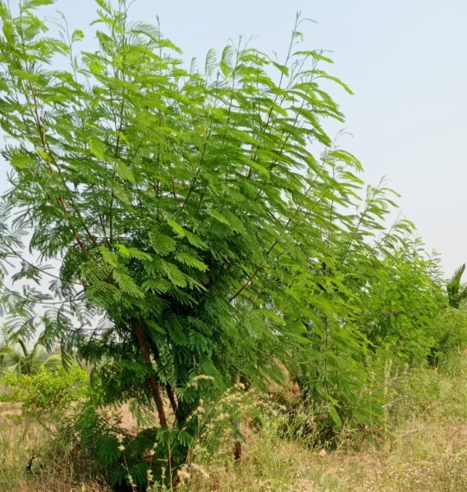
7: Demonstration of NARI Nirbeeja Subabul grafts for nutritious fodder
Place: Irigenahalli
Taluk: Devanahalli
Season:Kharif
Rationale
Farmers are getting low milk yield and SNF as they are not practicing mixed ration balancing with leguminous fodders.
Though subabul is a potential fodder, farmers are not preferring it due to its weed menace and susceptible to psyllids.
Subabul variety released by NARI, Maharashtra is sterile in nature, resistant to psyllids and high yielding with more palatability.
Therefore it is necessary to demonstrate NARI Nirbeeja grafts of subabul for nutritious fodder.
Source of Technology : NARI, Maharastra, 2016
Psyllid resistant
Sterile in nature
High palatability & digestibility
High Quality feed supplement (Dry matter 36-37%)
High yielding & fast growing (10kg of green foliage at every cutting of 12 weeks interval)
Check: Farmer’s Practice

Slide 56
Implementation
Critical Inputs
No of units : 20 (20 grafts/demo)
No of farmers: 20
Scientists – AE, Hort(SS & H) & Agron.
Particulars | Qty./ demo | Cost/ demo (Rs.)
Grafts/Plants | 20 | 1,000
Total (per demo) |  | 1000
Cost for 20 demos |  | 20,000
Board and Field day |  | 6000
Total Cost |  | 26000
Parameters
Plant height (cm)
Green fodder Yield/plant (Kg)
Green fodder Yield (t/ha)
Palatability (%)
Statistical test: Two way ‘t’ test
Educational activities
Method Demonstration
Training
Field Day

Slide 57
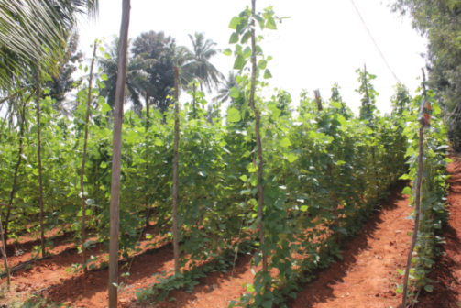
8: Integrated Nutrient Management in Pole bean
Avg. Yield: 29 t/ha
Pot Yield: 40 t/ha
Place: Kammasandra
Taluk: Hoskote
Season : Kharif/Rabi
Rationale
Pole bean is an important vegetable crop cultivated in Bengaluru Rural District. Farmers have not adopted integrated nutrient management, which has resulted in low yield and poor quality of beans.
Further, farmers are not using biological agents viz., Rhizobium, PSB, AMC and also micronutrients mixture like vegetable special though they are potential in enhancing yield and quality.
Hence, it is planned to demonstrate the INM practice in pole bean.
Source of Technology: UAS, Bengaluru, 2019
Rhizobium – 200 g for seed treatment per acre
PSB – 150 g for seed treatment per acre
AMC – 5 kg for 500 kg FYM/Compost
FYM: 10 t/ha, RDF – 25:40:30 kg/acre
50% N, 100 % PK as basal and 50 % N as top dress after 4 WAS
Vegetable special (2 sprays: Flower bud initiation & 10-15 days after 1st spray)
Check : Farmer’s Practice

Slide 58
Critical Inputs
Implementation
Area: 0. 2 ha per demo
No of farmers: 05
Scientists: SS, Hort (Sr.S & H) & Agron.
Particulars | Qty. /demo | Cost/ demo (Rs.)
Rhizobium | 1 Kg | 100
PSB | 1 kg | 100
Vegetable special | 1 kg | 200
AMC powder | 5 kg | 1000
Soil analysis | 3 | 900
Total (Per demo) |  | 2300
Cost for 5 demos |  | 11500
Board and Field day |  | 6000
Total Cost |  | 17500
Parameters
Soil fertility status
Plant height (cm)
No of branches/plant
No. of pods/plant
Length and girth of pod (cm)
Yield (t/ha)
B:C
Statistical test: Two way ‘t’ test
Educational activities
Method Demonstration
Training
Field Day
Distribution of Soil Health Cards

Slide 59
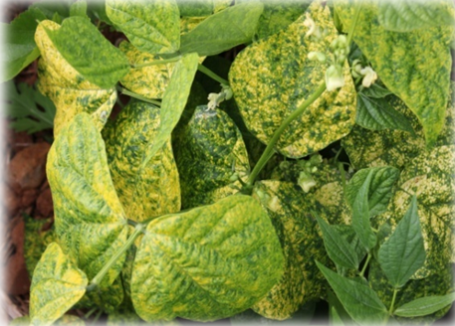
9: Management of Yellow Mosaic Virus in Pole bean through Integrated Approach
Place: Narasapura
Taluk: Nelamangala
Season : Kharif
Avg. Yield: 29 t/ha
Potential Yield: 40 t/ha
Rationale
Bengaluru Rural District having 570 ha. under pole bean which is highly susceptible to
YMV with a crop loss to an extent of 40 %.
Farmers are indiscriminately using pesticides to control whiteflies which act as a vector for YMV leading to higher cost of cultivation.
Therefore, it is need of the hour to conduct demonstration on integrated management of YMV in pole bean to enhance yield and quality.
Source of Technology : UAS (B), 2020
Seed treatment with Thiomethaxam 70 WS – 5g/kg seeds
Mulching with black silver mulch
Two rows of maize as border crop
Soil application of Pseudomonas fluorescens (2 L) along with neem cake (200 kg)
Installation of yellow sticky cards @ 10No./acre
Spraying of neem soap (10g/L), Seaweed extract -1.5ml/L, Thiamethoxam 25% WG (0.5 g/L) and Imidacloprid 17.8 SL (0.5ml/L)
Check: Farmer’s Practice

Slide 60
Implementation
Critical Inputs
Area : 0.2 ha. per demo
No. of farmers : 05
Scientists: PP, Hort (SS & H), Agron & SS
Critical Input | Qty./ trial | Cost/ trial
Pseudomonas fluorescens | 2 L | 1300
Neem cake | 200 kg | 2800
Yellow Sticky cards | 10 | 600
Neem soap | 2 kg | 550
Seaweed extract | 300 ml | 2250
Thiomethaxam | 20 g | 200
Total (per demo) |  | 7700
Cost for 5 demos |  | 38500
Board and Field day |  | 6000
Total Cost |  | 44500
Parameters
Plant height (cm)
No. of branches /plant
No. of pods/plant
Pod length (cm)
Whitefly incidence (%)
YMV incidence (%)
No. & cost of sprays
Yield (q/ha)
B:C
Statistical test: Two way ‘t’ test
Educational activities
Method Demonstration
Training
Field day

Slide 61
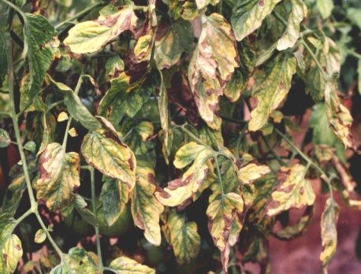
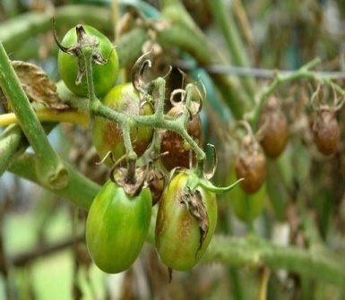
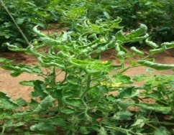
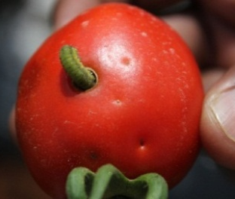
10: Integrated Pest and Disease Management in Tomato
Avg. Yield: 64 t/ha
Pot Yield: 75 t/ha
Place: Sonnamaranahalli
Taluk: Doddaballapura
Season : Kharif
Rationale
Tomato is an important vegetable crop in Bengaluru Rural District with an area of 2000 ha. Early blight, late blight, bacterial wilt , TLCV, pinworm and fruit borer are the major cause for reduction in yield (up to 40%) and quality in tomato.
Farmers are indiscriminately using pesticides to control above pest and diseases resulting in increased cost of cultivation.
Therefore, it Is necessary to conduct demonstration on IPDM in tomato using resistant hybrid and eco friendly inputs.
Early blight
Late blight
Leaf curl
Fruit borer

Slide 62
Source of Technology : IIHR & NBAIR, Bengaluru, 2019 & 2020
Arka Abedh hybrid
Marigold as trap crop (16:1)
Enrichment of FYM with bio agents
Spraying of neem soap (10g/L) & Bt (2ml/L)
Installation of yellow & blue sticky cards (10/acre)
Use of incandescent bulb @ one bulb/150 m² ₊ 1 pheromone trap/300 m²
Spraying of spinosad 0.25 ml/L & Flubendiamide @ 0.20 ml/l in rotation at 3 weeks interval & decamethrin 2.5 EC @ 1 ml/L
Spraying of Shatpada Master Blaster – 20g/L at 20, 30, 40 & 50 DAT
Check: Farmer’s Practice

Slide 63
Critical Inputs
Implementation
Area: 0.2 ha. Per demo
No of farmers: 05
Scientist : PP, Hort (SS & H), SS & Agron
Particulars | Qty./ demo | Cost/ demo (Rs.)
Arka Abedh seeds | 10 g | 300
Trichoderma harzianum | 2 kg | 400
Pseudomonas fluorescens | 2 kg | 500
Wota-T trap | 5 | 500
Blue Sticky cards | 10 No. | 600
Yellow Sticky cards | 10 No. | 600
Neem soap | 2 kg | 550
Bt | 500 ml | 1250
Spinosad (microbial) | 75ml | 2000
Shatpada – Master Blaster | 16 kg | 3200
Total (Per demo) |  | 9,900
Cost for 5 demos |  | 49,500
Board and Field day |  | 6000
Total Cost |  | 55500
Parameters
Plant height (cm)
No. of branches/plant
Disease incidence (%)
Pest incidence (%)
No. & cost of sprays
No. of fruits/plant
Fruit weight/plant
Fruit yield (q/ha)
B:C
Implementation
Statistical test: Two way ‘t’ test
Educational activities
Method Demonstration
Training
Field day

Slide 64
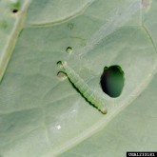
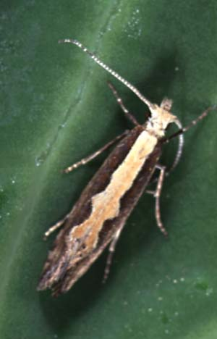
11: Eco friendly Management of pest and diseases in Cauliflower
Rationale
Avg. Yield: 36 t/ha
Pot. Yield: 48 t/ha
Place: Sonnamaranahalli
Taluk: Doddaballapura
Season : Kharif/ Rabi
Cauliflower is an important vegetable crop being cultivated in Bengaluru Rural District with an area 250 ha.
DBM (>37%), aphids, leaf webber and black rot (>10 %) causes severe yield loss in cauliflower with poor quality curd.
Farmers are indiscriminately using pesticides to manage above pest and disease which is hazardous to human health.
Therefore eco friendly management of these pest and disease is need of the hour.
DBM larva
DBM Adult

Slide 65
Source of Technology : UAS (B) & IIHR, Bengaluru, 2019
Timely application of RDF
Intercropping with Mustard as trap crop (25:2), Installation of WOTA-T traps (DBM traps)
Spraying of Boric acid (0.3%) & Ammonium molybdate (0.02%) 15 DAT @ 15 days interval (3 times)
Spraying of vegetable special (5g/L)
Spraying of Neem Soap (10g/L) and Bt (2ml/L)
Spraying of Neem seed powder pellets (20g/L)
Use of blue Sticky cards (10 no./acre)
Spraying of Emamectin benzoate 5SG (0.05%), Chlorfenapyr 10SC (0.1%) and Spinosad 2.5SC (0.15%)
Spraying of CoC + Streptocycline
Check: Farmer’s Practice

Slide 66
Critical Inputs
Implementation
Particulars | Qty./ demo | Cost/ Demo (Rs.)
Mustard seeds | 0.5 kg | 100
WOTA – T traps | 5 No | 400
Blue Sticky cards | 10 No | 600
Neem soap | 2 kg | 530
Neem seed powder pellets | 6 kg | 1500
Bt | 3 L | 2170
Boric acid | 1 kg | 150
Ammonium molybdate | 1 kg | 150
Vegetable special | 6 kg | 1200
Spinosad (microbial) | 75ml | 2000
Total (per demo) |  | 8,800
Cost for 5 demos |  | 44, 000
Board and Field day |  | 6000
Total Cost |  | 50000
Area: 0.2 ha. Per demo
No. of farmers: 05
Scientists: SS & H, PP & SS
Parameters
DBM & Aphids incidence (%)
Black rot incidence (%)
No. & cost of sprays
Weight of curd/plant
Yield (q/ha)
Quality
B:C
Statistical test: Two way ‘t’ test
Implementation
Educational activities
Method Demonstration
Training
Field day

Slide 67
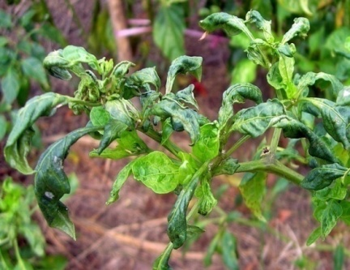
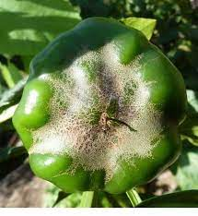
12: Management of mites & thrips in Capsicum under polyhouse
Place: Turuvanahalli
Taluk: Doddaballapura
Season : Kharif
Avg. Yield: 62 t/ha
Pot. Yield: 80 t/ha
Rationale
Capsicum is one of the important vegetable grown under polyhouse with warm humid condition which creates congenial environment for development of mites and thrips causing yield loss up to 32%.
Use of synthetics results in destruction of natural enemies, pest resurgence and simultaneous development of resistance against insecticides.
Therefore it is necessary to conduct demonstration on management of mites and thrips in capsicum under polyhouse with eco friendly inputs.
Source of Technology : NBAIR & IIHR, Bengaluru, 2020
Spraying of Shatpada All Rounder – 20g/L at 20, 30, 40 & 50 DAT
Spraying of Spinosad – 0.25ml/L
Installation of blue sticky cards – 10 no.s/acre
Spraying of abamectin – 0.5ml/L
Check : Farmer’s Practice

Slide 68
Implementation
Area: 300 m² per demo
No. of farmers: 05
Scientists: Hort (SS & H), PP & SS
Critical Inputs
Particulars | Qty./ demo | Cost/ demo (Rs.)
Blue Sticky cards | 10 No. | 600
Spinosad (microbial) | 75ml | 2000
Abamectin (Actinomycetes) | 200 ml | 1200
Shatpada – All rounder | 16 kg | 3200
Total (per demo) |  | 7,000
Cost for 5 demos |  | 35,000
Board and Field day |  | 6000
Total Cost |  | 41000
Parameters
Plant height (cm)
No. of branches/plant
Mites & thrips incidence (%)
No. & cost of sprays
No. of fruits/plant
Yield (t/ha)
Marketable yield (t/ha)
B:C
Statistical test: Two way ‘t’ test
Educational activities
Method Demonstration
Training
Field day

Slide 69
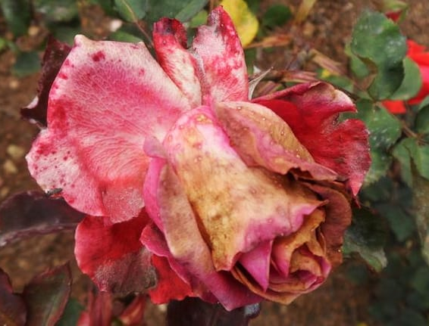
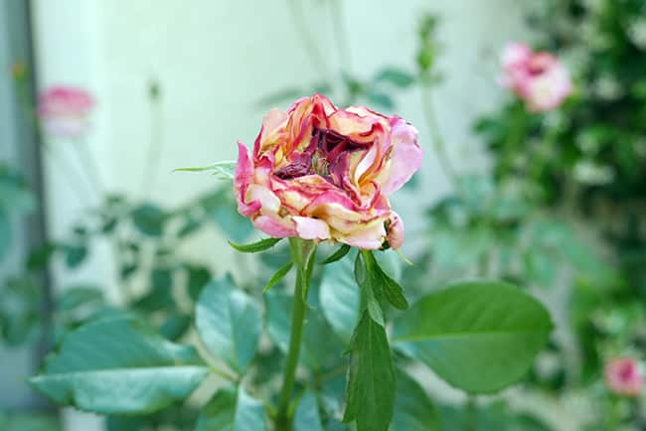
13 : Bio - Intensive Management of Pest and Diseases in Rose
Place: Sonnamaranahalli
Taluk: Doddaballapura
Season : Across the year
Avg. Yield: 5.49 t/ha
Pot. Yield: 12 t/ha
Rationale
Rose is an important crop of the District with an area of 1200 ha.
Reduction in yield and quality are the major constraints faced by farmers due to severe thrips incidence (>30 %), blackspot and powdery mildew.
Therefore, it is necessary to take up bio intensive management of pest and diseases in Rose for maximum yield and quality.
Thrips

Slide 70
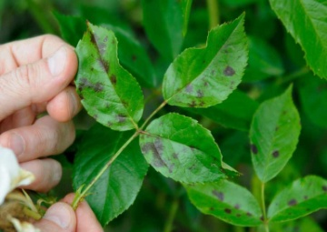
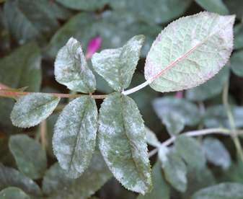
Black spot
Powdery mildew
Source of Technology : IIHR, 2016
Soil test based nutrient application
Enrichment of FYM with bio agents
Timely Pruning
Use of sticky cards
Foliar spray of micronutrient mixture
Timely spraying of plant protection chemicals
Maturity index for harvest
Check: Farmer’s practice

Slide 71
Critical Inputs
Implementation
Area: 0.2 ha. Per demo
No. of farmers: 05
Scientists: Hort. (SS & H), PP, Agron. & SS
Particulars | Qty./ demo | Cost/ Demo (Rs.)
Trichoderma harzianum | 5 kg | 1000
Pseudomonas fluorescens | 5 kg | 1250
Rose mixture | 1 kg | 200
Blue Sticky cards | 10 No. | 600
Yellow Sticky cards | 10 No. | 600
Spinosad (Microbial) | 75 ml | 2000
Nativo | 500 g | 3500
Total (per demo) |  | 9150
Cost for 5 demos |  | 45750
Board and Field day |  | 6000
Total Cost |  | 51750
Parameters
Plant height (cm)
No. of branches/plant
No. of flowers/plant
Thrips incidence(%)
Black spot incidence (%)
Powdery mildew incidence (%)
Flower yield (q/ha)
Flower Quality
B:C
Statistical test: Two way ‘t’ test
Educational activities
Method Demonstration
Training
Field day

Slide 72
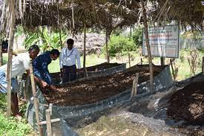
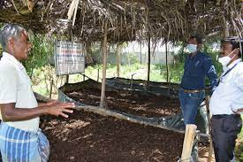
14: Demonstration of compost culture for quality compost production using Seri farm residue
Place: Kammasandra
Taluk: Hoskote
Season: Round the year
Area: 6482 ha
Yield: 60 t/ha
Rationale
Bengaluru Rural District comprising mulberry cultivation in an area of 6400 ha. Shoot rearing of 100 DFL’s yields an residue of 1.5 to 2 tons and farmers are not converting this farm residue into organic matter in a scientific way.
Therefore, it is required to take up this demonstration in order to make farmers aware about scientific conversion of sericulture farm residue into compost using compost culture.
Source of Technology : UAS(B), 2021
1 ton Seri farm residue + waste decomposer solution (2 kg Jaggery + 1 Kg microbial consortia in 200 litres of water)
Check: Farmer’s practice

Slide 73
Critical Inputs
Implementation
Particulars | Qty./ demo | Cost (Rs.)
Compost bag | 1 | 3000
Compost culture (1 kg/ton of waste) | 1 kg | 100
Compost analysis | 1 | 300
Total (per demo) |  | 3400
Cost for 5 demos |  | 17000
Board and Field day |  | 6000
Total Cost |  | 23000
No of units: 5
No of farmers : 05
Scientists: AE, Sr.S &H and SS
Parameters
Conversion period (days)
Compost recovery (%)
N:P:K content in compost
B:C
Statistical test: Two way ‘t’ test
Educational activities
Method Demonstration
Training
Field Day

Slide 74
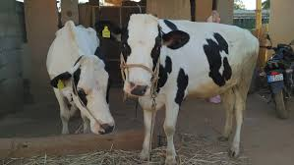
15: Ration Balancing through Integrated Approach in Dairy Animals
Avg. Yield : 8.7 L
Pot. Yield: 10.5 L
Place: Sonnamaranahalli
Taluk: Doddaballapura
Season : Round the year
Rationale
Bangalore rural district is known for milk production in Karnataka. Farmers are spending more cost towards milk production (Rs. 16/l) and getting moderate fat and SNF due to improper ration balancing to milching animals.
Therefore, it is essential to demonstrate ration balancing in dairy animals through integrated approach.
Source of Technology : NIANP (2018)& KVAFSU (2009)
Urea enrichment of dry fodder
Chaff cutting of forages
Total Mixed Ration (TMR)
Mineral mixture
Azolla supplementation
Silage production technology
Check: Farmers practice

Slide 75
Critical Inputs
Implementation
Particulars | Qty./demo | Cost/ demo (Rs.)
Silpaulin sheet | 1 | 1000
Silage bags/drums | 1 | 1000
Azolla rings | 1 | 1500
Azolla | 1kg | 100
Feed chart | 1 | 50
Silage inoculants | 10 g | 800
Total (Per demo) |  | 4450
Cost for 10 demos |  | 44500
Board and Field day |  | 6000
Total Cost |  | 50500
No. of Units : 10
No. of milching animal per demo: 01
Scientists: AS, AE, Hort (SS & H) & PP
Parameters
Avg. Milk yield for 3 months (L)
Milk fat (%)
Milk SNF (%)
Reduction in cost of milk production (Rs)
B:C
Statistical test: Two way ‘t’ test
Educational activities
Method Demonstration
Training
Field day

Slide 76
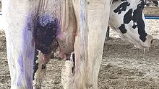
16 : Demonstration to prevent mastitis in HF cattle
Place: Irigenahalli
Taluk: Devanahalli
Season : Round the year
Rationale
Mastitis is a major problem in dairy cattle after calving which reduces milk yield (up to 40%) and quality.
If mastitis is not prevented in earlier stages, it leads to expensive treatment under clinical condition.
Therefore, it is essential to have demonstration on prevention of sub – clinical mastitis in HF cattle.
Source of Technology : NDDB, Gujarat (2017) and NDRI, Karnal (2019)
Clean milk production
Dry cow therapy with cefalonium
CMT (twice in a week)
Post milking teat dip with povidone iodine solution @ 0.5 %
Chelated minerals and vitamin supplementation
Ethno-veterinary medicine practice (Alovera + Turmeric + Lime + Calcium oxide)
Check: No sub clinical mastitis prevention
Notes:
(iodophore solution) 0.5 %. (Povidone idoine solution)

Slide 77
Critical Inputs
Implementation
Critical Input | Qty./ trial | Cost /trail (Rs.)
Cefalonium antibiotics | 4 | 1200
CMT Kit | 1 | 450
Teat dip | 2 L | 700
Chelated mineral mixture & vitamin supplement | 2 Kg | 800
Cost (per demo) |  | 3150
Cost for 10 demos |  | 31500
Board and Field day |  | 6000
Total |  | 37500
No. of units: 10 HF cattle
No. of cattle per demo : 1
Scientists : AS & AE
Parameters
Incidence of mastitis (%)
Avg. milk yield (L)
Fat and SNF (%)
B:C
Educational activities
Method Demonstration
Training
Field day
Notes:
SCC Normal : 250000

Slide 78
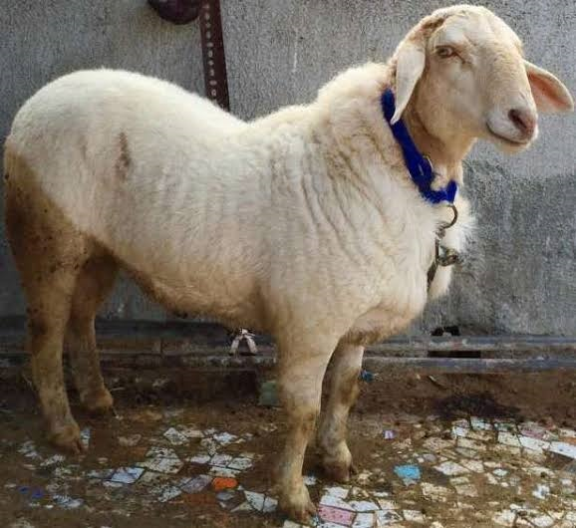
17: Pro-biotics for optimum post-weaning growth in lambs
Rationale
Place: Kammasandra
Taluk: Hoskote
Season: Round the year
Improper post weaning in lambs leads to imbalance in rumen microflora resulting in decreased growth rate.
Pro - biotics plays an important role in maintaining gut health during post weaning period.
Therefore, it is essential to conduct demonstration on Pro-biotics for optimum post-weaning growth in lambs
Source of Technology: TANUVAS (Tamil Nadu), 2018
Pro - biotics with bypass protein for better digestion and ruminal microflora
20-25g/day/animal
Check: No pro-biotics during post weaning period

Slide 79
Implementation
No. of units: 10
No. of lambs per demo: 03
Scientists: AS & AE
Critical Inputs
Particulars | Qty./demo | Cost/demo (Rs.)
Pro – biotics | 6 kg | 3000
Total (per demo) |  | 3000
Cost for 10 demos |  | 30,000
Board and Field day |  | 6000
Total Cost |  | 36000
Parameters
Body weight gain in lambs over a period of 3 months (kg)
Incidence of Diarrhoea
B:C
Statistical test: Two way ‘t’ test
Educational activities
Method Demonstration
Training
Field day

Slide 80
18: Demonstration of Genetically Improved Farmed Tilapia (GIFT) in farm ponds
Place: Irigenahalli
Taluk: Devanahalli
Season : Rabi
Rationale
There are about 5000 farm ponds in Bengaluru rural district, where in only few farmers are practicing aqua culture with rohu, common carp and catla which generally takes a year for harvesting.
Whereas, Genetically Improved Farmed Tilapia weighing around 350-500gm suitable for table purpose and takes 5-6 months for their harvest.
Hence, there is a need to demonstrate rearing of GIFT in farm ponds.
Source of Technology : UAS(B), 2010
Application of lime
Net covering
Manuring by cow dung (300gm/sq mt)
Fish stocking (5 fingerlings / Sq mt)
Feeding through floating feeds
Check: No pisciculture

Slide 81
Critical Inputs
Implementation
Unit area: farm pond of 10m X10 m
No. of farmers: 10
Scientists: AS & AE
Particulars | Qty./demo | Cost/demo (Rs.)
Tilapia Fingerlings | 500 | 2500
Floating feed | 1 bag | 2500
Cost (per demo) |  | 5000
Cost for 10 demos |  | 50000
Board and Field day |  | 6000
Total Cost |  | 56000
Parameters
No. of days for harvest
No. of fish harvested
Weight of fish(g)
Yield (kg/pond)
Profit (Rs)
Statistical test: Two way ‘t’ test
Educational activities
Method Demonstration
Training
Field day

Slide 82
Nutri garden for farm families

Slide 83
Nutri garden for farm families
Place: Tubgere, Rajaghatta and Budigere FPO
Season: Kharif, Rabi and Summer
Rationale
Malnutrition is a major problem in rural area and 23 % women and 18.8 % men are under weight in Bengaluru Rural District apart from 48.8 % children (<5 yrs) and 46.6 % women (15-40yrs) are suffering from anaemia.
Further, farmers are not aware of major role of fruits and vegetables in daily diet.
Therefore, it is essential to demonstrate nutri garden for farm families to ensure nutritional security and additional income generation.
Source of Technology : IIHR, 2012
Establishment of nutrition garden for FPO members

Slide 84
Critical Inputs
Particulars | Qty./demo | Cost/ demo (Rs.)
Planting material Vegetable Seeds-24 types Medicinal plants-10 types | 34 | 500
Vegetable special | 1kg | 200
Neem oil | 250 ml | 400
Pongamia cake | 10kg | 450
AMC | 1kg | 200
Total (per demo) |  | 1750
Cost for 30 demos |  | 52,500
Board & Field Day |  | 6,000
Total cost (Rs.) |  | 58,500
Implementation
Area: 2 guntas/demo
No of farmers: 30
Scientists: HS, Sr.S & H and All Scientists
Parameters
Vegetable production (kg/1 gunta)
Vegetable consumption (kg/family)
Sale of vegetables (kg)
B:C

Slide 85
Trainings
Particulars | Target Group | Number
On Campus trainings | Rural Youth | 7
 | Extension personnel | 6
Off Campus trainings | Farmers and farm women | 6
 | Rural Youth | 7
 | Extension personnel | 8
Total | Total | 34

Slide 86
Abstracts of Activities

Slide 87
Abstract of activities for Senior Scientist & Head (Horticulture)
Activities | Number
OFT | 03
FLD | 18
OFT Trainings | 06
FLD Trainings | 36
On- Campus Trainings | 18
Off- campus Trainings | 48
Projects | 03
SAC activities | 3
Method Demonstrations | 10
Field days | 21
Diagnostic field visits | 18

Slide 88
Abstract of activities for Scientist (Agronomy)
Activities | Number
OFT | 01
FLD | 03
OFT Trainings | 02
FLD Trainings | 06
On- Campus Trainings | 04
Off- campus Trainings | 08
Projects | 01
SAC activities | 07
Method Demonstrations | 03
Field days | 04
Diagnostic field visits | 08

Slide 89
Abstract of activities for Scientist (Plant Protection)
Activities | Number
OFT | 01
FLD | 03
OFT Trainings | 02
FLD Trainings | 06
On- Campus Trainings | 05
Off- campus Trainings | 10
Projects | 03
SAC activities | 03
Method Demonstrations | 04
Field days | 04
Diagnostic field visits | 21

Slide 90
Abstract of activities for Scientist (Soil Science)
Activities | Number
OFT | 01
FLD | 03
OFT Trainings | 02
FLD Trainings | 06
On- Campus Trainings | 04
Off- campus Trainings | 08
Projects | 03
SAC activities | 02
Method Demonstrations | 04
Field days | 04
Diagnostic field visits | 08

Slide 91
Abstract of activities for Scientist (Agril. Extension)
Activities | Number
FLD | 02
FLD Trainings | 04
On- Campus Trainings | 18
Off- campus Trainings | 21
Projects | 01
SAC activities | 04
Method Demonstrations | 02
Field days | 02
Celebration of important days | 19
Preparation of technical reports, Leaflets, folders | 12

Slide 92
Abstract of activities for Scientist (Animal Science)
Activities | Number
FLD | 04
FLD Trainings | 08
On- Campus Trainings | 04
Off- campus Trainings | 06
Projects | 01
SAC activities | 03
Method Demonstrations | 04
Field days | 04
Diagnostic field visits | 08

Slide 93
Abstract of activities for Scientist (Home Science)
Activities | Number
FLD | 01
FLD Trainings | 02
Nutrition garden | 01
On- Campus Trainings | 03
Off- campus Trainings | 05
Projects | 01
SAC activities | 03
Method Demonstrations | 04
Field days | 02

Slide 94
Abstract of activities for Farm manager
Activities | Number
Seed Production | 5.0 ha.
Farm trials | 14
Planting materials | 2000
SAC activities | 06
Method demonstrations | 04
Demonstration Units | 12

Slide 95
Abstract of activities for Programme Assistant (lab)
Activities | Number
Soil testing | 1000
Water Testing | 500
Assisting in organizing Trainings / Seminars / Workshops / Method Demonstrations | 20
Abstract of activities for Programme Assistant (Computer)
Activities | Number
MPR-Monthly Progress Report | 12
MR-Monthly Report | 12
QR-Quarterly Report | 02
AR- Annual Report | 01
OLRS- Online Reporting System | 01
Action plan | 01

Slide 96
Abstract of Activities Planned for 2022-23
Sl. No. | Activity | Unit | Quantity | Approx. amount
1 | On-farm Test | 3 | 13 | 96250
2 | Front line demonstration | 18 | 135 | 615300
3 | Special programmers (ARYA) | 1 | 120 | 2000000
3 | Capacity Development
3.1 | Training- Institutional | 30 | 900 | 100000
3.2 | Training- Off campus | 42 | 1200 | 100000
3.3 | Training - sponsored | 5 | 200 | 200000
4 | Production and Supply of Technological Inputs
4.1 | Production of seeds |  | 40q | 150000
4.2 | Production of planting material | 2000 |  | 150000
4.3 | Production of organic manure |  | 15 t | 30000
4.4 | Production of poultry chicks | 500 |  | 20000

Slide 97
Sl. No. | Activity | Unit | Quantity | Approx. amount
5 | Field days | 21 | 630 | 118000
6 | Method demonstrations | 50 | 750 | 100000
7 | Workshops | 2 | 100 | 50000
8 | Multi- agency extension activities (NGOs/CSOs) | 4 | 140 | 200000
9 | E-Extension( mobile/short video) | 5 | 150 | 10000
10 | Market led extension (Market oriented production) | 2 | 120 | 25000
11 | Group lead extension activities(CBOs/ UGs) | 4 | 110 | 50000
12 | Farming systems extension activities (IFS based) | 5 | 5 | 50000

Slide 98
Sl. No. | Activity | Unit | Quantity | Approx. amount
13 | Diagnostic/ advisory visits | 25 | 130 | 5000
14 | Soil and Water analysis
14.1 | Soil samples analysis | 800 | 800 | 240000
14.2 | Water sample analysis | 500 | 500 | 100000
15 | Publications
15.1 | Leaflets/ Folders | 10 | 1000 | 50000
15.2 | Research papers | 5 | 5 | 30000
15.3 | Booklets/ Brochures | 5 | 250 | 25000
16 | Electronic media activities
16.1 | Radio talk | 5 | - | -
16.2 | TV programme | 3 | - | -
17 | Special day/ events
17.1 | Special days | 15 | 900 | 75000

Slide 99
Sl. No. | Activity | Unit | Quantity | Approx. amount
18 | Instructional farm activities
18.1 | Development works(land, irrigation, equipment, etc.) | 5 ha. | - | 200000
18.2 | Production and maintenance of demonstration units |  | 15 No. | 300000
18.3 | Inputs and operational expenses for crops production | 10 ha. | - | 500000

Slide 100
Thank you

