Slide 1


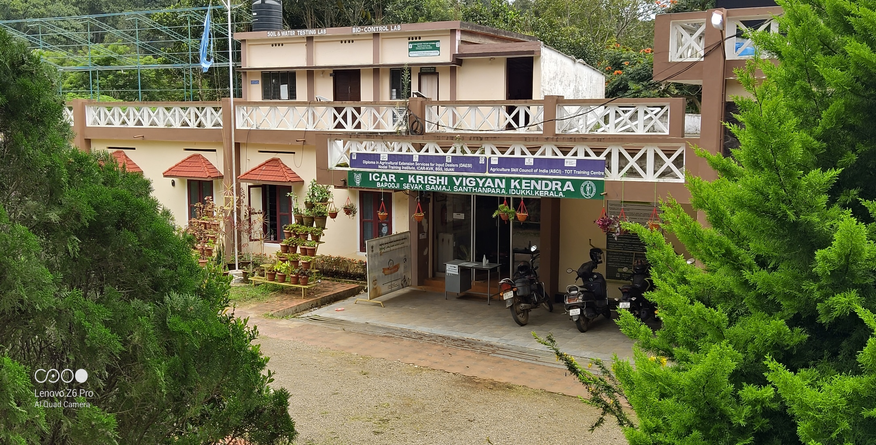
ICAR - KRISHI VIGYAN KENDRA (BSS)
IDUKKI
ANNUAL REVIEW WORKSHOP (2020-21)

Slide 2
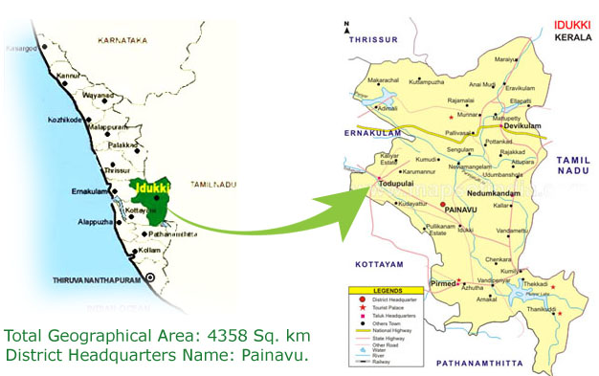

IDUKKI DISTRICT PROFILE
Geographical area: 4358 sqkm. Population : 11.08 lakhs Taluks : 5 Blocks : 8 Panchayats : 53 Villages : 65 | Avg. ann. rainfall : 2900 mm Temperature : max 35ºC min 10ºC Relative Hum. (%) : 73.7% Agro climatic Zone : High Altitude Zone (KE – 4) Agro Ecological Zone : Western Plains and Ghat region(XII)
Annual Review Workshop 2020-21 ICAR-KVK (BSS), Idukki

Slide 3
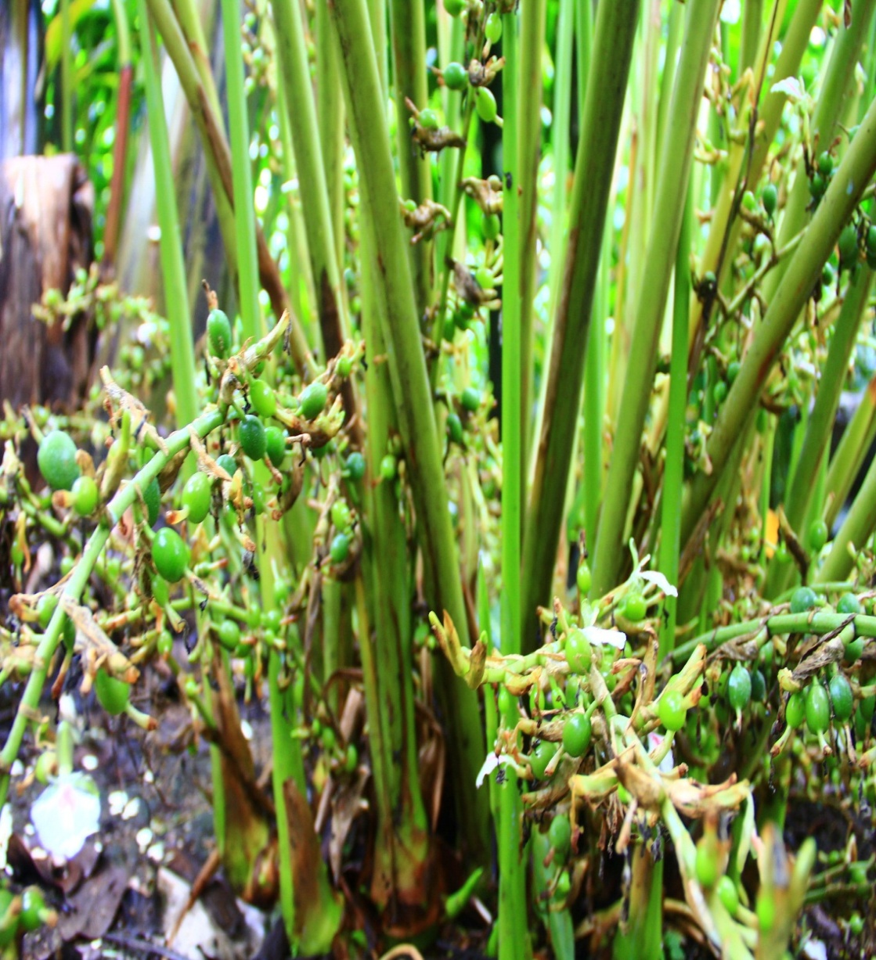
Month | Rainfall (mm)
April 2020 | 90.90
May 2020 | 104.40
June 2020 | 63.30
July 2020 | 790.00
Aug. 2020 | 108.20
Sep. 2020 | 108.40
Oct. 2020 | 191.20
Nov. 2020 | 148.30
Dec. 2020 | 70.30
Jan. 2021 | 27.90
Feb. 2021 | 17.20
Mar. 2021 | 46.00
TOTAL | 1766.10 mm
RAINFALL 2020-21
Average Rainfall 3671.5mm
SOUTH WEST MONSOON – 1069.9 mm
NORTH EAST MONSOON – 409.8 mm
SUMMER – 286.4 mm
Annual Review Workshop 2020-21 ICAR-KVK (BSS), Idukki

Slide 4
STAFF IN POSITION
CATEGORY OF POSTS | SANCTIONED | FILLED
Senior Scientist & Head | 1 | 1
Subject Matter Specialist | 6 | 5
Programme Assistant | 3 | 3
Administrative staff | 2 | 2
Auxiliary staff | 2 | 1
Supporting staff | 2 | 2
Total | 16 | 14
* Screening of application completed on 24 & 25.03.2021
Annual Review Workshop 2020-21 ICAR-KVK (BSS), Idukki

Slide 5
AREA, PRODUCTION AND PRODUCTIVITY OF MAJOR CROPS
Crop | Area (ha) | Production (Metric tons) | Productivity (kg / ha)
Cardamom | 31165 | 16505 | 530
Pepper | 43790 | 18726 | 428
Banana | 7535 | 67469 | 8954
Rice | 695 | 1631 | 2347
Coconut | 16122 | 63 million nuts | 3907
Tapioca | 6998 | 297870 | 42565
Coffee | 12717 | 8310 | 653
Tea | 40590 | 44991 | 2048
Annual Review Workshop 2020-21 ICAR-KVK (BSS), Idukki

Slide 6
AREA UNDER AGRICULTURAL CROPS IN IDUKKI DISTRICT
Annual Review Workshop 2020-21 ICAR-KVK (BSS), Idukki

Slide 7
OPERATIONAL AREA
LEGEND
1. | VATTAVADA
2. | KOVILOOR
3. | KDHP VILLAGE
4. | RAJAKUMARI
5. | SANTHANPARA
6. | SENAPATHY
7. | VANDANMEDU
8. | NEDUMKANDAM
9. | UDUMBANCHOLA
10. | KATTAPPANA
KVK
Taluks : 2 Blocks : 2 | Clusters : 3 Villages : 10
Annual Review Workshop 2020-21 ICAR-KVK (BSS), Idukki

Slide 8
TARGET AND ACHIEVEMENTS OF MAJOR MANDATES
Sl. No. | Mandates | Target (Nos.) | Achievements (Nos.)
1. | OFT | 5 | 5
2. | FLD | 10 | 10
3. | Trainings | 175 | 125
4. | Extension Programmes | 1686 | 1829
5. | Production and Supply of Seeds (q) | 0.1Q
 |  | Target | Production | Supply
6. | Planting materials | 12000 | 9734 | 7734
7a. | Bio products (lit) | 19550 | 7220 | 6961
7b. | Bio products (kg) | 9320 | 17985 | 16064
7c. | Spawn | 0 | 3182 Pkts. | 2577 Pkts.
Annual Review Workshop 2020-21 ICAR-KVK (BSS), Idukki

Slide 9
MAJOR THRUST AREA FOR DOUBLING THE FARMERS INCOME
Sl. No. | Thrust area
Theme A | IMPROVEMENT IN PRODUCTIVITY
 | Integrated crop management practices
 | Soil health management
 | Crop improvement
 | Drought management
 | Bio intensive crop health management
 | Live stock production and management
Theme B | RESOURCE USE EFFICIENCY OR SAVING IN COST OF PRODUCTION
 | Natural resource management
 | Bio waste Management
 | Bee keeping
Theme C | INCREASE IN CROPPING INTENSITY
 | Intercropping
Theme D | CROP DIVERSIFICATION TOWARDS HIGH VALUE CROPS
 | Popularisation of hybrid poultry birds
Annual Review Workshop 2020-21 ICAR-KVK (BSS), Idukki

Slide 10
Completed OFTs of (2019-20)
Sl. No. | Crop/ Enterprises | Title of Assessment | No. of trials
1. | Finger millet | Assessment of finger millet varieties in tribal belts of Idukki district | 3
2. | Black pepper | Assessment of different potting mixture to produce healthy planting material of Black pepper | 2
3. | Passion Fruit | Assessment of micro-nutrient sprays for mitigating irregularities in passion fruit | 2
4. | Poultry | Assessment of Production performance of different breeds of poultry under homesteads in Idukki district | 5
Approved OFTs (2020-21)
1. | Banana | Assessment of Fusarium Wilt Disease management in Banana | 5
2. | Yard Long Bean | Assessment of Yard Long Bean Varieties in Idukki district | 5
3. | Cassava | Assessment of Cassava varieties in high ranges | 5
4. | Composting | Assessment of different decomposing cultures in composting of agricultural wastes | 5
5. | Dairy Cattle | Assessment of EVM preparations for control of ectoparasites in dairy cattle. | 5
Annual Review Workshop 2020-21 ICAR-KVK (BSS), Idukki

Slide 11
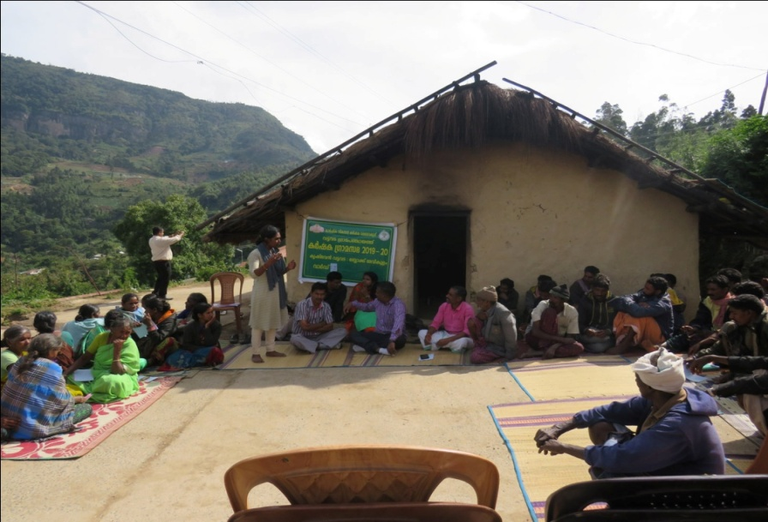
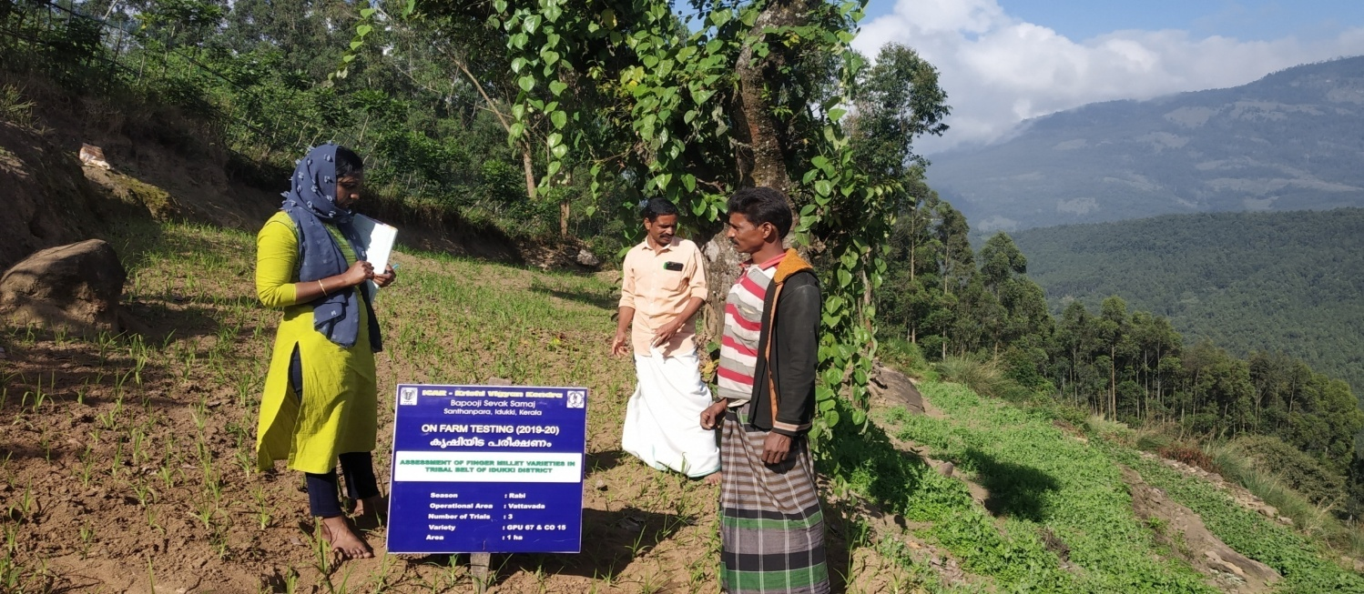
OFT 1. ASSESSMENT OF FINGER MILLET VARIETIES IN TRIBAL BELTS OF IDUKKI DISTRICT
Operational area | Vattavada
Area under finger millet | 27 ha
Season | Rabi
Area | 1 ha
Trials | 3
Prioritized Problem | Lodging (Yield loss 16 - 19%) Shattering losses Severe disease incidence (Yield loss 28%) Non availability of improved variety
Technological options
TO1 | Farmer Practice – Traditional variety
TO2 | CO 15 (TNAU)
TO3 | GPU 67 (UAS, Bangalore)
Annual Review Workshop 2020-21 ICAR-KVK (BSS), Idukki

Slide 12
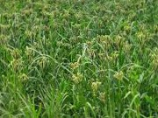
RESULTS
Parameters | To 1 (Traditional) | TO 2 (CO 15) | To 3 (GPU 67)
No. of tillers/plant | 6 | 5 | 7
Ear length (cm) | 8.17 | 7.0 | 6.93
Shattering loss | 23 % | 7% | 4%
Disease incidence | 47% | 12% | 5%
Yield (q/ha) | 10.8 | 13.5 | 19.5
Gross Cost (Rs./ha) | 13833.00 | 14667.00 | 15333.00
Gross Return (Rs./ha) | 21667.00 | 27000.00 | 39000.00
Net return | 7833.00 | 12333.00 | 23667.00
BC ratio | 1.57 | 1.84 | 2.54
Conclusion
GPU 67 found effective in terms of yield compared to CO 15 and traditional
Pest and disease incidence was less in GPU 67
Feed back
26 farmers took sowing with GPU 67
GPU 67
Annual Review Workshop 2020-21 ICAR-KVK (BSS), Idukki

Slide 13
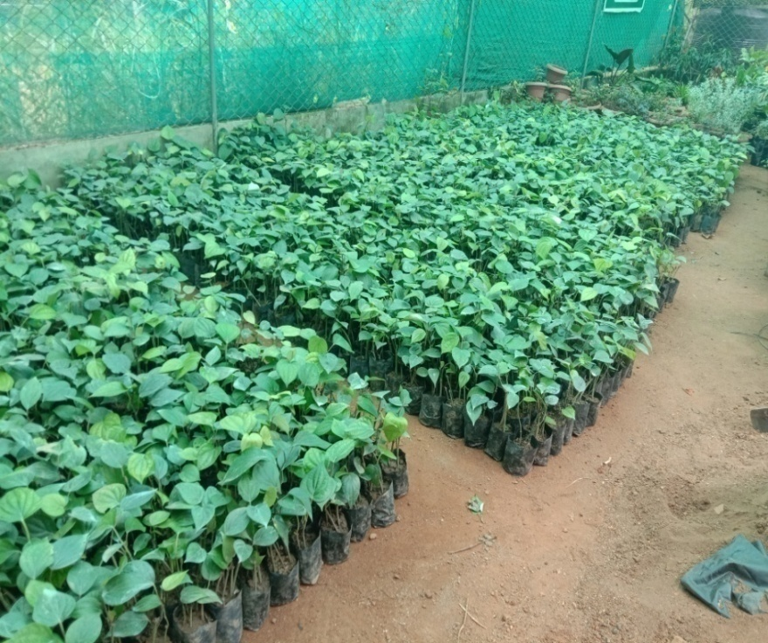
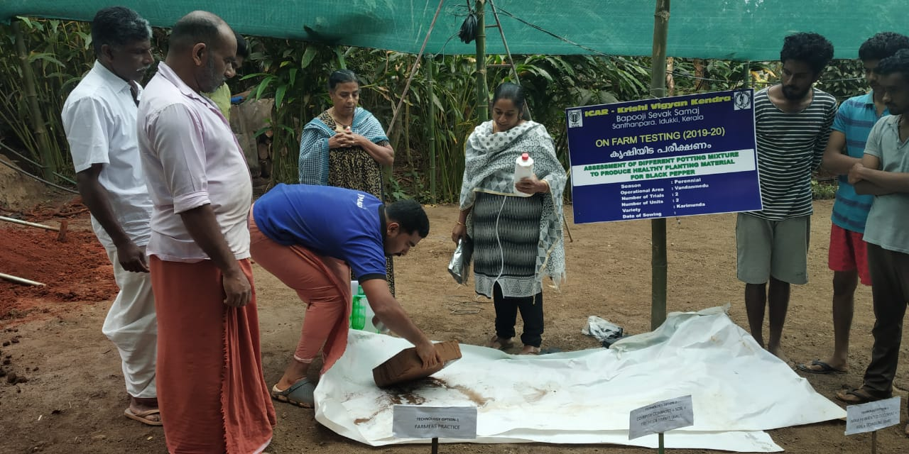
OFT 2. ASSESSMENT OF DIFFERENT POTTING MIXTURE TO PRODUCE HEALTHY PLANTING MATERIAL OF BLACK PEPPER
Operational area | Vadanmedu
Area under Pepper | 1215 ha
Season | Summer
Area/units | 02
Trials | 02
Prioritized Problem | Less recovery of plants due to Quick wilt Growth retardation
Technological options
TO1 | Farmers Practice (1:1:1 of soil+ cowdung + sand)
TO2 | Coir pith compost + Soil + Trichoderma - ( KAU)
TO3 | Arka fermented cocopeat + soil + cowdung ( IIHR)
Annual Review Workshop 2020-21 ICAR-KVK (BSS), Idukki

Slide 14
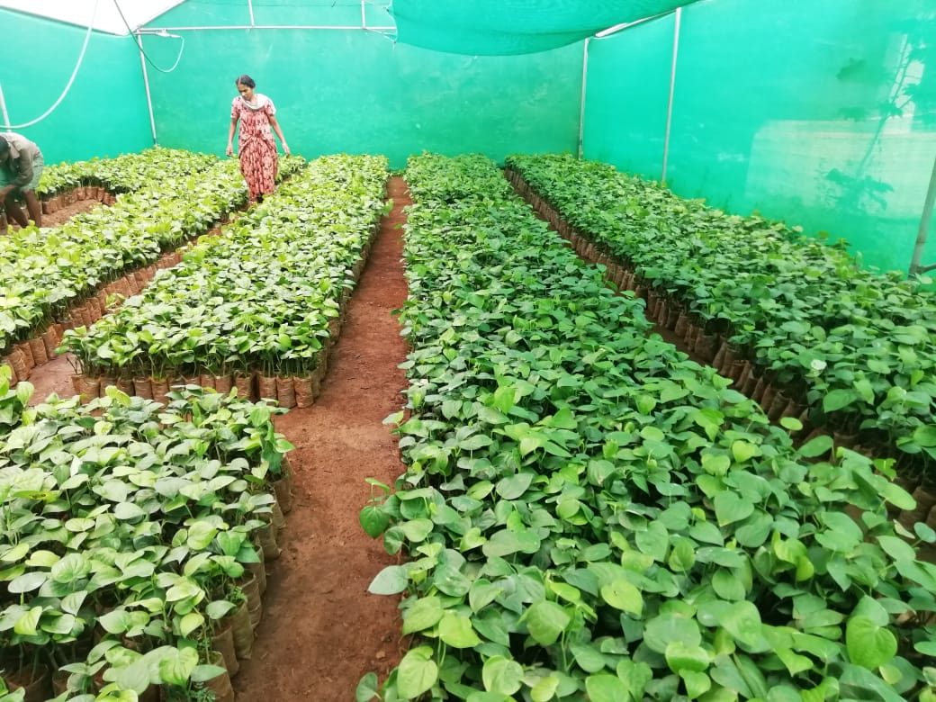
RESULTS
Parameters | TO 1 | TO 2 | TO 3
% recovery of plants | 58 | 82 | 75
% incidence of diseases | 42 | 18 | 25
Gross Cost (Rs / 500 bag) | 5990.00 | 5900.00 | 5850.00
Gross Return (Rs / 500 bag) | 8700.00 | 15560.00 | 11250.00
Net return | 2710.00 | 9660.00 | 5400.00
BC ratio | 1.45 | 2.63 | 1.9
Conclusion
Trichoderma enriched coir pith compost gave better result in reducing quick wilt incidence
Feed back
% recovery of plants were more in treatment with Trichoderma enriched coir pith compost
Two nursery units were established
Two lakhs rooted cutting were produced
Linked with FPOs
Annual Review Workshop 2020-21 ICAR-KVK (BSS), Idukki

Slide 15
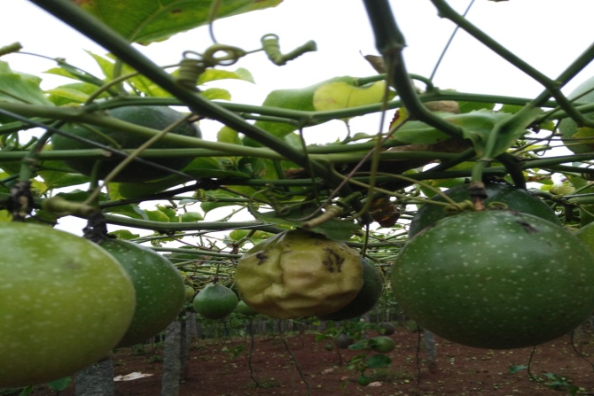
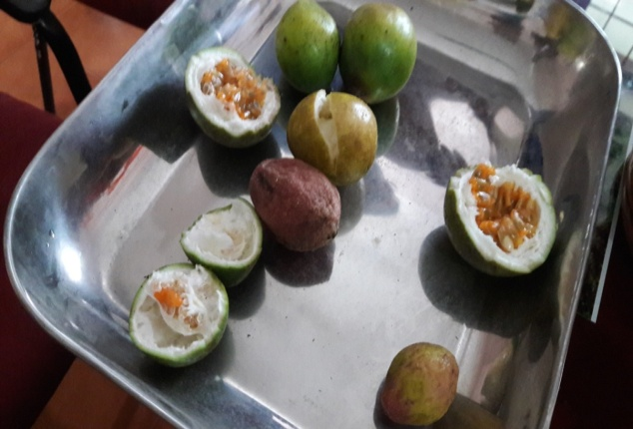
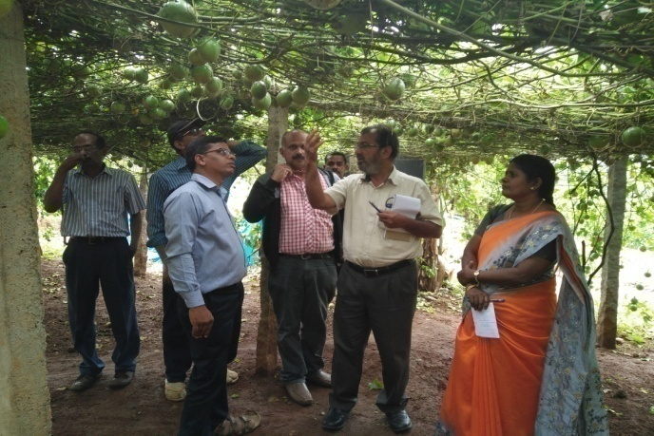
OFT 3. ASSESSMENT OF MICRONUTRIENT SPRAYS FOR MITIGATING IRREGULARITIES IN PASSION FRUIT
Operational area | Vadanmedu & Koviloor
Season | Rabi 2019
Situation | Irrigated
Area | 1 ha
No. of trials | 02
Prioritized Problem | High fruit drop, Malformed fruits
Soil test report
Parameters | TO-1 | TO-2 | TO-3 | TO-4
Soil pH | 4.5 | 4.9 | 5.3 | 5.6
Potassium (Kg/ha) | 155 | 250 | 399 | 298
Zinc ppm | 0.2 | 0.5 | 1.2 | 0.9
Boron ppm | 0.4 | 1.0 | 0.9 | 0.8
Annual Review Workshop 2020-21 ICAR-KVK (BSS), Idukki

Slide 16
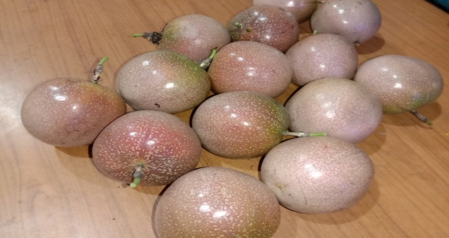
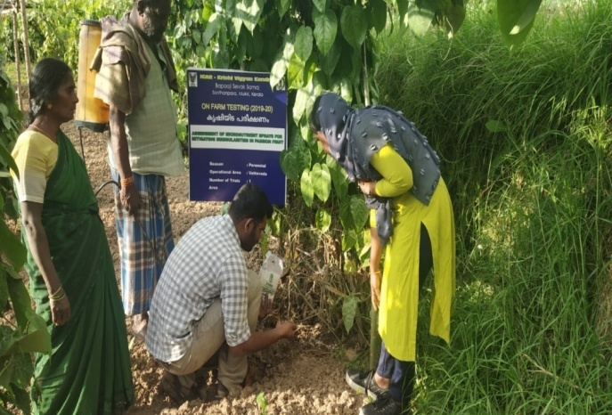
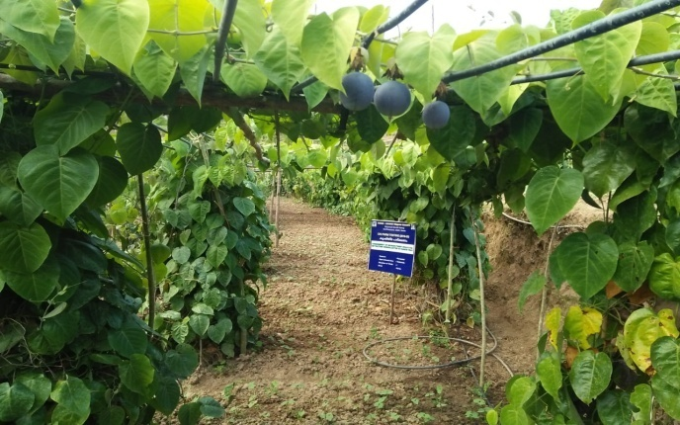
Technological options
TO1 | Farmers Practice (Basal application of FYM + complex fertilizers+ Secondary nutrients)
TO2 | Recommended POP fertilizers(FYM 10 kg, N-20 g, P-20 g, K- 15 g/plant + Boron spray @1.5g/lit)
TO3 | FYM- 10 kg , N-110g, P- 60g, K-110g per vine/annum + IIHR micronutrient spray @ 1g/lit
TO4 | FYM- 10 kg , N-110g, P- 60g, K-110g per vine/annum + Ayar @ 50g/plant
IIHR Micro Nutrient sprayed fruit
Annual Review Workshop 2020-21 ICAR-KVK (BSS), Idukki

Slide 17
RESULTS
Parameters | TO 1 | TO 2 | TO 3 | TO4
Fruit drop (%) | 25 | 20 | 10 | 15
Malformed fruits (%) | 30 | 25 | 15 | 18
TSS (Brix unit) | 11.0 | 11.6 | 12.3 | 11.9
Average weight of fruit (Kg) | 0.15 | 0.18 | 0.23 | 0.20
Yield (q/ha) | 70 | 90 | 100 | 80
Gross Cost (Rs/ha) | 215000.00 | 210000.00 | 200000.00 | 212000.00
Gross Return (Rs/ha) | 350000.00 | 450000.00 | 500000.00 | 400000.00
Net return | 135000.00 | 240000.00 | 300000.00 | 188000.00
BC ratio | 1.62 | 2.14 | 2.5 | 1.88
Conclusion
TO3 was found effective in terms of yield, less fruit fall and less malformed fruits as compared to other treatments.
Feed back
TO-3 showed better result in terms of size, appearance and juiciness of fruit which increased the marketability
Annual Review Workshop 2020-21 ICAR-KVK (BSS), Idukki

Slide 18
OFT 4. ASSESSMENT OF PRODUCTION PERFORMANCE OF DIFFERENT BREEDS OF POULTRY UNDER HOMESTEADs IN HIGHRANGES
Operational area | Devikulam
Season | Through out the year
Situation | Homestead
Area | 3
No. of trials | 3
Prioritized Problem | Non availability of quality layer chicks, low growth rate, poor laying performance and feather pecking
Technological options
TO1 | Rearing non descript breeds
TO2 | Rearing of Kalinga Brown chicks as per recommended concentrate feed along with mineral mixture and vitamin supplements (CPDO)
TO3 | Rearing of B V 380 chicks as per recommended concentrate feed along with mineral mixture and vitamin supplements (CPDO)
TO4 | Rearing of Krishi bro chicks as per recommended concentrate feed along with mineral mixture and vitamin supplements (DPR)
Annual Review Workshop 2020-21 ICAR-KVK (BSS), Idukki

Slide 19
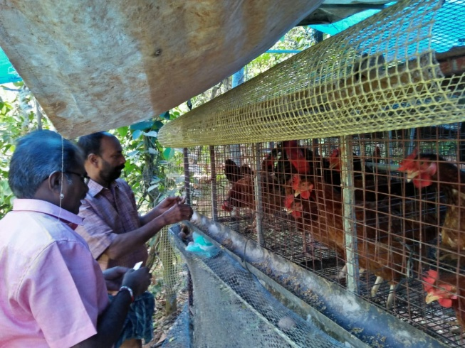
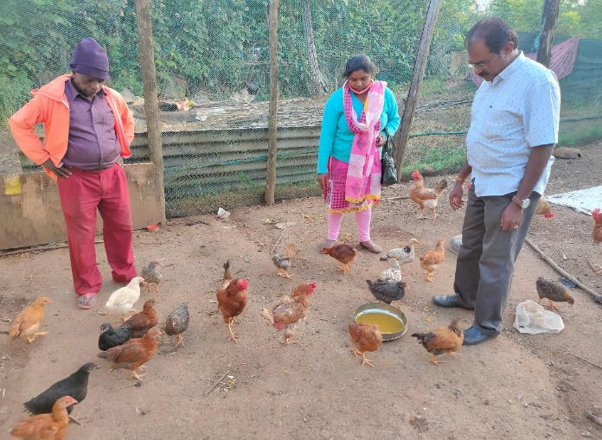
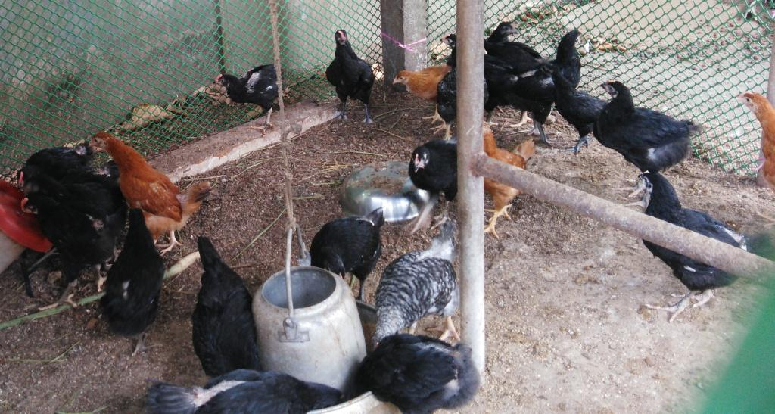
Parameters | TO 1 | TO2 | TO 3 | TO 4
Age at sexual maturity (days) | 180 | 150 | 150 | 150
Body weight (Kg) | 0.980 | 1.410 | 1.400 | 1.450
Mortality(%) | 40 | 0 | 0 | 0
Feather pecking(%) | 30 | 0 | 0 | 0
Annual Egg production( Nos) | 79 | 162 | 284 | 169
KALINGA BROWN
BV 380
KRISHI BRO
Conclusion
BV 380 was found effective in terms of egg yield/ annum
Feed back
Kalinga brown, BV 380 and Krishi bro was found effective in terms of adaptability in high ranges and Krishi bro attained higher body weight
Annual Review Workshop 2020-21 ICAR-KVK (BSS), Idukki

Slide 20
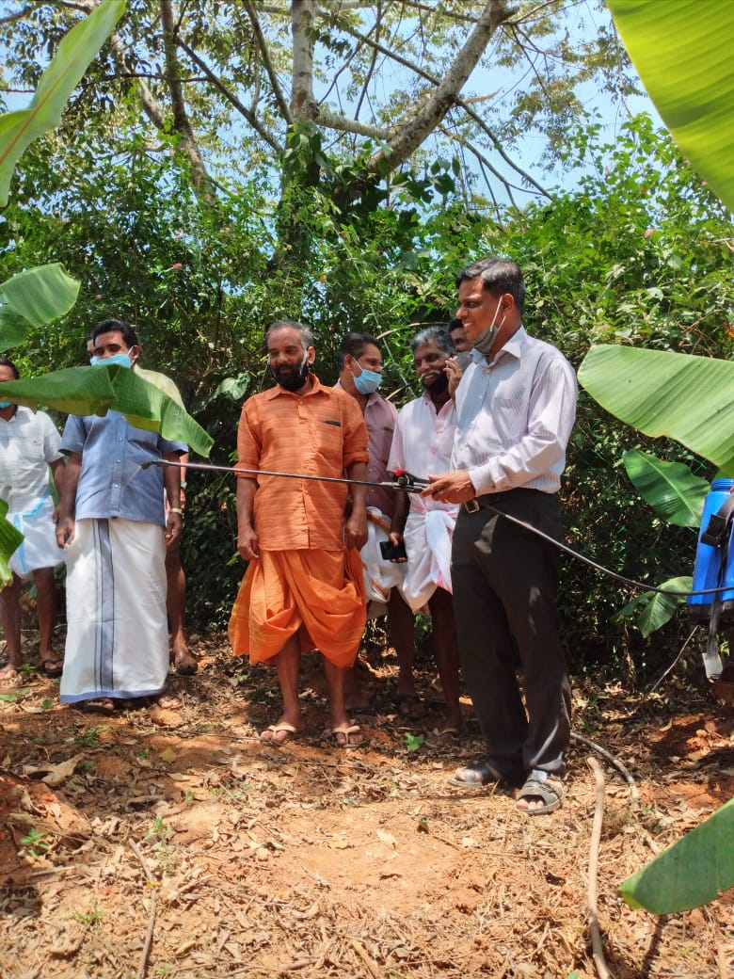
OFT 1. ASSESSMENT OF FUSARIUM WILT DISEASE MANAGEMENT IN BANANA
Operational area | Udumbanchola
Area under finger millet | 50 ha
Season | Perennial
Area | 2 ha
Trials | 5
Prioritized Problem | Sudden Plant mortality Splitting of Pseudostem Poor root establishment Considerable reduction in yield
Technological options
TO1 | Farmers practice-Uprooting and cutting of infected mother plants and allowing side sucker to grow
TO2 | Drench Pseudomonas fluorescens liquid formulation @ 4 lit /ha at planting, 2nd, 4th and 6th MAP.
TO3 | Soil application of Trichoderma viride NRCB 1+ Penicillium sp @ 10 g/plant as basal + 2nd, 4th, 6th MAP
Annual Review Workshop 2020-21 ICAR-KVK (BSS), Idukki

Slide 21
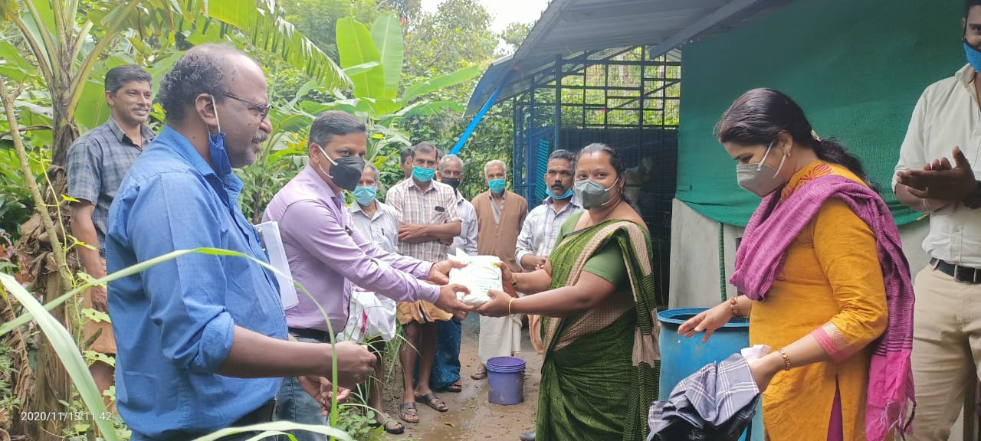
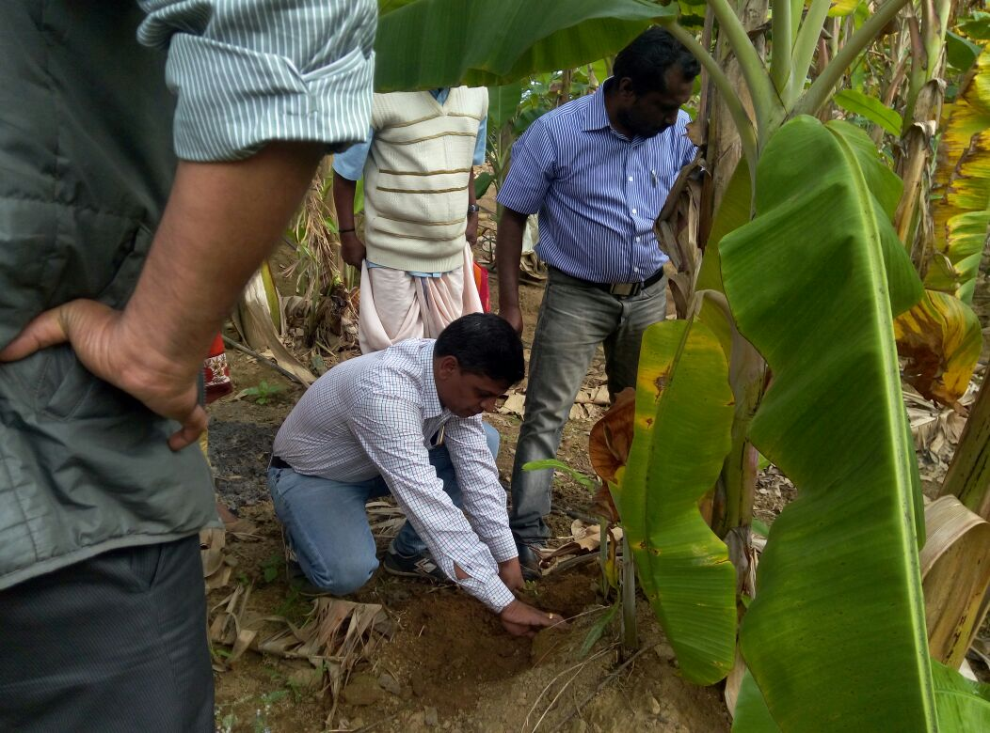
RESULTS
Activities Carried out | No. of Programmes
Group Meeting | 1
Field Visit | 2
Method demo. | 2
Training | 1
Other Extension Activities | 05
Crop stage 4 months - In Progress

Slide 22
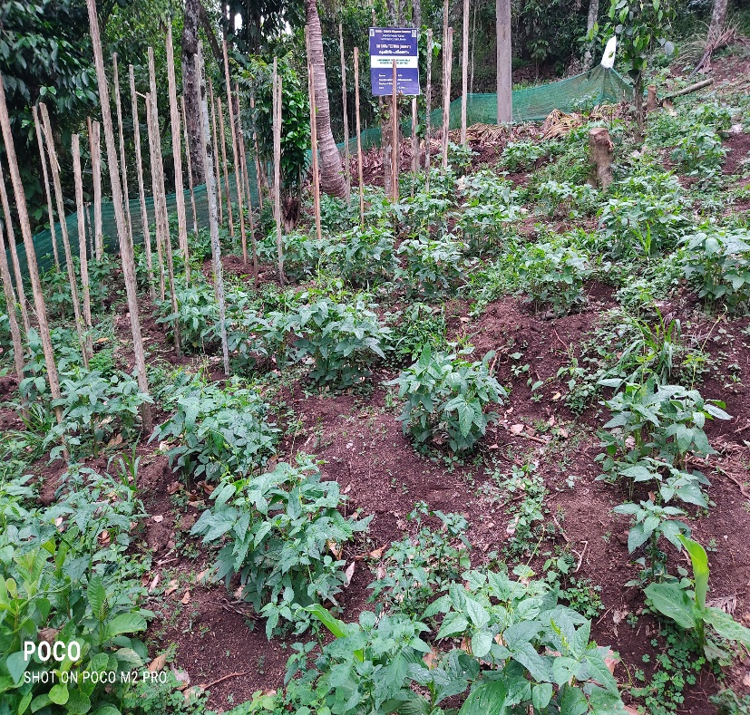
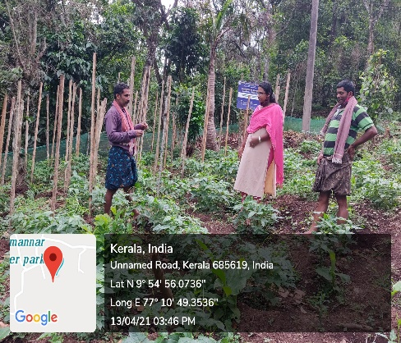
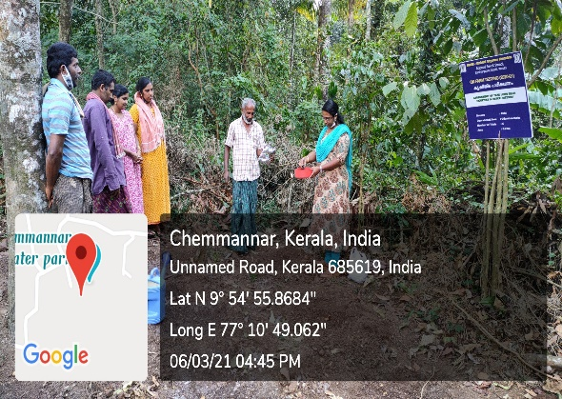
OFT 2 ASSESSEMENT OF YARD LONG BEAN VARIETIES IN IDUKKI DISTRICT
Operational village | Udumbanchola
Area under kiwi | 0.20 ha
Demos | 05
Prioritized Problem | Lack of high yielding varieties, More incidence of pest and disease
Technological options | TO1: Local TO2: Manjeri TO3: Arka Mangala
Activities Carried out | No. of Programmes
Group Meetings | 1
Field Visit | 3
Method demo. | 2
Training | 1
Other Extension Activities | 5
Status: Ongoing - Vegetative stage

Slide 23
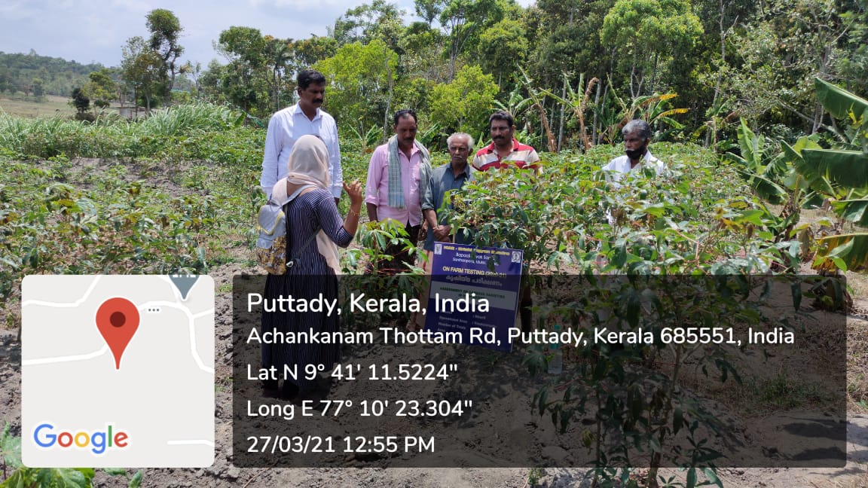
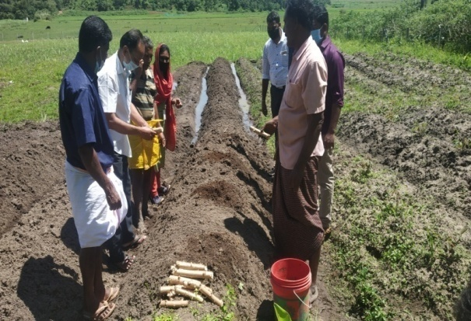
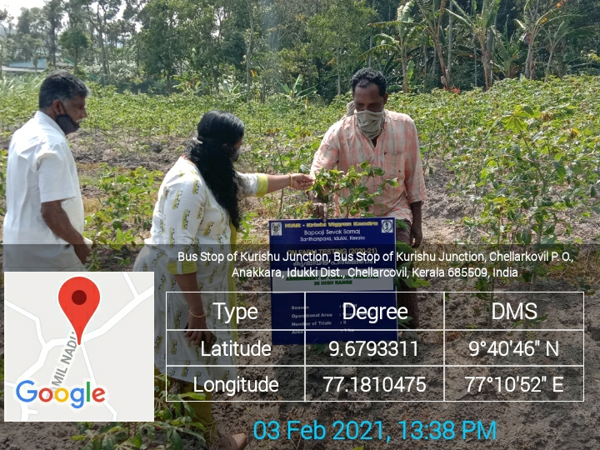
OFT 3. ASSESSMENT OF CASSAVA VARIETIES IN HIGH RANGES
Operational village | Vandanmedu
Area | 1 ha
No. of trials | 05
Prioritized Problem | Lack of high yielding variety Less marketability due to bitterness of existing local variety
Technological options | TO 1: Local
 | TO 2: Sree Pavithra
 | TO 3: Vellayani Hraswa
 | TO 4: KAU Uthama

Slide 24
Activities carried out | No. of programme
Group meeting | 1
Field visit | 3
Method demo. | 1
Training | 1
Other extension activities | 10
OBSERVATION RECORDED
Parameter | Observation recoded at 3 Months After Planting
 | Sree Pavithra | KAU Uthama | Vellayani Hraswa
Plant height (cm) | 55 cm | 130 cm | 32 cm
No. of branches | 2 | 2 | 2
No. of leaves | 48 | 68 | 24
Status: Ongoing. The crop is at tuber development stage

Slide 25
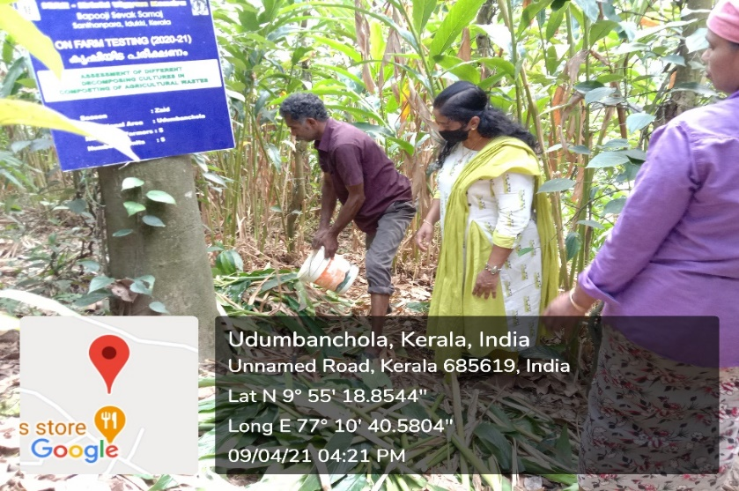
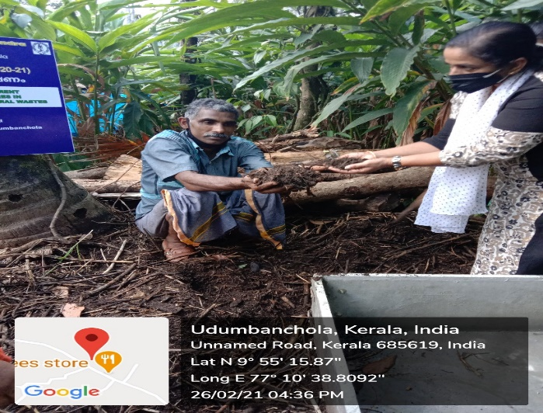
OFT 4. ASSESSMENT OF DIFFERENT DECOMPOSING CULTURES IN COMPOSTING OF AGRICULTURAL WASTES
Operational area | Udumbanchola
Season | Zaid
Area/units | 05
Trials | 05
Prioritized Problem | Lack of knowledge on disposal of cardamom stem Natural composting is time consuming
Technological options
TO1 | Farmers Practice (Biomass & Cow dung Slurry)
TO2 | Arka Microbial Consortium( IIHR)
TO3 | Organic Waste Decomposer (NCOF)
TO4 | Composting Inoculum(KAU)
Annual Review Workshop 2020-21 ICAR-KVK (BSS), Idukki

Slide 26
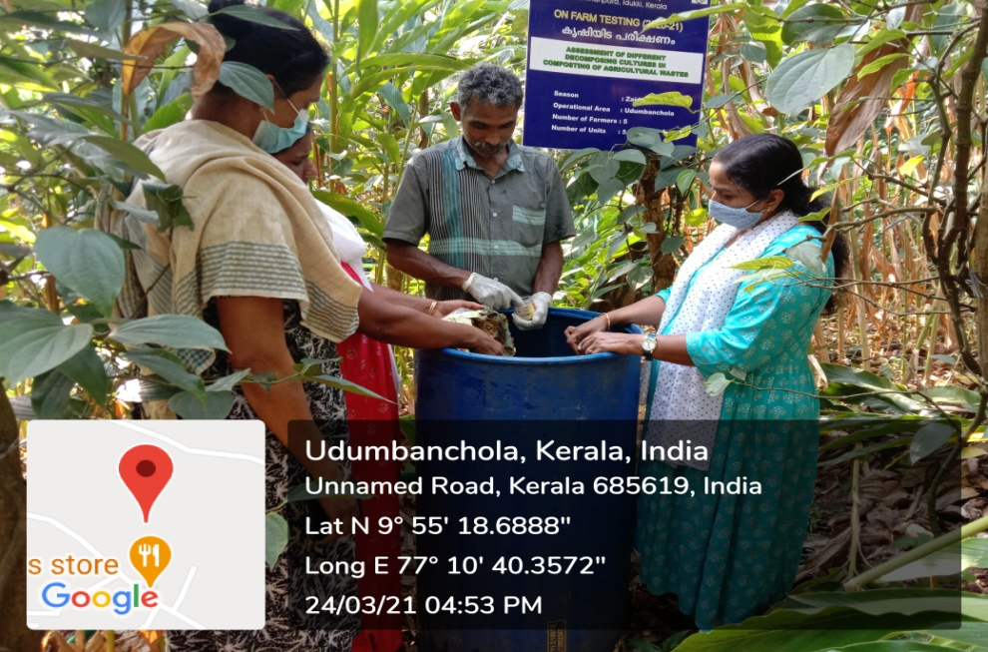
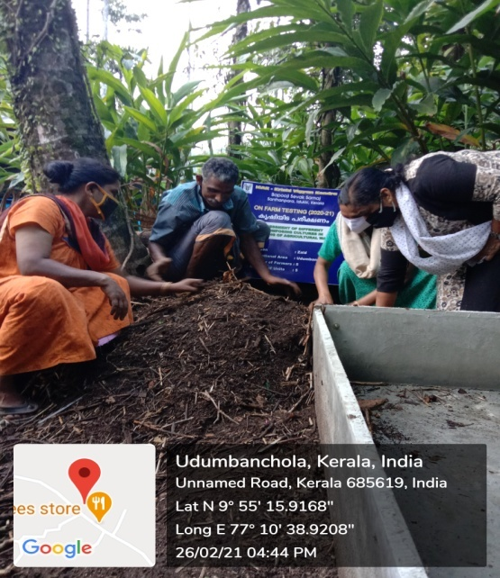
Activities Carried out | No. of Programmes
Group Meeting | 1
Field Visit | 6
Method demo. | 5
Training | 2
Other Extension Activities | 30
OBSERVATION RECORDED
Method Demonstration
 | Raw materials | pH of initial substrate | Volume reduction % | C:N ratio of initial
TO1 | 1000kg | 5.2 | 30% | 32:1
TO2 | 1000kg | 5.4 | 25% | 30:1
TO3 | 1000kg | 5.6 | 25% | 29:1
TO4 | 1000kg | 5.3 | 22% | 30:1
Status: Ongoing. Decomposition stage (2month stage)

Slide 27
OFT 5. ASSESSMENT OF EVM PREPARATIONS FOR CONTROL OF ECTO-PARASITES IN DAIRY CATTLE
Operational area | Udumbanchola
Season | Through out the year
Situation | Homestead
Area | 5
No. of trials | 5
Prioritized Problem | Severe Ecto-parasitic infestation in dairy cattle Debilitation, anemia and weight loss Poor growth performance and productivity
Technological options
TO1 | Chemical Ecto- Parasiticide Source:-KAU,2010
TO2 | Herbal preparation of crushed Garlic and neem oil Source:- KVASU 2013
TO3 | Preparation of Aloe Vera (Sothu Katrala)- 200g Ocimum sanctum (Thulasi)- 50g Acorus calamus (Sweet flag) -25 g Piper nigrum (Pepper)-10 berries Curcuma longa (Turmeric) – 10g Source:- TANUVAS 2015
Annual Review Workshop 2020-21 ICAR-KVK (BSS), Idukki

Slide 28
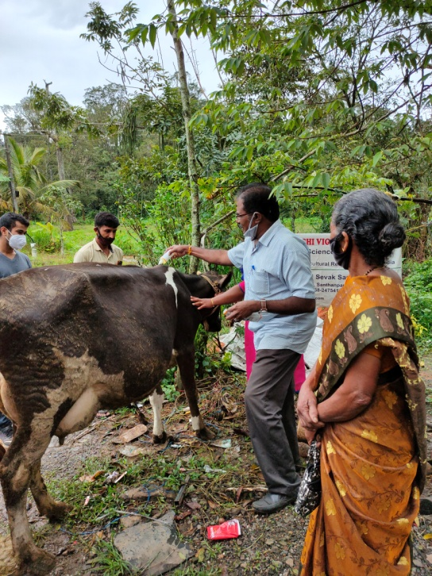
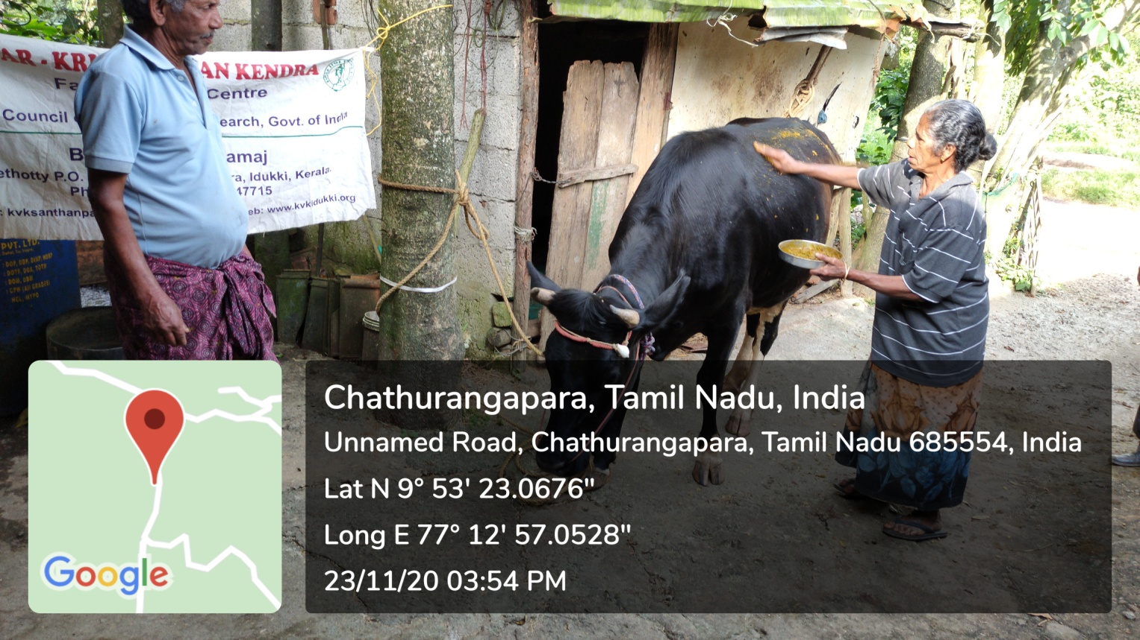
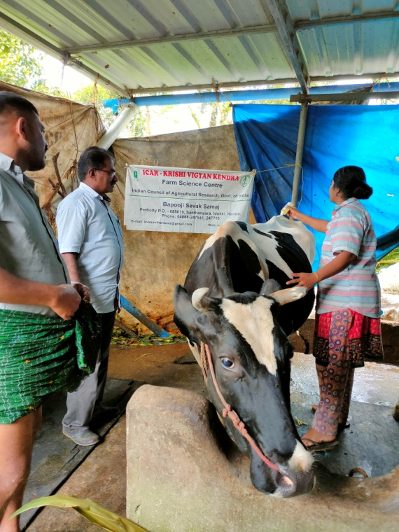
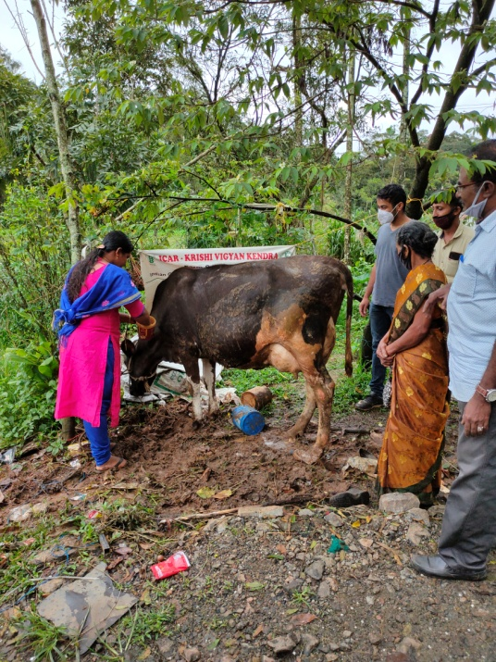
Parameters | TO 1 | TO2 | TO 3
Parasites & its density(%) | 50 | 40 | 30
Reduction in infestation | 70 | 60 | 90
Interval of reappearance of parasite infestation (days) | 55 | 45 | Nil
Gross cost | 72400.00 | 102800.00 | 131800.00
Gross return | 120400.00 | 200500.00 | 276400.00
Net return | 48000.00 | 97700.00 | 144600.00
BCR | 1.61 | 1.93 | 2.12
Conclusion
EVM treatment was found effective in terms of control of ectoparasites
Feed back
EVM treatment was found effective in terms of adaptability in high ranges and also an farmer friendly technology
Annual Review Workshop 2020-21 ICAR-KVK (BSS), Idukki

Slide 29
LIST OF APPROVED FLDs
Sl. No | Crop/ Enterprise | Title of FLDs (2019-20) | Status
1 | Cowpea | Enhancing productivity and nitrogen use efficiency in cowpea | Comp.
2 | Cowpea | Bio-intensive pest management in cowpea | Comp.
3 | Cabbage | Integrated crop management in cabbage | Comp.
4 | Bitter gourd | Bio-intensive pest management in bitter gourd | Comp.
5 | Pepino | Demo.on Pepino (Solanum muricatum) as an exotic salad vegetable in high ranges | Comp.
6 | Banana | Demonstration of INM in banana | Comp.
7 | Kiwi | Popularization of kiwi fruit in high ranges of idukki district | Comp.
8 | Dairy | Demonstration on estrus synchronization in cattle | Comp.
9 | Nutrition garden | Implementation of home stead garden for easy availability of Nutritional plants | Comp.
Approved FLDs (2020-21)
10 | Paddy | Demonstration of paddy Variety “Manuratna” in High ranges | Progr.
11 | Garden Pea | Demonstration of new whole pod edible dual purpose pea variety of Arka Apoorva | Progr.
12 | Black Pepper | Demonstration of IISR-PGPR consortium for growth promotion in black pepper | Comp.
13 | Ginger | GAP in Aswathy variety of Ginger | Progr.
14 | Cabbage | Integrated Nutrient Management in Cabbage | Progr.
15 | Small cardamom | Bio intensive intervention of Pest, Drought management and deterring crop raiding wild elephants in small cardamom | Comp.
16 | Strawberry | AESA based integrated Pest Management in Strawberry | Comp.
17 | Dairy cattle | Popularization of EVM for prevention of Ranikhet Disease | Comp.
18 | Dairy cattle | Demonstration of estrus synchronization in cattle by using Progesterone Vaginal Sponge | Comp.
19 | Tapioca | Demonstration of Customized fertilizer-1 in tapioca. | Progr.

Slide 30
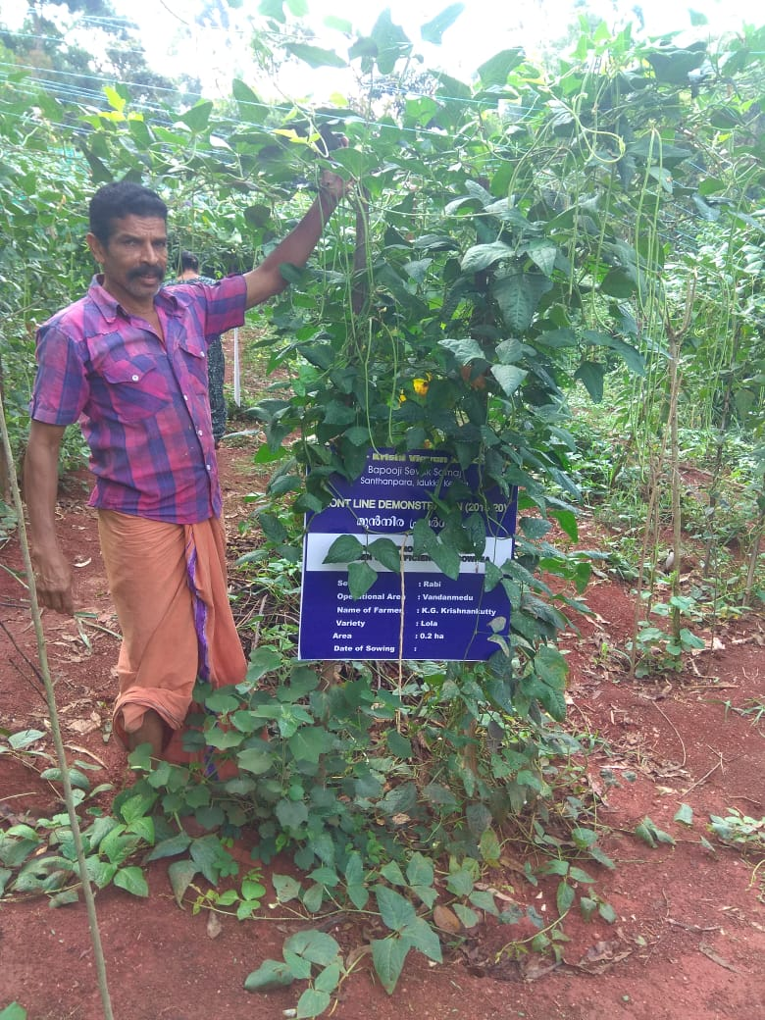
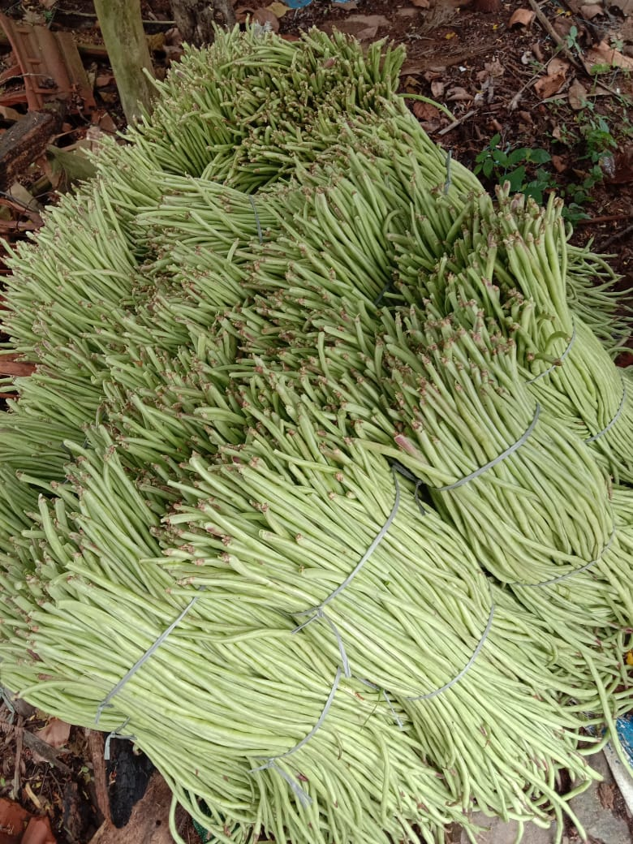
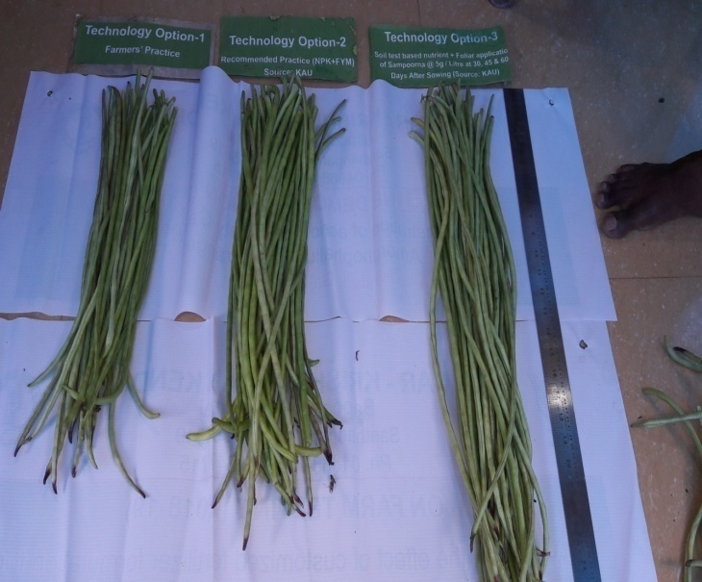
FLD 1. ENHANCING PRODUCTIVITY AND NITROGEN USE EFFICIENCY IN COWPEA
Operational area | Vandanmedu
Area | 1 ha
Demos | 05
Prioritized Problem | Low nutrient efficiency
Technologies Demonstrated | Seed treatment with Rhizobium@200g/acre of seed Lime @ 600kg/ha STL based nutrient application Foliar spray of Veg. special @ 2g / lit. of water
Annual Review Workshop 2020-21 ICAR-KVK (BSS), Idukki

Slide 31
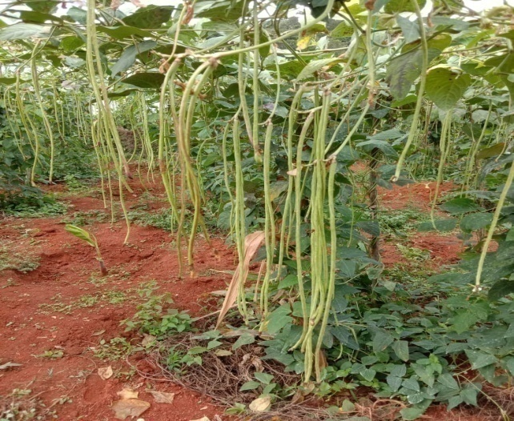
SOIL TEST RESULTS
Parameters | Check | Demo
Soil pH | 4.30 | 6.2
Potassium (Kg/ha) | 101 | 151
Calcium (meq/100g) | 1.5 | 1.8
Magnesium (meq/100g) | 0.3 | 0.45
Zinc ppm | 0.7 | 0.5
Boron ppm | 0.4 | 1.0
Parameters | Check | Demo
Average Pod length (cm) | 50.1 | 66.2
No of seeds per pod | 20 | 27
Average weight of pod (g) | 32 | 50
Yield (t/ha) | 10 | 13.0
Gross cost (Rs/ha) | 89000 | 87000
Gross income (Rs/ha) | 200000 | 260000
Net return (Rs./ha) | 111000 | 173000
BCR | 2.2 | 2.9
FEED BACK:
Ca & B deficiency was reduced as compared to check which suppressed the Anthracnose disease and enhanced the yield
Annual Review Workshop 2020-21 ICAR-KVK (BSS), Idukki

Slide 32
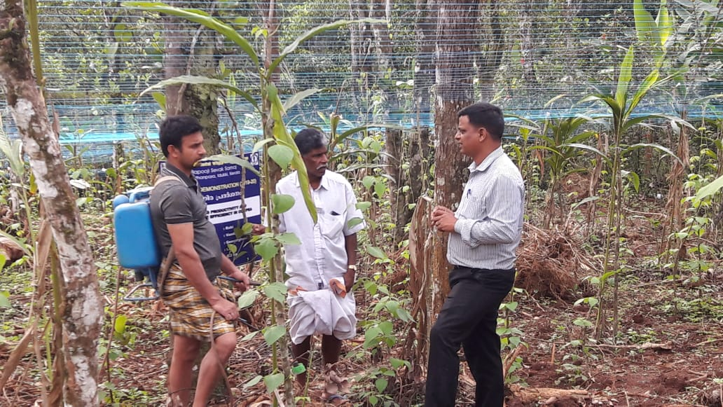
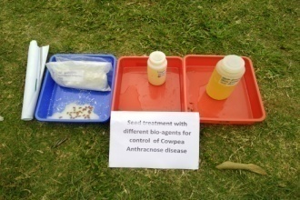
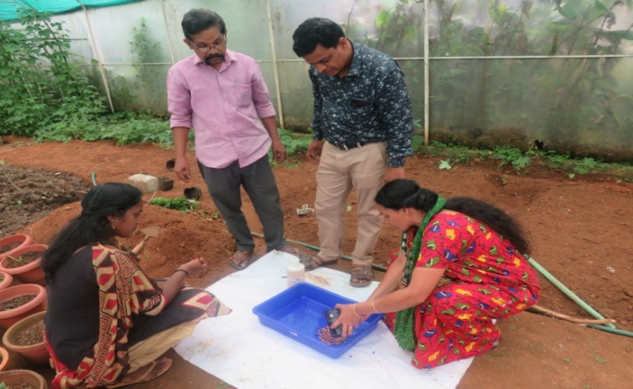
FLD 2. BIO- INTENSIVE PEST AND DISEASE MANAGEMENT IN COWPEA
Operational area | Udumbanchola
Season | Rabi
Situation | Irrigated
Area | 2 ha
Demonstrations | 5
Total Area | 343
Area affected | 51
Prioritized problem | Indiscriminate use of chemical inputs
Technologies Demonstrated | Seed treatment of Trichoderma harzianum 10g of concentrated formulation with 100ml with water/1 kg of seed. Spraying of Hanseniaspora uvarum @ 5ml/L of water each strains separately from 15^{th,} 25th ,40th , 65th and 80th days after transplanting (Special Strain from ICAR-NBAIR). Spraying of Lecanicillium saksenae @ 15g / litre three times (Special Strain from KAU).
Source | ICAR NBAIR, KAU & TNAU
Annual Review Workshop 2020-21 ICAR-KVK (BSS), Idukki

Slide 33
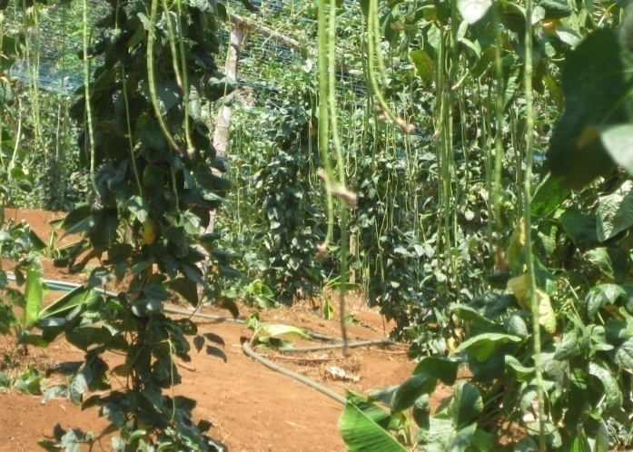
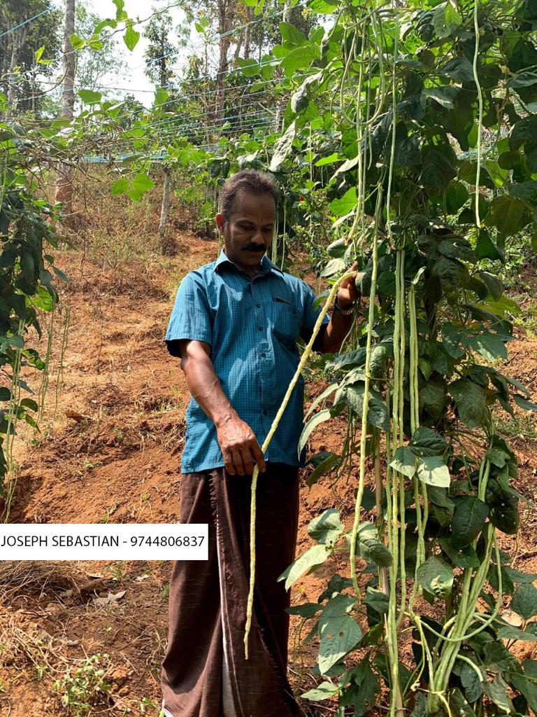
RESULTS
Parameters | Check | Demo
Disease Index (%) | 34 | 16
Pest Incidence (%) | 41 | 22
Yield (q/ha) | 112 | 155
Gross Cost (Rs/ha) | 165000 | 175000
Gross Return (Rs/ha) | 300500 | 387500
Net Return (Rs/ha) | 135500 | 212500
BCR | 1.82 | 2.21
FEED BACK:
Application of Bio agents along with PPFM increased the number of harvest, keeping quality, taste which lead to better acceptability (scale 5.0)
Annual Review Workshop 2020-21 ICAR-KVK (BSS), Idukki

Slide 34
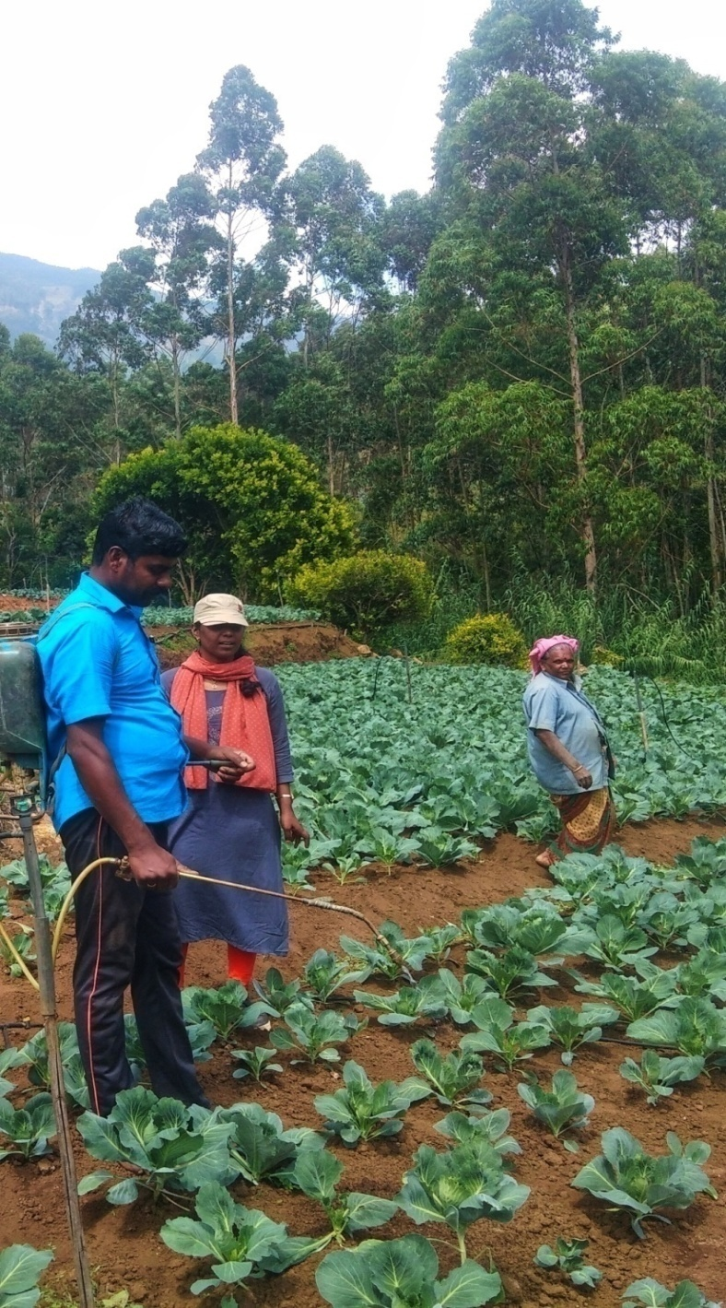
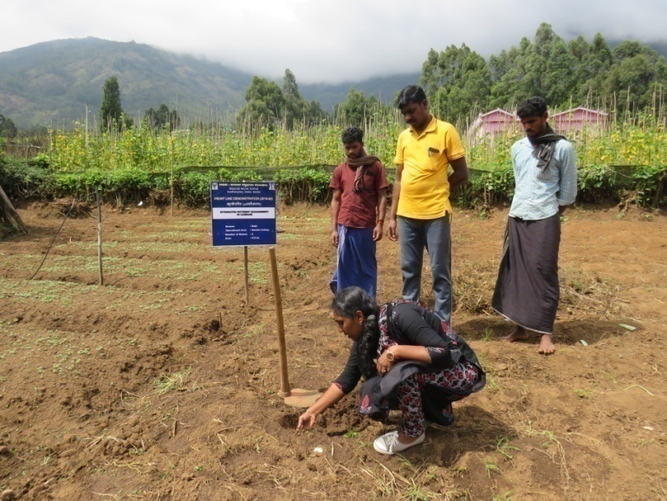
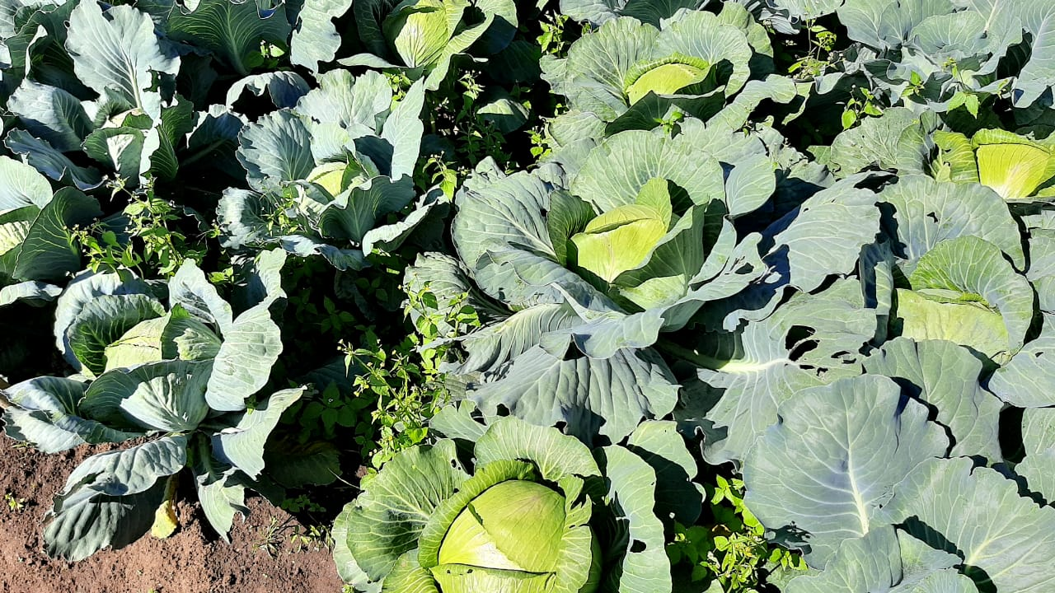
FLD 3. INTEGRATED NUTRIENT MANAGEMNT IN CABBAGE
Operational area | Vattavada
Area under cabbage | 218 ha
Demos . | 05
Season | Rabi
Prioritized Problem | Inadequate knowledge on soil test based nutrient management Indiscriminate use of chemical inputs Physiological disorders due to deficiency of nutrients
Technologies Demonstrated | Seed tr. With Pseudomonas@10g/kg seed Lime@600kg/ha STL based nutrient application Foliar application of Veg. special @5g/lit of water
Annual Review Workshop 2020-21 ICAR-KVK (BSS), Idukki

Slide 35
SOIL TEST RESULT
PARAMETERS | CHECK | DEMO
Soil pH | 4.2 | 5.9
Nitrogen (kg/ha) | 312.6 | 588.1
Phosphorus (kg/ha) | 20.5 | 46.0
Potassium (kg/ha) | 215 | 385
Zinc (ppm) | 0.4 | 1.0
Boron (ppm) | 0.3 | 0.9
Annual Review Workshop 2020-21 ICAR-KVK (BSS), Idukki

Slide 36
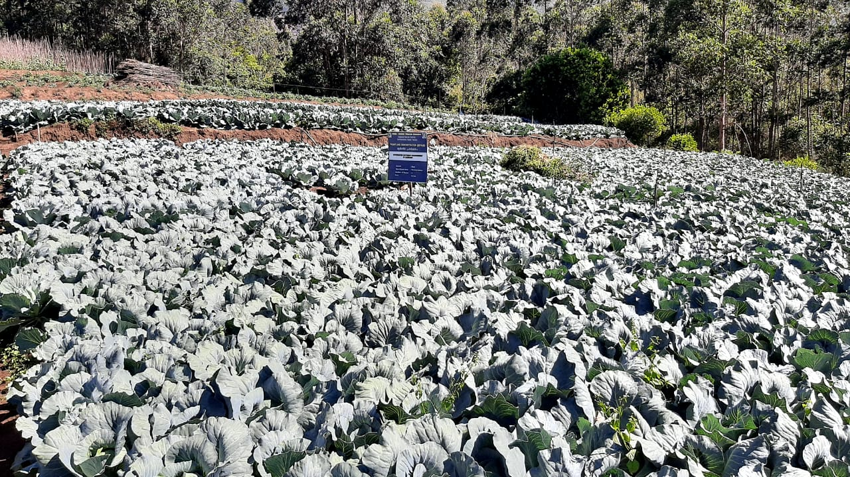
RESULTS
Parameters | Check | Demo
Head weight (kg) | 2.7 | 4.3
Head size (cm) | 14.2 | 19.8
Yield (q/ha) | 377 | 596
Gross Cost (Rs./ha) | 1,13,700 | 1,19,400
Gross Return(Rs./ha) | 2,26,080 | 3,57,600
Net Return (Rs./ha) | 1,12,380 | 2,38,200
BCR | 1.98 | 3.0
FEED BACK:
Soil test based nutrient management reduced the acidity, enhanced the potassium availability which lead to decreased disease incidence, increased head size & weight
Annual Review Workshop 2020-21 ICAR-KVK (BSS), Idukki

Slide 37
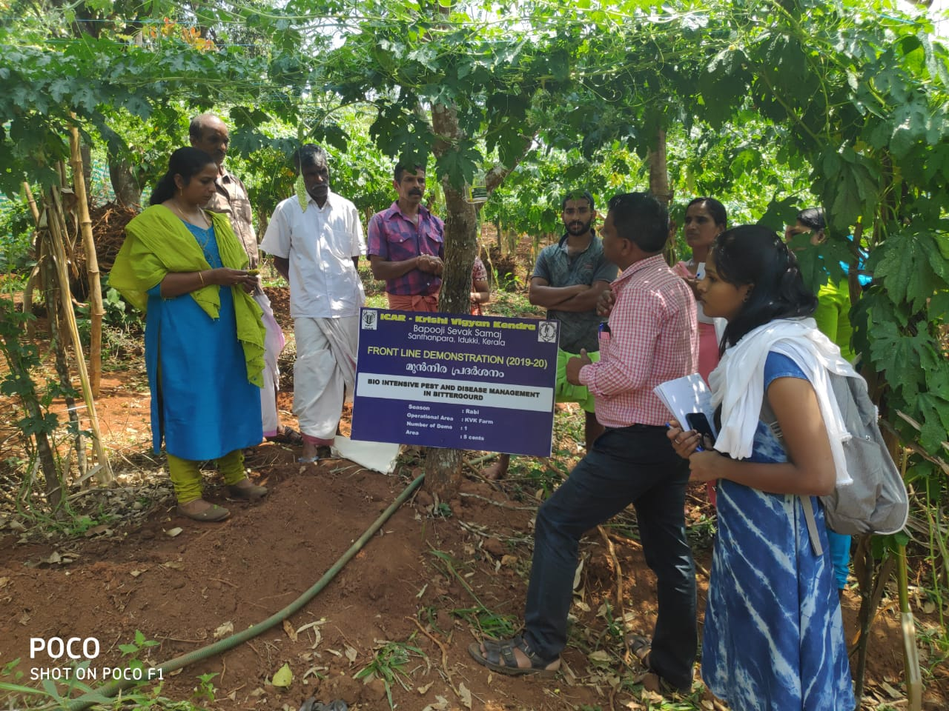
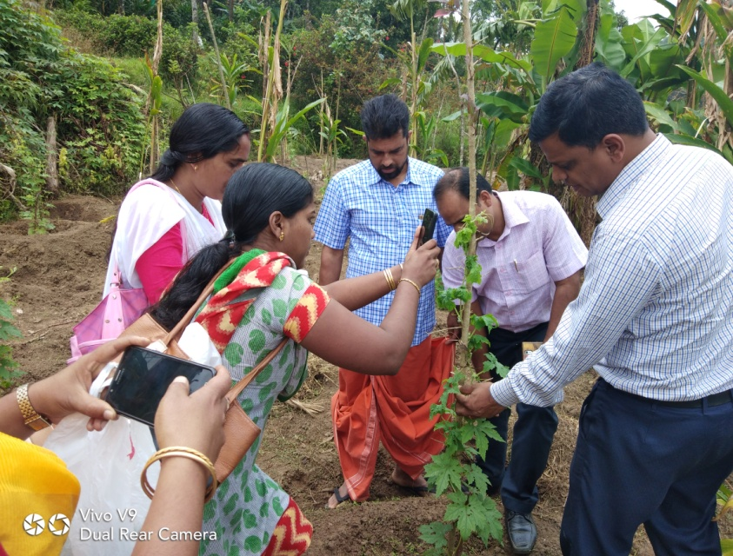
FLD 4 BIO - INTENSIVE PEST AND DISEASE MANAGEMENT IN
BITTER GOURD
Operational area | Udumbanchola
Season | Rabi
Situation | Irrigated
Area | 2 ha
Demonstrations | 5 nos.
Total Area | 533
Area affected | 72
Prioritized problem | Indiscriminate use of chemical inputs & Yield loss due to diseases
Technologies Demonstrated | Seed treatment of SeedPro (IIHR)10g of concentrated formulation with 100ml with water/1 kg of seed. Place of Pheromone trap (Cue-lure) Spraying of Lecanicillium saksenae @ 15g / litre three times. Spraying of Beauveria bassiana @ 20g/litre two times.
Source | ICAR-IIHR,ICAR-NBAIR
Annual Review Workshop 2020-21 ICAR-KVK (BSS), Idukki

Slide 38
RESULTS
Parameters | Check | Demo
Disease Index (%) | 41 | 19
Pest Incidence (%) | 32 | 13
Yield (q/ha) | 67.2 | 85.6
Gross Cost (Rs/ha) | 157000 | 162000
Gross Return (Rs/ha) | 235200 | 367400
Net Return (Rs/ha) | 78200 | 205400
BCR | 1.50 | 2.26
FEED BACK:
Bio-intensive pest management technologies were adopted to alleviate the pest problems for vegetables which increased yield and decreased the cost of cultivation
Annual Review Workshop 2020-21 ICAR-KVK (BSS), Idukki

Slide 39


FLD 5. CULTIVATION OF PEPINO (SWEET CUCUMBER, MELON PEAR) AS AN EXOTIC SALAD VEGETABLE
Operational area | Udumbanchola
Area under pepino | 0.25 ha
Demos | 05
Season | Kharif 2019
Prioritized problem | Lack of awareness on the scope of exotic vegetables Less aware on the benefits of salad vegetables in daily diet
Technologies Demonstrated | Cultivation of Pepino (Sweet Cucumber, Melon Pear) as an exotic salad vegetable
Annual Review Workshop 2020-21 ICAR-KVK (BSS), Idukki

Slide 40

RESULTS
Parameters | Check | Demo
Plant height (cm) | - | 94
Number of fruit (Number) | - | 9
Fruit weight (g) | - | 189.8
Incidence of pest & disease (%) | - | 11
Yield (q/ha) | - | 83.8
Gross Cost (Rs./ha) | - | 58000
Gross Return(Rs./ha) | - | 167600
Net Return (Rs./ha) | - | 109600
BCR | - | 2.92
FEED BACK:
Consumer acceptability was more in cultivation of Pepino as it gave better result in yield, taste and quality
Annual Review Workshop 2020-21 ICAR-KVK (BSS), Idukki

Slide 41



FLD 6. INTEGRATED NUTRIENT MANAGEMENT IN BANANA
Operational area | Udumbanchola
Area under paddy | 120 ha
Demos | 05
Prioritized Problem | Soil acidity Iron toxicity Nutrient deficiencies
Technologies Demonstrated | Sucker tr. with Pseudomonas@ 20g lit Lime @500gm /plant STL based nutrient application in 6 split doses IIHR banana special spray @ 5gm/lit at 5,6,7,8 and 30th and 60th day after bunch emergence
Annual Review Workshop 2020-21 ICAR-KVK (BSS), Idukki

Slide 42
RESULTS
Parameters | Check | Demo
Soil pH | 4.0 | 5.9
Average weight of the bunch/plant | 10 | 15
No. of hands/bunch | 7 | 10
N (Kg/ha) | 551.9 | 624.6
P (Kg/ha) | 45 | 62.5
K (Kg/ha) | 260 | 361.2
Zinc (PPM) | 0.5 | 1.2
Boron (PPM) | 0.4 | 1.0
Yield (t/ha) | 22.69 | 38.82
Gross Cost (Rs/ha) | 215000 | 225000
Gross Return (Rs/ha) | 340350 | 582300
Net Return (Rs/ha) | 125350 | 357300
BCR | 1.58 | 2.58
FEED BACK:
INM along with IIHR banana special spray gave better result in no of hands/bunch, weight of the bunch and addressed the nutrient deficiencies as compared to check.
Annual Review Workshop 2020-21 ICAR-KVK (BSS), Idukki

Slide 43



FLD 7. CULTIVATION OF KIWI FRUIT WHICH REQUIRE RELATIVELY LESS CHILLING PERIOD
Operational village | Vattavada
Area under kiwi | 0.75 ha
Demos | 05
Prioritized Problem | Lack of awareness on the scope of exotic fruits
Technologies Demonstrated | Cultivation of Kiwi fruit which require relatively less chilling period
Activities Carried out | No. of Programmes
Group Meetings | 2
Field Visit | 12
Method demo. | 2
Training | 1
Other Extension Activities | 10
Status: Ongoing. It is on vegetative stage

Slide 44



FLD 8. DEMONSTRATION ON ESTRUS SYNCHRONISATION IN CATTLE USING Pro Sync-NF NANOPATCH TECHNOLOGY
Operational area | Udumbanchola
Animal population | 52,119
Demos | 5
Prioritized Problem | Anoestrous, Repeat breeding, Infertility problem
Technologies Demonstrated | Progesterone Nanopatch – ProSync-NF The progesterone is absorbed thro skin & sudden reduction in progesterone levels induces heat within 5-7 days post application. Source :TANUVAS-2018
Annual Review Workshop 2020-21 ICAR-KVK (BSS), Idukki

Slide 45
RESULTS
Parameters | Check | Demo
Showing heat (Days) | - | 4
A I done (Nos.) | 3 | 1
Conception rate (%) | 0 | 60
Quantity of milk production (lit) | 3240 | 4175
Gross Cost (Rs) | 64765.00 | 65250.00
Gross Return (Rs) | 109825.00 | 124527.00
Net Return (Rs) | 45060.00 | 59277.00
BCR | 1.69 | 1.90
FEED BACK:
This technology provided more opportunity to Artificially Inseminate the animal within the time period of 72hrs
Annual Review Workshop 2020-21 ICAR-KVK (BSS), Idukki

Slide 46



FLD 9. IMPLEMENTATION OF HOMESTEAD GARDEN, EASY AVAILABILITY OF NUTRITIONAL PLANTS
Operational area | Namari Mannakkudy, Udumbanchola
Thematic Area | Organic Vegetable cultivation
Demos / Unit | 5
Season | Kharif
Prioritized Problem | Inadequate intake of vegetables
Technologies Demonstrated | Homestead nutritional garden
Annual Review Workshop 2020-21 ICAR-KVK (BSS), Idukki

Slide 47
RESULTS
Parameters | Check | Demo
Consumption of vegetables/person (g/day) | 85g | 120g
Yield (kg/cent) | 0 | 89.00
Dietary Diversity Score | 4.3 | 7
Gross Cost (Rs) | 0 | 1082.00
Gross Return (Rs) | 0 | 3115.00
Net Return (Rs) | 0 | 2033
BCR | 0 | 2.88
FEED BACK
Out of 89kg produced, 76kg consumed by the family for 5 months and remaining 13 kg was sold to the neighbouring family and earned Rs.455/- as additional income
Annual Review Workshop 2020-21 ICAR-KVK (BSS), Idukki

Slide 48




FLD 1. DEMONSTRATION OF PADDY VARIETY MANURATNA IN HIGH RANGES
Operational village | Udumbanchola
Area | 1 ha
Demos | 05
Season | Rabi 2020
Prioritized Problem | Continuous cultivation of traditional variety Heavy incidence of pest and disease (yield loss 17-26 %)
Technologies Demonstrated | Paddy variety Manuratna in high ranges
Annual Review Workshop 2020-21 ICAR-KVK (BSS), Idukki

Slide 49
Activities carried out | No. of programme
Group meeting | 1
Field visit | 4
Method demo. | 3
Training | 1
Other extension activities | 12
OBSERVATION RECORDED
Parameter | Observation recoded at 3 Months After Planting
Plant height (cm) | 80 cm
No. of tillers | 32
No. of productive tillers | 27
Status: Ongoing. The crop is at grain filling stage

Slide 50



FLD 2. DEMONSTRATION OF DUAL PURPOSE WHOLE POD EDIBLE PEA VARIETY OF ARKA APOORVA
Operational Village | Vattavada
Area under kiwi | 0.75 ha
Demos | 05
Prioritized Problem | Lack of awareness on suitable high yielding varieties Continuous cultivation of traditional varieties Shattering losses Less pod filling
Technologies Demonstrated | Demonstration of dual purpose whole pod edible pea variety of Arka Apoorva
Activities Carried out | No. of Programmes
Group Meetings | 1
Field Visit | 3
Method demo. | 2
Training | 0
Other Extension Activities | 5
Status: Ongoing. It is in germination stage

Slide 51



FLD 3. Demonstration of IISR-PGPR consortium for growth promotion in Black Pepper
Operational area | Vadanmedu
Area under Black pepper | 12230 ha
Demos | 05
Prioritized Problem | Soil acidity Iron toxicity Nutrient deficiencies
Technologies Demonstrated | Lime @500g/vine STL based nutrient application Foliar spray of IISR –Black Pepper @5g/lit at spike development and maturity stage PGPR consortium capsule @1/100lit of water for drenching

Slide 52


RESULTS
Parameters | Check | Demo
Soil pH | 4.4 | 5.6
No of spikes/vine | 165 | 300
Spike length | 6 cm | 10 cm
Yield (q/ha) | 3.2 | 4.8
Gross Cost (Rs/ha) | 90062 | 84094
Gross Return (Rs/ha) | 175600 | 196320
Net Return (Rs/ha) | 85538 | 112226
BCR | 1.94 | 2.33
Check
Demo
CONCLUSION
No of spikes/vine and spike length increased in demo as compared to check
Nutrient deficiencies were less in Demo as compared to check
FEED BACK
IISR-PGPR consortium improved the soil fertility status
Technology up scaling:
Name of Agency | No. of farmers benefitted | Area covered (ha)
Dept. of Agri. | 35 | 10
Annual Review Workshop 2020-21 ICAR-KVK (BSS), Idukki

Slide 53




FLD 4. GAP IN ASWATHY VARIETY OF GINGER
Operational area | Udumbanchola
Area under kiwi | 0.20 ha
Demos | 05
Prioritized Problem | Lack of suitable soft rot (Azhukal) resistant varieties Unavailability of good planting materials Inadequate knowledge on soil test based nutrient management in ginger
Technologies Demonstrated | GAP in Aswathy variety of ginger
Activities Carried out | No. of Programmes
Group Meetings | 2
Field Visit | 9
Method demo. | 3
Training | 1
Other Extension Activities | 20
Status: Ongoing. Seedlings on vegetative stage

Slide 54




FLD 5. INTEGRATED NUTRIENT MANAGEMNT IN CABBAGE
Operational Village | Sandoz colony
Area | 1 ha
Demos . | 05
Season | Rabi
Prioritized Problem | Inadequate knowledge on soil test based nutrient management Indiscriminate use of chemical inputs Physiological disorders due to deficiency of nutrients
Technologies Demonstrated | Seed tr. With Pseudomonas@10g/kg seed Lime@600kg/ha STL based nutrient application Foliar application of Veg. special @5g/lit of water
Annual Review Workshop 2020-21 ICAR-KVK (BSS), Idukki

Slide 55
FLD - INTEGRATED NUTRIENT MANAGEMNT IN CABBAGE
Activities carried out | No. of programme
Group meeting | 1
Field visit | 3
Method demo. | 3
Training | 1
Other extension activities | 14
OBSERVATION RECORDED (2 months DAT)
Parameter | Observation recoded
Plant height (cm) | 32.0
No. of Plants / sq.m | 6.0
Size of the head
Weight of the head (Kg)
Net Income (Rs.)
BCR
Status: Ongoing. The crop is in its Head formation stage

Slide 56


FLD 6. BIO-INTENSIVE INTERVENTION OF PEST ,DROUGHT MANAGEMENT AND DETERRING CROP RAIDING WILD ELEPHANTS IN SMALL CARDAMOM
Operational area | Udumbanchola
Season | Kharif
Situation | Irrigated
Area | 2 ha
Demonstrations | 2
Total Area | 1.45 lakhs ha
Area affected | 348
Prioritized problem | Indiscriminate use of chemical inputs
Technologies Demonstrated | Bio-intensive Pest Management along with Foliar Spray of 1% PPFM
Source | KAU-Cardamom Research Station , ICAR-NBAIR, Indian Cardamom Research Station and ICAR-IISR

Slide 57



RESULTS
Parameters | Check | Demo
Disease Index (%) | 41 | 16.5
Pest Incidence (%) | 54 | 21.0
No. of wild elephants raids | 42 | 14
Yield (q/ha) | 3.8 | 6.5
Gross Cost (Rs/ha) | 550000 | 690000
Gross Return (Rs/ha) | 850000 | 1480000
Net Return (Rs/ha) | 300000 | 790000
BCR | 1.54 | 2.14
FEED BACK
Bio agents suppressed the incidence of pest, disease and helped in mitigating the drought
Up scaling
Technologies spread through state Dept of Agriculture, ATMA, FEO and Farmers club through various scheme.

Slide 58


FLD 7. AESA BASED INTEGRATED PEST MANAGEMENT IN STRAWBERRY
Operational area | Vattavada
Season | Rabi
Situation | Irrigated
Area | 2 ha
Demonstrations | 5
Total Area | 50 ha
Area affected | 50 ha
Prioritized problem | Indiscriminate use of chemical inputs
Technologies Demonstrated | Soil application of Trichoderma harzianum @ 5L/ha Release of Lady bird beetles & Green lace wings@10-15 adults/bed. Spraying of Pseudomonas, Beauveria bassiana &Metarhizium @ 3ml/litre @2ml/L of water three times. Place Yellow and Blue sticky traps @ 1 card per 10 meter square. Source : NIPHM 2015
Annual Review Workshop 2020-21 ICAR-KVK (BSS), Idukki

Slide 59



RESULTS
Parameters | Check | Demo
Disease Index (%) | 28 | 17
Pest Incidence (%) | 26 | 18
Yield (q/ha) | 76 | 98
Gross Cost (Rs/ha) | 548000 | 583500
Gross Return (Rs/ha) | 704000 | 965000
Net Return (Rs/ha) | 256000 | 381500
BCR | 1.8 | 2.5
FEED BACK:
Pest and disease incidence notice below ETL and DI Level compare with check. Farmers are planning to set up a Minimal Processing Unit in the area by forming one FEOs named Vattavada Strawberry Farmers Club
Up scaling
Technologies spread through state Dept of Agriculture and ATMA through various scheme.
Annual Review Workshop 2020-21 ICAR-KVK (BSS), Idukki

Slide 60



FLD 8. POPULARISATION OF EVM PREPARATIONS FOR PREVENTION OF RANIKHET DISEASE IN POULTRY
Operational area | Sandoz colony,Vattavada
Animal population | 52,119
Demos | 10
Prioritized Problem | Incidence of Ranikhet disease, High mortality
Technologies Demonstrated | Keelianelli - 30g,Garlic - 8 No's, Small onion -10 No's, Pepper -10 berries Turmeric 10g,Cumin seed -25g Mix all ingredients, grinding and give orally in drinking water for two days. (Source: VUTRC-TANUVAS-2014)
Annual Review Workshop 2020-21 ICAR-KVK (BSS), Idukki

Slide 61
RESULTS
Parameters | Check | Demo
Disease Incidence (%) | 20 | Nil
Mortality (%) | 10 | Nil
Body weight (kg) | 1.450 | 1.800
Gross Cost (Rs) | 5100.00 | 10410.00
Gross Return (Rs) | 10126.00 | 24080.00
Net Return (Rs) | 5026.00 | 13670.00
BCR | 1.98 | 2.30
FEED BACK:
This farmer friendly EVM technology provided more opportunity to farmers themselves for prevention and control of Ranikhet disease in poultry
UPSCALING
Technologies spread through Farmers Organization, SHGs and Dept. of Animal Husbandry through various scheme.
Annual Review Workshop 2020-21 ICAR-KVK (BSS), Idukki

Slide 62


FLD 9. DEMONSTRATION ON ESTRUS SYNCHRONISATION IN CATTLE BY USING PROGESTERONE VAGINAL SPONGE
Operational area | Vandanmedu
Animal population | 52,119
Demos | 5
Prioritized Problem | Anoestrous, Repeat breeding, Infertility problem
Technologies Demonstrated | The progesterone is absorbed through vaginal portion & induces heat within 48 hrs. and followed by AI Source :- TANUVAS -2015
Demo. On Sponge loaded with Antibiotic powder
Demo. On Sponge insertion through Speculum
Annual Review Workshop 2020-21 ICAR-KVK (BSS), Idukki

Slide 63
RESULTS
Parameters | Check | Demo
Showing heat (Days) | 3-4 | 2
A I done (Nos.) | 6 | 2
Conception rate (%) | 0 | 60
Qty. of milk production (lit) | 3480 | 4442
Gross Cost (Rs) | 79252.00 | 88686.00
Gross Return (Rs) | 127003.00 | 159008.00
Net Return (Rs) | 47751.00 | 70322.00
BCR | 1.65 | 1.87
FEED BACK:
This technology synchronize the animal and provided more opportunity to Artificially Inseminate within the time period of 48 hrs
UPSCALING
Technologies spread through state Dept of Animal Husbandry and APCOS Milk society
Annual Review Workshop 2020-21 ICAR-KVK (BSS), Idukki

Slide 64



FLD 10. DEMONSTRATION OF CUSTOMIZED FERTILIZER-1 in CASSAVA
Operational area | Vandanmedu
Area under Tapioca | 300 ha
Demos | 05
Prioritized Problem | 1 ha
Technologies Demonstrated | Customized fertilizer-1 in Tapioca
FIELD VISIT
METHOD DEMONSTRATION
Annual Review Workshop 2020-21 ICAR-KVK (BSS), Idukki

Slide 65


Activities Carried out | No. of Programmes
Group Meeting | 1
Field Visit | 5
Method demo. | 2
Training | 2
Other Extension Activities | 26
OBSERVATION RECORDED
Ongoing- 5th month stage
 | Local Check | Demo.
Plant Height (cm) | 80.10 | 93.0
No. of Primary branches /plant | 2.0 | 3.0
No. of secondary branches/plant | 3.0 | 4.0

Slide 66
LIST OF APPROVED SPECIALIZED / INNOVATIVE ACTIVITIES
Sl. No. | Title | No. of units | Budget (Rs)
1 | Nutrition Garden | 25 | 25000.00
2 | Farmers Field School on GAP in Bitter Gourd | 1 Group (25 Farmers) | 30000.00
Total |  |  | 55000.00
Annual Review Workshop 2020-21 ICAR-KVK (BSS), Idukki

Slide 67

SPECIAL PROGRAMME - NUTRI GARDENS 2019-20
Operational area | Pothakally and Ramankudy
Thematic Area | Organic Vegetable cultivation
Demos / Unit | 25 (one cent per unit)
Total area | 25 cents
Prioritized Problem | Inadequate intake of vegetables
Technologies Demonstrated | Nutritional garden
Expenses for vegetables per month | ₹1200
Amount saved after the introduction of nutri garden per month | ₹450
AGE GROUP | MALE | FEMALE
Under 18 | 10 | 14
18 and above | 33 | 37

Slide 68
GENERAL DATA OF HOUSEHOLDS
Parameters | Demo
Occupation | Home makers:0 Daily wage labour: 25 Private sector:0 Govt. Employee:0
Experience in farming / nutri garden | Yes – 6 No - 19
Purpose of nutri garden | Recreation: Family health: Financial:
Average time spent for nutri garden in a week | 4 hours
Reasons for not having nutri garden | All the beneficiaries are estate laborers and have less time that forced them not to practice nutri garden before the intervention
Health problems identified | Obesity: 0 Diabetes: 2 BP: 6

Slide 69
Results
Sl. No. | Observations | Demo | Check
1 | Production of vegetables from 1 cent | 42 Kg | 4 Kg
2 | Consumption of vegetables (Approximate monthly value) | 8 kg | 2 Kg
3 | Dietary diversity score | 6 | 4
4 | Time spent for Nutri garden in a week | 4 hrs | 1.5 hrs
5 | Expenditure on vegetables | Rs. 800.00 | Rs. 1600.00
FEED BACK:
Implementation of Nutri garden in the Tribal villages helps to increase the intake of vegetables by the families
Annual Review Workshop 2020-21 ICAR-KVK (BSS), Idukki

Slide 70



SPECIAL PROGRAMME - NUTRI GARDENS 2020-21
Operational area | Udumbanchola
Thematic Area | Organic Vegetable cultivation
Demos / Unit | 25 (one cent per unit)
Total area | 25 cents
Prioritized Problem | Inadequate intake of vegetables
Technologies Demonstrated | Nutritional garden
Expenses for vegetables per month | ₹ 1400
Amount saved after the introduction of nutri garden per month | ₹ 900

Slide 71


Activities carried out | No. of programmes
Group meeting | 1
Field visit | 7
Method demonstration | 3
Training | 1
Other extension activities | 4
Parameters | Demo | Check
Production of vegetables (kg) | 56.54 | 6
Consumption of vegetable (kg) | 50 | 31
Amount saved during the period (Rs.) | 1925 | -
Vegetable | Quantity of produce in kg
Green Chilly | 100
Tomato | 194
Brinjal | 137.5
Cluster Beans | 267.5
Chinese cabbage | 220
Cauliflower/ Cabbage | 332
Carrot | 51
Beetroot | 19
Palak | 77
Mehti | 12.5
Coriander | 3
TOTAL PRODUCE: | 1413.5
In Progress
Average produce = 56.54 kg

Slide 72


FARMERS’ FIELD SCHOOL (FFS) - GOOD AGRICULTURAL PRACTICE IN BITTER GOURD (2020-21)
Village : Kochera
Crop | Thematic area | Technology demonstrated | Season | No. of farmers
 |  |  |  | Male | Female | Total
Bitter gourd | IPDM | Pest & Disease in Bitter gourd | Rabi | 25 | 0 | 25
Details of farming situation
Crop | Season | Farming situation | Soil type | Status of soil |  |  | Previous crop
 |  |  |  | N | P | K
Bitter Gourd | Rabi | Irrigated | Forest loam | L | M | H | Kharif

Slide 73
IMPACT OF GAP IN BITTER GUARD
Technology | Awareness |  | Adoption
 | No. | % | No. | %
Soil sample collection | 30 | 100 | 20 | 67
Integrated Nutrient Management | 30 | 100 | 21 | 70
Foliar spraying of nutrients | 30 | 100 | 23 | 76
Integrated pest management | 30 | 100 | 23 | 76
Integrated disease management | 30 | 100 | 21 | 70
Spraying of plant protection chemicals | 30 | 100 | 30 | 100
Drought management | 30 | 100 | 30 | 100
Bee keeping | 30 | 100 | 10 | 33
Average | 30 | 100 | 23 | 77
Economic Impact
Average cost of cultivation (Rs/ha) |  | Average gross return (Rs/ha) |  | Average Net Return (Rs/ha) |  | Benefit Cost Ratio
Demo | Check | Demo | Check | Demo | Check | Demo | Check
162000 | 157000 | 367400 | 235200 | 205400 | 78200 | 2.26 | 1.50
Extension and training activities
S. No. | Activity | No. of activities
1. | Farmers training | 3
2. | Demonstrations | 2

Slide 74
SUCCESS STORIES
Annual Review Workshop 2020-21 ICAR-KVK (BSS), Idukki

Slide 75




Best Farm Practices to Combat
Stress Management in Small Cardamom by KVK-IDUKKI, Kerala
Background
Small cardamom (Elettaria cardamomum Maton) the Queen of Spices is major cultivated crop (1.47lakhs ha) in Idukki District.
COVID-19 lockdown restricted to do agricultural operation and reduced the work labour per acre.
Farmers usually irrigate the crop @ 8–10 litres /Clump (once in 10-12 days) to save the crop during summer or drought.
Drought affects 60% of the crop production.
Contribution: KVK, IDUKKI, Kerala.
दो गज की दूरी - है बहुत जरुरी ।

Slide 76

Best Farm Practices to Combat
Stress Management in Small Cardamom by KVK-IDUKKI ,Kerala
Action points
KVK Idukki intervene in different ways to bring farmers out of this crisis.
Pink Pigmented Facultative Methylotrophs (PPFM) is multiplied by KVK and supplied to farmers to avoid adverse effects of drought. It also improves growth, development , quality and yield of crop plants to 25 %.
Around 358 farmers (700ha) were benefited by the technology transfer through KVK . Low cost mass multiplication of PPFM online training were also given to farmers and procedure sent through WhatsApp message.
Print media and advisories of the technology by the KVK during Covid-19 period which the farmers to overcome the situation.
Contribution: KVK, IDUKKI, Kerala.
दो गज की दूरी - है बहुत जरुरी ।

Slide 77



Assessment of different innovative technologies for deterring crop raiding wild elephants
Background: An average of 30% of the crop was damaged by wild elephant attack
Technology: Placing 10 units (KrishiRakshak) per acre + Spray Panchagavya based Herbal Extract @ 100ml/ L of water + Placing 10 bee boxes
Intervention process : OFT, FLD, Training, Advisory
Impact:
Horizontal spread : 70 ha
Increase in Yield : 68 %
Reduction in elephant attack : 75%
Cost saving : 26%
Complimentary effect : Growth increased due to Panchagavya spray
Net return : 60-80 %
BCR : 2.14

Slide 78



Application of IIHR Vegetable Nutrient spray which results in mitigating nutritional irregularities in Passion fruit
Background: Micronutrient deficiency leading fruits with less juice, soft seeds, less fruit set, high fruit drop, malformed / shriveled fruits, low TSS and high acidity of juice.
Source of Technology: TNAU, 2015 and IIHR -2016
Intervention process : OFT, Training, Advisory, Demonstrations
Impact:
Horizontal spread : 15 ha
Increase in Yield : 29%
Reduction in nutrient deficiency : 69%
Labour saving : 25 %
Cost saving : 45 %
Complimentary effect : More chances for value addition
And marketing
BCR :2.5

Slide 79



Integrated Nutrient Management in Banana variety of Nendran
Background: High soil acidity, inward marginal yellowing of older leaf followed by marginal necrosis, yellow stripes parallel to leaf midrib and crinkling of leaves, delayed unfolding of leaves, deformation of flag leaves, and growth retardation
Source of Technology: KAU, and IIHR
Intervention process : OFT, FLD, Training, Advisory, Demonstrations
Impact:
Horizontal spread : 355 ha
Increase in Yield : 61%
% Reduction in iron toxicity : 33%
% Root rot incidence : 10%
Complimentary effect : Increased quality of fruits
BCR : 2.58

Slide 80



Strawberry: A Potential Crop for Doubling the Farmer’s Income at Vattavada village in Idukki District
Background: Indiscriminate use of chemical inputs, Snail damage, Reduce Marketability , Micronutrient deficiency, Soil borne pathogen cause huge crop losses.
Source of Technology: KAU, and IIHR
Intervention process : FLD, Training, Advisory, Demonstrations
Impact:
Horizontal spread : 65 ha
Increase in Yield : 75 %
Labour cost : 20 %
Cost saving : 10%
BCR : 2.58

Slide 81






Case study-IIHR Vegetable Special – A booster spray for the vegetable growers
Activities | Number of Activities | No. of farmers covered
FLD | 10 | 67
OFT | 4 | 30
Trainings | 195 | 5739
Extension activities | 256 | 3568
Total | 465 | 9404
Parametres | Cowpea |  | Cabbage |  | Bitter gourd
 | BI | AI | BI | AI | BI | AI
Yield (Q/ha) | 108.6 | 137.9 | 376 | 590 | 1.3 | 1.6
Yield increase (%) | - | 26.97 | - | 56.9 | - | 23.07
Net Income (Rs) | 79800 | 100200 | 112380 | 238200 | 35000 | 49140
BCR | 1.59 | 1.64 | 1.92 | 2.97 | 1 | 1.32
Out Come :
Yield Increase :15-20%
Quality of vegetables : keeping quality, Colour, selflife, some extend pest & disease resistance
Impact:
Horizontal spread :564ha
Farmers adopted :4002
Stake holders : State dept. of Agriculture, VDP, FPOs, FC

Slide 82
SPECIAL PROGRAMMES
&
CELEBRATION OF DAYS
Annual Review Workshop 2020-21 ICAR-KVK (BSS), Idukki

Slide 83
UTILIZATION OF BUDGET – SPECIAL PROGRAMMES (Rs.)
Particulars | Budget allotted (Rs) | Expenditure (Rs)
DAMU | 1,20,000.00 | 1,20,000.00
24.10.2019 RKVY - ASCI – Bee keeper | 1,49,600.00 | 1,49,600.00
PKVY – Swachhta Plan – Vermicompost unit | 37,500.00 | 37,500.00
National Scheme on Agro - Forestry | 1,00,000.00 | 1,00,000.00
Annual Review Workshop 2020-21 ICAR-KVK (BSS), Idukki

Slide 84




ASCI – BEE KEEPER
No. of Farmers : 50
Assessment : Awaiting

Slide 85
PKVY – MICROBIAL BASED AGRICULTURAL WASTE MANAGEMENT USING VERMICOMPOSTING - SWACHHTA PLAN UNIT
Name of Village | Udumbanchola
Demo / Unit | 5 (Size of the Unit : 8ftX3FtX3ft)
Critical Inputs | Silpauline sheet, Worms, Vermicompost
Parameters | Demo
Days to decomposition | 85-90 days
Raw materials (kg) | 1500 kg
Conversion ratio (%) | 32 %
Avg. Vermicompost Produced / cycle @Rs.10/kg | 480 kg
Avg. Vermiworms multiplied / cycle @Rs. 400/kg | 6kg
Gross Cost (Rs / unit) | 6500.00
Gross Return (Rs / unit) | 9600.00
Net Return (Rs / unit) | 3000.00
BCR | 1.5
*In Progress
Annual Review Workshop 2020-21 ICAR-KVK (BSS), Idukki

Slide 86



AGROFORESTRY
Date of the Programme : 27/03/2021
No. of Farmers participated : 140

Slide 87



WORLD SOIL DAY
Date of the Programme : 5/12/20
No. of Farmers participated : 120
No. of Soil Health card distributed : 100
Annual Review Workshop 2020-21 ICAR-KVK (BSS), Idukki

Slide 88


NATIONAL KISAN DIWAS
Date of the Programme : 23.12.2020
No. of farmers participated : 18

Slide 89



SWACHH BHARATH PHAKAWADA
Date of the Programme : 16-31/12/2020
No. of Farmers participants : 361
No. of Programmes : 16
Annual Review Workshop 2020-21 ICAR-KVK (BSS), Idukki

Slide 90



INTERNATIONAL WOMEN'S DAY
Date of the Programme : 08/03/2021
No. of Farmers participated : 20
Annual Review Workshop 2020-21 ICAR-KVK (BSS), Idukki

Slide 91



WORLD WATER DAY
Date of the Programme : 43
No. of Farmers participated : 22/03/2021

Slide 92
SPONSORED PROGRAMMES
Sl. No. | Agency | Name of the Scheme | Amount (Rs.)
1. | ICAR NBAIR | Tribal sub plan – Sustainable Livelihood enhancement of tribal | 4,00,000.00
2. | NIPHM | Insecticide management for Input dealers | 3,80,000.00
3. | ATMA & MANAGE | DAESI | 11,00,000.00
Annual Review Workshop 2020-21 ICAR-KVK (BSS), Idukki

Slide 93




ICAR-NBAIR (TSP) PROJECT AT TRIBAL AREA

Slide 94




NIPHM-INSECTICIDES MANAGEMENT FOR INPUT DEALERS

Slide 95




DAESI 2020-2021 ( Two batches)

Slide 96
TRAININGS (up to March 2021)
Particulars | No. trainings | No. of participants
On campus training | 34 | 1589
Off campus training | 91 | 2742
Rural youth | 2 | 83
Extension personnel | 3 | 145
Sponsored | 7 | 272
Total | 137 | 4831

Slide 97




ON CAMPUS TRAININGS
Annual Review Workshop 2020-21 ICAR-KVK (BSS), Idukki

Slide 98




OFF CAMPUS TRAININGS
Annual Review Workshop 2020-21 ICAR-KVK (BSS), Idukki

Slide 99




SPONSORED TRAININGS
Annual Review Workshop 2020-21 ICAR-KVK (BSS), Idukki

Slide 100






EXTENSION ACTIVITIES
Demo. On seed treatment with Rhizobium
Film Show
Diagnostic Visits
Field day on Paddy
Field visit - INM in Banana
Ex. Trainees Meet
Annual Review Workshop 2020-21 ICAR-KVK (BSS), Idukki

Slide 101
DETAILS ON TECHNOLOGICAL PRODUCTS
Sl. No. | Name of the Product | Produced (q / lit / No.) | Sold (q / lit / No.) | Farmers benefited (No.)
1 | Pseudomonas | 2800 | 2751 | 699
2 | Pseudomonas Test tube | 50 | 50 | 50
3 | Trichoderma | 2000 | 1886 | 418
4 | Trichoderma Test tube | 503 | 503 | 503
5 | Beauveria | 630 | 630 | 216
6 | Azosprillum | 540 | 539 | 184
7 | Metarhizium | 525 | 525 | 143
8 | Phosphobacteria | 535 | 535 | 125
9 | Potash Bacteria | 540 | 540 | 122
10 | Effective Microorganisms | 757 | 757 | 287
11 | Entomo Pathogenic Nematode | 180 | 180 | 100
12 | Neem soap | 400 | 375 | 99
13 | Humic acid | 350 | 183 | 74
14 | Paecilomyces | 450 | 411 | 145
15 | Zyme granules | 2710 | 2710 | 248
16 | AMC | 2100 | 2096 | 550
17 | PPFM | 1250 | 1250 | 722
18 | Pheromone trap | 110 | 110 | 25
19 | Arka Decomposer | 500 | 320 | 148
20 | Bacillus substillis | 150 | 150 | 47
21 | Bacillus megatherium | 50 | 50 | 21
23 | VAM | 3530 | 2584 | 256
24 | Pepper Rooted cuttings | 12929 | 7575 | 22
25 | Ornamental seedlings | 4380 | 2740 | 227
26 | Vegetable seeds | 0.02 | 0.02 | 23
27 | Micro Nutrient Mixtures | 2476.60 | 2040.83 | 2040
28 | Vermiculture | 1661.80 | 1661.80 | 1105
29 | Mushroom spawn | 3182 | 2577 | 52
30 | Cardamom seedlings | 1600 | 1600 | 1
 | Total | 179.85q, 7220lit, 19145 no. | 160.64q, 6961lit, 12151no. | 8652

Slide 102

FOOTFALLS OF FARMERS (VISITS TO KVK)
Particulars | Category | No. of farmers
Seed | Cowpea Beans Fodder | 22
Planting material | Black pepper , Small cardamom & ornamentals | 250
Animals/ Poultry/ Fingerlings | Poultry Birds Fish finger links | 13
Bio-agents | Trichoderma PseudomonasMetarhizium Beauveria & Neem oil | 3697
Bioinoculants/ biofertilizers | Arka Micobial Consortium | 2664
Micronutrients | IISR cardamom special IISR Black pepper special IIHR Banana special IIHR vegetable special | 2040
Testing services (soil, water, plant) | Soil | 365
Bio-agents | Mushroom | 52
farmers visited KVK
Year | Total farmers visited
2020-21 (January) | 11476
Total | 11476
22 farmers provided with seeds
250 farmers received seedlings
365 Water and soil analyzed
8466 of framers received bio products

Slide 103


SOIL SAMPLE ANALYSIS
DETAILS | Progress during (2020-21)
Samples analyzed (No.) | 419
Farmers benefited (No.) | 365
Villages covered (No) | 20
Amount realized (Rs.) | 104750.00
Annual Review Workshop 2020-21 ICAR-KVK (BSS), Idukki

Slide 104



SOIL HEALTH & AWARENESS CAMPAIGNS
Number of the Programmes : 03
No. of Farmers participated : 1596
No. of Soil Health card distributed : 325
Annual Review Workshop 2020-21 ICAR-KVK (BSS), Idukki

Slide 105








PUBLICATIONS
PUBLICATIONS | NUMBER OF COPIES
News Letter | 120
Leaflets | 7500
Booklets | 1000
Technology Display board | 124

Slide 106



KVK FARM OPERATIONS
Total Area (Ha) | 6.48
Buildings (Ha) | 0.074
Cultivated area (Ha) | 2.0ha
Demo / Production Units (Ha) | 0.5 (Animal Husbandry unit, Vermicompost, Azolla, Fodder bank, Pepper nursery, Bio hub, Apiculture unit, Poly house, Medicinal plants, Cardamom varietal garden)
Agro-forestry (Ha) | 0.50
Others | 3.246ha
Laboratories details | 1.SWTL
VERMICOMPOST UNIT
VAM PRODUCTION UNIT
APICULTURE UNIT
Annual Review Workshop 2020-21 ICAR-KVK (BSS), Idukki

Slide 107









FODDER UNIT
CARDAMOM PLANATATION
POLY HOUSE VEGETABLE UNIT
MUSHROOM UNIT
ORNAMENTAL NURSERY UNIT
MEDICINAL PLANTS
CARDAMOM VARIETAL GARDEN
BIO HUB UNIT
AZOLLA UNIT

Slide 108

LINKAGES
Dept. of Agriculture
NBAIR
Spices board
ATMA
Coffee board
KVK
Dept. of Animal Husbandry
KAU
Dept. of
forestry
PDS
NIPHM
VFPCK
Annual Review Workshop 2020-21 ICAR-KVK (BSS), Idukki

Slide 109
REVOLVING FUND STATUS (Rs. )
Year | Opening balance as on 1st April | Income during the year | Expenditure during the year | Net balance in hand as on 31st March (including stock)
April 2018 to March 2019 | 13,41,593 | 30,33,360 | 30,22,873 | 13,52,080
April 2019 to March 2020 | 13,52,080 | 79,58,619 | 73,26,187 | 19,84,512
April 2020 to March 2021 | 19,84,512 | 75,95,293 | 45,24,926 | 50,54,879
Annual Review Workshop 2020-21 ICAR-KVK (BSS), Idukki

Slide 110
UTILIZATION OF BUDGET (Rs. Lakhs)
Sl. No. | Particulars | Sanctioned | Released | Expenditure
A. Recurring Contingencies
1 | Pay & Allowances | 163.57 | 163.57 | 163.57
2 | Traveling allowances | 1.0 | 1.0 | 1.0
3
A | Stationery, telephone, postage and other expenditure on office running, publication of Newsletter and library maintenance (Purchase of News Paper & Magazines) | 4.23 | 4.23 | 4.23
B | POL, repair of vehicles, tractor and equipments | 1.20 | 1.20 | 1.226
C | Meals / refreshment for trainees (ceiling up to Rs.150 / day / trainee be maintained) | 1.0 | 1.0 | 1.0
D | Training material (posters, charts, demonstration material including chemicals etc. required for conducting the training) | 0.60 | 0.60 | 0.60
E | Frontline demonstration except oilseeds and pulses (minimum of 30 demonstration in a year) | 2.45 | 2.45 | 2.45
F | On farm testing (on need based, location specific and newly generated information in the major production systems of the area) | 0.82 | 0.82 | 0.82
G | Training of extension functionaries | 0.25 | 0.25 | 0.25
H | Maintenance of buildings | 0.60 | 0.60 | 0.60
I | Establishment of Soil, Plant & Water Testing Laboratory | 0.25 | 0.25 | 0.25
J | Library | 0.005 | 0.005 | 0.005
K | Extension activities | 0.25 | 0.25 | 0.25
L | Farmers Field School (FFS) | 0.30 | 0.30 | 0.30
M | EDP/Video Production | 0.30 | 0.30 | 0.30
N | Special Progamme – Nutrition Garden | 0.25 | 0.25 | 0.25
TOTAL (A) |  | 177.12 | 177.12 | 177.146
B. Non-Recurring Contingencies
1 | Works | 0.0 | 0.0 | 0.0
2 | Equipments including SWTL & Furniture | 2.43 | 2.43 | 2.43
3 | Vehicle (Four wheeler/Two wheeler, please specify) | 0.0 | 0.0 | 0.0
4 | Library (Purchase of assets like books & journals) | 0.0 | 0.0 | 0.0
TOTAL (B) |  | 2.43 | 2.43 | 2.43
C. REVOLVING FUND |  | 0.0 | 0.0 | 0.0
GRAND TOTAL (A+B+C) |  | 179.55 | 177.12 | 177.146
Rs.2601.00

Slide 111

THANK U…

