Slide 1


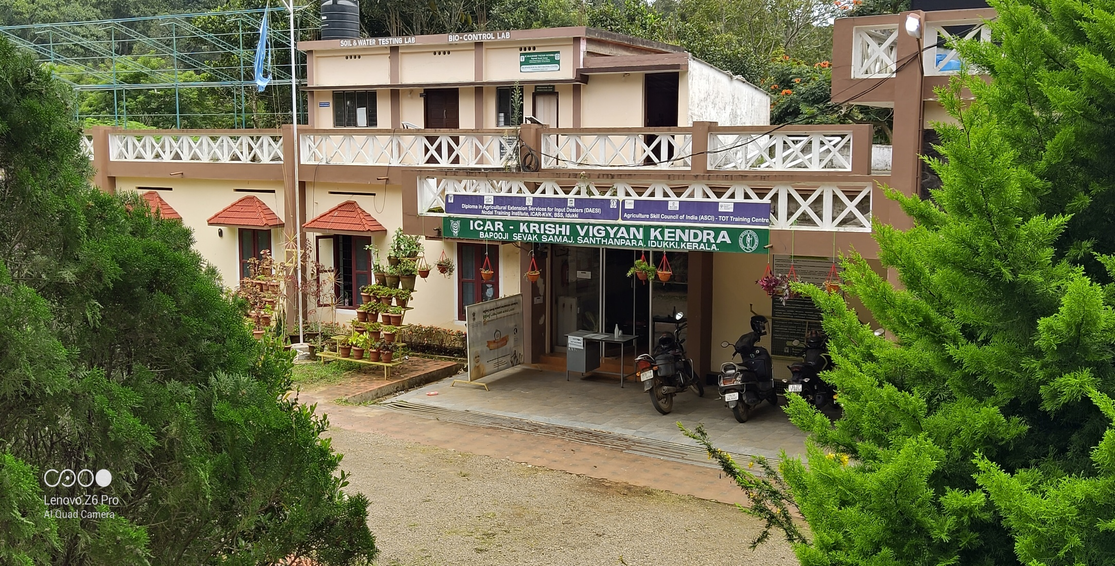
ICAR - KRISHI VIGYAN KENDRA (BSS)
IDUKKI
ANNUAL REVIEW WORKSHOP (2019-20)

Slide 2
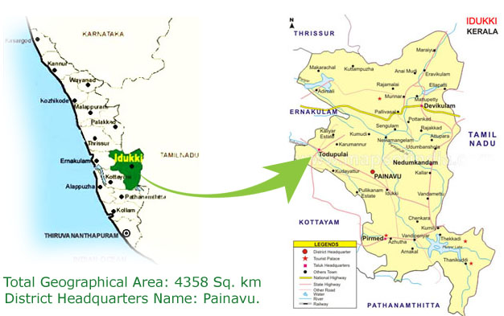

IDUKKI DISTRICT PROFILE
Geographical area: 4358 sqkm. Population : 11.08 lakhs Taluks : 5 Blocks : 8 Panchayats : 53 Villages : 65 | Avg. ann. rainfall : 2900 mm Temperature : max 35ºC min 10ºC Relative Hum. (%) : 73.7% Agro climatic Zone : High Altitude Zone (KE – 4) Agro Ecological Zone : Western Plains and Ghat region(XII)
Annual Review Workshop 2019-20 ICAR-KVK (BSS), Idukki

Slide 3
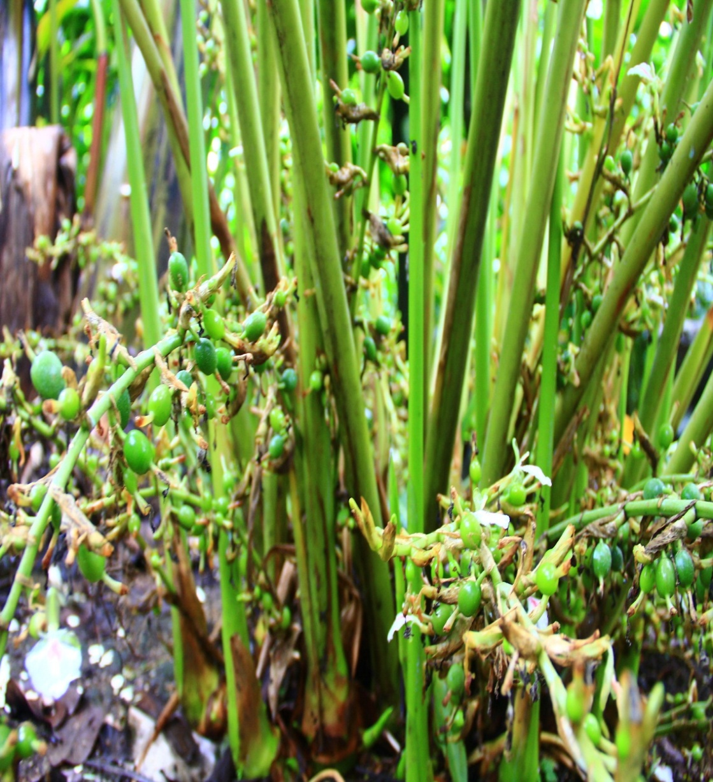
Month | Rainfall (mm)
April 2019 | 122.0
May 2019 | 190.0
June 2019 | 356.0
July 2019 | 454.0
Aug. 2019 | 287.0
Sep. 2019 | 184.0
Oct. 2019 | 271.0
Nov. 2019 | 181.0
Dec. 2019 | 73.0
Jan. 2020 | 15.24
Feb. 2020 | 25.4
Mar. 2020 | 53.3
TOTAL | 2211.94mm
RAINFALL 2019 - 20
SOUTH WEST MONSOON – 1281 mm
NORTH EAST MONSOON – 525mm
SUMMER – 405.94mm
Annual Review Workshop 2019-20 ICAR-KVK (BSS), Idukki

Slide 4
STAFF IN POSITION
CATEGORY OF POSTS | SANCTIONED | FILLED
Senior Scientist & Head | 1 | 1
Subject Matter Specialist | 6 | 5
Programme Assistant | 3 | 3
Administrative staff | 2 | 2
Auxiliary staff | 2 | 1
Supporting staff | 2 | 2
Total | 16 | 14
Annual Review Workshop 2019-20 ICAR-KVK (BSS), Idukki

Slide 5
AREA, PRODUCTION AND PRODUCTIVITY OF MAJOR CROPS
Crop | Area (ha) | Production (Metric tons) | Productivity (kg / ha)
Cardamom | 31165 | 16505 | 530
Pepper | 43790 | 18726 | 428
Banana | 7535 | 67469 | 8954
Rice | 695 | 1631 | 2347
Coconut | 16122 | 63 million nuts | 3907
Tapioca | 6998 | 297870 | 42565
Coffee | 12717 | 8310 | 653
Tea | 40590 | 44991 | 2048
Annual Review Workshop 2019-20 ICAR-KVK (BSS), Idukki

Slide 6
AREA UNDER AGRICULTURAL CROPS IN IDUKKI DISTRICT
Annual Review Workshop 2019-20 ICAR-KVK (BSS), Idukki

Slide 7

OPERATIONAL AREA
LEGEND
1 | VATTAVADA
2 | KOVILUR
3 | KDHP VILLAGE
4 | RAJAKUMARI
5 | SANTHANPARA
6 | SENAPATHY
7 | VANDANMEDU
8 | NEDUMKANDAM
9 | UDUMBANCHOLA
10 | KATTAPPANA
KVK
Taluks : 2 Blocks : 2 | Clusters : 3 Villages : 10
Annual Review Workshop 2019-20 ICAR-KVK (BSS), Idukki

Slide 8
TARGET AND ACHIEVEMENTS OF MAJOR MANDATES
Sl. No. | Mandates | Target (Nos.) | Achievements (Nos.)
1 | OFT | 6 | 6
2 | FLD | 14 | 14
3 | Trainings | 82 | 138
4 | Extension Programmes | 1837 | 1390
5 | Production and Supply of Seeds (q) | 0.45 | 2.35
 |  | Target | Production | Supply
6 | Planting materials | 33260 | 6000 | 5695
7a | Bio products (lit) | 10000 | 10000 | 6000
7b | Bio products (kg) | 15000 | 12000 | 6780
Annual Review Workshop 2019-20 ICAR-KVK (BSS), Idukki

Slide 9
MAJOR THRUST AREA FOR DOUBLING THE FARMERS INCOME
Sl. No. | Thrust area
Theme A | IMPROVEMENT IN PRODUCTIVITY
 | Integrated crop management practices
 | Soil Health Management
 | Crop improvement
 | Drought management
 | Bio intensive crop health management
 | Live stock production and management
Theme B | RESOURCE USE EFFICIENCY OR SAVING IN COST OF PRODUCTION
 | Mechanization in Paddy
 | Bio waste Management
 | Bee keeping
Theme C | INCREASE IN CROPPING INTENSITY
 | Intercropping
Theme D | CROP DIVERSIFICATION TOWARDS HIGH VALUE CROPS
 | Diversification in cereals, vegetables and fruits
 | Popularisation of hybrid poultry birds
 | Value addition in vegetables and fruits
Annual Review Workshop 2019-20 ICAR-KVK (BSS), Idukki

Slide 10
LIST OF APPROVED OFTs
Sl. No. | Crop/ Enterprises | Title of Assessment | No. of trials | Total Cost (Rs.)
1. | Finger millet | Assessment of finger millet varieties in tribal belt of Idukki district | 3 | 8550.00
2. | Black pepper | Assessment of different potting mixture to produce healthy planting material of Black pepper | 2 | 15920.00
3. | Plantation Crops | Assessment of different innovative technologies for deterring crop raiding wild elephants | 1 | 12630.00
4. | Small Cardamom | Assessment of different biological control agents for the management of thrips (Sciothrips cardamomi ) in small cardamom | 2 | 46800.00
5. | Passion Fruit | Assessment of micro-nutrient sprays for mitigating irregularities in passion fruit | 2 | 10600.00
6 | Poultry | Assessment of Production performance of different breeds of poultry under homesteads in Idukki district | 5 | 10500.00
 | 2018-19 | Total | 15 | 1,05,000.00
7 | Tapioca | Assessing the effect of Customized fertilizer formulation for Cassava and Elephant Foot Yam | 5
Annual Review Workshop 2019-20 ICAR-KVK (BSS), Idukki

Slide 11
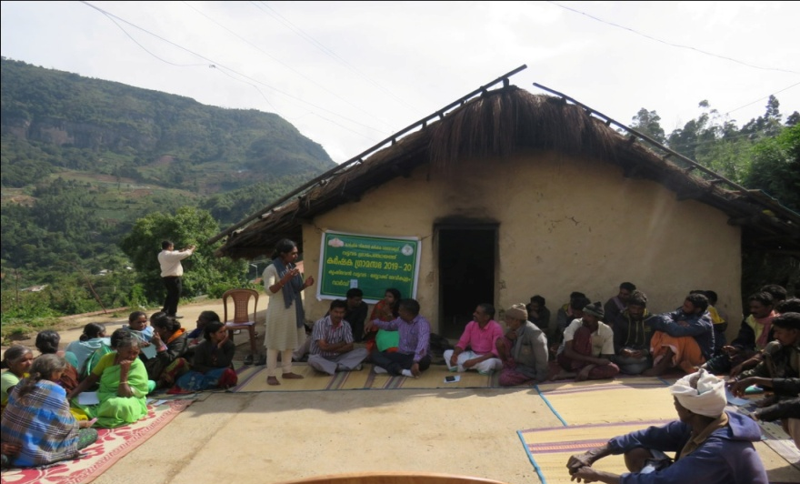
OFT 1. ASSESSMENT OF FINGER MILLET VARIETIES IN TRIBAL BELTS OF IDUKKI DISTRICT
Operational area | Vattavada
Area under finger millet | 27 ha
Season | Rabi
Area | 1 ha
Trials | 3
Prioritized Problem | Lodging (Yield loss 16 - 19%) Shattering losses Severe disease incidence (Yield loss 28%) Non availability of improved variety
Technological options
TO1 | Farmer Practice – Traditional variety
TO2 | CO 15 (TNAU)
TO3 | GPU 67 (UAS, Bangalore)
Annual Review Workshop 2019-20 ICAR-KVK (BSS), Idukki

Slide 12
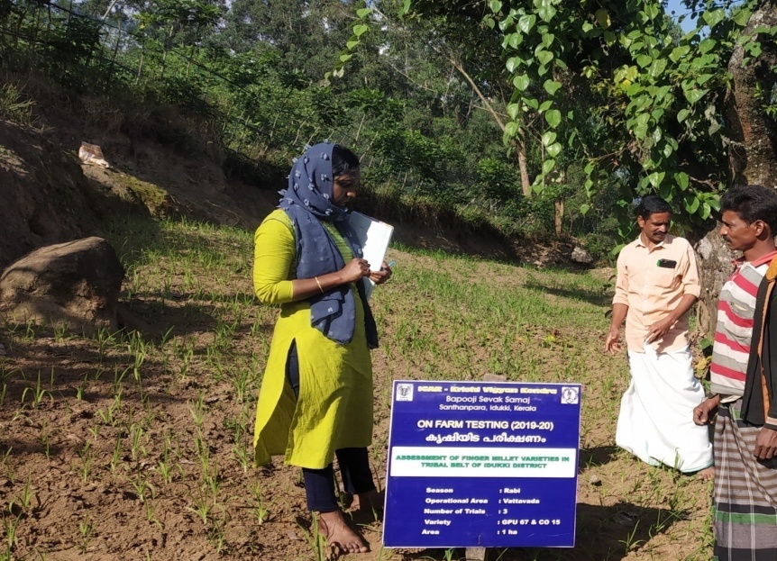
RESULTS
Parameters | To 1 (Traditional) | TO 2 (CO 15) | To 3 (GPU 67)
No. of tillers/plant | 6 | 5 | 7
Ear length (cm) | 8.17 | 7.0 | 6.93
Shattering loss | 23 % | 7% | 4%
Disease incidence | 47% | 12% | 5%
Yield (q/ha) | 10.8 | 13.5 | 19.5
Gross Cost (Rs./ha) | 13833.00 | 14667.00 | 15333.00
Gross Return (Rs./ha) | 21667.00 | 27000.00 | 39000.00
Net return | 7833.00 | 12333.00 | 23667.00
BC ratio | 1.57 | 1.84 | 2.54
CONCLUSION
GPU 67 found effective in terms of yield compared to CO 15 and traditional
Pest and disease incidence was less in GPU 67
26 farmers took sowing with GPU 67
Annual Review Workshop 2019-20 ICAR-KVK (BSS), Idukki

Slide 13
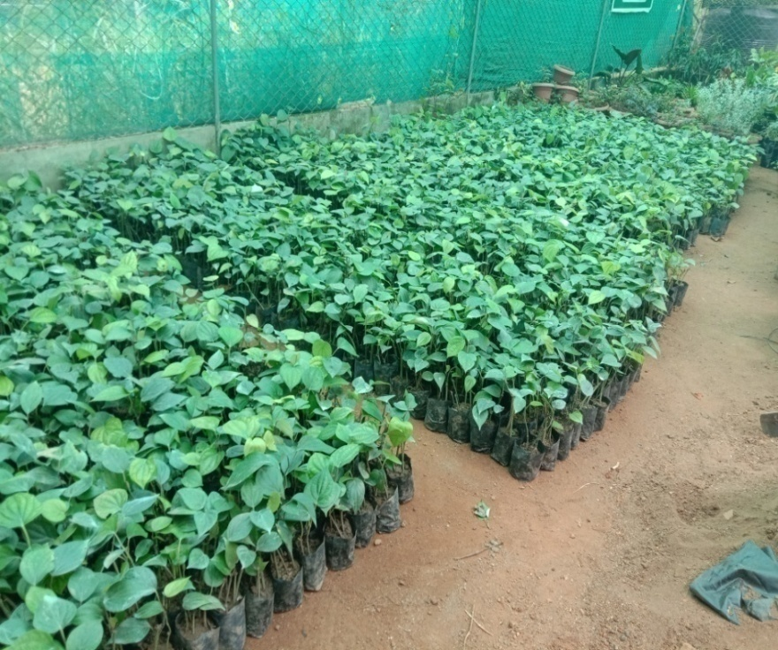
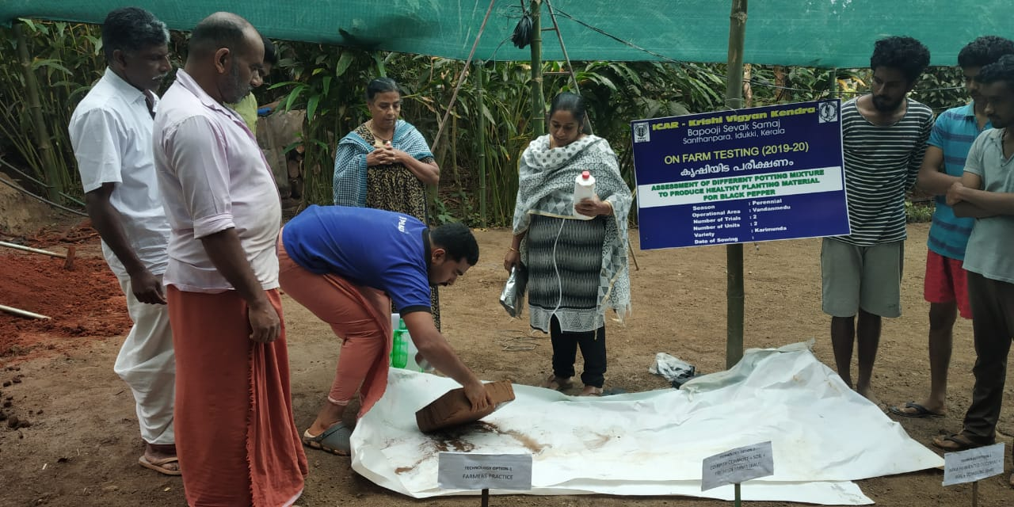
OFT 2. ASSESSMENT OF DIFFERENT POTTING MIXTURE TO PRODUCE HEALTHY PLANTING MATERIAL OF BLACK PEPPER
Operational area | Vadanmedu
Area under Pepper | 1215 ha
Season | Summer
Area/units | 02
Trials | 02
Prioritized Problem | Less recovery of plants due to Quick wilt Growth retardation
Technological options
TO1 | Farmers Practice (1:1:1 of soil+ cowdung + sand)
TO2 | Coir pith compost + Soil + Trichoderma - ( KAU)
TO3 | Arka fermented cocopeat + soil + cowdung ( IIHR)
Annual Review Workshop 2019-20 ICAR-KVK (BSS), Idukki

Slide 14
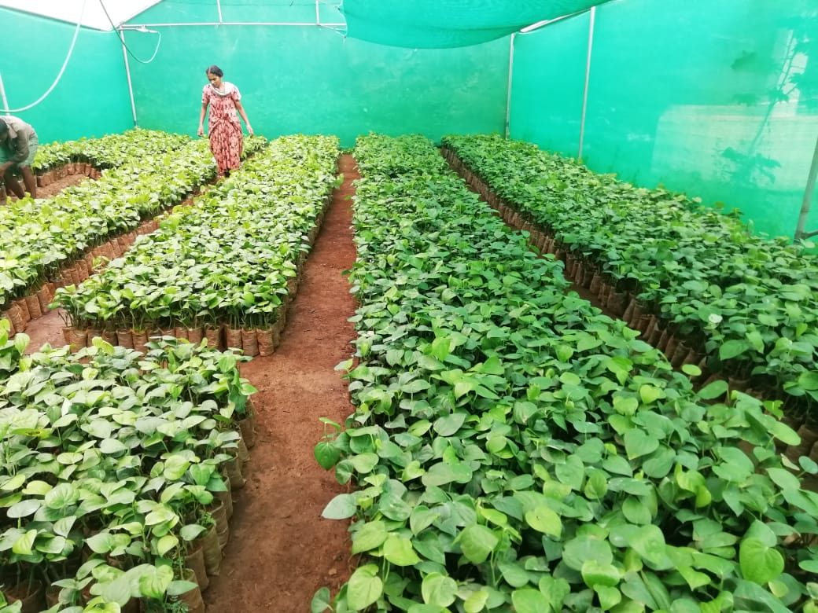
RESULTS
Parameters | TO 1 | TO 2 | TO 3
% recovery of plants | 58 | 82 | 75
% incidence of diseases | 42 | 18 | 25
Gross Cost (Rs/500 plant) | 5990.00 | 5900.00 | 5850.00
Gross Return (Rs/500plant) | 8700.00 | 15560.00 | 11250.00
Net return | 2710.00 | 9660.00 | 5400.00
BC ratio | 1.45 | 2.63 | 1.9
Conclusion
Trichoderma enriched coir pith compost gave better result in reducing quick wilt incidence
Feed back
% recovery of plants were more in treatment with Trichoderma enriched coir pith compost
2 nursery units were established
2lakhs rooted cutting were produced
Linked with FPOs
Annual Review Workshop 2019-20 ICAR-KVK (BSS), Idukki

Slide 15
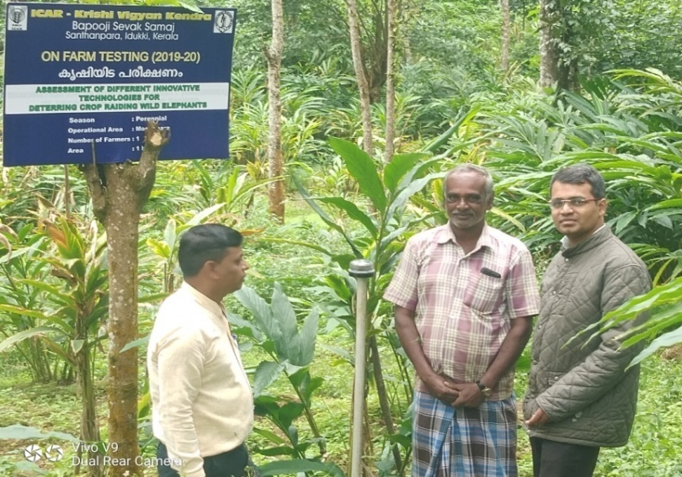
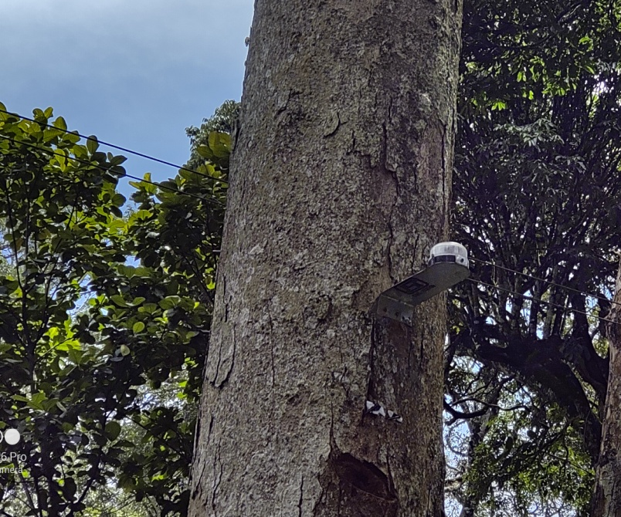
OFT 3 ASSESSMENT OF DIFFERENT INNOVATIVE TECHNOLOGIES FOR DETERRING CROP RAIDING WILD ELEPHANTS
Operational area | Udumbanchola
Season | Perennial
Situation | Irrigated
Area | 2 ha
Trials | 1
Area under Small cardamom | 2602 ha
Area under wild elephant problems | 828 ha
Prioritized problem | Crop raiding by wild elephants targeting field , pose serious socio economic and conservation problems in Idukki district
Krishi Rakshik LED light fixed field

Slide 16
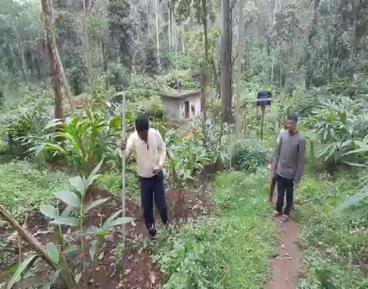
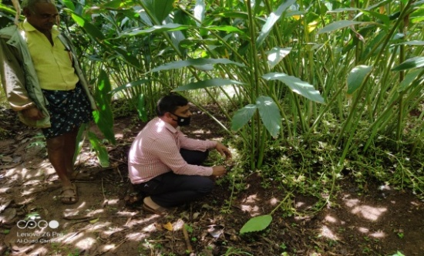
Technological options
TO1 | Farmer Practice (solar fencing)
TO2 | Placing of 3 units (Krishi Rakshak) per acre to keep the light units at 8 feet height for the wild elephants
TO3 | Spray Panchagavya based Herbal Extract @ 100ml/ L of water ( 20-days intervals).
TO4 | Placing of 10 bee boxes with colonies per acre
Parameters | To 1 | To 2 | To 3 | To 4
No. of wild animals raids | 14 | 1 | 3 | 8
Per cent of crop damage | 68 | 15 | 31 | 43
Yield q/ha | 3.8 | 6.5 | 5.9 | 4.1
Gross cost (Rs.) | 550000 | 690000 | 690000 | 590000
Gross return (Rs.) | 850000 | 1480000 | 1200000 | 1010000
Net return (Rs.) | 300000 | 790000 | 510000 | 489000
BC ratio | 1.54 | 2.14 | 1.73 | 1.71
Conclusion :
Solar based LED light fixed field was not trespassed by wild elephants as compared to different treatments and crop stand is good.

Slide 17
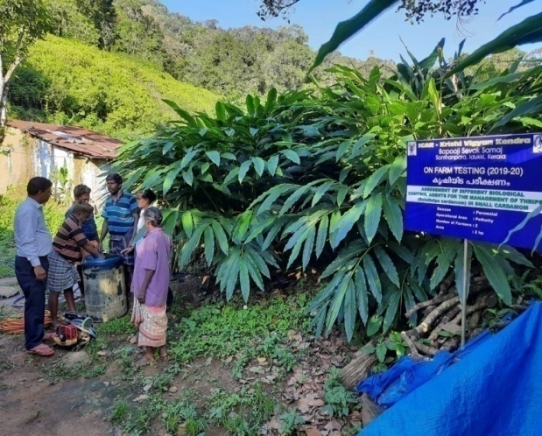
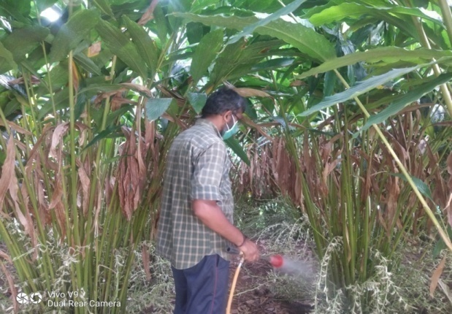
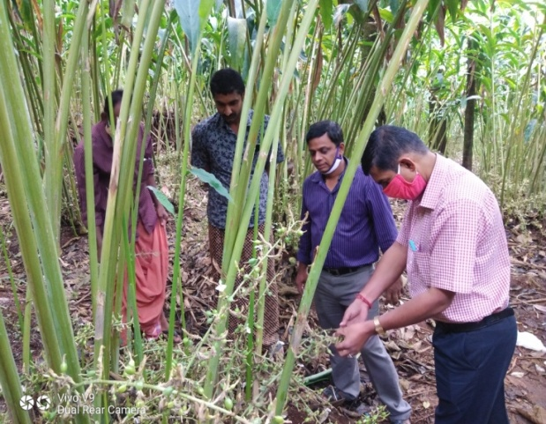
OFT4. ASSESSMENT OF DIFFERENT BIOLOGICAL CONTROL AGENTS FOR THE MANAGEMENT OF THRIPS IN SMALL CARDAMOM
Operational area | Udumbanchola
Season | Perennial
Situation | Irrigated
Area | 2 ha
Trials | 2
Area under small cardamom | 39080 ha
Area under Thrips affected | 3450 ha
Prioritized problem | Panicles become stunted. Shedding of flowers and immature capsules Malformed and shriveled capsules

Slide 18
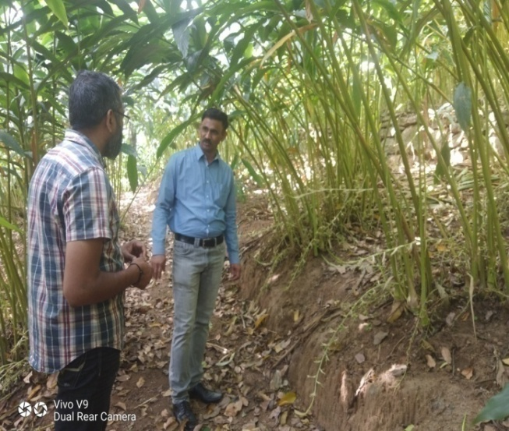
Technological options
TO1 | Farmer Practice (PPC)
TO2 | Spray of Lecanicillium psalliotae @ 10 ml/lit of water during March, April ,May , August, September and December (IISR)
TO3 | Spray of Steinernema sp @ 3g/L of water during March, April, May , August, September and December (NBAIR)
Parameters | To 1 | To 2 | To 3
Per cent reduction over control (%) | 65 | 37.5 | 49.5
Yield (q/ha) | 4.1 | 6.8 | 5.2
Gross cost (Rs.) | 555000 | 675000 | 675000
Gross return (Rs.) | 1189000 | 1943000 | 1566000
Net return (Rs.) | 629000 | 1268000 | 891000
BC ratio | 2.12 | 2.87 | 2.32
Conclusion :
Lecanicillium psalliotae treated field recorded below ETL of thrips (10 thrips/panicle)as compared to other treatments

Slide 19
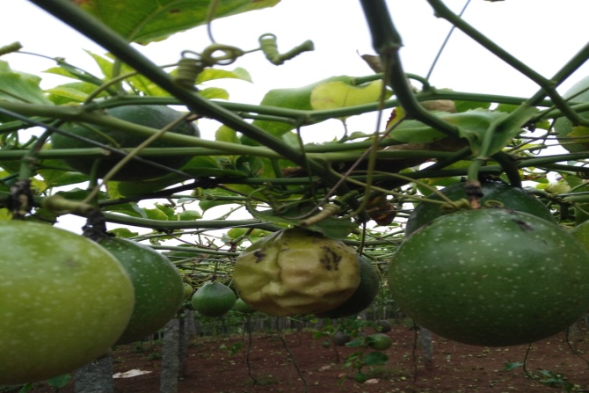
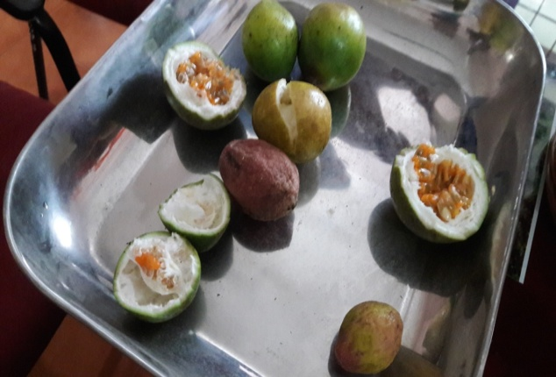
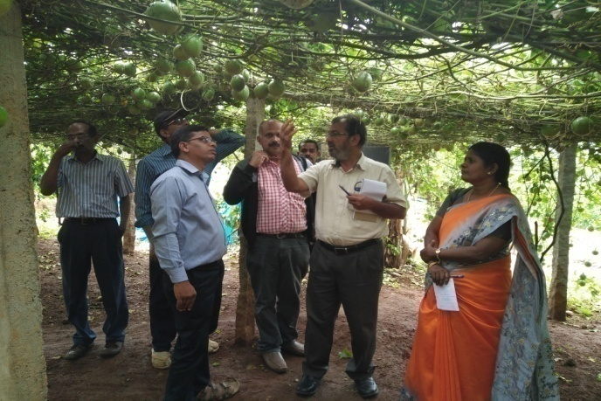
OFT 5. ASSESSMENT OF MICRONUTRIENT SPRAYS FOR MITIGATING IRREGULARITIES IN PASSION FRUIT
Operational area | Vadanmedu & Koviloor
Season | Rabi 2019
Situation | Irrigated
Area | 1 ha
No. of trials | 02
Prioritized Problem | High fruit drop, Malformed fruits
Soil test report
Parameters | TO-1 | TO-2 | TO-3 | TO-4
Soil pH | 4.5 | 4.9 | 5.3 | 5.6
Potassium (Kg/ha) | 155 | 250 | 399 | 298
Zinc ppm | 0.2 | 0.5 | 1.2 | 0.9
Boron ppm | 0.4 | 1.0 | 0.9 | 0.8
Annual Review Workshop 2019-20 ICAR-KVK (BSS), Idukki

Slide 20
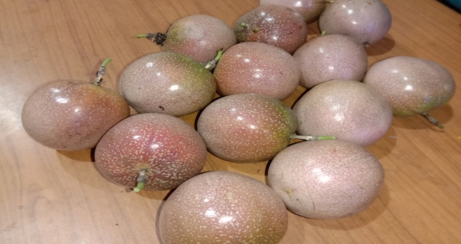
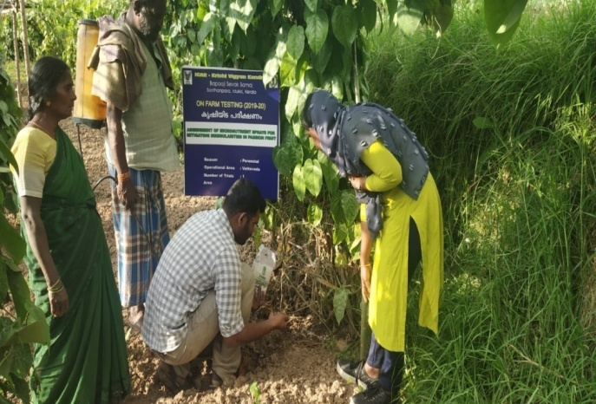
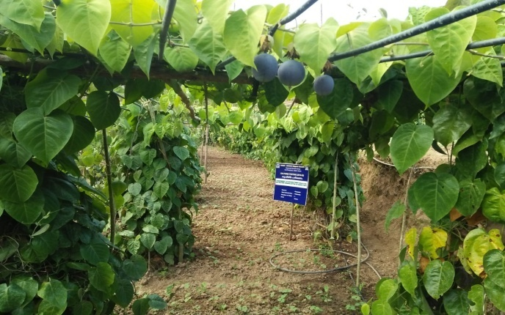
Technological options
TO1 | Farmers Practice ( Basal application of FYM + complex fertilizers+ Secondary nutrients)
TO2 | Recommended POP fertilizers(FYM 10 kg, N-20 g, P-20 g, K- 15 g/plant + Boron spray @1.5g/lit)
TO3 | FYM- 10 kg , N-110g, P- 60g, K-110g per vine/annum + IIHR micronutrient spray @ 1g/lit
TO4 | FYM- 10 kg , N-110g, P- 60g, K-110g per vine/annum + Ayar @ 50g/plant
IIHR Micro Nutrient sprayed fruit
Annual Review Workshop 2019-20 ICAR-KVK (BSS), Idukki

Slide 21
RESULTS
Parameters | TO 1 | TO 2 | TO 3 | TO4
Fruit drop (%) | 25 | 20 | 10 | 15
Malformed fruits (%) | 30 | 25 | 15 | 18
TSS (Brix unit) | 11.0 | 11.6 | 12.3 | 11.9
Average weight of fruit (Kg) | 0.15 | 0.18 | 0.23 | 0.20
Yield (q/ha) | 70 | 90 | 100 | 80
Gross Cost (Rs/ha) | 215000.00 | 210000.00 | 200000.00 | 212000.00
Gross Return (Rs/ha) | 350000.00 | 450000.00 | 500000.00 | 400000.00
Net return | 135000.00 | 240000.00 | 300000.00 | 188000.00
BC ratio | 1.62 | 2.14 | 2.5 | 1.88
Conclusion
TO3 was found effective in terms of yield, less fruit fall and less malformed fruits as compared to other treatments.
Feed back
TO-3 showed better result in terms of size , appearance and juiciness of fruit which increased the marketability
Annual Review Workshop 2019-20 ICAR-KVK (BSS), Idukki

Slide 22
OFT 6. ASSESSMENT OF PRODUCTION PERFORMANCE OF DIFFERENT BREEDS OF POULTRY UNDER HOMESTEADs IN HIGHRANGES
Operational area | Devikulam
Season | Through out the year
Situation | Homestead
Area | 3
No. of trials | 3
Prioritized Problem | Non availability of quality layer chicks, low growth rate, poor laying performance and feather pecking
Technological options
TO1 | Rearing non descript breeds
TO2 | Rearing of Kalinga Brown chicks as per recommended concentrate feed along with mineral mixture and vitamin supplements (CPDO)
TO3 | Rearing of B V 380 chicks as per recommended concentrate feed along with mineral mixture and vitamin supplements (CPDO)
TO4 | Rearing of Krishi bro chicks as per recommended concentrate feed along with mineral mixture and vitamin supplements (DPR)
Annual Review Workshop 2019-20 ICAR-KVK (BSS), Idukki

Slide 23
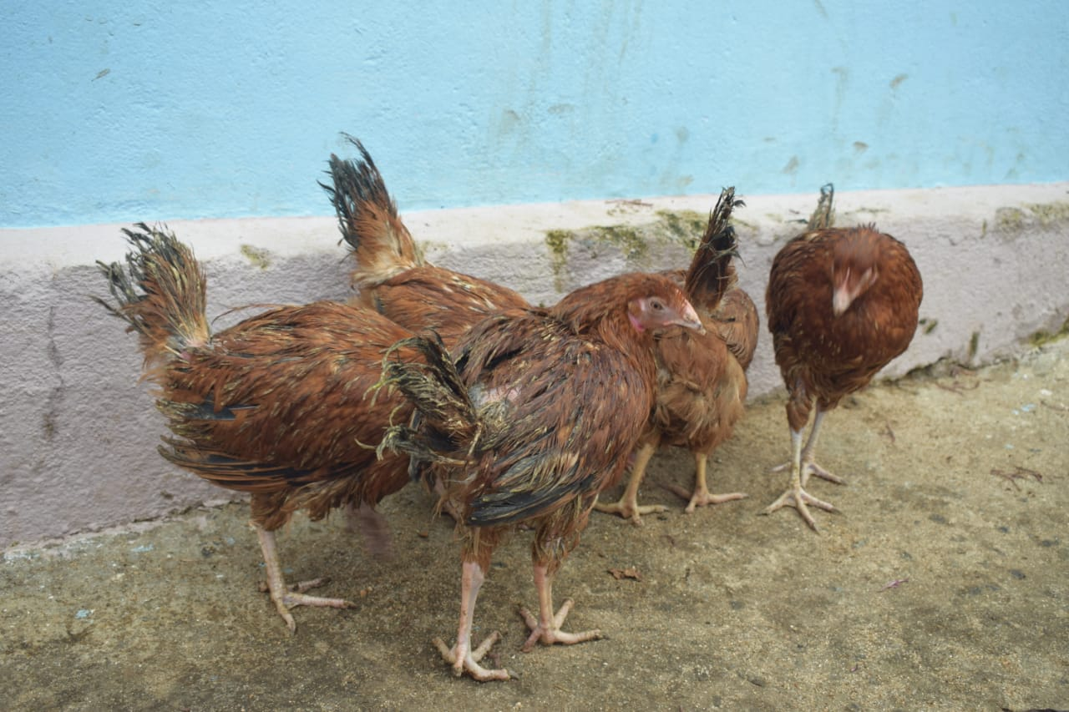
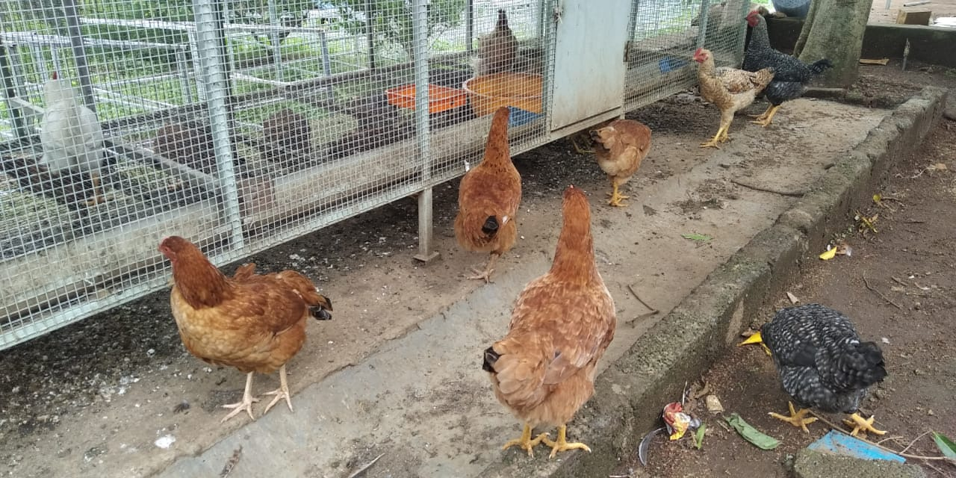
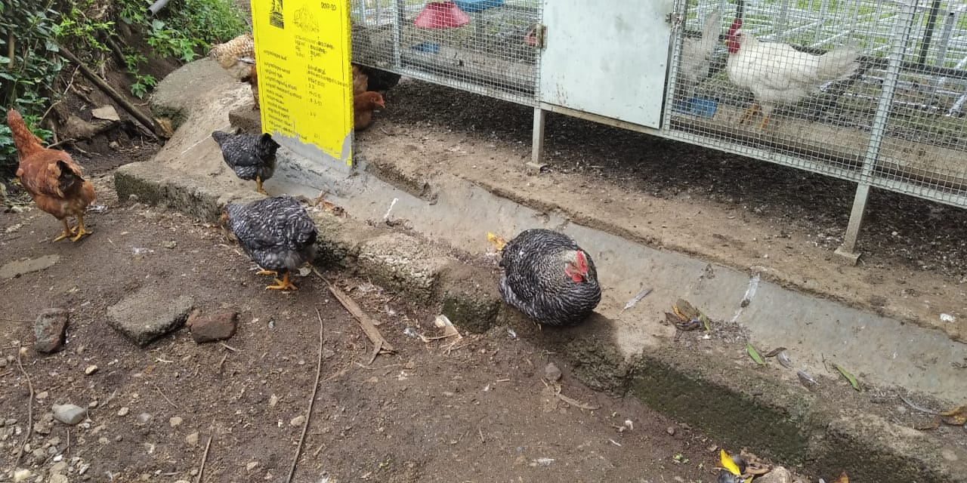
Parameters | TO 1 | TO2 | TO 3 | TO 4
Age at sexual maturity (days) | 180 | 150 | 150 | 150
Body weight (Kg) | 0.980 | 1.410 | 1.400 | 1.450
Mortality(%) | 40 | 0 | 0 | 0
Feather pecking(%) | 30 | 0 | 0 | 0
Annual Egg production( Nos) | 79 | 162 | 284 | 169
KALINGA BROWN
BV 380
KRISHI BRO
Conclusion
BV 380 was found effective in terms of egg yield/ annum
Feed back
Kalinga brown, BV 380 and Krishi bro was found effective in terms of adaptability in high ranges and Krishi bro attained higher body weight
Annual Review Workshop 2019-20 ICAR-KVK (BSS), Idukki

Slide 24
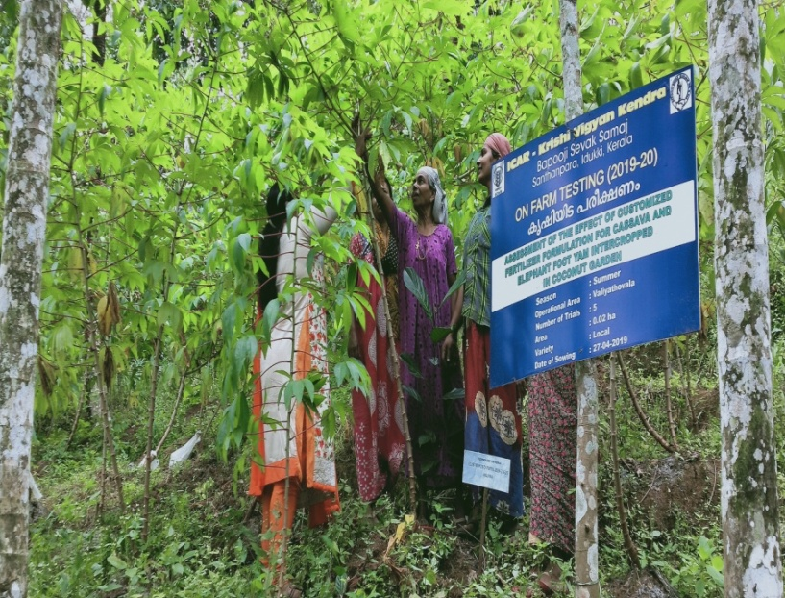
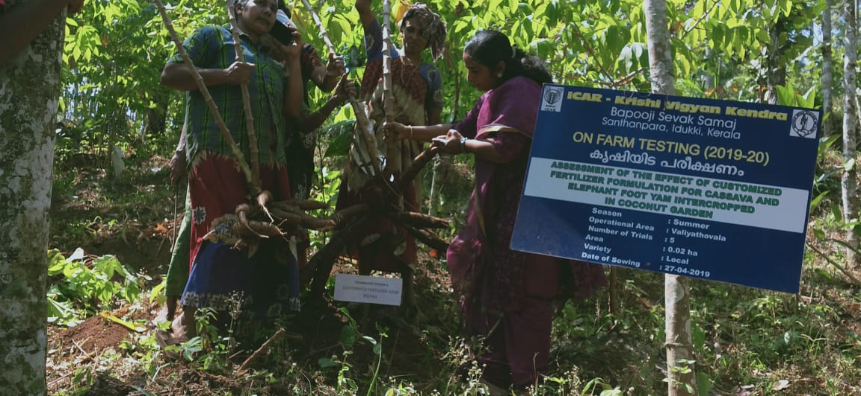
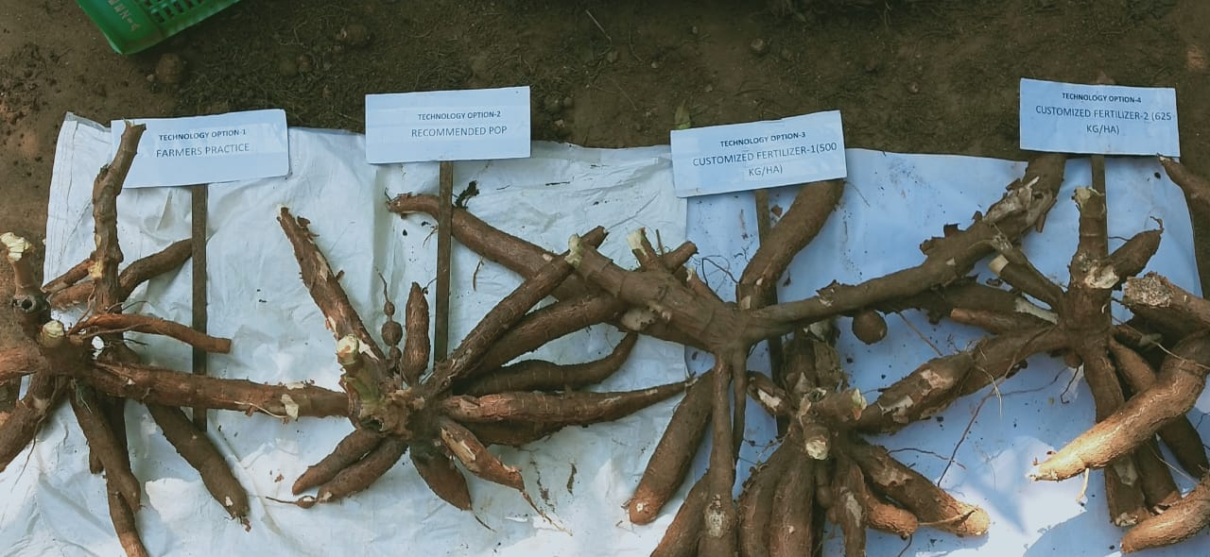
OFT 7. ASSESSMENT OF CUSTOMIZED FERTILIZER FORMULATION FOR CASSAVA (2018-19)
Operational area | Valiathovala village
Season | Rabi 2018
Situation | Irrigated
Area | 1 ha
No. of trials | 5
Prioritized Problem | Soil acidity, Secondary and micronutrient deficiency
Annual Review Workshop 2019-20 ICAR-KVK (BSS), Idukki

Slide 25
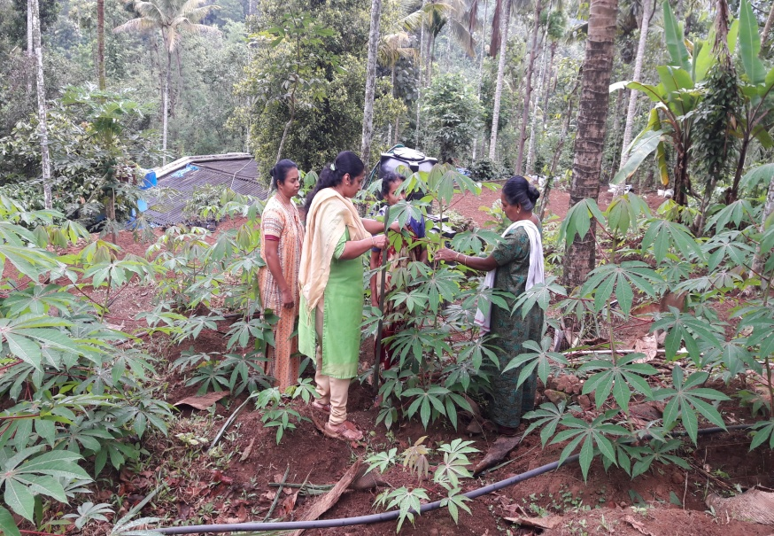
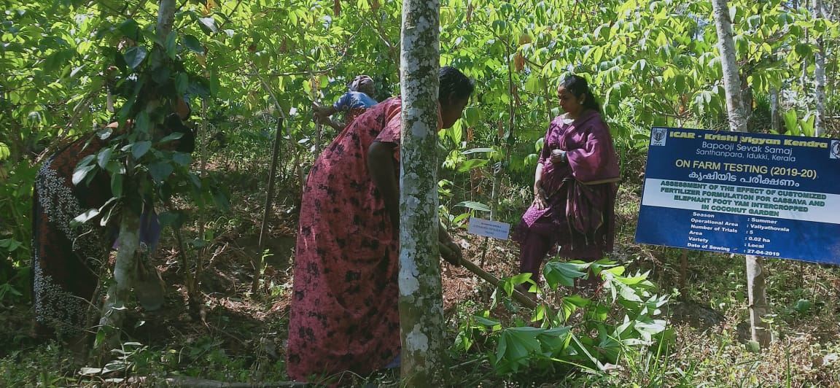
Technological options
TO1 | Farmers Practice
TO2 | Recommended POP fertilizers
TO3 | Customized fertilizer formulation @ 500 kg/ha
TO4 | Customized fertilizer formulation @ 625kg/ha
Soil test report
Parameters | TO-1 | TO-2 | TO-3 | TO-4
Soil pH | 4.30 | 5.5 | 6.2 | 5.8
Potassium (Kg/ha) | 101 | 151 | 255 | 250
Calcium meq/100g | 1.5 | 1.8 | 1.9 | 1.9
Magesium meq/100g | 0.3 | 0.45 | 0.56 | 0.67
Zinc ppm | 0.5 | 0.9 | 1.0 | 1.1
Boron ppm | 0.4 | 0.5 | 0.9 | 0.8
Annual Review Workshop 2019-20 ICAR-KVK (BSS), Idukki

Slide 26
RESULTS
Parameters | TO1 | TO 2 | TO 3 | TO4
Wt of tubers/plant (kg) | 8 | 9.5 | 11 | 10
No . of tubers/plant (No) | 5 | 7 | 9 | 8
Plant height (cm) | 2.1 | 3.2 | 5.0 | 4.5
Tuber length (cm) | 20 | 22 | 25 | 24
Tuber girth (cm) | 10.1 | 10.97 | 11.8 | 10.7
Yield (t/ha) | 10.1 | 12.8 | 15.8 | 14.2
Gross Cost (Rs/ha) | 240000 | 264352 | 210105 | 231900
Gross Return (Rs/ha) | 303300 | 386700 | 474600 | 426900
Net return | 63300 | 122348 | 264495 | 195000
BC ratio | 1.26 | 1.46 | 2.25 | 1.84
Conclusion
Customized fertilizers gave better result in yield, weight of tubers and also reduction in nutrient deficiencies.
Feed back
Customized fertilizer1 @ 500kg/ha application showed better result in tuber girth, length and cooking quality
Annual Review Workshop 2019-20 ICAR-KVK (BSS), Idukki

Slide 27
LIST OF APPROVED FLDs
Sl. No | Crop/ Enterprise | Title of FLDs | No. of Demo | Budget (Rs)
1 | Paddy | Demonstration on AKSHAYA variety of rice | 5 | 25000.00
2 | Paddy | Demonstration on the effect of fine silica in paddy | 5 | 24250.00
3 | Cowpea | Enhancing productivity and nitrogen use efficiency in cowpea | 5 | 35450.00
4 | Cowpea | Bio-intensive pest management in cowpea | 5 | 9100.00
5 | Cabbage | Integrated crop management in cabbage | 5 | 33400.00
6 | Bitter gourd | Bio-intensive pest management in bitter gourd | 5 | 22000.00
7 | Carrot | Bio-intensive pest management of root knot nematode and soft rot in carrot | 5 | 8500.00
8 | Peppino | Introduction of pepino (Solanum muricatum) as an exotic salad vegetable in high ranges | 5 | 11250.00
9 | Banana | Demonstration of INM in banana | 5 | 23250.00
10 | Kiwi | Popularization of kiwi fruit in high ranges of idukki district | 3 | 17300.00
11 | Dairy | Demonstration on ethno veterinary medicine (EVM) for bloat in dairy cattle | 5 | 3000.00
12 | Dairy | Prophylactic management of mastitis in dairy cows by using masti-guard | 5 | 7500.00
13 | Dairy | Demonstration on estrus synchronization in cattle | 5 | 8000.00
14 | Nutrition garden | Implementation of home stead garden for easy availability of Nutritional plants | 5 | 15000.00
 | 2018-19 | TOTAL | 68 | 243000.00
 | Amorphophallus | Demonstration of acrid free variety (Gajendra) of Amorphophallus | 5
Annual Review Workshop 2019-20 ICAR-KVK (BSS), Idukki

Slide 28
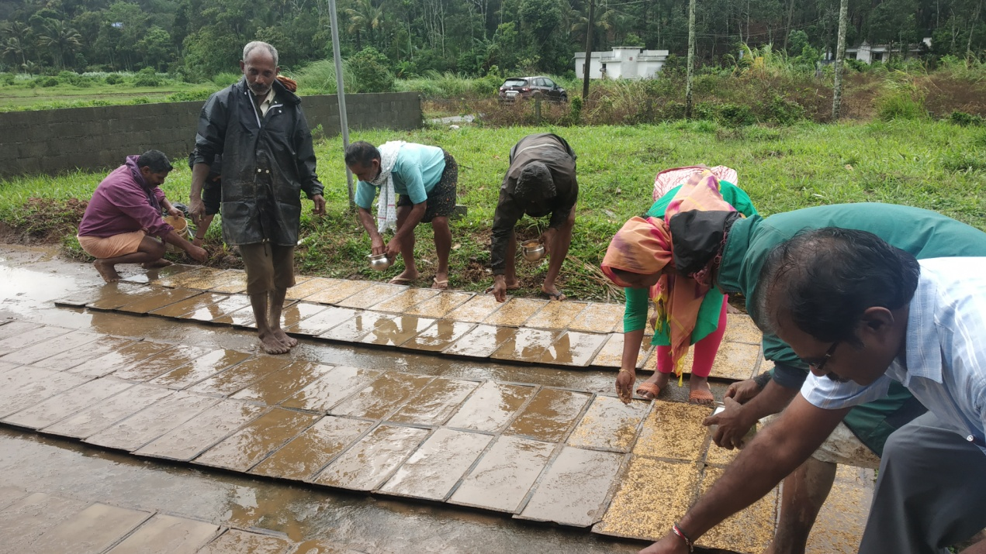
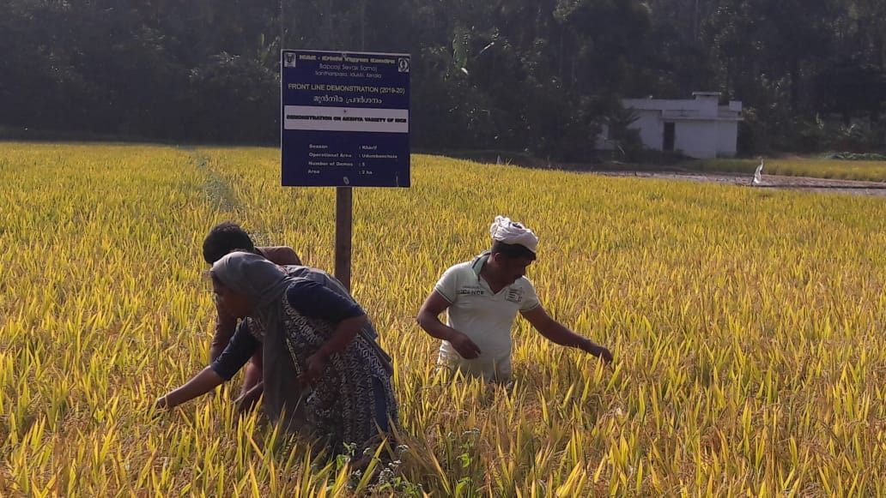
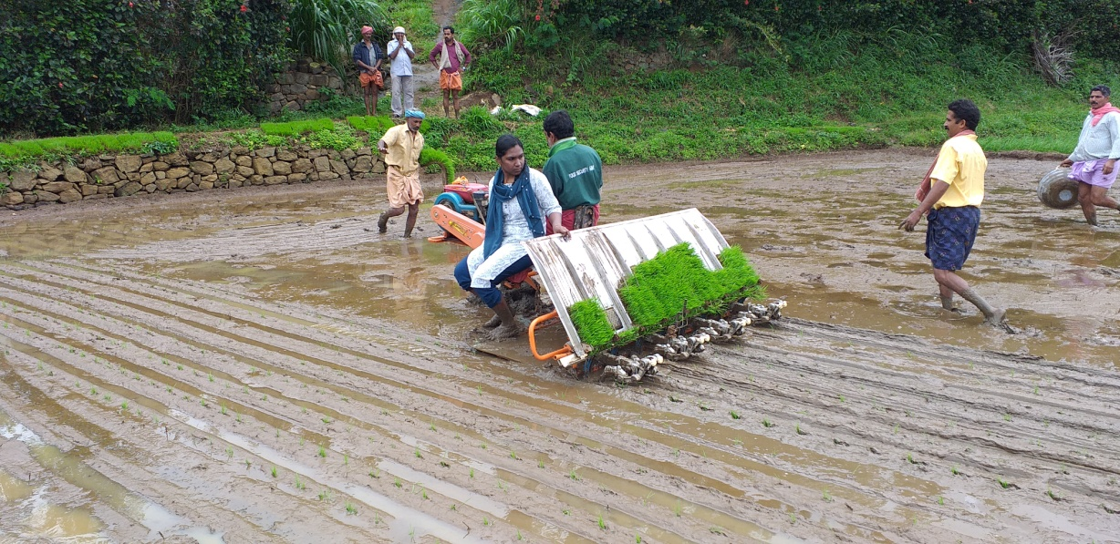
FLD 1. DEMONSTRATION OF AKSHAYA VARIETY OF RICE
Operational area | Udumbanchola
Area under paddy | 50 ha
Demos | 05
Season | Kharif 2019
Prioritized Problem | Continuous cultivation of traditional variety Heavy incidence of pest and disease (yield loss 17-26 %)
Technologies Demonstrated | Demonstration of Akshaya variety of rice
Annual Review Workshop 2019-20 ICAR-KVK (BSS), Idukki

Slide 29
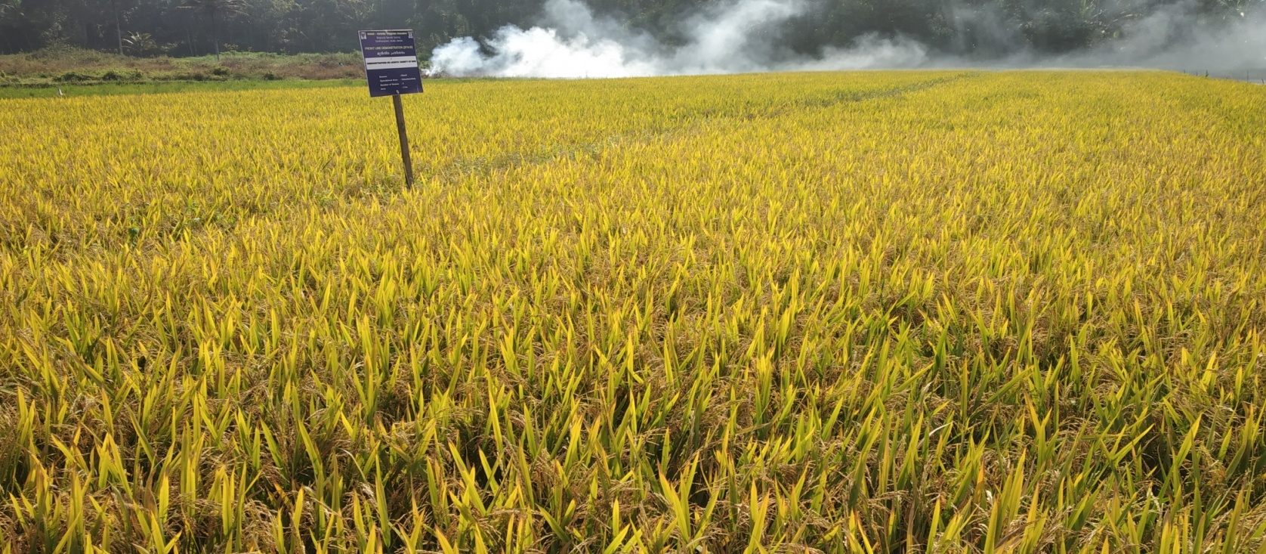
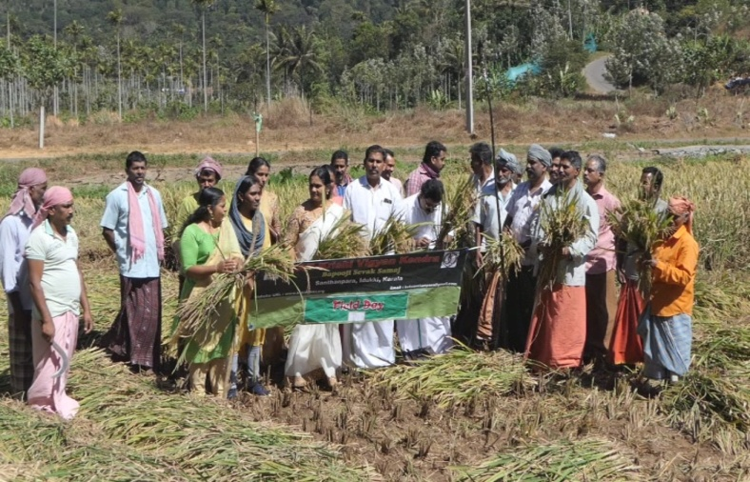
RESULTS
Parameters | Check | Demo
No. of productive tillers/hill | 19 | 24
Number of grains/panicle (no.) | 120 | 158
Test weight (g) | 25 | 29.5
Disease incidence (%) | 30 % | 10%
Yield (q/ha) | 511 | 700
Gross Cost (Rs./ha) | 140000 | 140000
Gross Return(Rs./ha) | 298410 | 397500
Net Return (Rs./ha) | 158410 | 257500
BCR | 2.13 | 2.84
FEED BACK:
Cultivation of Akshaya variety of paddy in high range performed better than traditional variety with respect to high yield, non lodging, straw yield and pest below ETL
Technology up scaling:
KAU Akshaya variety adopted through FPOs with an area of 25ha
Annual Review Workshop 2019-20 ICAR-KVK (BSS), Idukki

Slide 30
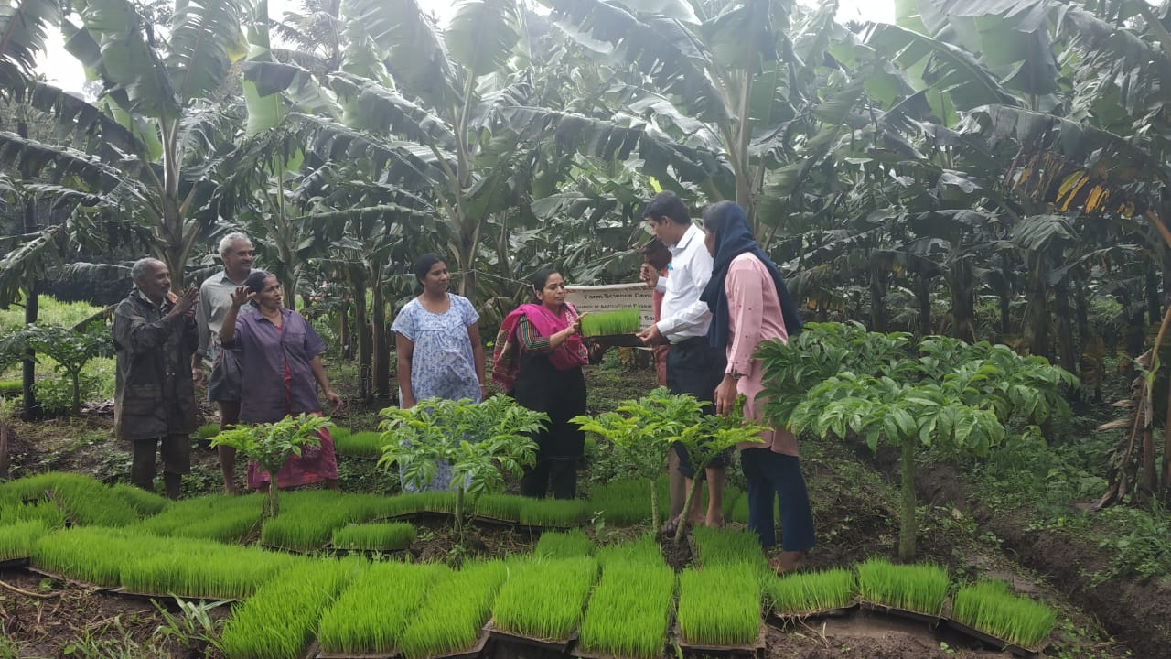
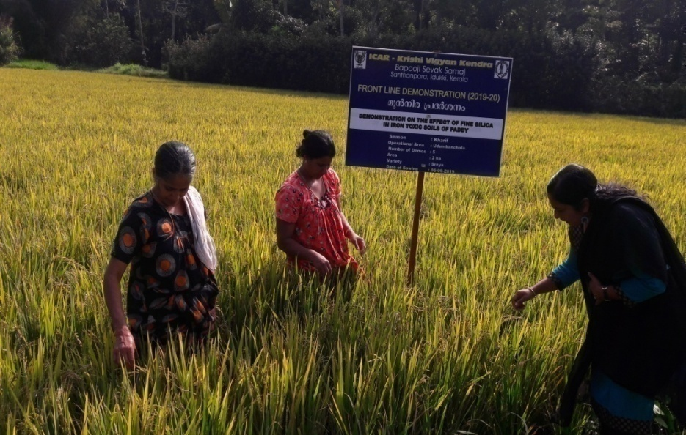
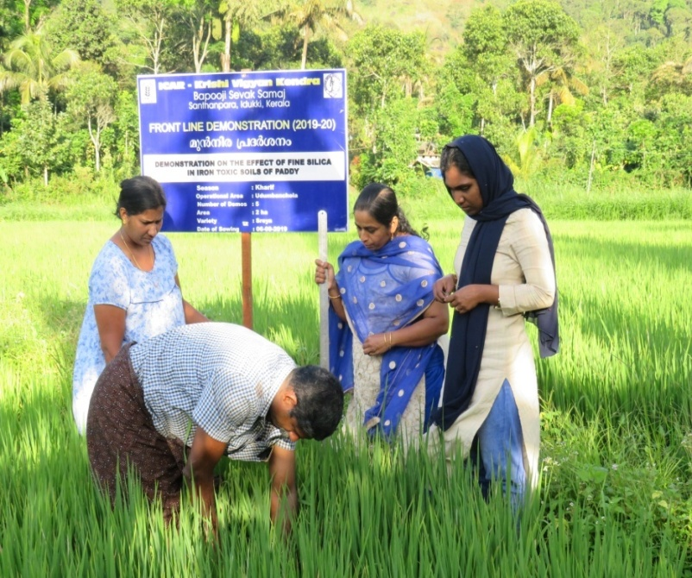
FLD 2. DEMONSTRATION ON THE EFFECT OF FINE SILICA IN IRON TOXIC SOILS OF PADDY
Operational area | Udumbanchola
Area under paddy | 50 ha
Demos | 05
Season | Kharif
Prioritized Problem | Soil acidity Iron toxicity Nutrient deficiencies
Technologies Demonstrated | Integrated Nutrient Management
Annual Review Workshop 2019-20 ICAR-KVK (BSS), Idukki

Slide 31
RESULTS
Parameters | Check | Demo
Soil pH | 4.3 | 6.2
% reduction in iron toxicity | 33 | 95
No. of panicles/plant | 18 | 23
% chaffiness | 18 | 7
% root rot incidence | 25 | 10
No. of tillers/hill | 23 | 25
No. of grains/panicle | 105 | 136
Yield (t/ha) | 5.1 | 6.9
Gross Cost (Rs/ha) | 127500.00 | 136000.00
Gross Return (Rs/ha) | 285900.00 | 368800.00
Net Return (Rs/ha) | 158400.00 | 232800.00
BCR | 2.24 | 2.71
FEED BACK:
Application of fine silica @ 100kg / ha enhanced the root proliferation and absorption of Ca & Boron
Technology up scaling:
Application of fine silica adopted by Tribal Development Project and covered an area of 28ha in Adimali Block

Slide 32
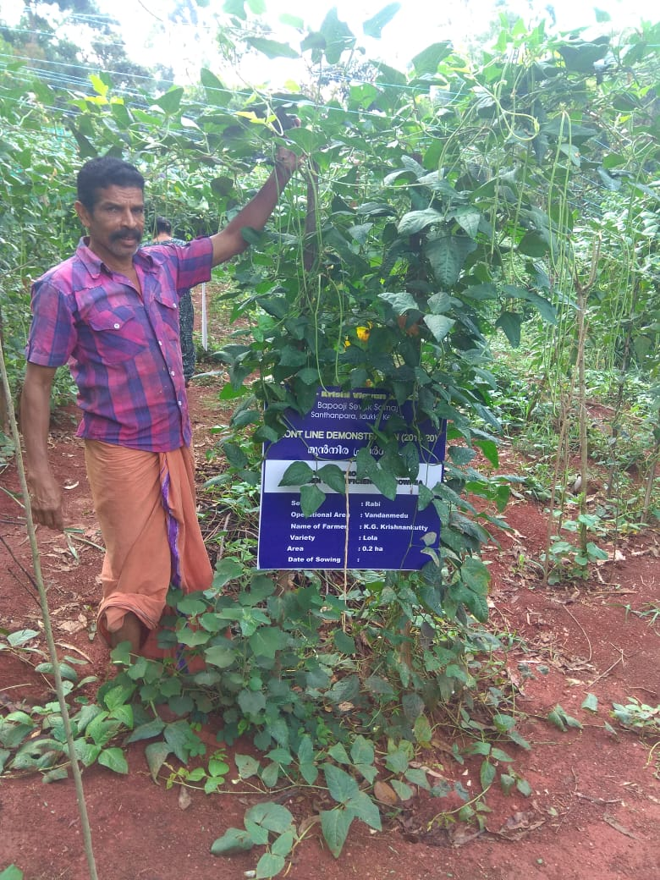
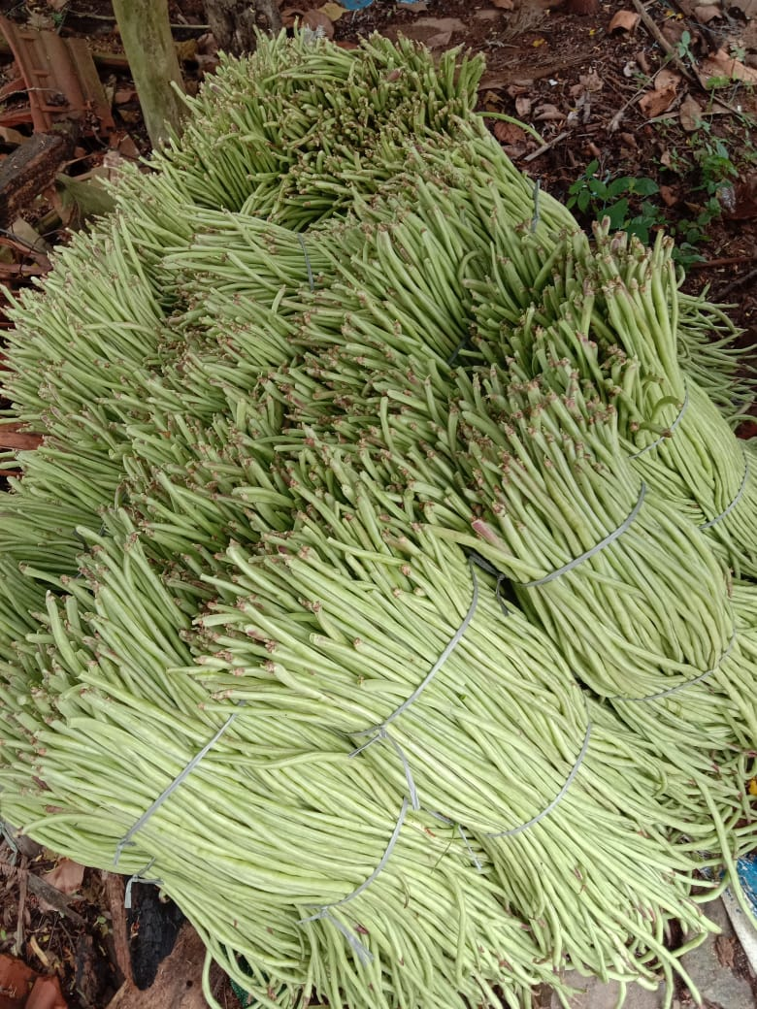
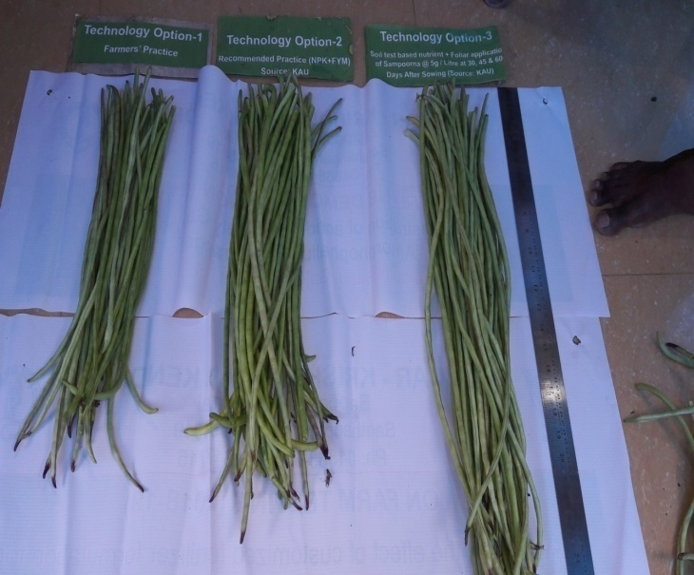
FLD 3. ENHANCING PRODUCTIVITY AND NITROGEN USE EFFICIENCY IN COWPEA
Operational area | Vandanmedu
Area | 1 ha
Demos | 05
Prioritized Problem | Low nutrient efficiency
Technologies Demonstrated | INM in cowpea
Annual Review Workshop 2019-20 ICAR-KVK (BSS), Idukki

Slide 33
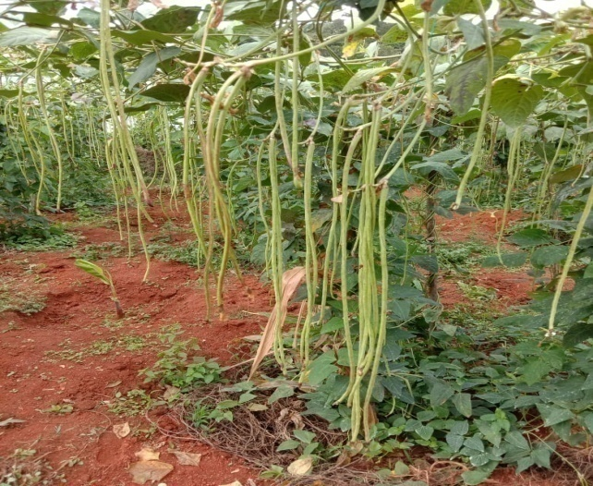
SOIL TEST RESULTS
Parameters | Check | Demo
Soil pH | 4.30 | 6.2
Potassium (Kg/ha) | 101 | 151
Calcium (meq/100g) | 1.5 | 1.8
Magesium (meq/100g) | 0.3 | 0.45
Zinc ppm | 0.7 | 0.5
Boron ppm | 0.4 | 1.0
Parameters | Check | Demo
Average Pod length (cm) | 50.1 | 66.2
No of seeds per pod | 20 | 27
Average weight of pod (g) | 20 | 50
Yield (t/ha) | 10 | 13.0
Gross cost (Rs/ha) | 89000 | 87000
Gross income (Rs/ha) | 200000 | 260000
Net return (Rs./ha) | 111000 | 173000
BCR | 2.2 | 2.9
FEED BACK:
Ca & B deficiency was reduced as compared to check which suppressed the Anthracnose disease and enhanced the yield
Annual Review Workshop 2019-20 ICAR-KVK (BSS), Idukki

Slide 34
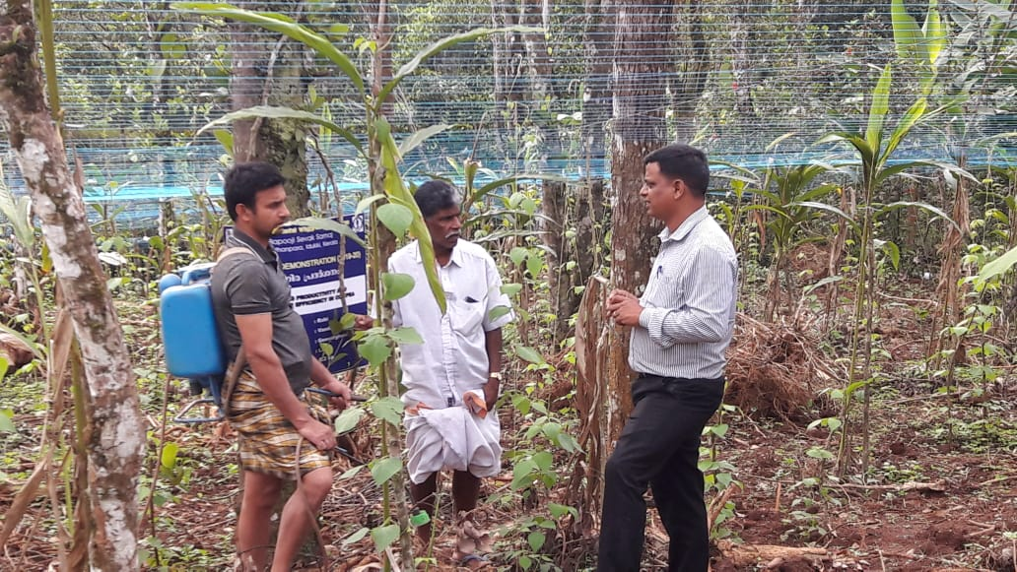
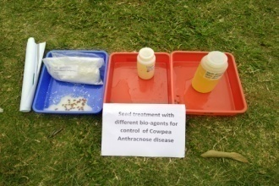
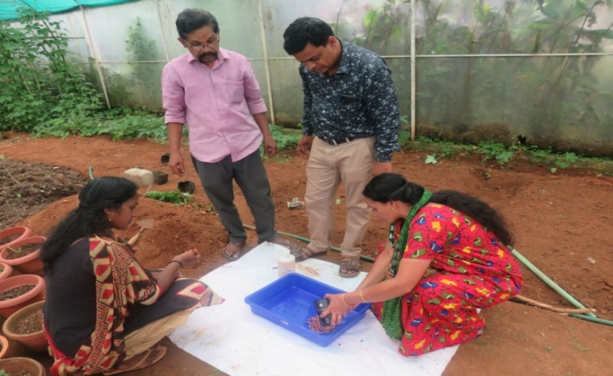
FLD 4. BIO- INTENSIVE PEST AND DISEASE MANAGEMENT IN COWPEA
Operational area | Udumbanchola
Season | Kharif
Situation | Irrigated
Area | 2 ha
Demonstrations | 5
Total Area | 343
Area affected | 51
Prioritized problem | Indiscriminate use of chemical inputs
Technologies Demonstrated | Bio-intensive Pest Management along with Foliar Spray of 1% PPFM
Source | OFT conducted- KVK-Idukki (2016, 2017 & 2018)

Slide 35
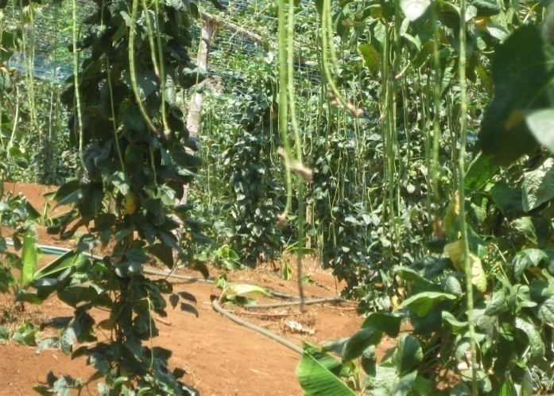
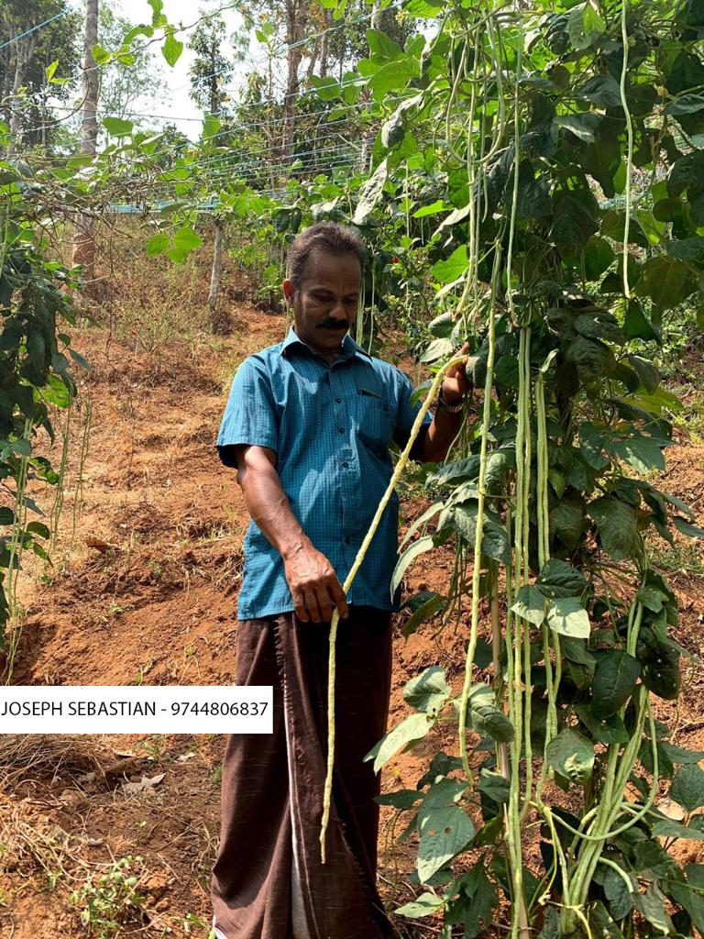
RESULTS
Parameters | Check | Demo
Disease Index (%) | 34 | 16
Pest Incidence (%) | 41 | 22
Yield (q/ha) | 112 | 155
Gross Cost (Rs/ha) | 165000 | 175000
Gross Return (Rs/ha) | 300500 | 387500
Net Return (Rs/ha) | 135500 | 212500
BCR | 1.82 | 2.21
FEED BACK:
Application of Bio agents along with PPFM increased the number of harvest, keeping quality, taste which lead to better acceptability (scale 5.0)
Annual Review Workshop 2019-20 ICAR-KVK (BSS), Idukki

Slide 36
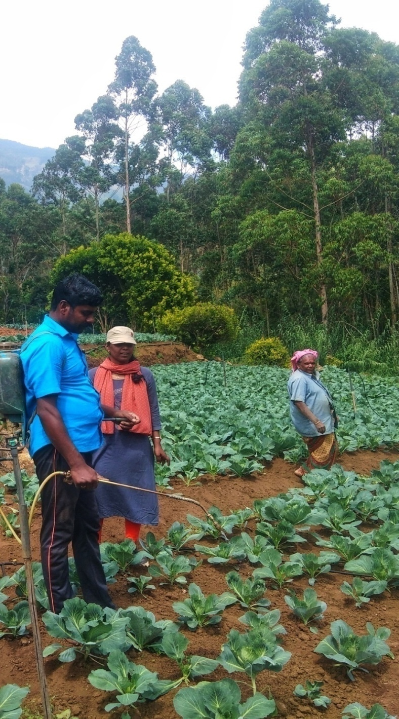
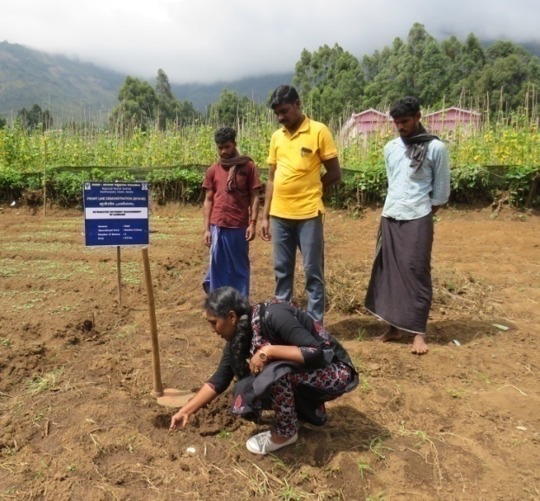
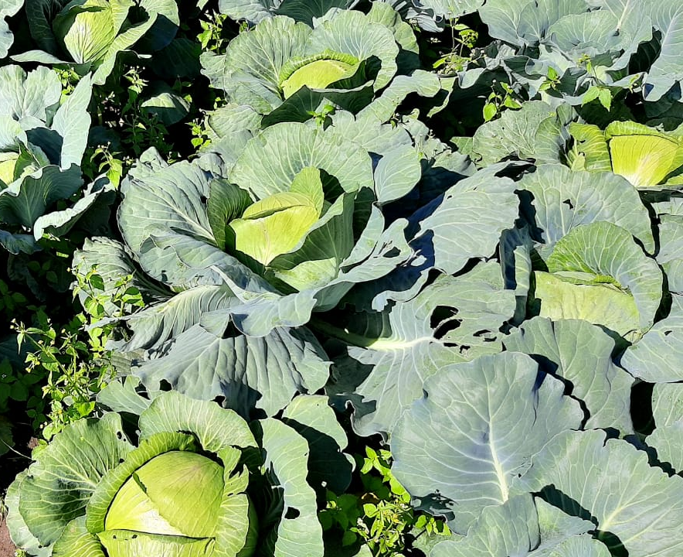
FLD 5. INTEGRATED NUTRIENT MANAGEMNT IN CABBAGE
Operational area | Vattavada
Area under cabbage | 218 ha
Demos . | 05
Season | Rabi
Prioritized Problem | Inadequate knowledge on soil test based nutrient management Indiscriminate use of chemical inputs Physiological disorders due to deficiency of nutrients
Technologies Demonstrated | Integrated nutrient management
Annual Review Workshop 2019-20 ICAR-KVK (BSS), Idukki

Slide 37
SOIL TEST RESULT
PARAMETERS | CHECK | DEMO
Soil pH | 4.2 | 5.9
Nitrogen (kg/ha) | 312.6 | 588.1
Phosphorus (kg/ha) | 20.5 | 46.0
Potassium (kg/ha) | 215 | 385
Zinc (ppm) | 0.4 | 1.0
Boron (ppm) | 0.3 | 0.9
Annual Review Workshop 2019-20 ICAR-KVK (BSS), Idukki

Slide 38

RESULTS
Parameters | Check | Demo
Head weight (kg) | 2.7 | 4.3
Head size (cm) | 14.2 | 19.8
Yield (q/ha) | 377 | 596
Gross Cost (Rs./ha) | 1,13,700 | 1,19,400
Gross Return(Rs./ha) | 2,26,080 | 3,57,600
Net Return (Rs./ha) | 1,12,380 | 2,38,200
BCR | 1.98 | 3.0
FEED BACK:
Soil test based nutrient management reduced the acidity, enhanced the potassium availability which lead to decreased disease incidence, increased head size & weight
Annual Review Workshop 2019-20 ICAR-KVK (BSS), Idukki

Slide 39


FLD 6 BIO- INTENSIVE PEST AND DISEASE MANAGEMENT IN
BITTER GOURD
Operational area | Udumbanchola
Season | Kharif
Situation | Irrigated
Area | 2 ha
Demonstrations | 5 nos
Total Area | 533
Area affected | 72
Prioritized problem | Indiscriminate use of chemical inputs & Yield loss due to diseases
Technologies Demonstrated | Bio-intensive Pest Management along with Foliar Spray of 1% PPFM
Source | ICAR-IIHR,ICAR-NBAIR
Annual Review Workshop 2019-20 ICAR-KVK (BSS), Idukki

Slide 40
RESULTS
Parameters | Check | Demo
Disease Index (%) | 41 | 19
Pest Incidence (%) | 32 | 13
Yield (q/ha) | 67.2 | 85.6
Gross Cost (Rs/ha) | 157000 | 162000
Gross Return (Rs/ha) | 235200 | 367400
Net Return (Rs/ha) | 78200 | 205400
BCR | 1.50 | 2.26
FEED BACK:
Bio-intensive pest management technologies were adopted to alleviate the pest problems for vegetables which increased yield and decreased the cost of cultivation
Annual Review Workshop 2019-20 ICAR-KVK (BSS), Idukki

Slide 41



FLD 7 BIO- INTENSIVE PEST MANAGEMENT OF ROOT KNOT NEMATODE AND SOFT ROT IN CARROT
Operational area | Devikulam
Season | Rabi
Situation | Irrigated
Area | 2 ha
Demos. | 5
Total Area | 430 ha
Area affected | 122 ha
Prioritized problem | Root knot nematode caused root damage affecting both quality and quantity
Technologies Demonstrated | Seed treatment with Bacillus substillis IIHR BS-2 @10ml/kg of seeds. Soil application of Bacillus substillis IIHR BS-2 (5lit/ha) enriched vermicompost(2 t/ha) . Spray of Bacillus substillis IIHR BS-2 @ 5ml/L of water 30th 60^{th,} and 80th days. (source IIHR)

Slide 42


RESULTS
Parameters | Check | Demo
Nematode population % | 35.1 | 21.7
Disease incidence % | 41.0 | 29.8
Yield (q/ha) | 60 | 85
Gross Cost (Rs/ha) | 40000 | 39000
Gross Return (Rs/ha) | 90000 | 112500
Net Return (Rs/ha) | 50000 | 72000
BCR | 2.26 | 2.80
FEED BACK:
Seed treatment with B. subtilis and soil application of B. subtillis enriched vermicompost recorded the increase in carrot yield, decrease in nematode population (69.3%), soft rot incidence (70.2%) thus increased both keeping quality and marketable yield
Annual Review Workshop 2019-20 ICAR-KVK (BSS), Idukki

Slide 43


FLD 8. CULTIVATION OF PEPINO (SWEET CUCUMBER, MELON PEAR) AS AN EXOTIC SALAD VEGETABLE
Operational area | Udumbanchola
Area under pepino | 0 ha
Demos | 05
Season | Kharif 2019
Prioritized problem | Lack of awareness on the scope of exotic vegetables Less aware on the benefits of salad vegetables in daily diet
Technologies Demonstrated | Cultivation of Pepino (Sweet Cucumber, Melon Pear) as an exotic salad vegetable
Annual Review Workshop 2019-20 ICAR-KVK (BSS), Idukki

Slide 44

RESULTS
Parameters | Check | Demo
Plant height (cm) | - | 94
Number of fruit (Number) | - | 9
Fruit weight (g) | - | 189.8
Incidence of pest & disease (%) | - | 11
Yield (q/ha) | - | 83.8
Gross Cost (Rs./ha) | - | 58000
Gross Return(Rs./ha) | - | 167600
Net Return (Rs./ha) | - | 109600
BCR | - | 2.92
FEED BACK:
Consumer acceptability was more in cultivation of Pepino as it gave better result in yield, taste and quality
Annual Review Workshop 2019-20 ICAR-KVK (BSS), Idukki

Slide 45



FLD 9. INTEGRATED NUTRIENT MANAGEMENT IN BANANA
Operational area | Udumbanchola
Area under paddy | 120 ha
Demos | 05
Prioritized Problem | Soil acidity Iron toxicity Nutrient deficiencies
Technologies Demonstrated | Integrated Nutrient Management
Annual Review Workshop 2019-20 ICAR-KVK (BSS), Idukki

Slide 46
RESULTS
Parameters | Check | Demo
Soil pH | 4.0 | 5.9
Average weight of the bunch/plant | 10 | 15
No. of hands/bunch | 7 | 10
N (Kg/ha) | 551.9 | 624.6
P (Kg/ha) | 45 | 62.5
K (Kg/ha) | 260 | 361.2
Zinc (PPM) | 0.5 | 1.2
Boron (PPM) | 0.4 | 1.0
Yield (t/ha) | 22.69 | 38.82
Gross Cost (Rs/ha) | 215000 | 225000
Gross Return (Rs/ha) | 340350 | 582300
Net Return (Rs/ha) | 125350 | 357300
BCR | 1.58 | 2.58
FEED BACK:
INM along with IIHR banana special spray gave better result in no of hands/bunch, weight of the bunch and addressed the nutrient deficiencies as compared to check.
Annual Review Workshop 2019-20 ICAR-KVK (BSS), Idukki

Slide 47


FLD 10. CULTIVATION OF KIWI FRUIT WHICH REQUIRE RELATIVELY LESS CHILLING PERIOD
Operational area | Vattavada
Area under kiwi | 1.5 ha
Demos | 05
Prioritized Problem | Lack of awareness on the scope of exotic fruits
Technologies Demonstrated | Cultivation of Kiwi fruit which require relatively less chilling period
Status: Ongoing.
It is on vegetative stage attained 1.5 to 2 m height and 3 no. of branches
Annual Review Workshop 2019-20 ICAR-KVK (BSS), Idukki

Slide 48



FLD 11. DEMONSTRATION ON ETHNO VETERINARY MEDICINE (EVM) FOR BLOAT IN DAIRY CATTLE
Operational area | Udumbanchola
Animal population | 40,119
Demos /Unit | 5 ( 1 animal/unit)
Prioritized Problem | Feeding of more grains/concentrates, Cassava leaves and jack rind
Technologies Demonstrated | Cissus Quadrangularis –Pirandai Adamant creeper or Veldt grape - 10g , Garlic -15 No's , Betel leaf -10 No's Ginger - 100g , Onion -15 No's , Pepper -10 No's Cumin seed -25g, Turmeric 10g Mix all ingredients, grinding and give oral drenching twice daily per animal for two days. (VUTRC-Thanjavur-2013)
Annual Review Workshop 2019-20 ICAR-KVK (BSS), Idukki

Slide 49
RESULTS
Parameters | Demo | Check
Treatment Duration (Days) | 1.5 | 3
Days of Recovery (Days) | 2 | 4
Respiratory distress (%) | 0 | 82
Quantity of milk production(lit) | 4172 | 3418
Feed intake (%) | 94 | 70
Gross Cost (Rs) | 103000.00 | 97400.00
Gross Return (Rs) | 192981.00 | 165240.00
Net Return (Rs) | 89981.00 | 67840.00
BCR | 1.87 | 1.69
FEED BACK:
Management of Ruminal Tympany (Bloat) by this technology was very cost effective and solved the bloat problem in ruminants.
Annual Review Workshop 2019-20 ICAR-KVK (BSS), Idukki

Slide 50



FLD 12. PROPHYLACTIC MANAGEMENT OF MASTITIS IN DAIRY COWS BY USING MASTI-GUARD (TEAT PROTECT SPRAY &TANUCHEK SCC KIT)
Operational area | Udumbanchola
Animal population | 1,09,432
Demos / Unit | 5
Prioritized Problem | Incidence of Mastitis in high yielders
Technologies Demonstrated | * Masti-Guard Germicidal teat Product spray for preventing common Mastitis bacteria from entering teat canal and extended anti microbial protection. * Tanuchek SCC Kit- On farm test for quick determination of somatic cell counts. Source :TANUVAS-2014
Annual Review Workshop 2019-20 ICAR-KVK (BSS), Idukki

Slide 51
RESULTS
Parameters | Demo. | Check
Quantity of milk production(lit) | 3382 | 2586
Quality- Fat (%) | 3.89 | 3.28
Quality- SNF (%) | 7.75 | 7.34
Incidence of Mastitis (%) | 0 | 20
Gross Cost (Rs) | 75000.00 | 74600.00
Gross Return (Rs) | 158236.00 | 130349.00
Net Return (Rs) | 83236.00 | 55749.00
BCR | 2.10 | 1.74
FEED BACK:
Preventive and Protective technology
Easily adopted by farmers
Low cost technology (Rs.250/kit covers 10animals)
Annual Review Workshop 2019-20 ICAR-KVK (BSS), Idukki

Slide 52



FLD 13. DEMONSTRATION ON ESTRUS SYNCHRONISATION IN CATTLE USING Pro Sync-NF NANOPATCH TECHNOLOGY
Operational area | Udumbanchola
Animal population | 52,119
Demos | 5
Prioritized Problem | Anoestrous, Repeat breeding, Infertility problem
Technologies Demonstrated | Progesterone Nanopatch – ProSync-NF The progesterone is absorbed thro skin & sudden reduction in progesterone levels induces heat within 5-7 days post application. Source :TANUVAS-2018
Annual Review Workshop 2019-20 ICAR-KVK (BSS), Idukki

Slide 53
RESULTS
Parameters | Demo | Check
Showing heat (Days) | 4 | -
A I done (Nos.) | 1 | 3
Conception rate (%) | 60 | 0
Quantity of milk production (lit) | 4175 | 3240
Gross Cost (Rs) | 65250.00 | 64765.00
Gross Return (Rs) | 124527.00 | 109825.00
Net Return (Rs) | 59277.00 | 45060.00
BCR | 1.90 | 1.69
FEED BACK:
This technology provided more opportunity to Artificially Inseminate the animal within the time period of 72hrs
Annual Review Workshop 2019-20 ICAR-KVK (BSS), Idukki

Slide 54



FLD 14. IMPLEMENTATION OF HOMESTEAD GARDEN, EASY AVAILABILITY OF NUTRITIONAL PLANTS
Operational area | Namari Mannakkudy, Udumbanchola
Thematic Area | Organic Vegetable cultivation
Demos / Unit | 5
Season | Kharif
Prioritized Problem | Inadequate intake of vegetables
Technologies Demonstrated | Homestead nutritional garden
Annual Review Workshop 2019-20 ICAR-KVK (BSS), Idukki

Slide 55
RESULTS
Parameters | Demo | Check
Consumption of vegetables/person (g/day) | 120g | 85g
Yield (kg/cent) | 89.00 | 0
Dietary Diversity Score | 7 | 4.3
Gross Cost (Rs) | 1082.00 | 0
Gross Return (Rs) | 3115.00 | 0
Net Return (Rs) | 2033 | 0
BCR | 2.88 | 0
FEED BACK
Out of 89kg produced , 76kg consumed by the family for 5 months and remaining 13 kg was sold to the neighbouring family and earned Rs. 455 as additional income
Annual Review Workshop 2019-20 ICAR-KVK (BSS), Idukki

Slide 56



FLD 15 DEMONSTRATION ON ACRID FREE VARIETY GAJENDRA OF AMORPHOPHALLUS IN HIGH RANGES (2018-19)
Operational area | Manjappara
Area | 1 ha
Demos | 05
Prioritized Problem | Lack of acrid free Variety
Technologies Demonstrated | Demonstration of acrid free variety
Annual Review Workshop 2019-20 ICAR-KVK (BSS), Idukki

Slide 57
RESULTS
Parameters | Check | Demo
Weight of corms/plant (kg) | 14 | 18
Consumer acceptability (Scale unit) | 3 | 5
Yield (t/ha) | 28 | 36
Gross Cost (Rs/ha) | 372000.00 | 373105.00
Gross Return (Rs/ha) | 560000.00 | 906895.00
Net Return (Rs/ha) | 188000.00 | 533790.00
BCR | 1.5 | 2.4
FEED BACK:
Acrid free variety had more consumer acceptability , good in cooking quality, soft in texture and good in taste
Technology up scaling:
Horizontal spread over 38 farmers obtained the planting materials from our FLD farmers
Annual Review Workshop 2019-20 ICAR-KVK (BSS), Idukki

Slide 58




FLD 16. DEMONSTRATION ON HYDROPONICS METHOD OF FODDER PRODUCTION (2018-19)
Operational area | Santhanpara
Animal population | 2,37,678
Demos /Unit | 1
Prioritized Problem | Non availability of quality fodder slips
Technologies Demonstrated | Demonstration of hydroponics method of fodder production
Annual Review Workshop 2019-20 ICAR-KVK (BSS), Idukki

Slide 59
RESULTS
Parameters | Demo | Check
Fodder Yield (Kg) | 122.4 | -
Fodder Production per day (Kg) | 30 | -
Bio mass ratio | 10 | -
Increase in Milk increase | 13%
Milk Yield (Lit) | 3900 | 2400
Gross Cost (Rs) | 109200 | 76800
Gross Return (Rs) | 175500 | 108000
Net Return (Rs) | 66300 | 31200
BCR | 1.61 | 1.41
FEED BACK
Increased the milk yield to a tune of 550 to 750ml
Improvement in health status
Requirement of less space and water
Reduction in concentrate feeding
Freshness and high palatability
Annual Review Workshop 2019-20 ICAR-KVK (BSS), Idukki

Slide 60
LIST OF APPROVED SPECIALIZED/INNOVATIVE ACTIVITIES
Sl. No. | Title | No. of units | Budget (Rs)
1 | Nutrition Garden | 25 | 25000.00
2 | Farmers Field School on Good Agricultural Practices in Potato | 1 Group (25 Farmers) | 25000.00
3 | EDP on “ Doubling Farmers Income”- Waste to Wealth Management | 1 unit (6 Farmers) | 25000.00
Total |  |  | 50000.00
Annual Review Workshop 2019-20 ICAR-KVK (BSS), Idukki

Slide 61

SPECIAL PROGRAMME - NUTRI GARDENS
Operational area | Pothakally and Ramankudy
Thematic Area | Organic Vegetable cultivation
Demos / Unit | 25 (one cent per unit)
Total area | 25 cents
Prioritized Problem | Inadequate intake of vegetables
Technologies Demonstrated | Nutritional garden
Expenses for vegetables per month | ₹1200
Amount saved after the introduction of nutri garden per month | ₹450
Under progress
AGE GROUP | MALE | FEMALE
Under 18 | 10 | 14
18 and above | 33 | 37

Slide 62



FARMERS’ FIELD SCHOOL (FFS) - GOOD AGRICULTURAL PRACTICE IN POTATO (2019-20)
Village : Vattavada
Crop | Thematic area | Technology demonstrated | Season | No. of farmers
 |  |  |  | Male | Female | Total
Potato | IPDM | GAP-Potato | Rabi | 22 | 3 | 25
Details of farming situation
Crop | Season | Farming situation | Soil type | Status of soil |  |  | Previous crop
 |  |  |  | N | P | K
Potato | Rabi | Irrigated | Forest loam | L | M | H | Kharif
Annual Review Workshop 2019-20 ICAR-KVK (BSS), Idukki

Slide 63
IMPACT OF GAP IN POTATO
Technology | Awareness |  | Adoption
 | No. | % | No. | %
Soil sample collection | 30 | 100 | 20 | 67
Integrated Nutrient Management | 30 | 100 | 21 | 70
Foliar spraying of nutrients | 30 | 100 | 23 | 76
Integrated pest management | 30 | 100 | 23 | 76
Integrated disease management | 30 | 100 | 21 | 70
Spraying of plant protection chemicals | 30 | 100 | 30 | 100
Drought management | 30 | 100 | 30 | 100
Bee keeping | 30 | 100 | 10 | 33
Average | 30 | 100 | 23 | 77
Economic Impact
Average cost of cultivation (Rs/ha) |  | Average gross return (Rs/ha) |  | Average net return (Rs/ha) |  | Benefit Cost ratio
Demo | Check | Demo | Check | Demo | Check | Demo | Check
199700 | 195000 | 450000 | 347000 | 250300 | 152000 | 2.25 | 1.77
Extension and training activities
S. No. | Activity | No. of activities
1. | Farmers training | 2
2. | Demonstrations | 4

Slide 64


EDP- “DOUBLING FARMERS INCOME” - WASTE TO WEALTH MANAGEMENT
Operational area | PUTHAYALPARA
Area | 1 SHG Unit (6members)
Demo | 01
Prioritized Problem | Lack of knowledge in agricultural waste management for additional income
Technologies Demonstrated | Entrepreneurship development in value addition of agricultural waste.
Annual Review Workshop 2019-20 ICAR-KVK (BSS), Idukki

Slide 65



EDP - Value addition of agricultural waste
Sl.No. | Name of the Activity | Number of activity | Status
1 | Awareness Programme | 1 | SHG has collected the waste materials , processed it and they are trained to make best out from the waste. The activity is in progress. % adoption : 78 % Income generated : Started in 11th March ’20 Products Planned : Ecofriendly products Viz., Palm leaf sheath bouquets, carry bag, flower vase, flower making from millets & paper
2 | Collection &process of agri.waste material | 4
3 | Training on processing of waste materials | 4
4 | Training on coloring of materials | 2

Slide 66
SUCCESS STORIES
Annual Review Workshop 2019-20 ICAR-KVK (BSS), Idukki

Slide 67




BIOLOGICAL CONTROL OF CARDAMOM ROOT GRUB MANAGEMENT WITH EPN
Background: Cardamom root grub affects 70% of the yield
Source of Technology: ICAR – NBAIR
Intervention process : OFT, FLD, Training, Low cost unit at on site Advisory, Testing of Infective juveniles stage
Impact:
Horizontal spread : 1245 ha
Increase in Yield : 74%
Reduction in root grub attack : 98%
Labour saving : 50% (2times/yr upto 2 years)
Cost saving : 26%
Complimentary effect : increased the microbial load from 6.10x10⁷ –
9.80x10⁷ (CFU/g of soil), optimizing the pH and
enhanced the Organic carbon
Net return : 80-120%
BCR :2.16

Slide 68




BIO INTENSIVE PEST & DISESASE MANAGEMENT IN CARDAMOM
Background: Major pest affects 40% of the yield
Source of Technology: ICAR – NBAIR , ICRI & CRS
Intervention process : Training, Advisory, Demonstrations
Impact:
Horizontal spread : 355 ha
Increase in Yield : 29%
Reduction in pest & Disease : 69%
Labour saving : 57%(microbes have compatibility while release)
Reduction in rounds of spray : 14 to 6
Cost saving : %
Complimentary effect : Total number of beneficial microbes increased
(27%) – Beauveria, Metarhizium, Bt,
Pseudomonas & Trichoderma
BCR :2.39

Slide 69




REVITALIZATION OF RICE FARMING IN IDUKKI DISTRICT
Background: Declining trend in both area & Production
Source of Technology: KAU
Intervention process : OFT, FLD,Training, Advisory, Demonstrations
Impact:
Horizontal spread : 355 ha
Increase in Yield : 61%
% Reduction in iron toxicity : 33%
% Root rot incidence : 10%
Complimentary effect : 1. Enhanced the uptake of secondary and
micro nutrients which reduced the % of
saffiness, increased the no. of grains /panicle
and productive tillers /hill
2. Introduction of new high yielding variety
“Akshaya” which helped in replication of area
BCR : 2.8

Slide 70




IMPACT OF PEPPER SPECIAL IN BLACK PEPPER
Background: Nutritional disorders and premature spike shedding
Source of Technology: IISR
Intervention process : OFT, FLD,Training, Advisory, Demonstrations
Impact:
Horizontal spread : 256ha (900kg of IISR Special)
% adoption : 61%
% Reduction in deficiency : 98%
% yield increase : 19-27%
Complimentary effect : Enhanced the uptake of secondary and
micro nutrients which reduced the % of
deficiency, spike shedding and increased the
% fruit set (82% ), uniform ripening of
berries
BCR : 2.33

Slide 71
TRAININGS (up to December 2019)
Particulars | No. trainings | No. of participants
On campus training | 34 | 1589
Off campus training | 91 | 2742
Rural youth | 2 | 83
Extension personnel | 3 | 145
Sponsored | 7 | 272
Total | 137 | 4831
Annual Review Workshop 2019-20 ICAR-KVK (BSS), Idukki

Slide 72




ON CAMPUS TRAININGS
Annual Review Workshop 2019-20 ICAR-KVK (BSS), Idukki

Slide 73




OFF CAMPUS TRAININGS
Annual Review Workshop 2019-20 ICAR-KVK (BSS), Idukki

Slide 74




SPONSORED TRAININGS
Annual Review Workshop 2019-20 ICAR-KVK (BSS), Idukki

Slide 75
EXTENSION ACTIVITIES (up to December 2019)
Nature of Extension Programme | No. of Program. | No. of Participants (General) |  |  | No. of Participants SC / ST |  |  | No. of extension personnel
 |  | M | F | Total | M | F | Total | M | F | Total
Field Day | 6 | 88 | 57 | 145 | 10 | 5 | 15 | 10 | 6 | 16
Exhibition | 1 | 4 | 117 | 121 | 0 | 0 | 0 | 13 | 7 | 20
Method Demonstrations | 40 | 365 | 113 | 478 | 19 | 13 | 32 | 13 | 0 | 13
Farmers Seminar / Workshop | 4 | 79 | 13 | 92 | 16 | 39 | 55 | 16 | 2 | 18
Group meetings | 29 | 40 | 196 | 236 | 41 | 139 | 180 | 4 | 54 | 58
Lectures delivered | 1 | 21 | 10 | 31 | 2 | 2 | 4 | 2 | 0 | 2
Newspaper coverage | 8
Radio talks | 2
TV talks | 2
Popular articles | 0
Extension Literature | 10
Advisory Services | 566 | 502 | 95 | 597 | 135 | 237 | 372 | 13 | 3 | 16
Scientific visit to farmers field | 73 | 184 | 64 | 248 | 5 | 38 | 43 | 0 | 0 | 0
Farmers visit to KVK | 561 | 1472 | 222 | 1694 | 213 | 184 | 397 | 37 | 7 | 44
Diagnostic visits | 39 | 58 | 11 | 69 | 2 | 0 | 2 | 3 | 0 | 3
Ex-trainees Sammelan | 2 | 48 | 11 | 59 | 0 | 0 | 0 | 2 | 0 | 2
Soil health Camp | 6 | 259 | 72 | 331 | 41 | 11 | 52 | 4 | 2 | 6
Self Help Group Conveners meetings | 29 | 0 | 348 | 348 | 0 | 108 | 108 | 0 | 12 | 12
Formation of SHG | 3 | 0 | 13 | 13 | 0 | 14 | 14 | 0 | 5 | 5
Celebration of important days | 7 | 119 | 64 | 183 | 50 | 21 | 71 | 7 | 1 | 8
Farm Science Club conveners meet | 2 | 110 | 12 | 122 | 2 | 2 | 4 | 4 | 2 | 6
Bimonthly meeting | 1 | 0 | 0 | 0 | 0 | 0 | 0 | 66 | 0 | 66
Exposure visit | 1 | 50 | 0 | 50 | 0 | 0 | 0 | 3 | 0 | 3
Total | 1392 | 3399 | 1418 | 4817 | 536 | 813 | 1349 | 197 | 101 | 298

Slide 76






EXTENSION ACTIVITIES
Demo. On seed treatment with Rhizobium
Film Show
Diagnostic Visits
Field day on Paddy
Field visit - INM in Banana
Ex. Trainees Meet
Annual Review Workshop 2019-20 ICAR-KVK (BSS), Idukki

Slide 77
SPECIAL PROGRAMME &
CELEBRATION OF DAYS
Annual Review Workshop 2019-20 ICAR-KVK (BSS), Idukki

Slide 78
UTILIZATION OF BUDGET – SPECIAL PROGRAMMES (Rs.)
Particulars | Budget allotted (Rs) | Expenditure (Rs)
16.09.2019 Tree Plantation Campaign | 10000.00 | 10000.00
29.07.2019 PKVY – Cluster Demonstration on Organic Farming | 330000.00 | 276000.00
24.10.2019 RKVY - ASCI – Bee keeper | 329600.00 | 149600.00
01.01.2020 NADCP – FMD Scheme | 15000.00 | 15000.00
30.01.2020 PKVY – Biennial Fertilizer Awareness Programme | 50000.00 | 50000.00
21.01.2020 PKVY – Swachhta Plan – Vermicompost unit | 37500.00 | 37500.00
Annual Review Workshop 2019-20 ICAR-KVK (BSS), Idukki

Slide 79



TREE PLANTATION
Date of the Programme : 17.09.19
No. of Farmers participated : 45
No. of seedlings planted :1022
No. of seedlings distributed : 135
Annual Review Workshop 2019-20 ICAR-KVK (BSS), Idukki

Slide 80



PKVY – CLUSTER DEMONSTRATION ON ORGANIC FARMING
Parameters | Demo | Check
Organic carbon % | 1.5 | 1.3
pH | 5.8 | 5.6
Yield (q/ha) | 325.0 | 260.0
Gross Cost (Rs/ha) | 90000.00 | 105000.00
Gross Return (Rs/ha) | 335000.00 | 226080.00
Net Return (Rs/ha) | 245000.00 | 121080
BCR | 3.72 | 2.15
Season : Rabi
No. of villages covered : 1
No. of Farmers : 50
No. of clusters formed : 1
Crop selected : 3
Annual Review Workshop 2019-20 ICAR-KVK (BSS), Idukki

Slide 81



ASCI – BEE KEEPER
Date of initiation : 14.02.2020
Date of completion : 15.03.2020
No. of Farmers : 20
Assessment :Awaiting
Annual Review Workshop 2019-20 ICAR-KVK (BSS), Idukki

Slide 82



No. Of Animals for AI and Vaccination
NADCP – FMD & AI PROGRAMME
Date of the Programmes : 11-09-2019
No. of Farmers participated : 67
No. Of Animals for AI and Vaccination : 10
Annual Review Workshop 2019-20 ICAR-KVK (BSS), Idukki

Slide 83



BIENNIAL FERTILIZER AWARENESS PROGRAMME
Date of the Programme : 22-10-19
No. of Farmers participated : 183
Amount Sanctioned : Rs.50000.00
Annual Review Workshop 2019-20 ICAR-KVK (BSS), Idukki

Slide 84



PKVY –MICROBIAL BASED AGRICULTURAL WASTE MANAGEMENT USING VERMICOMPOSTING - SWACHHTA PLAN UNIT
Name of Village | Valiathovala
Demo / Unit | 5 (Size of the Unit : 8ftX3FtX3ft)
Critical Inputs | Silpauline sheet, Worms, Vermicompost
Parameters | Demo
Days to decomposition | 85-90 days
Raw materials (kg) | 1500 kg
Conversion ratio (%) | 32 %
Avg. Vermicompost Produced / cycle @Rs.10/kg | 480 kg
Avg. Vermiworms multiplied / cycle @Rs. 400/kg | 6kg
Gross Cost (Rs/unit) | 6500.00
Gross Return (Rs/ unit) | 9600.00
Net Return (Rs/unit) | 3000.00
BCR | 1.5

Slide 85


SOIL SAMPLE ANALYSIS
DETAILS | Progress during 2019-20
Samples analyzed (No.) | 325
Farmers benefited (No.) | 208
Villages covered (No) | 20
Amount realized (Rs.) | 81250.00
Annual Review Workshop 2019-20 ICAR-KVK (BSS), Idukki

Slide 86



SOIL HEALTH & AWARENESS CAMPAIGNS
Number of the Programmes : 07
No. of Farmers participated : 300
No. of Soil Health card distributed : 325
Annual Review Workshop 2019-20 ICAR-KVK (BSS), Idukki

Slide 87



WORLD SOIL DAY
Date of the Programme : 5/12/19
No. of Farmers participated : 120
No. of Soil Health card distributed : 100
Annual Review Workshop 2019-20 ICAR-KVK (BSS), Idukki

Slide 88



WORLD FOOD DAY
Date of the Programme : 16.10.19
No. of Farmers participated : 47
Annual Review Workshop 2019-20 ICAR-KVK (BSS), Idukki

Slide 89



SWACHH BHARATH PHAKAWADA
Date of the Programme: 16/12/19 to 31/12/2019
No. of Farmers participants :
Annual Review Workshop 2019-20 ICAR-KVK (BSS), Idukki

Slide 90



VIGILANCE AWARENESS WEEK
Date of the Programme : 23 – 27.12.19
No. of Farmers participated : 68
Annual Review Workshop 2019-20 ICAR-KVK (BSS), Idukki

Slide 91



INTERNATIONAL WOMEN'S DAY
Date of the Programme : 08.03.2020
No. of Farmers participated : 101
Annual Review Workshop 2019-20 ICAR-KVK (BSS), Idukki

Slide 92



NATIONAL MILK DAY- 2019
Date of the Programme : 26/11/19
No. of Farmers participated : 68

Slide 93



KVK FARM OPERATIONS
Total Area (Ha) | 26.026
Buildings (Ha) | 0.074
Cultivated area (Ha) | 0.50
Demo / Production Units (Ha) | 0.5 (Animal Husbandry unit, Vermicompost, Azolla, Fodder bank, Pepper nursery, Bio hub, Apiculture unit, Poly house, Medicinal plants, Cardamom varietal garden)
Agro-forestry (Ha) | 0.5
Laboratories details | 1.SWTL
VERMICOMPOST UNIT
VAM PRODUCTION UNIT
APICULTURE UNIT
Annual Review Workshop 2019-20 ICAR-KVK (BSS), Idukki

Slide 94









FODDER UNIT
PEPPER NURSERY UNIT
POLY HOUSE VEGETABLE UNIT
MUSHROOM UNIT
ORNAMENTAL NURSERY UNIT
MEDICINAL PLANTS
CARDAMOM VARIETAL GARDEN
BIO HUB UNIT
AZOLLA UNIT

Slide 95
DETAILS ON TECHNOLOGICAL PRODUCTS
Sl. No. | Name of the Product | Produced (q / lit / No.) | Sold (q / lit / No.) | Farmers benefited (No.)
1 | Pseudomonas | 2088 | 2552 | 710
2 | Pseudomonas Test tube | 60 | 50 | 50
3 | Trichoderma | 1720 | 1668 | 651
4 | Trichoderma Test tube | 100 | 100 | 100
5 | Beauveria | 9.3 | 8.39 | 244
6 | Azosprillum | 16.9 | 14.61 | 166
7 | Metarhizium | 7.50 | 7.45 | 210
8 | Phosphobacteria | 12.9 | 12.52 | 196
9 | Effective Microorganisms | 650 | 650 | 205
10 | VAM | 26.45 | 18.99 | 147
11 | Entomo Pathogenic Nematode | 24.0 | 24.0 | 213
12 | Neem soap | 75.0 | 64.4 | 286
13 | Humic acid | 10.0 | 4.0 | 425
14 | Paecilomyces | 10.0 | 6.75 | 238
15 | Zyme granules | 40.0 | 40.0 | 350
16 | AMC | 31.5 | 30.43 | 379
17 | PPFM | 1500 | 1500 | 750
18 | Pheromone trap | 300 | 300 | 300
19 | Pepper seedlings | 8427 | 8083 | 89
20 | Cardamom seedlings | 970 | 770 | 2
21 | Ornamental seedlings | 3441 | 3258 | 172
22 | Vegetable seeds | 2.35 | 2.35 | 442
23 | Potash bacteria | 10.0 | 10.0 | 181
24 | Micro Nutrient Mixtures | 26.97 | 22.55 | 555
25 | Vermiculture | 45.9 | 44.33 | 360
26 | Mushroom spawn | 2.05 | 1.58 | 64
Total |  | 5955lit, 316.37q & 13298no. |  | 7485

Slide 96
SPONSORED PROGRAMMES
Sl. No. | Agency | Name of the Scheme | Amount (Rs.)
1. | Coconut Development Board | District Level seminar | 50,000.00
2. | MANAGE & ATMA | Diploma In Agriculture Extension Service for Input Dealers | 16,00,000.00
3. | IFFCO | Trial on Nano Fertilizers | 0.00
4. | Neyveli Lignite Corporation (NLC) | Trial on Humic Acid for Plantation Crops | 50,000.00
Annual Review Workshop 2019-20 ICAR-KVK (BSS), Idukki

Slide 97



DISTRICT LEVEL SEMINOR ON COCONUT CULTIVATION
Date of the Programme :26.11.2019
No. of Farmers participated : 80

Slide 98

IFFCO TRIAL ON NANO FERTILIZERS
Treatment | Details
T1 | Farmers Fertiliser Practice (FFP) (100 % NPK Kg/ha & 100 % Zinc Kg/ha application)
T2 | FFP (50 % N, 100 % PK ) + 2 spray of Nano Nitrogen
T3 | FFP (50 % Zinc fertiliser, 100 % NPK ) + 2 spray of Nano Zinc
T4 | FFP + 2 spray of Nano Copper
T5 | FFP ( 50 % N & 50 % Zn ; 100 % PK )+ 1st spray of Nano N at tillering / branching stage (25 - 30 DAS) + 2nd Spray of Nano Zinc 10-15 Days after 1st spray + 3rd Spray of Nano Copper 10 -15 days after 2nd Spray
Treatment | Average Plant Height (cm.) | No. of effective Tillers / Tubers/ Siliqua / plant | Grain / Tuber/ Siliqua sample Yield (Kg/ sq.m) | Grain / Tuber Yield (q/ha) | Straw / Stover Yield (q/ ha)
T1 | 101.6 | 60 | 0 | 0 | 0
T2 | 134.3 | 96 | 0 | 0 | 0
T3 | 99.0 | 72 | 0 | 0 | 0
T4 | 90.0 | 63 | 0 | 0 | 0
T5 | 110.4 | 120 | 0 | 0 | 0
Annual Review Workshop 2019-20 ICAR-KVK (BSS), Idukki

Slide 99


NLC PROJECT ON HUMIC ACID
Technology Assessed | Yield (q/ha) | Net Return (Profit) | BC Ratio
Cardamom
TO 1 - Farmer’s practice | 0.75 | 324160.00 | 2.00
TO 2 – Recommended POP | 0.83 | 447419.00 | 2.11
TO 3 - recommended POP + Humic Acid @ 3ml/lit of water | 0.92 | 619752.00 | 2.58
Black Pepper
TO 1 - Farmer’s practice | 2.1 | 100000.00 | 1.69
TO 2 – Recommended POP | 2.78 | 112000.00 | 1.73
TO 3 - recommended POP + Humic Acid @ 3ml/lit of water | 2.85 | 180000.00 | 1.97
Nutmeg
TO 1 - Farmer’s practice | 30 | 600000.00 | 1.90
TO 2 – Recommended POP | 45 | 680000.00 | 2.50
TO 3 - recommended POP + Humic Acid @ 3ml/lit of water | 50 | 750000.00 | 2.80
Annual Review Workshop 2019-20 ICAR-KVK (BSS), Idukki

Slide 100

LINKAGES
Dept. of Agriculture
Spices board
ATMA
KVK
Dept. of Animal Husbandry
Coffee board
PDS
Dept. of
forestry
VFPCK
Annual Review Workshop 2019-20 ICAR-KVK (BSS), Idukki

Slide 101
REVOLVING FUND STATUS (Rs. )
Year | Opening balance as on 1st April | Income during the year | Expenditure during the year | Net balance in hand as on 31st March (including stock)
April 2017 to March 2018 | 4,10,526 | 24,53,736 | 15,22,669 | 13,41,593
April 2018 to March 2019 | 13,41,593 | 30,33,360 | 30,22,873 | 13,52,080
April 2019 to March 2020 | 13,52,080 | 79,58,619 | 73,26,187 | 19,84,512
Annual Review Workshop 2019-20 ICAR-KVK (BSS), Idukki

Slide 102
UTILIZATION OF BUDGET (Rs. Lakhs)
Sl. No. | Particulars | Sanctioned | Released | Expenditure
A. Recurring Contingencies
1 | Pay & Allowances | 138.10 | OB - 0.67 | 138.20
2 | Traveling allowances | 1.10 | 149.96 | 1.10
3 | Contingencies
A | Stationery, telephone, postage and other expenditure on office running, publication of Newsletter and library maintenance (Purchase of News Paper & Magazines) | 2,25 |  | 2.25
B | POL, repair of vehicles, tractor and equipments | 1.60 |  | 1.60
C | Meals / refreshment for trainees (ceiling up to Rs.150 / day / trainee be maintained) | 1.10 |  | 1.10
D | Training material (posters, charts, demonstration material including chemicals etc. required for conducting the training) | 0.50 |  | 0.50
E | Frontline demonstration except oilseeds and pulses (minimum of 30 demonstration in a year) | 2.43 |  | 2.43
F | On farm testing (on need based, location specific and newly generated information in the major production systems of the area) | 1.05 |  | 1.05
G | Training of extension functionaries | 0.25 |  | 0.25
H | Maintenance of buildings | 0.50 |  | 0.50
I | Establishment of Soil, Plant & Water Testing Laboratory | 0,50 |  | 0.50
J | Library | 0.005 |  | 0.005
K | Extension activities | 0.45 |  | 0.45
L | Farmers Field School (FFS) | 0.25 |  | 0.25
M | EDP | 0.25 |  | 0.25
N | Special Progamme – Nutrition Garden | 0.25 |  | 0.25
TOTAL (A) |  | 150.63 |  | 150.65
B. Non-Recurring Contingencies
1 | Works | 0.00 |  | 0.00
2 | Equipments including SWTL & Furniture | 0.00 |  | 0.00
3 | Vehicle (Four wheeler/Two wheeler, please specify) | 0.00 |  | 0.00
4 | Library (Purchase of assets like books & journals) | 0.00 |  | 0.00
TOTAL (B) |  | 0.00 |  | 0.00
C. REVOLVING FUND |  | 0.00 |  | 0.00
GRAND TOTAL (A+B+C) |  | 150.63 | 150.63 | 150.65

Slide 103
LIST OF APPROVED OFTs
Sl. No. | Crop/ Enterprises | Title of Assessment | Season | No. of trials
1 | Banana | Assessment of Fusarium wilt disease management in banana | Khari | 5
2 | Yard long bean | Assessment of yard long bean varieties in Idukki district | Rabi | 5
3 | Tapioca | Assessment of cassava varieties in high range | Rabi | 5
4 | Composting | Assessment of different decomposing cultures in composting of agricultural wastes. | Zaid | 5
5 | Dairy cattle | Assessment of EVM preparations for control of ecto-parasites in dairy cattle | Round the year | 5
 |  | Total |  | 25
Annual Review Workshop 2019-20 ICAR-KVK (BSS), Idukki

Slide 104
LIST OF APPROVED FLDs
Sl. No | Crop/ Enterprise | Title of FLDs | Season | No. of Demo
1 | Paddy | Demonstration of paddy variety ‘Manuratna’ in high range | Kharif | 5
2 | Garden pea | Demonstration of new whole pod edible dual purpose pea variety of ArkaApoorva | Rabi | 5
3 | Black Pepper | Demonstration of IISR- PGPR consortium for growth promotion in Black Pepper | Perennial | 5
4 | Ginger | GAP in Ashwathy variety of Ginger | Zaid | 5
5 | Cabbage | Integrated nutrient management in cabbage | Rabi | 5
6 | Small cardamom | Bio-intensive intervention of pest, drought management and deterring crop raiding wild elephants in small cardamom | Perennial | 5
7 | Strawberry | AESA based Integrated Pest Management in Strawberry | Kharif | 5
8 | Poultry | Popularization of Ethno Veterinary Medicine (EVM) for prevention of Ranikhet disease | Round the Year | 10
9 | Dairy cattle | Demonstration on estrus synchronization in cattle by using progesterone vaginal sponges | Round the Year | 5
10 | Tapioca | Demonstration of Customized fertilizer-1 in Tapioca | Rabi | 5
 |  | Total |  | 55
Annual Review Workshop 2019-20 ICAR-KVK (BSS), Idukki

Slide 105
LIST OF SPECIAL PROGRAMMES
Sl. No | ACTIVITY/PROGRAMME | Title of FLDs | Season | No. of Demo
1 | FFS | Good Agricultural Practices in Bitter gourd | RABI | 25
SUMMARY OF BUDGET
Sl. No | TECHNICAL ACTIVITY | NO. OF TECHNOLOGIES | BUDGET (Rs.)
1 | OFT | 25 | 81625.00
2 | FLD | 10 | 242850.00
3 | Special Activities : FFS | 1 | 30000.00
 |  | TOTAL | 354475.00
Annual Review Workshop 2019-20 ICAR-KVK (BSS), Idukki

Slide 106

THANK U…

