Slide 1
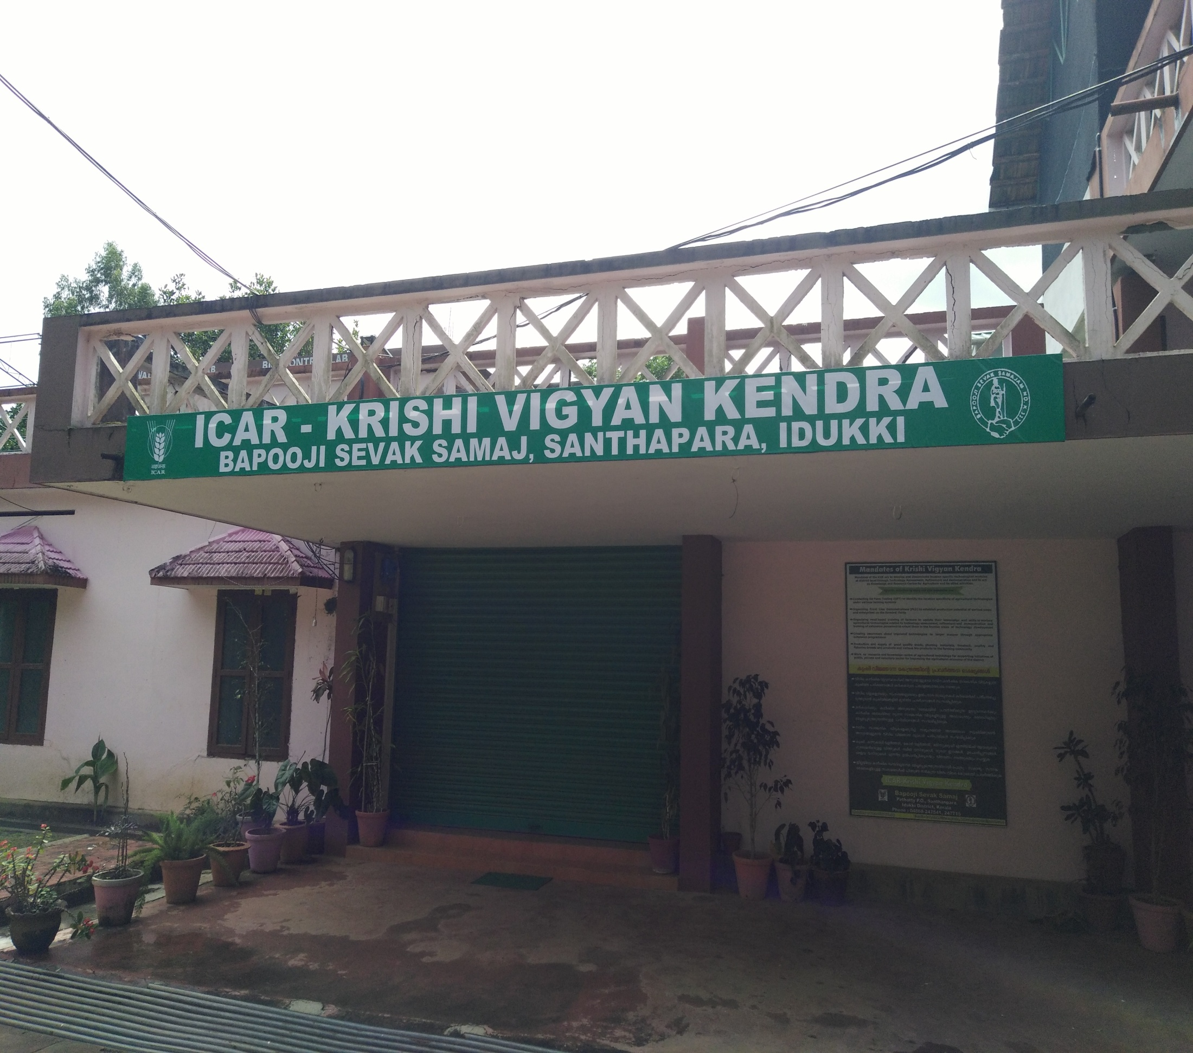
ICAR - KRISHI VIGYAN KENDRA (BSS)
IDUKKI
ANNUAL REVIEW WORKSHOP (2018-19)

Slide 2
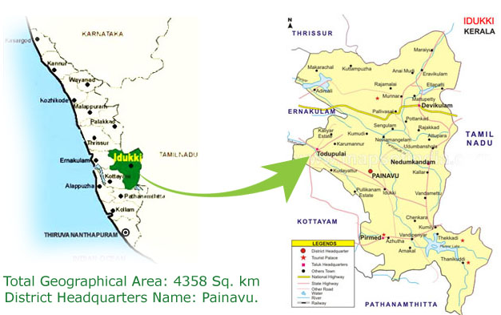
IDUKKI DISTRICT PROFILE
Geographical area: 4358 sqkm. Population : 11.08 lakhs Taluks : 5 Blocks : 8 Panchayats : 53 Villages : 65 | Avg. ann. rainfall : 2900 mm Temperature : max 35ºC min 10ºC Relative Hum. (%) : 73.7% Agro climatic Zone : High Altitude Zone (KE – 4) Agro Ecological Zone : Western Plains and Ghat region(XII)
Annual Review Workshop 2018-19 ICAR-KVK (BSS), Idukki

Slide 3
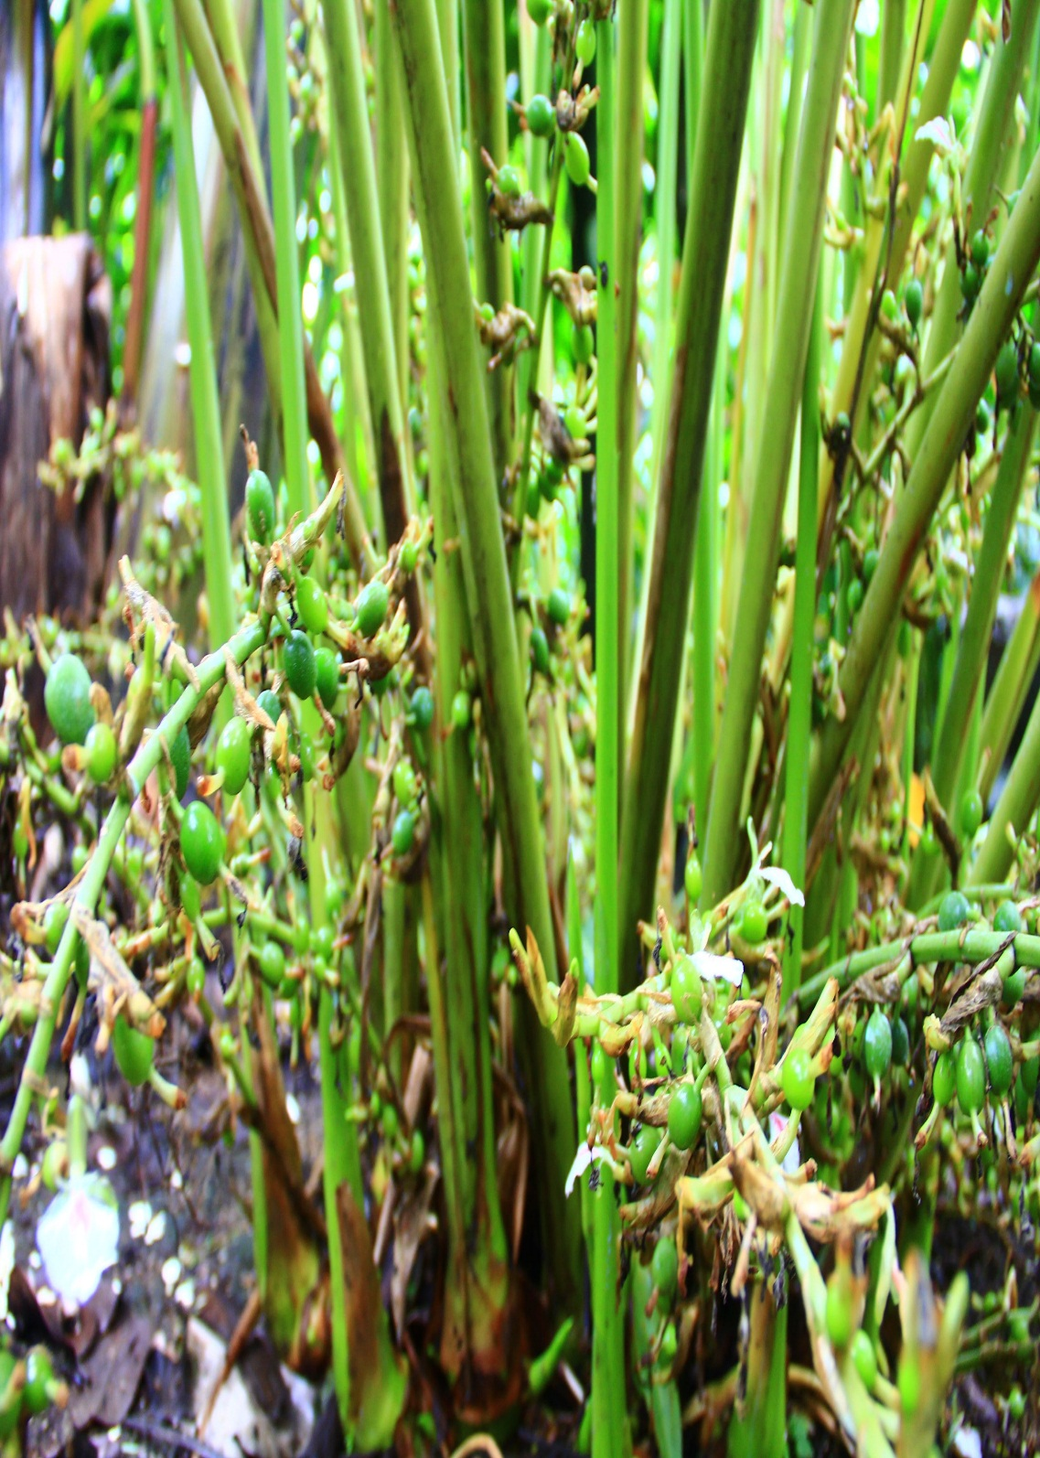
Month | Rainfall (mm)
April 2018 | 122
May 2018 | 190
June 2018 | 356
July 2018 | 454
Aug. 2018 | 287
Sep. 2018 | 184
Oct. 2018 | 271
Nov. 2018 | 181
Dec. 2018 | 73
Jan. 2019 | 22
Feb. 2019 | 31
Mar. 2019 | 55
TOTAL | 2526 mm
RAINFALL 2018 - 19
SOUTH WEST MONSOON – 1771mm
NORTH EAST MONSOON – 525mm
SUMMER – 230mm
Annual Review Workshop 2018-19 ICAR-KVK (BSS), Idukki

Slide 4
STAFF IN POSITION
CATEGORY OF POSTS | SANCTIONED | FILLED
Senior Scientist & Head | 1 | 1
Subject Matter Specialist | 6 | 6
Programme Assistant | 3 | 3
Administrative staff | 2 | 2
Auxiliary staff | 2 | 2
Supporting staff | 2 | 2
Total | 16 | 16
Annual Review Workshop 2018-19 ICAR-KVK (BSS), Idukki

Slide 5
AREA, PRODUCTION AND PRODUCTIVITY OF MAJOR CROPS
Crop | Area (ha) | Production (Metric tons) | Productivity (kg /ha)
Cardamom | 31165 | 16505 | 530
Pepper | 43790 | 18726 | 428
Banana | 7535 | 67469 | 8954
Rice | 695 | 1631 | 2347
Coconut | 16122 | 63 million nuts | 3907
Tapioca | 6998 | 297870 | 42565
Coffee | 12717 | 8310 | 653
Tea | 40590 | 44991 | 2048
Annual Review Workshop 2018-19 ICAR-KVK (BSS), Idukki

Slide 6
AREA UNDER AGRICULTURAL CROPS IN IDUKKI DISTRICT
Annual Review Workshop 2018-19 ICAR-KVK (BSS), Idukki

Slide 7
OPERATIONAL AREA
LEGEND
1 | MARAYOOR
2 | SANTHANPARA
3 | RAJAKKAD
4 | RAJAKUMARI
5 | KUMILI
6 | IDUKKI
7 | VANDANMEDU
8 | NEDUMKANDAM
9 | UDUMBANCHOLA
10 | SENAPATHY
KVK
Taluks : 3 Blocks : 5 | Clusters : 3 Villages : 10
Annual Review Workshop 2018-19 ICAR-KVK (BSS), Idukki

Slide 8
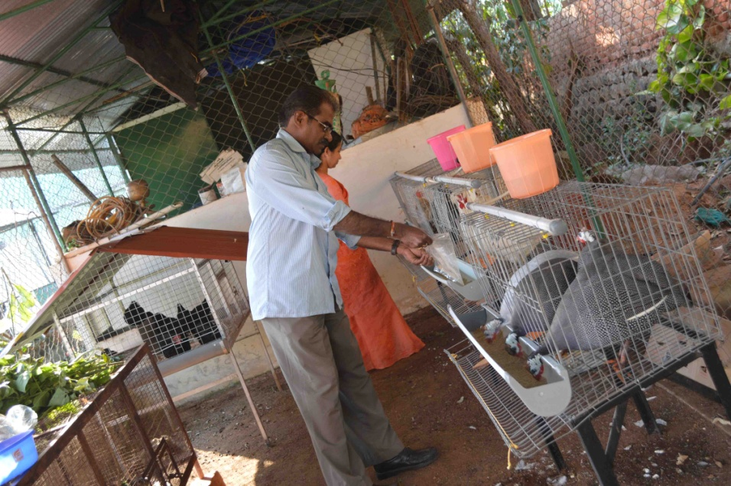
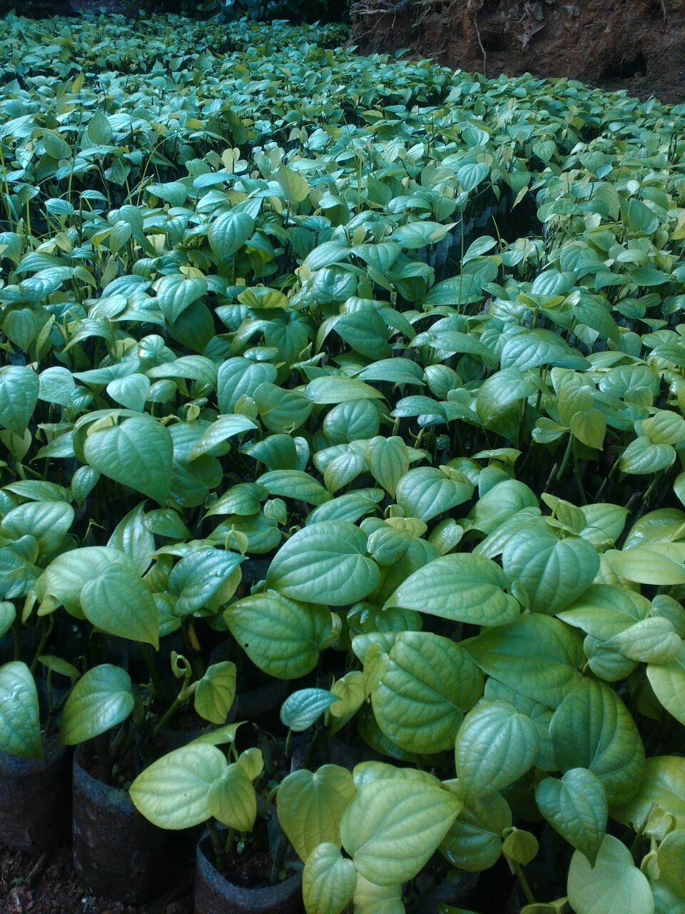
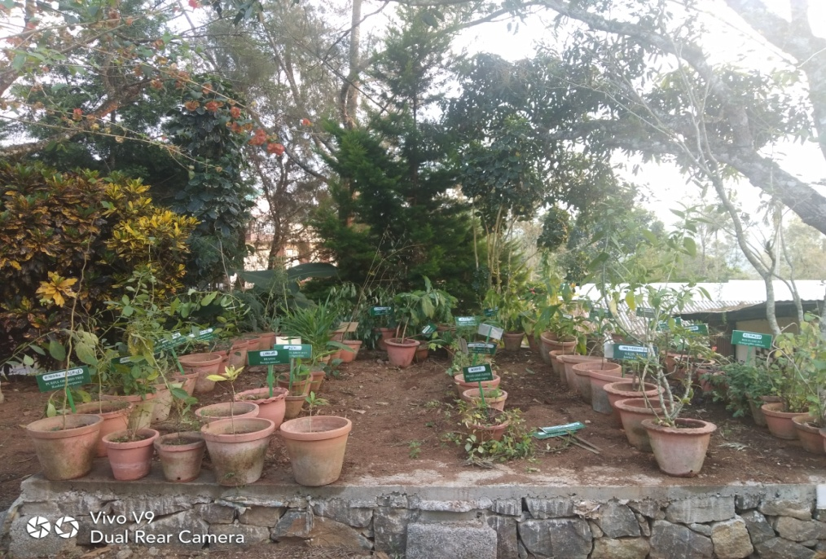
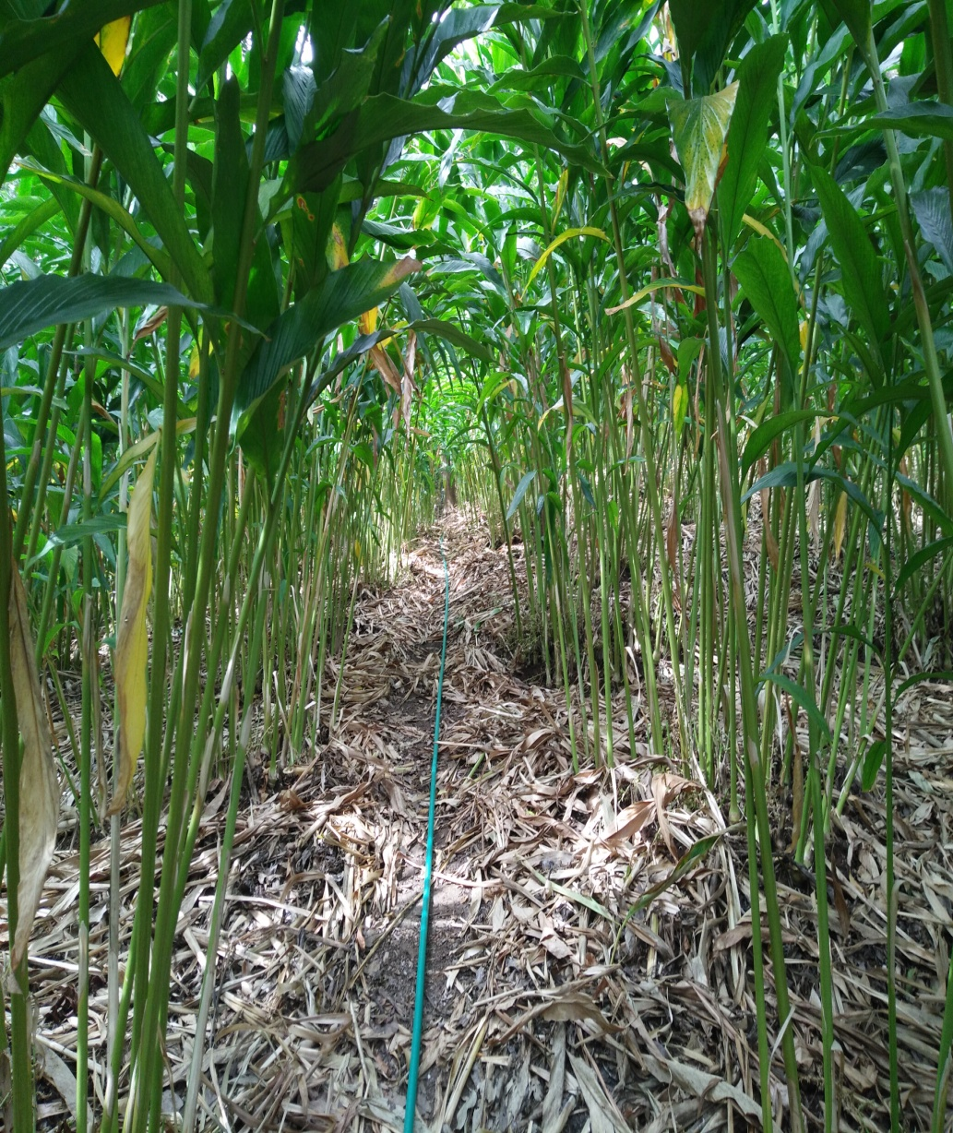
KVK FARM OPERATIONS
Total Area (Ha) | 26.026
Buildings (Ha) | 0.074
Cultivated area (Ha) | 0.50
Demo / Production Units (Ha) | 0.5 (Animal Husbandry unit, Vermicompost, Azolla, Fodder bank, Pepper nursery, Bio hub, Apiculture unit, Poly house, Medicinal plants, Cardamom varietal garden)
Agro-forestry (Ha) | 0.5
Laboratories details | 1.SWTL
Animal Husbandry
Pepper nursery
Apiculture Unit
Azolla production unit
Medicinal Plants
Cardamom varietal Garden
Annual Review Workshop 2018-19 ICAR-KVK (BSS), Idukki

Slide 9
KVK LAND AREA UTILIZATION
Farm Block-I
Cardamom Production Unit-I
Apiculture unit
Farm Block-V
Vegetable Seed Production Unit-I
Cardamom Varietal Garden
Banana Production Unit
Black Pepper Varietal Garden
Fish Culture Unit -I
KVK- FARM PLAN
Medicinal Plants units
Dairy Unit
Farm Block-II
Area : 6 ha
Cardamom Nursery Unit
AH Unit
Horticulture Nursery
Vermicompost Unit
Azolla
Rose Garden
B -Mother Plant Unit
Store room
Landscaping-I
B-Nursery
Bio-Hub
Store room
Fish culture
Poly house
Store room
Farm Block-IV
Farm Block-III
Production Unit
Ornamental Plants Unit
Vegetable P unit
Terrace cultivation
Cardamom Production Unit-II
Main Building

Slide 10
REVENUE GENERATED
Sl. No. | Name of the Product | Produced (q) | Sold (q) | Farmers benefited (No.)
1 | Pseudomonas | 2184 | 1449 | 657
2 | Pseudomonas Test tube | 50 | 11 | 11
3 | Trichoderma | 3823 | 2456 | 1018
4 | Trichoderma Test tube | 100 | 60 | 60
5 | Beauveria | 240 | 159 | 34
6 | Beauveria Test tube | 20 | 17 | 17
7 | Metarhizium | 240 | 161 | 46
8 | Metarhizium test tube | 10 | 2 | 2
9 | Effective Microorganisms | 1491 | 964 | 251
10 | VAM | 3134 | 2495 | 164
11 | Entomo Pathogenic Nematode | 400 | 248.5 | 76
12 | Neem oil | 400 | 360 | 433
13 | Pheromone trap | 50 | 40 | 15
14 | Paceliomyces | 100 | 50 | 14
15 | Downy controller | 100 | 50 | 25
Total |  | 12870 | 8648.5 | 3189
Annual Review Workshop 2018-19 ICAR-KVK (BSS), Idukki

Slide 11
MAJOR THRUST AREA
Sl. No. | Thrust area
1. | Integrated Nutrient Management in major crops
2. | IPDM in major Plantation and Vegetable crops
3. | Integrated sustainable farming system models
4. | Organic agriculture
5. | Value addition of farm produce
6. | Crop improvement
7. | Scientific management of livestock and poultry
8. | Scientific Disease Management in dairy cattle and Poultry
9. | Fodder production and management
10. | Popularization of poultry breeds
Annual Review Workshop 2018-19 ICAR-KVK (BSS), Idukki

Slide 12
LIST OF APPROVED OFTs
Sl. No. | Crops | Title of OFTs | No. of Trials | Budget (Rs)
1 | Paddy | Assessing the effect of Silicate Solubilizing Bacteria in iron toxic soils of rice cultivation. | 03 | 15768.00
2 | cowpea | Assessing the effect of Sampoorna in cowpea. | 05 | 4500.00
3 | Bitter gourd | Assessment of different biological control agents for the management of Downy Mildew on Cucurbits | 05 | 23000.00
4 | Tapioca and Elephant Foot Yam | Assessing the effect of Customized Fertilizer Formulation in Tapioca and Elephant Foot Yam intercropped in coconut garden . | 05 | 7800.00
5 | Sugarcane | Assessment of different biological control agents and herbal based repellents for the management of termites in sugarcane crop | 10 | 24250.00
6 | Poultry | Assessment of production performance of different breeds of poultry under homesteads in Idukki district. | 10 | 74100.00
 |  | Total | 38 | 149418.00
Annual Review Workshop 2018-19 ICAR-KVK (BSS), Idukki

Slide 13
LIST OF APPROVED FLDs
Sl. No | Crop/ Enterprise | Title of FLDs | No. of Demo | Budget (Rs)
1 | Cowpea | Bio intensive pest management in cowpea | 10 | 21800.00
2 | Cucumber | Bio intensive root rot and Root Knot Nematode management of Cucumber under Poly house conditions | 5 | 4150.00
3 | Vegetables | Growing Organic vegetable at home through nutritional garden | 5 | 10,000.00
4 | Amorphophallus | Demonstration of acrid free variety Gajendra of Amorphophallus in high ranges | 05 | 11,000.00
5 | Coconut | Bio control of Rugose Spiralling Whitefly in coconut plantation | 50 | 42500.00
6 | Black Pepper | Integrated Nutrient Management in Black Pepper | 05 | 15250.00
7 | Bush pepper | Cultivation of Bush Pepper for additional income | 20 | 25000.00
8 | Cardamom | Bio intensive intervention of pest and drought management in small cardamom | 05 | 36000.00
9 | Mushroom | Demonstration of Milky Mushroom Variety Bheema | 5 | 12500.00
10 | Fodder | Demonstration of hydroponics method of fodder production at KVK | 1 | 50,000.00
11 | Dairy Cows | Management of Sub Clinical mastitis in dairy cows | 20 | 18060.00
12 | Dairy Cows | Demonstration on feeding anionic mixture to prevent milk fever in dairy cows | 20 | 18600.00
13 | Dairy Cows | Popularization of GnRH treatment in prolonged estrus animals for improvement of fertility | 10 | 6700.00
 |  | Total | 161 | 271560.00
Annual Review Workshop 2018-19 ICAR-KVK (BSS), Idukki

Slide 14
LIST OF APPROVED SPECIALIZED/INNOVATIVE ACTIVITIES
Sl. No. | Title | No. of units | Budget (Rs)
1 | Farmers Field School on Good Agricultural Practices in Small Cardamom | 1 (25 Farmers) | 30000.00
2 | EDP on Jack product diversification through SHG | 1 (4 Farmers) | 37000.00
Total |  |  | 67000.00
Annual Review Workshop 2018-19 ICAR-KVK (BSS), Idukki

Slide 15
TARGET AND ACHIEVEMENTS OF MAJOR MANDATES
Sl. No. | Mandates | Target (Nos.) | Achievements (Nos.)
1 | OFT | 6 | 6
2 | FLD | 13 | 13
3 | Trainings | 119 | 98
4 | Extension Programmes | 792 | 495
5 | Production and Supply of Seeds | 0.45q | 0.0
 |  | Target | Production | Supply
6 | Planting materials | 10000 no | 10000 no | 10000 no
7a | Bio products (lit) | 19000 | 8000 | 7620
7b | Bio products (kg) | 3000 | 6000 | 5217
Annual Review Workshop 2018-19 ICAR-KVK (BSS), Idukki

Slide 16
ON FARM TRIALS

Slide 17
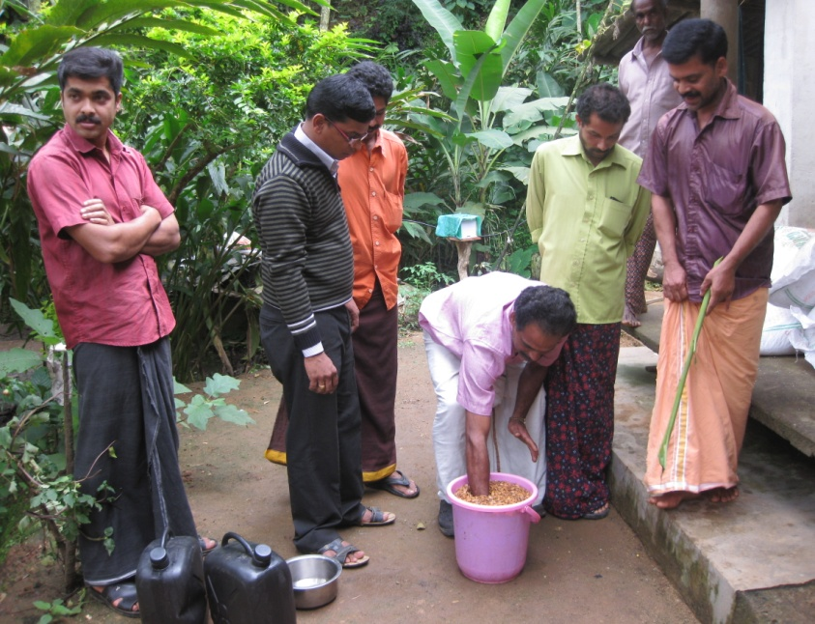
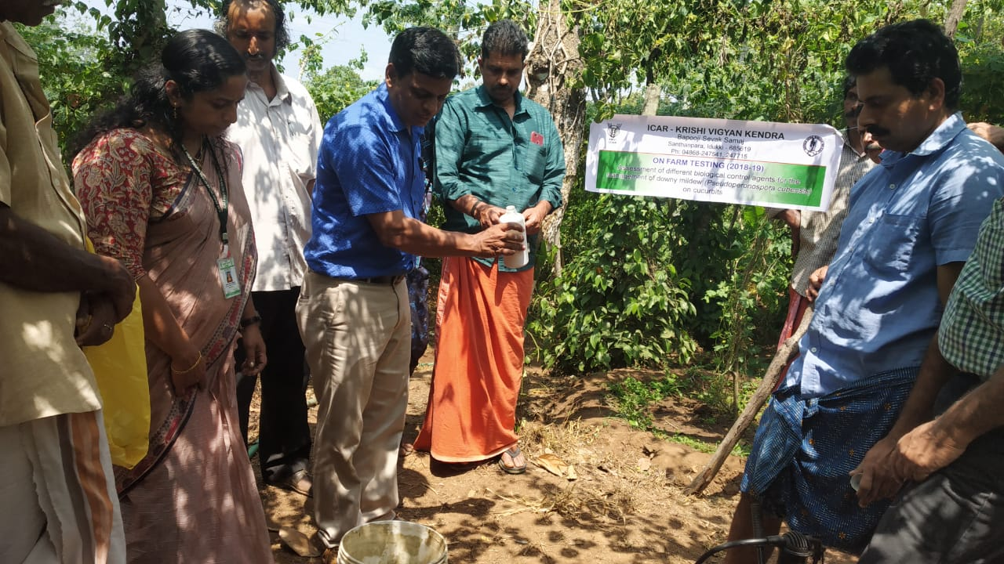
OFT 1. ASSESSMENT OF DIFFERENT BIOLOGICAL CONTROL AGENTS FOR THE MANAGEMENT OF DOWNY MILDEW (PSEUDOPERONOSPORA CUBENSIS) ON CUCURBITS - BITTERGOURD
Operational area | Anakkara
Season | Kharif
Situation | Rainfed
Area | 1 ha
Trials | 05
Area under Bitter gourd | 450 ha
Area under Downy Mildew | 364 ha
Prioritized problem | Heavy dosage of fungicides are applied for the control of downy mildew
Annual Review Workshop 2018-19 ICAR-KVK (BSS), Idukki

Slide 18
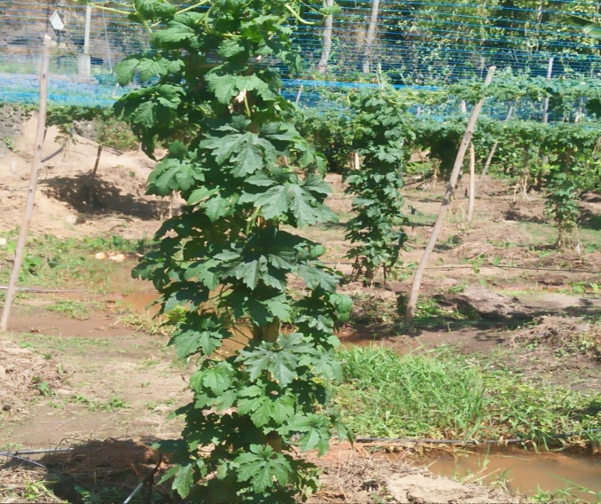
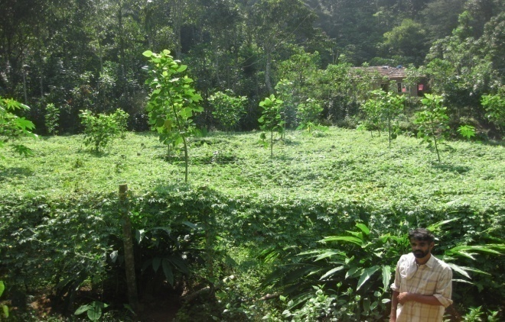
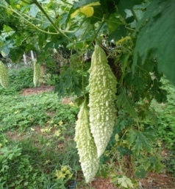
Technological options
TO1 | Farmer Practice
TO2 | Spray extract of licorice @ 20ml/L of water from 10-day intervals between each spray.
TO3 | Spray Pseudomonas @ 20g/L of water from 10-day intervals between each spray.
TO4 | Spray Effective Microorganisms @ 5ml/L of water from 10-day intervals between each spray
Parameters | To 1 | To 2 | To 3 | To 4
Disease Incidence (%) | 61% | 26% | 32% | 29%
Yield (q/ha) | 56 | 75 | 62 | 63
Gross cost (Rs.) | 74000 | 87500 | 93000 | 94500
Gross return (Rs.) | 196000 | 275000 | 248000 | 252000
Net return (Rs.) | 122000 | 187500 | 155000 | 157500
BC ratio | 1.50 | 3.14 | 2.66 | 1.96
Conclusion : Licorice extract was performed well by recording the low downy mildew incidence and higher economic return.
Annual Review Workshop 2018-19 ICAR-KVK (BSS), Idukki

Slide 19
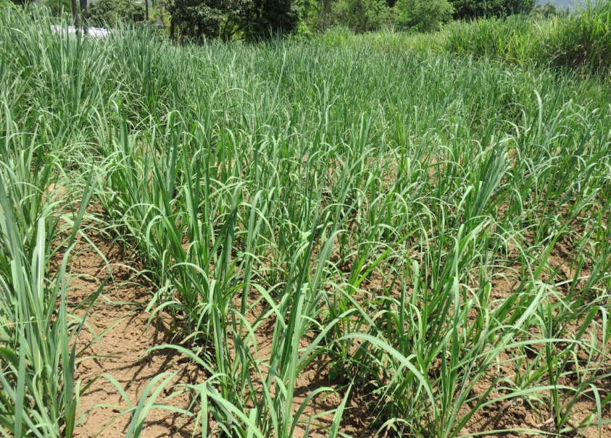
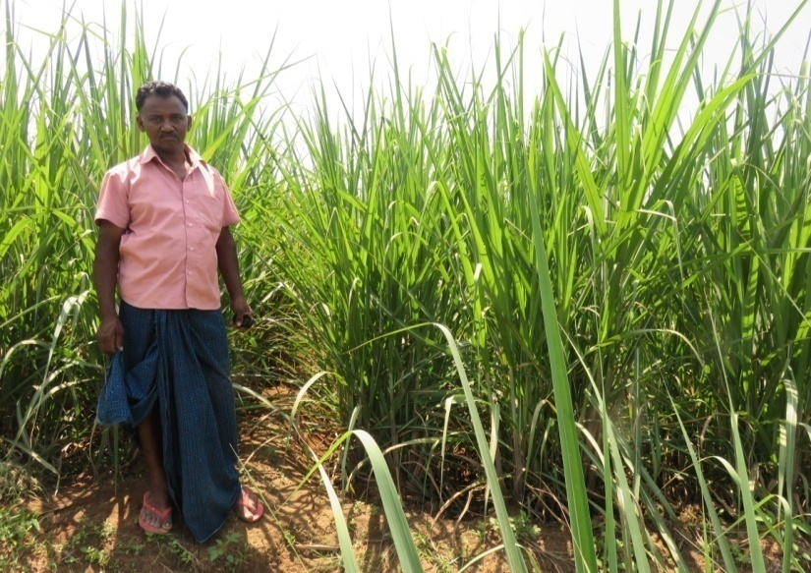
OFT. 2 ASSESSMENT OF DIFFERENT BIOLOGICAL CONTROL AGENTS AND HERBAL BASED REPELLENTS FOR THE MANAGEMENT OF TERMITES IN SUGARCANE CROP
Operational area | Kanthalloor
Season | Kharif
Situation | Rainfed
Area | 1 ha
Trials | 10
Area under sugarcane | 2100 ha
Area under Termites affected | 450 ha
Prioritized problem | Excessive use of termiticides is harmful for environment and the results are not sustainable
Herbal Extract treated field
EPN treated field
Annual Review Workshop 2018-19 ICAR-KVK (BSS), Idukki

Slide 20
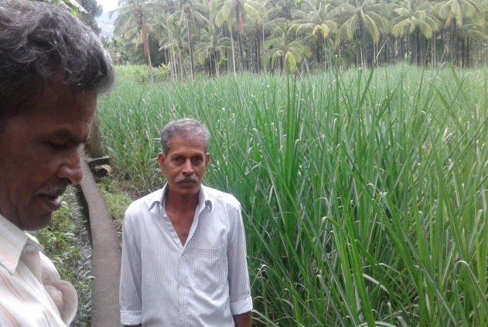
Technological options
TO1 | Farmer Practice
TO2 | Drench Herbal Extract @ 25ml/L of water. (Three spray in 20-day intervals )
TO3 | Drench EPN @ 5g/L of water. (Two spray in 20-day intervals)
TO4 | Drench Metarhizium anisopliae @ 30g/L of water. (Four spray in 20-day intervals)
Metarhizium anisopliae
treated field
Parameters | To 1 | TO 2 | To 3 | To 4
Per cent reduction over control
Yield (q/ha) | 665 | 720 | 806 | 801
Gross cost (Rs.) | 80000 | 65000 | 67000 | 68000
Gross return (Rs.) | 192850 | 201600 | 224000 | 216000
Net return | 112850 | 136600 | 164000 | 160000
BC ratio | 2.4 | 3.10 | 3.34 | 3.17
Conclusion: EPN was performed well by recording the low termites incidence and higher economic return.
Annual Review Workshop 2018-19 ICAR-KVK (BSS), Idukki

Slide 21
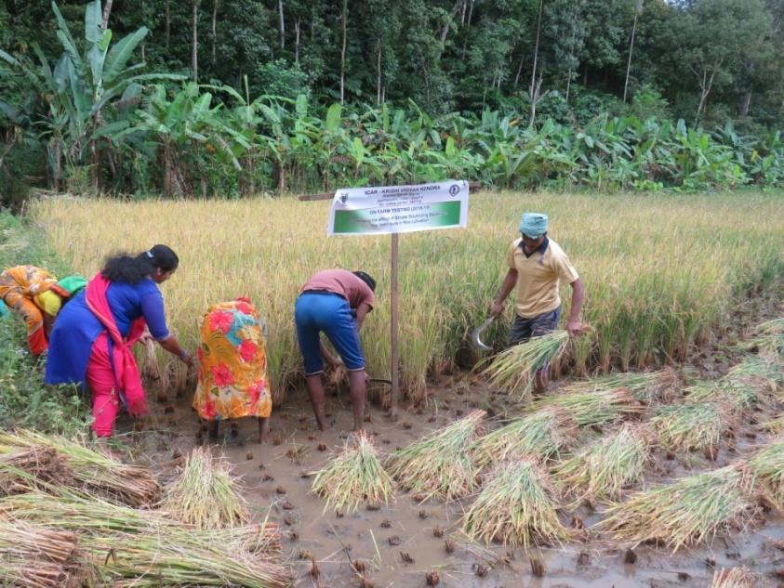
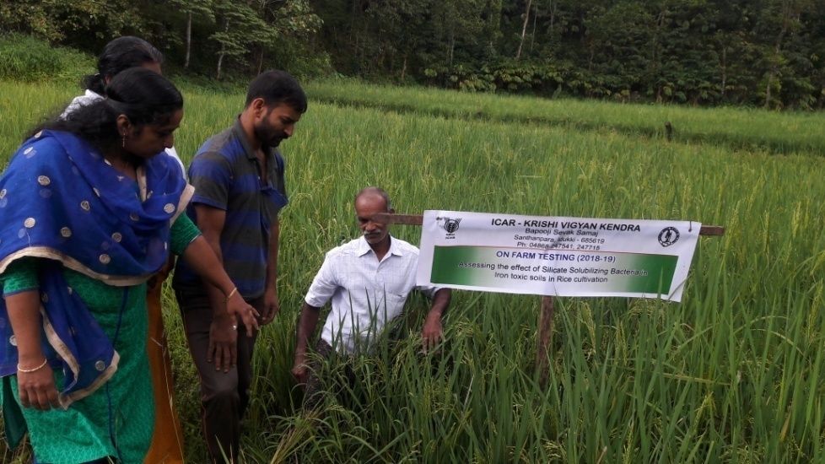
OFT 3. ASSESSING THE EFFECT OF SILICATE SOLUBILIZING BACTERIA IN IRON TOXIC SOILS IN RICE CULTIVATION
Operational area | Kanthipara Village
Area under Paddy | 50 ha
Season | Kharif
Situation | Rainfed
Area | 0.2 ha
Demos | 20
Area under acidity | 35 ha
Prioritized Problem | Iron toxicity due to strongly acidic soils Growth retardation
Annual Review Workshop 2018-19 ICAR-KVK (BSS), Idukki

Slide 22
Technological options
TO1 | Farmer Practice
TO2 | Recommended POP fertilizers+ Fine Silica(100 kg/ha)+ Lime (150 kg/ha)
TO3 | Recommended POP fertilizers + SSB (3 kg/ha)+ Lime (600 kg/ha)
Fine Silica Application @ 100 kg/ha
SSB application @ 3 kg/ha
Annual Review Workshop 2018-19 ICAR-KVK (BSS), Idukki

Slide 23
RESULTS
Parameters | To 1 | TO 2 | To 3
Soil pH | 4.10 | 5.3 | 5.5
Iron (ppm) | 25 | 12 | 5.0
Plant height (cm) | 110.2 | 114.2 | 105.5
No. of panicles/m² | 345 | 358 | 356
Yield (t/ha) | 3.12 | 3.75 | 3.50
Gross Cost (Rs/ha) | 56000 | 55000 | 54000
Gross Return (Rs/ha) | 101250 | 120000 | 112500
Net return | 45250 | 65000 | 58500
BC ratio | 1.81 | 2.18 | 2.08
Conclusion
Treatment with Fine silica and Lime gave better result in reducing iron toxicity
Feed back
Fine Silica application reduced Iron Toxicity which resulted in higher yield
Annual Review Workshop 2018-19 ICAR-KVK (BSS), Idukki

Slide 24
OFT 4. ASSESSING THE EFFECT OF SAMPOORNA IN COWPEA CULTIVATION IN IDUKKI DISTRICT
Operational area | Rajakumary Village
Area under cowpea | 50 ha
Season | Rabi 2018
Situation | Rainfed
Area | 0.06 ha
Trials | 5
Prioritized Problem | Soil acidity, Secondary and micronutrient deficiency
Technological options
TO1 | Farmers Practice
TO2 | Recommended POP fertilizers
TO3 | Soil test nutrients + Foliar application of Sampoorna @ 5 g/l- 30,45,60 DAS
Annual Review Workshop 2018-19 ICAR-KVK (BSS), Idukki

Slide 25
SOIL TEST RESULTS
Parameters | TO1 | TO2 | TO3
Soil pH | 4.30 | 5.5 | 5.89
Potassium (Kg/ha) | 101 | 151 | 301
Calcium meq/100g | 1.5 | 1.8 | 2.0
Magesium meq/100g | 0.3 | 0.45 | 0.5
Zinc ppm | 0.7 | 0.5 | 1.55
Boron ppm | 0.4 | 0.3 | 0.99
RESULTS
Parameters | TO1 | TO2 | TO3
Average Pod length (cm) | 41 cm | 48 cm | 69 cm
No of seeds per pod | 14 | 15 | 19
Yield (t/ha) | 12.6 | 13.5 | 15.9
Gross cost of cultivation (Rs/ha) | 165000.00 | 167000.0 | 175000.0
Gross income (Rs/ha) | 315000.00 | 337500.00 | 397500.00
Net return (Rs./ha) | 150000.00 | 170500.00 | 222500.00
BCR | 1.81 | 2.02 | 2.3
Annual Review Workshop 2018-19 ICAR-KVK (BSS), Idukki

Slide 26
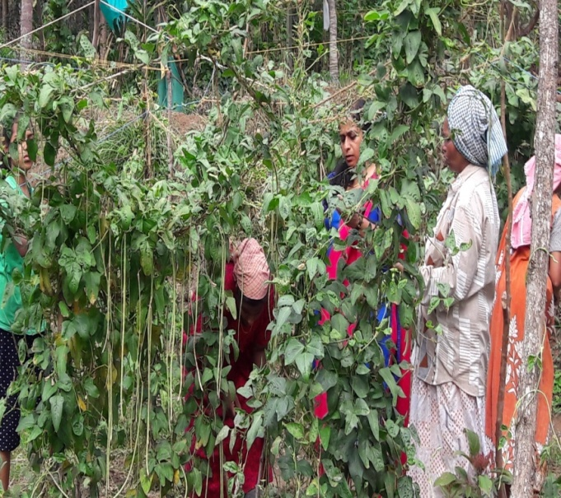
TO-1
TO-2
TO-3
Conclusion
Treatment with sampoorna showed better result in yield, also less deficiency symptoms in TO3 as compared to other treatments
Feed back
Sampoorna micronutrient mixtures is effective for cowpea in reducing calcium, Magnesium and micronutrient deficiencies
Annual Review Workshop 2018-19 ICAR-KVK (BSS), Idukki

Slide 27
OFT 5. ASSESSING THE EFFECT OF CUSTOMIZED FERTILIZER FORMULATION FOR CASSAVA AND ELEPHANT FOOT YAM INTERCROPPED IN COCONUT GARDEN
Operational area | Valiathovala village
Season | Rabi 2018
Situation | Irrigated
Area | 0.02 ha
No. of trials | 5
Prioritized Problem | Soil acidity, Secondary and micronutrient deficiency
Land preparation and Planting done on 27/04/19
Technological options
TO1 | Farmers Practice
TO2 | Recommended POP fertilizers
TO3 | Customized fertilizer formulation @ 500 kg/ha
TO4 | Customized fertilizer formulation @ 625kg/ha
ongoing
Annual Review Workshop 2018-19 ICAR-KVK (BSS), Idukki

Slide 28
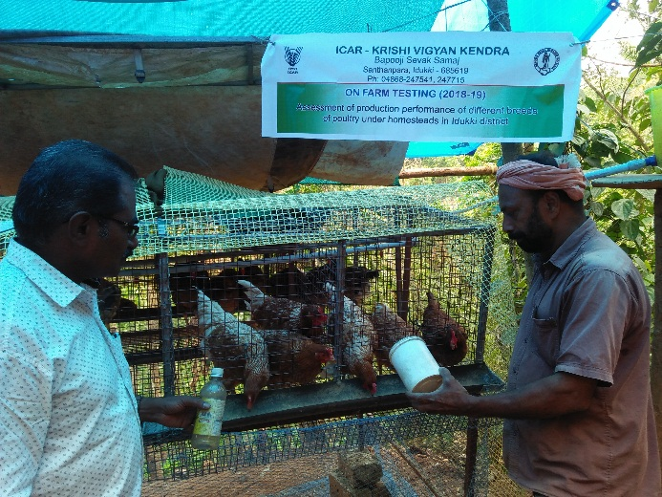
OFT 6. ASSESSMENT OF PRODUCTION PERFORMANCE OF DIFFERENT BREEDS OF POULTRY UNDER HOMESTEAD
Operational area | Manjappara, Thovala and Rajakumary
Season | Through out the year
Situation | Homestead
Area | 10
No. of trials | 10
Prioritized Problem | Non availability of Hybrid poultry birds, Low egg production
Technological options
TO1 | Rearing of Gramasree chicks as per recommended concentrate feed along with mineral mixture and vitamin supplements (KVASU)
TO2 | Rearing of B V 380 chicks as per recommended concentrate feed along with mineral mixture and vitamin supplements(PDP)
TO3 | Rearing of Kalinga brown chicks as per recommended concentrate feed along with mineral mixture and vitamin supplements (CPDO)
Annual Review Workshop 2018-19 ICAR-KVK (BSS), Idukki

Slide 29
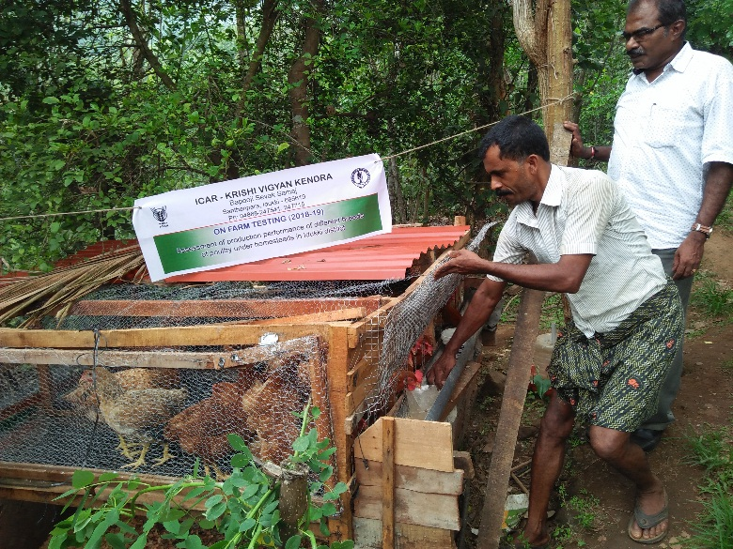
RESULTS
Parameters | TO1 | TO 2 | TO3
Age at sexual maturity | 150 days | 140 days | 150 days
Annual Egg Production (Nos) | 1440 | 2640 | 1440
Gross cost | 4900 | 7500 | 5100
Gross income | 7200 | 13200 | 7200
Net return | 2300 | 4700 | 2100
BCR | 1.46 | 1.76 | 1.41
Conclusion
The BV 380 hybrid poultry variety is getting wide popularity due to adaptability and high productivity
Feed back
Among these three breeds, BV380 have high production characteristics and well suited for high ranges.
Annual Review Workshop 2018-19 ICAR-KVK (BSS), Idukki

Slide 30
FRONT LINE DEMONSTRATIONS

Slide 31
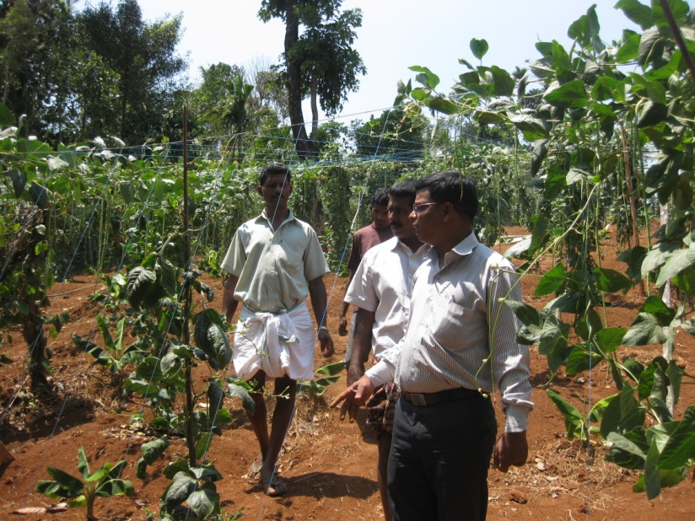
FLD. 1 BIO-INTENSIVE PEST AND DISEASE MANAGEMENT IN COWPEA
Operational area | Baisonvalley
Season | Kharif
Situation | Irrigated
Area | 1 ha
Demonstrations | 10
Total Area | 50 ha
Area affected | 32 ha
Prioritized problem | Indiscriminate use PPC chemicals in Cowpea
Technologies Demonstrated | Seed treatment of Trichoderma harzianum @ 10g with 100ml water/1 kg of seed. Spraying of Hanseniaspora uvarum @ 5ml/L of water each strains separately from 15th, 40th , 65th and 80th days after transplanting Spraying of Lecanicillium saksenae @ 15g / litre three times Spraying of Beauveria bassiana @ 20g/litre two times.
Source | KAU & ICAR-NBAIR
Annual Review Workshop 2018-19 ICAR-KVK (BSS), Idukki

Slide 32
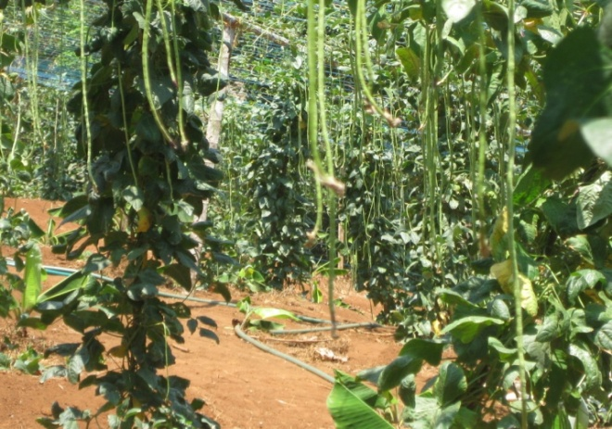
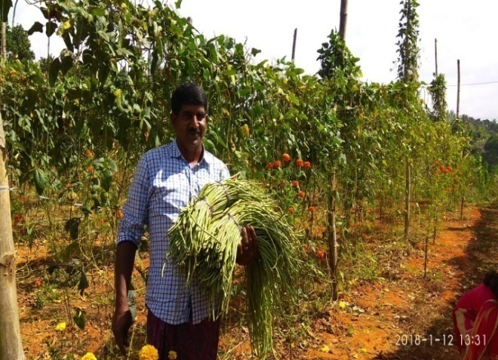
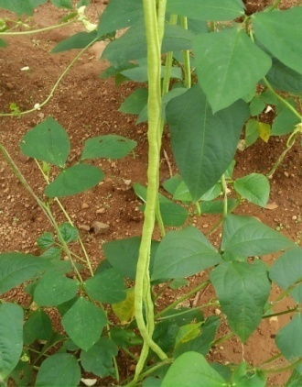
RESULTS
Parameters | Check | Demo
% reduction of pest and disease | 40 16 | 29 32
Yield (q/ha) | 112 | 155
Gross Cost (Rs/ha) | 165000 | 175000
Gross Return (Rs/ha) | 300500 | 387500
Net Return (Rs/ha) | 135500 | 212500
BCR | 1.82 | 2.21
Conclusion:
Effective balance of pests and beneficial organisms in ecological system.
Yield economic level of quality produce .
Technology up scaling:
Name of Agency | No. of farmers benefitted | Area covered (ha)
ATMA | 5 | 10
Annual Review Workshop 2018-19 ICAR-KVK (BSS), Idukki

Slide 33
FLD.2 BIO-INTENSIVE ROOT ROT AND ROOT KNOT NEMATODES MANAGEMENT IN CUCUMBER UNDER POLY HOUSE CONDITIONS
Operational area | Adimali
Season | Rabi
Situation | Irrigated
Area | 1 ha
Demonstrations | 10
Total Area | 50 ha
Area affected | 25 ha
Prioritized problem | Heavy dosage of fungicides/Nematicide are applied for the control of nematodes and root rot.
Technologies Demonstrated | Seed treatment with IIHR-organic plant growth enhancer and yield promoters @ 15-20g/kg of seed . Treat with IIHR-organic plant growth enhancer and yield promoters @ 5 to 10g of formulation/kg of coco-peat . Drench Paecilomyces lilacinus @5g/lit of water basal and 45 DAT Pseudomonas has to be spray on the plants at regular intervals of 30 days @ 5g/ lit
Source | ICAR-IIHR
Annual Review Workshop 2018-19 ICAR-KVK (BSS), Idukki

Slide 34
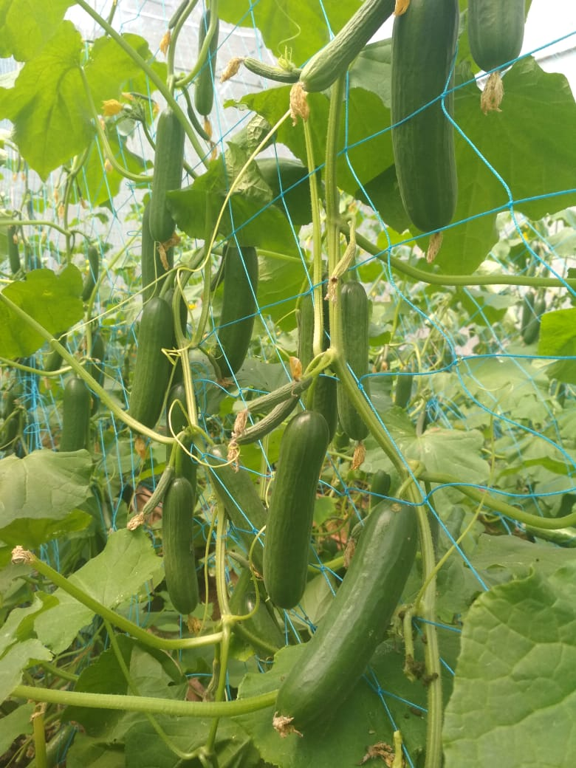
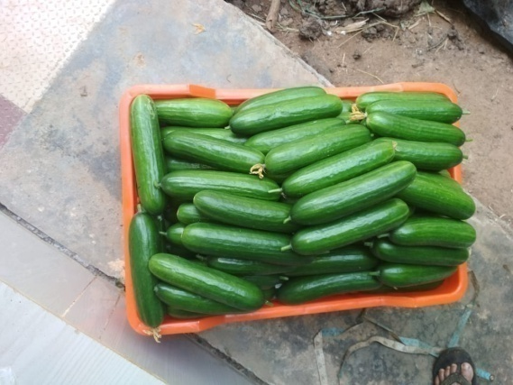
RESULTS
Parameters | Check | Demo
Disease reduction % | 45 | 26
Yield (q/ha) | 32 | 46
Gross Cost (Rs/ha) | 36000 | 31250
Gross Return (Rs/ha) | 58000 | 82800
Net Return (Rs/ha) | 22000 | 51550
BCR | 1.61 | 2.64
Conclusion:
Organic Plant Growth Enhancer and Paecilomyces lilacinus were effective against root rot and root knot nematodes
Technology up scaling:
Name of Agency | No. of farmers benefitted | Area covered (ha)
ATMA | 10 | 0.1
Annual Review Workshop 2018-19 ICAR-KVK (BSS), Idukki

Slide 35
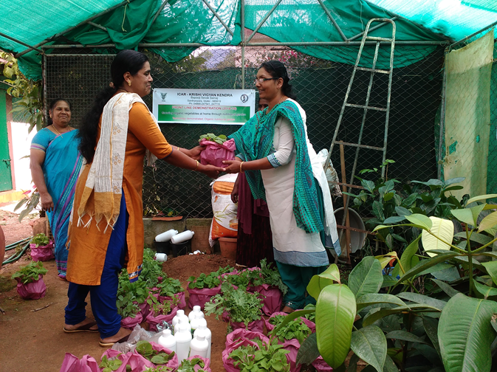
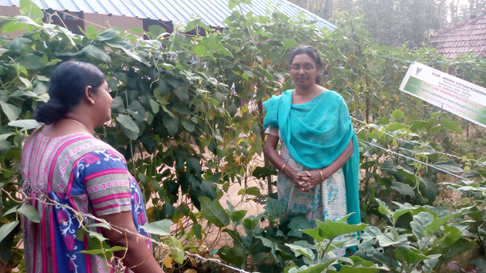
FLD 3: GROWING ORGANIC VEGETABLES AT HOME THROUGH NUTRITIONAL GARDEN
Operational area | Murickumthotty
Season | -
Situation | -
Area | 0.2 ha
Trials | 05
Prioritized problem | Inadequate intake of vegetables and improper nutritional balance
 | Growing organic vegetables in the homesteads Provided quality seedlings for nutritional garden
Annual Review Workshop 2018-19 ICAR-KVK (BSS), Idukki

Slide 36
RESULTS
Parameters | Check | Demo
Intake of vegetables in the diet | Once or twice a week (150g/intake) | Daily (100g)
Intake of green leafy vegetables in the diet | Once in a month (50g) | Thrice a week (50g)
Acceptability(3 point Rating scale) | Medium | High
Yield (q/ha) | 84.75 | 132.75
Gross cost | 18500 | 65000
Gross return | 26750 | 131325
Net return | 8250 | 66326
BCR | 1.44 | 2.02
Number of family members - 25
CONCLUSION
BCR is higher in the demonstration. This FLD was useful to get quality produce of vegetables at homesteads which secured the nutritional balance.
Annual Review Workshop 2018-19 ICAR-KVK (BSS), Idukki

Slide 37
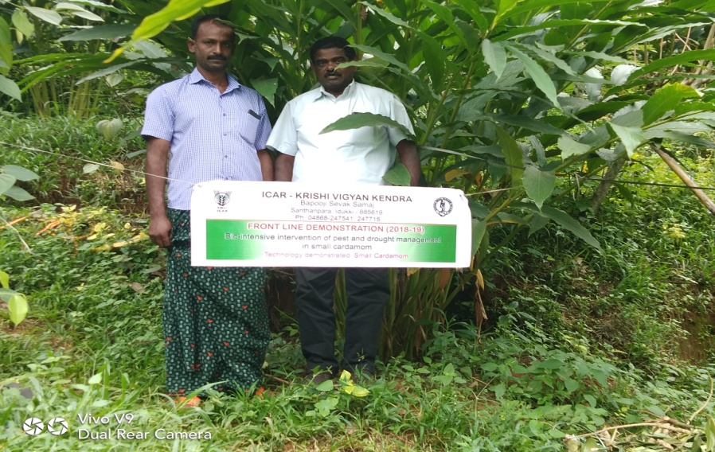
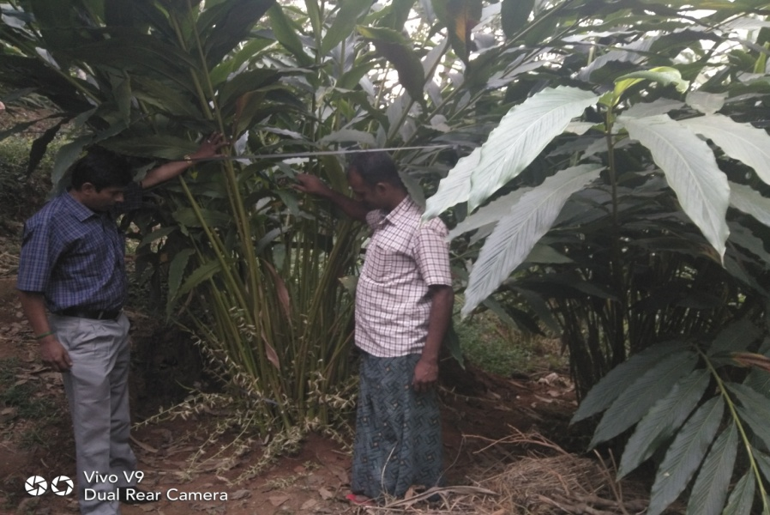
FLD. 4 BIO-INTENSIVE INTERVENTION OF PEST AND DROUGHT MANAGEMENT IN SMALL CARDAMOM
Operational area | Baisonvalley
Season | Kharif
Situation | Rainfed
Area | 3 ha
Demonstrations | 5
Total Area | 200 ha
Area affected | 125 ha
Prioritized problem | Indiscriminate use PPC chemical in cardamom plantation
Technologies Demonstrated | Bio-intensive Pest Management along with Foliar Spray of 1% PPFM
Source | CRS-KAU, Pampudumpara and ICRI, Myladumpara
Annual Review Workshop 2018-19 ICAR-KVK (BSS), Idukki

Slide 38
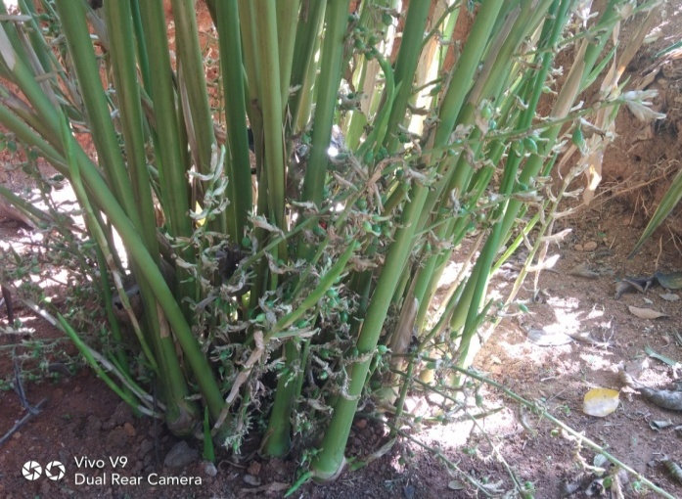
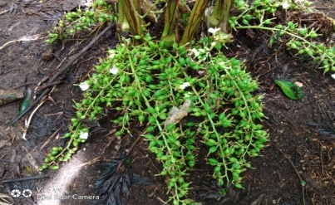
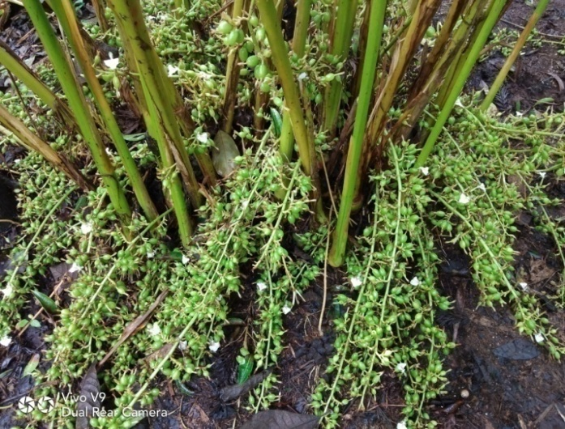
RESULTS
Parameters | Check | Demo
Pest reduction(%), Disease incidence(%) | 46 % 61% | 19 % 26%
Yield (q/ha) | 45.00 | 57.00
Gross Cost (Rs/ha) | 378500 | 310000
Gross Return (Rs/ha) | 671250 | 690000
Net Return (Rs/ha) | 292750 | 380000
BCR | 1.77 | 2.22
Conclusion: Bacillus thuringiensis var Kurstaki sprays in combination with the releases of parasites Apanteles sp and Friona sp gave effective control of stem and capsule borer and 20 % yield increased .
Technology up scaling:
Name of Agency | No. of farmers benefitted | Area covered (ha)
ATMA | 10 | 20
Spices Board | 250 | 180
Annual Review Workshop 2018-19 ICAR-KVK (BSS), Idukki

Slide 39
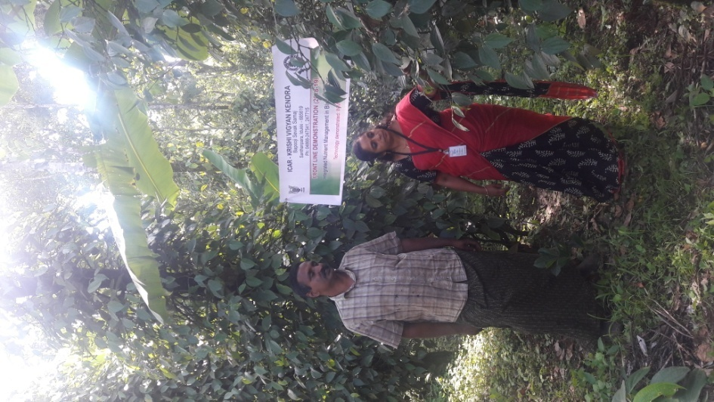
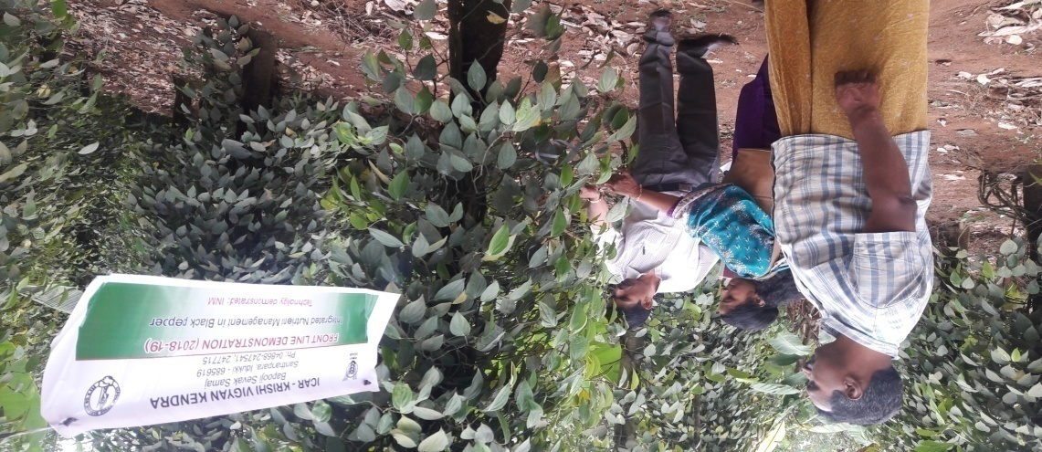
FLD 5. INTEGRATED NUTRIENT MANAGEMENT IN BLACK PEPPER
Operational area | Manjakuzhi
Area under Black Pepper | 1215 ha
Demos | 05
Prioritized Problem | Soil acidity Nutrient deficiencies
Technologies Demonstrated | Integrated Nutrient Management
Annual Review Workshop 2018-19 ICAR-KVK (BSS), Idukki

Slide 40
RESULTS
Parameters | Check | Demo
Soil pH | 4.3 | 5.7
No of spikes/vine | 148 | 200
Spike length | 6 cm | 10 cm
Yield (q/ha) | 3.2 | 4.8
Gross Cost (Rs/ha) | 90062 | 84094
Gross Return (Rs/ha) | 175600 | 196320
Net Return (Rs/ha) | 85538 | 112226
BCR | 1.94 | 2.33
CONCLUSION
No of spikes/vine and spike length increased in demo as compared to check.
Nutrient deficiencies were less in Demo as compared to check.
FEED BACK
Integrated Nutrient Management improved the soil fertility status .
Technology up scaling:
Name of Agency | No. of farmers benefitted | Area covered (ha)
Dept. Of Agri. | 35 | 10
Annual Review Workshop 2018-19 ICAR-KVK (BSS), Idukki

Slide 41
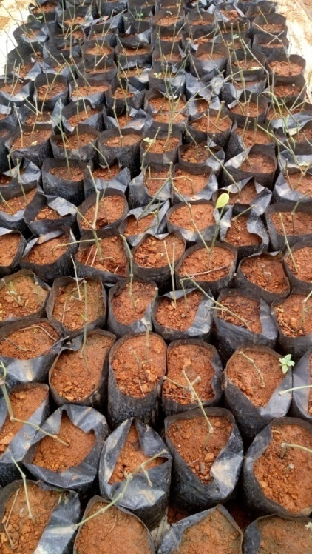
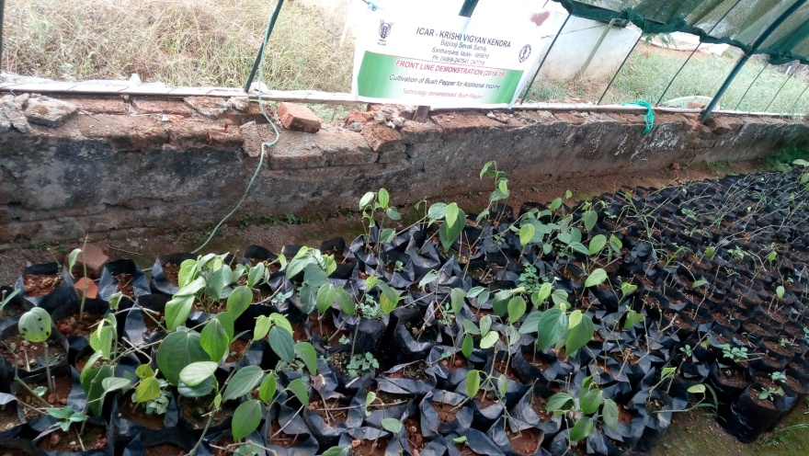
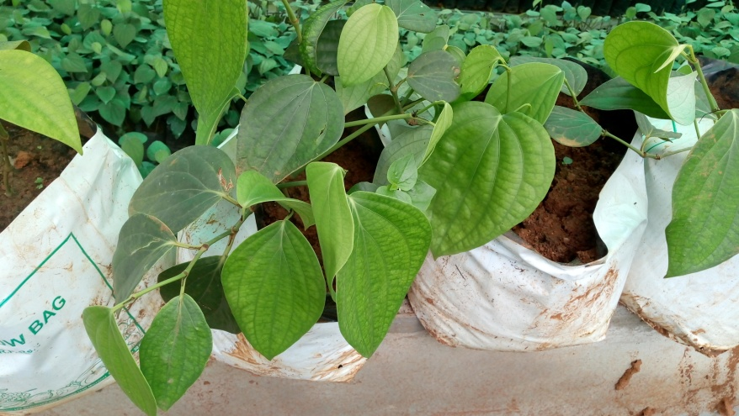
FLD 6. CULTIVATION OF BUSH PEPPER FOR ADDITIONAL INCOME
Operational area | Areekuzha
Area under Black Pepper | 1215 ha
Demos | 20
Prioritized Problem | Lateral shoots are more often wasted after harvest of black pepper corns Need for additional income
Technologies Demonstrated | Cultivation of bush pepper
Annual Review Workshop 2018-19 ICAR-KVK (BSS), Idukki

Slide 42
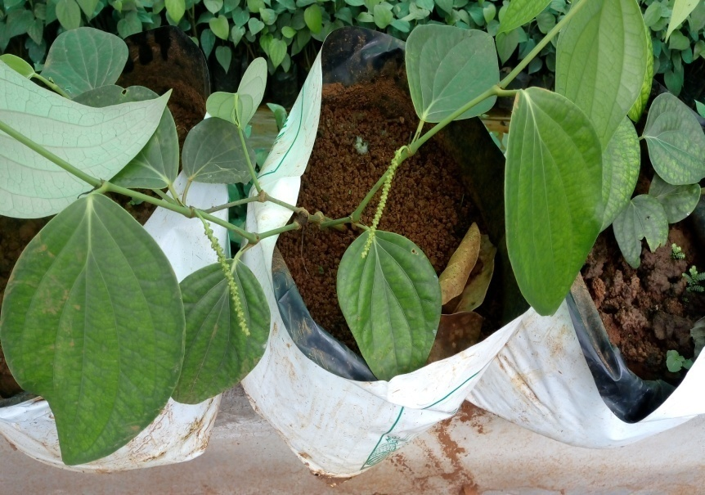
RESULTS
Parameters | Check | Demo
Percentage survival rate | - | 52
Number of laterals |  | 3
Gross Cost (Rs) |  | 800
Gross Return (Rs) |  | 1560
Net Return (Rs) |  | 760
BCR |  | 1.95
CONCLUSION
Additional income is realized by utilizing the lateral shoots of Black Pepper after harvest, which otherwise is wasted
A good source of income when channelized through tourist hot spots.
FEED BACK
Income got by little extra effort during leisure time is of great additional financial support.
Annual Review Workshop 2018-19 ICAR-KVK (BSS), Idukki

Slide 43
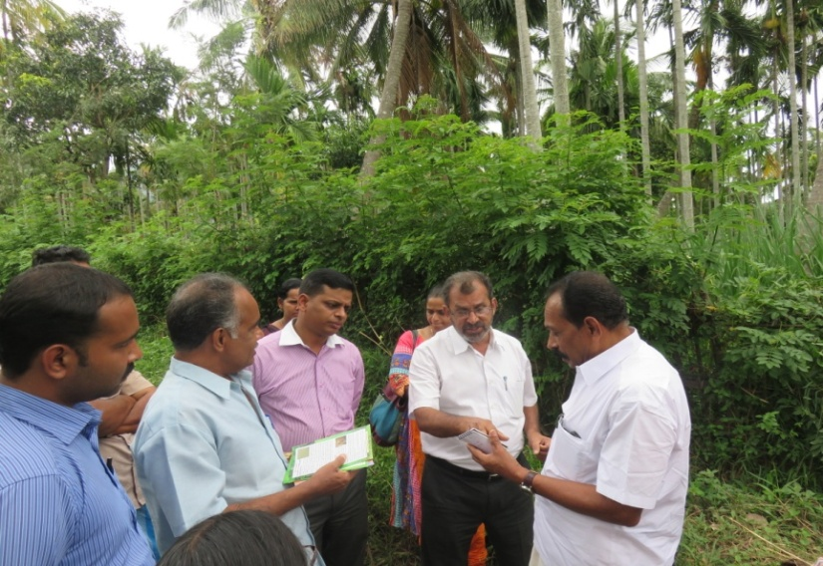
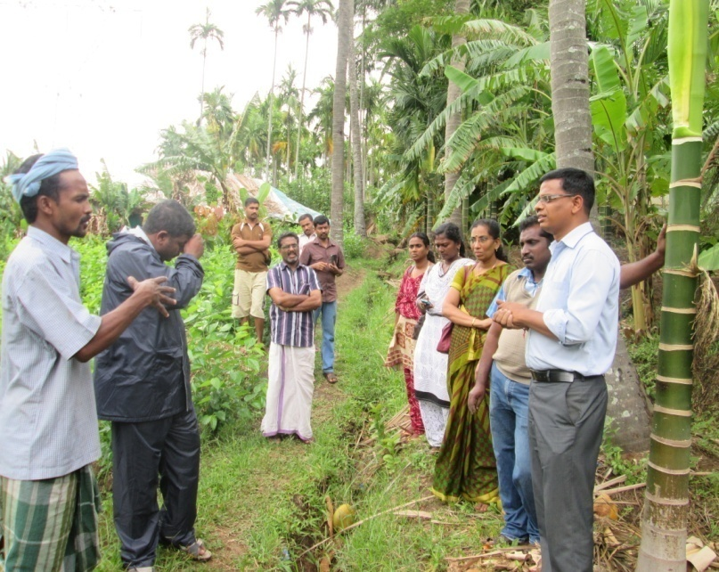
FLD. 7 BIOLOGICAL CONTROL OF RUGOSE SPIRALLING WHITEFLY-RSW (ALEURODICUS RUGIOPERCULATUS) IN COCONUT PLANTATION
Operational area | Kanthalloor
Season | Kharif
Situation | Irrigated
Area | 25 ha
Demonstrations | 50
Total Area | 75 ha
Area affected | 25 ha
Prioritized problem | Invasive pest and cause direct damage by sucking sap, profuse honey dew excretion resulted in sooty mould which reduces the photosynthetic efficiency
Technologies Demonstrated | Release of Parasitoids (Encarsia guadeloupae and E. dispersa
Source | ICAR-NBAIR
Annual Review Workshop 2018-19 ICAR-KVK (BSS), Idukki

Slide 44
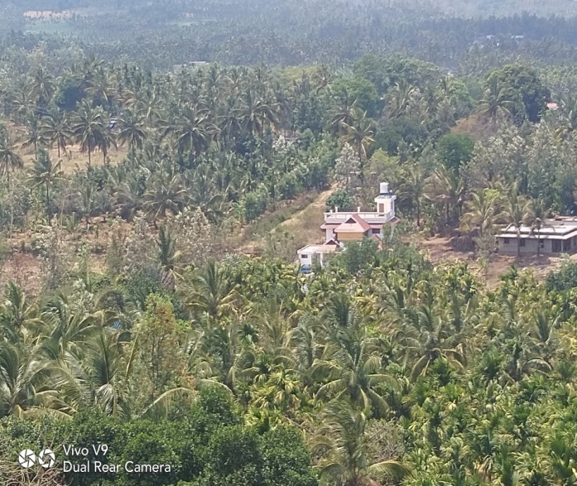
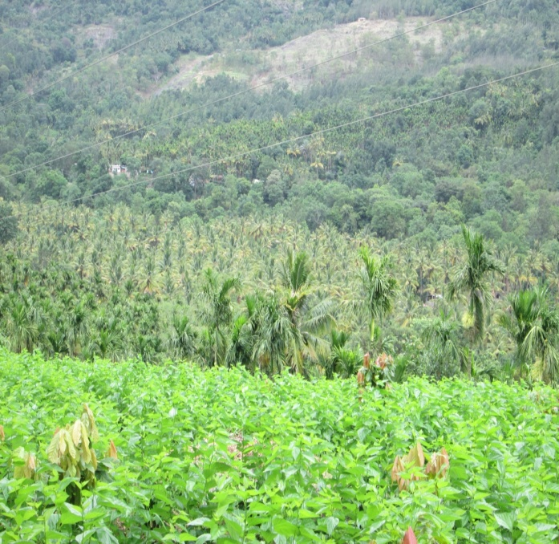
RESULTS
Parameters | Check | Demo
Pest reduction % | 52 | 18
Yield (q/ha) | 520 | 750
Gross Cost (Rs/ha) | 50000 | 65000
Gross Return (Rs/ha) | 98000 | 150000
Net Return (Rs/ha) | 48000 | 85000
BCR | 1.96 | 2.30
Before Encarsia release field
Conclusion:
The pest population was greatly suppressed by an Encarsia which in a period of three months, which could effectively parasitize more than 65% of pest population.
Technology up scaling:
Name of Agency | No. of farmers benefitted | Area covered (ha)
ATMA | 150 | 250
After Encarsia released field
Annual Review Workshop 2018-19 ICAR-KVK (BSS), Idukki

Slide 45
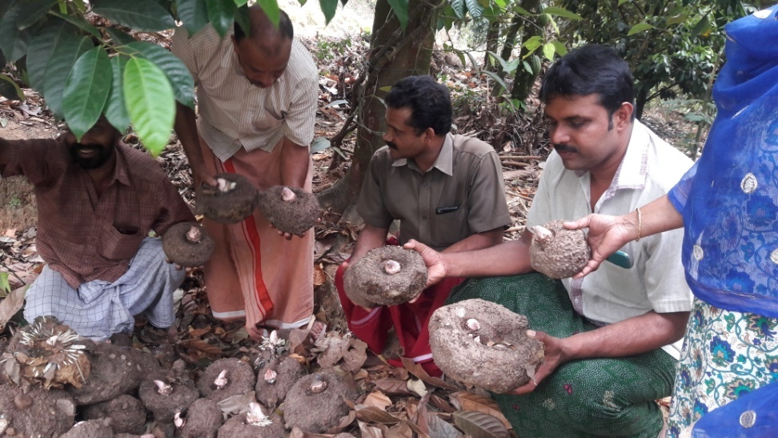
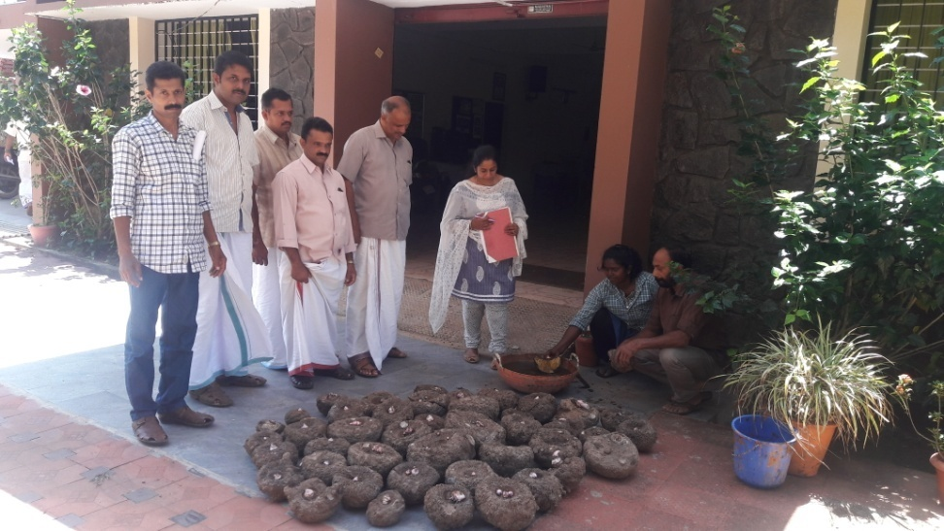
FLD 8. DEMONSTRATION ON ACRID FREE VARIETY GAJENDRA OF AMORPHOPHALLUS IN HIGH RANGES
Operational area | Manjappara
Area | 0.02 ha
Demos | 05
Prioritized Problem | Lack of acrid free Variety
Technologies Demonstrated | Demonstration of acrid free variety
Corms treated with cowdung and Trichodermma on 11/3/19. Planting done on 27/4/19
Ongoing
Annual Review Workshop 2018-19 ICAR-KVK (BSS), Idukki

Slide 46
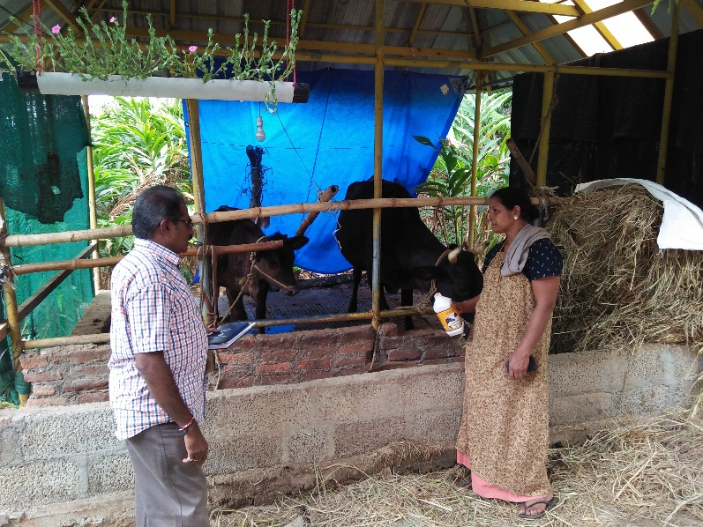
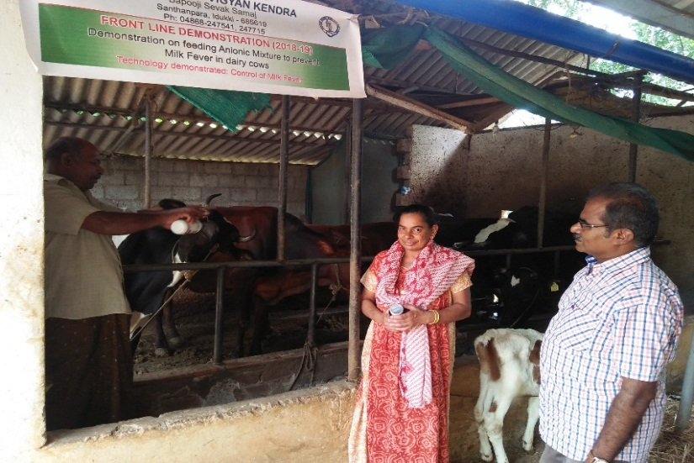
FLD 9. DEMONSTRATION ON FEEDING ANIONIC MIXTURE TO PREVENT MILK FEVER IN DAIRY COWS
Operational area | Kanthipara and Rajakumary
Animal population | 3,67,956
Demos /Unit | 20
Prioritized Problem | Low yield of milk . Occurrence of Milk fever
Technologies Demonstrated | Feeding Anionic Mixture @ 30-50gm/animal/day mixed with jaggery or feed to prevent milk fever in dairy cows.
Annual Review Workshop 2018-19 ICAR-KVK (BSS), Idukki

Slide 47
RESULTS
Parameters | Check | Demo
Disease incidence(%) | 50 | 0
Production performance(%) | 0 | 15
Gross Cost (Rs) | 45308 | 45675
Gross Return (Rs) | 70243 | 84873
Net Return (Rs) | 24935 | 39198
BCR | 1.55 | 1.86
CONCLUSION
Management of Milk fever disease by this technology was very effective and improve more milk production and the farming community has to be ensure regularly following this technology in future.
FEED BACK
To overcome the Milk fever problem thro this technology was highly appreciated.
Annual Review Workshop 2018-19 ICAR-KVK (BSS), Idukki

Slide 48
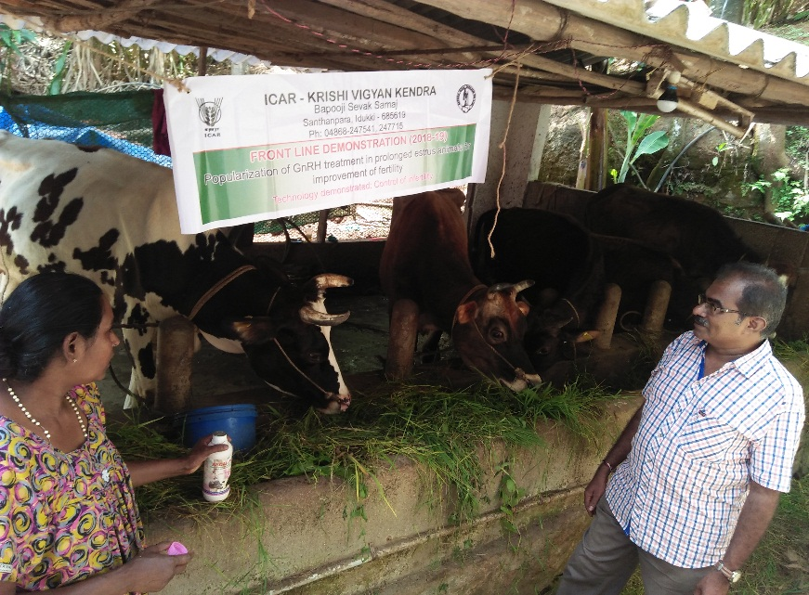
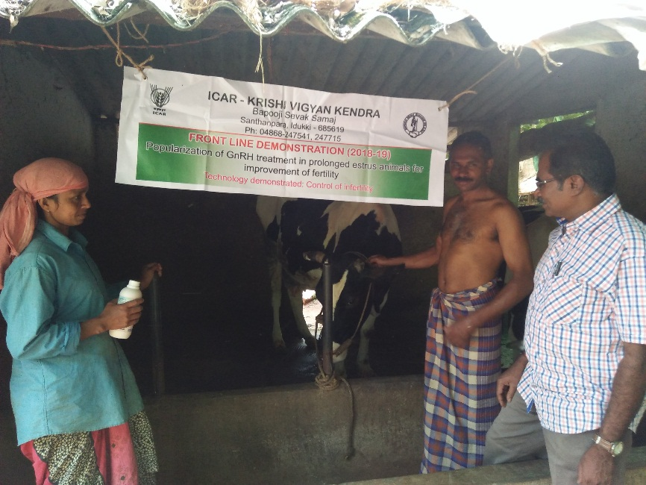
FLD 10. POPULARIZTION OF GnRH TREATMENT IN PROLONGED ESTRUS ANIMALS FOR IMPROVEMENT OF FERTILITY
Operational area | Rajakumary
Animal population | 1,54,611
Demos | 10
Prioritized Problem | Higher occurrence of infertility rate among dairy cattle (25%)
Technologies Demonstrated | Administer Inj GnRH and followed by first AI and subsequently 2nd AI at 24 hrs interval
Annual Review Workshop 2018-19 ICAR-KVK (BSS), Idukki

Slide 49
RESULTS
Parameters | Check | Demo
% of infertility rate reduction | - | 70%
Gross Cost (Rs) | 45175 | 45620
Gross Return (Rs) | 71295 | 85995
Net Return (Rs) | 26120 | 40375
BCR | 1.58 | 1.88
CONCLUSION
Usage of Inj GnRH technology helped animals to induce heat on time and AI was done.
FEED BACK
To overcome the infertility problem thro this technology was highly appreciated.
Annual Review Workshop 2018-19 ICAR-KVK (BSS), Idukki

Slide 50
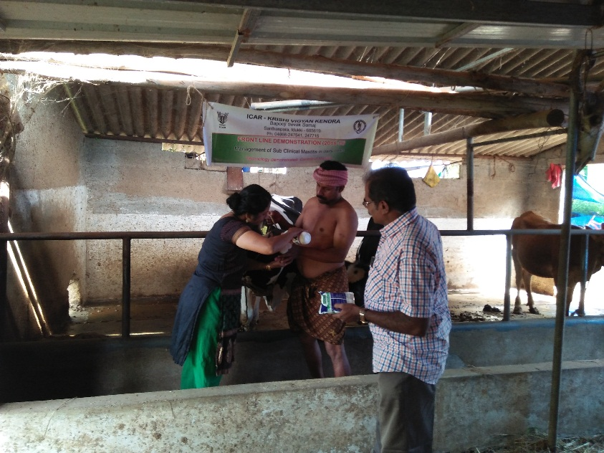
FLD 11. MANAGEMENT OF SUB CLINICAL MASTITIS IN DAIRY COWS
Operational area | Rajakumary
Animal population | 2,54,790
Demos / Unit | 20
Prioritized Problem | Higher occurrence of Mastitis disease
Technologies Demonstrated | Antibiotic treatment along with oral supplementation Trisodium citrate @ 30 mg/kg body weight for 5 days
Annual Review Workshop 2018-19 ICAR-KVK (BSS), Idukki

Slide 51
RESULTS
Parameters | Check | Demo
Milk yield(L) | 1995 | 2290
Gross Cost (Rs) | 44765 | 45250
Gross Return (Rs) | 69825 | 84527
Net Return (Rs) | 25060 | 39277
BCR | 1.56 | 1.86
CONCLUSION
Management of Mastitis disease by this technology was very effective and improve more milk production and convinced by farming community.
FEED BACK
To overcome the Mastitis problem through this technology was highly appreciated.
Annual Review Workshop 2018-19 ICAR-KVK (BSS), Idukki

Slide 52
FLD 12: DEMONSTRATION ON HYDROPONICS METHOD OF FODDER PRODUCTION
Operational area | Santhanpara
Animal population | 2,37,678
Demos /Unit | 1
Prioritized Problem | Non availability of quality fodder slips
Technologies Demonstrated | Demonstration of hydroponics method of fodder production
Ongoing
Annual Review Workshop 2018-19 ICAR-KVK (BSS), Idukki

Slide 53
FLD 13: DEMONSTRATION OF MILKY MUSHROOM var. BHEEMA
Operational area | Kavunthy, Adimali, Santhanpara
Demos | 5
Prioritized Problem | Low yield of Oyster Mushrooms during Summer months Unable to keep up the continuous supply
Technologies Demonstrated | Cultivation of Milky Mushroom
Variety Introduced | Bheema
Source of Technology | KAU (2015)
Annual Review Workshop 2018-19 ICAR-KVK (BSS), Idukki

Slide 54
RESULTS
Parameters | Check | Demo
Yield per bed (kg) | 1.25 | 1.37
Av. Wt. of one Mushroom (g) | - | 218.6
No. of Mushrooms per kg wt | - | 4.6
Gross Cost (Rs) | 90 | 85
Gross Return (Rs) | 375 | 410
Net Return (Rs) | 285 | 325
BCR | 4.16 | 4.82
CONCLUSION
Cultivation of Milky mushroom var. Bheema is recommended during summer months in high ranges of Idukki, to mitigate the reduction in supply of oyster mushroom.
FEED BACK
This variety is gaining popularity due to its extended shelf-life and better cooking quality
Annual Review Workshop 2018-19 ICAR-KVK (BSS), Idukki

Slide 55
Entrepreneurship Development Programme on production and marketing of jack based diversified products through SHG
Operational area | Murickasserry
Season | -
Situation | -
Area | 1 unit
Trials | 4
Prioritized problem | Under utilisation of jack High spoilage Low income
Technologies Demonstrated | Jack chips, dried jack, dried tender jack, jack pickle, tender jack pickle, powdered jack , jack jam, jack squash
Annual Review Workshop 2018-19 ICAR-KVK (BSS), Idukki

Slide 56
RESULTS
Parameters | Demo
Products (kg) | 625
Shelf life( days) | 120
Gross cost (Rs.) | 95000
Gross return (Rs.) | 173250
Net return (Rs.) | 78250
BCR | 1.82
The group works for 25 days in a month.
This SHG is a group of four farmwomen and share their profit equally.
FSSAI No-2131817700024
Area of Marketing – Murikkaserry, Adimali, Thodupuzha and Ernakulam.
Annual Review Workshop 2018-19 ICAR-KVK (BSS), Idukki

Slide 57
Parameters | Demo (unit) | Demo (per head)
Products (kg/day) | 25* | -
Gross cost (Rs./day) | 3800 | 950
Gross return (Rs./day) | 6930 | 1732.5
Net return (Rs./day) | 3130 | 782.5
* jack chips(10kg) + dried jack(3 kg) + dried tender jack (2kg) + jack pickle(1kg) + tender jack pickle(1.6kg) + powdered jack(1.2kg) + jack jam(2.6kg) + jack fritters and squash(3.6kg)
CONCLUSION
Provided hands on training on jack diversified products to selected farmwomen. They started a functional group at Murickasserry named Navami new taste vege centre and is running successfully.
Annual Review Workshop 2018-19 ICAR-KVK (BSS), Idukki

Slide 58
Farmers’ Field School

Slide 59
FARMERS’ FIELD SCHOOL (FFS) - GOOD AGRICULTURAL PRACTICE IN
SMALL CARDAMOM (2018-19)
Village :Vandanmedu
Crop | Thematic area | Technology demonstrated | Season | No. of farmers
 |  |  |  | Male | Female | Total
Small Cardamom | IPDM | GAP and Drought Mitigation Programme | Kharif | 22 | 3 | 25
Details of farming situation
Crop | Season | Farming situation | Soil type | Status of soil |  |  | Previous crop
 |  |  |  | N | P | K
Small Cardamom | Samba | Irrigated | Forest loam Soil | L | M | H | Perennial

Slide 60
Impact of GAP in Small Cardamom
Technology | Awareness |  | Adoption
 | No. | % | No. | %
Soil sample collection | 30 | 100 | 20 | 67
Integrated Nutrient Management | 30 | 100 | 21 | 70
Foliar spraying of nutrients | 30 | 100 | 23 | 76
Clump after pruning dry leaf | 30 | 100 | 23 | 76
Integrated pest and disease management | 30 | 100 | 21 | 70
Spraying of plant protection chemicals | 30 | 100 | 30 | 100
Drought management | 30 | 100 | 30 | 100
Bee keeping | 30 | 100 | 10 | 33
Average | 30 | 100 | 23 | 77

Slide 61
Economic Impact
Average cost of cultivation (Rs/ha) |  | Average gross return (Rs/ha) |  | Average net return (Rs/ha) |  | Benefit Cost ratio
Demo | Check | Demo | Check | Demo | Check | Demo | Check
310000 | 378500 | 690000 | 671250 | 380000 | 292750 | 2.22 | 1.77
Extension and training activities
Sl. No. | Activity | No. of activities
1. | Farmers training | 6
2. | Demonstrations | 8

Slide 62
SUCCESS STORIES

Slide 63
SUCCESS STORY OF A WOMAN ENTREPRENEUR
Background
Name of the entreprenuer: Manju Mathew
M/s. Harithasree Vegetable Seedling Nursery
Ullathu, Anjumukku, Valiyathovala, 685514 (mob: 9544761240)
Village : Valiyathovala
Taluk : Udumbanchola
2. Intervention Technology
Created a platform, where she could analyse her SWOT in current system of farming.
Hand holding activities to promote result oriented agri-business concepts.
Timely intervention, not just for farming activities, but also for allied support inventory.
Corrective deliberations and fool proof measures in all the stages of entrepreneurial development.
Annual Review Workshop 2018-19 ICAR-KVK (BSS), Idukki

Slide 64
3. Intervention Process
Feasibility assessment of the site earmarked for construction of rain shelter.
Availability of all the basic input resources
Project formulation and onward submission to District Panchayat for grant.
Hands-on training on nursery production and management of vegetable seedlings.
Timely intervention on different stages of seedling growth.
Intervention for getting adequate sales tenders from department machinery.
Advisory services.
Follow-up visits and technical support as and when required.
4. Impact Horizontal Spread:
M/s. Harithasree Vegetable Seedling Nursery, Valiyathovala, gives employment directly to 50 rural youth and many multiples of it, indirectly through the never ending increase in demand for quality vegetable seedlings at the right planting season ex-situ.
Annual Review Workshop 2018-19 ICAR-KVK (BSS), Idukki

Slide 65
5. Impact on economic gains
An economic gain of around Rs. 5.00 lakhs per annum is now being realized on an average after getting the unit to a breakeven point.
Cost of production | 7,12,000/-
Gross income | 11,84,000/-
Net income | 4,72,000/-
B C R | 1.66
6. Impact on Employment Generation.
Employment generation through self-employment ventures is the need of the hour.
Those benefitted through these ventures are indirectly getting hands on experience also to be independent at a point of time.
This venture provides employment to over 50 persons every year.
It will also provide as a knowledge hub for trainings related to vegetable seedling, thereby paving way for further chance of employment generation.
Annual Review Workshop 2018-19 ICAR-KVK (BSS), Idukki

Slide 66
SKILLED ENTERPRISE FOR RURAL YOUTH
1. Backgound
A group of 45 tribal school drop-outs is an example how rural youth can effectively utilize their talents, which would help to lead towards personality development and to reduce poverty
2. Intervention Process
To assess their educational needs and to provide essential training.
*To enhance their life-skills by extending life-skill education.
*Skill development vocational training
Annual Review Workshop 2018-19 ICAR-KVK (BSS), Idukki

Slide 67
4. Impact Horizontal Spread
To create an environment where women can seek knowledge and information and there by empower them to play positive role in their own development and development of society
To provide women and adolescent girls with the necessary support structures and an informal learning environment to create opportunities for education.
5. Impact Economic Gains
Cost of production | Rs.10200/-
Gross income | Rs.32,530/-
Net return | Rs.22,330/-
Benefit cost Ratio | 3.18
Annual Review Workshop 2018-19 ICAR-KVK (BSS), Idukki

Slide 68
SUCCESS STORY OF A WOMAN ENTREPRENEUR
Entreprenuer Name : Lovely Babu,Kollarackal
Village :Rajakumary
Taluk :Udumbanchola
Intervention Technology
6 months vocational training.
Motivation to start an enterprise.
Technical guidance for starting the unit .
Details about availability of raw materials given.
Advisory services.
Follow- up visits.
Technical back up in running the unit as when required.
Intervention Process
To provide skill development vocational training to make her self- sufficient and self-reliant
Annual Review Workshop 2018-19 ICAR-KVK (BSS), Idukki

Slide 69
4.Impact Horizontal Spread:
This enterprise will provide skill development for the women dwellers in identified area, families will be benefited directly and creating a ray of hope for better source of livelihood , and live a sustainable life with self – sufficiency and self –reliance.
5.Impact on economic gains
Cost of production | 20000/-
Gross income | 45000/-
Net income | 25000/-
B C R | 2.25
6. Impact on Employment Generation.
Motivated from the above mentioned Mrs.Lovely’s successful enterprise,12 rural women formed a self help group named Arts Vigyan SHG under Rural Craft discipline KVK, they started designing , jewellery making and production of home care products on a commercial basis.In addition to this unit, they are planning to start a small fancy store with loan availing from nearby Co-operative bank
Annual Review Workshop 2018-19 ICAR-KVK (BSS), Idukki

Slide 70
TRAININGS
Particulars | No. trainings | No. of participants
On campus training | 11 | 294
Off campus training | 41 | 1806
Rural youth | 38 | 800
Extension personnel | 6 | 185
Sponsored | 2 | 122
Total | 98 | 3207
Annual Review Workshop 2018-19 ICAR-KVK (BSS), Idukki

Slide 71
ON CAMPUS TRAININGS
Annual Review Workshop 2018-19 ICAR-KVK (BSS), Idukki

Slide 72
OFF CAMPUS TRAININGS
Annual Review Workshop 2018-19 ICAR-KVK (BSS), Idukki

Slide 73
SPONSORED TRAININGS
Annual Review Workshop 2018-19 ICAR-KVK (BSS), Idukki

Slide 74
EXTENSION ACTIVITIES
Nature of Extension Programme | No. of Program. | No. of Participants (General) |  |  | No. of Participants SC / ST |  |  | No. of extension personnel
 |  | M | F | Total | M | F | Total | M | F | Total
Field Day | 1 | 20 | 4 | 24 | 0 | 0 | 0 | 1 | 0 | 0
Exhibition | 2 | 2629 | 2829 | 5458 | 220 | 330 | 550 | 206 | 146 | 352
Method Demonstrations | 9 | 82 | 16 | 98 | 0 | 0 | 0 | 4 | 5 | 9
Farmers Seminar / Workshop | 6 | 206 | 90 | 296 | 0 | 0 | 0 | 25 | 30 | 55
Group meetings | 10 | 85 | 48 | 133 | 0 | 93 | 93 | 10 | 30 | 40
Lectures delivered as resource persons | 6 | 375 | 366 | 741 | 0 | 0 | 0 | 0 | 28 | 28
Newspaper coverage | 2 | MASS
Radio talks | 2 | 0 | 0 | 0 | 0 | 0 | 0 | 0 | 0 | 0
TV talks | 1 | 0 | 0 | 0 | 0 | 0 | 0 | 0 | 0 | 0
Popular articles | 3 | MASS
Extension Literature | 7
Advisory Services | 90 | 142 | 109 | 251 | 15 | 0 | 15 | 8 | 4 | 12
Scientific visit to farmers field | 40 | 136 | 51 | 187 | 0 | 0 | 0 | 29 | 25 | 54
Farmers visit to KVK | 246 | 290 | 25 | 315 | 0 | 0 | 0 | 13 | 1 | 14
Diagnostic visits | 10 | 54 | 6 | 60 | 0 | 0 | 0 | 5 | 8 | 13
Ex-trainees Sammelan | 2 | 26 | 16 | 42 | 0 | 35 | 35 | 6 | 14 | 20
Soil health Camp | 6 | 161 | 42 | 203 | 0 | 0 | 0 | 6 | 6 | 12
Self Help Group Conveners meetings | 34 | 3 | 160 | 163 | 0 | 287 | 287 | 6 | 89 | 95
Celebration of important days (World Soil Day) | 1 | 110 | 7 | 117 | 0 | 0 | 0 | 2 | 1 | 3
Celebration of important days (World Food Day) | 1 | 10 | 20 | 30 | 0 | 0 | 0 | 0 | 0 | 0
Celebration of important days (specify) | 15 | 250 | 249 | 499 | 0 | 0 | 0 | 62 | 98 | 160
Total | 495 | 4579 | 4038 | 8617 | 235 | 745 | 980 | 383 | 485 | 868

Slide 75
EXTENSION ACTIVITIES
SMS visit to farmers field
Exhibition
Diagnostic Visits
Paddy harvest festival Exhibition
Post Flood survey
Demo. On VAM production
Annual Review Workshop 2018-19 ICAR-KVK (BSS), Idukki

Slide 76
SPECIAL PROGRAMME &
CELEBRATION OF DAYS

Slide 77
UTILIZATION OF BUDGET – SPECIAL PROGRAMMES (Rs.)
Particulars | Budget allotted (Rs) | Expenditure(Rs)
Pre Rabi Campaign - ICAR | 80,000.00 | 80,000.00
ASCI - Mushroom Grower - ICAR | 1,65,200.00 | 1,65,200.00
ASCI – Bee keeper - ICAR | 1,41,300.00 | 1,41,300.00
DAESI Programme - ATMA | 16,00,000.00 | 16,00,000.00

Slide 78
Pre Rabi Campaign cum Technology Week
Date of the Programme : 13.02.2019 to 15.02.2019
No. of Farmers participated : 1140
Annual Review Workshop 2018-19 ICAR-KVK (BSS), Idukki

Slide 79
ASCI – MUSHROOM GROWER
ASCI – BEE KEEPER

Slide 80
DAESI PROGRAMME
Annual Review Workshop 2018-19 ICAR-KVK (BSS), Idukki

Slide 81
Annual Review Workshop-2018
Participants of Annual Review Workshop of KVKs in Zone XI
Inaugural Address by Dr.M.J.Chandra Gowda Director, ICAR-ATARI,Begaluru
Inaugurating Annual Review Workshop of KVKs-ICAR-KVK
Chairperson
Annual Review Workshop of KVKs Special Address by Dr.Jiju.P.Alex DE,KAU
ICAR- Krishi Vigyan Kendra , Idukki

Slide 82
SAC 2018-19
Annual Review Workshop-2018
Interaction with Innovative
Black Pepper farmer
Felicitating Vice Chancellor UAS, Bengalru by KVK Chariperson
Vote of thanks by Dr.D.V.Srinivasa Reddy Pricipal Scientist
Team KVK appreciated by all officials during ARM
ICAR- Krishi Vigyan Kendra , Idukki

Slide 83
WORLD SOIL DAY
Date of the Programme : 5/12/18
No. of Farmers participated : 120
No. of Soil Health card distributed : 100
Annual Review Workshop 2018-19 ICAR-KVK (BSS), Idukki

Slide 84
WORLD FOOD DAY
Date of the Programme : 16/10/18
No. of Farmers participated : 34
Annual Review Workshop 2018-19 ICAR-KVK (BSS), Idukki

Slide 85
SWACHH BHARATH PHAKAWADA
Date of the Programme : 16/12/18 to 31/12/2018
No. of Farmers participated : 346
Annual Review Workshop 2018-19 ICAR-KVK (BSS), Idukki

Slide 86
VIGILANCE AWARENESS WEEK
Date of the Programme : 29/10/18 to 3/11//18
No. of Farmers participated : 769
Annual Review Workshop 2018-19 ICAR-KVK (BSS), Idukki

Slide 87
POST FLOOD CROP MANAGEMENT
Annual Review Workshop 2018-19 ICAR-KVK (BSS), Idukki

Slide 88
Mahila Kisan Divas Celebration
Date of the Programme : 15/10/18
No. of Farmers participated : 23
Annual Review Workshop 2018-19 ICAR-KVK (BSS), Idukki

Slide 89
Krishi Kalayan Karyashala
ICAR- Krishi Vigyan Kendra , Idukki
Annual Review Workshop 2018-19 ICAR-KVK (BSS), Idukki

Slide 90
INTERNATIONAL WOMEN'S DAY
Date of the Programme : 08.03.2019
No. of Farmers participated : 75
Annual Review Workshop 2018-19 ICAR-KVK (BSS), Idukki

Slide 91
LINKAGES
Dept. of Agriculture
Spices board
ATMA
Dept. of Animal Husbandry
Coffee board
KVK
PDS
Dept. of
forestry
VFPCK

Slide 92
PUBLICATIONS
Literature | Number
Books | 1
Booklets | 4
Pamphlets | 40
Folders | 2
Leaflet | 2
Popular articles | 3

Slide 93
PUBLICATIONS

Slide 94
SOIL SAMPLE ANALYSIS
DETAILS | Progress during 2018-19 | Cumulative progress
Samples analyzed (No.) | 450 | 844
Farmers benefited (No.) | 220 | 554
Villages covered (No) | 20 | 42
Amount realized (Rs.) | 1,12,500 | 2,11,000

Slide 95
REVOLVING FUND STATUS (Rs. Lakhs)
Year | Opening balance as on 1st April | Income during the year | Expenditure during the year | Net balance in hand as on 31st March
April 2016 to March 2017 | 4,27,760 | 19,86,677 | 20,03,911 | 4,10,526
April 2017 to March 2018 | 4,10,526 | 24,53,736 | 15,22,669 | 13,41,593
April 2018 to March 2019 | 13,41,593 | 30,33,360 | 30,22,873 | 13,52,080

Slide 96
UTILIZATION OF BUDGET (Rs. Lakhs)
Sl. No. | Particulars | Sanctioned | Released | Expenditure
A. Recurring Contingencies
1 | Pay & Allowances | 107.81 | 107.81 | 107.14108
2 | Traveling allowances | 1.25 | 1.25 | 1.25
3 | Contingencies
A | Stationery, telephone, postage and other expenditure on office running, publication of Newsletter and library maintenance (Purchase of News Paper & Magazines) | 2.15 | 2.15 | 2.15
B | POL, repair of vehicles, tractor and equipments | 1.90 | 1.90 | 1.90
C | Meals / refreshment for trainees (ceiling up to Rs.40 / day / trainee be maintained) | 1.00 | 1.00 | 1.00
D | Training material (posters, charts, demonstration material including chemicals etc. required for conducting the training) | 0.35 | 0.35 | 0.35
E | Frontline demonstration except oilseeds and pulses (minimum of 30 demonstration in a year) | 2.72 | 2.72 | 2.72
F | On farm testing (on need based, location specific and newly generated information in the major production systems of the area) | 1.50 | 1.50 | 1.50
G | Training of extension functionaries | 0.20 | 0.20 | 0.20
H | Maintenance of buildings | 0.5 | 0.5 | 0.5
I | Establishment of Soil, Plant & Water Testing Laboratory | 0.25 | 0.25 | 0.2499
J | Library | 0.03 | 0.03 | 0.03
K | Extension activities | 0.38 | 0.38 | 0.38
L | Farmers Field School (FFS) | 0.30 | 0.30 | 0.30
M | EDP | 0.37 | 0.37 | 0.37
N | Annual Review Meet(ARM) | 1.20 | 1.20 | 1.20
TOTAL (A) |  | 121.91 | 121.91 | 121.24
B. Non-Recurring Contingencies
1 | Works | 0.00 | 0.00 | 0.00
2 | Equipments including SWTL & Furniture | 0.00 | 0.00 | 0.00
3 | Vehicle (Four wheeler/Two wheeler, please specify) | 0.00 | 0.00 | 0.00
4 | Library (Purchase of assets like books & journals) | 0.00 | 0.00 | 0.00
TOTAL (B) |  | 0.00 | 0.00 | 0.00
C. REVOLVING FUND |  | 0.00 | 0.00 | 0.00
GRAND TOTAL (A+B+C) |  | 121.91 | 121.91 | 121.24

Slide 97
THANK U…

