Slide 1
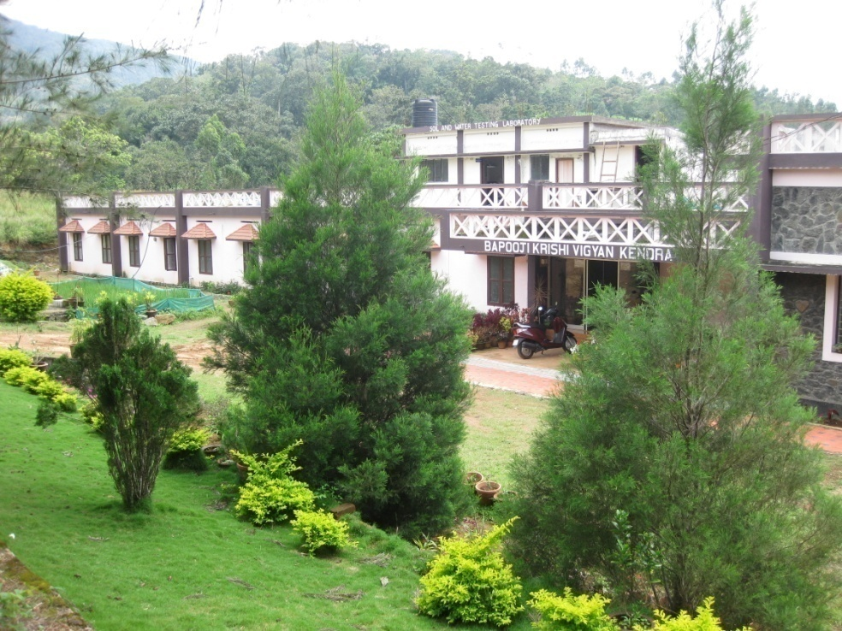
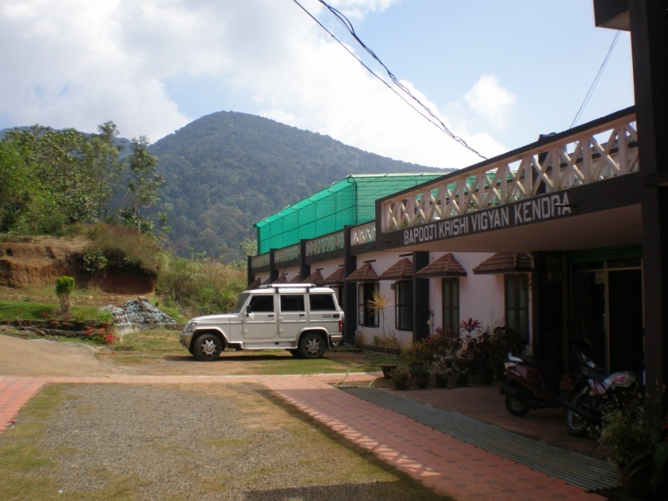
ANNUAL REVIEW MEETING 2015-16
Annual Report (April-2015 to March-2016)
ICAR-Krishi Vigyan Kendra
Santhanpara P. O.
Idukki - Kerala

Slide 2
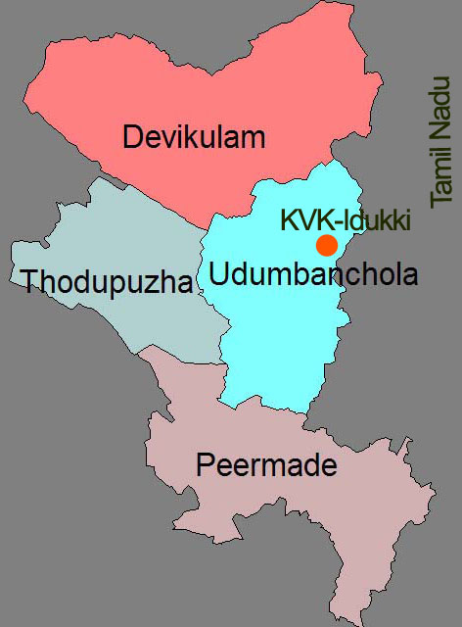
LOCATION & OPERATIONAL AREA
Situated in the mid of Kumily - Munnar state high way and geographically it is in the Cardamom Hill Reserve area of western ghats.
Point of elevation :1400 metres above MSL
Longitude : 77⁰ 10’ E
Latitude : 9⁰ 8’ N
Panchayats
Santhanpara, Rajakad, Rajakumari,
Udumbanchola, Senapathy, Nedumkandam,
Adimali, Vellathooval, Konnathady,
Vattavada, Marayoor, Chinnakkanal,
Upputhara, Karunapuram, Kanchiyar,
Pallivasal, Thodupuzha, Idavetti,
Chakkupallom & Vandanmedu.
ANNUAL REPORT 2015-16
ICAR-Krishi Vigyan Kendra, BSS, Idukki

Slide 3
Dr. Binu John Sam (SMS – Horticulture & PC i/c)
Dr. S. Jayababu (SMS – Animal Science)
Ms. Manju Jincy Varghese (SMS – Soil Science)
Dr. Benjamin Mathew (SMS – Agri. Extension)
Mr. Sudhakar Soundarajan (SMS – Plant Protection)
Ms. Jayisy Joseph (Programme Assistant – Home Science)
Ms. Rachel Skaria (Programme Assistant – Rural Craft)
Mr. Biju Narayanan (Programme Assistant – Computer)
VACANT POSTS (recruitment progressing)
Programme Coordinator
Subject Matter Specialist - Agronomy
ANNUAL REPORT 2015-16
ICAR-Krishi Vigyan Kendra, BSS, Idukki

Slide 4
Thrust Areas
Integrated Nutrient Management in major crops
IPDM in major Plantation and Vegetable crops
Integrated Sustainable Farming System models
Organic farming
Scientific management of livestock and poultry
Improvement in reproductive efficiency in dairy cattle
Feed and Nutrient Management in livestock
Value addition of under utilized crops
ANNUAL REPORT 2015-16
ICAR-Krishi Vigyan Kendra, BSS, Idukki

Slide 5
OFT
Approved | Achievement
7 | 7
ANNUAL REPORT 2015-16
ICAR-Krishi Vigyan Kendra, BSS, Idukki

Slide 6
LIST OF APPROVED OFTs for 2015-16
Sl. No. | Title of On Farm Testing | Amount Sanctioned (Rs)
1 | Assessment of suitable black pepper foot rot (quick wilt) resistant variety for Idukki district (On going). | 7,200.00
2 | Preparation of cropping calendar with two types of mushrooms for year round production in Idukki district | 18,120.00
3 | Management of snails & slugs in cardamom plantation | 12,250.00
4 | Assessment of suitable varieties of broccoli (Brassica oleracea var. italica) for high ranges | 8,000.00
5 | Management practices for secondary & micronutrient disorders for tapioca in acid soils | 2,250.00
6 | Assessment of suitable carrot varieties for Idukki district | 6,750.00
7 | Management of lodging / breaking of banana pseudostem nearing maturity | 43,750.00
 | TOTAL | 98,320.00

Slide 7
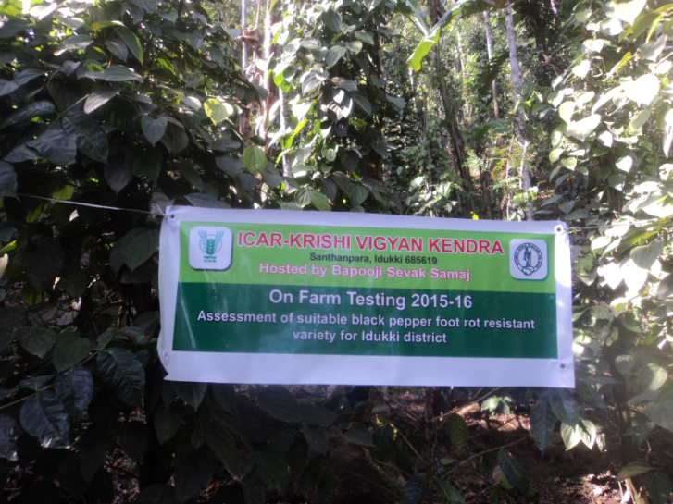
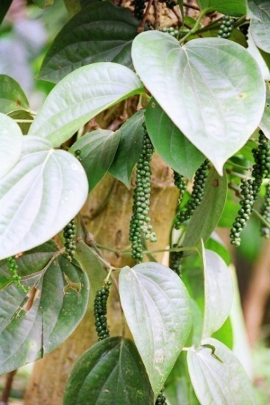
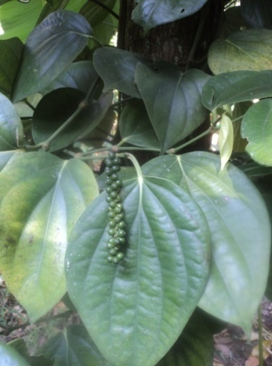
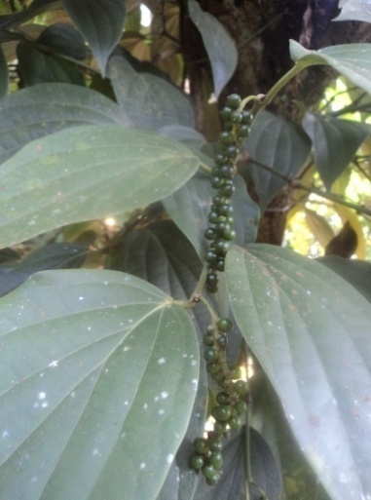
ANNUAL REPORT 2014-15
OFT-1 | Assessment of suitable black pepper foot rot (quick wilt) resistant variety for Idukki district
Problem Identified | Existing varieties are highly susceptible to quick wilt Heavy dosage of fungicides is applied for the control of quick wilt
Name of Village/Trial | Santhanpara / 5
Critical inputs supplied | Azospirillum Phosphobacteria VAM Trichoderma Pseudomonas
IISR-THEVAM
ASWATHI
SUVARNA
ANNUAL REPORT 2015-16
ICAR-Krishi Vigyan Kendra, BSS, Idukki

Slide 8
Details of Technology | T1 - Released variety – IISR-Thevam T2 - E variety 1 – Ashwathi T3 - E variety 2 – Suvarna
Status | Ongoing
ANNUAL REPORT 2014-15
Parameters observed | FP- Chengannoor | IISR-Thevam | Aswathi | Suvarna
Age of plant | 32 months | 32 months | 32 months | 32 months
% quick wilt incidence | 45% | 4% | 9% | 14%
Height of the vine | 1.7 m | 2.7 m | 2.34 m | 2.0 m
Yield | Testing to be continued one more year for concluding the yield and BCR.
BCR
Feedback | IISR-Thevam is showing least percentage of quick wilt disease incidence compared to farmer developed varieties and check
ANNUAL REPORT 2015-16
ICAR-Krishi Vigyan Kendra, BSS, Idukki

Slide 9
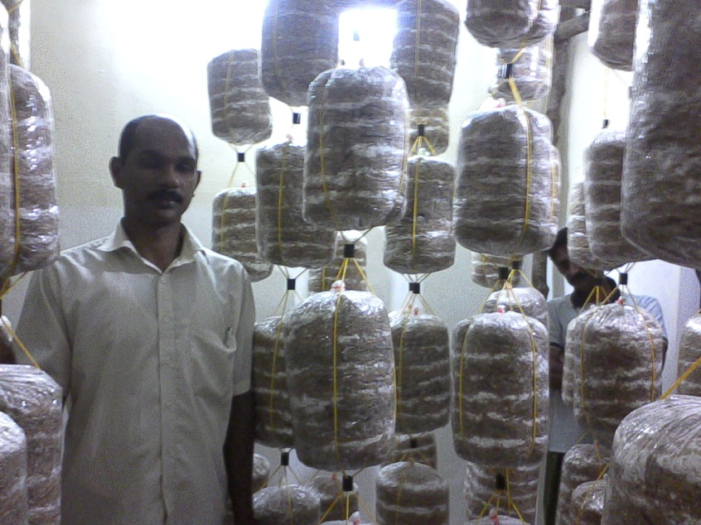
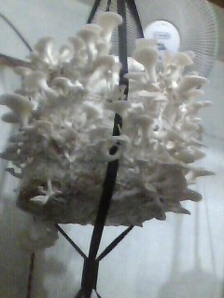
ANNUAL REPORT 2014-15
OFT-2 | Preparation of cropping calendar with two types of mushrooms for year round production in Idukki district
Problem Identified | Large demand & inadequate supply
Name of Village/Trial | Kavunthy / 4
Critical inputs supplied | Paddy straw Spawn Bed covers Casing Materials
ANNUAL REPORT 2015-16
ICAR-Krishi Vigyan Kendra, BSS, Idukki

Slide 10
Details of Technology | T1 – Oyster Mushroom T2 – Milky Mushroom
Status | Ongoing
ANNUAL REPORT 2014-15
RESULT
PARAMETERS |  | T-1 | T-2
Average yield per bed (till date average) |  | 0.84 |  | 0
BCR |  |  |  | -
Feedback | Oyster Mushroom yielding good in the months from October till March, Milky Mushroom beds have been prepared in March. Shall be over by September 2016
ANNUAL REPORT 2015-16
ICAR-Krishi Vigyan Kendra, BSS, Idukki

Slide 11
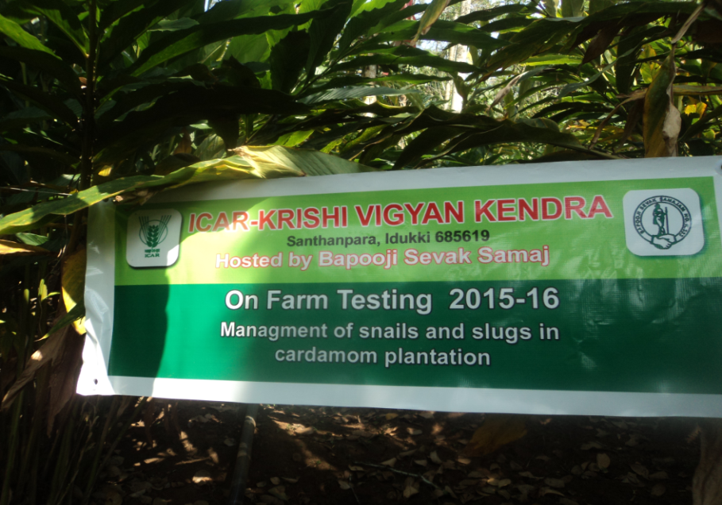
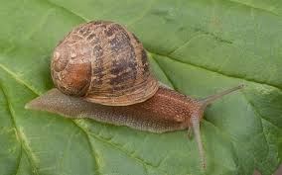
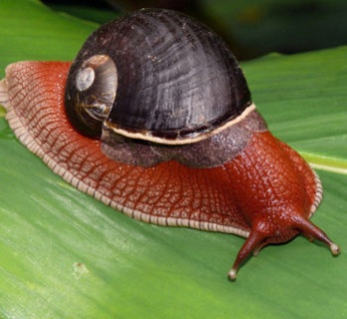
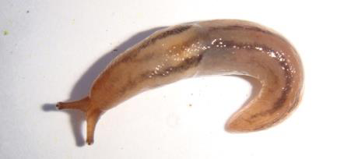
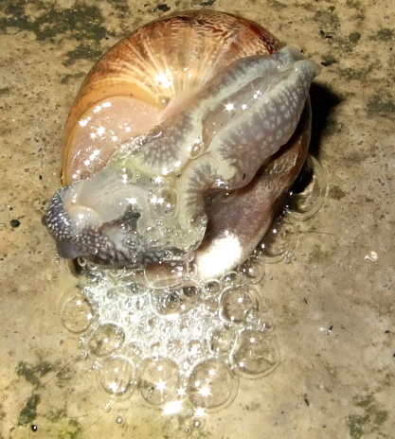
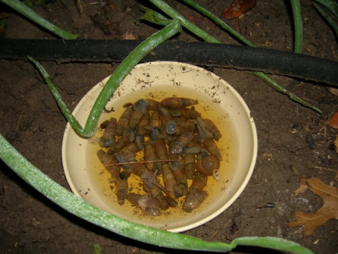
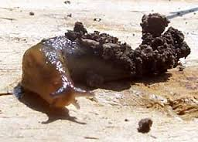
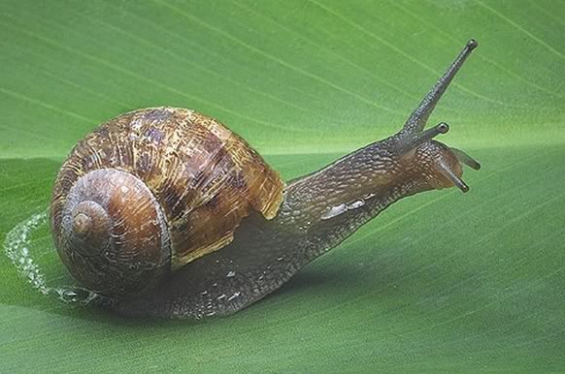
ANNUAL REPORT 2014-15
OFT-3 | Management of snails & slugs in cardamom plantation
Problem Identified | Snails and slugs damaged capsules leading to considerable economic loss
Name of Village/Trial | Pampadumpara / 5
Critical inputs supplied | Vinegar Coffee powder Yeast Honey
ANNUAL REPORT 2015-16
ICAR-Krishi Vigyan Kendra, BSS, Idukki

Slide 12
Details of Technology | T1 - Use of chemicals as directed by pesticide retail shops T2 - Spray of Vinegar @ 10ml / litre T3 - Spray of Coffee powder @ 10g / litre T4 - Yeast & Honey Mixture @ (100g:100ml) / litre (as trap)
Status | Completed
ANNUAL REPORT 2014-15
RESULT
PARAMETERS |  | T-1 | T-2 | T-3 | T-4
Reduction in snail & slug population at 60 days after treatment % |  | 39 | 96 | 77 | 41
BCR |  | 1.60 | 2.07 | 1.93 | 1.72
Feedback | Foliar spray of vinegar @ 10 ml/L of water effectively managed snails and slugs in cardamom field
ANNUAL REPORT 2015-16
ICAR-Krishi Vigyan Kendra, BSS, Idukki

Slide 13
ANNUAL REPORT 2014-15
OFT-4 | Assessment of suitable varieties of Broccoli (Brassica oleracea var. italica) for high ranges
Problem Identified | Low crop diversification
Name of Village/Trial | Rajakumari / 5
Critical inputs supplied | Seeds Bio-agents
ANNUAL REPORT 2015-16
ICAR-Krishi Vigyan Kendra, BSS, Idukki

Slide 14
Details of Technology | T1 - Palam Samirdhi T2 - F1 Green Magic
Status | Harvested
ANNUAL REPORT 2014-15
RESULT
PARAMETERS |  | T-1 | T-2 | Remarks
Average days to harvesting the head (days) |  | 67.8 | 66.4
Average weight of head (g) |  | 230 | 303.2
Average yield (t/acre) |  | 2.88 | 3.79
Feedback | Polyhouse and rain shelter cultivation of broccoli is suggested
ANNUAL REPORT 2015-16
ICAR-Krishi Vigyan Kendra, BSS, Idukki

Slide 15
ANNUAL REPORT 2014-15
OFT-5 | Management practices for secondary & micronutrient disorders for tapioca in acid soils
Problem Identified | Soil acidity leads to zinc and boron deficiency resulting in low yield
Name of Village/Trial | Valliyathovala/ 5
Critical inputs supplied | Lime Magnesium Sulphate Zinc Sulphate
ANNUAL REPORT 2015-16
ICAR-Krishi Vigyan Kendra, BSS, Idukki

Slide 16
Details of Technology | T1 - Farmers practice T2 - Foliar spray of 0.5% Mg Sulphate + 0.5% Zn Sulphate at 60 & 90 DAP T3 - Soil application of Mg Sulphate @ 20 kg/ha + Zn Sulphate @ 12.5 kg/ha within 2 months of planting
Status | Harvested
ANNUAL REPORT 2014-15
RESULT
PARAMETERS |  | T-1 | T-2 | T-3
Weight of tubers/clump (Kg) |  | 5.2 | 8.1 | 7.0
Yield (t/ha) |  | 20 | 30 | 22
Gross Cost (0.18 ha) |  | 6720 | 7200 | 7200
Gross Return |  | 8400 | 9600 | 9300
Net Return |  | 1680 | 2400 | 2100
BCR |  | 1.25 | 1.33 | 1.30
Feedback | T2 was found effective for managing Mg and Zn deficiency
ANNUAL REPORT 2015-16
ICAR-Krishi Vigyan Kendra, BSS, Idukki

Slide 17
ANNUAL REPORT 2014-15
OFT-6 | Assessment of suitable carrot varieties for Idukki district
Problem Identified | Non availability of high yielding varieties
Name of Village/Trial | Valliyathovala / 5
Critical inputs supplied | Seeds of Pusa Nayanjyothi Seeds of Pusa Rudhira
ANNUAL REPORT 2015-16
ICAR-Krishi Vigyan Kendra, BSS, Idukki

Slide 18
Details of Technology | T1-Farmers practice-Local Variety T2-Pusa Nayanjyothi T3-Pusa Rudhira
Status | Harvested
ANNUAL REPORT 2014-15
RESULT
PARAMETERS |  | T-1 | T-2 | T-3
Weight of tubers/clump (Kg) |  | 580 | 650 | 700
Yield (t/ha) |  | 29 | 32.5 | 35
Gross Cost (0.06 ha) |  | 3900 | 3212 | 3333
Gross Return |  | 5900 | 6100 | 7308
Net Return |  | 2000 | 2888 | 3975
BCR |  | 1.51 | 1.90 | 2.20
Feedback | Pusa Rudhira was found better in yield and weight of tubers
ANNUAL REPORT 2015-16
ICAR-Krishi Vigyan Kendra, BSS, Idukki

Slide 19
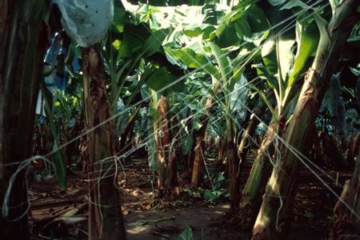
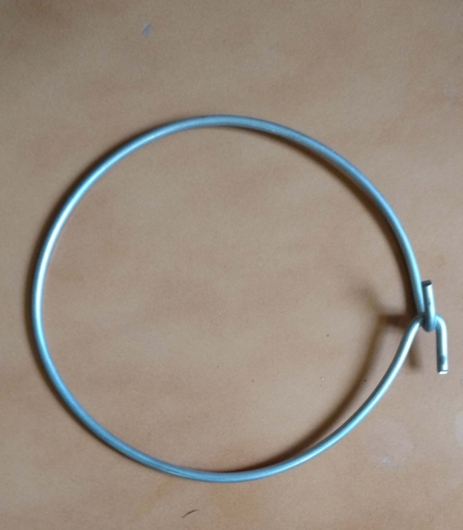
ANNUAL REPORT 2014-15
OFT-7 | Assessment of different props and support for mitigating wind damage in banana (Nendran)
Problem Identified | Lodging of banana plants nearing maturity
Name of Village/Trial | Kavunthy / 5
Critical inputs supplied | Props & Supports Tying Materials Collar ring
ANNUAL REPORT 2015-16
ICAR-Krishi Vigyan Kendra, BSS, Idukki

Slide 20
Details of Technology | T1 – Single propping T2 - Single propping coupled with tying with nylon ropes T3 – Collar ring method
Status | The plants are in the seventh month. Inputs supplied and shall be tried from the ninth month onwards
ANNUAL REPORT 2014-15
RESULT
PARAMETERS |  | T-1 | T-2 | T-3
Extent of wind damage
BCR
Feedback | Wind damage is commonly seen during the months of June-December
ANNUAL REPORT 2015-16
ICAR-Krishi Vigyan Kendra, BSS, Idukki

Slide 21
FLD
Approved | Achievement
12 | 12
ANNUAL REPORT 2015-16
ICAR-Krishi Vigyan Kendra, BSS, Idukki

Slide 22
LIST OF FLDs for 2015-16
Sl. No. | Title of Front Line Demonstration | Amount Sanctioned (Rs)
1 | Management of cardamom root grub with Entomopathogenic Nematodes (EPN) | 24,000.00
2 | INM in cardamom | 11,400.00
3 | Integrated Pest and Disease Management (IPDM) in bitter gourd | 15,050.00
4 | Demonstration of IIHR vegetable special in cowpea var. Arka Mangala | 17,500.00
5 | Column method for production of quality planting materials in black pepper | 29,700.00
6 | Demonstration of IISR nutrient mix in black pepper | 5,500.00
7 | Popularization of organic kitchen garden in homesteads for nutritional security | 6,500.00
8 | Utilization of Spent Mushroom Compost (SMC) as a medium for vegetable production in grow bags | 7,750.00
9 | Demonstration of Ivermectin injection for control of ecto-endo parasitic infestation in dairy cattle | 7,500.00
10 | Popularization of fodder cafeteria in rural households of Idukki district | 7,800.00
11 | Prophylactic management of Newcastle disease (Ranikhet) in poultry using oral pellet vaccine | 5,980.00
12 | Demonstration of Arka Microbial Consortium enriched Coco peat for protray vegetable nursery | 8,000.00
 | TOTAL | 1,46,680.00

Slide 23
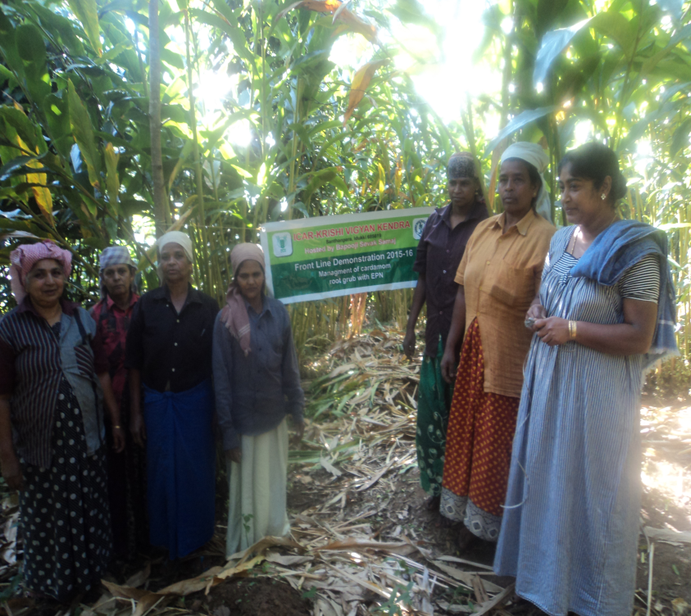
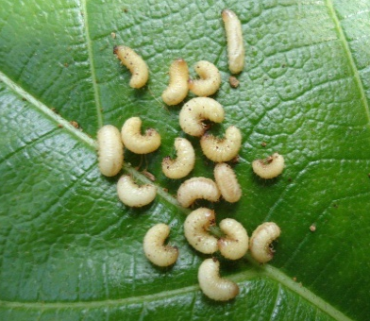
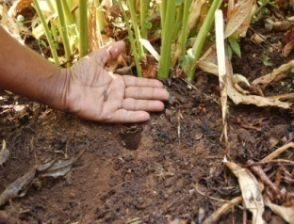
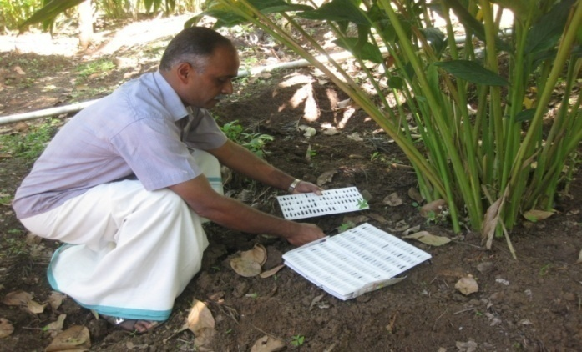
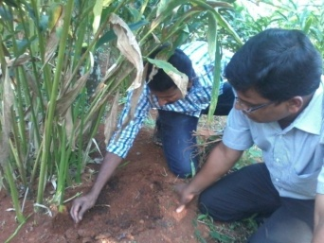
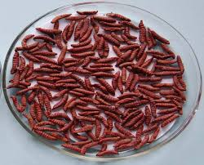
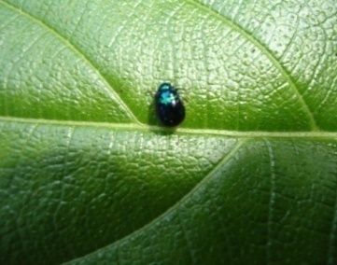
FLD-1 | Management of cardamom root grub with (EPN)
ANNUAL REPORT 2014-15
Thematic area | IPM
Name of Village/ Demo | Pampadumpara /10
Critical inputs supplied | EPN
Recommendation
Soil application of EPN @ 4 cadavers/plant
ANNUAL REPORT 2015-16
ICAR-Krishi Vigyan Kendra, BSS, Idukki

Slide 24
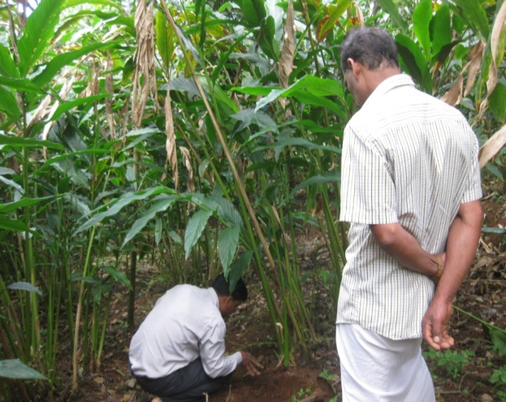
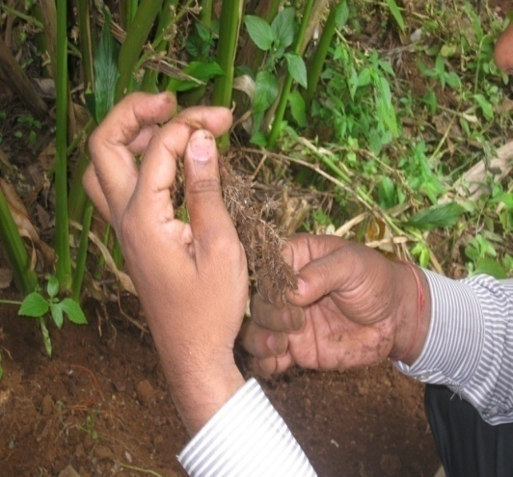
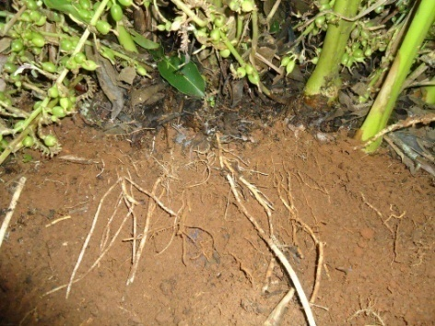
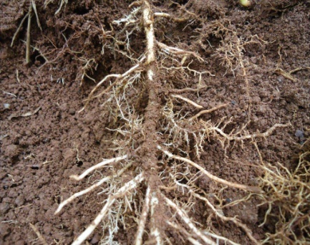
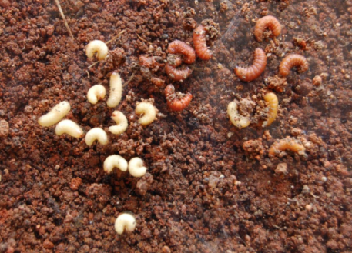
RESULT
PARAMETERS | Demo | Check
% reduction in root grub attack | 98 | 22
Gross cost | 358000 | 310000
Gross Return | 776000 | 488000
BCR | 2.16 | 1.57
ANNUAL REPORT 2015-16
ICAR-Krishi Vigyan Kendra, BSS, Idukki

Slide 25
FLD-2 | Integrated nutrient management in cardamom
ANNUAL REPORT 2014-15
Thematic area | Crop improvement
Name of Village/ Demo | Valliyathovala / 10
Critical inputs supplied | Lime Neem Cake 19:19:19 Azospirillum VAM CAN
Recommendation
Soil test based fertilizer recommendation along with organic manures
ANNUAL REPORT 2015-16
ICAR-Krishi Vigyan Kendra, BSS, Idukki

Slide 26
RESULT
PARAMETERS | Demo |  | Check
Yield (q/ha) | 10 |  | 8
Gross Cost 250000 |  |  | 21800
Gross Return 653600 |  |  | 414200
Net Return 403600 |  |  | 196200
BCR |  | 2.60 | 1.90
ANNUAL REPORT 2015-16
ICAR-Krishi Vigyan Kendra, BSS, Idukki

Slide 27
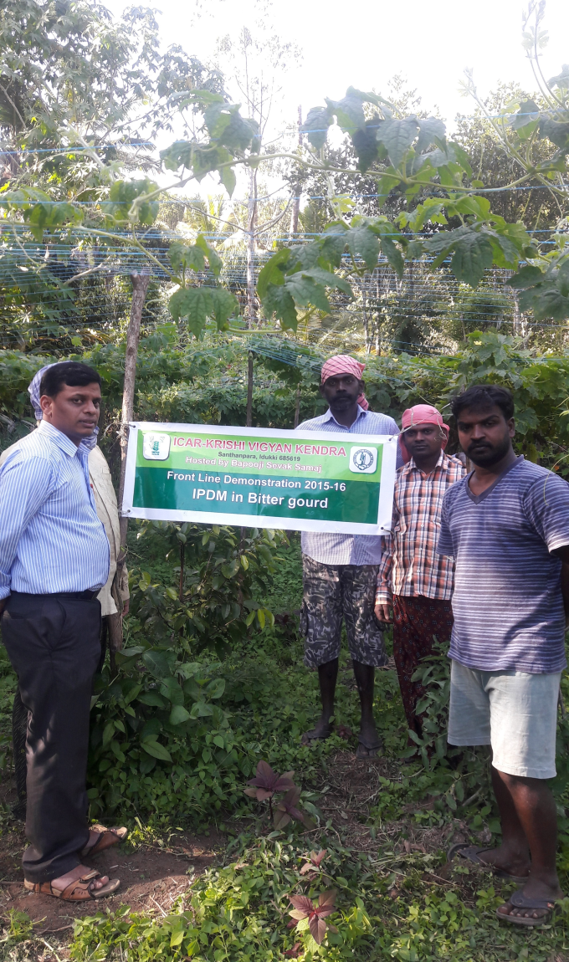
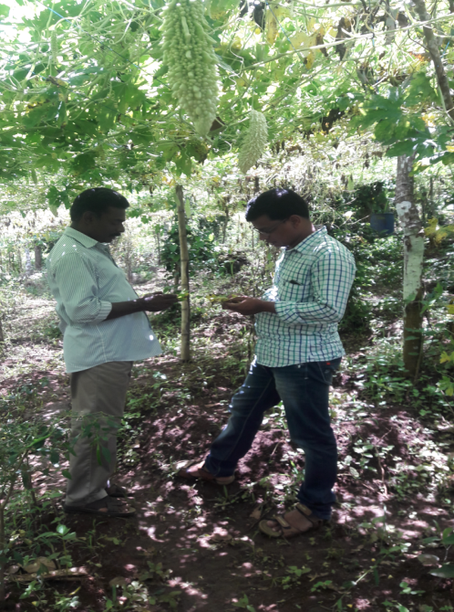
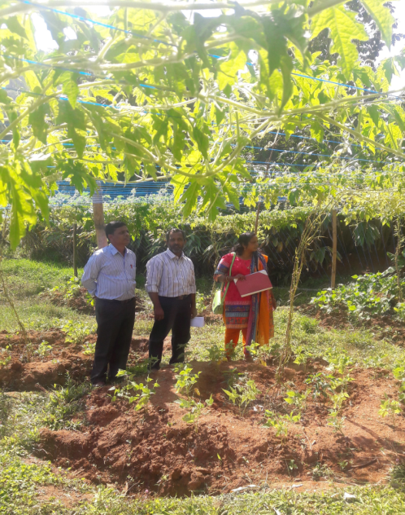
FLD-3 | Integrated Pest and Disease Management (IPDM) in Bitter gourd
ANNUAL REPORT 2014-15
Thematic area | IPDM
Name of Village/ Demo | Pampadumpara /10
Critical inputs supplied | Trichoderma IIHR Neem soap Cuelure trap Indoxacarb Imdachlopride Mancozeb & Zineb
ANNUAL REPORT 2015-16
ICAR-Krishi Vigyan Kendra, BSS, Idukki

Slide 28
Recommendation
Seed treatment with Trichoderma harzianum @ 5g/kg of seeds Apply Trichoderma enriched with FYM @ 1kg in 100kg of FYM Application of neem cake 250 kg/ha Placement of Cuelure traps @ 4 traps/acre Foliar spray of IIHR Neem soap @ 10g/ litre ETL based application of Indoxacarb @ 0.5 ml/litre, Imidachloprid @ 0.5ml/litre Mancozeb @ 2g/litre, Zineb @ 2g/litre
RESULT
PARAMETERS | Demo | Check
% reduction in pest and disease | 85 | 35
Gross cost | 240000 | 210000
Gross Return | 375000 | 290000
BCR | 1.56 | 1.38
ANNUAL REPORT 2015-16
ICAR-Krishi Vigyan Kendra, BSS, Idukki

Slide 29
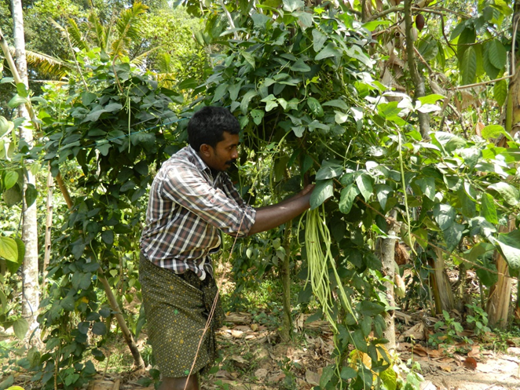
ANNUAL REPORT 2014-15
FLD-4 | Demonstration of IIHR vegetable special in cowpea var. Arka Mangala.
Thematic area | Crop improvement
Name of Village/ Demo | Chemmanar, Rajakumari,Konnathady / 10
Critical inputs supplied | IIHR Veg. special Seeds-Arka Mangala
Bapooji Krishi Vigyan Kendra - Idukki

Slide 30
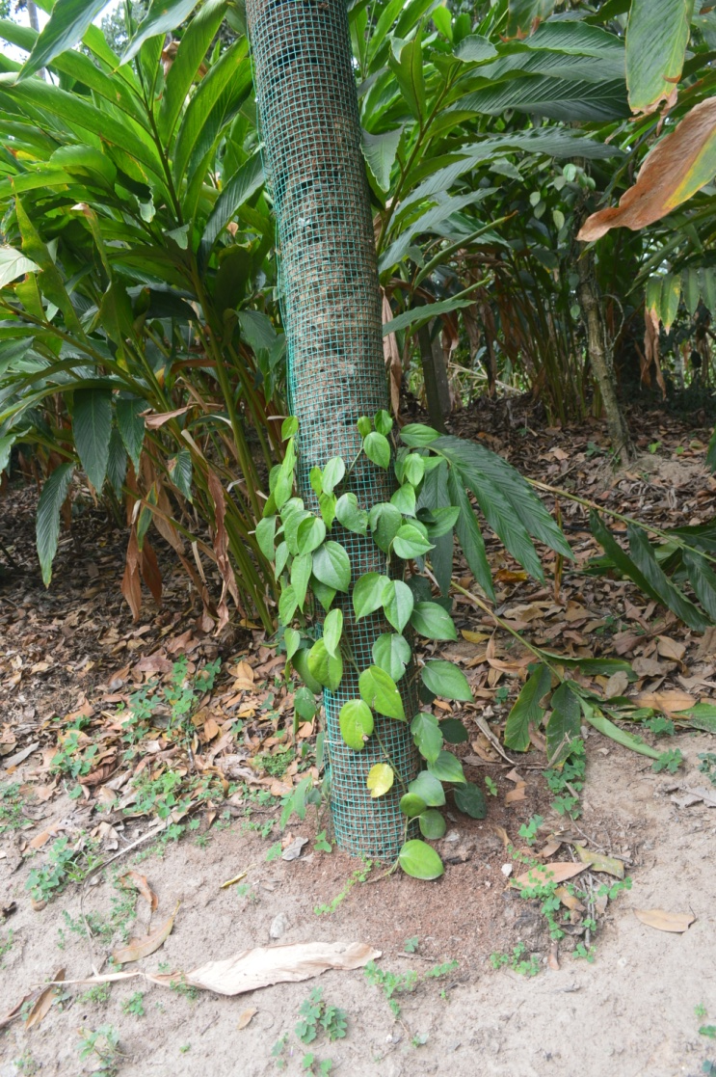
ANNUAL REPORT 2014-15
FLD-5 | Column Method for production of quality planting materials in Black Pepper
Thematic area | Integrated Pest Management
Name of Village/ Demo | Udumbanchola /3
Critical inputs supplied | Poles Mesh Compost Rooted Pepper cuttings irrigation lines
Recommendation
Ongoing. Started in February 2016 only.
ANNUAL REPORT 2015-16
ICAR-Krishi Vigyan Kendra, BSS, Idukki

Slide 31
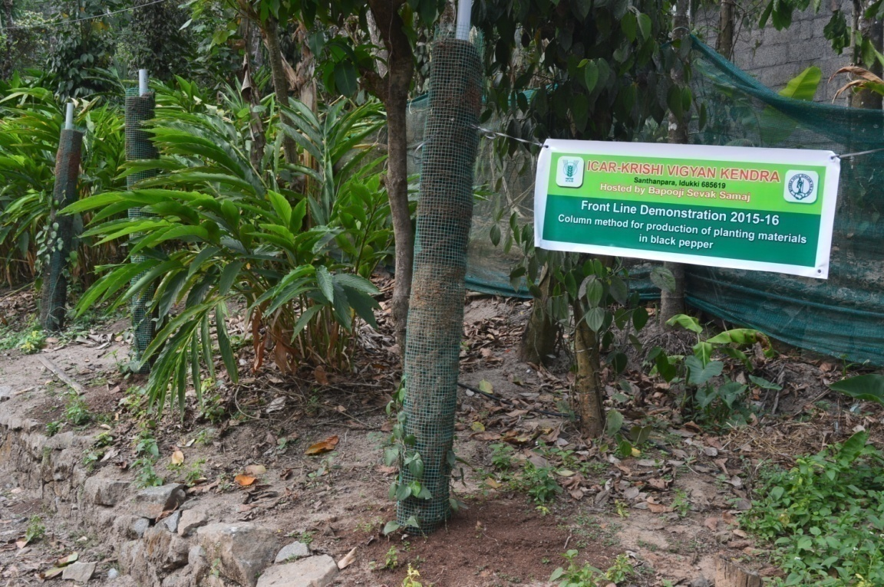
RESULT
PARAMETERS | Demo | Check
Visual stand of the crop | More robust and green | Normal growth
Number of cuttings per vine
ANNUAL REPORT 2015-16
ICAR-Krishi Vigyan Kendra, BSS, Idukki

Slide 32
ANNUAL REPORT 2014-15
FLD-6 | Demonstration of IISR Nutrient mix in Black Pepper
Thematic area | Crop improvement
Name of Village/ Demo | Santhanpara, Rajakumari / 10
Critical inputs supplied | IISR micro mix Hand sprayer
Recommendation
POP + two sprays of IISR Black Pepper Micronutrient mix (5g/l)
ANNUAL REPORT 2015-16
ICAR-Krishi Vigyan Kendra, BSS, Idukki

Slide 33
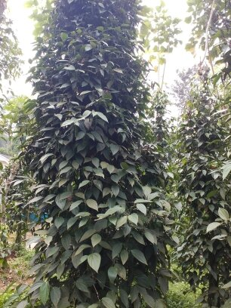
RESULT
PARAMETERS | Demo | Check
Yield (Quintal per acre) | 12.37 | 15.44
BCR | 1.12 | 1.13
ANNUAL REPORT 2015-16
ICAR-Krishi Vigyan Kendra, BSS, Idukki

Slide 34
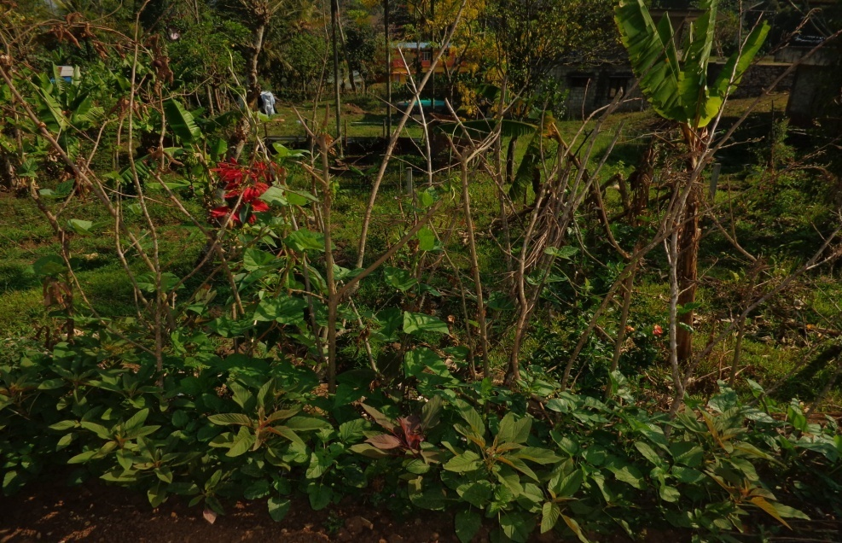
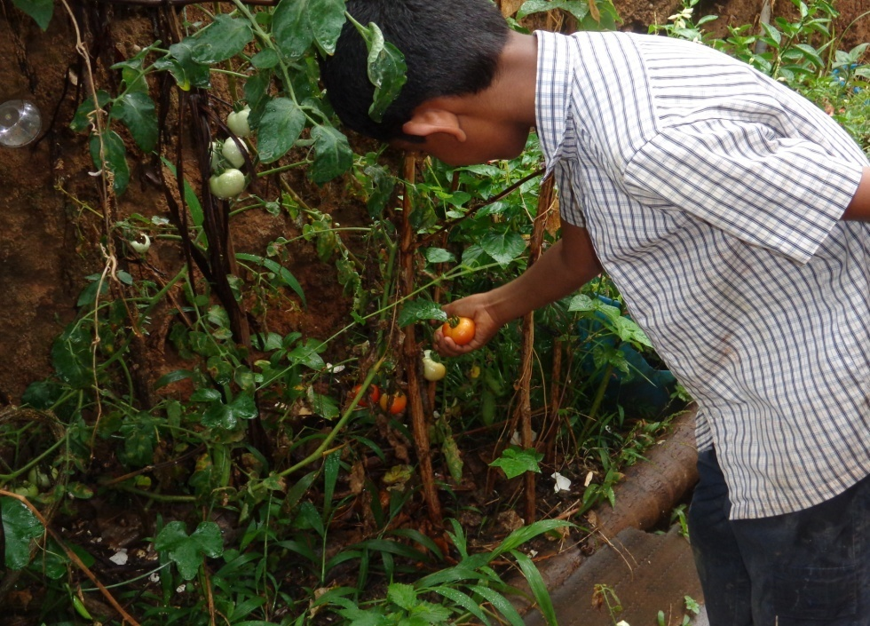
ANNUAL REPORT 2014-15
FLD-7 | Popularization of organic kitchen garden in homesteads for nutritional security
Thematic area | Organic farming
Name of Village/ Demo | Erattayar, Santhanpara / 5
Critical inputs supplied | Seeds, bio-agents
Recommendation
Use of bio-agents in organic farming increase the yield of vegetables in kitchen garden
ANNUAL REPORT 2015-16
ICAR-Krishi Vigyan Kendra, BSS, Idukki

Slide 35
RESULT
PARAMETERS | Demo | Check
BCR | 1.73 | 1.36
ANNUAL REPORT 2015-16
ICAR-Krishi Vigyan Kendra, BSS, Idukki

Slide 36
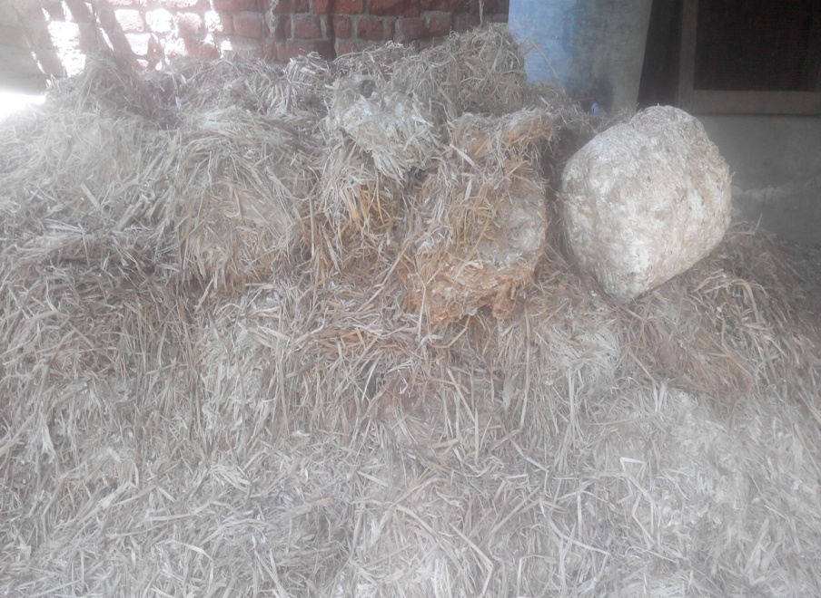
ANNUAL REPORT 2014-15
FLD-8 | Utilization of Spent Mushroom Compost (SMC) as a medium for vegetable production in grow bags
Thematic area | Integrated Pest Management
Name of Village/ Demo | Kavunthy/10
Critical inputs supplied | Seeds Bio-agents Grow-bags
Recommendation
Spent Mushroom Compost along with top soil and organic manure @ 1:1:1 was found to be a good media for vegetable cultivation in grow-bags
Crops grown
Amaranthus, Brinjal, Chilly, Tomato, Cowpea (Kutti), Moringa beans, Carrot, Beetroot, Pudhina, Clove beans, winged Beans
ANNUAL REPORT 2015-16
ICAR-Krishi Vigyan Kendra, BSS, Idukki

Slide 37
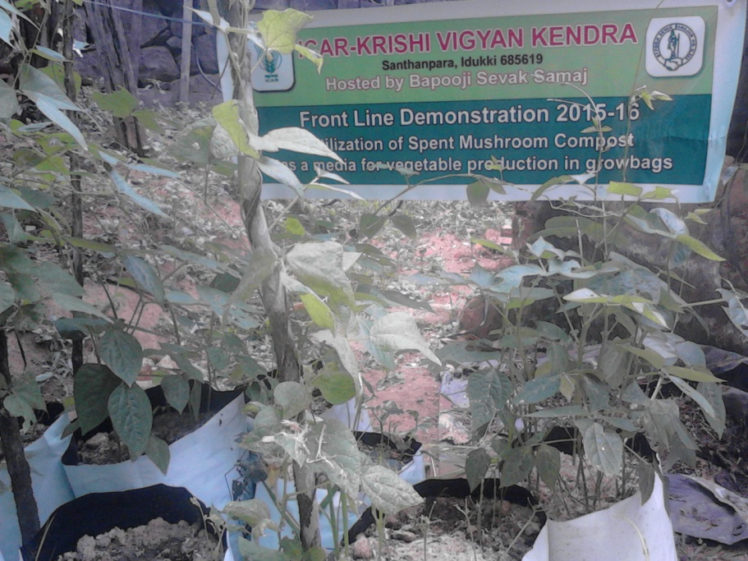
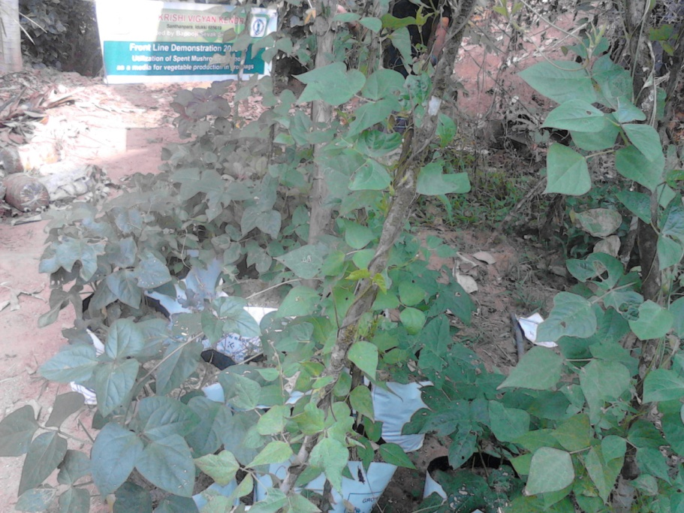
RESULT
PARAMETERS | Demo | Check
Visual Stand of the crop | Very good | Good
Yield | 172kg/50 bags | 144kg/50 bags
ANNUAL REPORT 2015-16
ICAR-Krishi Vigyan Kendra, BSS, Idukki

Slide 38
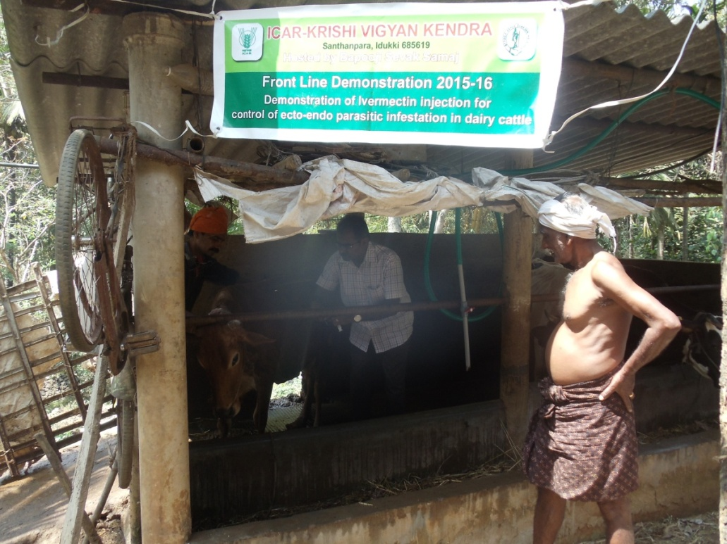
ANNUAL REPORT 2014-15
FLD-9 | Demonstration of Inj. Ivermectin for control of Ecto-Endo parasitic infestation in dairy cattle
Thematic area | Disease Management
Name of Village/ Demo | Nedumkandam / 10
Critical inputs supplied | Inj. Ivermectin
Recommendation
Subcutaneous Injection of Ivermectin is recommended for control of Ecto-Endo Parasitic infestation to improve body growth performance as well as milk production
RESULT
PARAMETERS | Check | Demo
Quantity of Milk Production Increase in body weight (%) | 713 L 20.4 | 903 L 5.0
BCR | 1.66 | 1.90
ANNUAL REPORT 2015-16
ICAR-Krishi Vigyan Kendra, BSS, Idukki

Slide 39
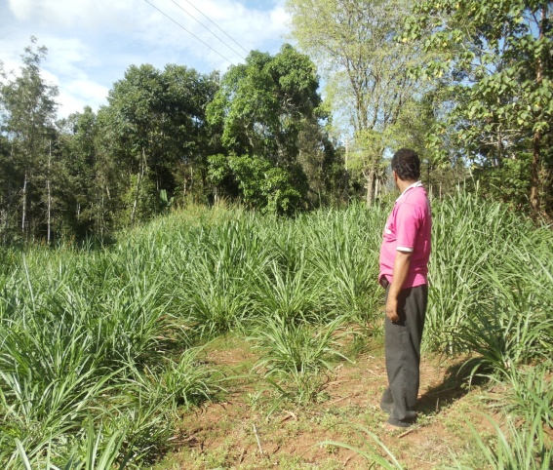
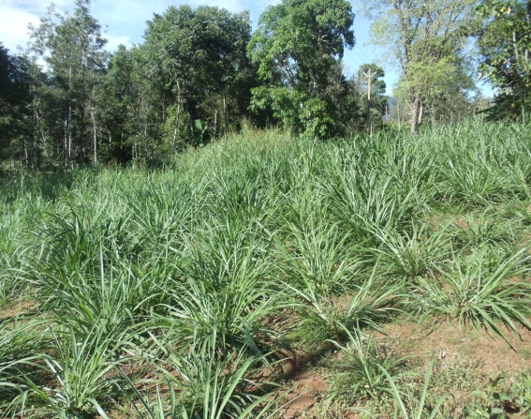
FLD-10 | Popularization of Fodder Cafeteria in rural households of Idukki district
Thematic area | Animal nutrition and production management
Name of Village/ Demo | Nedumkandam / 10
Critical inputs supplied | Seeds of COFS 29 Seeds of Desmanthus Seeds of Agathi Seeds of Subabul Seeds of Anjan grass Seeds of Stylosanthes
Recommendation
Create awareness among farmers about mixed fodder system
ANNUAL REPORT 2015-16
ICAR-Krishi Vigyan Kendra, BSS, Idukki

Slide 40
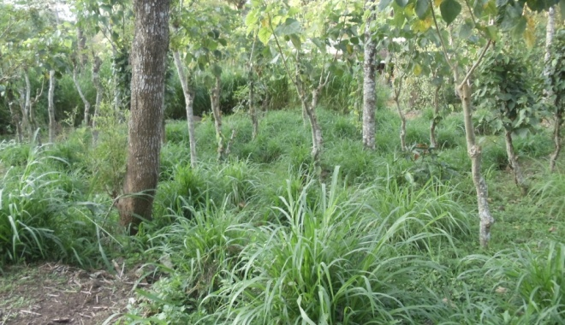
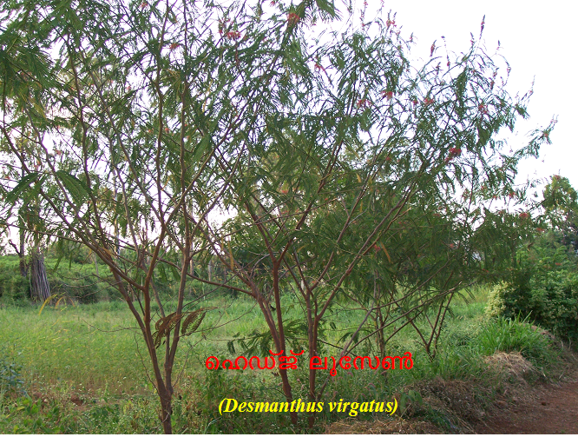
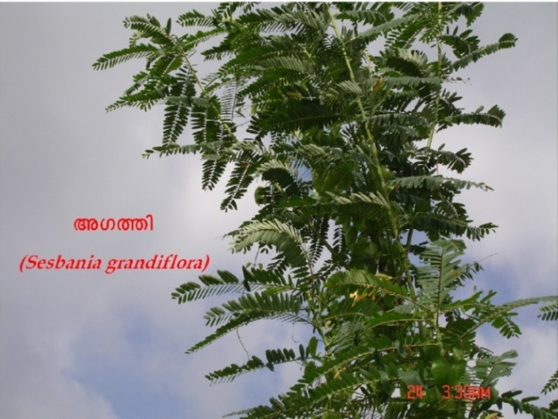
RESULT
PARAMETERS | Check | Demo
Quantity of milk production | 698 L | 860 L
BCR | 1.63 | 2.23
ANNUAL REPORT 2015-16
ICAR-Krishi Vigyan Kendra, BSS, Idukki

Slide 41
ANNUAL REPORT 2014-15
FLD-11 | Prophylactic management of Newcastle disease (Ranikhet) in poultry using oral pellet vaccine
Thematic area | Animal nutrition and production management
Name of Village/ Demo | Nedumkandam /20
Critical inputs supplied | Newcastle Disease oral pellet vaccine Anti stress medicines
Recommendation
Create awareness among farmers about new scientific Technologies for prevention & control of Poultry diseases. Highly effective to overcome poultry diseases and improve financial status
RESULT
PARAMETERS | Check | Demo
Mortality rate (%) | 5 | 0
Eggs Production in Nos | 370 | 530
BCR | 1.47 | 1.70
ANNUAL REPORT 2015-16
ICAR-Krishi Vigyan Kendra, BSS, Idukki

Slide 42
ANNUAL REPORT 2014-15
FLD-12 | Demonstration of Arka Microbial consortium enriched coco peat for protray vegetable nursery
Thematic area | Crop improvement
Name of Village/ Demo | Erattayar, Rajakumari / 5
Critical inputs supplied | Arka microbial consortium Protrays Vermiculite Perlite Coco peat
Recommendation
Coco peat enriched with Arka microbial consortium as protray media for vegetable nursery.
ANNUAL REPORT 2015-16
ICAR-Krishi Vigyan Kendra, BSS, Idukki

Slide 43
RESULT
PARAMETERS | Demo | Check
Germination percentage (%) | 82.8 | 93.63
Average seedling height during transplanting (cm) | 12.7 | 19.75
Average days for transplanting (days) | 24.15 | 18.23
ANNUAL REPORT 2015-16
ICAR-Krishi Vigyan Kendra, BSS, Idukki

Slide 44
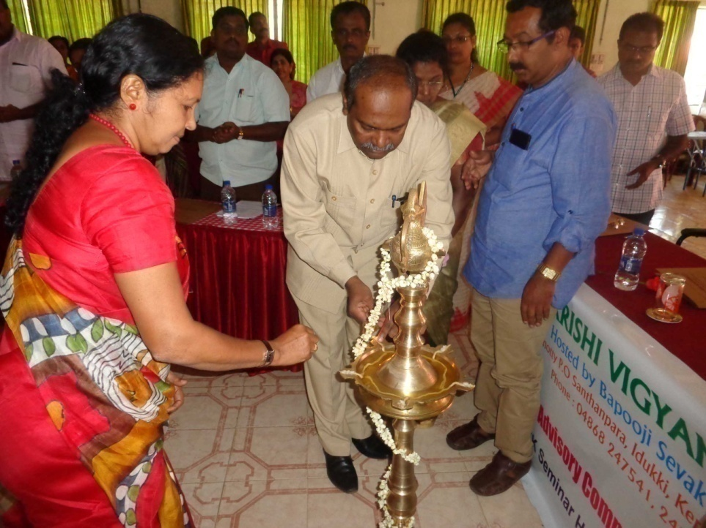
SAC MEETING
18th January, 2016
ANNUAL REPORT 2015-16
ICAR-Krishi Vigyan Kendra, BSS, Idukki

Slide 45
Newsletter released
ANNUAL REPORT 2015-16
ICAR-Krishi Vigyan Kendra, BSS, Idukki

Slide 46
Leaflets / booklets published
ANNUAL REPORT 2015-16
ICAR-Krishi Vigyan Kendra, BSS, Idukki

Slide 47
Bio-Hub

Slide 48
Leaflets published
BIO-HUB
Sponsored by Kerala State Planning Board

Slide 49
TECHNO POSHAN 2016 (Technology Week Celebration 19th – 22nd January, 2016)
1st Day inauguration by Panchayat President Smt. Jisha
2nd Day inauguration by Hon. MLA Shri. K.K. Jayachandran
MLA visiting KVK Stall
Bio-hub inauguration and visit by Hon. MLA Shri. K.K. Jayachandran
Technical Session
Presidential address by KVK Chairperson Smt. Deenamma
ANNUAL REPORT 2015-16
ICAR-Krishi Vigyan Kendra, BSS, Idukki

Slide 50
WORLD SOIL DAY CELEBRATION
5th December, 2015
ANNUAL REPORT 2015-16
ICAR-Krishi Vigyan Kendra, BSS, Idukki

Slide 51
Sponsored by Dept. of Agriculture
SDP-FARM BASED LOW COST MASS PRODUCTION TECHNOLOGY OF BIO-PESTICIDES
ANNUAL REPORT 2015-16
ICAR-Krishi Vigyan Kendra, BSS, Idukki

Slide 52
ANNUAL REPORT 2015-16
ICAR-Krishi Vigyan Kendra, BSS, Idukki

Slide 53
ANNUAL REPORT 2015-16
ICAR-Krishi Vigyan Kendra, BSS, Idukki

Slide 54
Seminar on IPDM in cardamom
ANNUAL REPORT 2015-16
ICAR-Krishi Vigyan Kendra, BSS, Idukki

Slide 55
Technical Convergence Sessions
LINKAGES
ATMA - Monthly Technology Advisory Meetings
ANNUAL REPORT 2015-16
ICAR-Krishi Vigyan Kendra, BSS, Idukki

Slide 56
Diagnostic visits
ANNUAL REPORT 2015-16
ICAR-Krishi Vigyan Kendra, BSS, Idukki

Slide 57
Diagnostic visits
ANNUAL REPORT 2015-16
ICAR-Krishi Vigyan Kendra, BSS, Idukki

Slide 58
Block level training to Extension Personals
ANNUAL REPORT 2015-16
ICAR-Krishi Vigyan Kendra, BSS, Idukki

Slide 59
On campus Training Programmes
ANNUAL REPORT 2015-16
ICAR-Krishi Vigyan Kendra, BSS, Idukki

Slide 60
On campus Training Programmes
ANNUAL REPORT 2015-16
ICAR-Krishi Vigyan Kendra, BSS, Idukki

Slide 61
Off campus Training Programmes
ANNUAL REPORT 2015-16
ICAR-Krishi Vigyan Kendra, BSS, Idukki

Slide 62
Off campus Training Programmes
ANNUAL REPORT 2015-16
ICAR-Krishi Vigyan Kendra, BSS, Idukki

Slide 63
VOCATIONAL TRAINING
ANNUAL REPORT 2015-16
ICAR-Krishi Vigyan Kendra, BSS, Idukki

Slide 64
OJT Programme for VHSE Students (3 Schools)
ANNUAL REPORT 2015-16
ICAR-Krishi Vigyan Kendra, BSS, Idukki

Slide 65
TRAINING PROGRAMME ACHIEVEMENT
Trainings | No. of course | Participants |  |  |  | Total
 |  | Others |  | SC/ST
 |  | Male | Female | Male | Female
Farmers | 102 | 2168 | 1361 | 133 | 121 | 3783
Rural youth | 11 | 61 | 144 | 10 | 9 | 224
Extension personnel | 3 | 18 | 36 | 0 | 0 | 54
Sponsored | 28 | 211 | 231 | 30 | 12 | 484
Vocational | 5 | 52 | 83 | 4 | 9 | 148
TOTAL | 149 | 2510 | 1855 | 177 | 151 | 4693
ANNUAL REPORT 2015-16
ICAR-Krishi Vigyan Kendra, BSS, Idukki

Slide 66
Other Extension Programmes
Sl. No. | Activities | No. of Programmes
1 | Field day | 05
2 | Advisory Services | 361
3 | Diagnostic visits | 17
4 | Exhibition | 01
5 | Scientist’s visit to farmers field | 46
6 | Technology week celebrations (5 days) | 01
7 | Farmer’s seminar/workshop | 03
8 | Brochures | 04
9 | Farmers visit to KVK | (211)
10 | Special day celebration (World Food Day) | 01
11 | Exposure visits | 01
12 | News paper coverage | 05
13 | Radio Talks | 02
14 | Ex trainee sammelan | 02
TOTAL |  | 449
ANNUAL REPORT 2015-16
ICAR-Krishi Vigyan Kendra, BSS, Idukki

Slide 67
NEWS PAPER COVERAGE
ANNUAL REPORT 2015-16
ICAR-Krishi Vigyan Kendra, BSS, Idukki

Slide 68
NEWS PAPER COVERAGE
ANNUAL REPORT 2015-16
ICAR-Krishi Vigyan Kendra, BSS, Idukki

Slide 69
PARTICIPATION IN EXHIBITION – ATMA AGRITECH 2015
ANNUAL REPORT 2015-16
ICAR-Krishi Vigyan Kendra, BSS, Idukki

Slide 70
PARTICIPATION IN EXHIBITION – RAJAKKAD FEST
ANNUAL REPORT 2015-16
ICAR-Krishi Vigyan Kendra, BSS, Idukki

Slide 71
Jai Kissan Jai Vigyan
ANNUAL REPORT 2015-16
ICAR-Krishi Vigyan Kendra, BSS, Idukki

Slide 72
Special Programme on Skill Development activity for Tribal students
Special Programme on Skill Development activity for NSS Camp
ANNUAL REPORT 2015-16
ICAR-Krishi Vigyan Kendra, BSS, Idukki

Slide 73
Tribal area visit - Potato leaf blight endemic areas
ANNUAL REPORT 2015-16
ICAR-Krishi Vigyan Kendra, BSS, Idukki

Slide 74
Success story: Skill Development Programme sponsored by DIC, Idukki
ANNUAL REPORT 2015-16
ICAR-Krishi Vigyan Kendra, BSS, Idukki

Slide 75
Success story: Skill Development Programme
ANNUAL REPORT 2015-16
ICAR-Krishi Vigyan Kendra, BSS, Idukki

Slide 76
WOMAN FARMER AWARDED
Best Entrepreneur Award by Konnathady Panchayat
Ms. Shybi Sabu
Mushroom Grower, Konnathady
ANNUAL REPORT 2015-16
ICAR-Krishi Vigyan Kendra, BSS, Idukki

Slide 77
SWACHH BHARAT CAMPAIGN
ANNUAL REPORT 2015-16
ICAR-Krishi Vigyan Kendra, BSS, Idukki

Slide 78
Exposure visit
ANNUAL REPORT 2015-16
ICAR-Krishi Vigyan Kendra, BSS, Idukki

Slide 79
Tribal area visit- Potato leaf blight endemic areas

Slide 80
Production and supply of technology products
Bio agent | Quantity | Amount | No of farmers benefitted
Pseudomonas | 2753 | 2,75,300.00 | 376
Trichoderma | 1110 | 1,11,000.00 | 138
Metarhizium | 232 | 23,200.00 | 71
Beauveria | 466 | 46,600.00 | 56
Pheromone trap | 1478 | 2,36,480.00 | 710
FEM | 68 | 6800.00 | 65
Nature plus | 206 | 20600.00 | 104
PK-Plus | 460 | 46000.00 | 220
J-plus | 149 | 14900.00 | 67
 |  | 785880.00 | 1807
ANNUAL REPORT 2015-16
ICAR-Krishi Vigyan Kendra, BSS, Idukki

Slide 81
OTHER SPECIALISED ACTIVITIES
A. Performance of Production Units
Sl. No. | Name of the Product | Quantity | Gross Income (Rs.)
6 | Mushroom Spawn | 5673 Packets | 170190.00
7 | Detergent powder | 78 kg | 3900.00
8 | Liquid soap | 75 L | 1875.00
TOTAL |  |  | 7,44,750.00
ANNUAL REPORT 2015-16
ICAR-Krishi Vigyan Kendra, BSS, Idukki

Slide 82
Black pepper rooted cuttings supplied to farmers
BP | Quantity | Amount | No of farmers benefitted
Karimunda | 11,000 | 1,10,000.00 | 148
Kottandan | 220 | 2640.00 | 10
Panniyoor 1 | 1293 | 12,930.00 | 25
Panniyoor 2 | 6 | 72.00 | 2
Panniyoor 4 | 10 | 1200.00 | 1
Panniyoor 7 | 162 | 1944.00 | 6
Chengannor | 393 | 3930.00 | 7
Thevam & Sakthi | 250 | 3000.00 | 21
Malabar Excel | 112 | 1344.00 | 11
Kumbakkal | 6 | 72.00 | 1
Thekken | 75 | 2250.00 | 4
Total | 16,777 | 1,26,382.00 | 236
ANNUAL REPORT 2015-16
ICAR-Krishi Vigyan Kendra, BSS, Idukki

Slide 83
B. Details of Soil and Water Sample Analysis & Fertilizer Recommendations
Details | No. of Samples Analyzed | No. of Farmers benefited | No. of Villages | Amount realized
Soil samples | 134 | 77 | 40 | 6700.00
Soil campaign | 15 | 15 | 7 | 750.00
TOTAL |  |  |  | 7,450.00
ANNUAL REPORT 2015-16
ICAR-Krishi Vigyan Kendra, BSS, Idukki

Slide 84
Soil Test Campaigns in different panchayats
Rajakumary
Rajakkad
Nedumkandam
Senapathy
Karunapuram
ANNUAL REPORT 2015-16
ICAR-Krishi Vigyan Kendra, BSS, Idukki

Slide 85
Healthy soils for a healthy life
Trainings based on International Soil Year-2015
ANNUAL REPORT 2015-16
ICAR-Krishi Vigyan Kendra, BSS, Idukki

Slide 86
Summary of Externally Aided Projects (From April 2015 till date)
Projects Sanctioned
1. Completed Projects - Rs. 4.010 lakhs
2. On-going Projects - Rs. 15.315 lakhs
3. Sanctioned Projects - Rs. 4.020 lakhs
B. Pipe-Line Projects - Rs. 239.300 lakhs
Total external funds solicited during the year
- Rs. 262.645 lakhs

Slide 87
Vegetable Development Programme-2015-16
Funded by Department of Agriculture
Micro-nutrients Demonstration programme
Nedumkandam Block
Pampadumpara
Nedumkandam
Udumbanchola
Karunapuram
Rajakkad
Rajakumary
Senapathy
ANNUAL REPORT 2015-16
ICAR-Krishi Vigyan Kendra, BSS, Idukki

Slide 88
Diagnostic visits in micronutrient demo project
ANNUAL REPORT 2015-16
ICAR-Krishi Vigyan Kendra, BSS, Idukki

Slide 89
Valedictory Session of Capacity Building Programme for Agro-Service Centre Executives

Slide 90
ANNUAL REPORT 2015-16
ICAR-Krishi Vigyan Kendra, BSS, Idukki

Slide 91
Demonstration Units
Animal Husbandry Unit
STRAWBERRY OPEN END FIELD DEMO
ANNUAL REPORT 2015-16
ICAR-Krishi Vigyan Kendra, BSS, Idukki

Slide 92
Demonstration Units
MIST CHAMBER
RAIN SHELTER
STOREHOUSE CUM POTTING SHED
MUSHROOM HOUSE
ANNUAL REPORT 2015-16
ICAR-Krishi Vigyan Kendra, BSS, Idukki

Slide 93
Demonstration Units
DUCK CUM FISH CULTURE
PEPPER NURSERY
VEGETABLE CULTIVATION
HDP IN BANANA
ANNUAL REPORT 2015-16
ICAR-Krishi Vigyan Kendra, BSS, Idukki

Slide 94
Other Salient Achievements
Farm Mechanization Mushroom Growers Club Popularization of Apiary Involving SHGs in various Self-employment opportunities Established Kitchen Gardens in Rural households Popularization of Moringa cultivation Dissemination of technologies related to sustainable agriculture and allied sectors
ANNUAL REPORT 2015-16
ICAR-Krishi Vigyan Kendra, BSS, Idukki

Slide 95
Utilization of KVK funds during the year 2015-16
Sl. No. | Particulars | Sanctioned | Released | Expenditure
A. Recurring Contingencies
1 | Pay & Allowances | 89.41 |  | 89.41094
2 | Traveling allowances | 0.90 |  | 0.77626
3 | Contingencies
A | Stationery, telephone, postage and other expenditure on office running, publication of Newsletter and library maintenance (Purchase of News Paper & Magazines) | 1.00 |  | 1.00
B | POL, repair of vehicles, tractor and equipments | 1.00 |  | 1.00
C | Meals/refreshment for trainees (ceiling up to Rs.40 /day/trainee be maintained) | 0.25 |  | 0.25
D | Training material (posters, charts, demonstration material including chemicals etc. required for conducting the training) | 0.25 |  | 0.25
E | Frontline demonstration except oilseeds and pulses (minimum of 30 demonstration in a year) | 1.59 |  | 1.59
F | On farm testing (on need based, location specific and newly generated information in the major production systems of the area) | 0.86 |  | 0.86
G | Training of extension functionaries | 0.00 |  | 0.00
H | Maintenance of buildings | 0.00 |  | 0.00
I | Farmer’s Field School | 0.00 |  | 0.00
J | Integrated Farming System | 0.00 |  | 0.00
K | Extension Activities | 0.50 |  | 0.50
L | Library | 0.05 |  | 0.05
TOTAL (A) |  | 95.81 | 95.81 | 95.6872
ANNUAL REPORT 2015-16
ICAR-Krishi Vigyan Kendra, BSS, Idukki

Slide 96
Utilization of KVK funds during the year 2015-16
Sl. No. | Particulars | Sanctioned | Released | Expenditure
B. Non-Recurring Contingencies
1 | Works | 0.00 | 0.00 | 0.00
2 | Equipments including SWTL & Furniture | 0.00 | 0.00 | 0.00
3 | Vehicle (Four wheeler/Two wheeler, please specify) | 0.00 | 0.00 | 0.00
4 | Library (Purchase of assets like books & journals) | 0.00 | 0.00 | 0.00
TOTAL (B) |  | 0.00 | 0.00 | 0.00
C. REVOLVING FUND |  | 0.00 | 0.00 | 0.00
GRAND TOTAL (A+B+C) |  | 95.81 | 95.81 | 95.6872
ANNUAL REPORT 2015-16
ICAR-Krishi Vigyan Kendra, BSS, Idukki

Slide 97
Status of Revolving Fund (Rs. in Lakh) for the three years
Year | Opening balance as on 1st April | Income during the year | Expenditure during the year | Net balance as on 1st April of each year
April 2013 to March 2014 | 6.87195 | 13.99190 | 16.26809 | 4.59576
April 2014 to March 2015 | 4.59576 | 18.60745 | 19.63 | 3.57322
April 2015 to March 2016 | 3.57322 | 10.18669 | 13.00758 | 0.75233

Slide 98
T | H | A | N | K | S..

