Slide 1
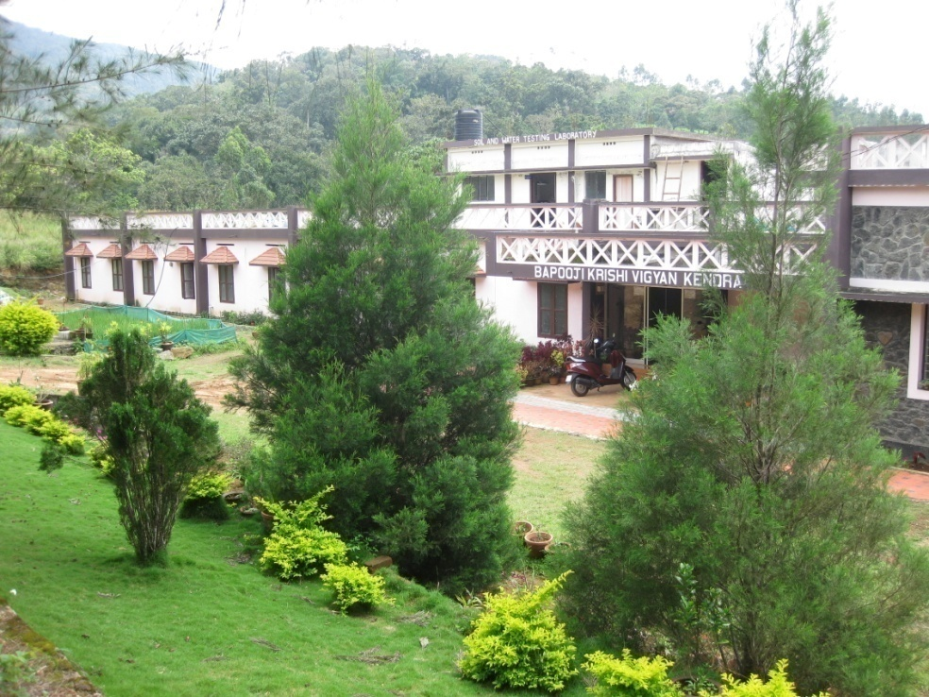
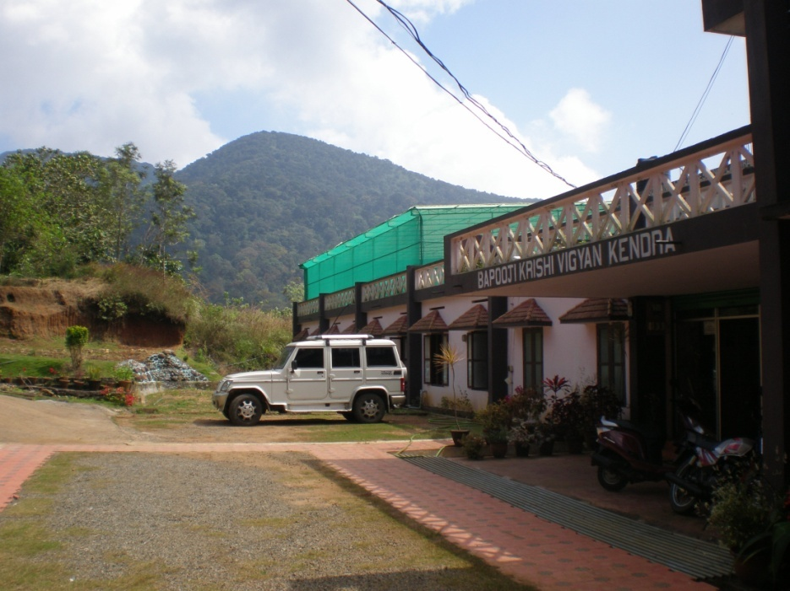
ANNUAL REVIEW MEETING 2014-15
Annual Report (April-2014 to March-2015)
Bapooji Krishi Vigyan Kendra
Santhanpara P. O.
Idukki - Kerala

Slide 2
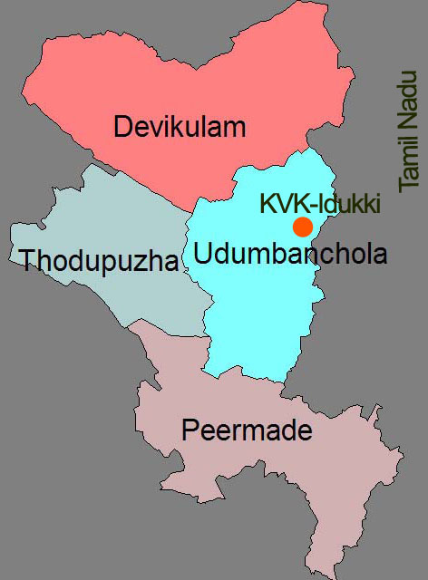
ANNUAL REPORT 2014-15
LOCATION & OPERATIONAL AREA
Situated in the mid of Kumily - Munnar state high way and geographically it is in the Cardamom Hill Reserve area of western ghats.
Point of elevation :1400 metres above MSL
Longitude : 77⁰ 10’ E
Latitude : 9⁰ 8’ N
Panchayats
Santhanpara, Rajakad, Rajakumari,
Udumbanchola, Senapathy, Nedumkandam,
Adimali, Vellathooval, Konnathady,
Vattavada, Marayoor, Chinnakkanal,
Upputhara, Karunapuram, Kanchiyar,
Pallivasal, Thodupuzha, Idavetti,
Chakkupallom & Vandanmedu.
ANNUAL REPORT 2014-15
Bapooji Krishi Vigyan Kendra - Idukki

Slide 3
ANNUAL REPORT 2014-15
Dr. Binu John Sam (SMS – Horticulture & PC i/c)
Dr. S. Jayababu (SMS – Animal Science)
Ms. Manju Jincy Varghese (SMS – Soil Science)
Dr. Benjamin Mathew (SMS – Agri. Extension)
Mr. Sudhakar Soundarajan (SMS – Plant Protection)
Ms. Jayisy Joseph (Programme Assistant – Home Science)
Ms. Rachel Skaria (Programme Assistant – Rural Craft)
Mr. Biju Narayanan (Programme Assistant – Computer)
VACANT POSTS (recruitment progressing)
Programme Coordinator
Subject Matter Specialist - Agronomy
ANNUAL REPORT 2014-15
Bapooji Krishi Vigyan Kendra - Idukki

Slide 4
ANNUAL REPORT 2014-15
Thrust Areas
Integrated Nutrient Management in major crops
IPDM in major Plantation and Vegetable crops
Integrated Sustainable Farming System models
Organic farming
Scientific management of livestock and poultry
Improvement in reproductive efficiency in dairy cattle
Feed and Nutrient Management in livestock
Value addition of under utilized crops
ANNUAL REPORT 2014-15
Bapooji Krishi Vigyan Kendra - Idukki

Slide 5
OFT
Approved | Achievement
7 | 5
ANNUAL REPORT 2014-15
Bapooji Krishi Vigyan Kendra - Idukki

Slide 6
ANNUAL REPORT 2014-15
OFT-1 | Management practices for secondary & micronutrient disorders for tapioca in acid soils
Problem Identified | Soil acidity leads to zinc and Boron deficiency resulting in low yield
Name of Village/Trial | Bison Valley/ 5
Critical inputs supplied | Lime Magnesiun Sulphate Zinc Sulphate
ANNUAL REPORT 2014-15
Bapooji Krishi Vigyan Kendra - Idukki

Slide 7
Details of Technology | T1- Farmers practice T2- Foliar spray of 0.5% Mg Sulphate + 0.5% Zn Sulphate at 60 & 90 DAP T3- Soil application of Mg Sulphate @ 20 kg/ha + Zn Sulphate @ 12.5 kg/ha within 2 months of planting
Status | Harvested
ANNUAL REPORT 2014-15
RESULT
PARAMETERS |  | T-1 | T-2 | T-3
Weight of tubers/clump (Kg) |  | 5.2 | 8.1 | 7.0
Yield (t/ha) |  | 25 | 40 | 36
BCR |  | 1.25 | 1.36 | 1.30
Feedback | T2 was found effective for managing Mg and Zn deficiency

Slide 8
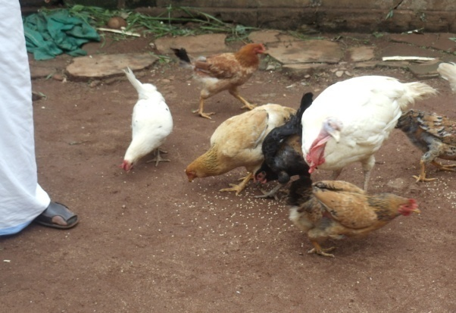
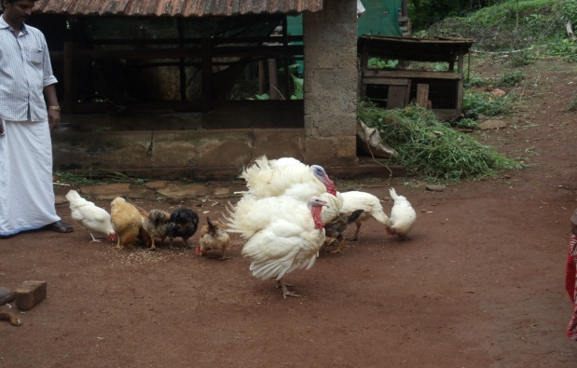
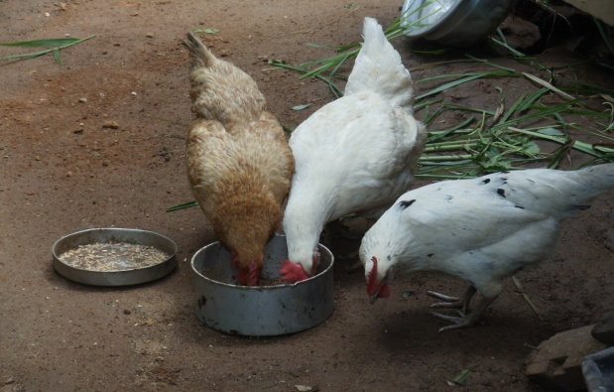
ANNUAL REPORT 2014-15
OFT-2 | Assessing the performance of Gramasree, Austra White & Sasso var. under high range conditions
Problem Identified | Low egg production and poor growth performance
Name of Village/Trial | Bison Valley/10
Critical inputs supplied | Gramasree, Austra White & Sasso birds Veterinary medicine Poultry Feed
ANNUAL REPORT 2014-15
Bapooji Krishi Vigyan Kendra - Idukki

Slide 9
Details of Technology | T1-Rearing of Desi birds T2-Rearing of Gramasree birds T3-Reaing of Austra White birds T4-Rearing of Sasso birds
Status | Birds are in laying stage Out of 3 birds Austra White showed excellent egg production
ANNUAL REPORT 2014-15
RESULT
PARAMETERS |  | T-1 | T-2 | T-3 | T-4
Egg production in Nos |  | 71 | 169 | 211 | 141
Growth rate (%) |  | 3.2 | 9.5 | 12.5 | 9.6
Mortality rate(%) |  | 0 | 0 | 0 | 0
BCR |  | 1.12 | 1.65 | 1.98 | 1.58
Feedback | Highly effective to overcome unemployment and improve financial status

Slide 10
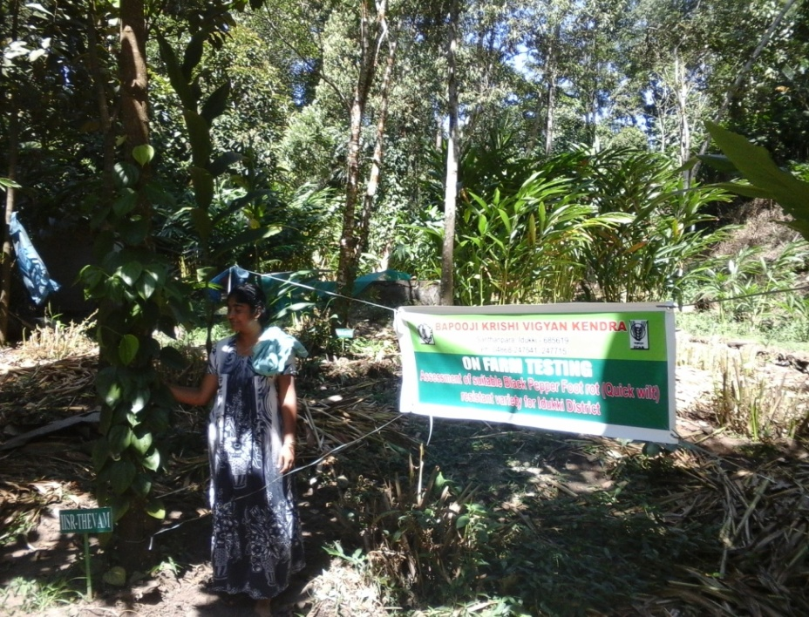
ANNUAL REPORT 2014-15
OFT-3 | Assessment of suitable black pepper foot rot (quick wilt) resistant variety for Idukki district
Problem Identified | Existing varieties are highly susceptible to quick wilt Heavy dosage of fungicides is applied for the control of quick wilt
Name of Village/Trial | Santhanpara / 5
Critical inputs supplied | Azosprillum VAM Pseudomonas
ANNUAL REPORT 2014-15
Bapooji Krishi Vigyan Kendra - Idukki

Slide 11
Details of Technology | T1- Released variety- IISR - Thevam T2- E variety 1 - Ashwati T3- E variety 2 - Suvarna
Status | IISR-Thevam is showing least percentage of quick wilt disease incidence compared to farmer developed varieties and check
ANNUAL REPORT 2014-15
RESULT
PARAMETERS |  | T-1 | T-2 | T-3
Percentage reduction in quick wilt incidence |  | - | - | -
Yield |  | - | - | -
BCR |  | - | - | -
Feedback | Ongoing till 2015-16

Slide 12
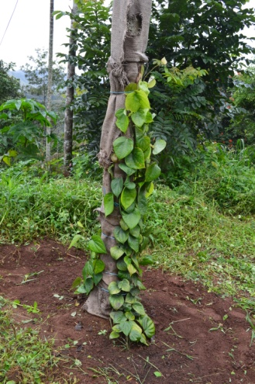
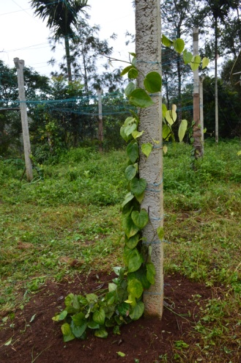
ANNUAL REPORT 2014-15
OFT-4 | Use of concrete poles as standards in black pepper
Problem Identified | High incidence of pest & disease in living standards of black pepper
Name of Village/Trial | Konnathady / 3
Critical inputs supplied | Fertilizers and PP chemicals
ANNUAL REPORT 2014-15
Bapooji Krishi Vigyan Kendra - Idukki

Slide 13
Details of Technology | T1 - Live standards of Glyricidia T2 - Live standards of Erythrina T3 - Concrete Poles
Status | Drying of anchoring roots seen on concrete poles resulting in total loss of the crop
ANNUAL REPORT 2014-15
RESULT
PARAMETERS |  | T-1 | T-2 | T-3
BCR |  | 1.82 | 1.72 | 0
Feedback | Adoptability restricted for small farmers as cost involved is high & not suitable for high temperature regions

Slide 14
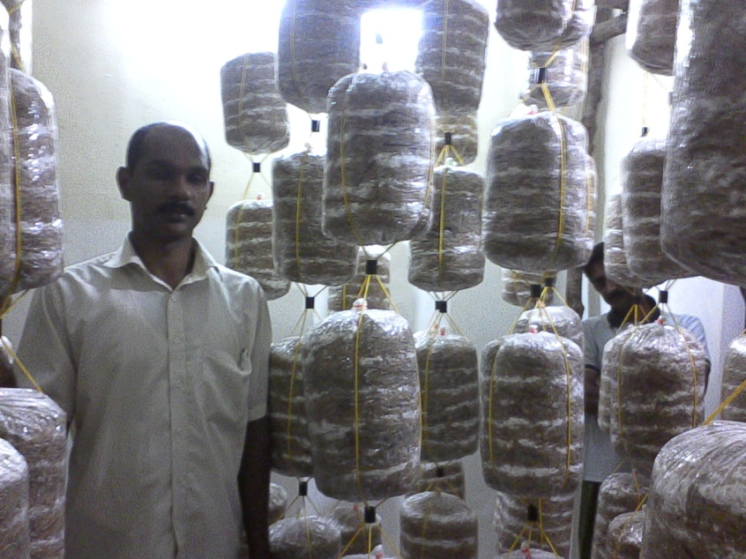
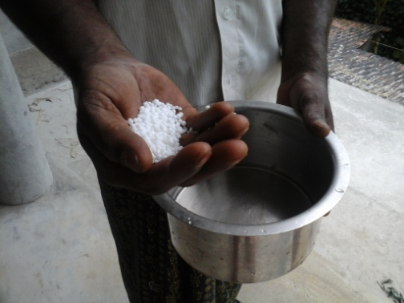
ANNUAL REPORT 2014-15
OFT-5 | Assessment of different additives in oyster mushroom bed preparation for maximizing yield
Problem Identified | Low porductivity in oysyter mushrooms
Name of Village/Trial | Thouvala / 4
Critical inputs supplied | Paddy straw Spawn PP covers Urea Bengal gram flour Groundnut cake
ANNUAL REPORT 2014-15
Bapooji Krishi Vigyan Kendra - Idukki

Slide 15
Details of Technology | T1 - No additives T2 - Urea spray @ 1g/lit T3 - Addition of Green gram flour T4 - Addition of Groundnut cake
Status | Completed
ANNUAL REPORT 2014-15
RESULT
PARAMETERS |  | T-1 | T-2 , T-3 & T-4
Average yield per bed |  | 0.84 |  | 0
BCR |  | 2.22 |  | -
Feedback | Repeated contamination seen on addition of different additives

Slide 16
FLD
Approved | Achievement
16+1 | 12
ANNUAL REPORT 2014-15
Bapooji Krishi Vigyan Kendra - Idukki

Slide 17
ANNUAL REPORT 2014-15
FLD-1 | Castor based herbal extract for the management of rodents and wild boar
Thematic area | Crop improvement
Name of Village/ Demo | Bison Valley / 10
Critical inputs supplied | Castor based herbal extract
Recommendation
Use of castor based herbal extract can effectively protect the crop from rodents and wild boar.
ANNUAL REPORT 2014-15
Bapooji Krishi Vigyan Kendra - Idukki

Slide 18
Method demonstration
RESULT
PARAMETERS | Demo | Check
Reduction in Rodents and wild boar attack (%) | 78 | 48
BCR | 1.88 | 1.46

Slide 19
FLD-2 | Site specific nutrient management in cardamom
ANNUAL REPORT 2014-15
Thematic area | Crop improvement
Name of Village/ Demo | Bison Valley / 10
Critical inputs supplied | Lime Neem Cake 19:19:19 Azospirillum VAM CAN
Recommendation
Soil test based fertilizer recommendation along with organic manures
ANNUAL REPORT 2014-15
Bapooji Krishi Vigyan Kendra - Idukki

Slide 20
RESULT
PARAMETERS | Demo | Check
Yield (q/ha) | 10 | 8
BCR | 2.88 | 2.01

Slide 21
ANNUAL REPORT 2014-15
FLD-3 | Management of berry drop in black pepper
Thematic area | Crop improvement
Name of Village/ Demo | Bison Valley / 10
Critical inputs supplied | Potassium Nitrate NAA
Recommendation
Potassium Nitrate (1%) + NAA (25 ppm) spray at berry set and fruit development stages (2 sprays)
ANNUAL REPORT 2014-15
Bapooji Krishi Vigyan Kendra - Idukki

Slide 22
RESULT
PARAMETERS | Demo | Check
Fruit set (%) | 83 | 70
No of spikes/vine (No) | 122 | 107
Yield Dry (Kg/vine) | 1.63 | 1.42
BCR | 2.96 | 2.14

Slide 23
ANNUAL REPORT 2014-15
FLD-4 | INM in banana cv. Nendran for high ranges
Thematic area | Crop improvement
Name of Village/ Demo | Bison Valley / 10
Critical inputs supplied | Lime Zinc Sulphate Bio fertilizers Borax
Recommendation
Soil test based fertilizer recommendation along with organic manures
ANNUAL REPORT 2014-15
Bapooji Krishi Vigyan Kendra - Idukki

Slide 24
RESULT
PARAMETERS | Demo | Check
Bunch weight (kg) | 14.2 | 10.8
No of hands/bunch | 5.1 | 4.9
No of fruits/bunch | 40.0 | 39.5
BCR | 2.38 | 1.80

Slide 25
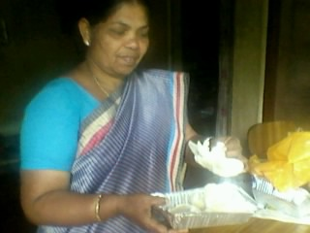
ANNUAL REPORT 2014-15
FLD-5 | Packaging of mushrooms in tray packs with cling film cover
Thematic area | Value addition
Name of Village/ Demo | Adimaly & Kambammettu / 10
Critical inputs supplied | Tray packs with cling film cover
Recommendation
Tray packs with cling film cover is suitable for mushroom packaging and increases its shelf life.
ANNUAL REPORT 2014-15
Bapooji Krishi Vigyan Kendra - Idukki

Slide 26
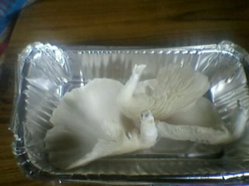
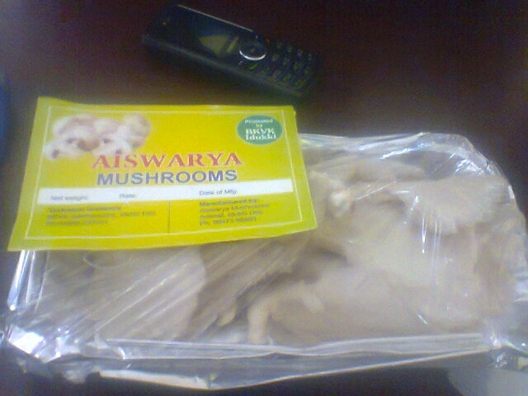
RESULT
PARAMETERS | Demo | Check
BCR | 2 | 1.6

Slide 27
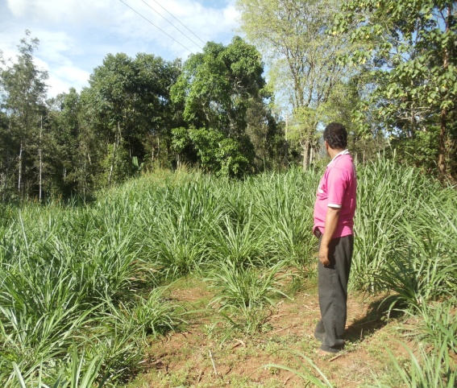
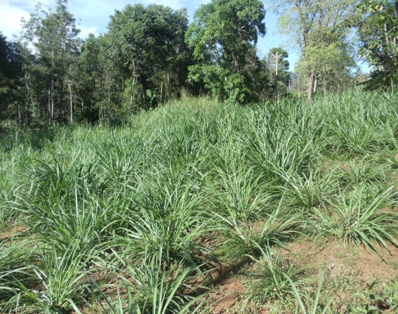
FLD-6 | Popularization of mixed fodder system
Thematic area | Animal nutrition and production management
Name of Village/ Demo | Bison valley /10
Critical inputs supplied | Seeds of COFS 29 Seeds of Desmanthus Seeds of Agathi Seeds of Subabul Seeds of Anjan grass Seeds of Stylosanthes
Recommendation
Create awareness among farmers about mixed fodder system
ANNUAL REPORT 2014-15
Bapooji Krishi Vigyan Kendra - Idukki

Slide 28
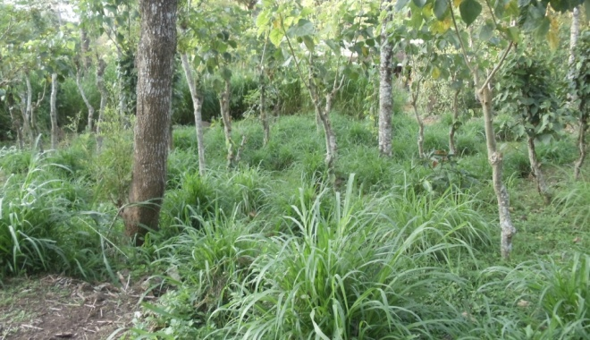
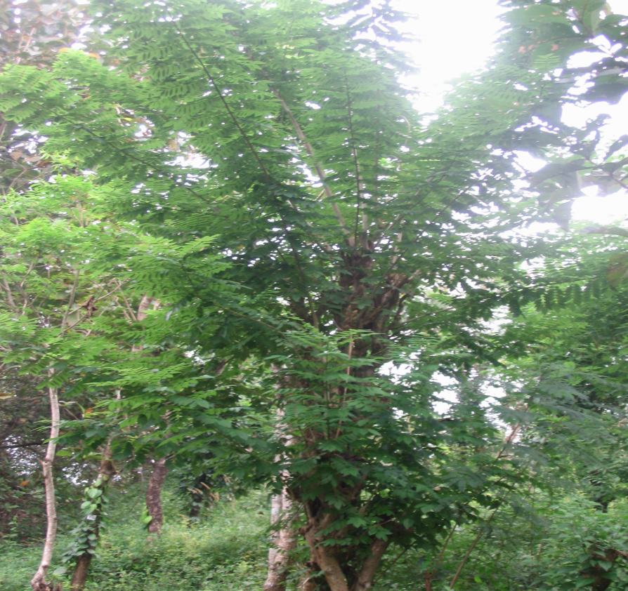
RESULT
PARAMETERS | Check | Demo
Quantity of milk production | 598 L | 760 L
Quality of milk production - Fat | 3.05% | 4.15%
% of wastage in Feed | 27% | 7%
BCR | 1.86 | 2.69

Slide 29
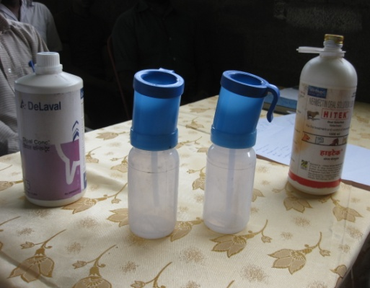
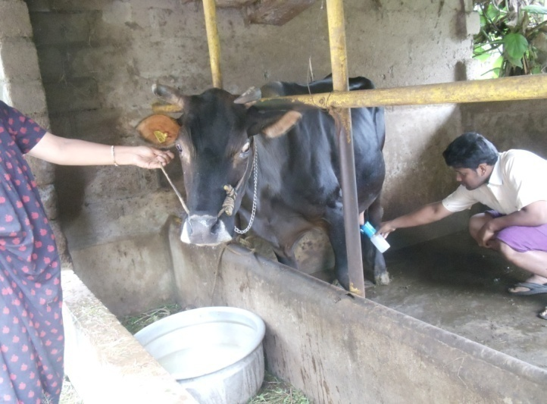
ANNUAL REPORT 2014-15
FLD-7 | Prophylactic management of mastitis in dairy cows using antiseptic solution in teat cups
Thematic area | Disease Management
Name of Village/ Demo | Bison valley / 10
Critical inputs supplied | Dipol Solution Teat Cups
Recommendation
Application of Dipol / KMnO₄ after milking is recommended for control of Mastitis Give adequate green fodder after milking thus avoiding sitting of animals and thereby contamination of udder
ANNUAL REPORT 2014-15
Bapooji Krishi Vigyan Kendra - Idukki

Slide 30
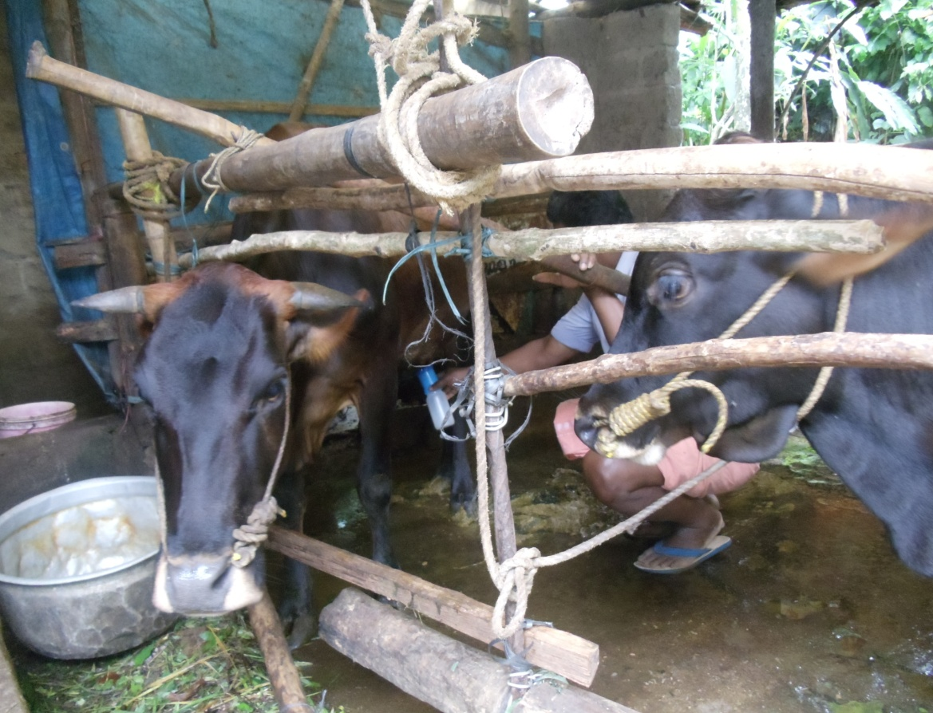
RESULT
PARAMETERS | Check | Demo
Incidence of Mastitis in % | 100 | 0
Quantity of Milk Production | 513 L | 603 L
Quality of Milk Production – Fat % | 2.45 % | 3.65%
BCR | 1.43 | 1.89

Slide 31
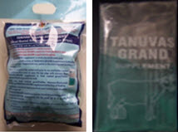
ANNUAL REPORT 2014-15
FLD-8 | Assessment of Gruel Rooted Additive Nourishment Drops (GRAND) supplement in crossbred cows
Thematic area | Nutrition Management
Name of Village/ Demo | Bison valley /10
Critical inputs supplied | GRAND Supplement
Recommendation
Create awareness among farmers about new nutrition technologies
ANNUAL REPORT 2014-15
Bapooji Krishi Vigyan Kendra - Idukki

Slide 32
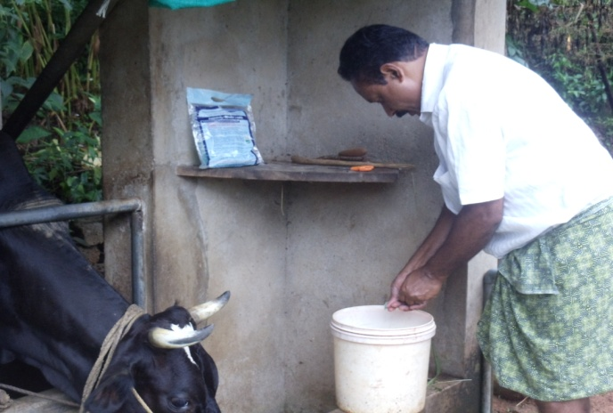
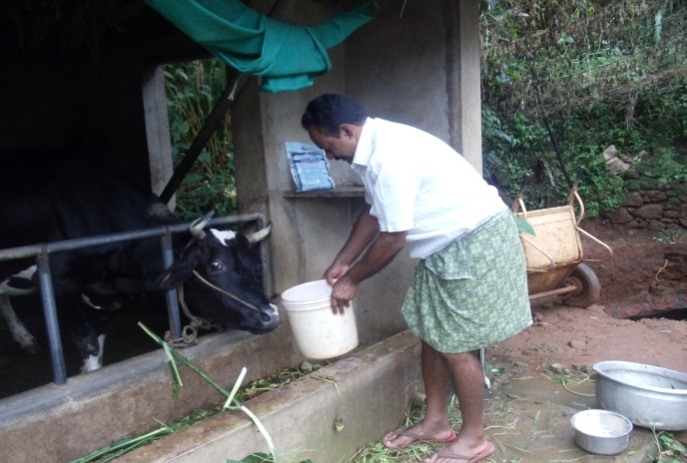
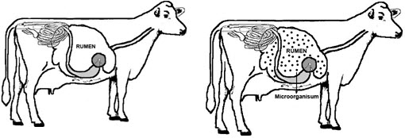
RESULT
PARAMETERS | Check | Demo
Milk production | 562 L | 693 L
Increase in body weight | 1.09% | 2.38%
BCR | 1.69 | 1.99

Slide 33
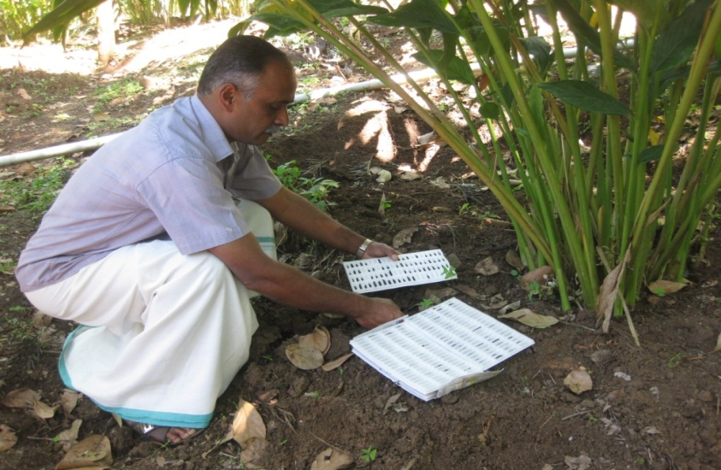
ANNUAL REPORT 2014-15
FLD-9 | Management of cardamom root grub with Entomo Pathogenic Nematodes (EPN)
Thematic area | Integrated Pest Management
Name of Village/ Demo | Bison valley /10
Critical inputs supplied | EPN
Recommendation
Soil application of EPN @ 4 cadavers/plant
ANNUAL REPORT 2014-15
Bapooji Krishi Vigyan Kendra - Idukki

Slide 34
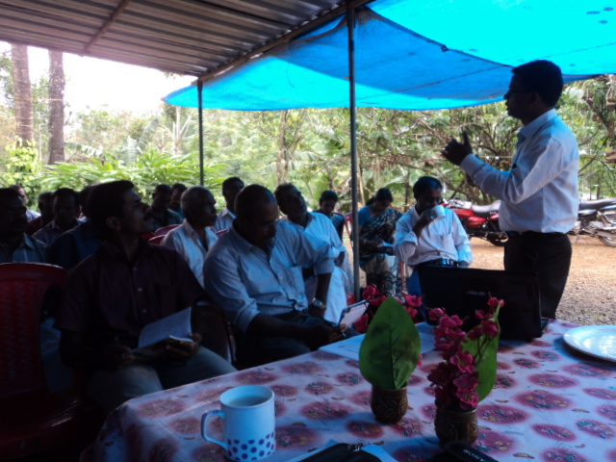
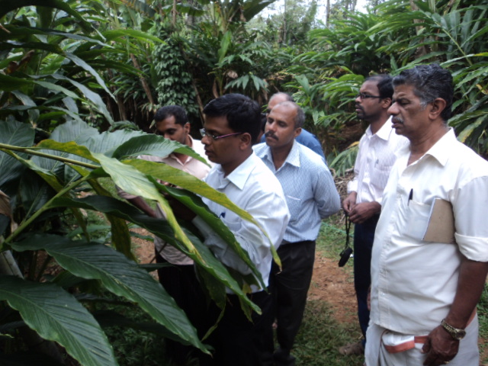
RESULT
PARAMETERS | Demo | Check
Percentage reduction in root grub attack | 83 | 46
Yield | 1350 kg/ha | 912 kg/ha
BCR | 2.96 | 2.11

Slide 35
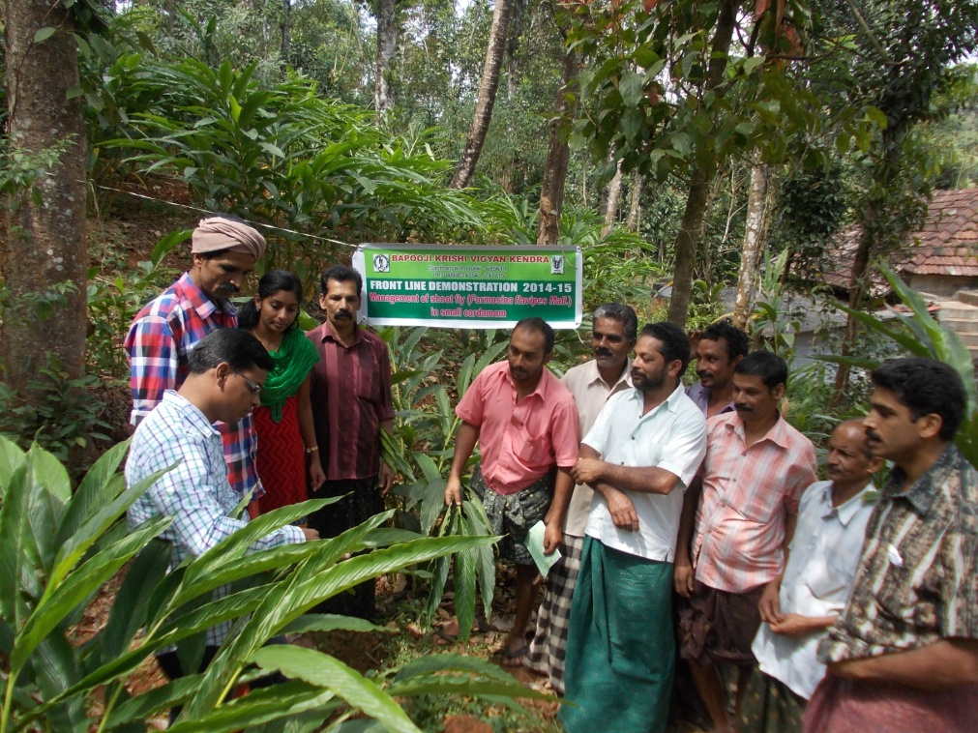
ANNUAL REPORT 2014-15
FLD-10 | Management of shoot fly (Formosina flavipes Mall.) in small cardamom
Thematic area | Integrated Pest Management
Name of Village/ Demo | Bison valley /10
Critical inputs supplied | Thiamethoxam
Recommendation
Spray thiamethoxam @ 0.5 g / L of water
ANNUAL REPORT 2014-15
Bapooji Krishi Vigyan Kendra - Idukki

Slide 36
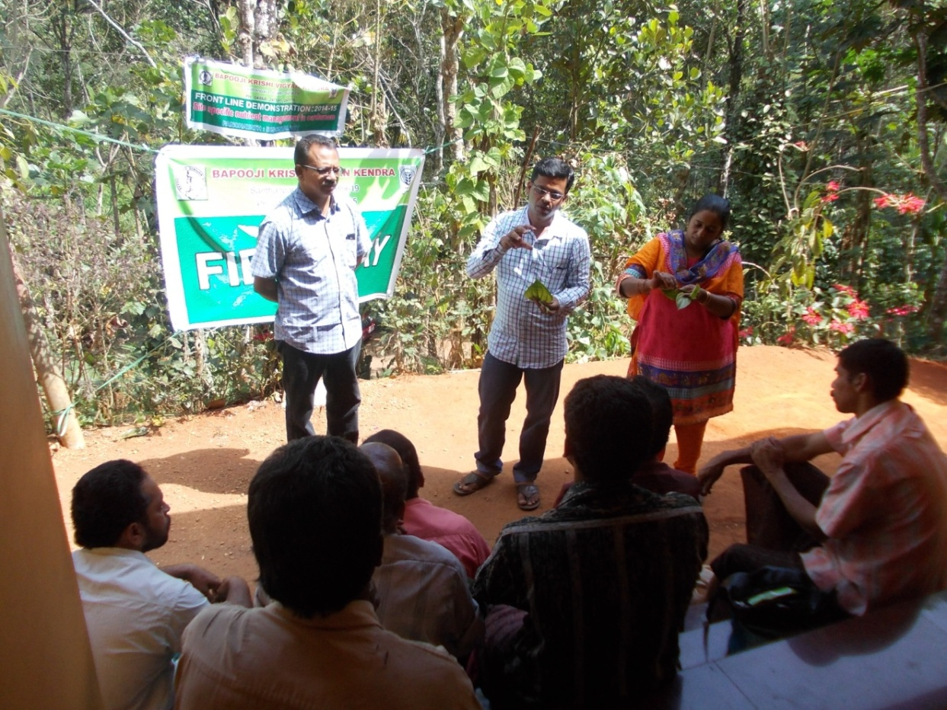
RESULT
PARAMETERS | Demo | Check
Percentage reduction in shoot fly attack | 87 | 30
Yield | 1620 kg/ha | 789 kg/ha
BCR | 2.94 | 1.45

Slide 37
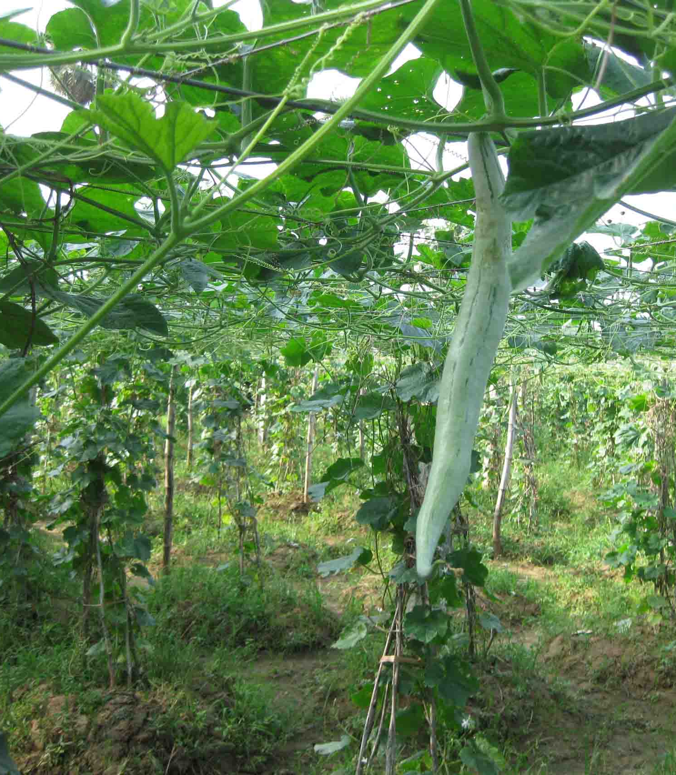
ANNUAL REPORT 2014-15
FLD-11 | Ensuring nutritional security through family farming
Thematic area | Crop management
Name of Village/ Demo | Bison valley / 3
Critical inputs supplied | Seeds Bio-agents
Recommendation
Family farming ensures availability of year-round production of organic vegetables for the family
ANNUAL REPORT 2014-15
Bapooji Krishi Vigyan Kendra - Idukki

Slide 38
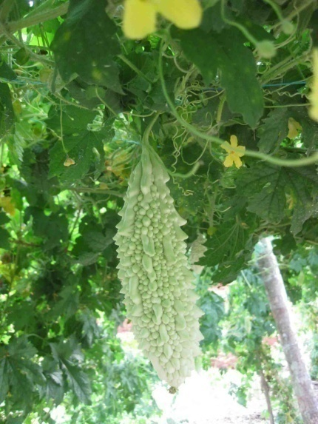
RESULT
PARAMETERS | Demo | Check
Availability of year round organic vegetable production | 100 % | -

Slide 39
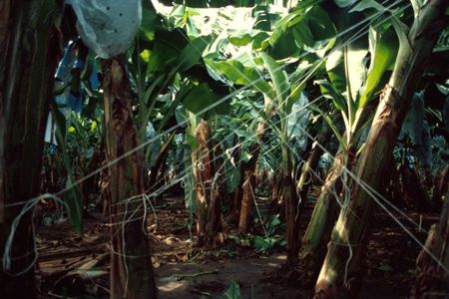
ANNUAL REPORT 2014-15
FLD-12 | Management of lodging / breaking of banana pseudostem nearing maturity
Thematic area | Crop management
Name of Village/ Demo | Bison valley / 5
Critical inputs supplied | Bamboo/ casuarina/ eucalyptus props Tying material ¾ inch nylon / polythene tapes
Recommendation
Single propping coupled with tying with nylon ropes
ANNUAL REPORT 2014-15
Bapooji Krishi Vigyan Kendra - Idukki

Slide 40
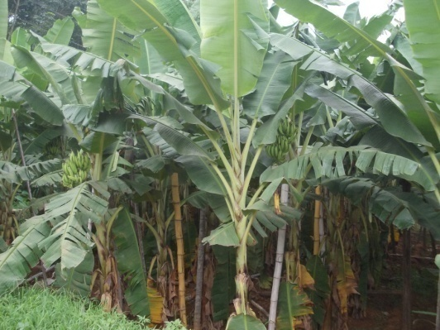
RESULT
PARAMETERS | Demo | Check
Extent of wind damage | 0 | 20
BCR | 1.99 | 1.17

Slide 41
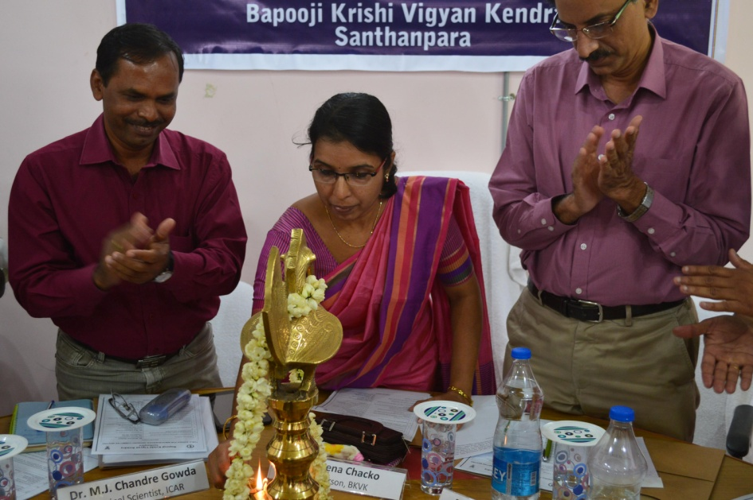
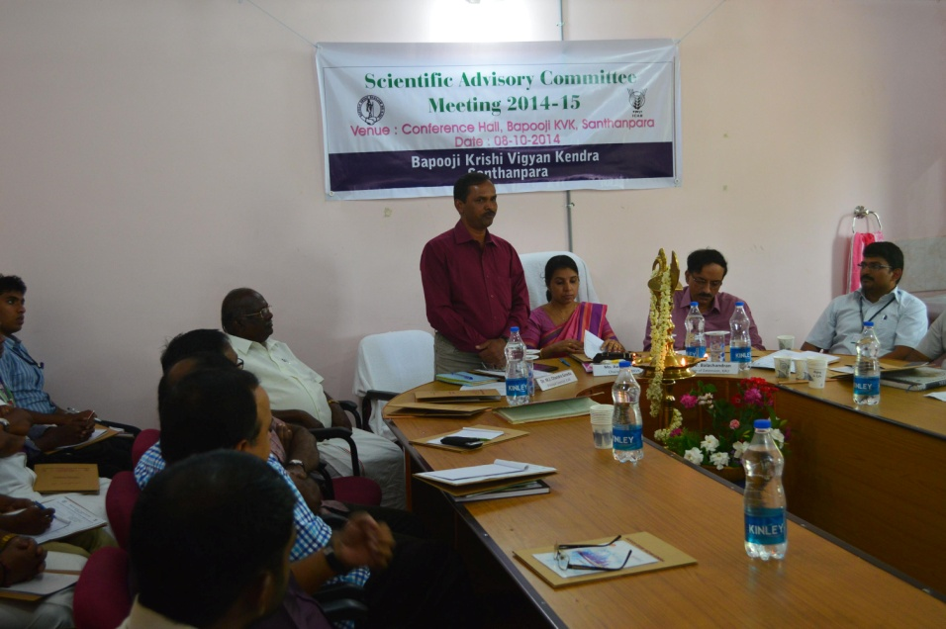
SAC MEETING
8th October, 2014
ANNUAL REPORT 2014-15
Bapooji Krishi Vigyan Kendra - Idukki

Slide 42
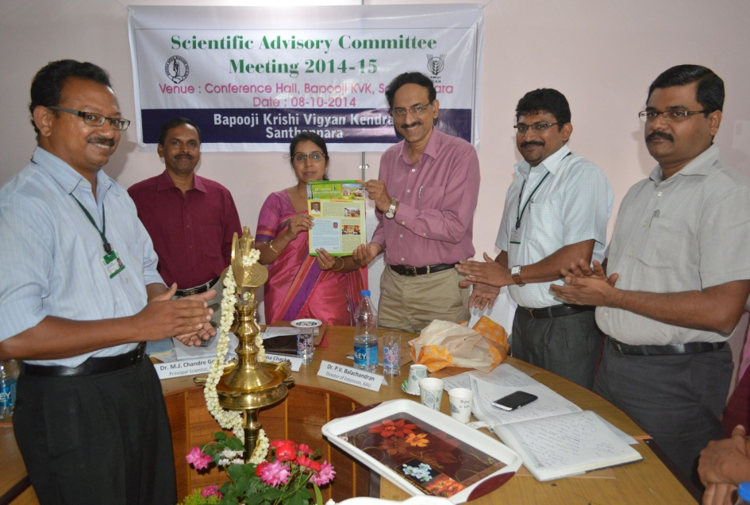
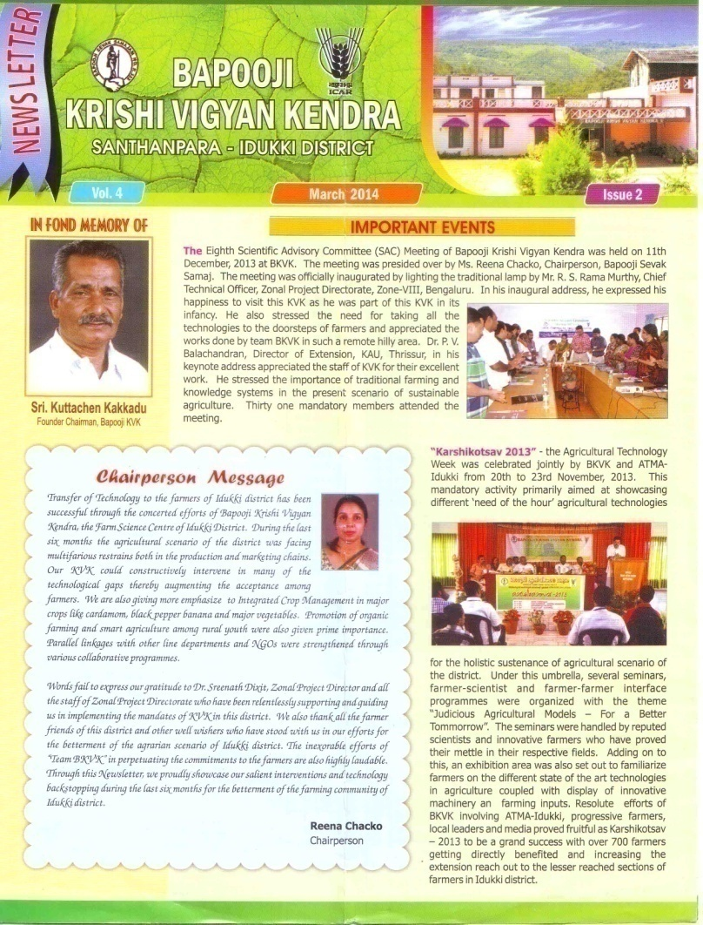
ANNUAL REPORT 2013-14
Newsletter released
Dr. P.V. Balachandran, Director of Extension, Kerala Agricultural University, releasing the Newsletter
Bapooji Krishi Vigyan Kendra - Idukki

Slide 43
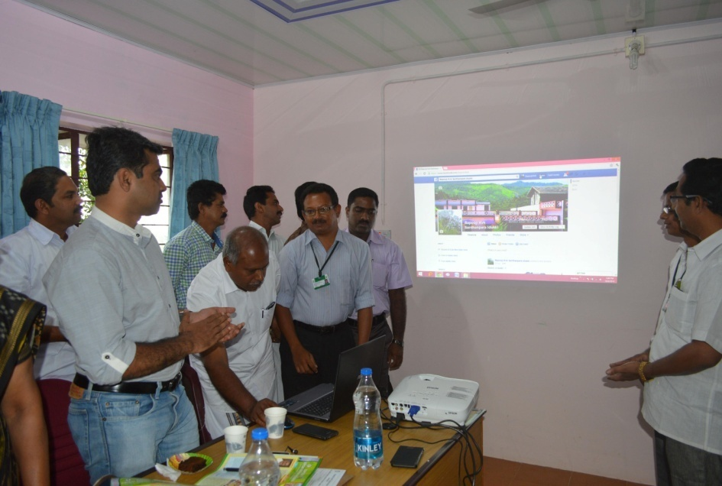
ANNUAL REPORT 2013-14
Launching of BKVK Facebook Page
Mr. Ajayan G., President, Spices Planters’ Association, launching the facebook page of BKVK
Bapooji Krishi Vigyan Kendra - Idukki

Slide 44
ANNUAL REPORT 2013-14
Leaflets published
Bapooji Krishi Vigyan Kendra - Idukki

Slide 45
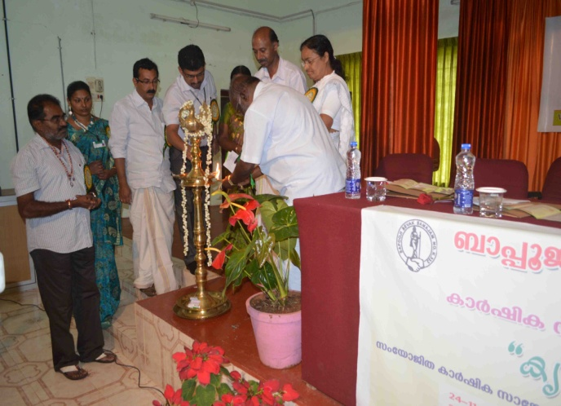
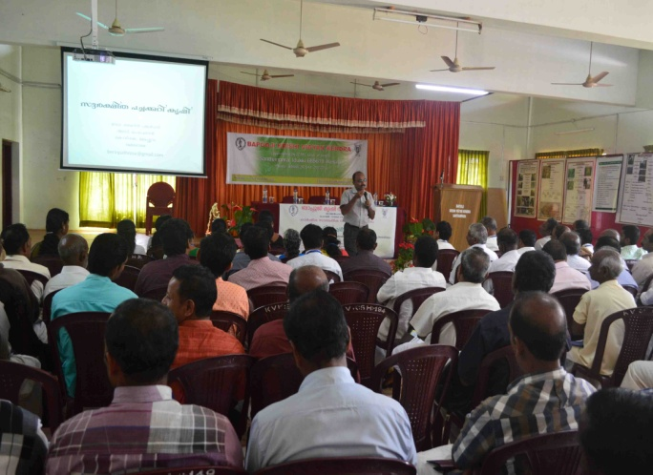
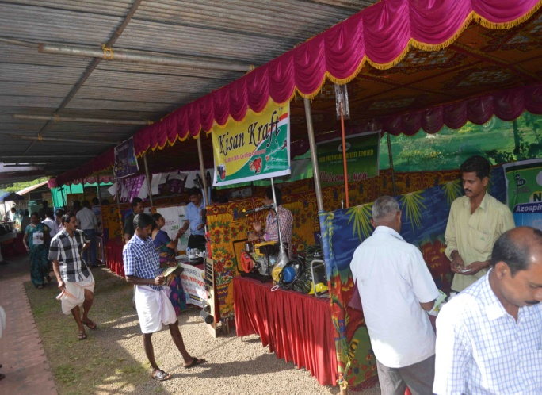
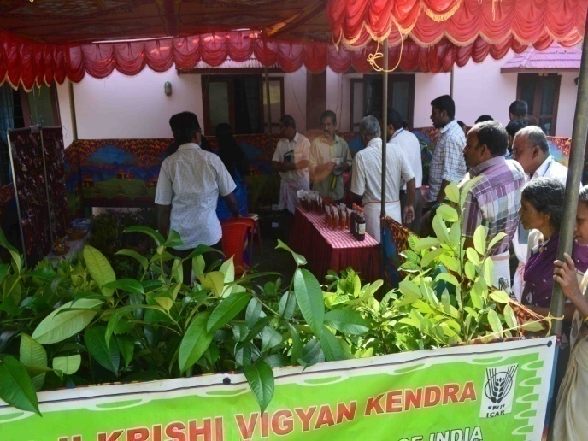
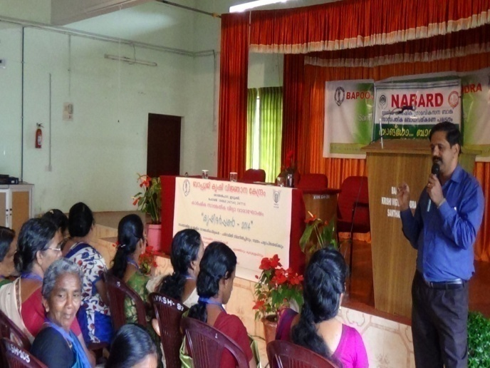
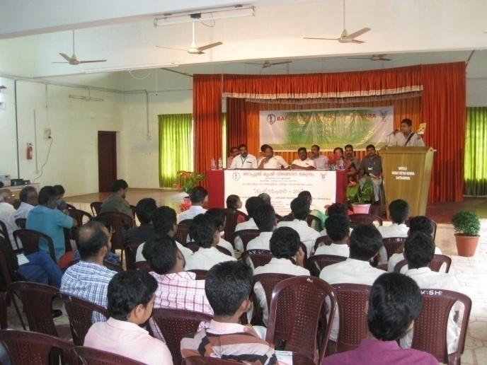
ANNUAL REPORT 2013-14
KRISHI DARPAN 2014 (Technology Week Celebration 24th – 28th November, 2014)
Inauguration
Technical Session
Exhibition area
Plants exhibition cum sales area
Technical Session
Valedictory function
ANNUAL REPORT 2014-15
Bapooji Krishi Vigyan Kendra - Idukki

Slide 46
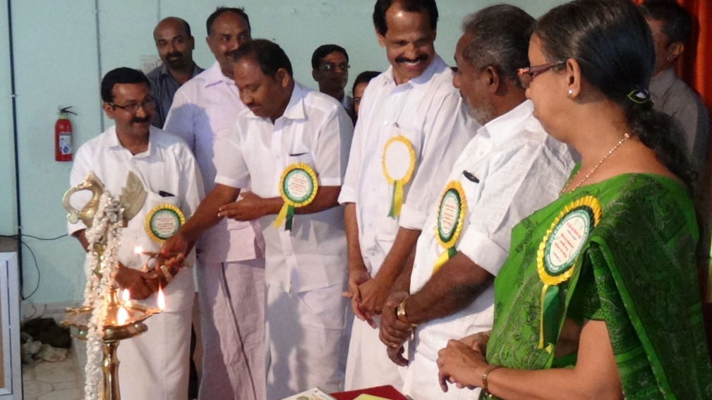
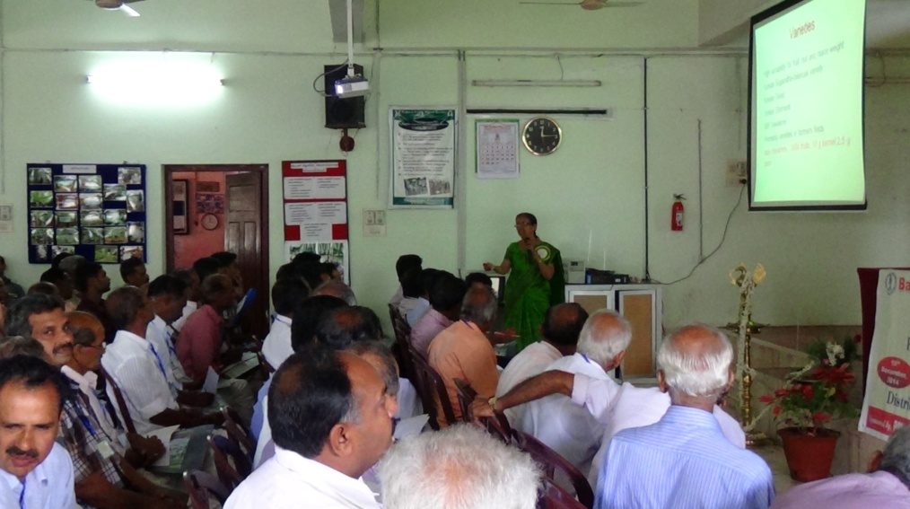
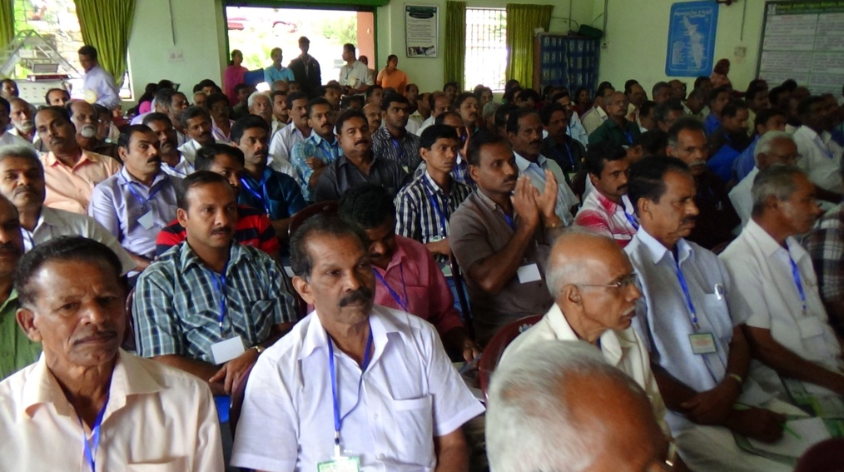
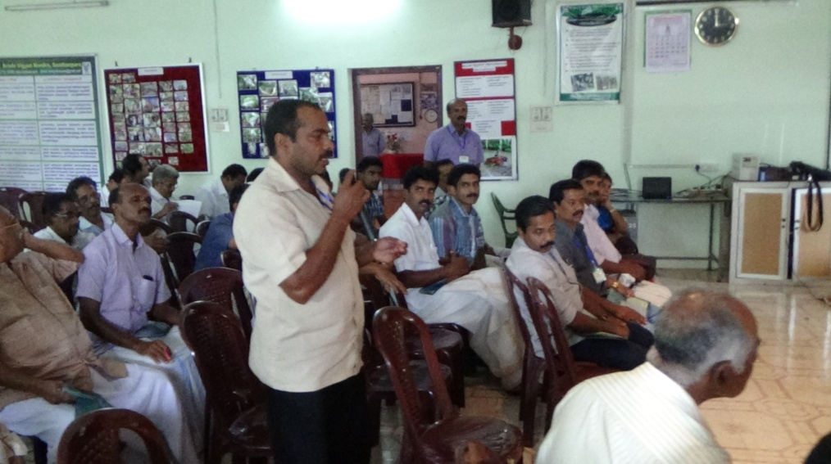
Seminar
PPV & FR Act Programme on 18th December, 2014
ANNUAL REPORT 2014-15
Bapooji Krishi Vigyan Kendra - Idukki

Slide 47
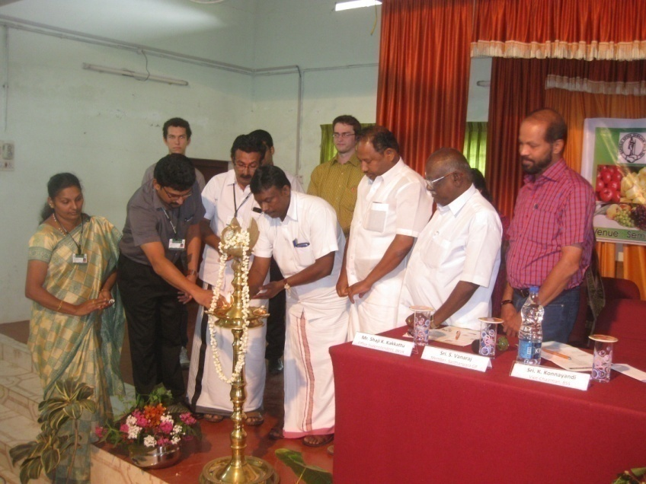
WORLD FOOD DAY CELEBRATION
24th October, 2014
ANNUAL REPORT 2014-15
Bapooji Krishi Vigyan Kendra - Idukki

Slide 48
Scouting Programme
Arjun var. cardamom
Pappalu var. cardamom
NIF Scouting programme on plant varieties
Punnathanam var. nutmeg
Zionmundi var. black pepper
ANNUAL REPORT 2014-15
Bapooji Krishi Vigyan Kendra - Idukki

Slide 49
Seminar on IPDM in cardamom
ANNUAL REPORT 2014-15
Bapooji Krishi Vigyan Kendra - Idukki

Slide 50
Technical Convergence Sessions
LINKAGES
ATMA - Monthly Technology Advisory Meetings
ANNUAL REPORT 2014-15
Bapooji Krishi Vigyan Kendra - Idukki

Slide 51
Apiculture training and bee boxes supplied to farmers
ANNUAL REPORT 2014-15
Bapooji Krishi Vigyan Kendra - Idukki

Slide 52
Demonstration on castor based herbal extract for control of field rodents and wild boars

Slide 53
Diagnostic visits

Slide 54
Field visits

Slide 55
On campus Training Programmes
ANNUAL REPORT 2014-15
Bapooji Krishi Vigyan Kendra - Idukki

Slide 56
Off campus Training Programmes
ANNUAL REPORT 2014-15
Bapooji Krishi Vigyan Kendra - Idukki

Slide 57
OJT Programme for VHSE Students (3 Schools)
ANNUAL REPORT 2014-15
Bapooji Krishi Vigyan Kendra - Idukki

Slide 58
ANNUAL REPORT 2013-14
TRAINING PROGRAMME ACHIEVEMENT
Trainings | No. of course | Participants |  |  |  | Total
 |  | Others |  | SC/ST
 |  | Male | Female | Male | Female
Farmers training including sponsored training programme | 102 | 2168 | 1361 | 133 | 121 | 3783
Rural youth | 11 | 61 | 144 | 10 | 9 | 224
Extension personnel | 3 | 18 | 36 | 0 | 0 | 54
Sponsored | 28 | 211 | 231 | 30 | 12 | 484
Vocational | 5 | 52 | 83 | 4 | 9 | 148
TOTAL | 149 | 2510 | 1855 | 177 | 151 | 4693
Bapooji Krishi Vigyan Kendra - Idukki

Slide 59
ANNUAL REPORT 2014-15
Other Extension Programmes
Sl. No. | Activities | No. of Programmes
1 | Field day | 05
2 | Advisory Services | 361
3 | Diagnostic visits | 17
4 | Exhibition | 01
5 | Scientist’s visit to farmers field | 46
6 | Technology week celebrations (5 days) | 01
7 | Farmer’s seminar/workshop | 03
8 | Brochures | 04
9 | Farmers visit to KVK | (211)
10 | Special day celebration (World Food Day) | 01
11 | Exposure visits | 01
12 | News paper coverage | 05
13 | Radio Talks | 02
14 | Ex trainee sammelan | 02
TOTAL |  | 449
Bapooji Krishi Vigyan Kendra - Idukki

Slide 60
PARTICIPATION IN EXHIBITION – RAJAKKAD FEST
ANNUAL REPORT 2014-15
Bapooji Krishi Vigyan Kendra - Idukki

Slide 61
Tribal Development Programme-ATMA

Slide 63
Special Programme on Skill Development activity for Tribal students
Special Programme on Skill Development activity for NSS Camp
ANNUAL REPORT 2014-15
Bapooji Krishi Vigyan Kendra - Idukki

Slide 64
Success story: Skill Development Programme sponsored by DIC, Idukki
ANNUAL REPORT 2014-15
Bapooji Krishi Vigyan Kendra - Idukki

Slide 65
Success story: Skill Development Programme
ANNUAL REPORT 2014-15
Bapooji Krishi Vigyan Kendra - Idukki

Slide 66
WOMAN FARMER AWARDED
Best Entrepreneur Award by Konnathady Panchayat
Ms. Shybi Sabu
Mushroom Grower, Konnathady
ANNUAL REPORT 2014-15
Bapooji Krishi Vigyan Kendra - Idukki

Slide 67
SWACHH BHARAT CAMPAIGN
ANNUAL REPORT 2014-15
Bapooji Krishi Vigyan Kendra - Idukki

Slide 68
Exposure visit
ANNUAL REPORT 2014-15
Bapooji Krishi Vigyan Kendra - Idukki

Slide 69
ANNUAL REPORT 2013-14
SPECIALISED ACTIVITIES
A. Performance of Production Units
Sl. No. | Name of the Product | Quantity | Gross Income (Rs.)
1 | Pseudomonas | 2271.50 L | 227150.00
2 | Trichoderma | 1163 L | 116300.00
3 | EPN | 49000 Nos. | 49000.00
4 | Metarhizium | 4 L | 400.00
5 | Pheromone trap | 951 Nos. | 175935.00
6 | Mushroom Spawn | 5673 Packets | 170190.00
7 | Detergent powder | 78 kg | 3900.00
8 | Liquid soap | 75 L | 1875.00
TOTAL |  |  | 7,44,750.00
ANNUAL REPORT 2014-15
Bapooji Krishi Vigyan Kendra - Idukki

Slide 70
ANNUAL REPORT 2013-14
B. Details of Soil and Water Sample Analysis & Fertilizer Recommendations
Details | No. of Samples Analyzed | No. of Farmers benefited | No. of Villages | Amount realized
Soil samples | 411 | 274 |  | 20550.00
Water | 1 | 1 | 1 | 50.00
TOTAL |  |  |  | 20,600.00
Bapooji Krishi Vigyan Kendra - Idukki

Slide 71
ANNUAL REPORT 2013-14
C. External Funded Programmes
Programme | Funding Agency | Amount (Lakhs)
Development of Pest Surveillance based Crop Advisory for Plant Health Management in Idukki District | Kerala State Planning Board | 6,00,000.00
Total |  | 6,00,000.00
ANNUAL REPORT 2014-15
Bapooji Krishi Vigyan Kendra - Idukki

Slide 72
Demonstration Units
MIST CHAMBER
RAIN SHELTER
STOREHOUSE CUM POTTING SHED
MUSHROOM HOUSE
ANNUAL REPORT 2014-15
Bapooji Krishi Vigyan Kendra - Idukki

Slide 73
Demonstration Units
DUCK CUM FISH CULTURE
PEPPER NURSERY
VEGETABLE CULTIVATION
HDP IN BANANA
ANNUAL REPORT 2014-15
Bapooji Krishi Vigyan Kendra - Idukki

Slide 75
Demonstration Units
Animal Husbandry Unit
STRAWBERRY OPEN END FIELD DEMO
ANNUAL REPORT 2014-15
Bapooji Krishi Vigyan Kendra - Idukki

Slide 76
ANNUAL REPORT 2013-14
Other Salient Achievements
Farm Mechanization Mushroom Growers Club Popularization of Apiary Involving SHGs in various Self-employment opportunities Established Kitchen Gardens in Rural households Popularization of Moringa cultivation Dissemination of technologies related to sustainable agriculture and allied sectors
Bapooji Krishi Vigyan Kendra - Idukki

Slide 77
Popularization of Moringa
 | Area (ha)
Adimali | 94.09
Nedumkandam | 64.08
Thodupuzha | 16.46
Elamdesam | 39.21
Kattappana | 80.77
Azhutha | 174.04
Idukki | 79.09
Devikulam | 11.24
Municipalities | 5.54
District Total | 564.52

Slide 78
Utilization of KVK funds during the year 2014-15
ANNUAL REPORT 2013-14
Sl. No. | Particulars | Sanctioned | Released | Expenditure
A. Recurring Contingencies
1 | Pay & Allowances | 83.10 |  | 83.13436
2 | Traveling allowances | 1.30 |  | 1.31373
3 | Contingencies
A | Stationery, telephone, postage and other expenditure on office running, publication of Newsletter and library maintenance (Purchase of News Paper & Magazines) | 0.55 |  | 1.73409
B | POL, repair of vehicles, tractor and equipments | 0.55 |  | 1.84311
C | Meals/refreshment for trainees (ceiling up to Rs.40 /day/trainee be maintained) | 0.20 |  | 0.29492
D | Training material (posters, charts, demonstration material including chemicals etc. required for conducting the training) | 0.20 |  | 0.46351
E | Frontline demonstration except oilseeds and pulses (minimum of 30 demonstration in a year) | 1.70 |  | 1.74242
F | On farm testing (on need based, location specific and newly generated information in the major production systems of the area) | 0.30 |  | 0.42486
G | Training of extension functionaries | 0.10 |  | 0.10000
H | Maintenance of buildings | 0.10 |  | 0.10146
I | Establishment of Soil, Plant & Water Testing Laboratory | 0.00 |  | 0.00
J | Integrated Farming System | 0.10 |  | 0.10330
K | Extension Activities | 0.10 |  | 0.42385
L | Farmers Field School | 0.10 |  | 0.01000
TOTAL (A) |  | 88.40 | 88.40 | 91.68961
ANNUAL REPORT 2014-15
Bapooji Krishi Vigyan Kendra - Idukki

Slide 79
ANNUAL REPORT 2013-14
Utilization of KVK funds during the year 2014-15
Sl. No. | Particulars | Sanctioned | Released | Expenditure
B. Non-Recurring Contingencies
1 | Works | 0.00 | 0.00 | 0.00
2 | Equipments including SWTL & Furniture | 0.00 | 0.00 | 0.00
3 | Vehicle (Four wheeler/Two wheeler, please specify) | 0.00 | 0.00 | 0.00
4 | Library (Purchase of assets like books & journals) | 0.00 | 0.00 | 0.00
TOTAL (B) |  | 0.00 | 0.00 | 0.00
C. REVOLVING FUND |  | 0.00 | 0.00 | 0.00
GRAND TOTAL (A+B+C) |  | 88.40 | 88.40 | 91.68961
ANNUAL REPORT 2014-15
Bapooji Krishi Vigyan Kendra - Idukki

Slide 80
T | H | A | N | K | S..

