Slide 1


First Workshop of Nodal Officers of
KRISHI: Knowledge based Resources Information Systems Hub for Innovations in Agriculture
(ICAR Research Data Repository for Knowledge Management)
AP Shinde Symposium Hall, NASC Complex, New Delhi
(04-05 August 2015)
KrishiKosh: A digital Repository of NARES for Sharing Knowledge Resources
Dr. A. K. Jain, Head & Principal Scientist
(akjain@iari.res.in)
Agricultural Knowledge Management Unit

Slide 2
Digital Content
In digital world all information is represented as bits, 0s and 1s as against conventional analog representation where infinitely variable nature of information is preserved.
Contents in every format and medium held by library, manuscripts to maps, moving images to musical recordings can be converted to digital form.
In addition to hardware and software needed for conversion and creation of digital content, the required practices for describing and retrieval of digital contents are developing fast.
Impact of this new technology on libraries and their collections, patrons and public needs to be understood in right perspective.

Slide 3
Benefit of Digitization
  The advantages of digital content normally outweighs the loss of fidelity in converting the information from continuous to discrete form
  Wider and easy access based on policies
  Easy maneuvering of data,
  Compression for large storage,
  Fast & multi dimensional retrieval,
  Reproducibility in different forms,
  Simultaneous & endless reusability,

Slide 4
Management Issues
Digital resources are best for facilitating access to information but questionable when it comes to traditional library role of authentic preservation.
Digital content is machine-legible only whereas conventional content is eye-legible.
Digitized information need computer h/w and s/w which are often proprietary and become obsolete very fast, requiring conversion to newer formats and technologies.
Transition from one file format to other does not produce exactly same file. Although there may not be any loss of intellectual content.
Assuring integrity of digital file and keeping track of versions is a challenging task.
Active human intervention for refreshing and migration of data is required for maintaining it in the fast changing digital technology environment.

Slide 5
Life Expectancy of Digital Media
Actual life expectancy of digital media will depend on a number of factors:
  The quality with which the media was manufactured
  The number of times the media is accessed over its lifetime
  The care with which the media is handled
  The storage temperature and humidity
  The cleanliness of the storage environment
  The quality of the device used to write to or read from the media

Slide 6
Typical Life Expectancy of some of the media
News Paper 10-20 years
Magnetic tapes 10-30 years
VHS Video Tape 10-30 years
CD/DVD 10-100 years
Digital Linear Tape 10-300 years
Microfilm 10-500 years
Photographic slides 100 years
Archival grade acid free paper 100-500 years
Egyptian Rosetta stone 2200 years
RNA/DNA might be the oldest Data storage medium ??? years

Slide 7
Bio-storage
The researchers of the Chinese University of Hong Kong used encoded E. coli plasmid DNA (a molecule of DNA usually present in bacteria that replicate independently of chromosomal DNA) to encrypt the data and store it in the bacteria.
Then, by using a novel information processing system they were able to reconstruct and recover the data with error checking.
Based on the procedures tested, they estimate the ability to store about 900 terabytes (TB) in one gram of bacteria cells. That is the equivalent of 450 hard drives, each with the capacity of 2 terabytes (2000 GB).
Another advantage of the system is that the bacteria cells abundantly replicate the data storage units thereby ensuring the integrity and permanence of the data by redundancy.
Taking the clue from this, strategy of ‘replication and evolution’ can help manage data preservation, even on magnetic media of today for very long time.

Slide 8
Digital Content in NARS
Indian National Agricultural Research System (NARS) has a very large collection of conventional knowledge base in agriculture and allied sciences, spread over the country in different libraries of ICAR Institutes and State Agricultural Universities.
Digitization of these valuable archives allows online access to researchers, teachers and students to which they would not otherwise have an easy access.
Duplication can be avoided by pooling the efforts and sharing through common standards and electronic protocols.
It was thought that a National Digital Repository can go long way to meet the challenges in agriculture sector.

Slide 9
Institutional Repository
Institutional repository is a “Digital Collections that captures, preserve, archives and provide policy based access to the intellectual output of an institution”
It can be perceived as an organization based set of services which the organization offers to the members of its community for the management and dissemination of digital materials created by the institution and its community members.
IR helps in increased control by scholars and the academy over the system of scholarly publishing.
IR provides scholarly information free or at fair and reasonable price.
IR should be seen as complementary channel, not intended to replace commercial publishing.

Slide 10
Why Have an IR?
To increase the visibility and citation impact of an institution’s intellectual output
To provide unified access to an institution’s output
To provide open access to your institution’s intellectual assets
To preserve your institution’s intellectual assets

Slide 11
Why Open Access IR ?
Structural problems with scholarly publishing are:
‘Impact barriers’
  authors give away their content and want to achieve impact not income
  want to disseminate research widely
  but publishers want to restrict circulation based on subscriptions
‘Access barriers’
  researchers want easy access to the scientific literature
  but most researchers do not have easy access to most of the literature

Slide 12
Benefits of IR
For the institution
  Helps raising profile and prestige of the institution
  Efficient management of institutional information assets
  Accreditation/performance management become easy
  Results in long-term cost savings
For the research community
  It ‘frees up’ the communication process
  Helps avoids unnecessary duplication

Slide 13
Common Concerns
Concerns:
  Quality control - particularly peer review
  IPR - particularly copyright
  Undermining the tried and tested status quo
  Work load increase
Responses:
  Institutional repository is complementary to the publishing status quo
  Help and advice on IPR
  Help and advice on research programme formulation
  The libraries can take-up the work load

Slide 14
Digitization and creation of open access Institutional Repositories including rare books, old journals and institutional publications
KrishiKosh
KrishiKosh is digital repository platform capable of Decentralized Management of Content but Centralized Hosting and maintenance for convenience of multiple users.
Each institution has its own repository with full control without botheration of maintaining hardware/software which is centrally managed at IARI.
KrishiKosh Institutional repository of NARS provides open access to institutional knowledge through an alternative route in addition to commercially subscribed digital contents by CeRA.
At present KrishiKosh has more than 16 million digitized pages in 50,000 digital items (volumes) like old books, old Journals, reports, proceedings, reprint, research highlights, training manuals, historical records.
includes 9,314 theses taken from Krishi Prabha plus digitized at various centers. While migrating from Krishi Prabha, value addition has been done by making theses full Text searchable.
Agrotags developed at IIT Kanpur has been integrated for semantic search.

Slide 15
KrishiKosh
KrishiKosh uses PDF/A format (ISO19005-1:2005) which is international standard format not dependent on Adobe and suitable for archiving as it has all the dependencies build into the document for proper display even with the future technologies.
KrishiKosh provides ready software platform, similar to ‘Cloud Service’ for individual institution’s self-managed repository with central integration of all individual repositories.
KrishiKosk is an open access Institutional Repository which has been developed by customizing open source software Dspace.
It is full text searchable repository. Semantic search enabled through the integration of Agrotags.
High-end book scanners and adobe software used to scan, clean/crop and convert to text in PDF/A compliant format.
A data center facility to centrally host the repository consisting of eight blade servers, Storage Area Network, LTO4 Tape Backup and 3 Terabyte SAN Storage has been created at Network centre, IARI, New Delhi.

Slide 16
ICAR adopts Open Access Policy
Each ICAR institute to setup an Open Access Institutional Repository.
ICAR shall setup a central harvester to harvest the metadata and full-text of all the records from all the OA repositories of the ICAR institutes for one stop access to all the agricultural knowledge generated in ICAR.
All the meta-data and other information of the institutional repositories are copyrighted with the ICAR. These are licensed for use, re-use and sharing for academic and research purposes. Commercial and other reuse requires written permission.
All publications viz., research articles, popular articles, monographs, catalogues, conference proceedings, success stories, case studies, annual reports, newsletters, pamphlets, brochures, bulletins, summary of the completed projects, speeches, and other grey literatures available with the institutes to be placed under Open Access.
The institutes are free to place their unpublished reports in their open access repository. They are encouraged to share their works in public repositories like YouTube and social networking sites like Facebook ®, Google+, etc. along with appropriate disclaimer.
The authors of the scholarly articles produced from the research conducted at the ICAR institutes have to deposit immediately the final authors version manuscripts of papers accepted for publication (pre-prints and post-prints) in the institute’s Open Access repository.
Cont.

Slide 17
ICAR adopts Open Access Policy
Scientists and other research personnel of the ICAR working in all ICAR institutes or elsewhere are encouraged to publish their research work with publishers which allow self- archiving in Open Access Institutional Repositories.
The authors of the scholarly literature produced from the research funded in whole or part by the ICAR or by other Public Funds at ICAR establishments are required to deposit the final version of the author's peer-reviewed manuscript in the ICAR institute’s Open Access Institutional Repository.
Scientists are advised to mention the ICAR’s Open Access policy while signing the copyright agreements with the publishers and the embargo, if any, should not be later than 12 months.
M.Sc. and Ph.D. thesis/dissertations (full contents) and summary of completed research projects to be deposited in the institutes open access repository after completion of the work. The metadata (e.g., title, abstract, authors, publisher, etc.) be freely accessible from the time of deposition of the content and their free unrestricted use through Open Access can be made after an embargo period not more than 12 months.
All the journals published by the ICAR have been made Open Access. Journals, conference proceedings and other scholarly literature published with the financial support from ICAR to the professional societies and others, to be made Open.
The documents having material to be patented or commercialised, or where the promulgations would infringe a legal commitment by the institute and/or the author, may not be included in institute’s Open Access repository. However, the ICAR scientists and staff as authors of the commercial books may negotiate with the publishers to share the same via institutional repositories after a suitable embargo period.

Slide 18
Implementation
The DKMA to function as nodal agency for implementation of the ICAR Open Access policy. The DKMA will organize advocacy workshops and capacity building of scientific & technical personnel, repository administrators, editors and publishers on Institutional Repositories, application and usage of Free and Open Source Software.
End Note
OA initiative is not a single event. It is a process and expects full compliance over a period of three years. Therefore, the proposed modest policy is a first step in the journey towards formal declaration of openness and then after reviews progress, compliance and impact periodically.

Slide 19
Krishikosh for Users
Full text access from anywhere
Comprehensive search options including semantic search
Various Browse Options and discovery
Easy to register, registered users can get collection updates
Old library resources normally not accessible to users
Preservation of documented heritage knowledge
Feedback
Institutional users can administer their own repository
They can upload, remove, set embargo on their institutional content
Institutional users need not setup & maintain their own hardware/software infrastructure

Slide 20
Agrotags
Keyword assignment is an important step towards semantic enabled search for any repository.
Agrotags which is designed by IIT, Kanpur for tagging agricultural documents is a carefully selected subset of Agrovoc and is much smaller: about 2100 as against 40,000 words.
This subset is further refined and validated by looking at manually assigned keywords from AGRIS database.
Agrotagger is a software tool for automatic generation of keywords for agricultural documents which has been integrated with KrishiKosh to provide more intelligent search.

Slide 21
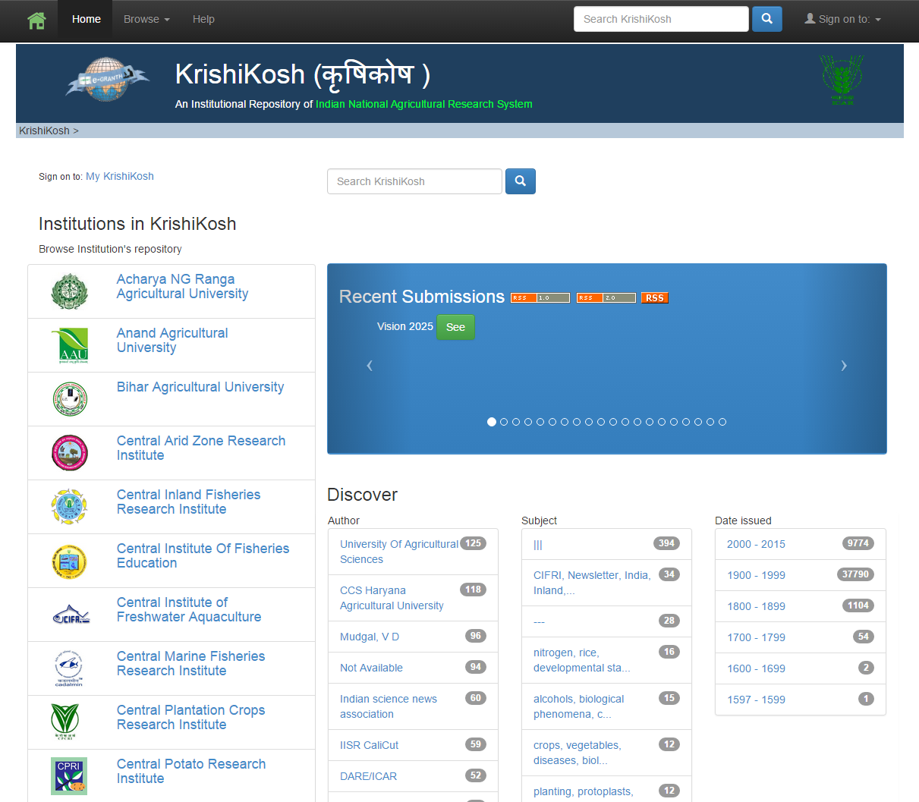

Slide 22
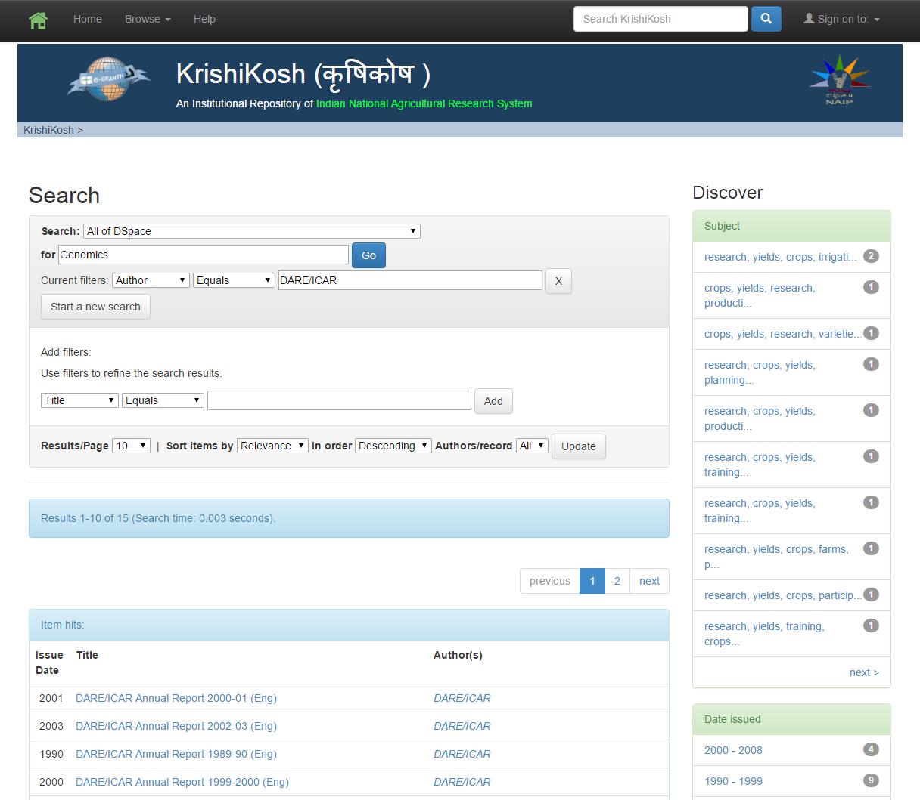

Slide 23
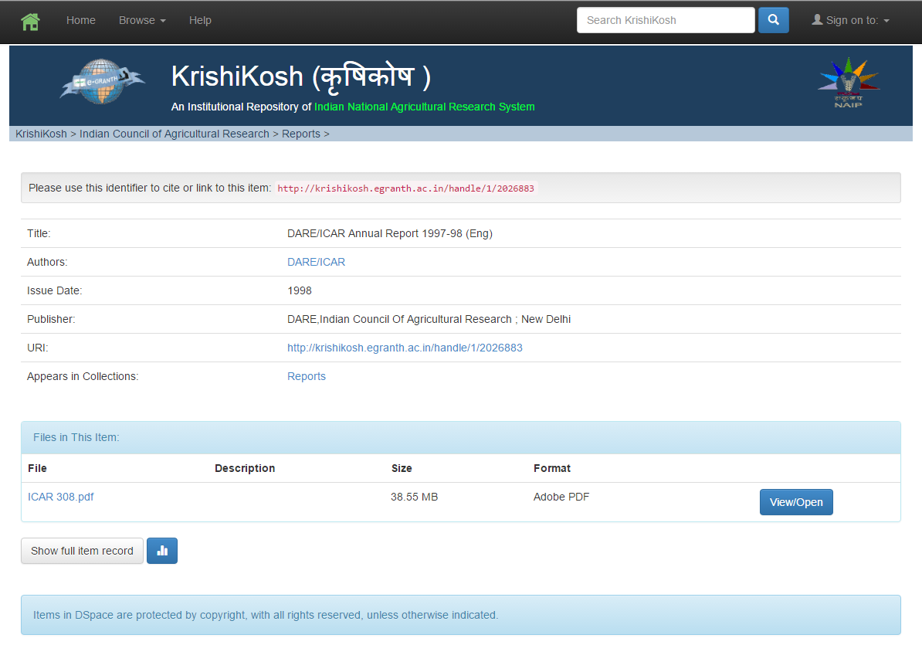

Slide 24
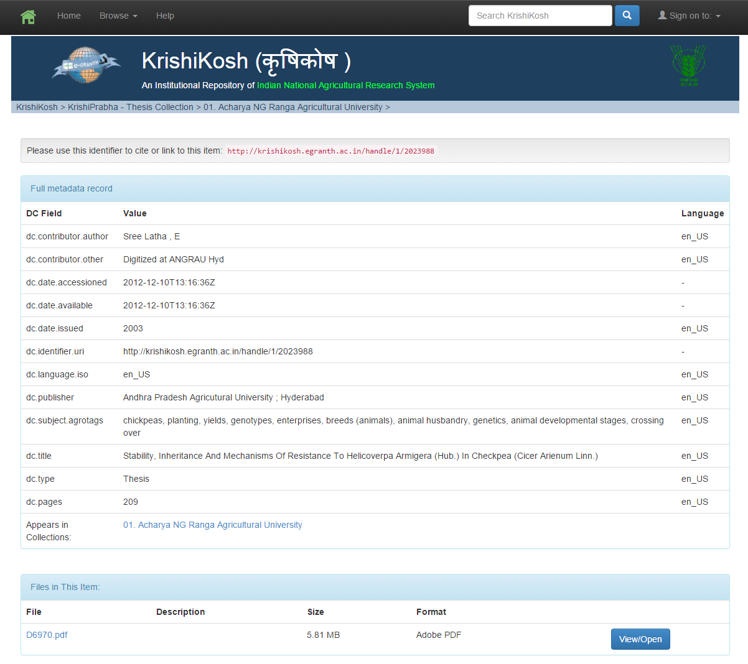

Slide 25
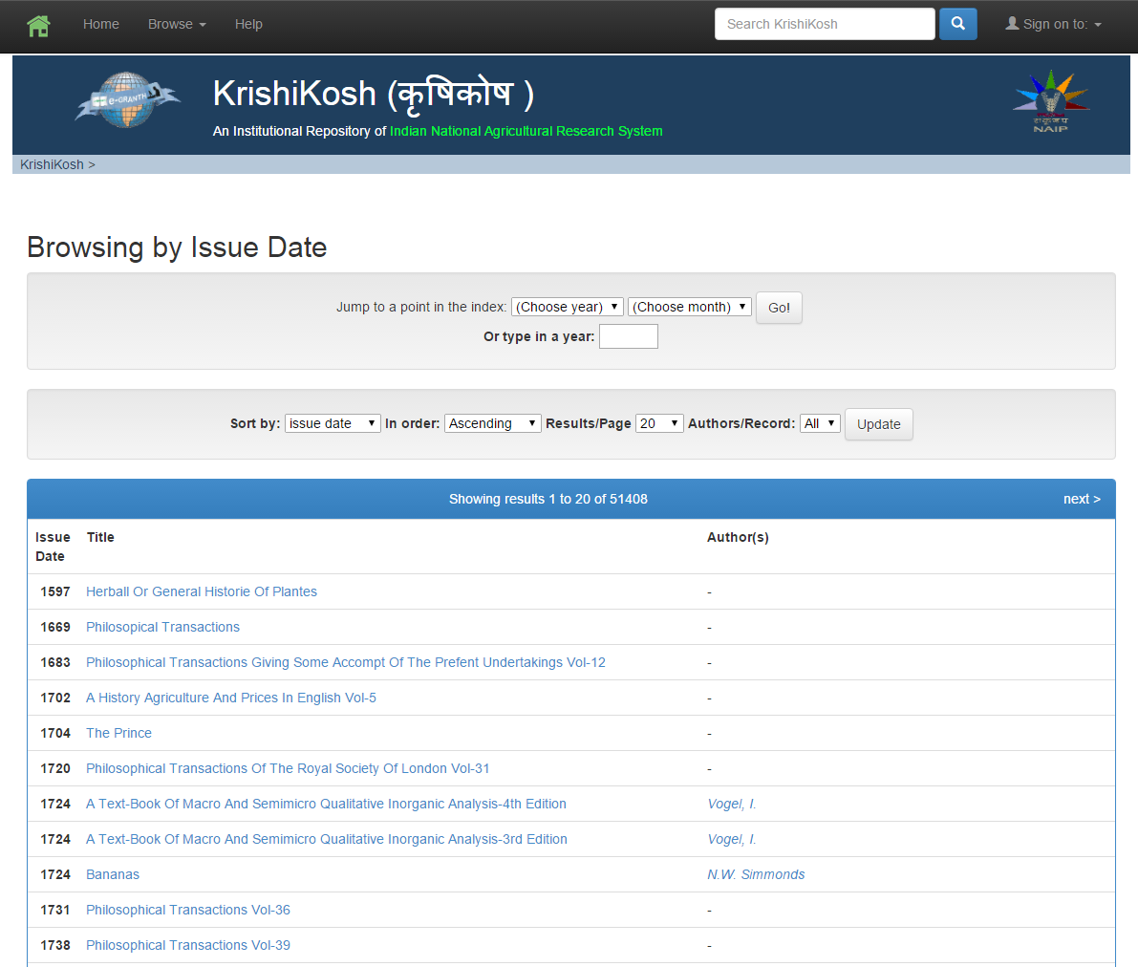

Slide 26
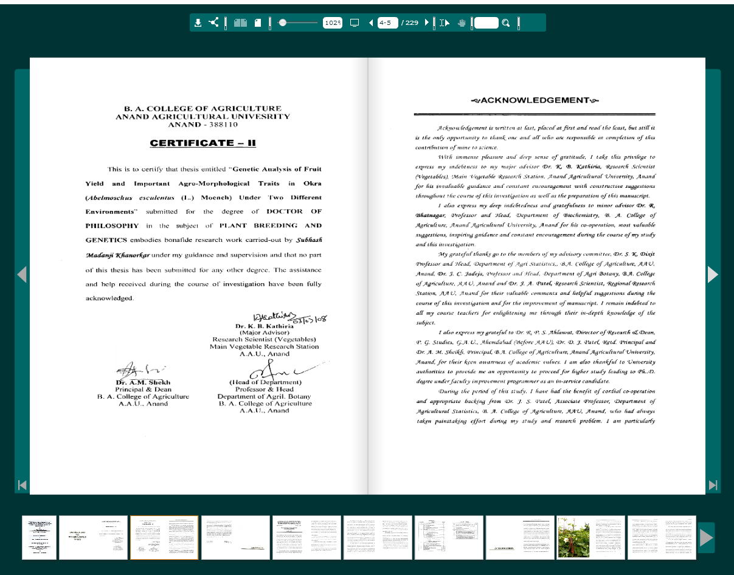

Slide 27
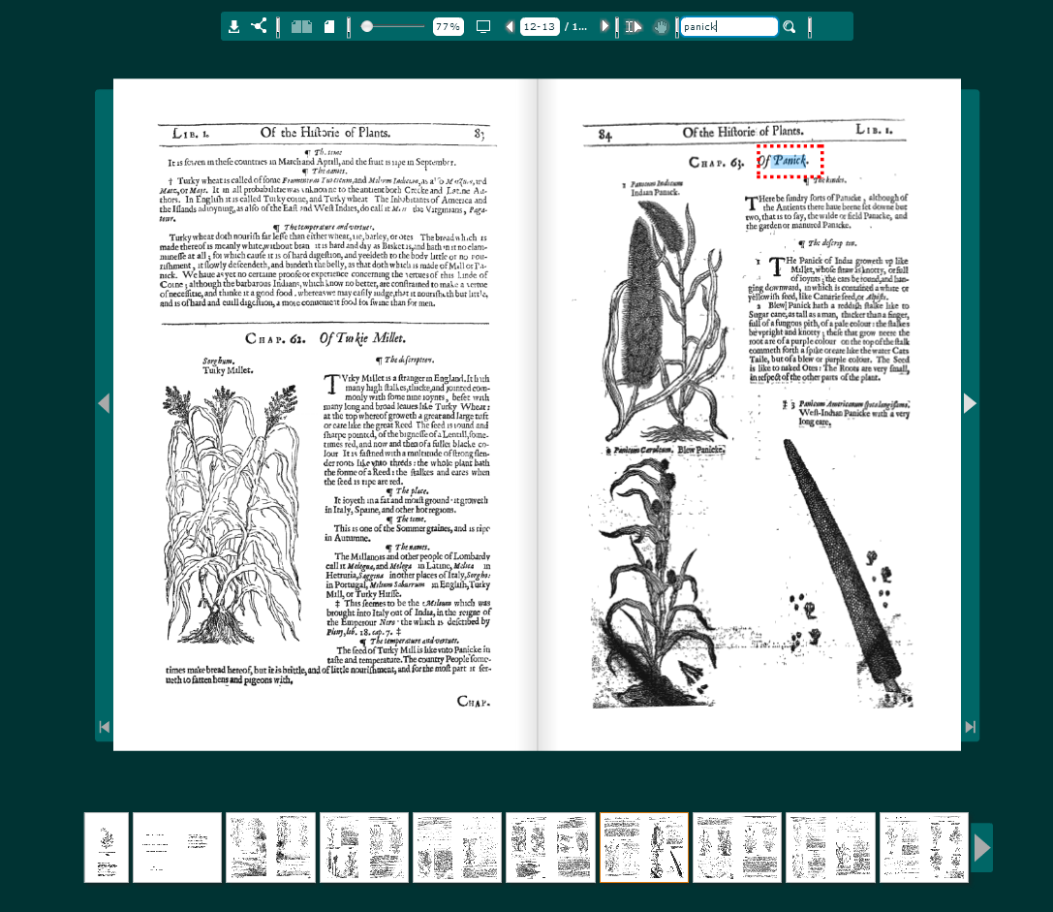

Slide 28
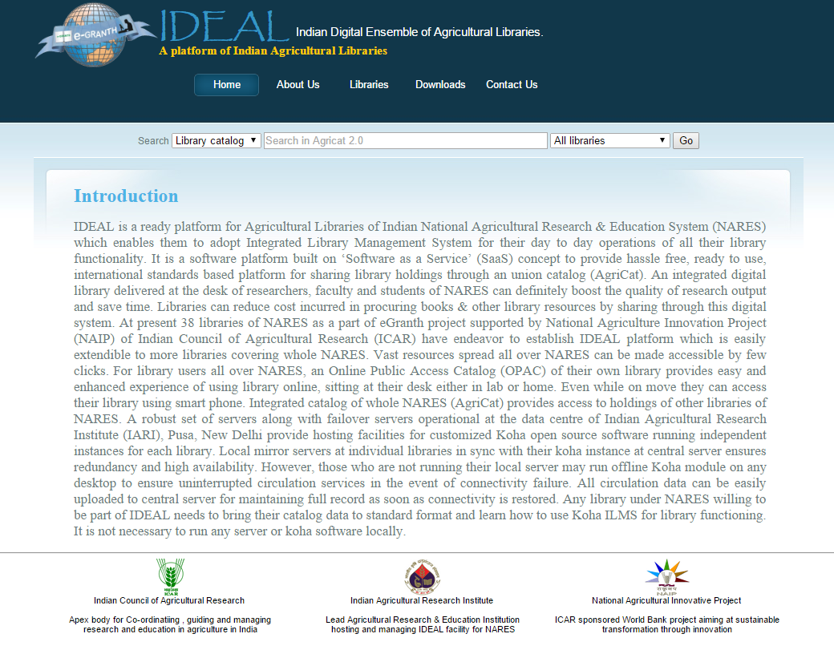
IDEAL is a ready platform for Agricultural Libraries of Indian National Agricultural Research & Education System (NARES) which enables them to adopt Integrated Library Management System for their day to day operations of all their library functionality. It is a software platform built on ‘Software as a Service’ (SaaS) concept to provide hassle free, ready to use, international standards based platform for sharing library holdings through an union catalog (AgriCat). An integrated digital library delivered at the desk of researchers, faculty and students of NARES can definitely boost the quality of research output and save time. Libraries can reduce cost incurred in procuring books & other library resources by sharing through this digital system. At present 38 libraries of NARES as a part of eGranth project supported by National Agriculture Innovation Project (NAIP) of Indian Council of Agricultural Research (ICAR) have endeavor to establish IDEAL platform which is easily extendible to more libraries covering whole NARES. Vast resources spread all over NARES can be made accessible by few clicks. For library users all over NARES, an Online Public Access Catalog (OPAC) of their own library provides easy and enhanced experience of using library online, sitting at their desk either in lab or home. Even while on move they can access their library using smart phone. Integrated catalog of whole NARES (AgriCat) provides access to holdings of other libraries of NARES. A robust set of servers along with failover servers operational at the data centre of Indian Agricultural Research Institute (IARI), Pusa, New Delhi provide hosting facilities for customized Koha open source software running independent instances for each library. Local mirror servers at individual libraries in sync with their koha instance at central server ensures redundancy and high availability. However, those who are not running their local server may run offline Koha module on any desktop to ensure uninterrupted circulation services in the event of connectivity failure. All circulation data can be easily uploaded to central server for maintaining full record as soon as connectivity is restored. Any library under NARES willing to be part of IDEAL needs to bring their catalog data to standard format and learn how to use Koha ILMS for library functioning. It is not necessary to run any server or koha software locally.

Slide 29
Central Server
In addition for uninterrupted services ‘Offline Koha Module’ installed on the issue/return desk computer can sync with local and/or central server.
Union CATALOGUE

Slide 30
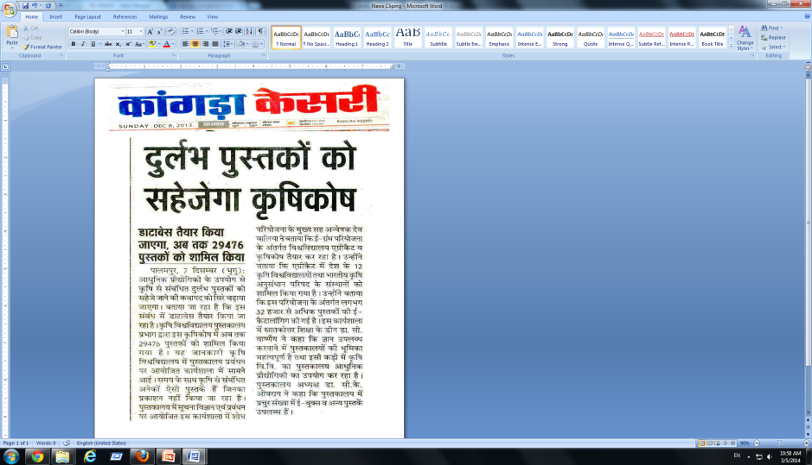
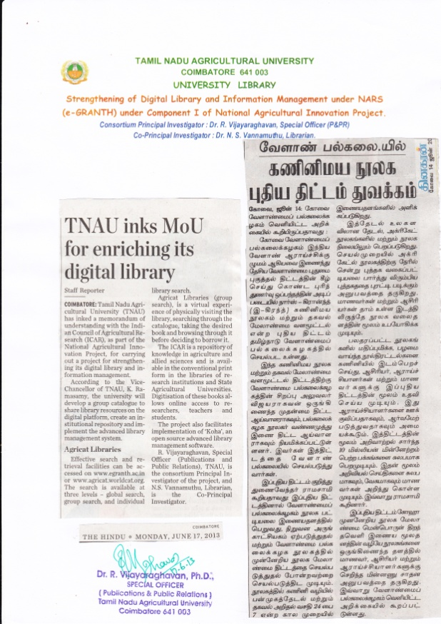
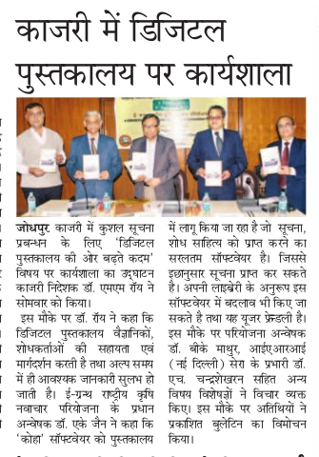
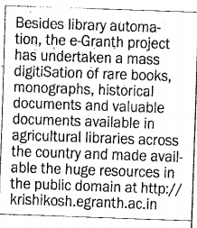
Thanks
eGranth in News

